Slide 1
An “Engineer” on Co-op?
Douglas Wilhelm Harder, M.Math. LEL
Department of Electrical and Computer Engineering
University of Waterloo
Waterloo, Ontario, Canada
ece.uwaterloo.ca
dwharder@alumni.uwaterloo.ca
© 2012 by Douglas Wilhelm Harder. Some rights reserved.

Slide 2
Outline
We will look at the use of the word “engineer” with respect to undergraduate students in engineering programs
The term is restricted
What is a violation?
What can you do?
Student Membership Program
Engineering Intern

Slide 3
What is Protected?
In Canada, the term “engineer” is protected:
In the United Kingdom, the term “chartered engineer” is protected—but not the term “engineer”
In the United States, the term “engineer” is protected in many states, but there are more cases of industrial exemptions

Slide 4
Professional Engineers Act
What is the relevant legislation?
The relevant clause is 40(2)(a.1)
Offence, use of term “professional engineer”, etc.
40 (2)(a.1) Every person who is not a holder of a licence or a temporary licence and who uses the title “engineer” or an abbreviation of that title in a manner that will lead to the belief that the person may engage in the practice of professional engineering is guilty of an offence and on conviction is liable for the first offence to a fine of not more than $10,000 and for each subsequent offence to a fine of not more than $25,000.

Slide 5
Professional Engineers Act
The onus is on the individual using the title:
The relevant clause is 40(2.1)
Onus of proof
40 (2.1) In a proceeding for an alleged contravention of clause (2) (a.1), the burden of proving that the use of the title or abbreviation will not lead to the belief referred to is on the defendant, unless the defendant’s use of the title or abbreviation is authorized or required by an Act or regulation.
Authorized exceptions include:
Flight Engineer
Train Engineer
Sound Engineer
Aircraft Maintenance Engineer
Federal or provincial legislation or regulations

Slide 6
What Else is Acceptable?
Suppose your co-op job is outside of Canada in a jurisdiction where the term engineer is not protected?
Example, you just finished a co-op job in England and your title was “Software Engineer”
This is the title you held as an employee and consequently, you may continue to use this title on your resume so long as there is no further indication that you can provide services within the practice of software engineering
Any such listing in a resume must make it clear that the job was in a jurisdiction outside of Canada

Slide 7
What is a Violation?
From Engineers Canada’s web site:
Until you become licensed, it is against the law in Canada for you
to approve [that is, seal, sign and date] engineering drawings or reports,
to use the title “engineer” or “professional engineer” (or any title like it), or
to offer any engineering services to the public.
You may do most other technical work legally, subject to other professional laws (such as the architecture or land surveyors acts).

Slide 8
What is a Violation?
You applied for a co-op job in Canada and your title is “software engineer”
You are in violation of the Professional Engineers Act
Your resume or LinkedIn states that you were employed in Canada with a title that contains the term engineer
You are in violation of the Professional Engineers Act

Slide 9
What is a Violation?
Has PEO ever applied for an order against an individual who called himself an engineer on the job?
In the January/February 2003 edition of the Gazette, the Association gained a court order against Dan Stolarchuk who, among other things, described himself as a “Field Applications Engineer” and a “R.D. Engineer” in a resume
He was ordered to pay PEO its costs at $6,750

Slide 10
What is a Violation?
Has PEO ever found a business holding a Certificate of Authorization guilty of professional misconduct in relation to this?
In the March/April 2008 edition of the Gazette, the Association found The Environment Management Group Ltd. guilty of professional misconduct for, among other things, issuing business cards for non-engineering staff, upon which was captioned “Member of Professional Engineers Ontario.”
For this and other actions, EMG was required to pay $2,500 and was given a reprimand, which was recorded for twelve months

Slide 11
What Can You Do?
First, approach your employer, and if nothing else, redirect them to these slides
If your employer has any questions, they can contact PEO directly
If your employer changes your job title, you must direct them to change your job title on JobMine

Slide 12
What Can You Do?
What can you do?
The term “engineering” is not protected in Canada—consequently, you may be able to use it instead of “engineer”
If you are using the term “engineering”, you cannot, however, use any of the words “professional”, “consultant” or “specialist”
These are highly restricted terms specified in the Professional Engineers Act and any suggestion that you are, for example, a consulting engineer, will demand the attention of PEO
Other terms or phrases that may replace the term “engineer” in a job title include:
Developer Engineering Developer Manager
Programmer Engineering Programmer Team Lead
Analyst Engineering Analyst Leader
Operator Engineering Operator Coordinator
Specialist Consultant

Slide 13
What Can You Do?
What if the job is over—what about my resume?
It would not be considered misrepresentation if you change an illegal job title that appears on a resume
The change must, however, be minimal in effect
Suggestions:
Replace “engineer” with “engineering” if possible
Otherwise, replace “engineer” with “developer”, “analyst”, “operator” or “programmer”
Do not use a term such as “specialist” or “consultant”—they suggest additional responsibilities

Slide 14
What Can You Do?
What can a student call him or herself?
The terms “computer engineering student” and “candidate for computer engineering” are acceptable
The terms “student engineer” or “engineer candidate” or anything with the phrase “computer engineer” is not acceptable
You can also join PEO’s Student Membership Program

Slide 15
Student Membership Program
Enroll in the Student Membership Program at PEO
Registration: http://www.engineeringstudents.peo.on.ca/

Slide 16
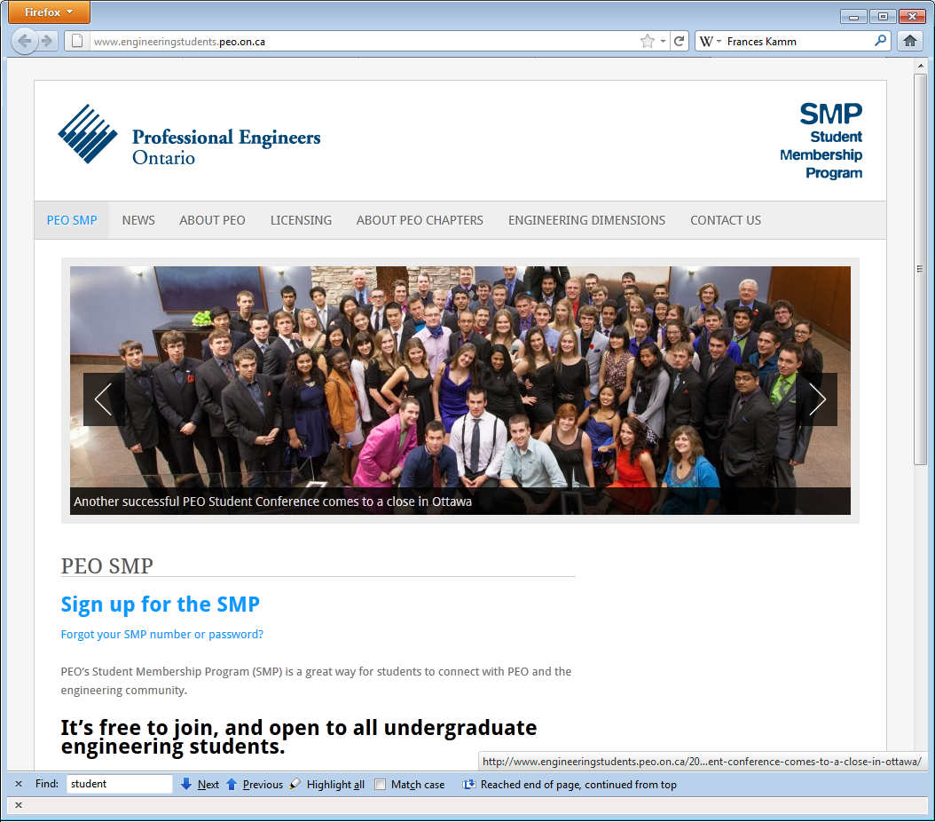
Student Membership Program
As of January 2013:
1 | University of Waterloo (25 %) | 3829
2 | McMaster University | 1963
3 | Lakehead University | 1678
4 | University of Toronto | 1460
5 | Carleton University | 1377
6 | Ryerson University | 1069
7 | Queen's University | 710
8 | University of Guelph | 593
9 | University of Western Ontario | 546
10 | University of Ottawa | 482
11 | University of Windsor | 424
12 | University of Ontario Institute of Technology | 413
13 | Royal Military College of Canada | 223
14 | Laurentian University | 158
15 | York University | 103
16 | Conestoga College | 29
 |  | Total : 15057

Slide 17
Engineer Intern
Once you graduate, you can apply for the position of engineering intern and use the initials EIT after your name
You can also:
Vote in regional chapter elections
Attend the annual meeting of the Association
Be appointed to a committee

Slide 18
Summary
Summary
The term “engineer” is restricted
The term “engineering” is not restricted except in conjunction with “consulting”, “specialist” or “professional”
There are numerous options and alternatives
Students can join PEO’s Student Membership Program
Graduates can become Engineering Interns

Slide 19
References
[1] Student Membership Program, http://www.engineeringstudents.peo.on.ca/
[2] Private communication with Steven Haddock
Compliance Officer with Professional Engineers Ontario
[3] Professional Engineers Act, http://www.e-laws.gov.on.ca/html/statutes/english/elaws_statutes_90p28_e.htm
[4] Ontario Regulation 941,
http://www.e-laws.gov.on.ca/html/regs/english/elaws_regs_900941_e.htm
These course slides are provided for the ECE 290 class. The material in it reflects Douglas Harder’s best judgment in light of the information available to him at the time of preparation. Any reliance on these course slides by any party for any other purpose are the responsibility of such parties. Douglas W. Harder accepts no responsibility for damages, if any, suffered by any party as a result of decisions made or actions based on these course slides for any other purpose than that for which it was intended.

