Slide 1
Solving Case Studies
Douglas Wilhelm Harder, M.Math. LEL
Department of Electrical and Computer Engineering
University of Waterloo
Waterloo, Ontario, Canada
ece.uwaterloo.ca
dwharder@alumni.uwaterloo.ca
© 2012 by Douglas Wilhelm Harder. Some rights reserved.

Slide 2
Outline
An introduction to the engineering profession, including:
Standards and safety
Law: Charter of Rights and Freedoms, contracts, torts, negligent malpractice, forms of carrying on business
Intellectual property (patents, trade marks, copyrights and industrial designs)
Professional practice
Professional Engineers Act
Professional misconduct and sexual harassment
Alternative dispute resolution
Labour Relations and Employment Law
Environmental Law

Slide 3
Case Studies
The standard means by which a student is tested with respect to his or her knowledge of ethics and professional practice
A scenario is provided and the student must identify instances of professional misconduct and must recommend ethical courses of action

Slide 4
Case Studies
The solution to a case study must always be in essay form
A correct answer that is in point form will result in a failing grade on the Professional Practice Examination
All forms of human communication consist of:
An introduction including relevant background
A body
A conclusion, including a summary and recommendations

Slide 5
Case Study
Steps in solving a case study:
Who are the main players involved?
What are their relationships?
Identify relevant actions
What are the relevant statutes, codes, regulations?
Determine professional misconduct and ethical responses

Slide 6
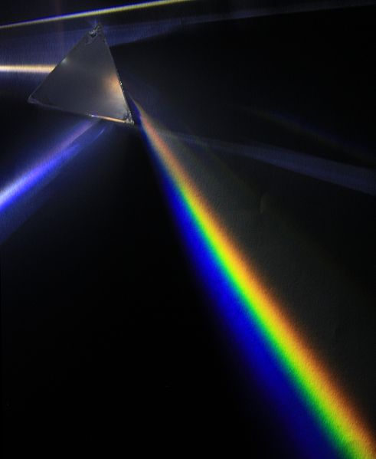
Case Study
Steps in solving a case study:
The Players involved
Their Relationships
Identify their actions
What Statutes apply?
Determine professional Misconduct and ethical responses
PRISM
User: D-Kuru

Slide 7
Case Study
“PRISM” may be a forced acronym, but it’s better than:
READ—EGAD!—SUMMARIZE
Read
Ethical issues
Generation of alternatives
Analysis
Decision
Summary
IGNORE THIS SLIDE…

Slide 8
Case Study 1
A case study from a previous Professional Practice Examination:
McGee¹ is a professional engineer who is employed on a full-time basis by EngrCIS, Inc., a large engineering firm. However, for a number of reasons, McGee is unhappy and for some time has been thinking about looking for a new job. Although McGee’s current employment at EngrCIS provides good pay and interesting work, McGee is finding it difficult to work with DiNozzo¹, a professional engineer who is McGee’s supervisor at EngrCIS.
¹ names taken from Paramount Network Television program NCIS

Slide 9
Case Study 1
In the year since McGee joined the company, DiNozzo has frequently made derogatory jokes and remarks about McGee’s race and religion—sometimes even in meetings with other engineers and clients. On many occasions, McGee has informed DiNozzo that such remarks are offensive, hurtful, and inappropriate and has asked DiNozzo to stop. DiNozzo refuses to do so and says that McGee should “toughen up and learn to take a joke” if McGee expects to have a successful career at EngrCIS.
Recently, McGee met with a professional engineer colleague, Sciuto¹, who is a vice president at NYCE, Ltd., another engineering company. Upon hearing that McGee was interested in considering other opportunities, Sciuto offered McGee a part-time job to work in the evenings and on weekends on a trial basis as an engineer for NYCE. McGee would work under Sciuto’s supervision with the intent that in a few months, if McGee preferred working at NYCE, McGee would resign from EngrCIS and become a full-time employee of NYCE.
¹ names taken from Paramount Network Television program NCIS

Slide 10
The Players
The players are:
McGee, P.Eng.
DiNozzo , P.Eng.
EngrCIS
Sciuto, P.Eng.
NYCE
PRISM

Slide 11
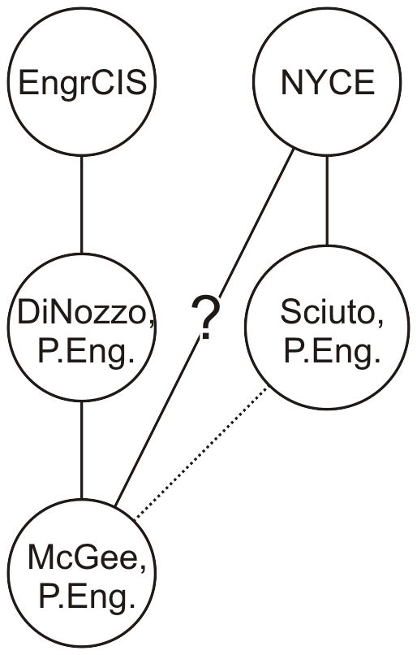
Relationships
Their relationships are:
McGee and DiNozzo are employed by EngrCIS
DiNozzo is McGee’s supervisor
McGee and his collegue
The colleague is a V.P. at NYCE
McGee has the option of contracting with NYCE
PRISM

Slide 12
Identify the Actions
The players are:
DiNozzo has been harassing McGee
The V.P. has made a contract offer to McGee
PRISM

Slide 13
Statutes, Codes, Regulations, etc.
In this case, the relevant statutes, codes, regulations, etc., include:
The Professional Engineers Act, including
The requirement that a Certificate of Authorization is required for any engineering services offered to the public
The Code of Ethics
The definition of professional misconduct
The Ontario Human Rights Code
The Ontario Occupational Health and Safety Act
PRISM

Slide 14
Statutes, Codes, Regulations, etc.
To the practitioner’s employer, he or she
Has a duty to act at all times with fairness and loyalty (77.1);
Shall act in professional engineering matters
As a faithful agent or trustee, and
Shall regard as confidential information obtained by the practitioner as to the business affairs, technical methods or processes of an employer (77.3); and
Shall avoid or disclose a conflict of interest that might influence the practitioner’s actions or judgment (77.3)
PRISM

Slide 15
Statutes, Codes, Regulations, etc.
To other members of the profession, he or she
Has a duty to act at all times with fairness, loyalty (77.1), courtesy and good faith (77.7);
Shall not
Accept an engagement to review the work of another for the same employer except with the knowledge of the other practitioner or except where the connection of the other practitioner with the work has been terminated, nor
Maliciously injure the reputation of another practitioner (77.7); and
Shall
Give proper credit for engineering work,
Provide opportunity for professional development and advancement of the practitioner’s associates and subordinates, and
Extend the effectiveness of the profession through the interchange of engineering information and experience (77.7).
PRISM

Slide 16
Statutes, Codes, Regulations, etc.
Certificate of authorization
12. (2) No person shall offer to the public or engage in the business of providing to the public services that are within the practice of professional engineering except under and in accordance with a certificate of authorization.
Both during the mid-term and final examinations of this course, you will have access to the Code of Ethics and the definition of professional misconduct—you will be required to quote the appropriate item
You will not be required to quote other section numbers from the Professional Engineers Act or the regulations
PRISM
Professional Engineers Act

Slide 17
Statutes, Codes, Regulations, etc.
The Human Rights Code prohibits discrimination on the the following grounds:
Race Ancestry Place of origin
Colour Ethnic origin Citizenship
Creed Sex Sexual orientation
Gender identity Gender expression Age
Marital status Family status Disability
Record of Offences Reprisal Association
The receipt of public assistance
PRISM
Discrimination, n.
The action of discriminating; the perceiving, noting, or making a distinction
or difference between things; a distinction (made with the mind, or in action).
Specifically, the making of distinctions prejudicial to people of a different race
or colour from oneself; racial discrimination.
Oxford English Dictionary

Slide 18
Statutes, Codes, Regulations, etc.
Policies, violence and harassment
32.0.1(1)(b) An employer shall prepare a policy with respect to harassment.
Program, harassment
32.0.6 (1) An employer shall develop and maintain a program to implement the policy with respect to workplace harassment required under clause 32.0.1(1)(b).
Contents
(2) Without limiting the generality of subsection (1), the program shall,
include measures and procedures for workers to report incidents of workplace harassment to the employer or supervisor;
set out how the employer will investigate and deal with incidents and complaints of workplace harassment; and
include any prescribed elements.
PRISM
Occupational Health and Safety Act

Slide 19
Determine Professional Misconduct and Ethical Responses
One instance of professional misconduct is DiNozzo’s harassment of McGee
Such harassment constitutes a violation of the Ontario Human Rights Code as well as professional misconduct
For whatever reason, it seems that McGee has not approached H.R. at EngrCIS
Given he appears to enjoy working at EngrCIS, it would be reasonable to give them the opportunity to correct this violation
If H.R. does not respond, McGee should file a complaint with PEO
Depending on the severity, a last step might be to file a human rights complaint
PRISM

Slide 20
Determine Professional Misconduct and Ethical Responses
McGee is being offered a contract by NYCE
The scenario suggests that he would be providing engineering services to NYCE
Providing such services requires a Certificate of Authorization
Providing such services without a C. of A. would be a breach of Section 12(2) the Act
A breach of the Act is professional misconduct under 72(2)(g)
McGee should acquire a C. of A. if he intends to enter into such a contract
PRISM

Slide 21
Determine Professional Misconduct and Ethical Responses
McGee is being offered a contract by NYCE
The scenario suggests that he would be providing engineering services to NYCE
The Code of Ethics requires McGee to
Provide, in writing, a statement to NYCE that he is employed by EngrCIS (even if this is obvious)
Ensure that there is no conflict in the work performed
Inform EngrCIS that he is entering into a contract with NYCE
Failure to do so would be professional misconduct under 72(2)(i) as an undisclosed conflict of interest
PRISM

Slide 22
Case Study 1
If you are simply required to respond to a case study, the response would be an essay-based which would cover the points provided in the past eleven pages
Every essay must have an introduction, a body, and a conclusion
The introduction would briefly cover the situation and explain the approach that the body of the essay will take
In each case, we will look at the obligations under the Code of Ethics and issues with respect to any statutes that may have been breached
We conclude by summarizing the actions that should be taken

Slide 23
Case Study 1
In the professional practice examination, there were three questions asked:
Comment on DiNozzo’s conduct with respect to Ontario Regulation 941.
In relation to the regulation of the practice of professional engineering what should McGee consider doing about DiNozzo’s conduct?
Specify and explain the requirements, if any, that McGee must satisfy in order to properly undertake such part-time employment with NYCE.
READ AND ANSWER ALL THE QUESTIONS!

Slide 24
Case Study 1
In these questions, it specifically restricts the response with respect to DiNozzo’s actions to the regulations—in this case, it would be therefore only a question of professional misconduct by harassment
Later, we will discuss the Occupational Health and Safety Act and the Ontario Human Rights Code
On the course web site is a model answer to the general case study

Slide 25
Case Study 2
Another case study from a previous Professional Practice Examination:
Gibbs¹, the owner of a house in the City of Waterloo, was notified by the city that the condition of the foundation walls of his house violated the standards set out in the city’s property standards by-law. The city, being concerned that the foundation walls had deteriorated to the point of being structurally unsafe, ordered Gibbs to obtain a written report by a professional engineer as to the condition of the walls. Fornell¹ prepared a report stating that he had inspected the foundation and that the foundation walls appeared to be “structurally sound and capable of safely sustaining the house for many more years.”
¹ names taken from Paramount Network Television program NCIS

Slide 26
Case Study 2
Gibbs submitted Fornell’s report to the city. In response, the city sent a letter to Gibbs with a copy to Fornell pointing out the city's observations regarding the deterioration of the walls, including evidence of significant water permeation, together with photographs taken by the city's inspector. In the letter, the city requested the condition of the foundation be reassessed and a response be made to the city within two weeks. Gibbs was unaware that Fornell would be waiting for authorization for him to spend more time on the project and accordingly did not contact Fornell and request him to respond. Fornell did not follow up with either Gibbs or the city.
Following a second request to Gibbs, copied to Fornell, Fornell responded by letter to the city, advising that he had never examined the interior of the walls, only the exterior and admitted the photographs provided by the city indicated that the foundation was structurally unsound.

Slide 27
Case Study 2
In the professional practice examination, there were two questions asked:
Comment on the services provided by Fornell, in relation to Regulation 941. In your answer, also discuss Fornell’s conduct regarding his dealings with the City.
Fornell does not have a certificate of authorization. Does Fornell need one under the facts described above? Explain why or why not. What are the possible consequences to a professional engineer of acting without a certificate of authorization when one is required?

Slide 28
Case Study 3
A third case study from a previous Professional Practice Examination:
Duckie¹, P.Eng., a senior professional engineer, established a small firm, Mallard Engineering, to provide professional engineering services to the public. The firm became busy very quickly and within a few months, he hired Palmer¹, a bright recent university graduate with an engineering degree, to assist with the work. Duckie strongly believed in mentoring and hoped that in several years, after obtaining the necessary experience requirements and becoming a professional engineer, Palmer would assume increasing managerial responsibility and possibly an ownership interest in the firm.
¹ names taken from Paramount Network Television program NCIS

Slide 29
Case Study 3
After about a year after Palmer joined the firm, Mallard Engineering was asked by one of its clients to provide a formal report that included an engineering option. Palmer performed the work on that matter and prepared a draft of the report. Before having a chance to review Palmer’s work, Duckie received an urgent request from another client that required Duckie to leave on a lengthy business trip. On the way out of the office, Duckie stopped at Palmer’s desk and said, “Sorry, but I’ll be out of the country and tied up completely for the next three weeks, so I won’t be able to review that report. I know that it’s due tomorrow, so go ahead and sign it under your own name and send it to the client so that we can meet the deadline.” Duckie was confident that that would be all right, since Palmer has always produced outstanding work in the past. Palmer proceed to complete the report, signed it “J. Palmer, Eng., Mallard Engineering” and sent it to the client.

Slide 30
Case Study 3
In the professional practice examination, there were three questions asked:
Discuss the conduct of both Duckie and Palmer. What, if anything, should they be concerned about?
Could Duckie or Palmer be subject to a hearing by the Discipline Committee of PEO? Discuss.
Is there anything about Duckie’s conduct relative to the Code of Ethics that is commendable?

Slide 31
Case Study 4
A third case study from a previous Professional Practice Examination:
IBF Engineering, a large engineering firm, was hired to prepare the design for a chemical production plant for AIC, Inc. In addition to preparing the plant design, IBF Engineering’s duties included providing inspection services during the construction stage of the project. The project was completed successfully.

Slide 32
Case Study 4
You are a professional engineer and have been employed on a full-time basis for IBF Engineering for several years. You work in the Process Division and are involved on several process design projects. You were an important member of the design team that prepared the design for AIC Inc.’s plant. In addition to working for IBF Engineering, you supplement your income by occasionally undertaking work on weekends and during evenings for Marine Engineering, Ltd., another engineering company. A colleague of yours, who is a professional engineer at Marine Engineering, Ltd., assigns you such work and assumes responsibility for it.

Slide 33
Case Study 4
A few years after the plant was completed, AIC, Inc., decides to restructure its operations and sell the plant. ASN Corp. has agreed to buy the plant, but before it does so, ASN Corp. wants to satisfy itself (and its bank) that the plant was built to proper standards and is in good physical condition. ASN Corp. hires Marine Engineering, Ltd. to inspect the physcial plant and to review relevant documents (including the original plans, “as-built” drawings, and operations and maintenance logs). Marine Engineering, Ltd. is very busy on several projects and asks you to assist with the plant inspection and document review.

Slide 34
Case Study 3
In the professional practice examination, there were three questions asked:
Discuss the appropriateness of your employment arrangements.
Assuming that your employment arrangements have not changed since the plant was designed and constructed, discuss how you respond to Marine Engineering, Ltd.’s request for assistance.
Would you need a Certificate of Authorization to provide services to Marine Engineering, Ltd.? Explain.

Slide 35
References
[1] Julie Vale, ECE 290 Course Notes, 2011.
[2] Wikipedia, http://www.wikipedia.org/
These course slides are provided for the ECE 290 class. The material in it reflects Douglas Harder’s best judgment in light of the information available to him at the time of preparation. Any reliance on these course slides by any party for any other purpose are the responsibility of such parties. Douglas W. Harder accepts no responsibility for damages, if any, suffered by any party as a result of decisions made or actions based on these course slides for any other purpose than that for which it was intended.

