Slide 1
ECE 290 Engineering Profession, Ethics and Law
Douglas Wilhelm Harder, M.Math. LEL
Department of Electrical and Computer Engineering
University of Waterloo
Waterloo, Ontario, Canada
ece.uwaterloo.ca
dwharder@alumni.uwaterloo.ca
© 2012 by Douglas Wilhelm Harder. Some rights reserved.
Based in part on the work of Prof. Julie Vale

Slide 2
Outline
Welcome to the course introduction
Description
Course web site and course texts
Grading
An introduction

Slide 3
Course Description
An introduction to the engineering profession, including:
Standards and safety
Law: Charter of Rights and Freedoms, contracts, torts, negligent malpractice, forms of carrying on business
Intellectual property (patents, trade marks, copyrights and industrial designs)
Professional practice
Professional Engineers Act
Professional misconduct and sexual harassment
Alternative dispute resolution
Labour Relations and Employment Law
Environmental Law

Slide 4
Course Description
Course web site:
ece.uwaterloo.ca/~ece290/
Course texts:
D.L. Marston, Law for Professional Engineers, 4th Ed., McGraw-Hill Ryerson, 2008.
G.C. Andrews et al., Introduction to Professional Engineering in Canada, 4th Ed., Pearson Prentice Hall, 2009.

Slide 5
Course Description
Course grading:
Mid-term examination 20 %
Final examination 50 %
Class participation 10 %
Two essays 7 and 13 %

Slide 6
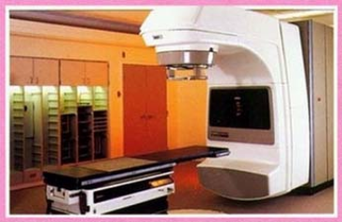
Therac-25
The issue with electrical and computer engineering is that the product is essentially invisible
The consumer can only infer what is happening by its response
This can lead to confusion which you must be ready to addresss
Jerry Weinberg

Slide 7
Therac-25
The VT-100
ClickRick

Slide 8
Therac-25
PATIENT NAME : JOHN DOE
TREATMENT MODE : FIX BEAM TYPE: X ENERGY (MeV): 25
ACTUAL PRESCRIBED
UNIT RATE/MINUTE 0 200
MONITOR UNITS 50 50 200
TIME (MIN) 0.27 1.00
GANTRY ROTATION (DEG) 0.0 0 VERIFIED
COLLIMATOR ROTATION (DEG) 359.2 359 VERIFIED
COLLIMATOR X (CM) 14.2 14.3 VERIFIED
COLLIMATOR Y (CM) 27.2 27.3 VERIFIED
WEDGE NUMBER 1 1 VERIFIED
ACCESSORY NUMBER 0 0 VERIFIED
DATE : 84-OCT-26 SYSTEM : BEAM READY OP.MODE: TREAT AUTO
TIME : 12:55. 8 TREAT : TREAT PAUSE X-RAY 173777
OPR ID : T25VO2-RO3 REASON : OPERATOR COMMAND:

Slide 9
Therac-25
“During the weeks following the accident, the patient continued to have pain in his neck and shoulder. He lost the function of his left arm and had periodic bouts of nausea and vomiting. He was eventually hospitalized for radiation-induced myelitis of the cervical cord causing paralysis of his left arm and both legs, left vocal cord paralysis (which left him unable to speak), neurogenic bowel and bladder, and paralysis of the left diaphragm. He also had a lesion on his left lung and recurrent herpes simplex skin infections. He died from complications of the overdose five months after the accident.”
This patient received 20,000 rad
Doses of more than 1,000 rad are almost invariably fatal.
US DOD

Slide 10
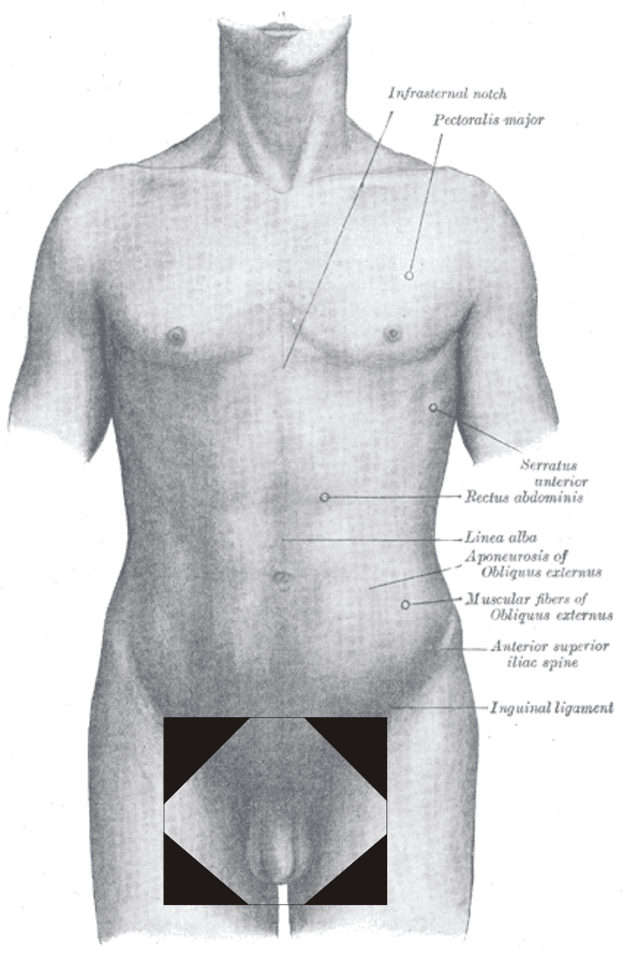
Instituto Oncologico Nacional
Treating prostate and cervical cancer

Slide 11
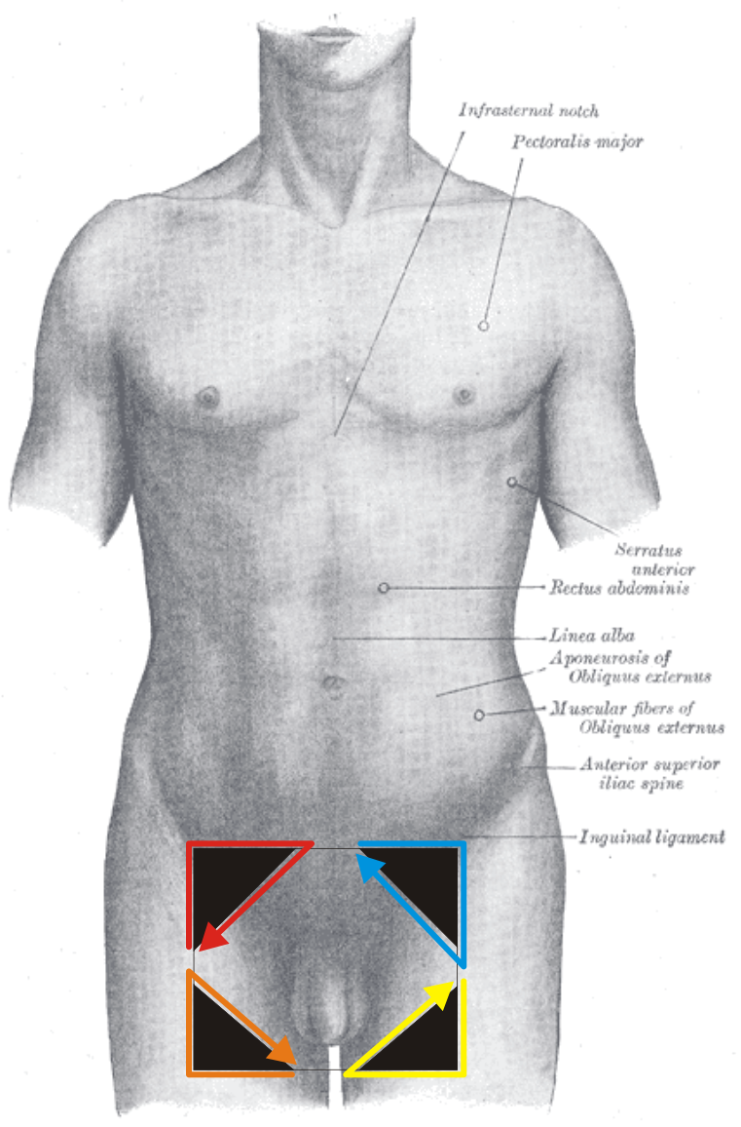
Instituto Oncologico Nacional
Shields protect but also affect dosage levels
Software allows for up to four shields

Slide 12
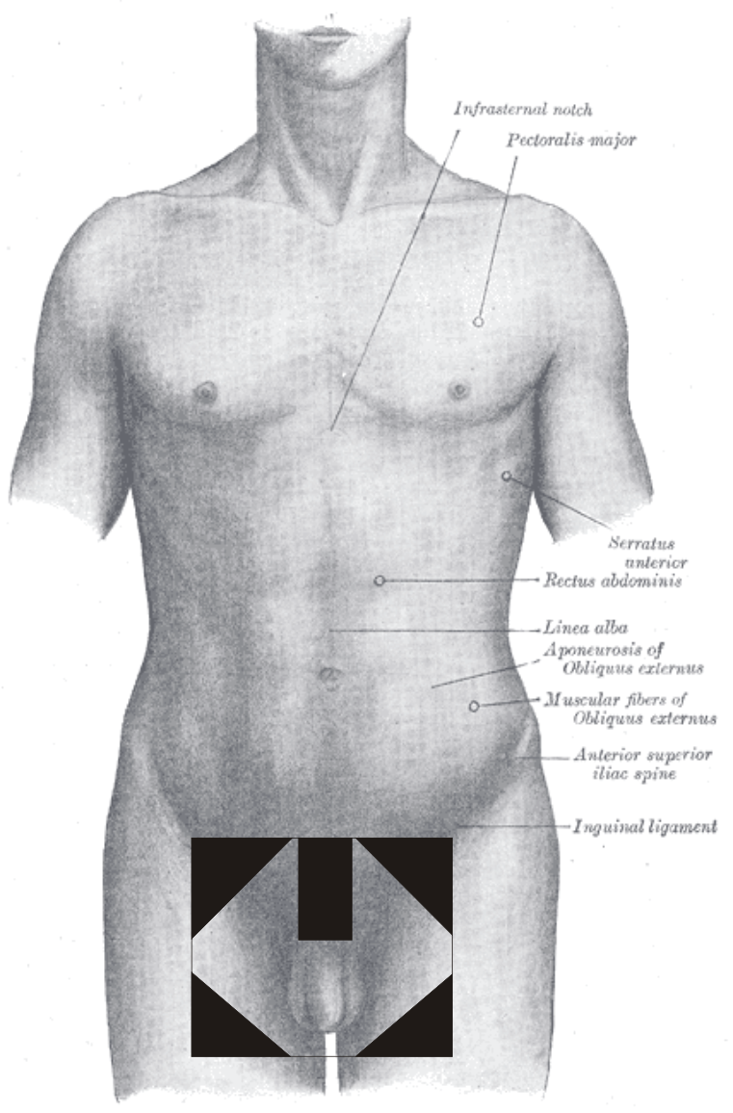
Instituto Oncologico Nacional
They wanted five shields

Slide 13
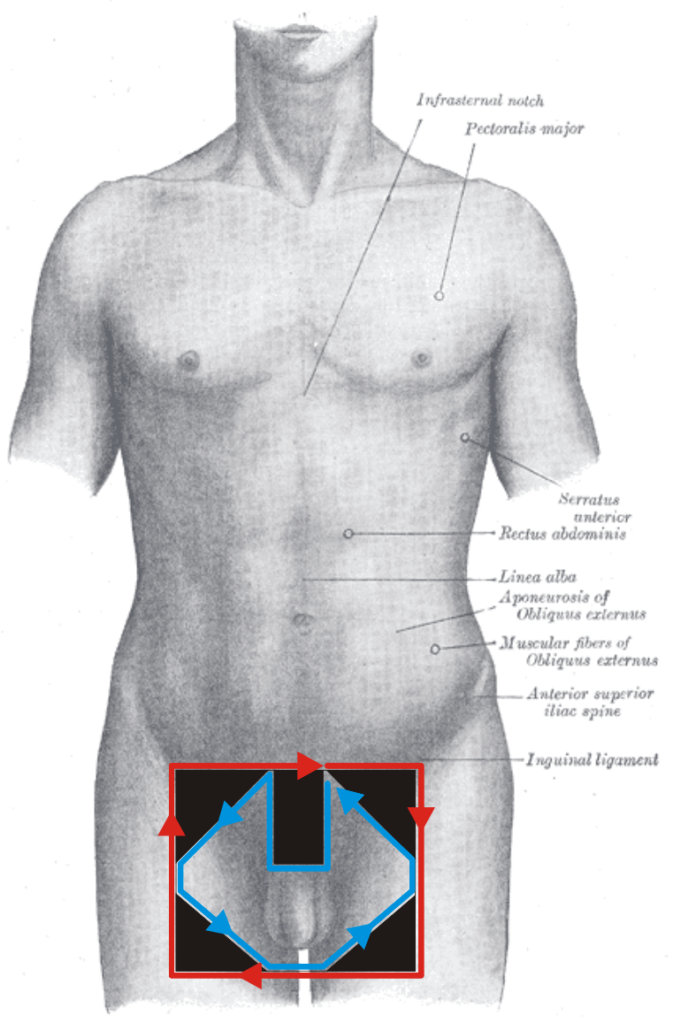
Instituto Oncologico Nacional
They fudged the system and it worked...

Slide 14
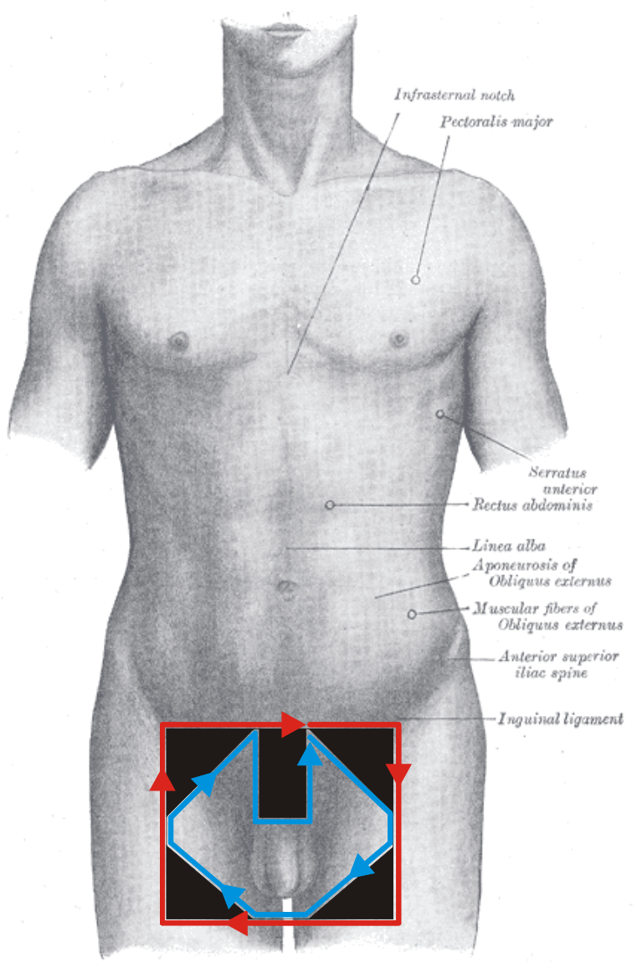
Instituto Oncologico Nacional
...if they did it right
17 deaths and 11 injuries

Slide 15
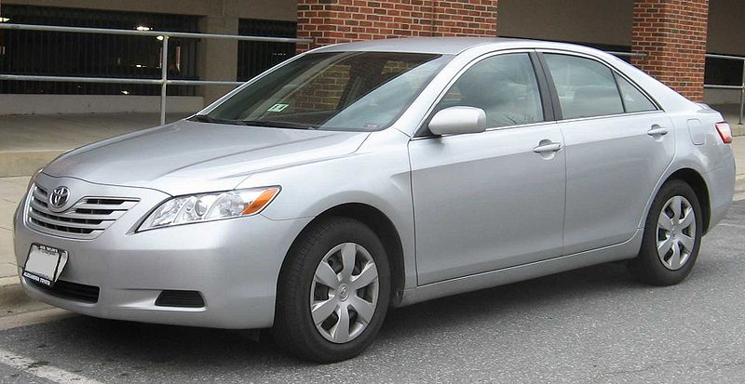
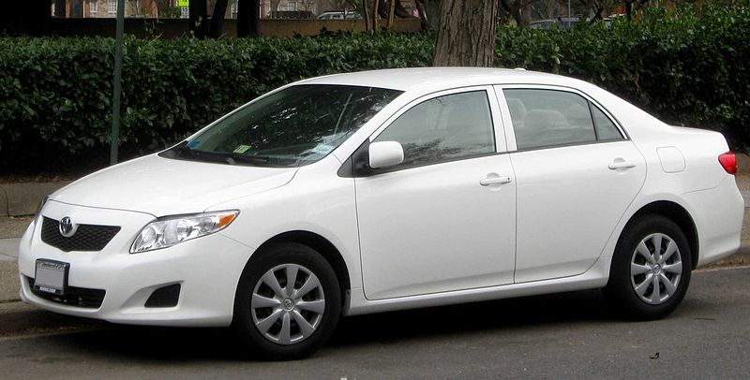
Toyota
9 million vehicles recalled...
IFCAR

Slide 16
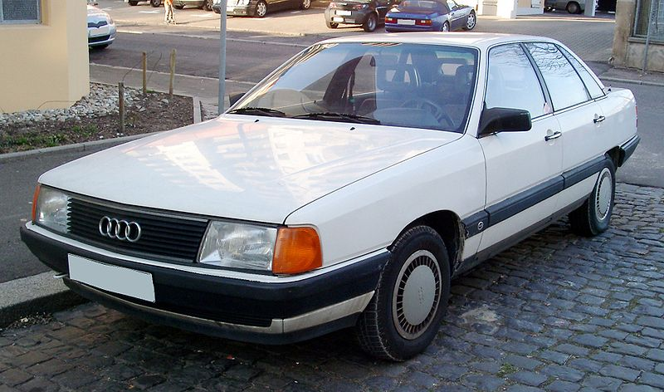
Audi 5000
9 million vehicles recalled...
Rudolf Stricker

Slide 17
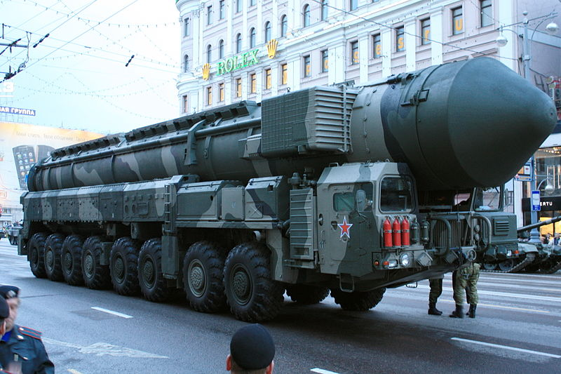
Lt. Col. Stanislav Yevgrafovich Petrov
Участник:Goodvint
http://sixperfections.blogspot.ca/2012/04/man-who-saved-world.html

Slide 18
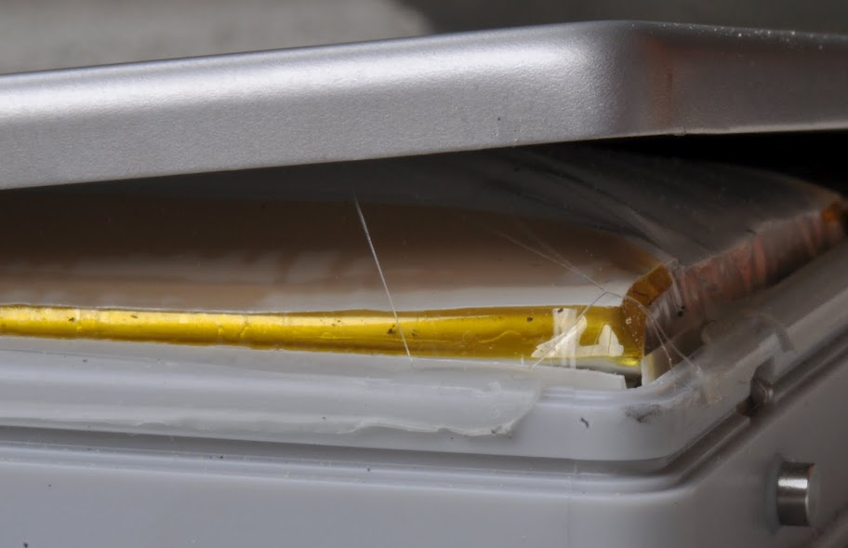
Li-Ion Batteries

Slide 19
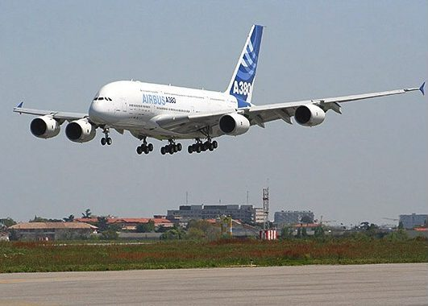
A380
User : P.loos

Slide 20
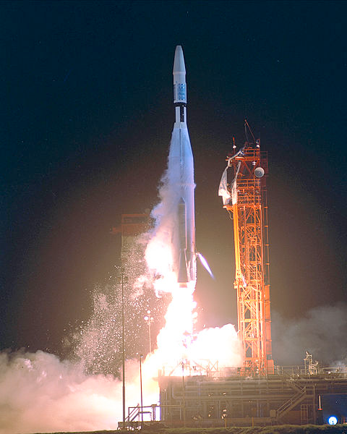
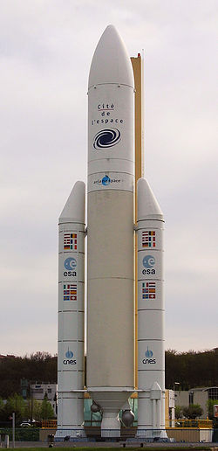
Mariner 1 Ariane 5 MCO
NASA
NASA
Poppy

Slide 21
Ariane 5
Double-precision floating-point number
L_M_BH_32 := TBD.T_ENTIER_32S(
(1.0/C_M_LSB_BH) * G_M_INFO_DERIVE( T_ALG.E_BH ) );
if L_M_BH_32 > 32767 then
P_M_DERIVE(T_ALG.E_BH) := 16#7FFF#;
elsif L_M_BH_32 < -32768 then
P_M_DERIVE(T_ALG.E_BH) := 16#8000#;
else
P_M_DERIVE(T_ALG.E_BH) :=
UC_16S_EN_16NS( TDB.T_ENTIER_16S( L_M_BH_32 ) );
end if;
P_M_DERIVE(T_ALG.E_BH) := UC_16S_EN_16NS( TDB.T_ENTIER_16S(
(1.0/C_M_LSB_BH) * G_M_INFO_DERIVE( T_ALG.E_BH ) ) );

Slide 22
Mars Climate Orbiter
1 lbf = 4.4482216152605 N

Slide 23
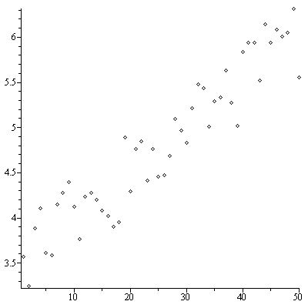
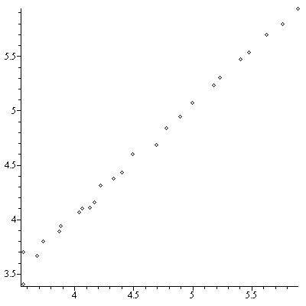
Ariane 5
The n^{th} smoothed value of the time derivative of a radius R

Slide 24
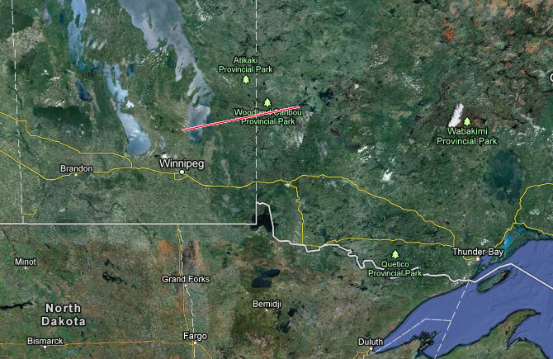
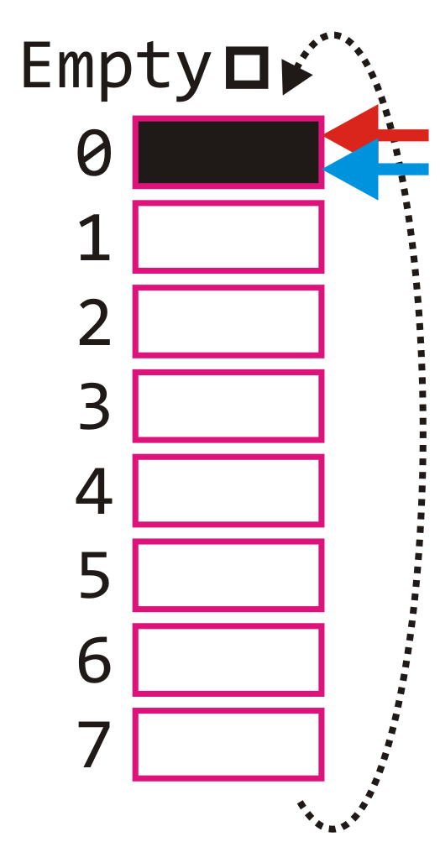
Gimli Glider
Imagine gliding a 767 over 200 km?

Slide 25
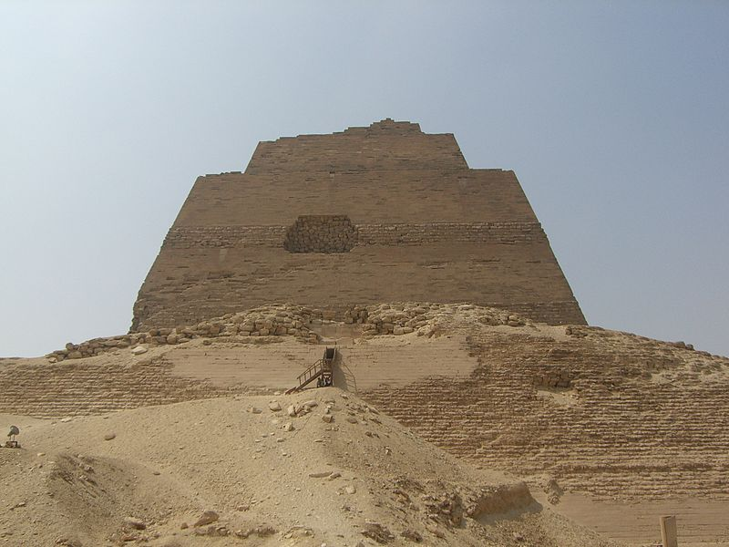
Civil Engineering
Evidence of errors in civil engineering go back to antiquity
The Meidum pyramid
Neithsabes

Slide 26
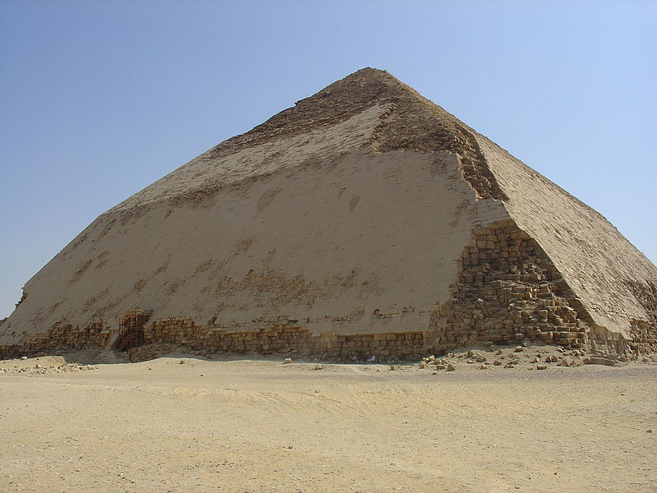
Civil Engineering
Evidence of errors in civil engineering go back to antiquity
The bent pyramid
User: Ivrienen

Slide 27
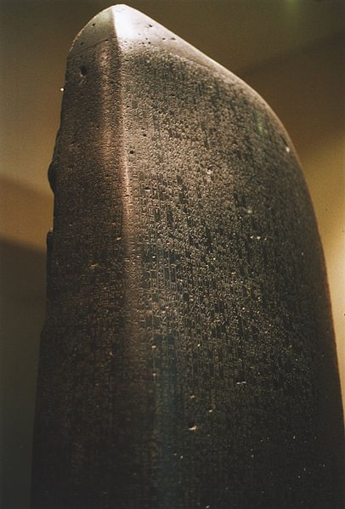
Code of Hammurabi
Casuistic
User: Rama

Slide 28
Code of Hammurabi
228. If a builder build a house for a man and complete it, (that man) shall give him two shekels of silver per sar of house as his wage.
0.3 troy ounces per 36 m²
Robert Francis Harper

Slide 29
Code of Hammurabi
229. If a builder build a house for a man and do not make its construction firm, and the house which he has built collapse and cause the death of the owner of the house, that builder shall be put to death.
230. If it cause the death of a son of the owner of the house, they shall put to death a son of that builder.
231. If it cause the death of a slave of the owner of the house, he shall give to the owner of the house a slave of equal value.
Robert Francis Harper

Slide 30
Code of Hammurabi
232. If it destroy property, he shall restore whatever it destroyed, and because he did not make the house which he built firm and it collapsed, he shall rebuild the house which collapsed from his own property (i. e., at his own expense).
233. If a builder builds a house for a man and do not make its construction meet the requirements and a wall fall in, that builder shall strengthen that wall at his own expense.
Robert Francis Harper

Slide 31
Topics
We will look at:
The law as it applies to engineering
Engineering practice
Ethics

Slide 32
Engineering Law
We will begin with engineering law
What is law and justice?
Laws applicable to the engineering profession
Contract law
Tort law
Intellectual property

Slide 33
Engineering Law
We will begin with engineering law
What is law? What is justice?
What is common law?
The Constitution Act and the Charter of Rights and Freedoms
Human rights
The Canadian government
Canadian law

