Slide 1
Justice
Douglas Wilhelm Harder, M.Math. LEL
Department of Electrical and Computer Engineering
University of Waterloo
Waterloo, Ontario, Canada
ece.uwaterloo.ca
dwharder@alumni.uwaterloo.ca
© 2013 by Douglas Wilhelm Harder. Some rights reserved.

Slide 2
Outline
An introduction to justice:
What is justice?
Aspects of justice
John Rawl’s theory of justice

Slide 3
What is Justice?
1. The quality of being (morally) just or righteous; the principle of just dealing; the exhibition of this quality or principle in action; just conduct; integrity, rectitude. (One of the four cardinal virtues.)
3. Conformity (of an action or thing) to moral right, or to reason, truth, or fact; rightfulness; fairness; correctness; propriety
4. Exercise of authority or power in maintenance of right; vindication of right by assignment of reward or punishment; requital of desert.
7. Personified, esp. in sense 4: often represented in art as a goddess holding balanced scales or a sword, sometimes also with veiled eyes, betokening impartiality.

Slide 4
What is Justice?
What is its purpose?
Plato defined justice as harmony
We also have define command theory
John Locke proposed a concept of natural law
This contrasts with justice being a societal creation
The theory of a social contract suggest that people surrender some rights and freedoms to the authority of the state in return for protection of the remaining rights and freedoms
Covenants with divine beings stretch back to antiquity
John Stuart Mill argues that justice is derived from consequentialism: what is just are those things with optimal contracts

Slide 5
What is Justice?
Another definition:
Justice is the preservation of property and the keeping of agreements

Slide 6
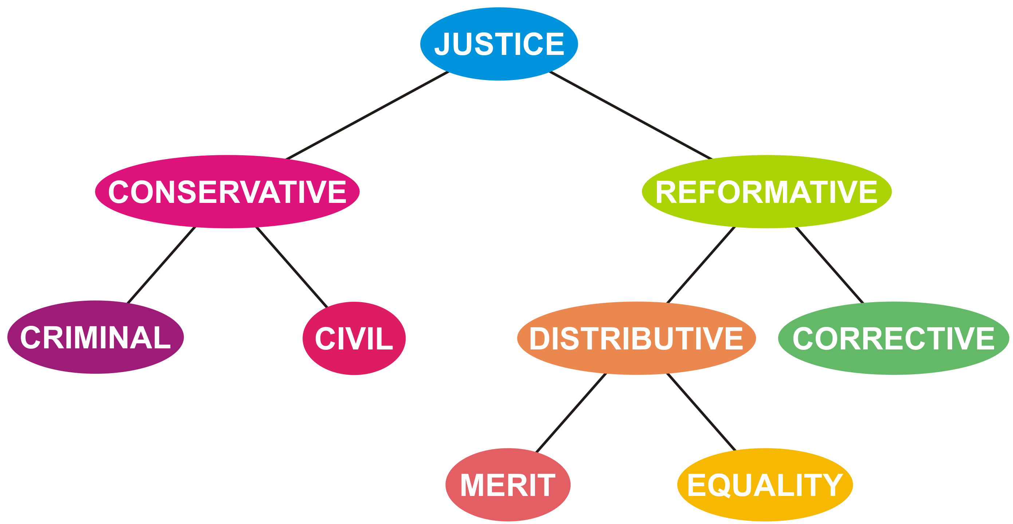
Justice

Slide 7
Conservative justice
One aspect of justice is to conserve the state of society
This involves the maintenance of laws
Criminal justice is the set of laws that the state has decided it will prosecute
Criminal justice seeks to maintain the society as a whole
Its purpose is to
Deter and mitigate crime
Penalize and rehabilitate offenders
Civil justice deals with interactions between individuals and requires the individual to initiate action
Civil justice is usually restorative: its goal is to restore the injured party, as much as possible to its original state

Slide 8
Reformative justice
Another aspect of justice is to reform society
Traditionally, this includes
Incarceration and other forms of punishment
Imprisonment was not preserved as a punishment in itself until recent history
Imprisonment was to hold the individual until punishment was administered
This can be through restoration and corrective justice
Victim-offender mediation
Family group or community conferencing and boards
Community restorative boards
Sentencing circles

Slide 9
Distributive justice
This involves the just allocation of goods in society
Distribution can be decided through
Equity
Equality
Power
Need
Responsibility

Slide 10
John Rawl’s theory of justice
In the 1970s, John Rawls came out with his seminal work A Theory of Justice
He equates justice with fairness

Slide 11
Guidelines
How do we set up guidelines for what is fair?
The veil of ignorance
Create guidelines for society under the assumption you are not aware of what position you will take within that socity

Slide 12
John Rawl’s principles
How do we set up guidelines for what is fair?
The veil of ignorance
Create guidelines for society under the assumption you are not aware of what position you will take within that society
Equal liberty
Social and economic inequalities must conform to:
They must be of most advantage to the least advantaged in society
Public offices and positions must be open to everyone under conditions of fair equality of opportunity

Slide 13
References
[1] Julie Vale, ECE 290 Course Notes, 2011.
[2] Wikipedia, http://www.wikipedia.org/Justice
These course slides are provided for the ECE 290 class. The material in it reflects Douglas Harder’s best judgment in light of the information available to him at the time of preparation. Any reliance on these course slides by any party for any other purpose are the responsibility of such parties. Douglas W. Harder accepts no responsibility for damages, if any, suffered by any party as a result of decisions made or actions based on these course slides for any other purpose than that for which it was intended.

