Slide 1
Tort Law: Occupiers’ Liability
Douglas Wilhelm Harder, M.Math. LEL
Department of Electrical and Computer Engineering
University of Waterloo
Waterloo, Ontario, Canada
ece.uwaterloo.ca
dwharder@alumni.uwaterloo.ca
© 2013 by Douglas Wilhelm Harder. Some rights reserved.

Slide 2
Outline
An introduction to the engineering profession, including:
Standards and safety
Law: Charter of Rights and Freedoms, contracts, torts, negligent malpractice, forms of carrying on business
Intellectual property (patents, trade marks, copyrights and industrial designs)
Professional practice
Professional Engineers Act
Professional misconduct and sexual harassment
Alternative dispute resolution
Labour Relations and Employment Law
Environmental Law

Slide 3
Occupier’s Liability
The owner of real property (real estate) is responsible for the health and safety of any who enter, including
Those entering legally
Trespassers (illegal entrance)

Slide 4
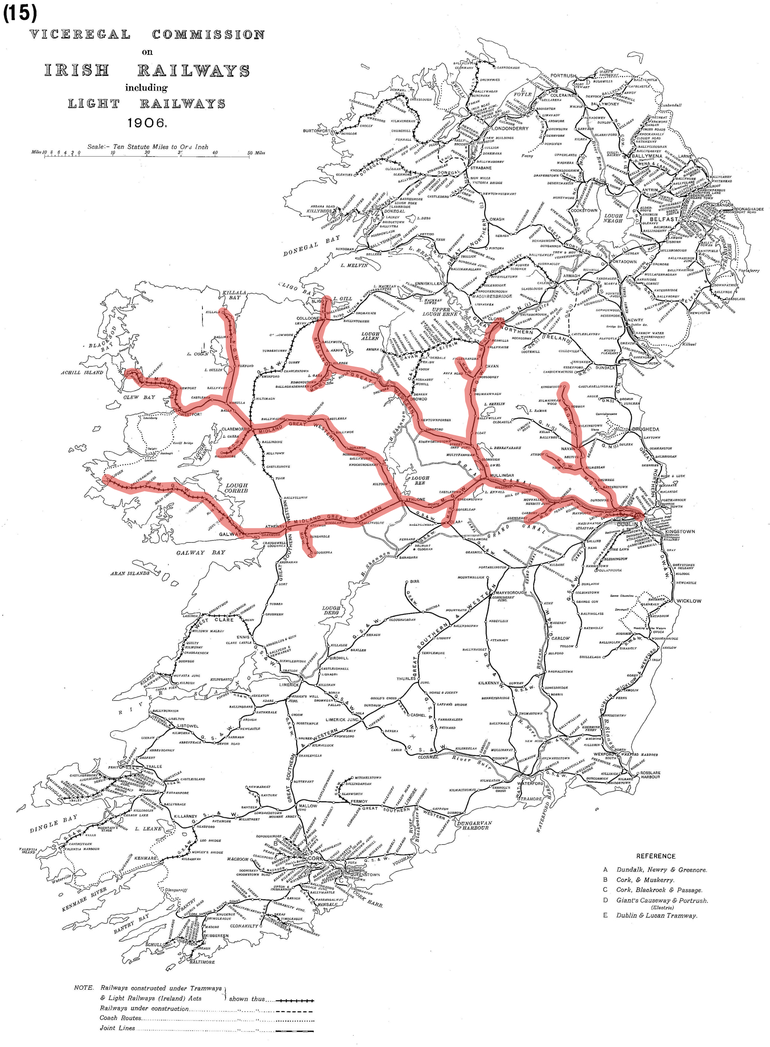
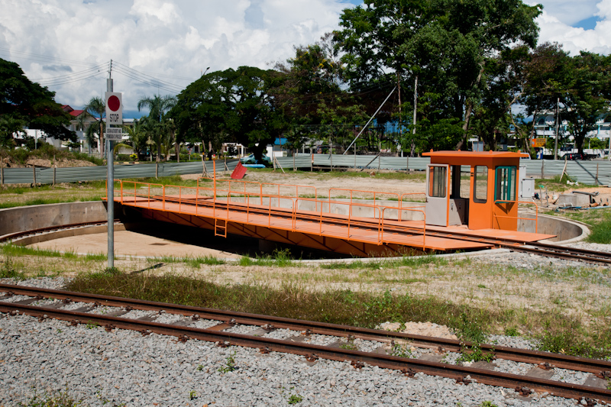
Occupier’s Liability
The precedence-setting case is Cooke v Midland Great Western Railway of Ireland, 1909
A railway turntable was unlocked
The workers were aware children trespassed and played on the turntable
Access was through a gap in a fence, which the defendant was required to maintain by statute
One boy was hurt
CEphoto, Uwe Aranas

Slide 5
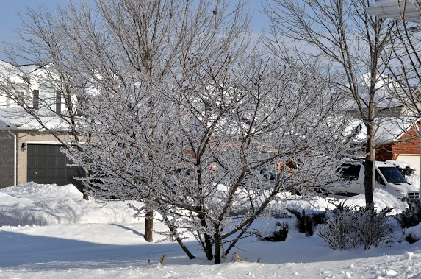
Occupier’s Liability
For those entering legally, the owner must make efforts to prevent harm caused to guests against known dangers
For example, ice buildup on any paths must be cleared or salted or something must indicate the possibility of danger
You are not responsible for criminals slipping on ice in your back yard...

Slide 6
Occupier’s Liability
You are also potentially liable for theft by children of dangerous substances
In Holian v United Grain Growers, boys stole fumigant tablets for killing insects from a shed and placed them in the plaintiff’s car as a stink bomb causing the plaintiff to become ill
Douglas Hodgson , The Law of Intervening Causation, Ashgate Publishing Ltd., 2008.

Slide 7
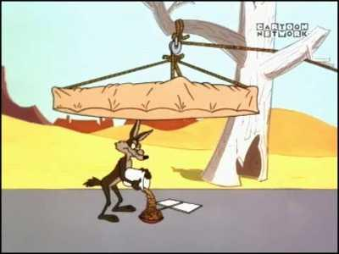
Trespassing
Even though you are not liable for harm caused to trespassers, you may not intentionally set traps
Warner Bros. Animation

Slide 8
Occupiers’ Liability Act
In Ontario, an occupier’s liability is defined by statute:
It’s reasonably short—only eleven sections
Common law duty of care superseded
Occupier’s duty
Risks willingly assumed, Criminal activity, Criminal activity, and Trespass and permitted recreational activity
Restriction of duty or liability, Extension of liability by contract, and Reasonable steps to inform
Liability where independent contractor
Obligations of landlord as occupier
Preservation of higher obligations, Employer and employee relationships, and Application of Negligence Act

Slide 9
References
[1] D.L. Marston, Law for Professional Engineers, 4th Ed., McGraw Hill, 2008.
[2] Julie Vale, ECE 290 Course Notes, 2011.
[3] Wikipedia, http://www.wikipedia.org/
[4] Occupiers’ Liability Act, 1990
http://www.e-laws.gov.on.ca/html/statutes/english/elaws_statutes_90o02_e.htm
These course slides are provided for the ECE 290 class. The material in it reflects Douglas Harder’s best judgment in light of the information available to him at the time of preparation. Any reliance on these course slides by any party for any other purpose are the responsibility of such parties. Douglas W. Harder accepts no responsibility for damages, if any, suffered by any party as a result of decisions made or actions based on these course slides for any other purpose than that for which it was intended.

