Slide 1
Professionalism
Douglas Wilhelm Harder, M.Math. LEL
Department of Electrical and Computer Engineering
University of Waterloo
Waterloo, Ontario, Canada
ece.uwaterloo.ca
dwharder@alumni.uwaterloo.ca
© 2012 by Douglas Wilhelm Harder. Some rights reserved.

Slide 2
Course Description
An introduction to the engineering profession, including:
Standards and safety
Law: Charter of Rights and Freedoms, contracts, torts, negligent malpractice, forms of carrying on business
Intellectual property (patents, trade marks, copyrights and industrial designs)
Professional practice
Professional Engineers Act
Professional misconduct and sexual harassment
Alternative dispute resolution
Labour Relations and Employment Law
Environmental Law

Slide 3
Course Description
Course web site:
ece.uwaterloo.ca/~ece290/
Course texts:
D.L. Marston, Law for Professional Engineers, 4th Ed., McGraw-Hill Ryerson, 2008.
G.C. Andrews et al., Introduction to Professional Engineering in Canada, 4th Ed., Pearson Prentice Hall, 2009.

Slide 4
Course Description
Course grading:
Mid-term examination 20 %
Final examination 50 %
Class participation 10 %
Two essays 10 % each

Slide 5
Course Description
Course web site:
ece.uwaterloo.ca/~ece290/
Course texts:
D.L. Marston, Law for Professional Engineers, 4th Ed., McGraw-Hill Ryerson, 2008.
G.C. Andrews et al., Introduction to Professional Engineering in Canada, 4th Ed., Pearson Prentice Hall, 2009.

Slide 6
Definition
What is a profession?
A self-selected self-disciplined group of individuals who hold themselves out to the public as possessing a special skill derived from training and education and are prepared to exercise that skill in the interests of the public.¹
¹ Mall Medical Group, Winnipeg and the Department of Surgery, University of Manitoba

Slide 7
History of Professions
How long have professions been around?
Providing specialized services has been a necessity since the dawn of civilization
The first cities were in Egypt
The first empires were in Mesopotamia
This fertile region is, relatively speaking, devoid of most other necessities for life
The earliest regulations meant to counter corruption are from Urukagina, the king of Lagash from 2380 to 2360 BCE
Hammurabi was a Babylonian king from 1728 to 1686 BCE and left one of the earliest extant codes

Slide 8
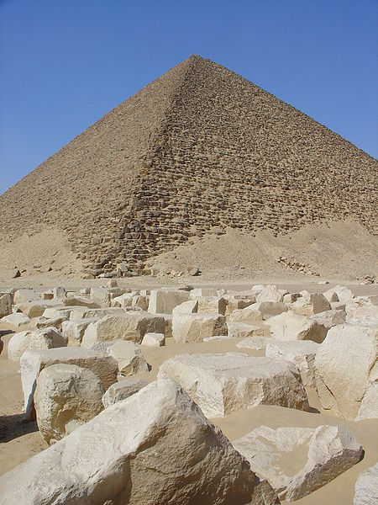
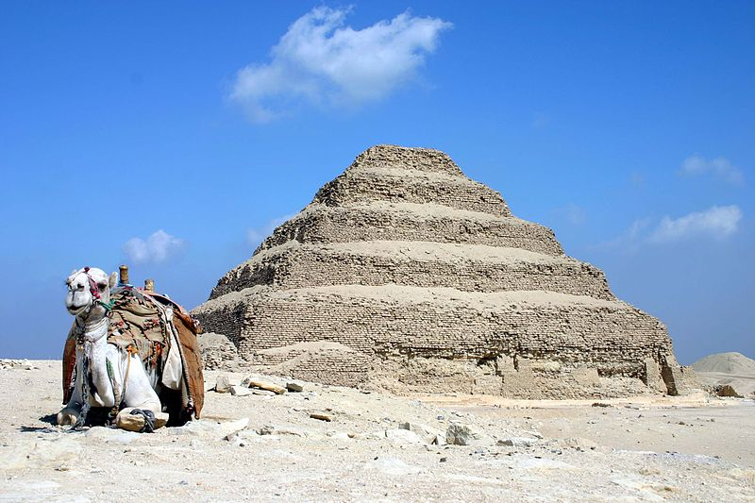
Civil Engineering
Sneferu was the first pharaoh to build what we consider a modern pyramid
2613 to 2589 BCE
User: Charlesjsharp
User: Ivrienen

Slide 9
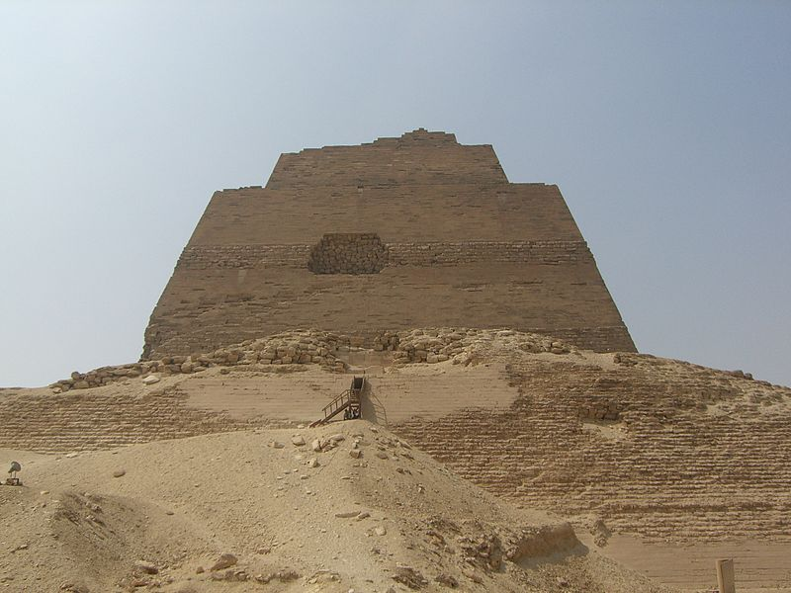
Civil Engineering
Evidence of errors in civil engineering go back to antiquity
The Meidum pyramid
Neithsabes

Slide 10
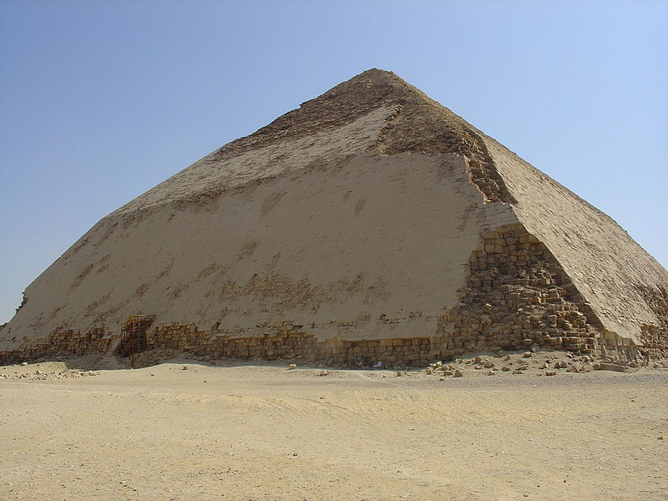
Civil Engineering
Evidence of errors in civil engineering go back to antiquity
The Bent Pyramid
User: Ivrienen

Slide 11
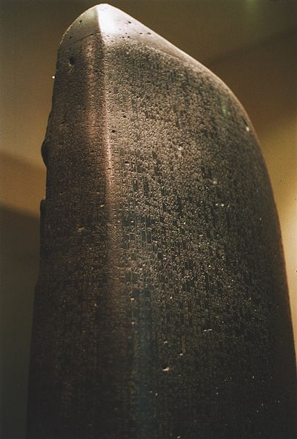
Code of Hammurabi
The Code of Hammurabi (1728 to 1686 BCE) is casuistic
User: Rama

Slide 12
Code of Hammurabi
The Code of Hammurabi recognizes a number of professions and places requirements on their work
228. If a builder build a house for some one and complete it, he shall give him a fee of two shekels in money for each sar of surface.
229. If a builder build a house for some one, and does not construct it properly, and the house which he built fall in and kill its owner, then that builder shall be put to death.
233. If a builder build a house for some one, even though he has not yet completed it; if then the walls seem toppling, the builder must make the walls solid from his own means.
0.3 troy ounces of silver per 36 m²

Slide 13
Code of Hammurabi
The Code of Hammurabi recognizes a number of professions and places requirements on their work
224. If a veterinary surgeon perform a serious operation on an ass or an ox, and cure it, the owner shall pay the surgeon one-sixth of a shekel as a fee.
225. If he perform a serious operation on an ass or ox, and kill it, he shall pay the owner one-fourth of its value.

Slide 14
Code of Hammurabi
The Code of Hammurabi recognizes a number of professions and places requirements on their work
215. If a physician make a large incision with an operating knife and cure it, or if he open a tumor (over the eye) with an operating knife, and saves the eye, he shall receive ten shekels in money.
218. If a physician make a large incision with the operating knife, and kill him, or open a tumor with the operating knife, and cut out the eye, his hands shall be cut off.
221. If a physician heal the broken bone or diseased soft part of a man, the patient shall pay the physician five shekels in money.

Slide 15
Code of Hammurabi
The Code of Hammurabi recognizes a number of professions and places requirements on their work
234. If a shipbuilder build a boat of sixty gur for a man, he shall pay him a fee of two shekels in money.
235. If a shipbuilder build a boat for some one, and do not make it tight, if during that same year that boat is sent away and suffers injury, the shipbuilder shall take the boat apart and put it together tight at his own expense. The tight boat he shall give to the boat owner.

Slide 16
Hippocratic Oath
How should professionals behave?
The Hippocratic Oath is a Ionic Greek oath from the late 5th century BCE taken by physicians to practice
It requires the physician to practice medicine ethically

Slide 17
Hippocratic Oath
Extracts:
I will prescribe regimens for the good of my patients according to my ability and my judgment and never do harm to anyone.
I will give no deadly medicine to any one if asked, nor suggest any such counsel; and similarly I will not give a woman a pessary to cause an abortion.
But I will preserve the purity of my life and my arts.
I will not cut for stone, even for patients in whom the disease is manifest; I will leave this operation to be performed by practitioners, specialists in this art.
In every house where I come I will enter only for the good of my patients, keeping myself far from all intentional ill-doing and all seduction and especially from the pleasures of love with women or men, be they free or slaves.

Slide 18
Early Professions
Originally, the three recognized learned professions were divinity, medicine, and law
There has always been a strong association between higher learning and professions versus trades
It became a full-time occupation
The first training school was established
The first university school was established
The first local association was established
The first national association was established
The codes of professional ethics were introduced
State licensing laws were established

Slide 19
Definition
A definition of a profession:
A self-selected self-disciplined group of individuals who hold themselves out to the public as possessing a special skill derived from training and education and are prepared to exercise that skill in the interests of the public.
Mall Medical Group, Winnipeg and the Department of Surgery, University of Manitoba

Slide 20
Characteristics
Professions will have
Specialized knowledge
Long and intensive preparation
Instruction in skills and methods
Scientific, historical or scholarly principles
Maintained by force of organization
High standards of achievement and conduct
Continued study
Providing service to the public

Slide 21
What is Engineering?
What is engineering:
The application of scientific, technological, algorithmic, and mathematical principles to make practical use of the properties of matter and sources of energy for the design, manufacture, evaluation, operation and maintenance of engines, machines, structures, devices, materials, systems or processes typically in such a way to be made useful, efficient, and economical for public or commercial purposes.

Slide 22
What is an Engineer?
A professional engineer is a person who holds a licence to engage in any act of planning, designing, composing, evaluating, advising, reporting, directing or supervising that requires the application of engineering principles and concerns the safeguarding of life, health, property, economic interests, the public welfare or the environment, or the managing of any such act.

Slide 23
What is an Engineer?
A professional engineer is a person who holds a licence to engage in any act of planning, designing, composing, evaluating, advising, reporting, directing or supervising that requires the application of engineering principles and concerns the safeguarding of life, health, property, economic interests, the public welfare or the environment, or the managing of any such act.

Slide 24
What is an Engineer?
A professional engineer is a person who holds a licence to engage in any act of planning, designing, composing, evaluating, advising, reporting, directing or supervising that requires the application of engineering principles and concerns the safeguarding of life, health, property, economic interests, the public welfare or the environment, or the managing of any such act.

Slide 25
What is an Engineer?
A professional engineer is a person who holds a licence to engage in any act of planning, designing, composing, evaluating, advising, reporting, directing or supervising that requires the application of engineering principles and concerns the safeguarding of life, health, property, economic interests, the public welfare or the environment, or the managing of any such act.

Slide 26
What is an Engineer?
A professional engineer is a person who holds a licence to engage in any act of planning, designing, composing, evaluating, advising, reporting, directing or supervising that requires the application of engineering principles and concerns the safeguarding of life, health, property, economic interests, the public welfare or the environment, or the managing of any such act.

Slide 27
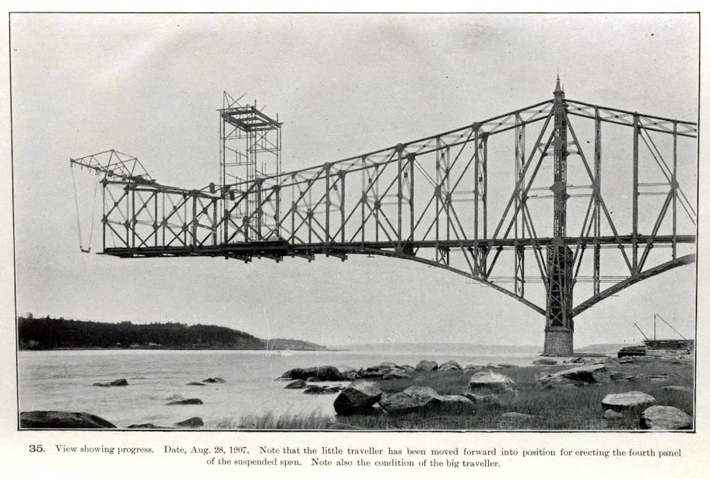
Quebec Railway Bridge
The day before the collapse

Slide 28
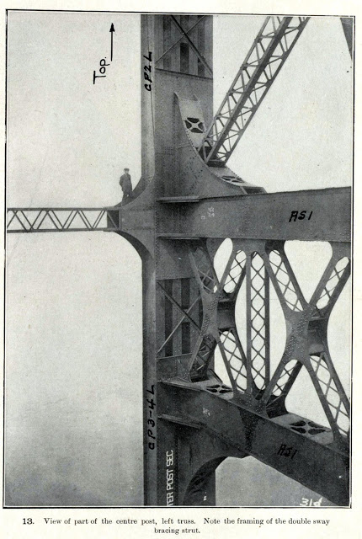
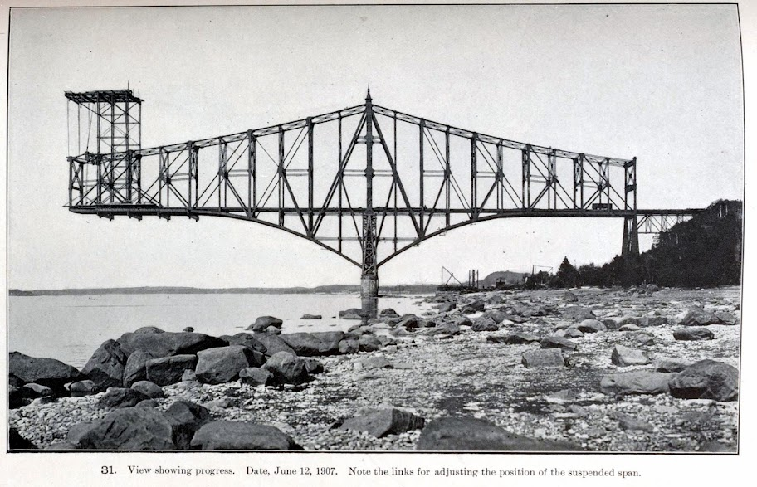
Quebec Railway Bridge
Two months before the collapse

Slide 29
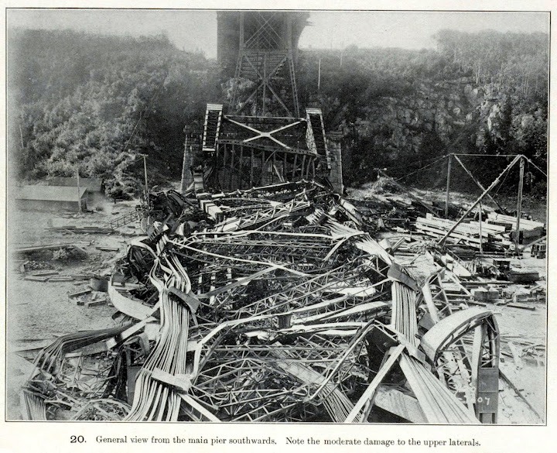
Quebec Railway Bridge
Where does the iron ring come from?

Slide 30
Quebec Railway Bridge
This disaster caused the engineers in Canada to organize into voluntary associations
The Ontario Government passed the Professional Engineers Act, but membership was voluntary
Following a series of incidents in the 1930s, membership became mandatory

Slide 31
Regulation
No one likes regulation
It infringes on personal freedom
Why is it, in some cases, necessary?
After all, engineers are quite intelligent...

Slide 32
Principal Object of the Association
From Section 3 of the Act:
...to regulate the practice of professional engineering and to govern its members, holders of certificates of authorization, and holders of [other] licences...in order that the public interest may be served and protected

Slide 33
Additional Objectives
Additional objects are stated in Section 4 of the Act
To establish, maintain and develop standards of:
1. knowledge and skill among its members,
2. qualification and practice for the practice of professional engineering, and
3. professional ethics among its members.
4. To promote public awareness of the role of the Association.
5. To perform such other duties and exercise such other powers as are imposed or conferred upon the Association by or under any Act.

Slide 34
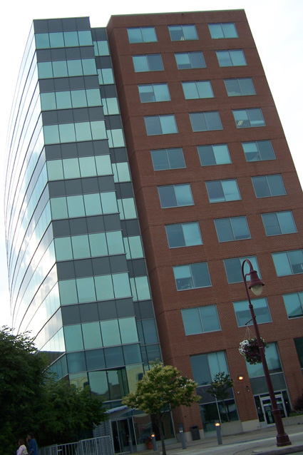
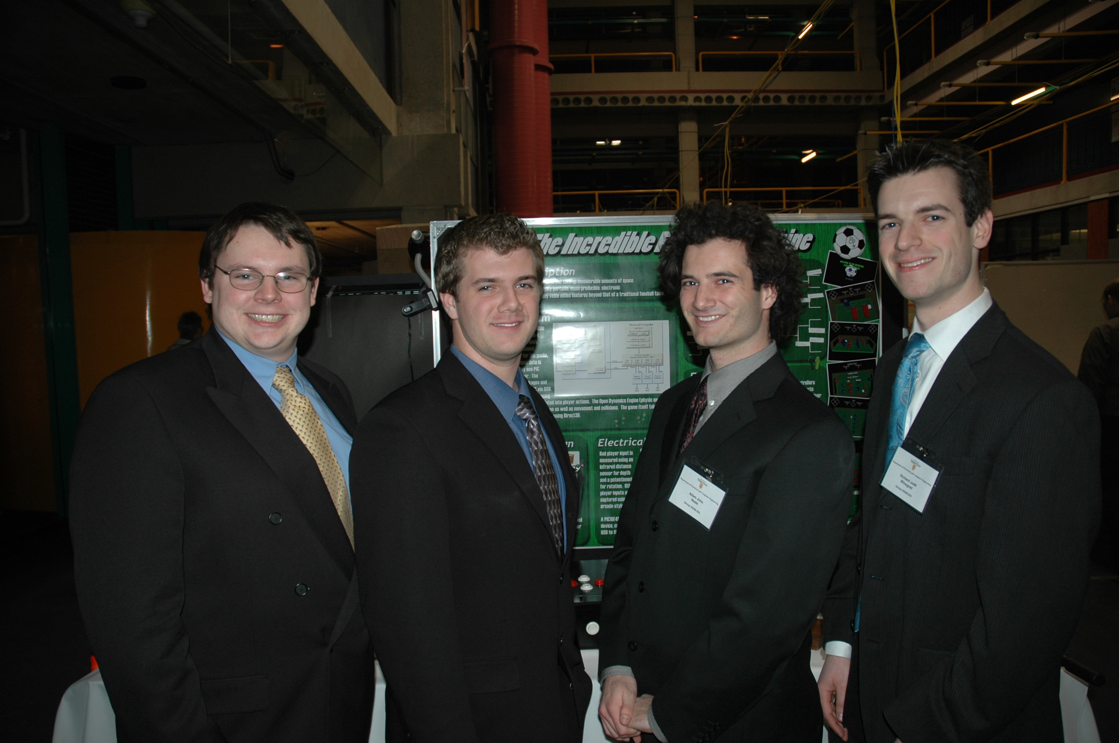
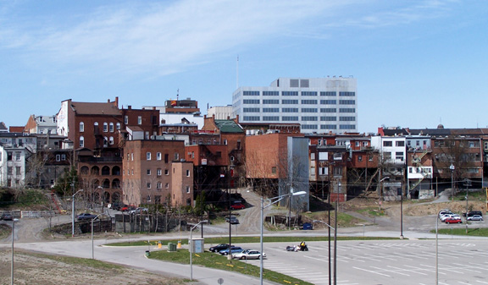
Overview
Issues certificates of authorization (CofA)
to individuals or business organizations
to engage in the business of providing
professional engineering services
to the public
Issues licences
to individuals to engage
in the practice of
professional engineering
At least one licenced professional
engineer must responsibility for
and supervises the services
provided by the holder of a CofA
The professional engineer
is employed by a business
organization to perform
engineering services
for the organization
The holder of the CofA
provides professional
engineering services to
the public usually through
contracts

Slide 35
Professional Education
Your degree is accredited by the Canadian Engineering Accreditation Board
You must satisfy all requirements of the degree to graduate

Slide 36
The Flexner Report
Consider the practice of medicine
At the start of the 20th century, “diploma mills” not associated with any accredited university were churning out medical doctors
In this environment, the quality of doctors was suspect at best
The poor quality of the medical services provided resulted in the expansion of pseudo-scientific practices such as chiropractic and homeopathy

Slide 37
The Flexner Report
Published by the Carnegie Foundation, Abraham Flexner’s report made a number of recommendations:
Reduce the number of medical schools
Increase the prerequisites to enter medical training
Train physicians to practice in a scientific manner and engage medical faculty in research
Give medical schools control of clinical instruction in hospitals
Strengthen state regulation of medical licensure
Modeled on the Johns Hopkins University School of Medicine

Slide 38
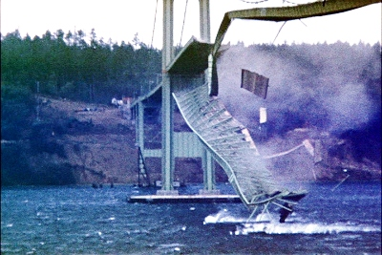
Engineering Failures
We will look at some engineering failures...
Everyone knows about the Tacoma Narrows Bridge
Barney Elliott

Slide 39
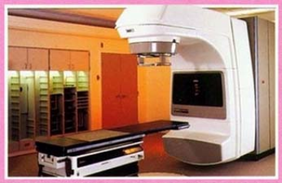
Therac-25
The issue with electrical and computer engineering is that the product is essentially invisible
The consumer can only infer what is happening by its response
This can lead to confusion which you must be ready to address
Jerry Weinberg

Slide 40
Therac-25
The VT-100 provided the interface for this system
PATIENT NAME : JOHN DOE
TREATMENT MODE : FIX BEAM TYPE: X ENERGY (MeV): 25
ACTUAL PRESCRIBED
UNIT RATE/MINUTE 0 200
MONITOR UNITS 50 50 200
TIME (MIN) 0.27 1.00
GANTRY ROTATION (DEG) 0.0 0 VERIFIED
COLLIMATOR ROTATION (DEG) 359.2 359 VERIFIED
COLLIMATOR X (CM) 14.2 14.3 VERIFIED
COLLIMATOR Y (CM) 27.2 27.3 VERIFIED
WEDGE NUMBER 1 1 VERIFIED
ACCESSORY NUMBER 0 0 VERIFIED
DATE : 84-OCT-26 SYSTEM : BEAM READY OP.MODE: TREAT AUTO
TIME : 12:55. 8 TREAT : TREAT PAUSE X-RAY 173777
OPR ID : T25VO2-RO3 REASON : OPERATOR COMMAND:
ClickRick

Slide 41
Therac-25
Cancer cells are weaker than regular cells making them easier to kill
Radiation is an appropriate tool to kill weaker cells
There where two modes of operation
Electron radiation (between 5 MeV and 25 MeV)
X-rays (25 MeV electrons bombarding a stationary target)

Slide 42
Therac-25
“During the weeks following the accident, the patient continued to have pain in his neck and shoulder. He lost the function of his left arm and had periodic bouts of nausea and vomiting. He was eventually hospitalized for radiation-induced myelitis of the cervical cord causing paralysis of his left arm and both legs, left vocal cord paralysis (which left him unable to speak), neurogenic bowel and bladder, and paralysis of the left diaphragm. He also had a lesion on his left lung and recurrent herpes simplex skin infections. He died from complications of the overdose five months after the accident.”
This patient received 20,000 rad
Doses of more than 1,000 rad are almost invariably fatal.
US DOD

Slide 43
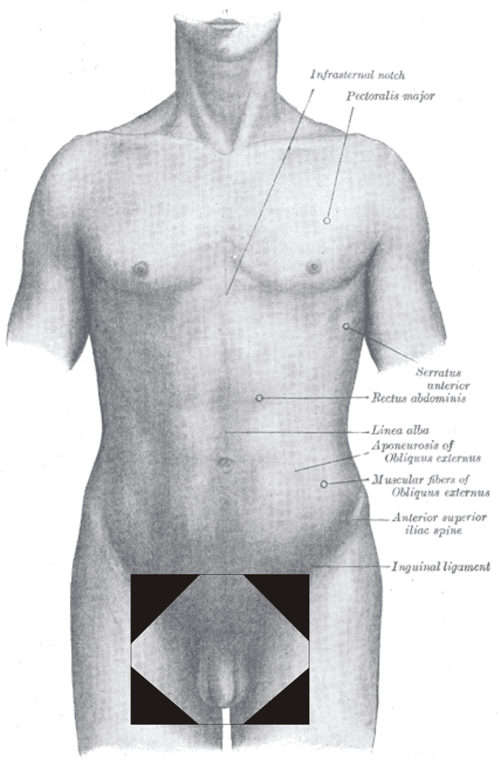
Instituto Oncologico Nacional
Treating prostate and cervical cancer

Slide 44
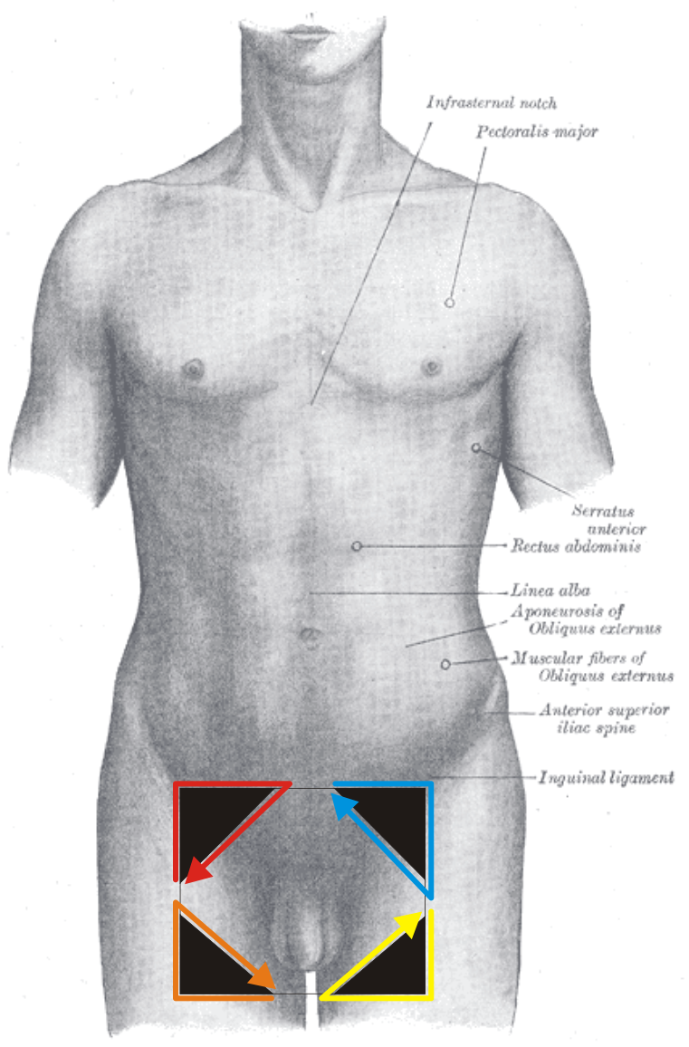
Instituto Oncologico Nacional
Shields protect but also affect dosage levels
Software allows for up to four shields

Slide 45
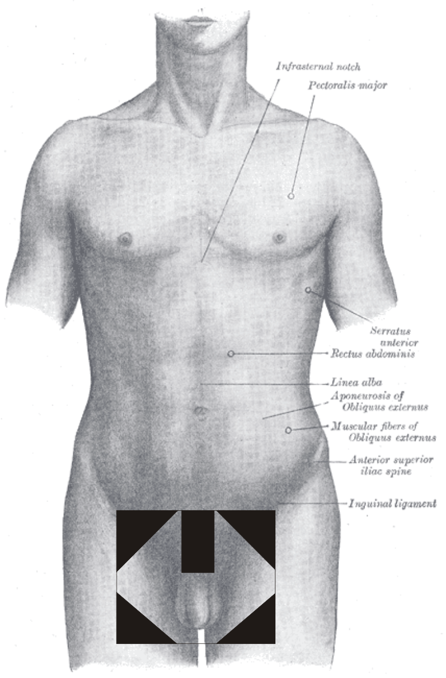
Instituto Oncologico Nacional
They wanted five shields

Slide 46
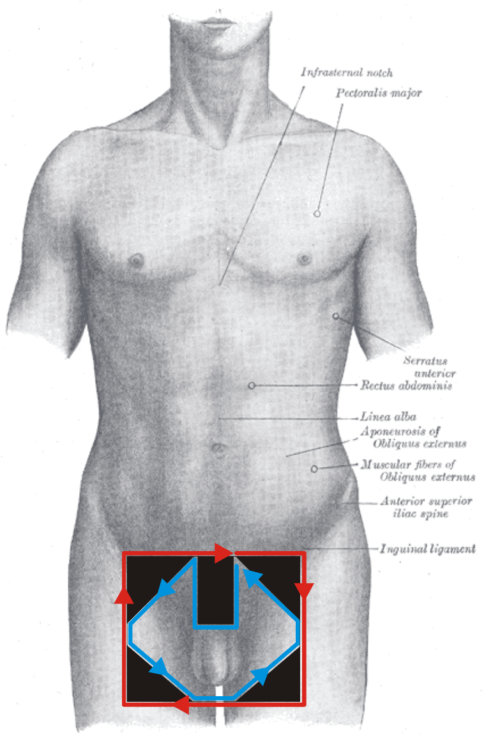
Instituto Oncologico Nacional
They fudged the system and it worked...

Slide 47
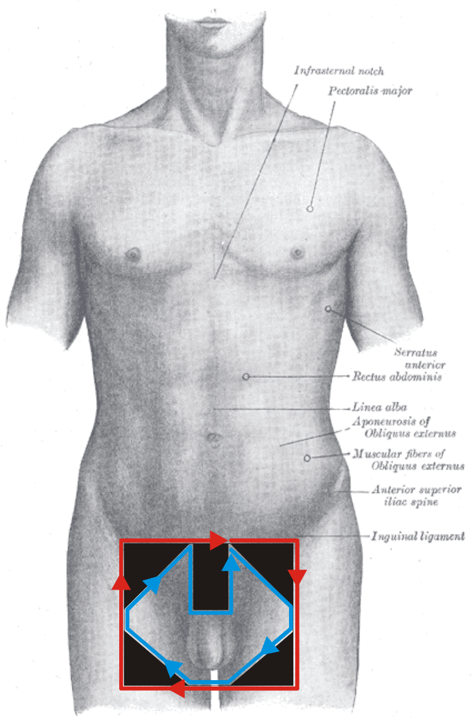
Instituto Oncologico Nacional
...if they did it right
17 deaths and 11 injuries

Slide 48
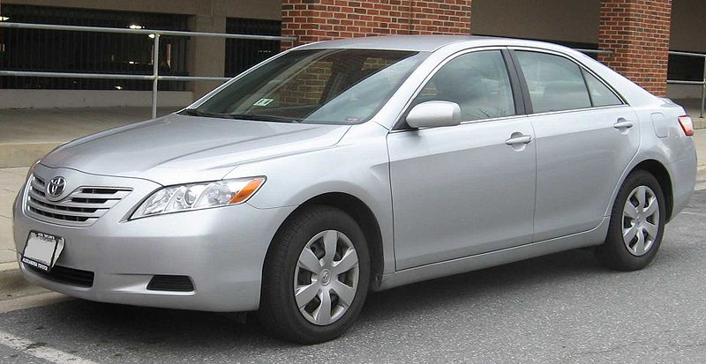
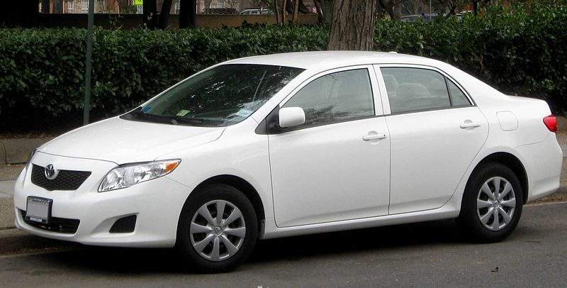
Toyota
9 million vehicles recalled...
IFCAR

Slide 49
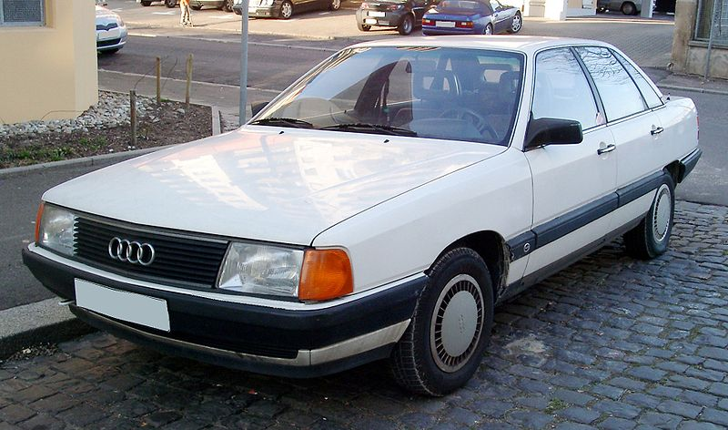
Audi 5000
9 million vehicles recalled...
Rudolf Stricker

Slide 50
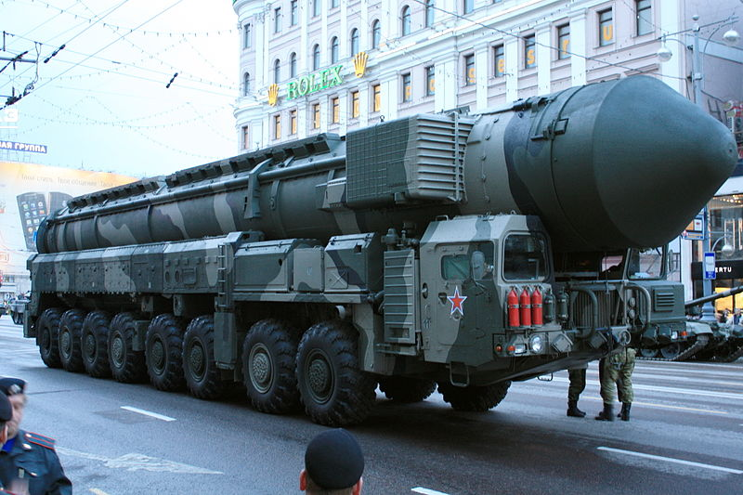
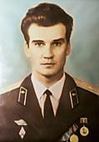
Lt. Col. Stanislav Yevgrafovich Petrov
Участник:Goodvint
http://sixperfections.blogspot.ca/2012/04/man-who-saved-world.html

Slide 51
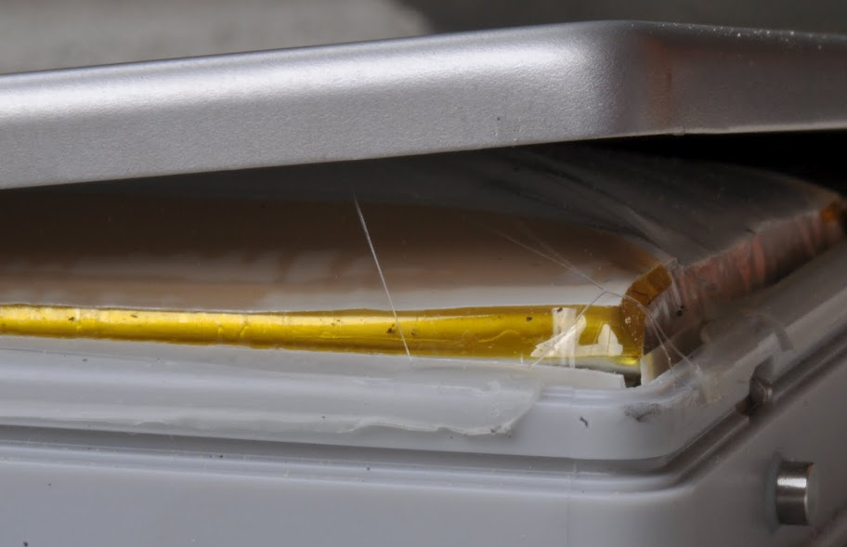
Li-Ion Batteries

Slide 52
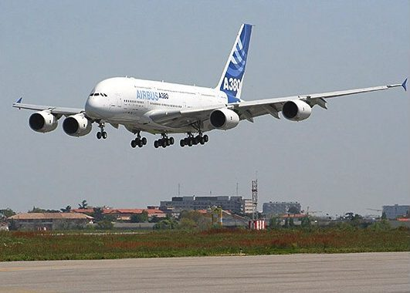
A380
User : P.loos

Slide 53
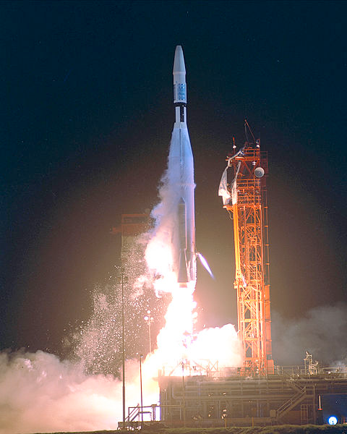
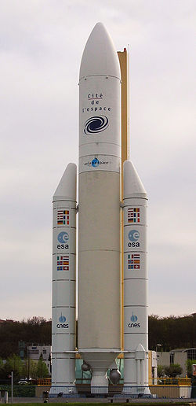
Mariner 1 Ariane 5 MCO
NASA
NASA
Poppy

Slide 54
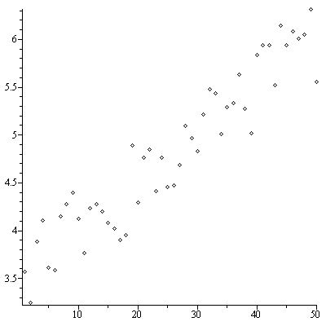
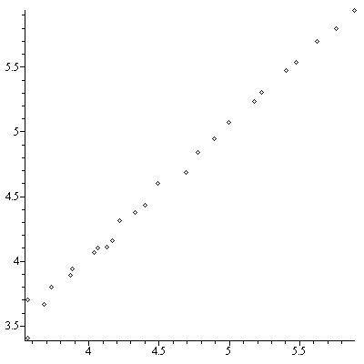
Mariner 1
The n^{th} smoothed value of the time derivative of a radius R

Slide 55
Ariane 5
Double-precision floating-point number
L_M_BH_32 := TBD.T_ENTIER_32S(
(1.0/C_M_LSB_BH) * G_M_INFO_DERIVE( T_ALG.E_BH ) );
if L_M_BH_32 > 32767 then
P_M_DERIVE(T_ALG.E_BH) := 16#7FFF#;
elsif L_M_BH_32 < -32768 then
P_M_DERIVE(T_ALG.E_BH) := 16#8000#;
else
P_M_DERIVE(T_ALG.E_BH) :=
UC_16S_EN_16NS( TDB.T_ENTIER_16S( L_M_BH_32 ) );
end if;
P_M_DERIVE(T_ALG.E_BH) := UC_16S_EN_16NS( TDB.T_ENTIER_16S(
(1.0/C_M_LSB_BH) * G_M_INFO_DERIVE( T_ALG.E_BH ) ) );

Slide 56
Mars Climate Orbiter
1 lbf = 4.4482216152605 N

Slide 57
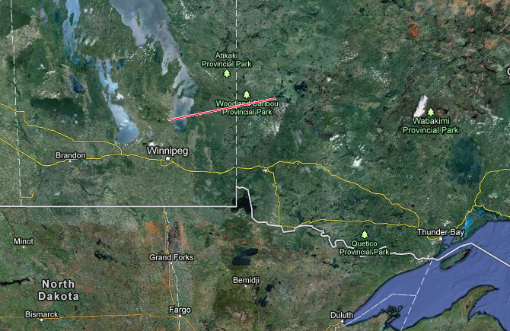
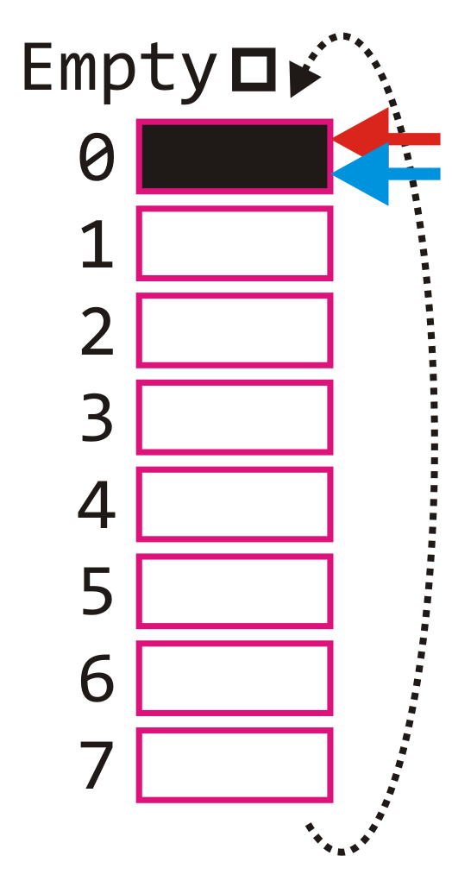
Gimli Glider
Imagine gliding a 767 over 200 km?

Slide 58
References
[1] Professional Engineers Act, http://www.e-laws.gov.on.ca/html/statutes/english/elaws_statutes_90p28_e.htm
[2] Ontario Regulation 941,
http://www.e-laws.gov.on.ca/html/regs/english/elaws_regs_900941_e.htm
[3] Julie Vale, ECE 290 Course Notes, 2011.
[4] Wikipedia, http://www.wikipedia.org/
These course slides are provided for the ECE 290 class. The material in it reflects Douglas Harder’s best judgment in light of the information available to him at the time of preparation. Any reliance on these course slides by any party for any other purpose are the responsibility of such parties. Douglas W. Harder accepts no responsibility for damages, if any, suffered by any party as a result of decisions made or actions based on these course slides for any other purpose than that for which it was intended.

