Slide 1
Tort Law: Strict Liability
Douglas Wilhelm Harder, M.Math. LEL
Department of Electrical and Computer Engineering
University of Waterloo
Waterloo, Ontario, Canada
ece.uwaterloo.ca
dwharder@alumni.uwaterloo.ca
© 2013 by Douglas Wilhelm Harder. Some rights reserved.

Slide 2
Outline
An introduction to the engineering profession, including:
Standards and safety
Law: Charter of Rights and Freedoms, contracts, torts, negligent malpractice, forms of carrying on business
Intellectual property (patents, trade marks, copyrights and industrial designs)
Professional practice
Professional Engineers Act
Professional misconduct and sexual harassment
Alternative dispute resolution
Labour Relations and Employment Law
Environmental Law

Slide 3
Strict Liability
We have seen that for product liability that:
It goes beyond the privacy of contract since MacPherson v. Buick Motor Co.
Liability for a tort caused by a product has been in force since Donahue v Stevenson
For liability in tort, however, it is necessary to establish a duty of care and negligence
Usually, the producer of a product has a duty of care to any who use the product
Establishing negligence, however, can be much more difficult

Slide 4
Strict Liability
Strict liability is, however, defined as
“Tort liability based solely on the causation of damage rather than proof of the defendant’s intent or negligence.”
“One person may be required to compensate another for injury or damages even though the loss was neither intentionally nor negligently inflected.”
Recall, the only unintentional tort is that of negligence
Vernon J. Paul, Strict Liability in Canadian Product Liability Law

Slide 5
Strict Liability in the United States
In the United States, strict liability for a tort resulting from a product requires:
The product is defective
The product reached the end user without substantial change in its condition from the time it was originally sold
The defect rendered the product unreasonably dangerous
The unreasonably dangerous defect caused harm to the user
This was described in Hollis v Birch, 1990, of the British Columbia Supreme Court
Strict liability simply requires that a device be used in the intended manner and that an injury was the result in a defect in the design or manufacture

Slide 6
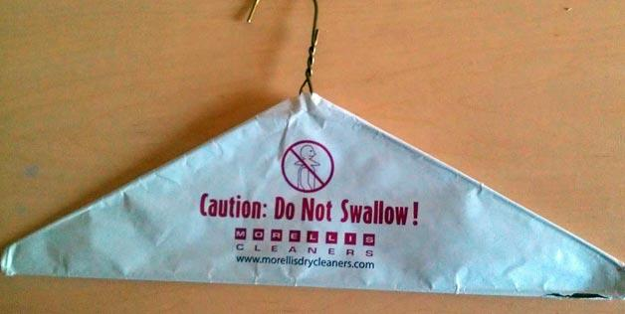
Strict Liability in the United States
This had led to a plethora of warnings — sometimes only included because someone was actually that stupid...
http://now.msn.com/ridiculous-product-warning-labels
CAUTION: may result in minor or moderate injury
WARNING: may result in serious injury or death
DANGER: will result in serious injury or death

Slide 7
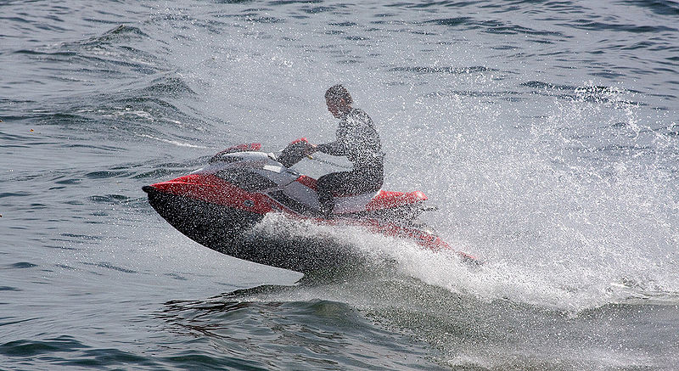
Strict Liability in the United States
An example of a warning:
User: Roqqy

Slide 8
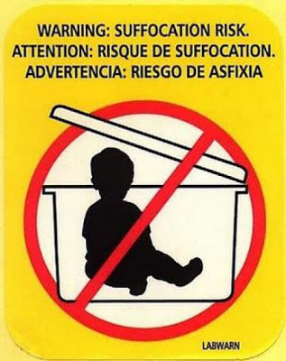
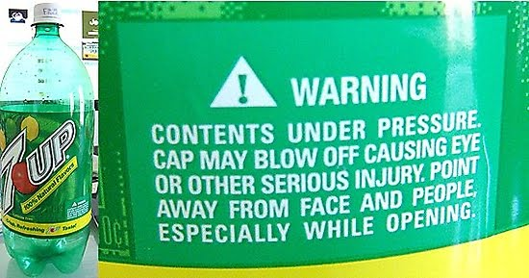
Strict Liability in the United States
Other example:
Champagne, anyone?
http://www.coolpicturegallery.us/2010/10/25-weird-unnecessary-product-warning.html

Slide 9
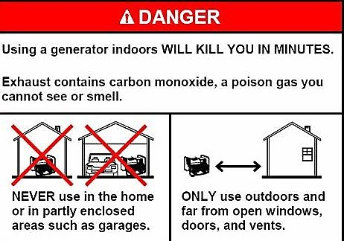
Strict Liability in the United States
An example of a danger:
http://www.coolpicturegallery.us/2010/10/25-weird-unnecessary-product-warning.html

Slide 10
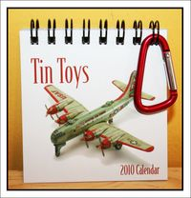
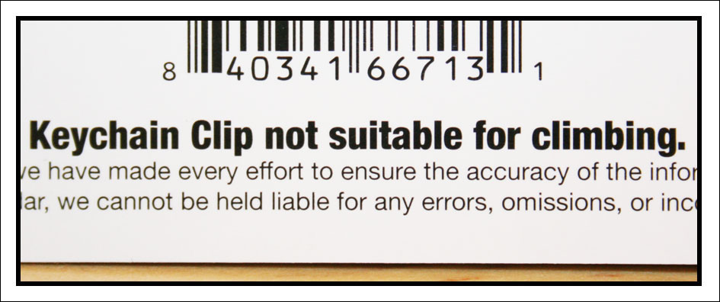
Strict Liability in the United States
A sad example:
http://heatherdwhite.typepad.com/unwrapped/2009/08/

Slide 11
Strict Liability in Canada
In Canada, strict liability has not yet been imposed by the courts
In Phillips et al. v Ford Motor Co. of Canada et al., a car that was over two years old was found to have faulty brakes:
“... our Courts do not, in product liability cases, impose upon manufacturers, distributors or repairers, ·as is done in some of the States of the American union, what is virtually strict liability. The standard of care exacted of them under our law is the duty to use reasonable care in the circumstances.”

Slide 12
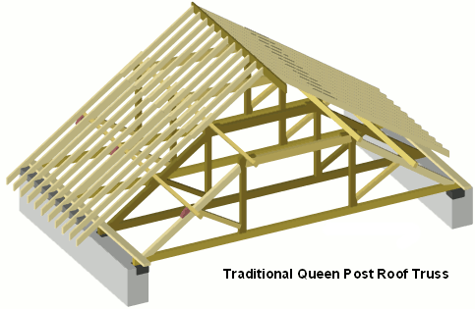
Strict Liability in Canada
In Meisel v Tolko Industries Ltd., the plaintiff was injured when a wooden purlin broke under the weight of a worker
The court refused to allow the concept of strict liability
Strict liability would automatically hold the manufacturer liable
The court held the plaintiff had to demonstrate negligence on the part of the manufacturer
Bill Bradley.AKA builderbill

Slide 13
Strict Liability in Canada
In another decision:
“The law does not require a manufacturer to produce articles which are accident proof, or incapable of doing harm. The manufacturer is not ‘an insurer’ of anyone who suffers injury while using, or misusing, the product. ”
In this case, the manufacturer of the Honda ATV claimed the injuries were a result of improper use

Slide 14
Where Does Strict Liability Apply?
Strict liability applies in:
“No fault” insurance—it is not necessary to establish fault
Workers compensation—it is not necessary to demonstrate the company was negligent for the worker to be compensated

Slide 15
References
[1] D.L. Marston, Law for Professional Engineers, 4th Ed., McGraw Hill, 2008.
[2] Julie Vale, ECE 290 Course Notes, 2011.
[3] Wikipedia, http://www.wikipedia.org/
These course slides are provided for the ECE 290 class. The material in it reflects Douglas Harder’s best judgment in light of the information available to him at the time of preparation. Any reliance on these course slides by any party for any other purpose are the responsibility of such parties. Douglas W. Harder accepts no responsibility for damages, if any, suffered by any party as a result of decisions made or actions based on these course slides for any other purpose than that for which it was intended.

