Slide 1
Duty to Report and Whistleblowing
Douglas Wilhelm Harder, M.Math. LEL
Department of Electrical and Computer Engineering
University of Waterloo
Waterloo, Ontario, Canada
ece.uwaterloo.ca
dwharder@alumni.uwaterloo.ca
© 2013 by Douglas Wilhelm Harder. Some rights reserved.

Slide 2
Outline
An introduction to engineering law and ethics:
ethical theories, code of ethics and misconduct
whistle blowing, conflict of interest and sexual harassment
health and safety, diversity, workplace equity and environment
Charter of Rights and Freedoms
torts, contract and intellectual property
Continuation of studies of professional practice:
history
Professional Engineers Act and Regulation
licensing, discipline and enforcement

Slide 3
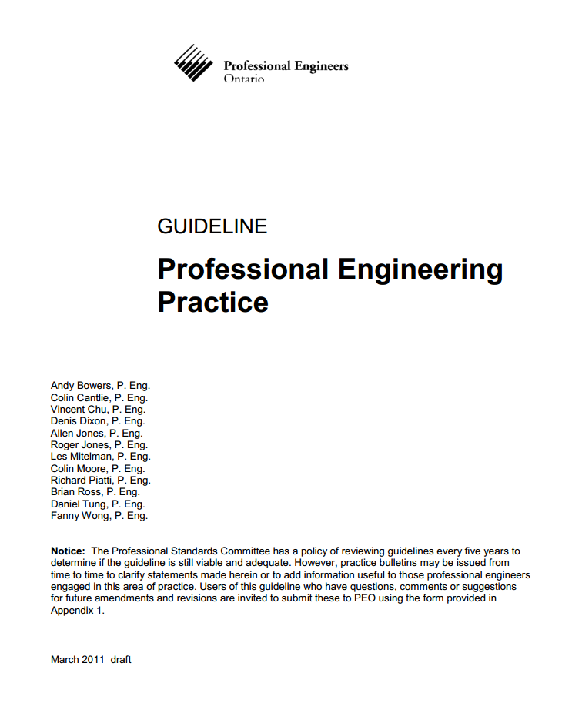
Comment
A significant amount of this topic is taken directly or paraphrased from PEO’s GUIDELINE: Professional Engineering Practice, a document you can download from PEO’s web site

Slide 4
Duty to Report
Engineers are responsible for ensuring that the products that we design and develop are safe for the public
What happens if company policy or culture is such that it is inevitably leading to the harm

Slide 5
Whistleblowing
We will look at how and when to blow the whistle, what level of “safe” is good enough, and possible repercussions of blowing or not blowing the whistle

Slide 6
Duty to Report
Any time engineers see a defect in a design, an unsafe plan, a faulty conclusions in an analysis, or an incomplete evaluation; or hear poor advice or insufficient direction within their practice, they are exercising the duty to report

Slide 7
Duty to Report
The duty to report relates to situations related to engineers’ ability to apply judgment based on their professional training, experience and competence
This duty is applied when engineers are engaged in the practice of professional engineer

Slide 8
Duty to Report
When engineers see a situation that compels them to report an issue, their primary duty is to report
Engineers are not required to solve problems in such cases unless they have the authority to make the required changes
In many cases, the issues will be in the purview of others
It is the responsibility of engineers to make those who have the appropriate influence aware of the issue

Slide 9
How Far to Go?
When do you go outside the privacy of a contract or employment?
Only when if is a matter that affects the public welfare or public interest

Slide 10
What Steps Should Be Taken?
An engineer would proceed as follows:
Ensure the problem is real and that the harm is a reasonable consequence of the issue
The severity of the consequences will dictate the urgency required
Determine who should be informed
As a mater of fairness, loyalty and being a faithful trustee or agent, one would always approach one’s employer or client first
Advise the employer or client and, if possible, provide possible remedial steps
Ensure that the individual is clearly aware of the consequences

Slide 11
What Steps Should Be Taken?
At this point, the engineer must decide:
“Will the consequential harm affect the public welfare?”
If the answer is no, it is an internal issue and your responsibilities are met

Slide 12
What Steps Should Be Taken?
Which of the following situations are purely internal and do not affect the public welfare?
A colleague is engaging in racist behaviour, ignoring or belittling those from other cultures or ethnicities
The design will have significant consequences on the extensibility of the system, thereby necessarily incurring significant additional expenses in the future
There is evidence of bribery between your employer and another client
A mechanical engineer is designing the framework for a software system
An engineer approved a report prepared by a subordinate that he didn’t have time to read
Any behaviour that is illegal

Slide 13
What Steps Should Be Taken?
If there is the potential for harm to the public welfare, the engineer should take the following additional steps:
Follow up with the employer or client within a reasonable period of time
You should inform them that you are obligated to report if the issue is not addressed appropriately
You are required to do so under the Professional Engineers Act
If the issue is not addressed, discuss the matter with colleagues
Again, you should maintain privacy of contract — talk to your fellow engineers in house where at all possible
If the issue is not resolved, follow up with higher management
Again, reiterate that you are obligated to report under the Act

Slide 14
What Steps Should Be Taken?
If the issue is not being addressed, it may be necessary to go external
What about any contractual obligations, employment contracts, or non-disclosure agreements?

Slide 15
Non-disclosure Agreements
A non-disclosure agreement is a contract between the parties and an agreement is legally enforceable only if it has legal purpose
If there is an imminent threat to life, health, property, economic interests, the public welfare or the environment, any agreement requiring confidentiality on such matters, it will no longer have legal purpose
Question: Threats to life, health, property and the environment can be more objectively quantified; what about threats to economic interests and the public welfare?

Slide 16
Whistleblowing
If you feel that there is an immanent threat to the public welfare, the next step is to blow the whistle
The first step is to approach a government regulatory body or a government ministry or ombudsperson
There must be an extreme situation before an engineer would approach either the media or a private watchdog agency
Any professional engineer can always contact PEO at this step of the process

Slide 17
Duty to Report Incompetence or Professional Misconduct
When must a professional engineer report professional misconduct or incompetence on the part of another engineer?
The Act only requires reporting when a professional engineer determines a situation is either unsafe or detrimental to the public welfare
If, however, the incompetence or misconduct of a professional engineer becomes threatening, an engineer would issue a complaint as any other person

Slide 18
When?
How often will engineers find themselves in a position where they will be confronted with corrupt and unprincipled managers or executives bent on throwing all caution and care to the wind?
Reality:
It is unlikely that even one student in this class will ever see such behaviour in his or her career — not impossible, but highly improbably

Slide 19
When?
Samuel C. Florman is a professional engineer and philosopher points out that in such extremely rare cases (as dramatized in Hollywood), most engineers would realize that such behaviour is unethical and almost certainly illegal
“What could be more obvious. And, once having been said, what could be more trite”

Slide 20
Care in Engineering
The very nature of the engineering profession is directly associated with mitigating harm, and when that fails, people, property and the public are injured
Does this injury occur because of unethical behaviour?
The more likely causes are inaccuracy, carelessness and inattentiveness
Only occasionally is lack of scientific or mathematical understanding the cause of such harm

Slide 21
Care in Engineering
Consequently, engineers must, by their training and obligations, take greater care
Alpern’s principle of proportionate care:
“When one is in a position to contribute to greater harm or when one is in a position to play a more critical part in causing harm than is another person, one must exercise greater care to avoid doing so.”

Slide 22
Care in Engineering
Unfortunately, there are other issues: in any large organization, there is the invariable dilution of individual responsibility
Engineers will change projects, teams, divisions and companies and, these days, seldom will they hold the same position for many years
Dennis Thompson describes this as a “problem of many hands”
Alternatively, should a single individual be held responsible for what is often a systemic problem?

Slide 23
References
[1] D.L. Marston, Law for Professional Engineers, 4th Ed., McGraw Hill, 2008.
[2] Julie Vale, ECE 290 Course Notes, 2011.
[3] Wikipedia, http://en.wikipedia.org/
[4] Ibo van de Poel et al., Philosophy and Engineering: An Emerging Agenda, Springer, 2010
[5] Professional Engineers Act, http://www.e-laws.gov.on.ca/html/statutes/english/elaws_statutes_90p28_e.htm
[6] Ontario Regulation 941,
http://www.e-laws.gov.on.ca/html/regs/english/elaws_regs_900941_e.htm
These course slides are provided for the ECE 290 class. The material in it reflects Douglas Harder’s best judgment in light of the information available to him at the time of preparation. Any reliance on these course slides by any party for any other purpose are the responsibility of such parties. Douglas W. Harder accepts no responsibility for damages, if any, suffered by any party as a result of decisions made or actions based on these course slides for any other purpose than that for which it was intended.

