Slide 1
Hardware Runtime Monitoring for Dependable COTS-based Real-Time Embedded Systems
Rodolfo Pellizzoni, Patrick Meredith, Marco Caccamo and Grigore Roşu
Department of Computer Science
University of Illinois at Urbana-Champaign

Slide 2
COTS HW & RT Embedded Systems
Embedded systems are increasingly built by using Commercial Off-The-Shelf (COTS) components to reduce costs and time-to-market.
This trend is true even for companies in the safety-critical avionic market such as Lockheed Martin Aeronautics, Boeing and Airbus.
COTS components usually provide better performance:
SAFEbus used in the Boing777 transfers data up to 60 Mbit/s, while a COTS interconnection such as PCI Express can reach 16Gbyte/s transfer speed (over three orders of magnitude higher).
Unfortunately, COTS components are hard or impossible to formally verify: specifications are often not available and/or extremely complex.

Slide 3
“Reliable” Embedded Systems: not so much!
In 2007, 12 F-22s were going from Hawaii to Japan.
After crossing the IDL, all 12 experienced multiple system crashes
No navigation
No fuel subsystems
Limited communications
Rebooting didn’t help
Our goal is to raise system reliability without requiring full system verification!
Formal Verification?
➔F-22 has 1.7 million lines of code.
➔ Verifying hardware modules is even more difficult.
Notes:
3

Slide 4
Peripheral Integration: Problem Scenario
Modern COTS-based embedded architectures are multi-master platforms: peripherals can start a data transfer everywhere in main memory.
A misbehaving peripheral can even overwrite critical OS information crashing the entire system!
Not necessarily a hardware problem; the driver could communicate a wrong memory address.
CPU
Task A
Task B
DDRAM
Front Side Bus
Host PCI
Bridge
PCI Bus
Master
peripheral
Slave
peripheral
Notes:
4

Slide 5
Our solution: Run-Time Monitoring
A formal requirement specification is attached to each COTS peripheral.
The specification acts as a certification: if the peripheral behaves according to the specification, the system remain safe.
At run-time, we monitor (check) the actual peripheral behavior against its requirement specification expressed as a set of properties.
If a requirement violation is detected, we perform a recovery action to restore the system to a safe state.

Slide 6
Challenges in Monitoring of HW components
Run-time monitoring has been successfully applied to monitor execution of CPU tasks.
Applying it to COTS peripherals brings new challenges:
Peripheral behavior is controlled both by its HW implementation and CPU driver.
Peripheral can start a transaction at any time with no CPU control.
Solution must be compatible with COTS infrastructure & real-time constraints.
}
We need to check all bus communication!
}
We can not add any overhead!

Slide 7
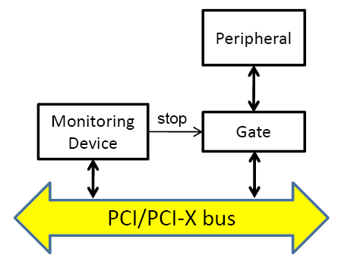
Monitoring Device
We developed a new hw monitoring device based on a Xilinx FPGA board.
The device is plugged on a PCI/PCI-X bus and “sniffs” all transmitted traffic.
All monitoring code runs on reconfigurable FPGA logic.
Sniffing adds zero overhead ➔ major advantage over software-based solutions.
Requirement violation detected & recovery initiated within 4 clock cycles from faulty transmission.

Slide 8
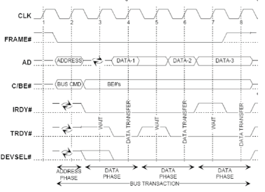
The Big Picture: Monitoring a Property
What we see are logical
states of bus wires.
Event Specification
2. User specifies a set of events.
Ex: memory write addess = x
3. Event Generator generates a
trace of observed events over time.
Event Generator
E1
-
E2
-
E1
E3
-
t
4. User specifies a formula
using defined events.
Ex: (E1 E2) *
Formula
Monitor
5. Monitor checks if formula is
validated / violated based on
event trace.
Violation /
Validation
6. User written handler performs
recovery if a validation / violation
is detected.
Handler (Recovery)

Slide 9
The Big Picture: Monitoring a Property
Event Specification
Event Generator
E1
-
E2
-
E1
E3
-
t
Formula
Monitor
: user specified
: automatically synthesized
Handler (Recovery)

Slide 10
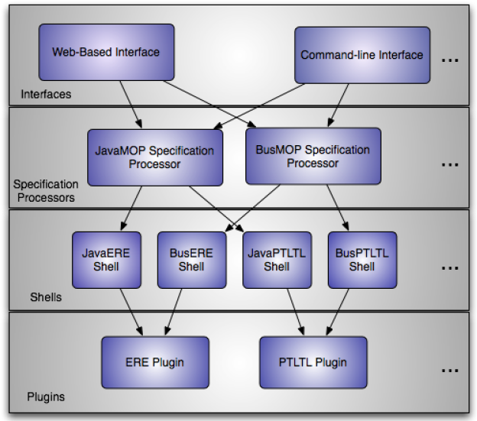
MOP framework and BusMOP
Automatic generation based on the MOP framework.
Highly extensible and customizable.
Decouples event specification (architecture specific) from formula specification (formal language specific).
BusMOP currently supports Extended Regular Expressions (ERE) and Past Time Linear Temporal Logic (PTLTL).
Chen & Rosu. MOP: An Efficient and Generic Runtime Verification Framework. Proc. ACM OOPSLA’07.

Slide 11
Peripheral Component Interconnect (PCI)
Standard family of peripheral interconnections in the personal computer market.
Implementation on parallel PCI/PCI-X physical specification.
Supports master peripherals, I/O and memory space, burst data transfer (transactions).
Plug-and-play:
Each peripheral can require multiple address blocks.
Both peripherals and monitoring device implements base registers.
At startup, the OS allocates all required address blocks and writes base address to base registers in both peripherals & monitoring device.

Slide 12
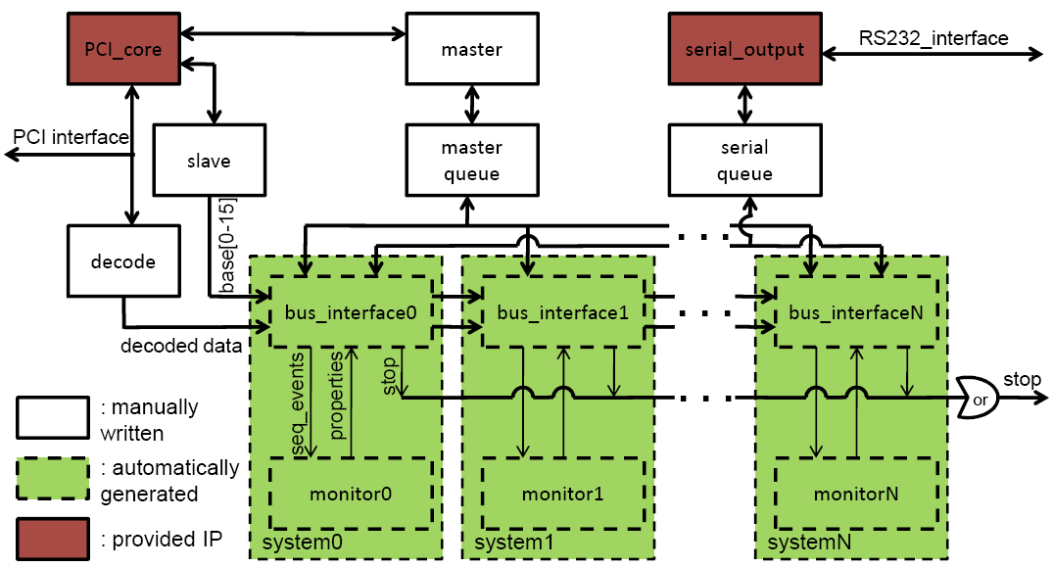
Monitoring Device Implementation
Implemented on a Xilinx ML455 board in mixed VHDL/Verilog RTL.
PCI_core and serial_output: PCI/PCI-X and RS232 basic communication.
Decode: decodes PCI burst transactions into a series of word reads/writes.
Slave: implements base registers.

Slide 13
Monitoring Device Implementation
Master: drives writes operation for recovery.
System_i: automatically generated for each formal properties.
Bus_interface_i: event generation and recovery (architecture specific).
Monitor_i: monitor (formal language specific).
Master/Serial_queue: queuing for recovery actions.

Slide 14
Event Specification
Three types of events: I/O access, memory access, interrupt.
Can specify both address and value ranges.
Ex: counter is enabled writing 1 to bit 0 in register x220 (base1).
Problem: a single read/write could produce multiple events.
An event_sequentializer module outputs simultaneous events one at a time based on user-defined ordering.

Slide 15
Formula Specification: ERE
Normal regular expressions extended with negation.
We reuse the MOP ERE plugin to generate a minimized Deterministic Finite Automata.
BusMOP ERE shell converts DFA to Verilog.
ERE monitors are reset on violation.

Slide 16
Formula Specification: PTLTL
Extends propositional logic with temporal operators in the past.
[*] A (always): A was always true in the past.
<*> A (eventually): A was true at least once in the past.
(*) A (previously): A was true at the previous step.
A S B (since) : A has always been true since B was last true.
Ex: if a peripheral is given a grant for a resource, it must have required that resource in the past.
grant implies <*> request

Slide 17
Formula Specification: PTLTL
Previous MOP PTLTL plugin generated sequential assignments.
We implemented a new plugin that generates parallel assignments.
grant implies <*> request
b[0] is intuitively the state of <*> request
b[0] := request or b[0];
output := not grant or b[0];
same as: grant implies b[0]
b[0] <= request or b[0];
output <= not grant or (request or b[0]);
Substitute b[0] with request or b[0]
because of parallel assignment

Slide 18
Recovery Specification
Three supported types of recovery:
Overwrite a I/O or memory location.
Disconnect the peripheral from the bus.
Send an error message (serial port).
Recovery action is user-specified in VHDL.
}
Write to memory,
register x228 + base1
}
Write value 45 (2 bytes)

Slide 19
Case Study: PCI703A Board
We applied our technique to monitor the PCI703A board.
High performance PCI ADC/DAC board using DMA mode.
Simple enough that driver could be manually inspected.
Complex enough that driver is not trivial – in fact, we found two bugs in it!
Requirement specification produced in two steps:
Plain English description of Communication Behavior.
Formal set of BusMOP events and formulae.
The specified properties are able to catch all bugs!

Slide 20
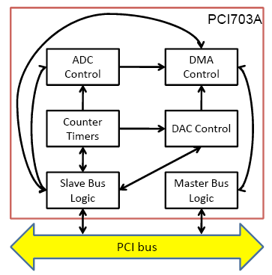
PCI703A
Counter module implements four counters.
Counter 0, 1, 3 are user programmable though CTconfig function.
Counter 2 provides clock to AD module; configurable using ADconfig function.
Each counter uses two registers: cntr_cntrl_i and cntr_divr_i.
Bug: CTconfig can be used to modify Counter 2.
Any user in the system can erroneously or maliciously stop sensor acquisition!

Slide 21
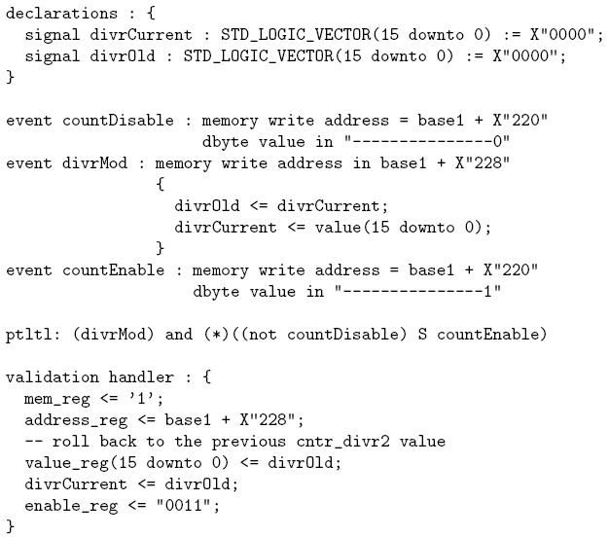
SafeDivrModify Property
Counter 2 parameters in cntr_divr2 should not be changed while Counter 2 is enabled.
}
Declare variables to hold
previous and current value
of cntr_divr2.
}
Counter enable is bit 0
of cntr_cntrl2 (x220).
}
Capture any write to cntr_divr2
(x228). Current and old values
are stored in variables.
}
}
Validated if cntr_divr2 is modified,
and the counter has not been disabled since it was last enabled.
}
Recovery: restore old cntr_divr2 value on validation.

Slide 22
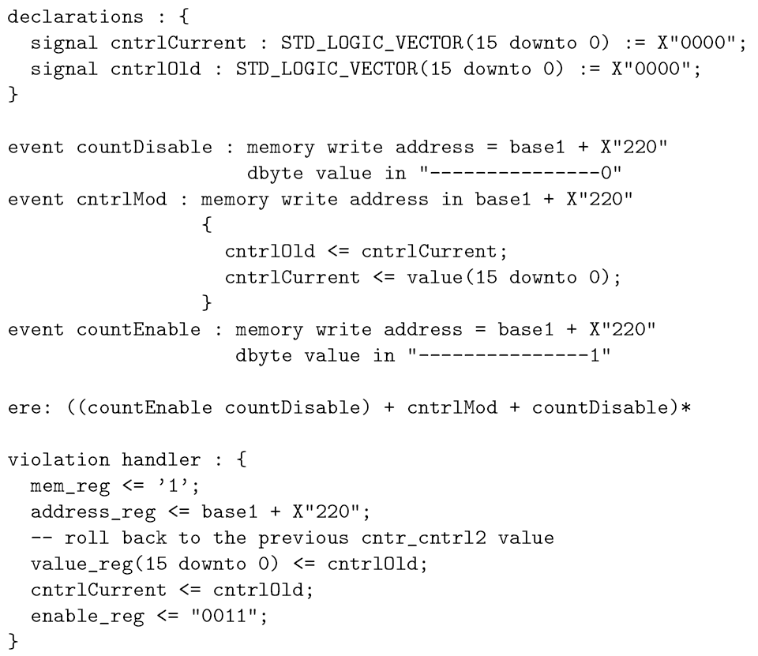
SafeCounterModify Property
Counter 2 parameters in cntr_cntrl2 should not be changed while Counter 2 is enabled.
}
Same as before except now
checks cntr_cntrl2
(simultaneous events!).
}
Valid trace is modification or
disable or (enable followed by
disable).
}
Recovery on violation (modification immediately after enable)

Slide 23
Conclusions
Formally verifying that the implementation of COTS components is correct is too difficult!
Instead, we propose to verify the system assuming that components implementation is correct.
We then monitor the component behavior at run-time and recover if a requirement violation is detected.
We implemented a zero-overhead monitoring framework for PCI/PCI-X.
We showed that the run-time monitoring approach is effective on a concrete case study.

Slide 24
Future Work
The current solution has some limitations.
It can not stop a faulty transactions from being transmitted on the bus, only restore the previous data.
We are implementing a new monitoring device with buffering capabilities that can “drop” faulty transactions.
Simultaneous events can introduce delay in monitoring.
We are planning to extend MOP to natively handle simultaneous events.
Modeling real-time properties is hard because ERE and PTLTL have no implicit notion of time.
We are planning to develop efficient monitors for a subset of timed automata.

