Slide 1
Predictable Implementation of Real-Time Applications on Multiprocessor
Systems-on-Chip
Alexandru Andrei,
Petru Eles,
Zebo Peng,
Jakob Rosen
Presented By:
Anirban Basu (20498909)

Slide 2
Outline
Single vs. Multiple Processor SOCs – Scheduling
Scheduling Example – Single vs. Multiple processor
Proposed Scheduling Algorithm
Predictability of the Proposed Algorithm
WCET Analysis for Multi-processor SOC
Bus Schedule
Experimentation & Results
Conclusions / Critique

Slide 3
Single vs. Multiple Processor SOCs – Scheduling
Scheduling Analysis provides the time predictability of a system.
This is based on WCET computed in isolation for each task.
Extensive research has been done to modelled effects the of Cache, pipelines, branch prediction to precisely predict execution times.
These techniques work fairly well for single processors SOC’s.
Multi-processor systems with shared resources (memory etc.) cannot be correctly characterized by WCET in isolation.
Resource access conflicts change the WCET in multi-processor system.
If a multi-processor system has dedicated resources for each processor, the WCET in isolation is a valid metric.
Correct WCET can be computed only by considering the global system with all tasks active.

Slide 4
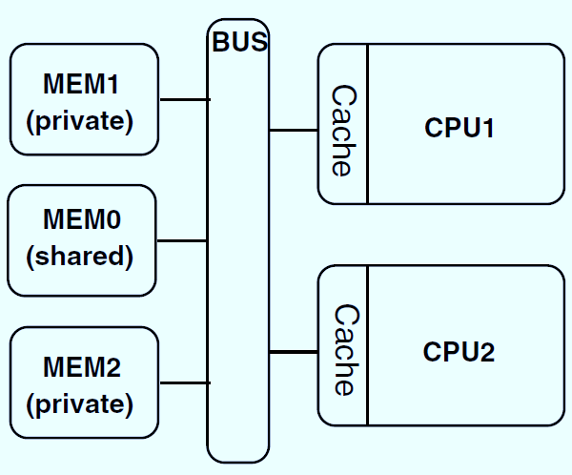
Multi-processor SOC Model
Two CPU’s
Each processor with it’s own Instruction / Data cache and a private Memory.
Private memory Accesses cached.
Shared Memory for inter-processor communication.
Shared Memory accesses are un-cached.
Implicit Communication : Bus Requests due to cache misses
Explicit Communication : Explicit use of the shared external memory for inter-processor communication by the tasks.

Slide 5
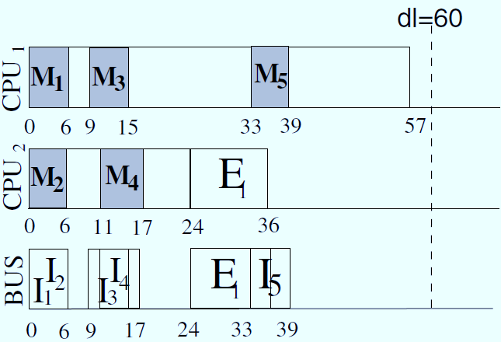

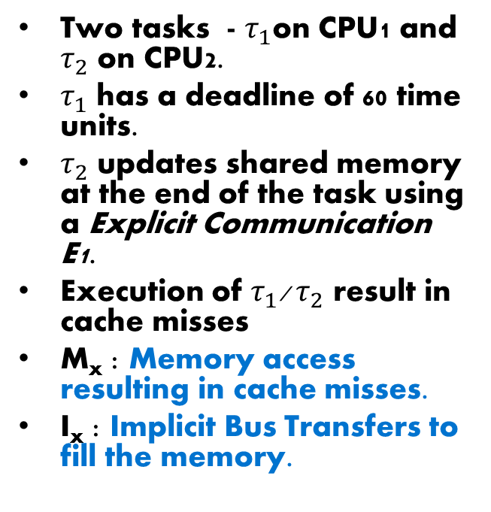
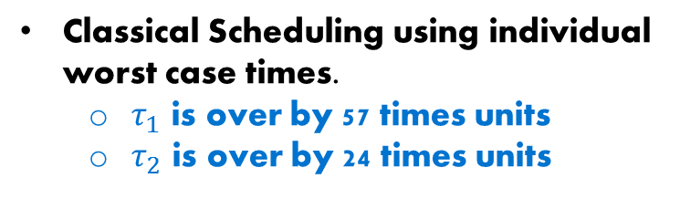
Scheduling : WCET in Isolation
Two tasks - $τ_{1}$on CPU1 and $τ_{2}$ on CPU2.
$τ_{1}$ has a deadline of 60 time units.
$τ_{2}$ updates shared memory at the end of the task using a Explicit Communication E1.
Execution of $τ_{1}$/${ τ}_{2}$ result in cache misses
M_{x} : Memory access resulting in cache misses.
I_{x} : Implicit Bus Transfers to fill the memory.
Classical Scheduling using individual worst case times.
  $τ_{1}$ is over by 57 times units
  $τ_{2}$ is over by 24 times units

Slide 6
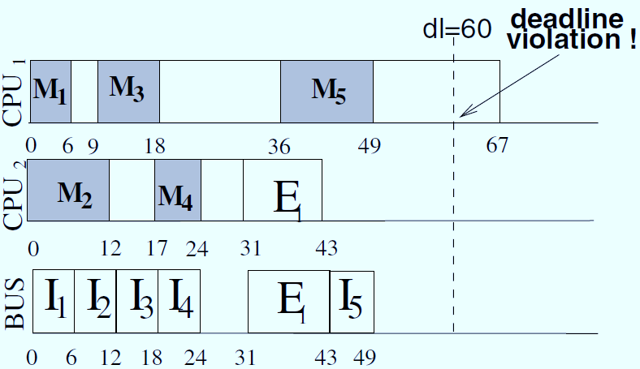
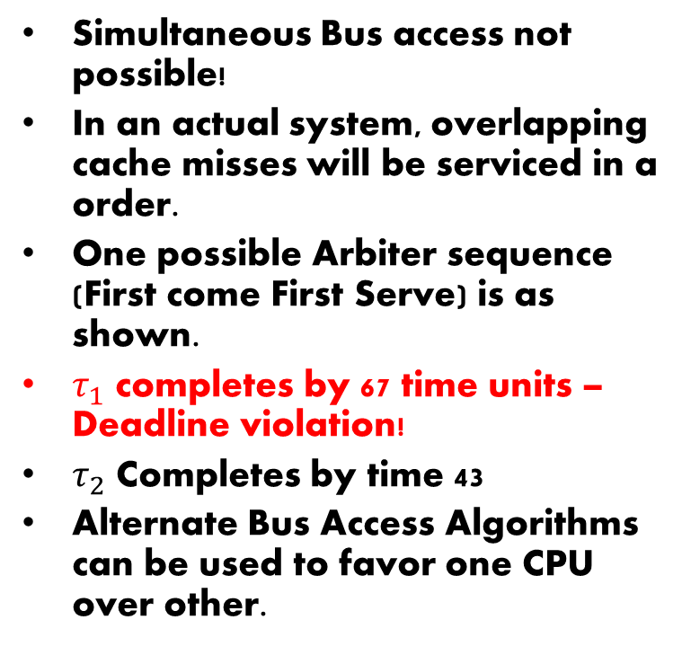
Scheduling : WCET of overall System
Simultaneous Bus access not possible!
In an actual system, overlapping cache misses will be serviced in a order.
One possible Arbiter sequence (First come First Serve) is as shown.
$τ_{1}$ completes by 67 time units – Deadline violation!
$τ_{2}$ Completes by time 43
Alternate Bus Access Algorithms can be used to favor one CPU over other.
Request | Start - End | Total Time
I₁ @ 0 | 0 – 6 | 6
I₂ @ 0 | 6-12 | 12
I₃ @ 9 | 12-18 | 9
I₄ @ 17 | 18-24 | 7
E₁ @ 31 | 31-43 | 8
I₅ @ 36 | 43-49 | 13

Slide 7
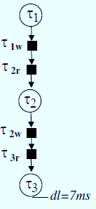
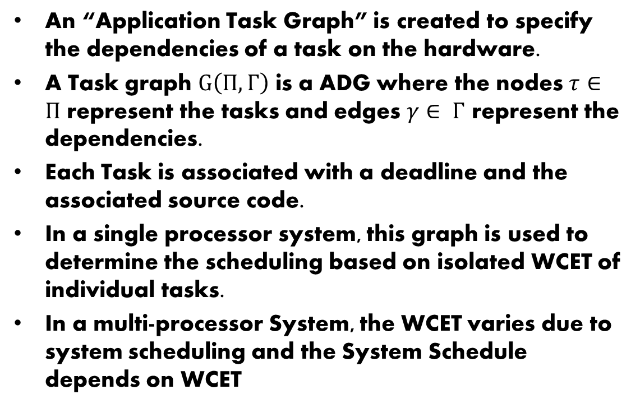
Proposed Scheduling Algorithm
An “Application Task Graph” is created to specify the dependencies of a task on the hardware.
A Task graph $G\left(Π, Γ\right)$ is a ADG where the nodes $τ∈Π$ represent the tasks and edges $γ∈ Γ$ represent the dependencies.
Each Task is associated with a deadline and the associated source code.
In a single processor system, this graph is used to determine the scheduling based on isolated WCET of individual tasks.
In a multi-processor System, the WCET varies due to system scheduling and the System Schedule depends on WCET
System Schedule
WCET

Slide 8
Proposed Scheduling Algorithm
To solve this issue, the authors propose to :
  Use a fixed TDMA Bus access policy that is at design time and run-time.
  Bus Access schedule is used for computing the WCET of the tasks.
List Scheduling Technique is used to determine the system level scheduling cycle. This is based on the task priorities
  A task is placed into a “Ready List” when all it’s predecessors are scheduled.
  When scheduling a new task, the task with the highest priority in the ready list is picked.
  Once a List Scheduler picks the tasks to be scheduled on each of the processor, WCET based on a bus arbitration policy has to be computed.
  Repeat till the “Ready List” is empty.
Explicit accesses can be considered as regular tasks but which request memory continuously.

Slide 9
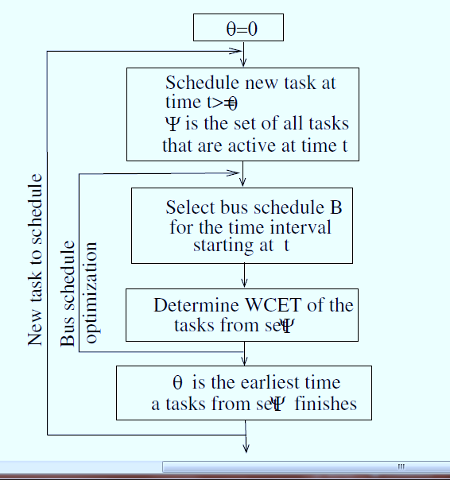
Proposed Scheduling Algorithm
The Bus Arbitration policy should be favourable for the tasks at hand.
Multiple policies will be considered to see which optimizes the WCET for the given tasks. The task on higher critical path will be prioritized for optimization.
Once the best arbitration policy is identified, the WCET is computed.
The scheduler then moves to the next task and repeats the process.

Slide 10
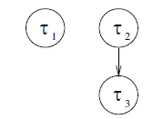
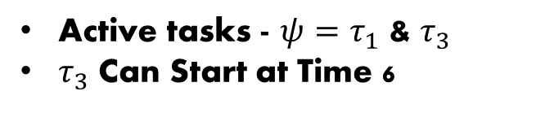
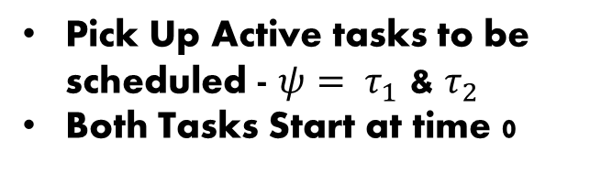


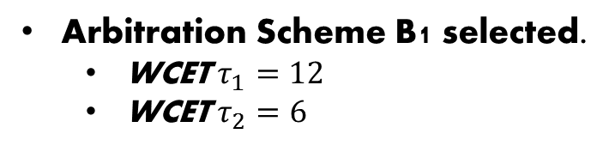
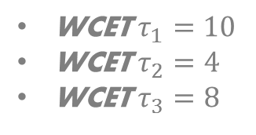
Proposed Scheduling Algorithm
Consider the Task Graph
Arbitration Scheme B1 selected.
  WCET $τ_{1}=12$
  WCET $τ_{2}=6$
WCET $τ_{1}=10$
WCET $τ_{2}=4$
WCET $τ_{3}=8$
$$τ_{1}$$
Pick Up Active tasks to be scheduled - $ψ= τ_{1}$ & $τ_{2}$
Both Tasks Start at time 0
0
12
$$τ_{2}$$
0
6
Compute WCET
Select Arbitration Scheme
B1
0
6
Active tasks - ${ψ=τ}_{1}$ & $τ_{3}$
$τ_{3}$ Can Start at Time 6

Slide 11
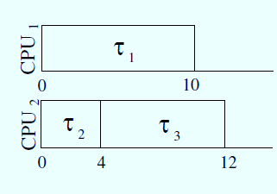
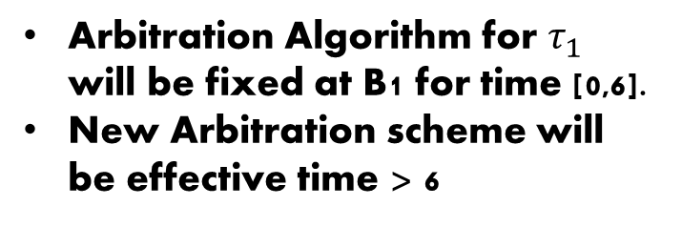
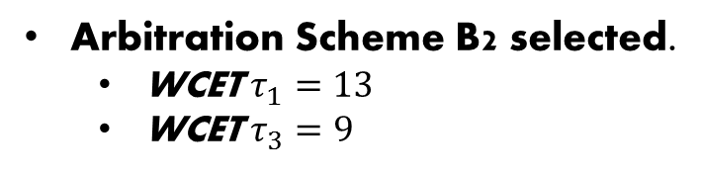



Proposed Scheduling Algorithm
Arbitration Algorithm for $τ_{1}$ will be fixed at B1 for time [0,6].
New Arbitration scheme will be effective time > 6
$$τ_{1}$$
0
13
$$τ_{2}$$
$$τ_{3}$$
Compute WCET
Select Arbitration Scheme
0
6
15
B1
B2
0
6
15
Arbitration Scheme B2 selected.
  WCET $τ_{1}=13$
  WCET $τ_{3}=9$

Slide 12
Predictability of the Algorithm
If Instructions sequence terminates earlier, there is no violation.
If a Cache miss occurs earlier than predicted, it may be served by a earlier bus access, never later than that considered for analysis.
A memory access assumed to be a miss and turns to be a hit, will perform better and hence no WCET violation.
If a bus request is issued by a processor earlier than expected, it will not impact other processors due to deterministic arbitration policy.

Slide 13
Multi-processor SOC WCET Analysis
Traditional WCET is used as the foundation for the multi-processor system WCET analysis.
Basic WCET is used along with Bus scheduling for this purpose.
Steps for WCET analysis:
  Create a Control Flow Graph (CFG) from the task code
  Nodes of CFG represent block of code lines.
  Edges represent flow of the software
Each node has a unique id and refers to the lines of code (lno) represented.
Loops are unrolled for the first iteration and looped for the remaining loop counter. This helps in cache analysis. First iteration will miss all instruction and data cache accesses.
Instruction cache miss is marked as “i” and data cache as “d”

Slide 14
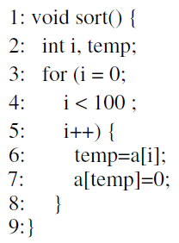
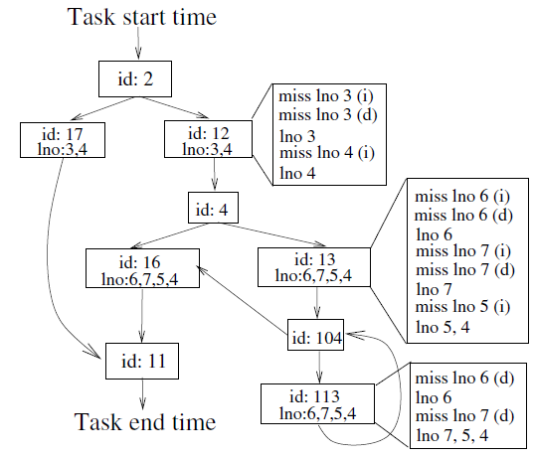
Multi-processor SOC WCET Analysis
Data Flow analysis is used to understand large scale interaction between blocks.
Data address is not always known – predictable vs. non-predictable.
Unpredictable data can evict predictable data

Slide 15
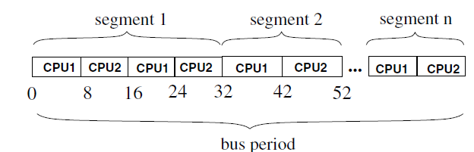
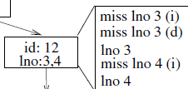
Multi-processor SOC WCET Analysis
This CFG can be used to compute the single-processor WCET using the basic computation cycles, cache-hit cycles, cache-miss penalty.
For multi-processor WCET analysis, further details like the sequence of misses and the time to service a miss is required.
This can be determined if the bus schedule and the task start time is known before hand.
Consider the node-12 and the given Bus Schedule

Slide 16

Multi-processor SOC WCET Analysis
Timing Assumption:
Task Start : 0
Instr. Execution : 1
Cache Hit : 0
Cache Miss : 6
0
16
32
lno3
lno3
lno4
CPU1
CPU2
CPU1
CPU2
CPU1
CPU2
Node 12 completes in 39 cycles
Traditional WCET will compute this to 20 Cycles.
This process should repeated for all possible start to end possible paths and find the longest path for WCET.
In a loop each iteration can have a different Execution time due to bus schedule.
The CWET analysis is exponential
Bus Access Schedule

Slide 17
Bus Schedule
The WCET analysis requires a available Bus Schedule.
A Bus Schedule has a large influence on the execution time.
For a given task, a schedule that allows it immediate access of bus is most favourable.
Such an algorithm will be complex and lead to a large schedule table.
The Authors have tried 4 different us schedules
  BSA_1 : Irregular Bus Schedule. Lowest WCET. Highly complex scheduler.
  BSA_2 : Simple complexity. Bus Schedule divided in segments, Each segment has it’s own pattern regarding order and size.
  BSA_3 : Simpler version of BS_2. Slots in a segment have same sizes.
  BSA_4 : All the slots in the bus have same size and are repeated in a fixed sequence.

Slide 18
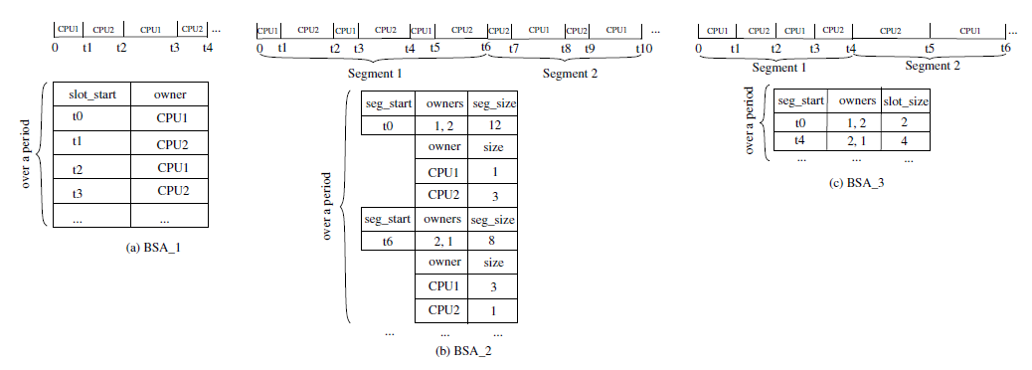
Bus Schedule

Slide 19
Experimentation & Results
The authors have experiments using a set of synthetic benchmarks consisting of random task graphs with tasks varying between 50-200.
Tasks were extracted from C different programs (sort, search, matrix multiplication, DSP Algorithms).
Tasks were mapped on architectures consisting of 2 – 20 ARM 7 processors . They have assumed Cache penalty of 12 Cycles once bus access has been granted.
The Scheduling algorithms proposed by the authors was run on a Intel 2.8 GHz processor.
All the four Bus Scheduling Algorithms were evaluated for the core Bus scheduling loop of the proposed Algorithm.
Simulated Annealing was used for the Bus Scheduling Analysis

Slide 20
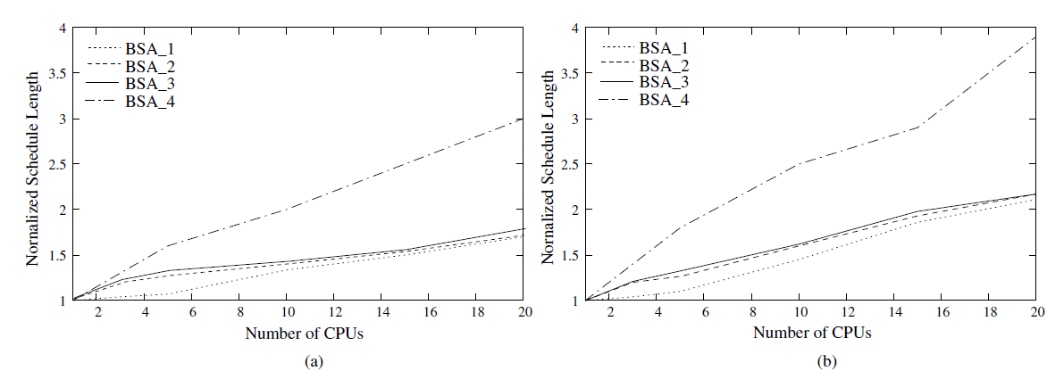
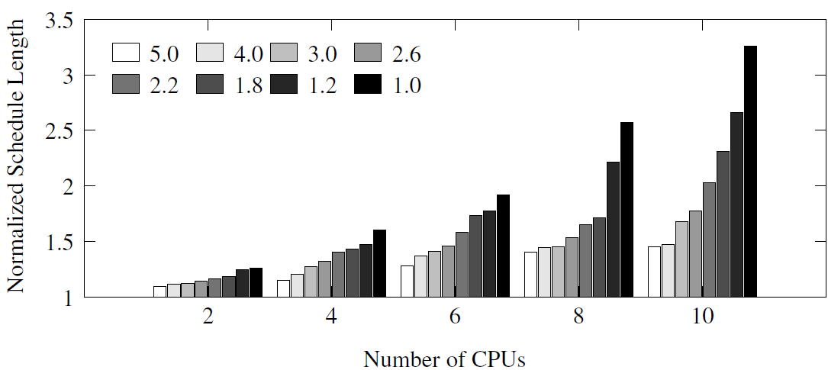
Results – Bus Scheduling Algorithms
BSA_1 produces the shortest delays.
BSA_2 & BSA_3 produce almost similar result with substantially reduced complexity.
BSA_4 produces inferior results.
WCET depends on the ratio of the memory access to the computations.
Results on the left obtained using BSA_3 bus schedule
Normalized performance compared by varying this ratio (instr/Mem).
Larger Ratio leads to better results.

Slide 21
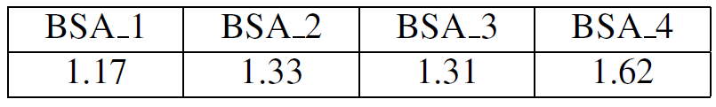
Results – Smartphone Application
Authors have also tested a smart-phone containing a GSM Encoder and decoder and a MP3 decoder mapped to 4 ARM processors.
  1 ARM processor for GSM Encoder.
  1 ARM processor for GSM Decoder
  2 Processors for MP3 decoder
The software was divided into 64 tasks with a task having:
  70 to 1304 lines of code in a GSM codec.
  200 to 2035 lines of code in a MP3 decoder
Data Cache and Instruction cache of 4 KB each.
The deviation of a schedule length from an ideal length was:

Slide 22
Conclusions
The Authors propose the first predictable implementation of real-time applications on multi-processor systems.
This approach takes into consideration the potential shared resource contention that is unique to multi-processor systems.
The authors also show that using such an approach does improve the predictability of the system.

Slide 23
Critique
The Authors fail to explain how the predictability will be affected when the Cache miss happens in a slot later than in was predicted to happen.
Memory accesses of a task at the boundary of arbitration policy change will be unpredictable.
No Clarity about task prioritization when selecting a Bus Scheduling Algorithm.
The Algorithm will become infeasible for larger applications with large of number of tasks and larger number of processors (>4)
Scheduling loops is a tedious affair as the bus schedule could vary for each iteration

Slide 24


Slide 25
Single vs. Multiple Processor SOCs – Scheduling
Performance predictability expectations are getting higher too.
  Existing applications like automotive, medical & Avionics.
  Newer applications like video streaming, telephony etc. have to guarantee QOS. This requires knowledge of the worst-case performance.
Multi-processor systems with shared resources (memory etc.) cannot be correctly characterized by WCET in isolation.
Resource access conflicts change the WCET in multi-processor system.
If a multi-processor system has dedicated resources for each processor, the WCET in isolation is a valid metric.
Correct WCET can be computed only by considering the global system with all tasks active,

Slide 26
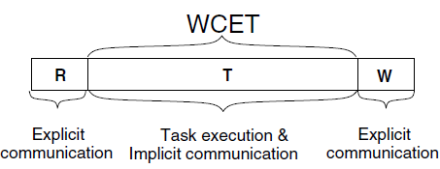
Handling Explicit Communication
Tasks could explicitly use shared external memory for inter-processor communication – Explicit Communication.
Such Communication not handled by the proposed Algorithm.
Can be scheduled individually – Will Block access from active process for long time
Alternately such access can be considered as regular tasks but which request memory continuously – Memory request equals worst case message length.

Slide 27
Results – Memory Access vs. Computation
The worst case is strongly influenced by the ratio of the memory access to the computations.
Experiments were done on 50 randomly generated task graphs for 2,4,…10 processors.
For Each execution the ratio of cycles spent on computation to memory access was varied as shown.
Bus Scheduling policy used was BSA_3.
Bar indicates the worst case execution time compared to ideal case.

Slide 28
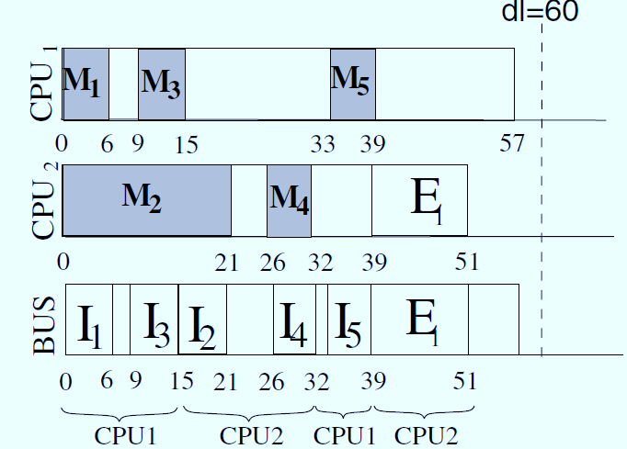
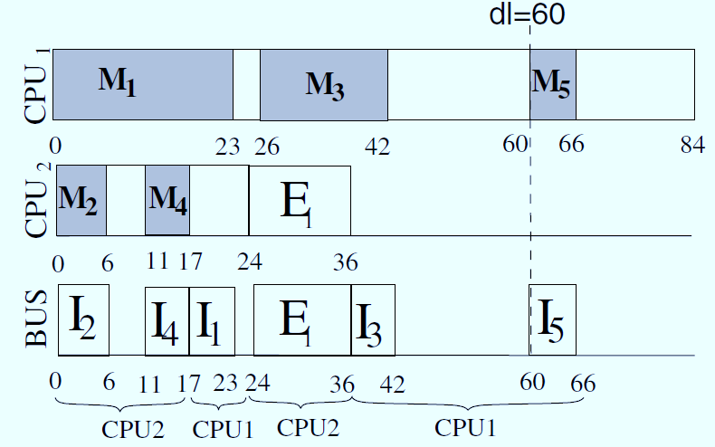
Scheduling : WCET of overall System
Instead of a FCFS Arbiter, we can have a TDMA arbiter that grants bus access to Each CPU for certain time.
This is optimized for CPU1
We can also have an alternate Arbitration scheme that favours CPU2.
The CPU1 misses the deadline

