Slide 1
Presented By: Michael Bieniek

Slide 2
Introduction Context
Embedded systems are increasingly using chip multiprocessors (CMPs) due to their low power and high performance capabilities.
Shared main memory becoming a significant bottleneck.
There is a need to bound worst case memory latency to provide hard guarantees to real-time tasks.
Notes:
-Applications running on CMPs are becoming more memory intensive.
-CMP example: Intel Core 2 Duo, multiple cores sharing cache and memory.

Slide 3
Introduction Context
Researchers have already proposed many different analyses that assume constant time for each memory request.
Modern CMPs use Double Data Rate Dynamic RAM (aka DDR DRAM) as their main memory.
Constant times for memory requests cannot be used for this type of memory as the latency of each request is highly variable on previous requests and states.
Commercial-Off-The-Shelf (COTS) memory controllers could have unbounded latency!

Slide 4
Introduction Paper Contributions
A modified memory controller to allow for bounded memory requests.
Derived worst case memory latency for DDR DRAM.
Evaluation of the memory system compared to alternate approaches.

Slide 5
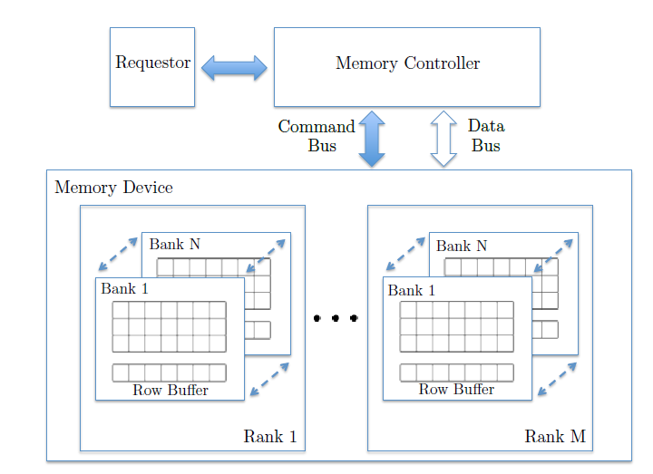
DRAM Background Organization
Notes:
-Modern DRAM system in which a memory controller interfaces between the memory devices and requestor (CPU, DMAs).
-Two buses interface the controller and memory devices: command and data. They can be used in parallel (one requester can use the command bus while a diff one uses the data bus). No more than one requester per bus can be in use.
-Memory organized into ranks, only one rank can be accessed simultaneously.
-Ranks are also divided into multiple banks, banks can be accessed simultaneously pending no collisions on either bus.
-Each bank has a row-buffer and storage cells organized as rows and columns. Paper only considers devices with one rank.
-Requesters can only access the data in the row buffer, if the data is outside the row buffer – other commands are necessary to load that data.

Slide 6
DRAM Background Open and Close Requests
Open Request: requested data is already cached in the row buffer. Row hit!
Closed Request: requested data is not cached in the row buffer. Row miss!
What happens if you have an open request?
R/W [CAS]
What happens if you have an closed request?
PRE, ACT, R/W [CAS]
Notes:
-For an open request, you only need to issue a read or write command since the desired row is already cached in the row buffer.
-For a closed request, you must write back the row buffer data by issuing a PRE command (precharge). Than an ACT (activate) command loads the desired row into the row buffer. Afterwards, you can issue read/write commands.
-Since row sizes are typically large (several kB), you only access a small portion of the row by selecting the appropriate column. This command is alluded to as Column-Address-Strobe (CAS).

Slide 7
DRAM Background Refresh
DRAM storage elements contain capacitors which must be recharged periodically.
A Refresh (REF) command must be issued to all ranks and banks occasionally.

Slide 8
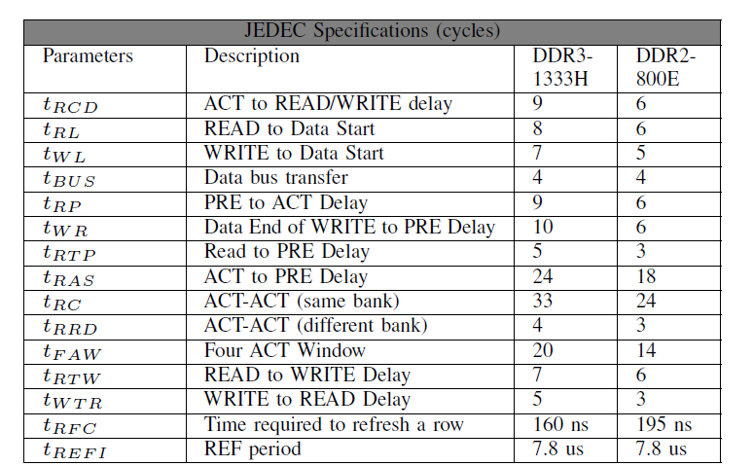
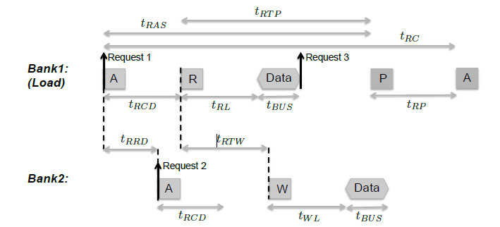
DRAM Background Timing Constraints
A JEDEC standard exists for defining operation and timing constraints of memory devices.
Notes:
-JEDEC standards exists for different families of devices and speeds. (i.e. DDR2, DDR3).
-Timing diagram illustrates a load request.
-Note the longer latency for a close request.
-There is a constraint between issuing a read command and a successive write command (or vice versa). No constraint between diff banks though.

Slide 9
DRAM Background Row Policy
Open Row Policy: leave the row buffer open as long as possible.
Closed Row Policy: automatically precharges the row buffer after every request. All requests will have an ACT/CAS command, thus predictable latency.
Notes:
-Open Row: the buffer will be pre-charged if the refresh period is reached or a row miss occurs. If there are a lot of row hits, only a CAS command is needed (low latency!).
-Closed row: timing will be predictable because PRE, ACT, CAS command always occurs. The downside is that this will have an overall higher latency since the row hit ratio is 0.

Slide 10
DRAM Background Row Mapping
Incoming requests must be mapped to the correct bank, row, and column.
Interleaved banks: each request access all banks. More BW but each requestor must utilize all banks in parallel.
Private banks: each requestor is assigned its own bank. No interference from other requester but less BW.
Notes:
-Interleaved banks: amount of data transferred per request is Burst Length * Width Bus * Number of banks. Reuquesters can cause mutual interference by closing each other’s rows.
-Private banks: the state of row buffers cannot be influenced by other requestors. Separate set of banks can be reserved for shared data that can be concurrently accessed. Data transferred is just Burst Length * Width Bus. Bank parallelism cannot be exploited.

Slide 11
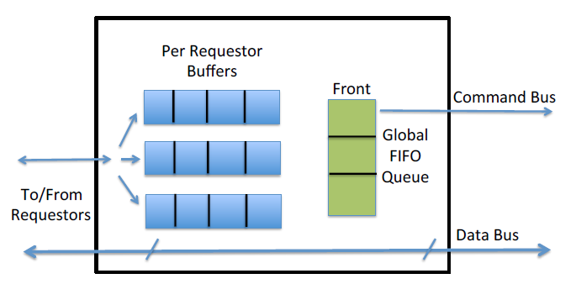
Memory Controller Design
Notes:
-Modified COTS-based memory controller.
-Private bank scheme.
-Private buffer for each requestor to store incoming requests. The buffers store the commands that comprise a specific request (i.e. ACT, PRE).
-There is a global arbitration FIFO queue in which memory commands from each private buffer are enquired.

Slide 12
Memory Controller FIFO Arbitration Rules
Only one command from each private buffer can be in the FIFO. Must wait for it to be serviced before enqueuing more.
A command can only be enqueued if all timing constraints that are caused by previous commands from the same requester are met.
At the start of a memory cycle, the FIFO queue is scanned front to end and the first command that can be serviced is issued.
If one CAS command is blocked due to timing constraints, all other CAS commands in the FIFO will also be blocked.
Notes:
-Each requestor can only enqueue one command from the private buffer into the FIFO and must wait until that command is serviced (dequeued from FIFO) before inserting another command. Since CAS commands trigger data transmission, we do not allow a requestor to insert a CAS command in the queue before the data of its previous CAS command has been transmitted.
-A command can only be enqueud if all timing constraints are met because there is a chance that the command will be executed immediately if there are no other requesters utilizing memory.
-For the third rule, an exception is made for CAS commands.
-No re-ordering of CAS commands is allowed.

Slide 13
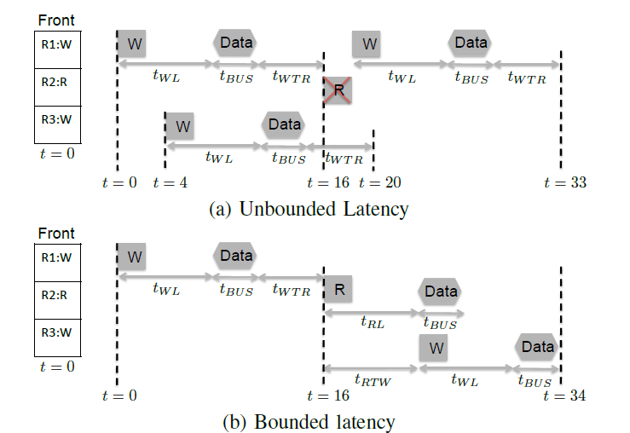
Memory Controller Rule 4 – Needed to prevent unbounded latency
Notes:
-(1) A write command from Requestor 1 (R1) is at the front of FIFO and it is serviced.
-(2) A read command (R2) cannot be serviced until t = 16 due to tWTR timing constraint (crossed box in figure).
-(3) The controller then services the next write command (R3) in the FIFO queue at t = 4 following Rule-
3. Due to tWTR constraint, the earliest time to service read command is now pushed back from t = 16 to t = 20.
-(4) Assume that another write command from Requestor 1 is enqueued at t = 17. The controller then services this command, effectively pushing the read command back even further to t = 33.

Slide 14
Worst Case Analysis System Model
The analysis assumes a system with M memory requestors and an in-order memory requests.
In order to model latency, the number of each request type and the order in which requests are generated.
How do we get the above info?
Run the task and get a memory trace or static analysis.
Notes:
-The table is the notation for the number of different request types.
-In order to get the breakdown of memory requests, the task can be run on actual hardware or in a simulator and a trace of memory requests can be obtained. This has the benefit of getting the number and order of requests. The downside to this approach is that we cannot be confident that we’ve obtained the worst case. Alternatively a static analysis tool can be used to obtain a safe upper bound on the number of requests although this approach won’t give any insight into the order of requests.

Slide 15
Worst Case Analysis Per Request Latency – Arrival to CAS
Arrival to CAS is the worst case interval between the arrival of a request to the memory controller and the subsequent enqueuing of the CAS command.
Notes:
-tAC is the worst case latency between the arrival of the request and the enqueuing of the CAS command.
-tCD is the worst case latency between the CAS command and the end of the data transfer.
-The dashed arrow is when the CAS command gets placed into the FIFO.

Slide 16
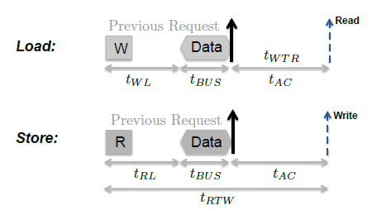
Worst Case Analysis Per Request Latency – Arrival to CAS, Open Request
In an open request, the memory request is just a single CAS command because the row is already open. This means that tAC contains the latency of the timing constraints of previous commands.
Notes:
-tAC is only dependent on the timing constraints of previous commands.
-If there are 2 back to back commands, tAC is zero because there are no timing constraints of requests of the same type.
-It is easy to see that the latency is the longest if the request arrives as soon as possible after the data of the previous request.
-Note that t_RTW applies from the time when the previous read command is issued, which is t_RL + T_bus cycles before the current request arrives.

Slide 17
Worst Case Analysis Per Request Latency – Arrival to CAS, Close Request
Notes:
-t_DP determine the time in which the PRE command can be enqueued into the FIFO.
-t_DA determines the time in which the ACT command can be enqueued into the FIFO.
-t_IA represents the worst case delay between when ACT is placed in the FIFO and it being issued.
-t_IP represents the worst case delay between when PRE is placed in the FIFO and it being issued.

Slide 18
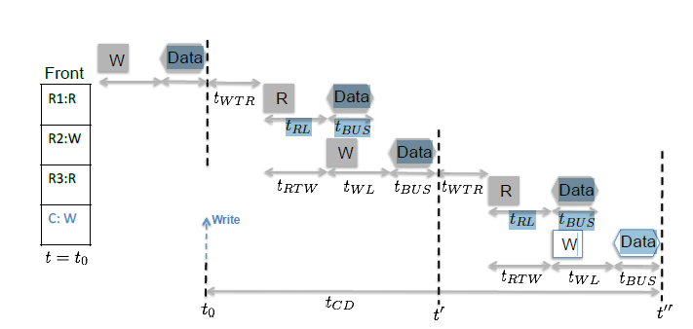
Worst Case Analysis Per Request Latency – CAS to Data, Write
Worst case interference is when all M-1 requestors enqueue a CAS command in the global FIFO in an alternating pattern of read and write commands.
Notes:
-CAS-to-Data delay depends on the CAS command of the current request: read or write.
-Worst case interference is when all M-1 requestors enqueue a CAS command in the global FIFO at the same time, along with an alternating pattern of read and write commands.
-In the above, each read command adds a latence of t_WTR + t_RTW.
-Each write command adds a latency of t_WL + t_BUS

Slide 19
Worst Case Analysis Per Request Latency – CAS to Data, Read
Worst case interference is when all M-1 requestors enqueue a CAS command in the global FIFO in an alternating pattern of read and write commands. Same as the write case except the last read command contributes diff latency.
Notes:
-CAS-to-Data delay depends on the CAS command of the current request: read or write.
-Worst case interference is when all M-1 requestors enqueue a CAS command in the global FIFO at the same time, along with an alternating pattern of read and write commands.
-In the above, each read command adds a latence of t_WTR + t_RTW.
-Each write command adds a latency of t_WL + t_BUS

Slide 20
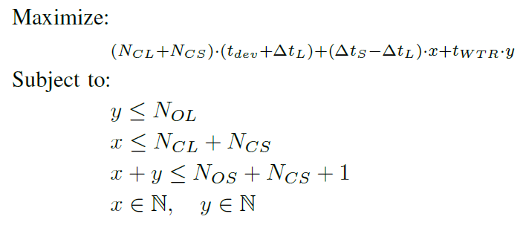
Worst Case Analysis Cumulative Latency
tAC:
Notes:
-t_CD is not dependent on the previous tasks.
-t_AC is dependent on the previous tasks. T_AC is the solution to the above integer linear programming problem (ILP). Variable x represents the number of stores that precede a close request and y represents the number of stores that precede an open load. Above gives a bound to the cumulative latency.
-For t_AC: (1) Open stores add no latency, (2) y open loads add latency t_TWR*y, the remaining N_OL-y requests add no latency, (3) x close requests add latency (t_dev + t_S)*x, in the worst case, the remaining N_CL + N_CS –x requests add latency (t_dev + t_L)*(N_CL + N_CS –x)

Slide 21
Worst Case Analysis Refresh, Overall Latency
Refresh commands are issued periodically and must be considered as it is a time in which the DRAM cannot service any requests.
Added complexity because all row buffers are closed, this turns open requests into close requests.
In order to determine how many open requests turn to close requests, need to compute how many refresh operations can take place during the execution of a task. Task execution depends on cumulative memory latency, circular dependency!
Notes:
-In order to determine how many open requests are turned into close requests, we need to compute how many refresh operations can take place during the execution of a task. The execution time of the task depends on the cumulative memory latency, which in turn depends on the number of open/close requests. Thus there is a circulator dependency!
-k represents an upper bound on the worst case number of refreshes suffered by the task under analysis.
-Need to change k open requests to close requests for final latency analysis.

Slide 22
Evaluation Setup
Compared against the Analyzable Memory Controller (AMC)
Fair comparison as AMC also utilizes a fair round robin arbitration system which does not prioritize requestors.
AMC uses interleaved banks.
AMC uses close row policy.
Notes:
-AMC uses interleaved banks however for a 64 bit data bus, it doesn’t make sense to interleave any banks together because the size of each request would be too large compared to cache block size.

Slide 23
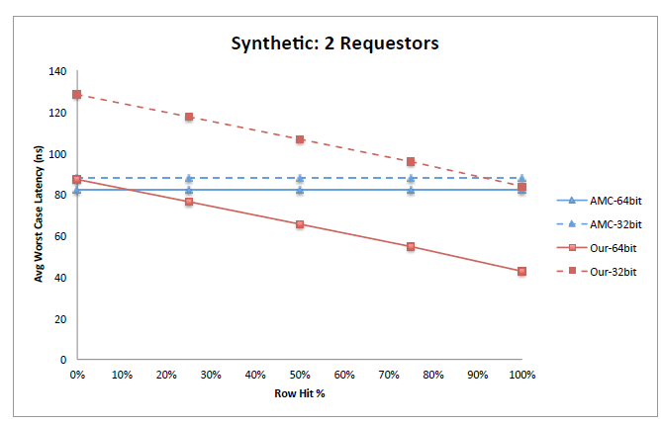
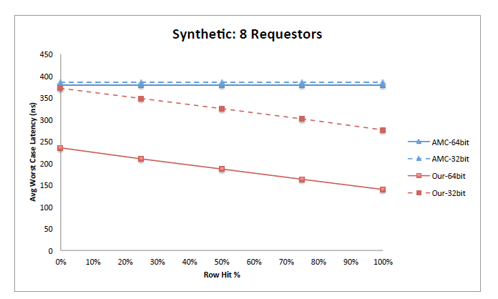
Evaluation Synthetic Benchmark
Notes:
-The row hit ratio is varied.
-Memory device used in the above figures is 2GB DDR3-1333H.
-AMC is a straight line because they use close row policy, thus latency doesn’t depend on row hit ratio.
-For the average latency of various DRAM devices, the proposed approach improves rapidly compared to AMC.
-As clock frequency increases – the difference in latency between open and close requests also increases.

Slide 24
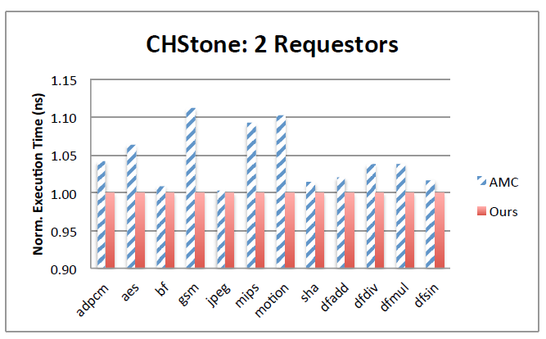
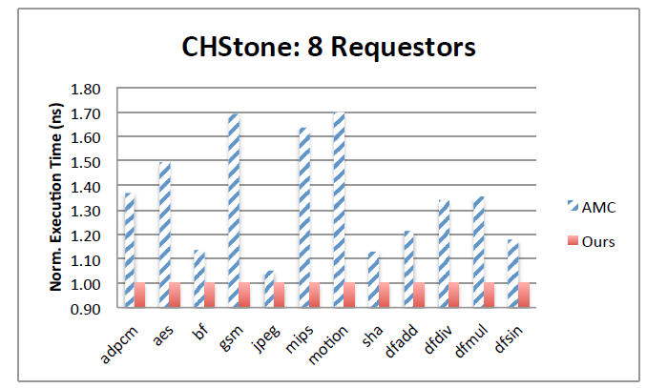
Evaluation CHStone Benchmark
Notes:
-CHStone benchmark suite is used.
-Run on the Gem5 simulator to obtain memory traces, which are used as inputs to the analysis.
-CPU at 1GHz with private LVL1/LVL2 caches.
-Results are normalized against the provided approach.
-Results varied between 0.3% to 11% and 5% to 70% better than AMC for 2 and 8 cores respectively.
-Benchmarks varied based on row hit ratio ranges.

Slide 25
Conclusion
Proposed approach utilizing an open row policy and private bank mapping appear to provide a better worst case bound for memory latency.
Evaluation results show that the proposed method scales better with increasing number of requestors and is more suited for current and future generations of memory devices as memory speed increases.
The proposed approach minimizes the amount of wasteful data transferred.

Slide 26
Q&A

