Slide 1
Timing Analysis of Concurrent Programs Running on Shared Cache Multi-Cores
Presented By: Rahil Shah
Candidate for Master of Engineering in ECE
Electrical and Computer Engg. Dept.
University of Waterloo

Slide 2
Outline
Background
Analysis Framework
Illustration
Analysis Components
Experiments
Results
Conclusion
Questions

Slide 3
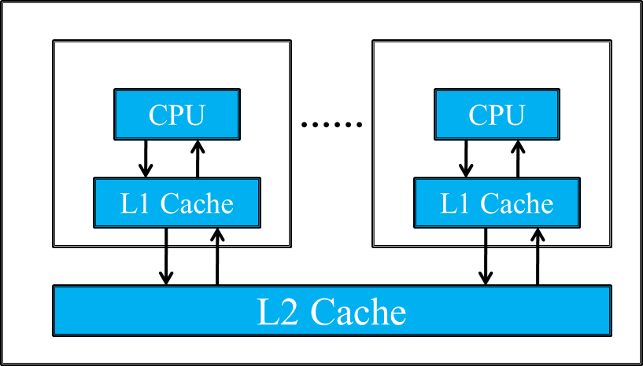
Multi-core Architecture with shared caches
Hard Real-time Systems
Increasing numbers of Multi-Cores in real time embedded systems
Multiprocessing - opens the opportunity for concurrent execution and memory sharing.
Introduces the problem of estimating the impact of resource contention.
Most Multi-Core Architecture Contains private L1 cache and shared L2 cache.
Timing Analysis – Abstract Interpretation

Slide 4
A simple MSC and a mapping of its processes to cores
Message Sequence Chart
Concurrent program visualized as a Graph
Vertical Lines – Individual Processes
Horizontal Lines – Interaction Between the processes
Blocks on vertical lines – Computation Blocks

Slide 5
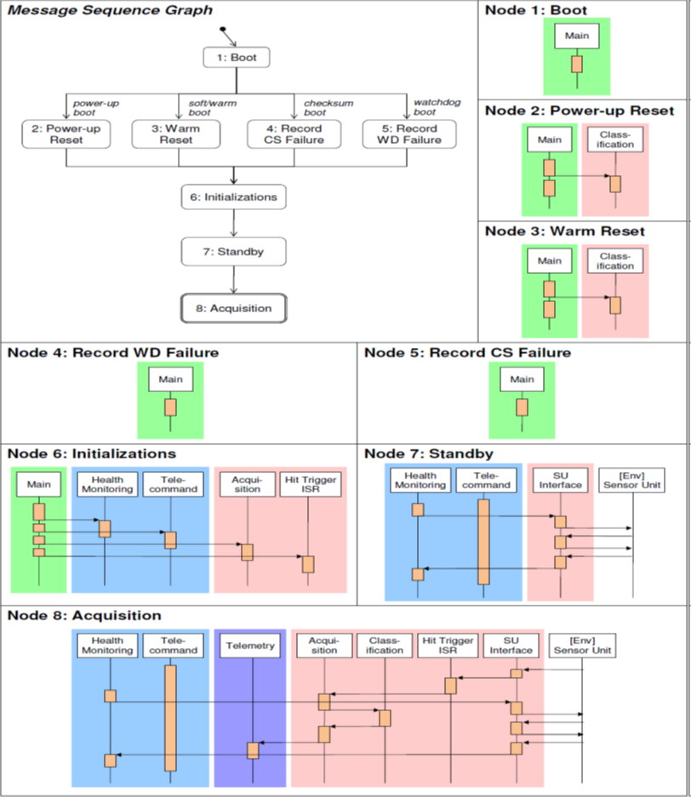
DEBIE Case Study.
Message Sequence Graph:
A Finite graph where each node is described by an MSC
Describes Control Flow

Slide 6
Analysis Framework
Assumptions:
It is assumed that the data memory references do not interfere in any way with the L1 and L2 instruction caches.
Least Recently Used(LRU) cache replacement policy for set-associative caches.
The L2 cache block size is assumed to be larger than or equal to the L1 cache block size.
They analyzed non-inclusive multi-level caches.
No Shared code across tasks.
Concurrent program is executed in a static priority-driven non-preemptive fashion.

Slide 7
Intra Core Analysis
Employs abstract interpretation methods at both L1 and L2 level
Persistent Block : Always Miss for its first reference, rest of the other references are considered always hit.
Filter Function in between the analysis at L1 level and L2 level cache
L1 Cache Analysis
AH
AM
NC
Filter
A
U
L2 Cache Analysis
L1 Classication | L2 Access
Always Hit (AH) | Never (N)
Always Miss (AM) | Always (A)
Not Classifed (NC) | Uncertain (U)
Filter function

Slide 8
Cache Conflict Analysis
Central component of the framework
Identify all potential conflict among the memory blocks from different cores
Consider two task T and T` from core-1 and core-2 respectively
If T has memory reference m which is from the cache set C mapped by the memory block referred by T` then convert m from ‘Always Hit’ to ‘Not Specified’.

Slide 9
Interference Graphs

Slide 10
Access latency of a reference in best case and worst case given its classifications
L1 cache | L2 cache | Best-case | Worst-case
AH | - | HIT-L1 | HIT-L1
AM | AH | HIT-L2 | HIT-L2
AM | AM | HIT-L2 | MISS-L2
AM | NC | HIT-L2 | MISS-L2
NC | AH | HIT-L1 | HIT-L2
NC | AM | HIT-L1 | MISS-L2
NC | NC | HIT-L1 | MISS-L2

Slide 11
Definitions:
EarliestReady[t]/LatestReady[t]: earliest/latest time when all of t's predecessors have completed execution.
EarliestFinish[t]/LatestFinish[t]: earliest/latest time when task t finishes its execution.
separated(t; u): If tasks t and u do not have any dependencies and their execution interval do not overlap or if asks t and u have dependencies , then separated(t; u) is assigned true; otherwise it is assigned false.

Slide 12
WCRT calculation

Slide 13
Experiments
DEBIE-I DPU Software
Total 35 tasks.
The code size of tasks vary from 320 bytes to 23,288 bytes.
Papabench (Unmanned Aerial Vehicle (UAV) control application)
Total 28 tasks
The code size of tasks vary from 96 bytes to 6,496 bytes.
Average number of task per set for different size of cache

Slide 14
Results and Comparison

Slide 15
Conclusion:
Studied worst-case response time (WCRT) analysis of concurrent programs, where the concurrent execution of the tasks is analyzed to bound the shared cache interferences.
It obtains lower WCRT estimates than existing shared cache analysis methods on a real-world application.

Slide 16
Thank You

