Slide 1
Impact of Cache Partitioning on Multi-Tasking Real Time Embedded Systems
Presentation by: Eric Magil
Research by: Bach D. Bui, Marco Caccamo, Lui Sha, and Joseph Martinez

Slide 2
why cache?
CPU
High Speed SRAM
Reduces memory access time by employing high-speed SRAM
Algorithm attempts to store copies of most-used DRAM memory items in cache
SRAM is expensive, so space is very limited!
This performance enhancement is also attractive for real-time systems
Address and Data bus
Lower Speed DRAM

Slide 3
The interference problem
Multiple tasks running concurrently, but only one shared cache
Will attempt to minimize “cache misses”
Tasks will overwrite each other’s cached memory when run
Not a problem on general-purpose computers, but can be dangerous for real-time computations…
Task 1
Task 2
…
Task n
Shared L2 Cache
Interference!

Slide 4
Cache Interference and real-time computing
A₁₀ = 10ms
A₁₁ = 20ms
A₁₂ = 30ms
Low-priority periodic task τ₁ with 10ms period and 5ms execution time
C₁
C₁
C₁
5mS
Add high-priority periodic task τ₂ with 10ms period and 3ms execution time – no problem
C₁
C₂
C₁
C₂
C₁
C₂
But consider that τ₂ may unload τ₁’s data from the shared cache - C₁ increases!
C₁
C₂
C₁
C₂
C₁
C₂
Cache interference: Tasks are no longer temporally isolated!

Slide 5
Solving the interference problem
Cache partitioning is proposed, with an emphasis on application to real-time systems
Tasks are given a number of fixed-size partitions of total cache space to work with
Partitions can be managed using hardware, compilers, or the OS itself
Advantages: Provides temporal isolation
Disadvantage: Inflexibility! Tasks are often forced to use only certain parts of the cache
Safety-critical
Task 1
Real-Time
Task 2
Non-Critical Tasks n
…
Private cache
partition
Private cache
partition
Shared cache partitions

Slide 6
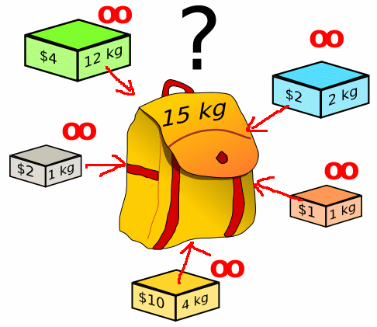
Optimizing cache usage
Problem: Which tasks require private cache, and how much?
Fixed partitioning can lead to inefficiencies and memory restrictions
Treat it as an optimization problem: What is the optimal task-partition assignment to maximize schedulability?
Reduces to the knapsack problem in CS -> NP-Hard
The knapsack problem – what items should we put in the fixed size knapsack to maximize the value?, www.mathcs.emory.edu

Slide 7
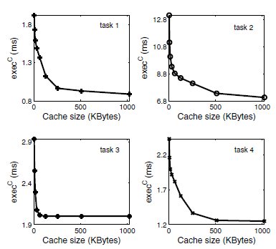
Optimizing cache usage (cont’d)
We must determine for each task:
Should the (non safety-critical) task be placed in private or shared cache?
How many “slices” of the cache should the task receive?
How big should the shared cache be?
The problem is formulated with objective function $U_{WC}= \sum_{i}{\frac{{WCET}_{i}(k_{i})}{p_{i}}}$
Where Worst-Case Execution Time = ${WCET}_{i}\left(k_{i}\right)={exec}_{i}^{C}\left(k_{i}\right)+\left(1−{a }_{i}\right)∗{CRT}_{i} (k_{i}$)
Constraints are added to ensure the solution is feasible
Execution time for various tasks in an avionic computer as a function of cache size

Slide 8
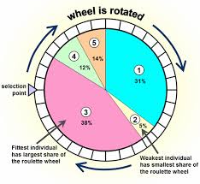
Optimization with genetic algorithms
Being NP-Hard, this would be a difficult problem to optimize using a standard linear optimizer
Authors therefore employ a genetic algorithm to solve the problem
Evolves a population of solutions using principles of natural selection
The “genes” of the best solutions are combined (crossed-over) to produce even better solutions from one generation to the next
Random mutations help prevent convergence to a local optimum
Advantages: Faster, several solutions are produced
Disadvantage: No guarantee of global optimality
Selection via biased roulette wheel – fitter candidates have a better chance of propagating their genes to the next generation. Roulette wheel selection, Newcastle University Engineering Design Centre

Slide 9
Application of genetic algorithms
Algorithm pseudo-code:
Initialize solution vector population X[N+1] * g individuals, where X[i] represents the number of private partitions to assign to task τ_{i}
Mutate the values of a randomly selected individual
Perform cross-over of some (likely the fittest) individuals
Locally optimize each solution using simulated annealing
Select individuals which will continue to the next generation
Repeat until generation limit is reached

Slide 10
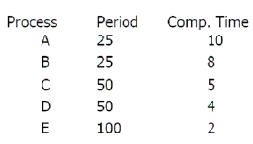
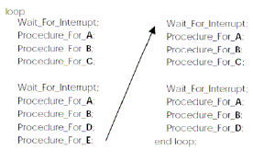
Testing the algorithm
Assume cyclic executive task manager
Can be applied to any offline scheduling method just as easily
All tasks have period of 16.67 mS
Compare baseline worst-case utilization (all shared cache) with proposed algorithm
Must also estimate the theoretical lower bound of task utilization to perform comparison…
Example of cyclic executive schedule.
Scheduling: Cyclic Executive and Rate
Monotonic, Calin Curescu, Real-Time Systems Laboratory
Department of Computer and Information Science
Linköping University, Sweden

Slide 11
Estimating Utilization
Start with a cache of infinite size
Make greedy choices of either shrinking a task’s private partition or moving some of it to shared space
The cost of each decision is calculated by:
$$∆_{i}^{e}\left(j\right)= \frac{{exec}_{i}^{C}\left(j −1\right)−{exec}_{i}^{C}(j)}{p_{i}}$$
$$∆_{j}^{r}(j)=\frac{{CRT}_{i}(j) }{j∗p_{i}}$$
Repeat until cache size is reduced to the target value
This is a theoretical bound only, since solution can split tasks between shared and private cache
Cost differential for reducing private cache size
Cost differential for moving to shared cache

Slide 12
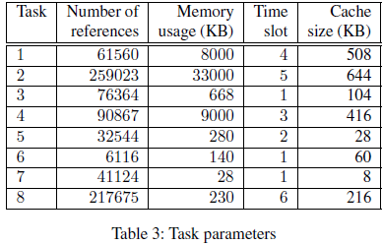
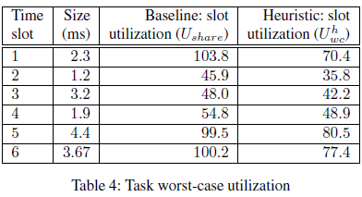
Testing the algorithm (Cont’d)
Significant improvement with proposed algorithm – all tasks are now schedulable!

Slide 13
Another contender?
Proposed algorithm is also compared with proportional cache partitioning:
$$k_{i}=\frac{k_{i}^{0}}{\sum_{1}^{N}{k_{j}^{0}}}∗K^{size}$$
As expected, the optimizing algorithm outperforms both the baseline and proportional algorithms, and approaches the theoretical minimum U_{b}

Slide 14
Conclusions
Cache interference is demonstrably a serious problem in real-time systems
Clear improvement when using optimizing algorithm compared to proportional algorithm or no partitioning at all
Proposed solution would help enable temporal isolation in real-time systems using a variety of scheduling algorithms
Extensible to a large number of concurrent tasks, due to use of genetic algorithm

Slide 15
Critique / Questions
With a maximum of 40 tasks, could they have not directly calculated the lower bound using brute-force?
How would this method interact with algorithms for isolating other shared resources?
“It is worth noticing that since CPU, memory bus speed, and cache size are constantly increasing in modern computer architectures, it is unlikely that this problem will be less severe in the near future” – wouldn’t increased memory bus speed and increased cache size reduce the severity of memory latency?
Algorithm not compared to other partitioning strategies…
An extension to this would be to somehow allow the algorithm to perform on-line scheduling…

Slide 16
References
Bui, Bach Duy, et al. "Impact of cache partitioning on multi-tasking real time embedded systems." Embedded and Real-Time Computing Systems and Applications, 2008. RTCSA'08. 14th IEEE International Conference on. IEEE, 2008.

