Slide 1
ECE 720T5 Winter 2014 Cyber-Physical Systems
Rodolfo Pellizzoni

Slide 2
Today’s Outline
Introduction to CPS
Break! Distributing survey form
(Detailed) Course Overview
Course Organization
Slides will be available on line (in fact, slides are meant as a reference, so they are fairly wordy).

Slide 3
Cyber-Physical Systems – Concepts and Challenges

Slide 4
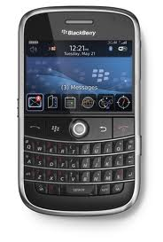
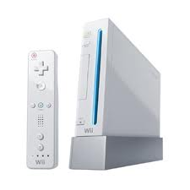
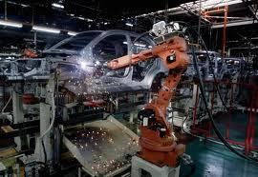
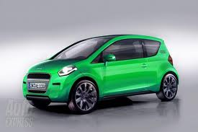
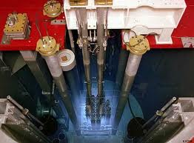
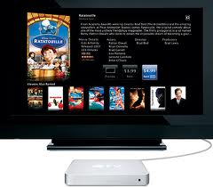

Embedded Systems
Embedded system: computing systems designed for a specific purpose.
Embedded systems are everywhere!

Slide 5
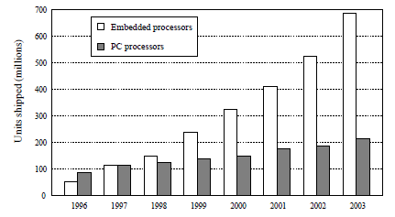
Embedded Systems and the Market
Quiz: what percentage of today’s current CPU shipment if destined to PC?
Answer: less than 1%.
In fact, embedded processor shipments surpassed PCs back in 1998.

Slide 6
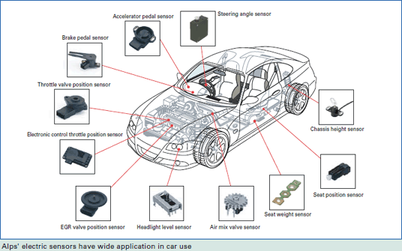
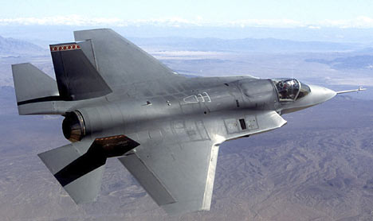
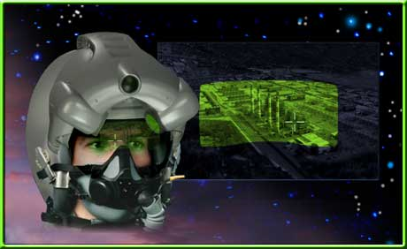
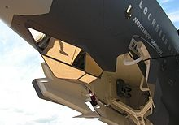
Embedded Systems are getting more complex
Modern high-end cars have over one hundred processors.
Increasing number of sensors, actuators, smart control, GUI…
Intelligent data fusion.
Helmet Mounted Display System
F-35 Lightning II
Optical Track.

Slide 7
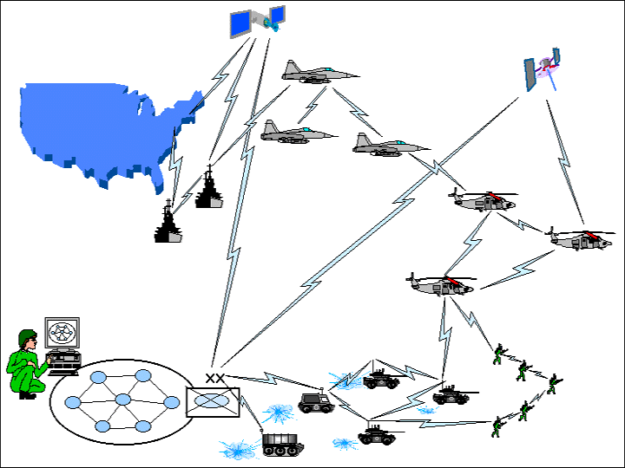
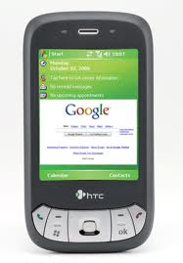

… and more Interconnected
Command-and-control network – real-time integration of vehicles, people, command.
Geotagging: useful or scary?
Many other examples
  Power Grid
  Medical systems
  Transportation
  Etc.
+

Slide 8
CPS – the next evolution
Cyber-physical systems: integration of computation with physical processes.
Still build on top of embedded computing systems.
Interaction with the physical environment is promoted to a “first class citizen”.
Promotes interaction and integration of subsystems
  Classic safety-critical embedded systems: black boxes
  CPS: white-boxes, open protocols
Main goals:
  Co-design the cyber and physical part of the system
  Engineer a “system of systems”

Slide 9
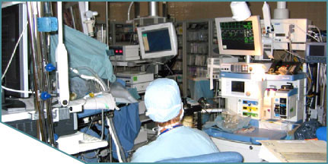
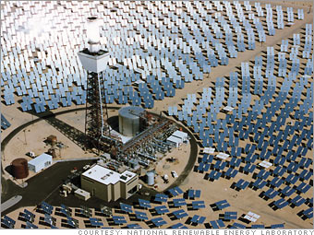
CPS applications
Several new application only possible thanks to the CPS revolution!
Integrated operating room: seemingly connect medical devices, plug-and-play functionality
  Currently: a cable mess
Smart power grid: predict and response to varying conditions in supply and demand of power.
An often ignored requirement for sustainable energy…

Slide 10
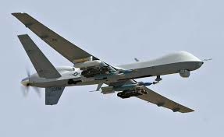
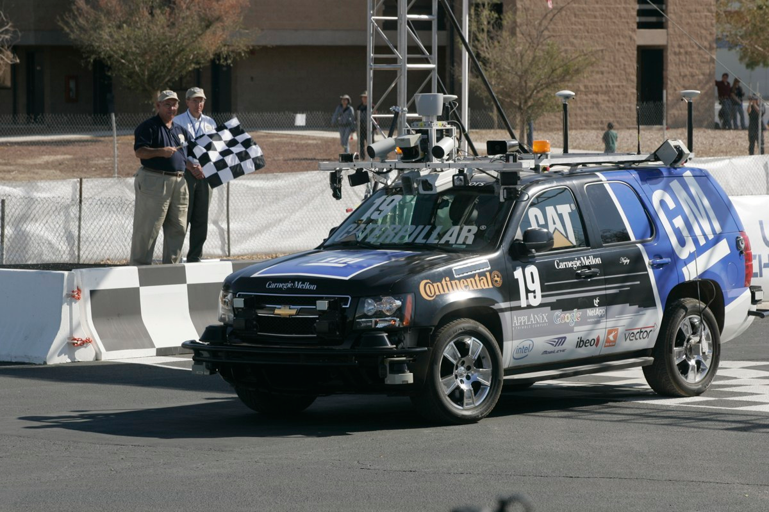
CPS applications
Other application are an evolution of existing systems.
Unmanned Arial Vehicles
Autonomous Vehicles

Slide 11
CPS Requirements
Safety
  All such systems interact with the environment.
  System failure can have catastrophic consequences.
  System correctness depends on both logical results and the time at which results are produced (real-time).
Performance
  Safety is number #1 requirement, but we still need to achieve sufficient performance.
  Many systems are resource constrained (in either weight, power, cost, etc.)
Interoperability
  Individual subsystems connected by open protocols.
  Security can be an issue.

Slide 12
CPS as multidisciplinary approach
Within ECE, CPS design requires competences in…
  Computer Architecture
  CAD & Embedded Design
  Software Engineering
  Control
  Formal Verification
  Real-Time Analysis
… plus whatever engineering field(s) are related to the design of the plant/actuator.
Problem: all such field and subfields have very different design & development conventions.
Perhaps we need a new science of CPS design?

Slide 13
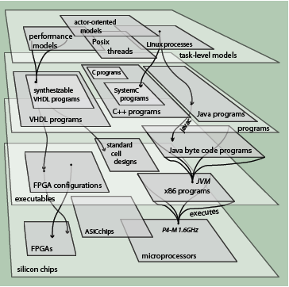
CPS Challenges – Design Abstractions
We could argue that the biggest design challenge is in abstractions – the entire ECE design is a stack-based process.
Unfortunately, most such abstractions do not directly encapsulate characteristics of the environment such as:
  Concurrency
  Criticality
  Timing
It is very hard to predict if the cyber part will meet the requirements of the physical part!
(from Prof. Edward Lee)

Slide 14
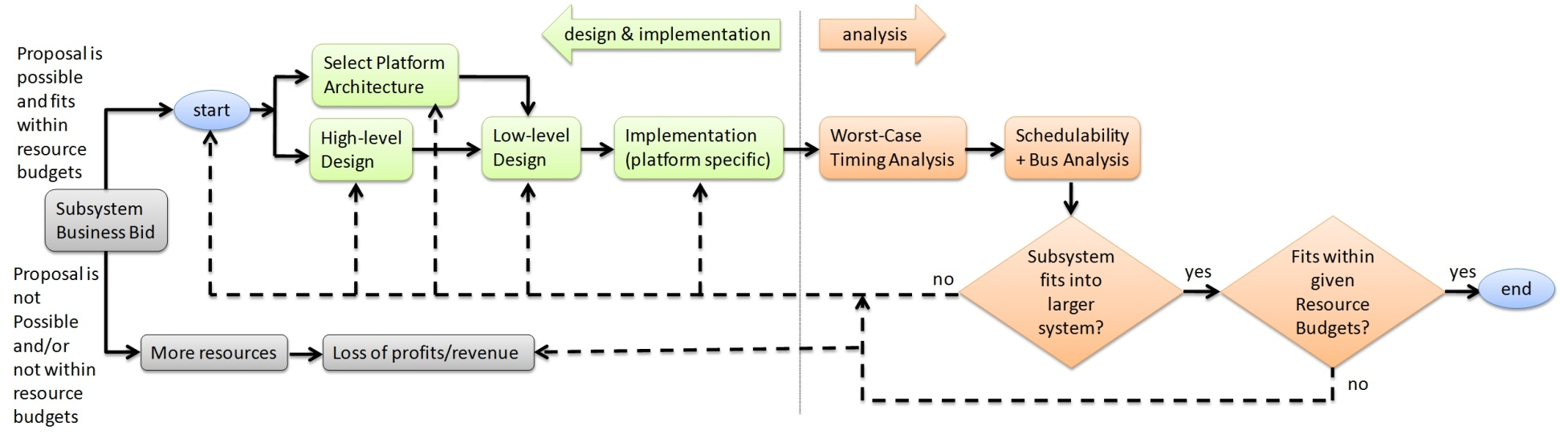
Current Design Flow
The picture below exemplifies a typical design flow for an avionic subsystem.
Analysis is required to verify that requirements are met.
Analysis can only be performed after implementation.
Recipe for disaster!

Slide 15
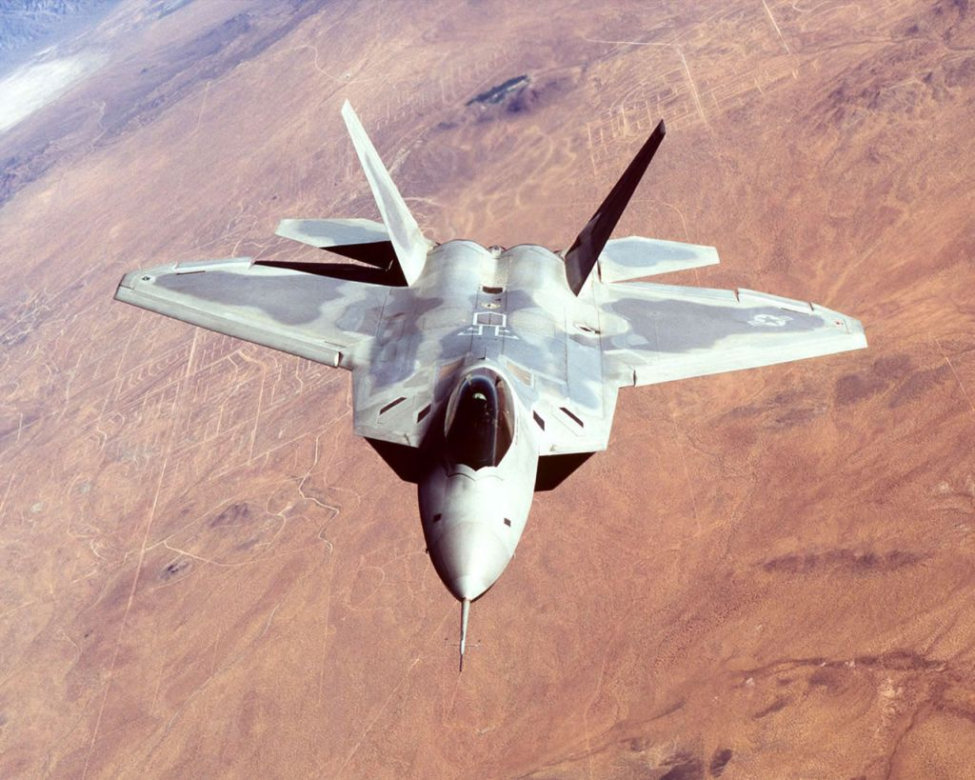
Reliable CPS: not so much!
In 2007, 12 F-22s were going from Hawaii to Japan.
After crossing the IDL, all 12 experienced multiple crashes.
  No navigation
  No fuel subsystems
  Limited communications
  Rebooting didn’t help
F-22 has 1.7 million lines of code.
F-22 Raptor

Slide 16
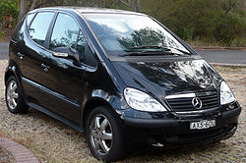
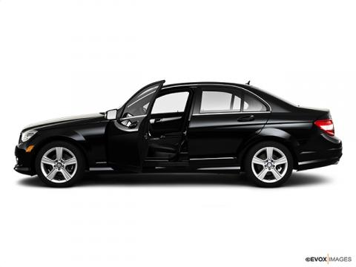
Reliable CPS: not so much!
Mercedes Class A failed the moose test in 1997.
Sensors on roof detect overturn and automatically open door.
What happens if a thief jumps on the car roof?
Mercedes Class A W168

Slide 17
CPS Challenges - Safety
Safety is hard to guarantee in interconnected and interdependent systems.
Do not trust communication channels.
  Ex: medical plug-and-play initiative is looking to interconnect medical devices using wireless technology.
  Problem: what happens if somebody jams the signal?
  Each subsystem must be independently safe.
Do not trust the users.
  Users are an (unfortunate) part of the systems.
  Users are very error prone: over 90% of avionic accidents are caused by flight crew/controllers.
  System must be protected against user mistakes.

Slide 18
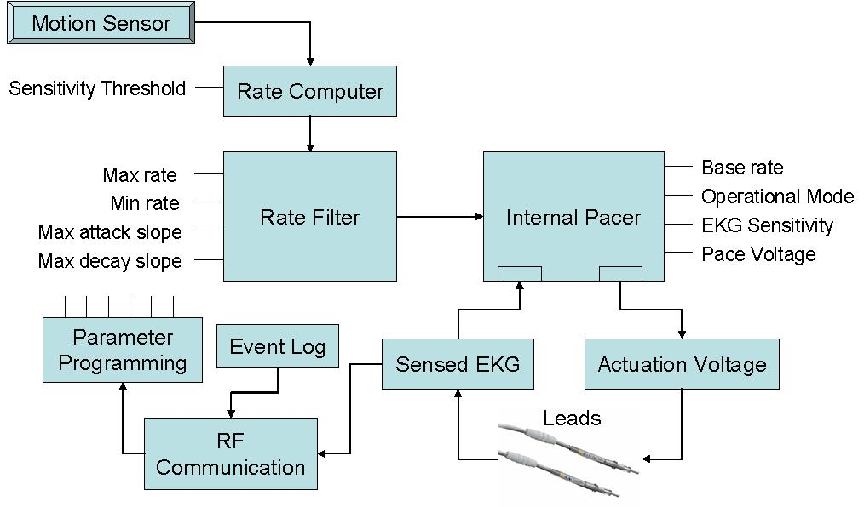
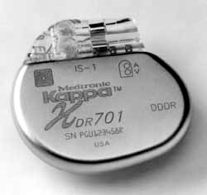
CPS Challenges - Safety
Do not trust lower-criticality subsystems.
  Medical pacemaker composed of multiple subsystems.
  Life-critical functionalities: base pacing, wiring, battery
  Non-critical functionalities: adaptive pacing, logging, programming, RF communication.
  Protect life-critical subsystem.
Pacemaker

Slide 19
Verification & Certification
How do we ensure safety?
Formal Verification
  Build a model of the systems.
  Prove (mathematically) that the system satisfies some safety property.
  Problem #1: can we model the whole system?
  Problem #2: model is not implementation.
Certification
  Usually a process-based mechanism: show that you have performed all process step according to some standard (ex: DO178a/b/c, IEC 61508).
  Typically includes extensive testing.
  Very expensive.

Slide 20
CPS Challenges - Integration
Putting the system together is much more challenging that implementing the individual subsystems.
Quiz (avionic systems): can you guess what % of $ goes in implementation vs debugging?
Individual productivity for safety-critical code is reported as 6 lines/day!
  F22: 1.7 million lines / 6 = 776 man-years
  Perhaps the US$66.7billion program cost is not a surprise…
Clearly the design process must be improved…
Implementation
20%
80%
Debugging &
Verification
Avionic Development Cost

Slide 21
CPS Challenges - Timing Predictability
The biggest architectural challenge.
The lowest abstraction layer (transistors) is pretty deterministic – we know how to compute exact timings.
However, higher levels lose all concept of timing.
  Deep pipelining, caches, out-of-order and speculative execution…
  Thread models, locking, interrupts…
This is fine for general purpose computing, but not for CPS – the physical system uses real time!
(by Prof. Edward Lee)

Slide 22
CPS Challenges - Timing Predictability
We need to ensure that computation always finishes within guarantee time windows -> We are interested in worst-case performance, not average performance!
Timing predictability
  The time that the system requires to perform an operation should exhibit little variation.
  Such time should be easy to compute.
  It should not be affected by other parallel operations in the system.
(by Prof. Edward Lee)

Slide 23
Real-Time and Composability
System correctness depends on:
  Logical correctness: system produces correct results.
  Temporal correctness: system produces results at the right time.
Timing (real-time) analysis = verify temporal correctness.
Ideally, we want composable analysis
  Verify each subsystem in isolation
  Then verify that their interaction is correct
Unfortunately, this is very hard in practice…
Main issue: hardware and software resources shared among multiple subsystems.

Slide 24
Ex: Memory and Composability Issues
Consider a dual-core system where last-level cache is shared among the cores.
We run two virtual machines, each on one core. VM#A is safety critical, VM#B is not.
If VM#B suffers a cache miss, it can replace a cache line of VM#A in last-level cache
  Result: VM#B delays VM#A.
  Criticality-inversion: the safety of VM#A depends on VM#B
Plenty of other examples in modern architecture!
  Main memory
  I/O data transfers
  Interrupts
  Etc.

Slide 25
COTS Components
So why don’t we use more predictable components?
Partially a performance problem.
Commercial-Off-The-Shelf (COTS) components are often much faster than components designed for safety-critical systems.
  Ex: avionic SAFEbus: 60 Mbit/s
  PCI Express 3.0: over 16Gbyte/s
Unfortunately, these hardware components are not designed to provide predictable performance.

Slide 26
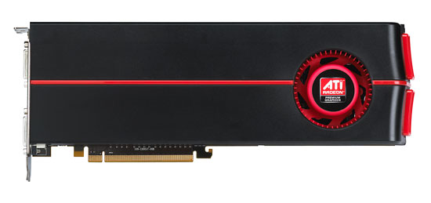
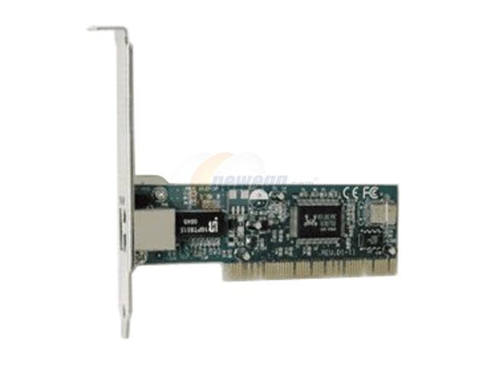
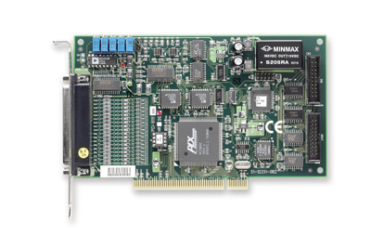
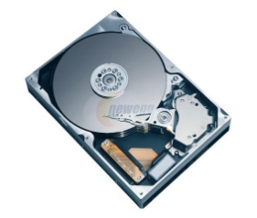
COTS example: Bus Arbitration
Two DMA peripherals transmitting at full speed on PCI-X bus.
Round-robin arbitration does not allow timing guarantees.
CPU
RAM
Transaction Length | Bandwidth (256B)
No interference | 596MB/s (100%)
128 bytes | 441MB/s (74%)
256 bytes | 346MB/s (58%)
512 bytes | 241MB/s (40%)

Slide 27
What is Required - Isolation
Isolation: one subsystem should not affect another unrelated subsystem.
Current architectures are pretty good at logical isolation…
  Ex: memory protection and privilege levels in the CPU make sure that a process can not mess with the memory of another process or the OS.
… but fairly poor at temporal isolation.
Note #1: any and all hw isolation mechanisms are useless if not supported by the OS.
Note #2: after the first OS was created, it took a while before hw architects started implementing protection mechanisms. So we stand a chance!

Slide 28
CPS Challenges – Software Models
Current software programming models and languages are inadequate to support CPS design.
C is by far the most popular language for embedded systems.
C has no intrinsic support for concurrency, timing parameters, synchronization, etc.
POSIX libraries (ex: threads) are often used, but again lack any explicit concept of timing.
Extremely common operations in controller implementation:
  specify that I want to execute an operation after a given amount of time
  specify that I want to complete an operation within a given amount of time
Why do I need to use OS constructs (times, watchdogs) for this?

Slide 29
CPS Challenges - Security
Interconnected systems are also open to attacks.
Security can become a significant concern!
  Integrity & availability are often more important than confidentiality, but not always.
Recent examples:
  Stuxnet
  Predator UAV hacking
Several more proven attacks by academia…
  Car hacking

Slide 30
What the course is about
Focus #1: provide an understanding of the challenges in CPS design
  CPS as an interdisciplinary field
  Specialize in one aspect, but understand the big picture
Focus #2: provide an understanding of the state-of-the-art solutions in architectures for CPS systems.
In particular we will focus on:
  Predictable computer architectures (largest portion of the course)
  Related Operating System support
  Timing analysis techniques

Slide 31
What the course is about
If you are doing research in any of the (general fields) of:
  Computer architecture
  Operating systems
the course will provide you with an appreciation of the specific techniques required for safety-critical embedded systems.
If you are doing research in control systems, the course will provide you with an appreciation of “what sits behind” and why the various parts of the system should be co-designed.
If you are specifically interested in safety-critical embedded systems, the course will provide an overview of the state-of-the-art in the field of embedded architectures and what is to come next.

Slide 32
What we are not going to cover
We will not cover in details:
Control theory: while modeling the physical part of the system is integral to CPS design, this is not a course on control.
Embedded software design: software application models are covered in ECE750T22. We are interested in sw/hw interactions.
Networking: CPS are usually networked systems, but we will focus on node-level architecture.

Slide 33
What about scheduling?
Real-Time schedulability theory: CPS systems are real-time systems, so we will provide an overview of related topic.
  ECE750T22 provides an introduction to the topic.
  I can cover other topics based on interest.

Slide 34
Course Overview

Slide 35
Why an overview?
Three main reasons:
All topics are interrelated - understanding the big picture helps following each individual topic
It gives you a better idea about the scope of the course (and possible project ideas)!
It let me better calibrate the course based on your interests and background.

Slide 36
Course Topics
More in details, we will cover the following topics:
Introduction to CPS
Introduction to Real-Time Systems
CPS applications
Predictable Computer Architecture
Predictable OS Abstractions
Timing and Performance Analysis
Introductions to Models of Computation and Verification for CPS.

Slide 37
Course Topics
More in details, we will cover the following topics:
Introduction to CPS
  This lecture!
Introduction to Real-Time Systems
CPS applications
Predictable Computer Architecture
Predictable OS Abstractions
Timing and Performance Analysis
Introductions to Models of Computation and Verification for CPS.

Slide 38
Course Topics
More in details, we will cover the following topics:
Introduction to CPS
Introduction to Real-Time Systems
  Required for students without relevant background.
  More or less in-depth based on interest.
CPS applications
Predictable Computer Architecture
Predictable OS Abstractions
Timing and Performance Analysis
Introductions to Models of Computation and Verification for CPS.

Slide 39
Course Topics
More in details, we will cover the following topics:
Introduction to CPS
Introduction to Real-Time Systems
CPS applications
  A more detailed look at specific examples of CPS systems and related challenges.
  I will focus on avionics and automotive systems, with additional examples from other fields.
Predictable Computer Architecture
Predictable OS Abstractions
Timing and Performance Analysis
Introductions to Models of Computation and Verification for CPS.

Slide 40
Course Topics
More in details, we will cover the following topics:
Introduction to CPS
Introduction to Real-Time Systems
CPS applications
Predictable Computer Architecture
Predictable OS Abstractions
Timing and Performance Analysis
Introductions to Models of Computation and Verification for CPS.

Slide 41
3. Predictable Computer Architecture
What we need:
  Timing Predictability
  Isolation
What we are going to see: how our computer architecture design must change to accommodate such requirements.
This involves all main components of the architecture:
  Pipeline (and other elements of the core)
  Caches
  Interconnects
  Memory controllers
  I/O Peripherals

Slide 42
Re-design vs Modification vs Analysis?
Three basic ways to achieve our objectives:
Analysis
  Do not modify the system. Instead, analyze it for safe performance bounds (worst-case).
  Problem #1: not composable. Analysis typically relies on exact information on all components (sw/hw) in the system.
  Problem #2: worst-case performance bounds can be pretty bad.
  Cache is a typical example – if we cannot compute the exact cache state, then using cache actually leads to decreased performance in the worst-case.
    If we cannot be sure about the cache state, each access can be a cache miss -> in the worst-case each access causes a write-back and a fetch.

Slide 43
Re-design vs Modification vs Analysis?
Modify the architecture
  The complexity of changing different portions of the architecture is not the same!
  Core redesign: very expensive.
  Interconnects/memory architecture: done all the time.
  Main idea: leave the core as-is. Adapt the rest to support more predictable performance.
Ex: ARM System-on-Chips
  Companies license either hard IP core (gate netlist) or soft IP core (Verilog) from ARM.
  Then they assemble the rest of the SoC.
  Highly competitive market in the consumer area (ex: smartphone SoC by Samsung, Qualcom, TI, NVIDIA…)

Slide 44
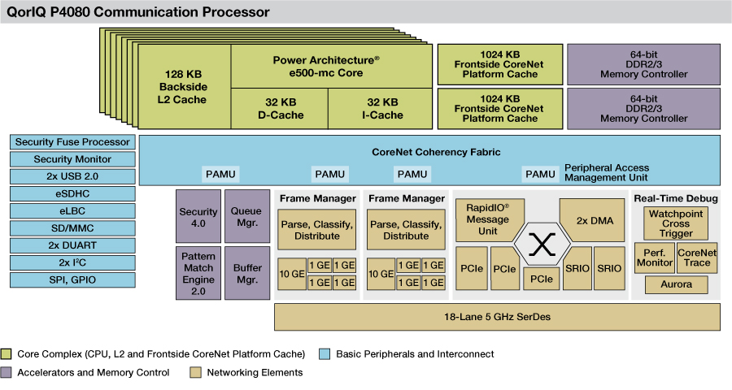
Re-design vs Modification vs Analysis?
Ex: Freescale produces PowerPC-based SoCs.
  Only two (currently) core models: e500mc and e600.
  Tens of different SoCs.
  Some SoCs are specialized for embedded architectures.

Slide 45
Re-design vs Modification vs Analysis?
Redesign the architecture
Main concept: current architectural paradigm does not work for CPS.
  No implicit concept of time.
  Only cares about average performance, not worst-case performance.
Therefore: change the architectural paradigm!
Challenge: built a fully-predictable machine but do not sacrifice (too much) performance.
Complete redesign means it is much harder to sell to industry
  CPS market is currently smaller than non-critical embedded systems (i.e. consumer market)
  No IP reuse means little economy of scale (at the moment)
  You will not see this in products for quite some time.

Slide 46
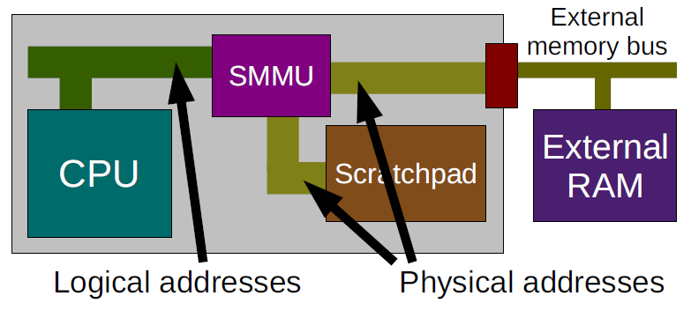
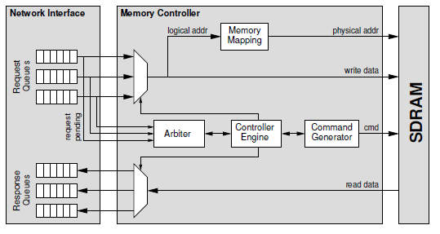
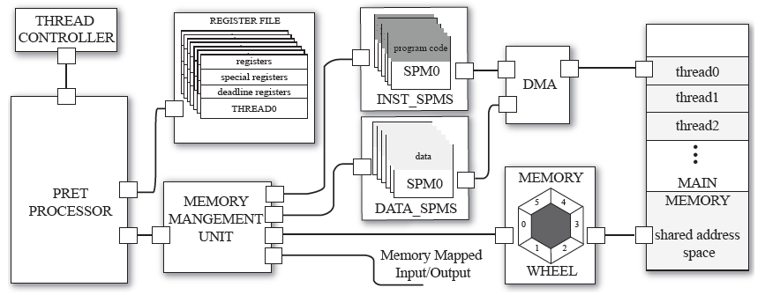
Re-design vs Modification vs Analysis?
Several very interesting research projects…
Predictable Scratchpads (York)
Predator DRAM controller (NXP)
PRecision Timed Machine (Berkeley)

Slide 47
Memory architectures
Memory wall problem: cpu speed (in the past) / number of cores (in the present/future) increases faster than memory bandwidth.
Caches are required to bridge the gap, but shared caches are inherently unpredictable.
  Allocation interference: one application can evict cache lines of another application
  Timing interference: two cores try to access the same cache bank at the same time.
Solutions?
  Smart allocation/replacement schemes
  Cache partitioning
  Do not share caches among cores (counterintuitive)!

Slide 48
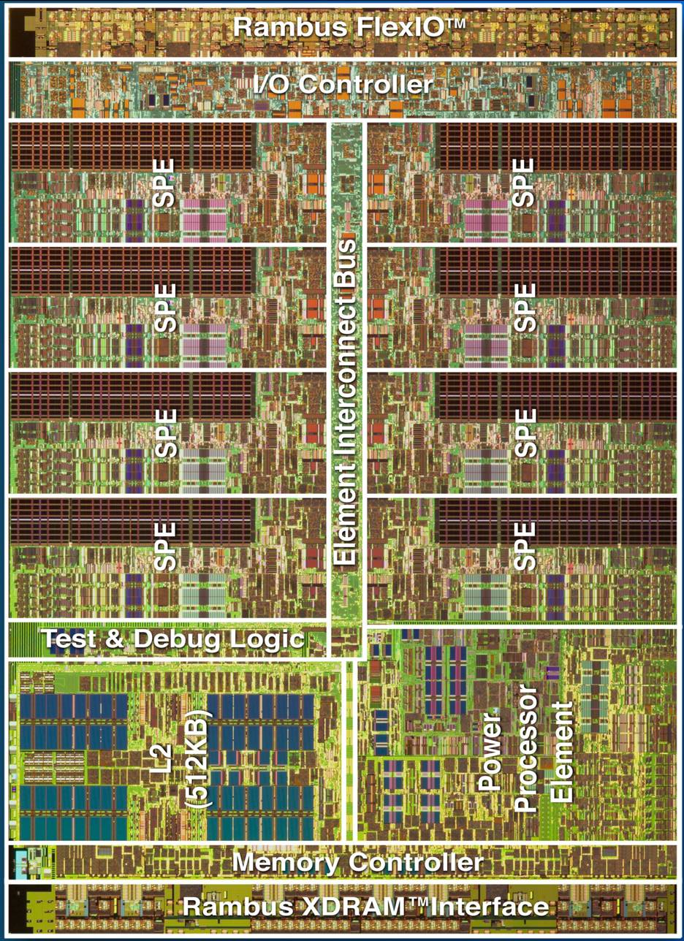
Memory architectures
More solutions? - Scratchpad memories
A programmable cache
Software is responsible for loading/unloading the scratchpad
Writing applications without OS/ compiler support becomes harder
  Non-transparent mechanism
  Main issue: pointers
(Partial) solutions:
  Scratchpad MMU
  Automatic allocation algorithms
Currently used in Sony PS3 (CellBE processor)
Sony/IBM/Toshiba CellBE processor

Slide 49

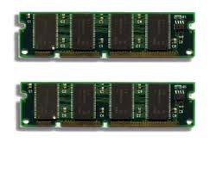
Memory controllers
Even with caches, main memory can easily become a bottleneck in multicores
What limits memory bandwidth?
Essentially: number of available pins on the package. Current fabrication processes have troubles integrating high-density memory (DRAM) with CMOS logic.
How should we arbitrate access to main memory to provide predictable performance to all cores?
Can you guess the number of pins?
Solution: 1336 (Intel i7 LGA1336)

Slide 50
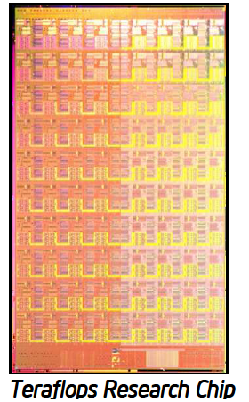
Interconnects and I/O
On-chip bandwidth wall.
  Scalable communication between cores in a multi-core system
  Networks-on-chip provide scalability and high-performance compared to point-to-point or bus-based solutions
  How can we provide isolation?
I/O data latency is as important as core execution latency for control systems
  How can we arbitrate access to communication resource between different peripherals?
80 cores connected using an NoC

Slide 51
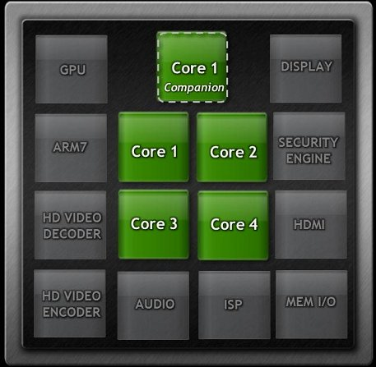
Heterogeneous Systems
Modern SoC devices are highly heterogeneous systems - use the best type of processing element for each job
Examples:
  GPU
  FPGA
  DSP
  Specialized Processors
Good for CPS – most of this processing elements are more predictable that a CPU!
Challenge: schedule and orchestrate computation among all processing units.
NVIDIA Tegra 3 SoC

Slide 52
Course Topics
More in details, we will cover the following topics:
Introduction to CPS
Introduction to Real-Time Systems
CPS applications
Predictable Computer Architecture
Predictable OS Abstractions
Timing and Performance Analysis
Introductions to Models of Computation and Verification for CPS.

Slide 53
Real-Time OS
General purpose OS are typically highly unpredictable – system activity (interrupt handlers, device drivers) can preempt applications at any time.
Traditional Real-Time Operating Systems have been designed to avoid such pitfalls. Three main requirements:
OS Predictability
User Configurability
Reliability

Slide 54
OS Predictability
  All OS operations are performed at fixed, predetermined times or within predetermined time intervals
  Examples:
    Time between receiving an event (interrupt) and activating a process
    Activation jitter for periodic events (i.e. max difference between expected and measured activation time)
    Context switch
    Time to acknowledge peripheral interrupts
    Time required to execute device drivers in the kernel

Slide 55
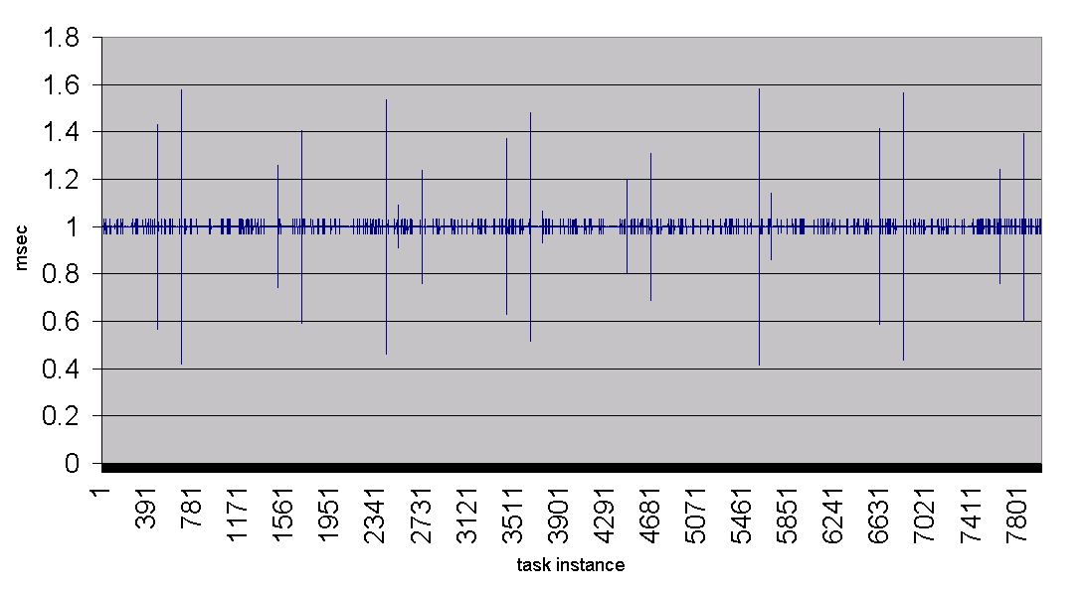
Example: Interrupt Processing
Interrupts are the number #1 source of unpredictability (jitter) in OS.
Especially problematic in I/O intensive systems – we must schedule not just processes, but interrupts as well!
The graph below was obtained on a RTLinux system (quite sad)!

Slide 56
User Configurability
Kernel must be highly configurable
  Scheduling algorithms, process allocation (if multicore)
  Selecting required OS components
  Manually controlling memory management (ex: locking pages for real-time tasks)
  Manually controlling I/O algorithms

Slide 57
Reliability
Faults in one portion of the system should not affect the rest of the system
  Faults in the code of one process should not be allowed to affect other process
  Faults in one kernel component (ex: driver) should not bring down the whole kernel
OS should be able to react to HW faults – degrade performance rather than shutting down the system
Key idea: safeguard safety-critical tasks at the cost of low-criticality tasks

Slide 58
New OS Abstractions?
A predictable hardware architecture is useless if the operating system does not take advantage of architectural features.
We need new OS abstractions to support such features.
We also need new abstractions to manage the increasing system complexity of CPS:
  Mixed-criticality systems
  Many-core systems
  Complex resources (memories, I/O, heterogeneous devices, etc.)

Slide 59
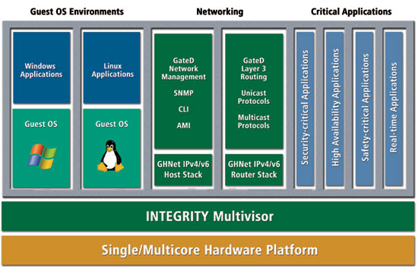
Safety Hypervisors
Simple idea: Virtual Machines for real-time systems
Complex implementation
  Standard virtual machine only provide logical isolation
  We also need temporal isolation
Green Hill INTEGRITY
“Multivisor”

Slide 60
Memory Optimization
Can the OS helps to alleviate memory bottlenecks?
Yes! The OS (or hypervisor) controls the allocation and scheduling of processes onto the various cores
  Also other processing elements for heterogeneous systems
Allocation and scheduling must be memory-aware
  Classic example: cache affinity. Try to avoid moving a process to a core that uses a different cache.

Slide 61
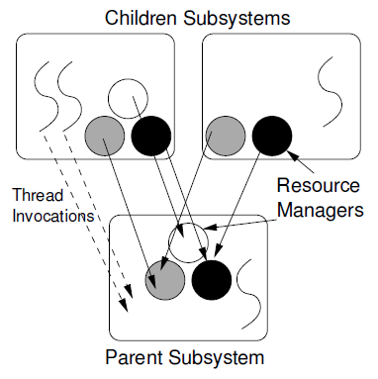
OS Organization
Increasing complexity of physical resources requires per-application allocation policies.
How should the system be structured to still guarantee isolation?
Component-based systems: build the OS from a collection of components with well-specified interfaces.
This components are typically hierarchical – parent subsystems delegate resource allocation and scheduling to children subsystems.
HIRES Hierarchical
Resource Model

Slide 62
Course Topics
More in details, we will cover the following topics:
Introduction to CPS
Introduction to Real-Time Systems
CPS applications
Predictable Computer Architecture
Predictable OS Abstractions
Timing and Performance Analysis
Introductions to Models of Computation and Verification for CPS

Slide 63
How Timing Analysis Work
Timing analysis = verify temporal correctness.
In real-time systems, computation and communication activities are associated with (absolute) deadlines – latest possible time by which the activity must complete.
Real-time schedulability analysis: algorithm that takes a set of CPU processes (real-time tasks) executed on the same core(s) as input, and outputs YES if we can guarantee that all tasks meet their deadline.
Problem: classic schedulability analysis assumes that the worst-case execution time of each task is known.
In practice, computing such worst-case execution time is much harder than running the schedulability analysis itself…

Slide 64
The Worst-Case Execution Time Problem
How do we compute the worst-case time required to execute a computation activity (task)?
How do we compute the worst-case time (latency) required to complete a communication activity?
The hardest problem in real-time computing!
Problem: both depend on the underlying hw architecture
If the architecture is not predictable, this is a tough problem!
If the architecture is predictable, it is still a non-trivial problem…
  Real applications use multiple resources, and their interactions must be understood.

Slide 65
The Worst-Case Execution Time Problem
Two main solutions : measurement and static analysis.
Measurement
  Run the task a lot of times varying inputs and other conditions that could affect it (ex: state of caches).
  Record the longest measured execution time.
  In reality a bit more complex that this…
    testing all inputs might be impractical, so we need to carefully select test vectors
    Stochastic analysis can help
  Main issue: only works if we have already implemented the whole system! Does not help with design
  Still, this is what industry does…

Slide 66
The Worst-Case Execution Time Problem
Static Analysis
  Run a (complex) algorithm that analyzes the task code and HW architecture and predicts the worst-case.
  This involves analyzing:
    Core execution, pipeline, branch prediction, etc.
    Caches
    Interconnects
    Main memory
  Current tools have limitations; still an area of active research.
  Also requires application code, i.e. implementation.

Slide 67
Performance Analysis
Neither measurement nor static analysis work very well at the design stage; they are instead useful to verify (also possibly certify) the final system.
What can we do at the design stage? How can we know if the system is correctly dimensioned (i.e. we have enough resources for the target applications)?
Main idea: early performance analysis
  Build a (possibly rough) model of the system
  Use it to analyze performance
  We do not need exact numbers, but rather a ballpark estimation.

Slide 68
Performance Analysis
Ex: Network Calculus and Real-Time Calculus
  Provide a characterization of available system resources (service curves). Resources can model computation or communication elements.
  Provide a characterization of requests for system resources (arrival curves)
  Compute deterministic worst-case delays and buffer sizes (the latter for communication activities).
Deterministic vs stochastic analyses
  Deterministic analyses focus on computing worst-case bounds.
  Stochastic analyses (ex: queuing theory) focus on probabilistic bounds
  Both are useful – correct use depends on uncertainties in the model.

Slide 69
Course Topics
More in details, we will cover the following topics:
Introduction to CPS
Introduction to Real-Time Systems
CPS applications
Predictable Computer Architecture
Predictable OS Abstractions
Timing and Performance Analysis
Introductions to Models of Computation and Verification for CPS.

Slide 70
Models, Verification, and other topics
Other topics not covered in the previous section.
Subject to change based on time and interest, but we will (at least briefly) cover some of the main remaining topics.
How can we model both the cyber and the physical systems?
How can we verify the whole system?

Slide 71
Architecture Description Languages
Let’s start by modeling the whole cyber system!
Several languages have been proposed in the field of software engineering to describe the architecture of the software system. Most famous: UML.
Problem: UML is really meant for object-oriented sw systems.
Timing characteristics of CPS software strictly depends on hw architecture, so we should model that as well.
Next step: also model the physical system.
  Much more complex: the model of computation of physical reality (i.e. differential equations) is very different than the one used for computation (ex: automata, touring machines, etc.)

Slide 72
Architecture Description Languages
Ex: AADL (Architecture Analysis & Design Language)
Gaining traction in the avionic domain
Models both logical components (sw) and physical components (hw)
Mapping: assign logical to physical components.
Alternatives exist (ex: SysUML, Marte, etc.)

Slide 73
Formal Methods and Timing
Formal Methods can be used to verify system correctness.
Usually the goal is to model-check the system, or a portion of the system.
To be useful in CPS verification, the formal language must include an explicit concept of time.
Ex: timed automata (UPPAAL model checker)
Location
closed guard
reset
Transition
Clocks: {a,b}

Slide 74
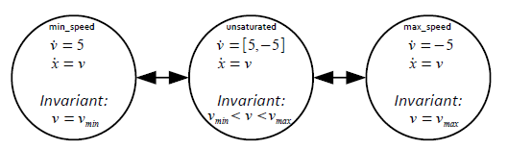
Hybrid Models and Verification
Most formal languages can only model discrete systems and events.
Unfortunately, while reality might indeed be discrete at the quantum level, people like to model the physical environment using continuous processes.
A hybrid model is a model that mixes discrete state with continuous state.
Active research on how to verify, control and synthesize…

Slide 75
Run-Time Monitoring
Two issues with formal methods:
  Struggle with verification of very large systems (state-space explosion)
  Proof is only as good as the model
Alternative solution: Run-Time Monitoring
  Formally specify safety properties, but not how the system works.
  At run-time, check system events against the formal safety specification.
  If a failure is detected, perform recovery
  Monitors can be implemented either in hw or in sw.
  Run-time overhead is a concern.

Slide 76
Course Organization & Administrative Matters

Slide 77
Instructors
Rodolfo Pellizzoni
Office: E5 4113
Email: rpellizz@uwaterloo.ca
What I study:
  Predictable hardware architecture
  Real-Time Operating Systems
  HW-SW Co-design of safety-critical systems
  System modeling and analysis

Slide 78
Lecture Organization
Lectures will consist of a mix of my presentations, presentations by students, and paper discussion.
How this is typically going to work:
  I introduce a topic and give some papers to read.
  We discuss those papers (and related results).
2-3 papers each week (depending on length/complexity)
Participation in class discussion is essential!
  This is a grad course; you need to be able to critique paper content
  It keeps everybody focused (3 hours can be long…)

Slide 79
Seminar Presentation
Students taking the course for credit are required to provide one formal seminar presentation during the course (in class).
  If you are auditing the course, you are welcomed to give a presentation, but are clearly not required.
The presentation should focus on 1-2 related papers and be 20-30 min long (to be decided based on # students).
A paper list for student presentations will be finalized by the weekend (after adjusting the course content based on people’s interests).
Your choices:
  Pick your paper from the presentation list.
  If you want to cover something else, please talk to me.

Slide 80
Seminar Presentation
Slots will be assigned first-come, first-serve. Please schedule your slot at least one week in advance.
What is the goal of the seminar presentation?
  Clearly explain the paper motivation: what problems are the authors trying to solve?
  Provide an (high-level) overview of the solution. Focus on:
    How applicable this technique/solution is? Does it have any major limitations?
    What are the strong points of this approach?
    What are the weak points of this approach?
    How does it relate to everything else we have seen in the course so far?

Slide 81
Website
Course website is hosted at http://ece.uwaterloo.ca/~rpellizz/ECE720T5-2014.php
We will post:
  Reading list
  Presentation list
  Lecture slides
  Seminar slides
Lecture slides will go online some time after the lecture itself.

Slide 82
Course Tracks
Two different course tracks for evaluation & assignments.
Research track
  Strongly suggested for PhD/MASc students.
  More focused on research project.
Applied track
  More structured project option.
  More focused on the course material (and final exam!)
Please make a decision and email me by Friday Jan 17.

Slide 83
Research Track
Involves a course project on a topic of the student’s choice (related to the course content).
Mark Breakdown:
  Lecture participation: 5%
  Seminar presentation: 10%
  Project proposal: 10%
  Project literature review: 15%
  Project presentation: 10%
  Final: 50%
    Project report 25%
    Essay 25%

Slide 84
Research Track
The project should be original and strive to make a new contribution.
You are welcomed to come up with your own ideas; I can also suggest some.
Bringing ideas from your specific research area in the CPS domain is a great idea! Diversity is appreciated.
You can work alone or in a group (max 2-3)
  Project complexity should be proportional to number of people.
  Responsibility should be clearly defined; all members should do part of the writing and work on each assignment.

Slide 85
Research Track
Project proposal
  Max 2 pages document
  Describe what you want to do, why is it relevant, what will be the contribution, and a brief summary of your workplan (possibly with group assignments).
  Should be in the form of an extended abstract.
  Due Monday February 3 at 8:00AM.
Project literature review
  At least 2 pages document
  Carefully review and summarize related literature on the topic.
  Explain how your approach relates to the state-of-the-art
  Due Monday March 3 at 8:00AM.

Slide 86
Research Track
Project presentation
  During final lecture
  Each individual/group will have a slot to present his findings.
  Similar to seminar presentation: stress not just the technical aspects, but also why your project is cool!
Project report
  Due on final exam date.
  It should be in the format of a 6 page (or more if needed) IEEE or ACM conference paper.
  It will be evaluated as a normal conference paper would be – novelty, presentation, technical content.

Slide 87
Research Track
Format for all project deliverables: IEEE or ACM double-column conference format.
I suggest using latex, but that is up to you…
Final exam
  Open-book final, essay-style
  We will ask you to discuss and possibly apply the results in one or more related papers discussed in class

Slide 88
Applied Track
Structured project assigned by the instructor.
Mark Breakdown:
  Lecture participation: 5%
  Seminar presentation: 10%
  Midterm project milestone: 10%
  Final project report : 15%
  Project presentation: 10%
  Final: 50%

Slide 89
Applied Track
Individual project
Project will not be original – goal is to get you development experience in a specific CPS subfield.
Project will be tailored based on your expertise - please fill the information form and contact me next week so we can set up a time to discuss it
General fields you can work on:
  Embedded applications
  System Software
  Hardware Development (FPGA)
  Formal Verification
Final report due last day of lectures

Slide 90
Applied Track
Closed-book final exam
It will cover all material in the course
What you are expected to know:
  The content of the lecture slides in detail (with possibly some exceptions that will be noted).
  The key points about each of the assigned papers
  I will not ask you to remember paper proofs or algorithms in detail (unless otherwise specified in the lecture notes)
  If we ask you to apply an algorithm, we will provide you the corresponding paper during the final

Slide 91
Office Hour
By appointment.
To ensure a prompt answer, use ECE750T5 in the title.
If you are looking for research ideas for your research project, please contact me by Friday Jan 17.
Similarly, if you wish to take the applied track, please contact me by Friday Jan 17.
For individual/groups in the research track, I recommend scheduling brief project meetings every 2 weeks (starting with project proposal).

