Slide 1
ECE 720T5 Winter 2014 Cyber-Physical Systems
Rodolfo Pellizzoni

Slide 2
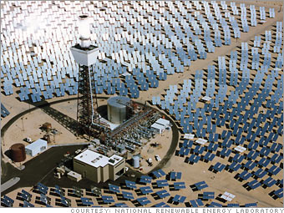
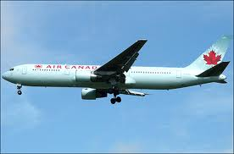
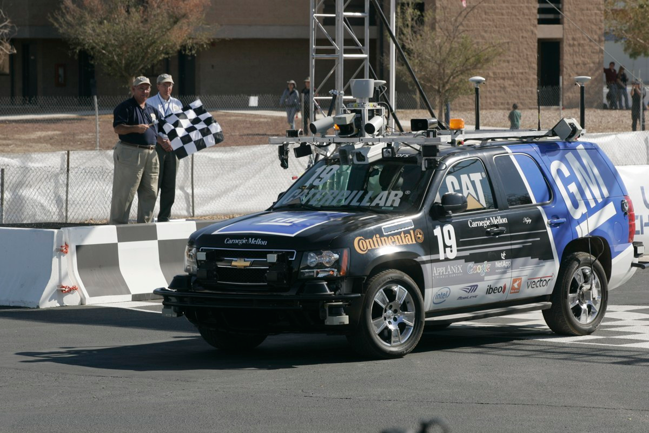
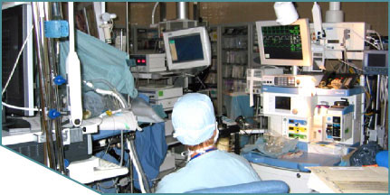

Today’s Lecture
CPS
Energy
Transportation
Medical Devices

Slide 3
Some Common Themes..
Sensing
  It’s all about gathering the correct information at the right time!
Modeling
  Building good models is hard!
  Models are currently very application-dependent
Validation
  Checking that you did the right thing is harder than implementing the system

Slide 4
Today’s Outline
Intro
Avionics Systems, Validation and Verification
Medical Devices
Energy
Security
Autonomous Vehicles (if we have time)

Slide 5
How the Avionics Market Works
Supply chain!
Aircraft integrator (ex: Boeing, Airbus, Lockheed) builds plane.
Suppliers provide components
  Ex: Avionics systems (electronics on the airplane): Rockwell Collins, Honeywell
  Ex: Engines: Pratt&Whitney, Rolls-Royce
Integrators are responsible for setting the requirements and validating the final product.
Similar in automotive, with subsystems providers such as Bosch, Siemens, Magneti-Marelli, etc.

Slide 6
It’s getting more and more complex…

Slide 7
Verification, Validation, Certification
Verification: ensuring that a subsystem (or step in the design) meets the objectives for that subsystem, i.e., it does what we want it to do.
Validation: ensuring that the whole system meets the requirements, i.e., it does what it is supposed to do.
Certification: convincing a given authority that the validation process is correct.

Slide 8
More on Certification
Certification is typically process-based, not proof-based.
You don’t have to convince people that your math/model is correct.
Instead, you show people that:
  You established good process management practices to track requirements, as well as quality and conformance of the deliverables.
  You followed the process.
Certification is typically very expensive!
  Document everything
  Review everything (use different people – independent verification/validation)

Slide 9
More on Certification
Different authorities have different certification processes…
Ex: Federal Aviation Administration establishes most of the regulations used worldwide in aviation.
For example, the DO-178b/c specifies certification requirements for avionics software.
Basic idea:
  Assess the safety implications of every failure mode.
  Map failure modes to subsystem – 5 safety levels (A to E).
  Satisfy a set of “objectives” related to code review and validation (with independence = reviewer must be different from coder).

Slide 10
777 Flight Control Validation Problem

Slide 11
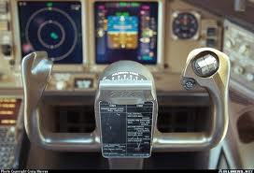
Fly-by-wire
All modern aircrafts use fly-by-wire.
Pilot does not directly move flight control surfaces (ailerons, elevator, rudder, …).
Instead, the yoke sends commands to the electronic Flight Control System
The FCS interprets yoke movement and actuates the surfaces.
Many aircrafts (especially military) are inherent unstable – the aircraft needs continuous surface adjustment.
Nobody could fly it without FCS!

Slide 12
Why reading this?
Realize how painful the whole validation/certification process it
Reason on the inefficiencies in the process
Not much progress since the early ‘90…

Slide 13
The steps
Requirements Definition
Requirements Validation
Allocation of Requirements
System
Validation

Slide 14
Selecting Requirements

Slide 15
Validating Requirements

Slide 16
Allocating Requirements

Slide 17
Testing: Painful but Necessary

Slide 18
Are standards good enough?
Certification standards are a work in progress…
  Upgrade to include new design methodologies.
  Changes are often driven by disasters – you learn from mistakes.
Ex: ARINC 653 (Avionics Application Standard Software Interface)
  The software base of Integrated Modular Avionics.
  Main idea: integrate software partitions with different criticality levels on the same/communicating computational node.
  A set of OS/Hypervisor provisions for safe partitioning and associated API.
  Problem: what about architectural effects (ex: shared caches) in multicores?

Slide 19
Are standards good enough?
AUTOSAR (AUTomotive Open System ARchitecture)
  Standardized automotive software architecture.
  Allows integration among multiple subsystems, especially by different suppliers.
  Standardizes basic functionalities and communication among subsystems.
  System is partitioned in a set of Electronic Control Units (ECU) – essentially computational nodes with attached sensors/actuators.
  Problem: AUTOSAR doesn’t specify anything about the implementation of the ECU.
  For example, you can express end-to-end latency requirements, but how do you validate them without knowledge of each ECU?

Slide 20
The cost of errors
20.5%
30x
Requirements
Engineering
Acceptance
Test
0%, 9%
15x
System
Design
System
Test
70%, 3.5%
10%, 50.5%
1x
10x
Software
Architectural
Design
Integration
Test
20%, 16%
Component
Software
Design
Unit
Test
5x
Source: NIST Planning report 02-3, “The Economic Impacts of Inadequate Infrastructure for Software Testing”, May 2002.
Where faults are introduced
Where faults are found
Code
Development
The estimated nominal cost for fault removal

Slide 21
A Possible Solution: Virtual Integration?
Several industry efforts, ex: System Architecture Virtual Integration (SAVI). Idea: catch design issues early on.
Build a library of components, with timing characteristics.
Assemble the system out of prefabs components.
Automatically generate analyses out of model library.
Challenges:
  How detailed the model is vs precision in the analysis.
  Software models are hard.

Slide 22
Today’s Outline
Intro
Avionics Systems, Validation and Verification
Medical Devices
Energy
Security
Autonomous Vehicles (if we have time)

Slide 23
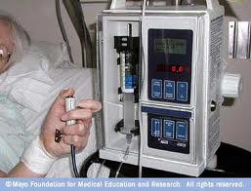
FDA regulation and medical devices
Federal Drug Administration regulations are somehow lacking compared to other federal agency (ex: FAA).
April 2010 push: “Infusion Pump Improvement Initiative”
Patient-controlled analgesia
  Nurses are expensive
  Patient feels bad, press button, gets a shot of morphine
  What if he presses the button too often?

Slide 24
Another Example…
Patient on ventilator (mechanically operates lungs) during surgery.
Surgeon asks assistant to take x-ray.
  Can’t take x-ray while lungs are moving (doctor always ask you to stop breathing…).
  Anesthesiologist stops ventilator.
  Assistant has trouble with x-ray – room is a cable mess.
Anesthesiologist go help with x-ray.
Nobody turns the ventilator back on…

Slide 25
Cyber-Physical Modeling of Implantable Cardiac Medical Devices

Slide 26
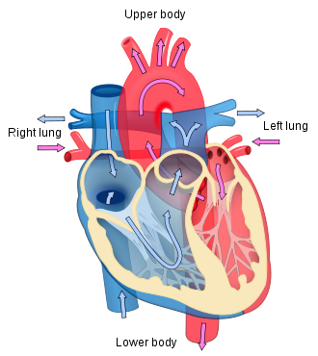
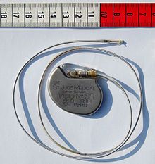
Heart and Pacemaker

Slide 27
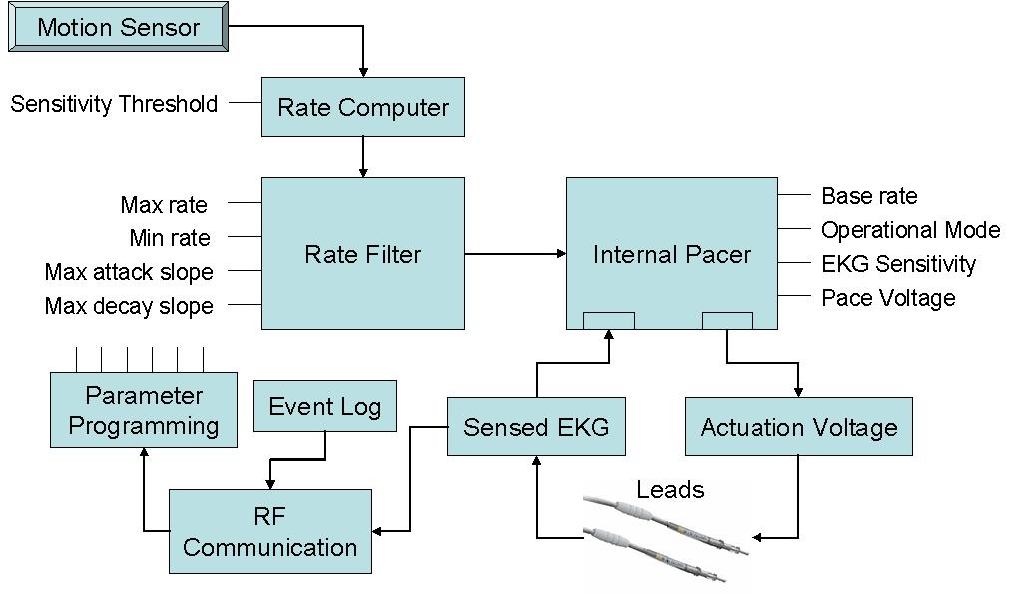
Modern Pacemaker?

Slide 28
Heart and Pacemaker Models

Slide 29
Multiple Models

Slide 30
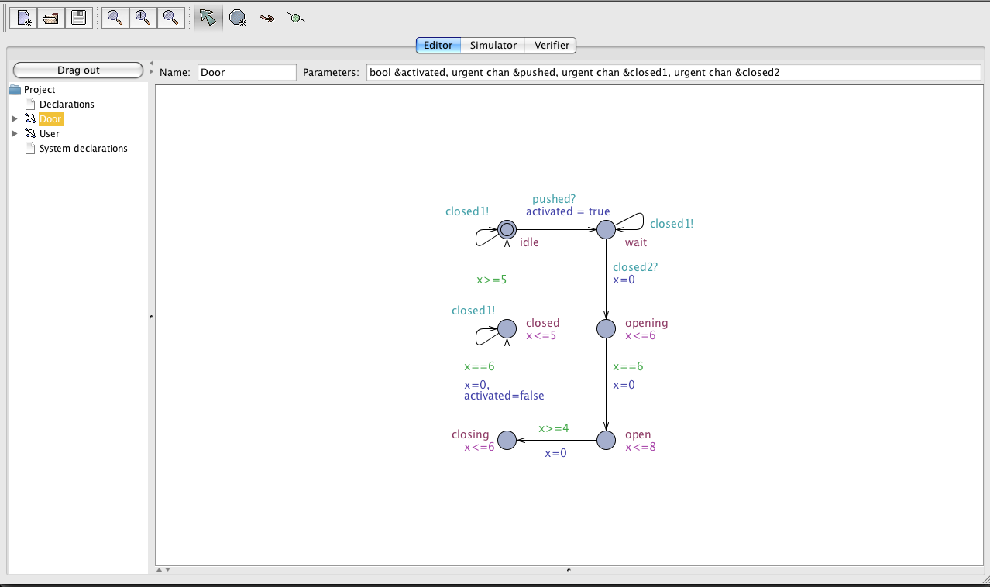
Timed Automata
Example of verification tool: UPPAAL
Based on the theory of Timed Automata
Adds variables and channels.
  Main idea: reduce the number of states and simplify composition of automata

Slide 31
How are properties specified?
Typically two ways:
Use another timed automata. Composed the two. Check if you reach some state.
Use another formal language (ex: linear temporal logic).
The verification engine is called a model-checker.
  Maintains a representation of states, clocks, variables (explicit or implicit)
  Compute which states can be reached from a given set of states (forward or backward)

Slide 32
Tissue Activation and Timed Automata Model

Slide 33
Path Model

Slide 34
Software Model

Slide 35
Other issues with medical equipment…
Interoperability
  Currently equipment of vendor X only works with other equipment of vendor X
  Strong push for an open medical interoperability standard
  Problem #1: if something goes wrong, who gets the blame (weak FDA regulations)?
  Problem #2: equipment vendors have nothing to gain…
Wireless Communication
  Solve the cable mess
  Problem: how to resist interference and jamming?
  Some physical-layer techniques are promising (Ultra-Wide Bandwidth, Dynamic Frequency Selection…)

Slide 36
Other issues with medical equipment…
General solution: stand-alone safety
  Design each component such that it is safe in isolation
  Device must be able to maintain a safe state even if all communication is lost
  Device must be able to maintain a safe state even if it receives incorrect information from other devices
  Ex: ventilator should automatically turn on after a maximum amount of time!

Slide 37
Today’s Outline
Intro
Avionics Systems, Validation and Verification
Medical Devices
Energy
Security
Autonomous Vehicles (if we have time)

Slide 38
Energy
Very hot topic.
Two main areas:
The power grid
  Turns out that the current power grid is not designed to support high variability in supply…
Saving energy (cost)
  Turns out there are many simple tricks you can use to save energy and lower your bills once you can control the energy-consuming system automatically
This is largely a sensing problem: we can do better if we can figure out what is going on with a good spatial and timing resolution.

Slide 39
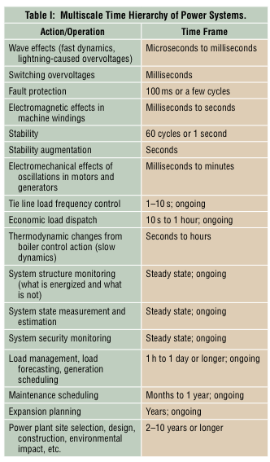
The Power Grid in North America
> 200,000 miles of transmission lines.
Thousands of generators.
Complex multiscale system.
Demand is highly variable – time of day, weather, etc.
Main issue: storing electricity is very difficult.
Generators must be flexible to adapt to current demand.
Note: even producing more energy that required is a problem!

Slide 40
Power Grid Today
Arrange generators in three categories:
  Baseload: run all the time to provide minimum demand level. Good efficiency.
  Intermediate: run it often to satisfy average demand.
  Peaking: run it sparingly to satisfy maximum load. Generally poor efficiency.
Generators are dispatched as needed by control area operators.
  There are three separate interconnects in North America
How? Mostly by phone calls…
Not very reactive to emergencies…

Slide 41
Power Grid Today
This mechanism does not work well when we add renewable sources in the mix…
Many sources are not flexible – you can not control the weather
Users can now start generating power (ex: through solar panel) and feeding it into the grid
  How do we pay them back?
  What happens if they actually produce more energy that it is needed at a given moment?

Slide 42
The Smart Grid
The new vision: Smart Grid.
Embed sensing and intelligence in every component of the network.
Wire all nodes together – a giant Cyber-Physical System
Collaboratively take decisions with the correct time granularity regarding:
  Supply
  Load balancing
  Pricing
  Etc.
Lots of open questions – both about the technology (sensors, materials, etc.) and about collaborative mechanisms/algorithms

Slide 43
Saving Energy: Examples
Optimizing Market Cost
  Due to aforementioned network inefficiency, in the USA the cost of energy can be very different across different markets
  You can trade energy just like stocks (with some limitations)!
  If you have large server farms (ex: Google), try to move the load to farms where energy costs less at the moment…
Optimizing Energy Usage in Building
  Key idea: lower temperature in no people are in a room.
  Problem: it takes time to heat a room.
  Solution: try to predict people’s behavior.
  Limited success: misprediction makes people really angry – only works if enforced.

Slide 44
Today’s Outline
Intro
Avionics Systems, Validation and Verification
Medical Devices
Energy
Security
Autonomous Vehicles (if we have time)

Slide 45
Security is Now Important
Traditionally, security not an issue in safety-critical embedded systems
  Black boxes
  Not interconnected
However, CPS are based on open protocols and networks! Several demonstrated attacks
Military Drone (UAV) Hacking
  Jam the UAV communication channel. UAV goes into autopilot
  Spoof the GPS signal. The UAV believes it is in a different location than its real one.
  UAV lands at the location decided by attacker

Slide 46
Stuxnet
Uses zero-day vulnerability to compromise and spread on Windows PC
Uses other zero-day vulnerabilities to access Siemens SCADA control software
Attacks attached Siemens Programmable Logic Controller used to control specifics variable-frequency electric motors spinning at precise frequencies and disturbs their operation
The type of motors and frequencies is typical of centrifuges in uranium enrichment facilities in Iran…

Slide 47
Car Hacking
Comprehensive Experimental Analysis of Automotive Attack Surfaces
Scary stuff: an attacker can very easily gain control over all electronics systems in your car
  Start/stop/rev up/rev down engine
  Brake/disable braking
  Open doors
  Determine your position through GPS
  Listen to whatever you say in the car (all without your knowledge)
Infiniti Q50 has steer-by-wire, so an attacker can remotely start and drive your car from your parking lot to his safehouse without moving from his couch…
At least handbrake is completely manual…

Slide 48
CAN Networks and Vulnerability
Set of ECU connected by CAN buses.
CAN buses are designed for real-time (fixed priority messages), but not security…
Broadcast with no authentication field: any ECU connected to a CAN bus broadcasts to all other ECU on the same bus. No way to determine the sender.
Weak Access Control: there is a challenge-response sequence but the codes must be known by all service centers to perform diagnostic = they are out in the open.
ECU Firmware Update: the firmware of any ECU can be updated over the CAN bus.
Bridge nodes: there are different CAN buses (critical / non-critical), but they are bridged by dedicated ECU nodes.
Result: if you can hack any ECU, you can re-flash any other ECU…

Slide 49
External I/O Channels

Slide 50
Results…

Slide 51
What are the problems?
Lack of care
  Most attacks use conventional buffers overflow
  Software simply isn’t checking for malicious inputs
  People writing safety software are not used to think about security..
Interfaces are not clearly specified
  ECU development delegated to subsystem providers
  Interfaces between components are not specified well-enough to check for malicious interaction
No separation among criticality levels
  Systems with different criticality are clearly isolated from a temporal perspective, but not a function one
  Very hard to solve…

Slide 52
Today’s Outline
Intro
Avionics Systems, Validation and Verification
Medical Devices
Energy
Security
Autonomous Vehicles (if we have time)

Slide 53
2007 DARPA Urban Challenge
Final goal: cars that drive themselves.
  The vision is to greatly reduce the number of accidents per year.
The 2007 DARPA Urban Challenge
  11 teams in the final event
  Autonomous car should be able to navigate an urban environment avoiding fixed obstructions and moving vehicles
  Carnegie Mellon’s BOSS vehicles won the competition after completing the run with limited problems

Slide 54
Sensing

Slide 55
“Seeing” the Road

Slide 56
Behavioral Reasoning

Slide 57
The Role of Testing
Huge testing effort!
  Not typical in university…
  They likely won thanks to superior management of testing and validation phase
Dedicated testing team
Subsystem testing is not enough – thousands of km on the car
Playbook capturing 250 driving events
Regression testing for every new feature!
Automated test reporting and analysis

