Slide 1
ECE 720T5 Winter 2014 Cyber-Physical Systems
Rodolfo Pellizzoni

Slide 2
Upcoming Deadlines
Course status
  All comments on research projects out by tonight.
  Hopefully all presentation comments out by Friday – sorry for the delay.
  As always, feel free to set up a meeting as needed.
Research Track: Literature Review March 3.
  Address comments in the project proposal.
  Add an expanded related work section – 1.5 / 2 pages.
  More detailed than normal related work – show your review work - provide a more in-depth description of the state-of-the-art in the specific area of the project.
Applied Track: preliminary result March 10.

Slide 3
Topic Today: Microarchitecture
Previously: system design.
Next: Microarchitecture.
Previous problem: determine interference due to multiple agents (tasks/cores) contending for access to shared resources.
This problem: compute worst-case execution time for a sequence of instructions.
In reality, the two problems are similar, because in modern microarchitectures instructions “contend” for multiple shared resources (virtual registers, execution units, etc.)

Slide 4
Microarchitectural Features and Predictability
Modern microarchitectures aggressively reduce average case at the cost of decreased predictability.
Processor state is very hard to predict when using:
  Deep pipelines
  Superscalar execution
  Out-of-order execution
  Virtual registers
  Branch predictors
  Hardware prefetchers
  Unpredictable replacement schemes for TLB/Caches
  Basically, any sort of architectural trick…

Slide 5
Computing the WCET
As we already mentioned, two main mechanisms…
Static analysis
  Analyze the application code together with a model of the architecture.
  Provable worst-case over the set of all possible input values and initial states of the processor.
  Very complex. Possibly very slow. Pessimistic.
Measurement
  Can fail to reveal the real worst-case.
  Still very much used.

Slide 6
Memory Hierarchies, Pipelines, and Buses for Future Architectures in Time-Critical Embedded Systems

Slide 7
Overview
In summary: the architecture should be designed to simplify timing analysis!
Several important concepts on static analysis and cache analysis.

Slide 8
Timing Analysis: How To

Slide 9
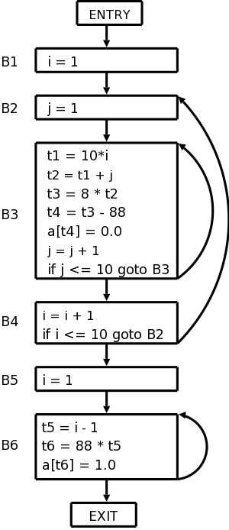
Control Flow Graph
Analyze the code (either source or binary)
Split the code into a sequence of basic blocks.
Basic blocks are typically terminated by jumps (or function calls/returns)

Slide 10
Abstract State
The analyzer must maintain the state of the processor (pipeline, cache, etc.) to determine BB duration.
Problem: the state can depend on all the BB before.
Flow-sensitive analysis: the analysis depends on the specific sequence of instructions in the BB.
Context-sensitive analysis: the analysis depends on the preceding/calling BBs.

Slide 11
Abstract State
Solution: abstract state.
A collection (set) of possible processor states; if context-sensitive, subsets of the current abstract state are tagged based on BB history.
Whenever a new BB is analyzed, perform an abstract state merge based on the abstract states of all preceding BBs.
Lose precision but avoids exponential analysis.

Slide 12
Timing Anomalies

Slide 13
To Summarize…
Domino effect: I can repeat a set of instructions any amount of times, but the timing of each iterations always depends on the processor state before starting the iteration.
In other words, the analysis never converges on a loop.
Fully-compositional architecture: no timing anomaly.
Compositional architecture with constant bounded effects: just take the worst-case for each component of the abnormal scenario (ex: A misses & B executes before C).
Noncompositional architecture: domino effects mean we need to keep the whole context.

Slide 14
PLRU
load line 1
load line 2
1
1
2
load line 3
access line 2
load line 4
1
3
2
1
3
2
4
3
2

Slide 15
Example

Slide 16
Convergence of May and Must Set

Slide 17
How Important is the Cache State?

Slide 18
Solving the Abstract State Problem
Virtual Interferences: timing penalties caused not by contention for shared resources, but because of loss of precision in the abstract state.
Solution: reset state at each basic block.
Naïve solution doesn’t work that well…
  We can’t do so for caches!
  We can only extract limited parallelism within a single basic block
  Branch prediction becomes useless (together with a bunch of other predictions mechanisms)
Better solution: bunch multiple BBs together.
  Doesn’t solve the cache problem, but good for the microarchitecture state.

Slide 19
Virtual Traces
Time-Predictable Out-of-Order Execution for Hard Real-Time Systems
Virtual trace: a limited-length path through a set of BBs.
Superblock: set of BBs with one entry and multiple exits.
  Main exit: WCET through the superblock
  Side exit: quicker exit.

Slide 20
Virtual Traces in the Processor
ISA changed to signal begin/end of traces.
State reset at trace exit.
The WCET of each trace is easy to compute!

Slide 21
Results – Alpha ISA

Slide 22
Precision-Timed Architecture

Slide 23
System Design

Slide 24
PRET Pipeline
Thread 1, Instruction 1
Thread 1, Instruction 2
THREAD#1
FETCH
DECODE
REGACC
MEM
EXECUTE
EXCEPT
FETCH
DECODE
REGACC
MEM
EXECUTE
EXCEPT
THREAD#2
FETCH
DECODE
REGACC
MEM
EXECUTE
EXCEPT
FETCH
DECODE
REGACC
MEM
EXECUTE
THREAD#3
FETCH
DECODE
REGACC
MEM
EXECUTE
EXCEPT
FETCH
DECODE
REGACC
MEM
FETCH
DECODE
REGACC
MEM
EXECUTE
EXCEPT
FETCH
DECODE
REGACC
THREAD#4
FETCH
DECODE
REGACC
MEM
EXECUTE
EXCEPT
FETCH
DECODE
THREAD#5
FETCH
DECODE
REGACC
MEM
EXECUTE
EXCEPT
FETCH
THREAD#6
t
1 clock

Slide 25
Producer Consumer with Deadline Inst

Slide 26
Video Game App

Slide 27
Video Controller

Slide 28
Inner Loop

