Slide 1
ECE 720T5 Winter 2014 Cyber-Physical Systems
Rodolfo Pellizzoni

Slide 2
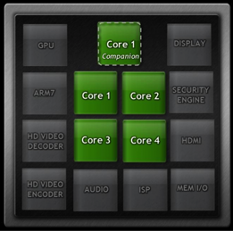
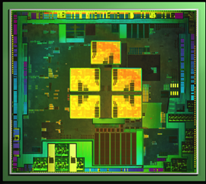
Topic Today: Heterogeneous Systems
Modern SoC devices are highly heterogeneous systems - use the best type of processing element for each job
Good for CPS – processing elements are often more predictable than GP CPU!
Challenge #1: schedule computation among all processing units.
Challenge #2: I/O & interconnects as shared resources.
NVIDIA Tegra 3 SoC

Slide 3
Processing Elements
Trade-offs of programmability vs performance/power consumption/area.
Not always in this order…
Application-Specific Instruction Processors
Graphics Processing Unit
Reconfigurable Field-Programmable Gate Array
Coarse-Grained Reconfigurable Device
I/O Processors
HW Coprocessors

Slide 4
Processing Elements
Application-Specific Instruction Processors
  The ISA and microarchitecture is tailored for a specific application.
  Ex: Digital Signal Processor.
  Sometimes “instructions” invoke HW coprocessors.
Graphics Processing Unit
  Delegate graphics computation to a separate processor
  First appear in the ’80, until the turn of the century GPUs were HW processors (fixed functions)
  Now GPUs are ASIP – execute shader programs.
  New trend: GPGPU – execute computation on GPU.

Slide 5

Ex: Real-Time Traffic Prediction Algorithms on GPU
2
Real-Time Congestion Prediction
On-line Vehicle Traffic Congestion Probing
1
3
Real-Time Route Assignment
[MAIN FOCUS]
Historic Traffic Data
Datacenter
Large Number of Vehicles

Slide 6
Processing Elements
Reconfigurable FPGA
  Logic circuits that can be programmed after production
  Static reconfiguration: configure FPGA before booting
  Dynamic reconfiguration: change logic at run-time
Coarse-Grained Devices
  Similar to FPGA, but the logic is more constrained.
  Device typically composed of word-wide reconfigurable blocks implementing ALU operations, together with registers, mux/demux and programmable interconnects.

Slide 7
Processing Elements
HW Processors
  ASIC logic block executing a specific function.
  Directly connected to the global system interconnects.
  Typically an active device (i.e., DMA capable).
  Can be more or less programmable.
  Ex#1: cellular baseband decoders – not programmable.
  Ex#2: video decoder – often highly programmable (sometimes more of an ASIP).
I/O Processor
  Same as before, but dedicated to I/O processing.
  Ex: accelerated Ethernet NICs – move some portion of the TPC/IP stack in HW.

Slide 8
GPGPU
Additional details: general purpose computing on GPU.
The elephant in the room: two competing standards…
  CUDA: Nvidia only. Exports more information on underlying architecture. Arguably better supported (started earlier, single vendor). Popular for high-performance computing.
  OpenCL: portable, supported by AMD and everybody else. Popular for embedded systems.
The GPU executes “kernels” (GPGPU equivalent of shaders).
  Subset of C/C++ with extensions to declare how variables are shared.
The CPU must prepare the kernel and data used by GPU and start the processing.
  Typically the most complex part of the process…

Slide 9
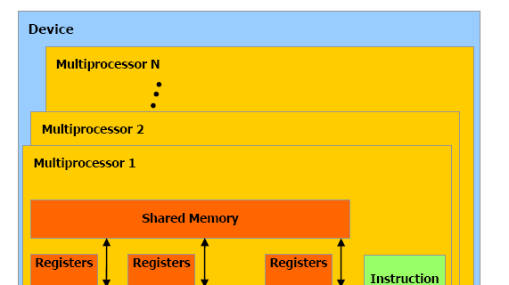
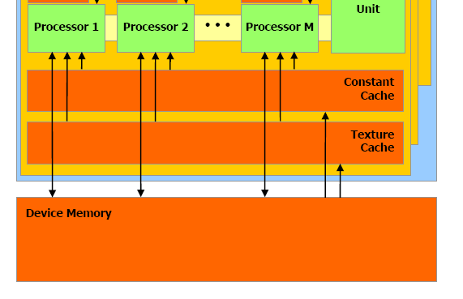
Architecture
Set of multiprocessor units
  Nvidia: SMX
  AMD: Compute Units
One instruction unit for all processors in a multiproc unit
Complex memory hierarchy
  Registers
  Multiple local memories (differs based on architecture)
  Device memory (fast DRAM) shared among all multiprocessors
Notes:
Nvidia Kepler: SMX “Streaming Multiprocessor”
AMD Graphic Core Next: Compute Unit
AMD is 16-wide, 4 cycles pipeline

Slide 10
Architecture
Each multiprocessor executes a block of threads
Threads are divided into “warps” (8-16 based on arch)
All threads in a warp execute the same instruction
4 threads at a time are pipelined through each processor
I.e., the block is 32-64 threads

Slide 11
Thread Scheduling
Multiple kernels can be issued to the GPU
Modern architectures then dynamically allocate and execute threads blocks onto multiprocessors
  Note this means that execution order tends to be non predictable
Thread divergence: what happens if threads of the same kernel follow different execution paths
  For small number of instructions, use conditional execution
  For large number of instruction, might not be able to fill the warp. Note cache misses are similarly bad
The thread scheduler will attempt to pack threads that follow the same execution path into the same warp

Slide 12
Processing Flow – Discrete GPU
Execution requires high memory bandwidth
PCI express bandwidth is not sufficient – solution: put fast main memory on GPU
This creates a lot of overhead…
Better solution: SoC
  GPU and CPU on the same chip use same main memory
  No need to copy data

Slide 13
Ex: Real-Time GPU Framework
GPUSync: A Framework for Real-Time GPU Management
Schedule of system with multiples GPU.
Tasks run on the CPU and use one or multiple GPUs as HW Coprocessors.
GPU resources (copy engines, execution engines) are treated as shared resources – real-time resource sharing algorithms are used to ensure mutual exclusion between tasks.

Slide 14
I/O and Peripherals
What about peripherals and I/O?
Standardized Off-Chip Interconnects are popular
  PCI Express
  USB
  SATA
  Etc.
Peripherals can interfere with each other on off-chip interconnects and with cores in memory!
  Dangerous if assigned different criticalities
  We can not schedule peripherals like we do for tasks

Slide 15
I/O and Peripherals
Solution 1: analysis
  Build a model of data transfers (i.e., how much data is transferred over an interval of time)
  Perform analysis to derive delay on the interconnect
  Perform analysis to derive task delay in memory
  More on this next lecture…
Solution 2: controlled DMA
  Ex: Real-Time Control of I/O COTS Peripherals for Embedded Systems
  Idea: use a controllable DMA engine
  DMA transfers are synchronized with each other and with core data transfers
  Implicit schedule of memory transfers

Slide 16
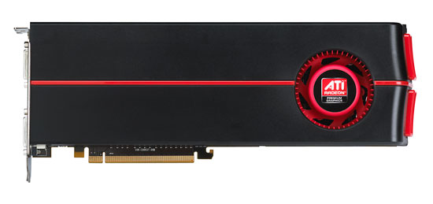
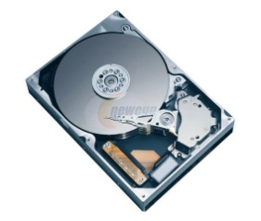
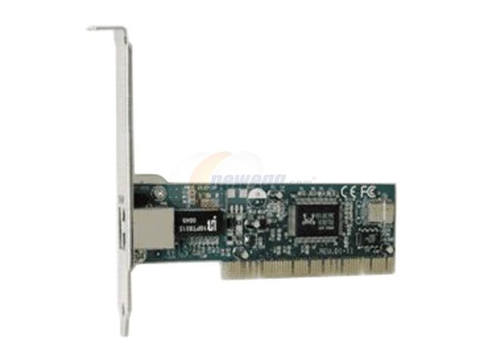
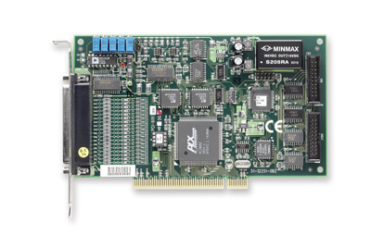
Real-Time Control of I/O COTS Peripherals for Embedded Systems
A Real-Time Bridge is interposed between each high-throughput peripheral and COTS bus.
The Real-Time Bridge buffers incoming/outgoing data and delivers it predictably.
Reservation Controller enforces global implicit schedule.
Assumption: all flows share main memory…
… only one peripheral transmit at a time.
Reservation
Controller
CPU
RAM
North
Bridge
RT
Bridge
PCIe
RT
Bridge
ATA
South
Bridge
RT
Bridge
PCI-X
RT
Bridge
6/19

Slide 17
Real-Time Bridge
FPGA System-on-Chip design with CPU, external memory, and custom DMA Engine.
Connected to main system and peripheral through available PCI/PCIe bridge modules.
Host CPU
FPGA
FPGA CPU
Interrupt
Controller
IntFPGA
Controlled
Peripheral
System + PCI
PCI Bridge
PLB
PCI Bridge
PCI
DMA Engine
Memory
Controller
Main Memory
IntMain
block
data_rdy
Local RAM
8/19

Slide 18
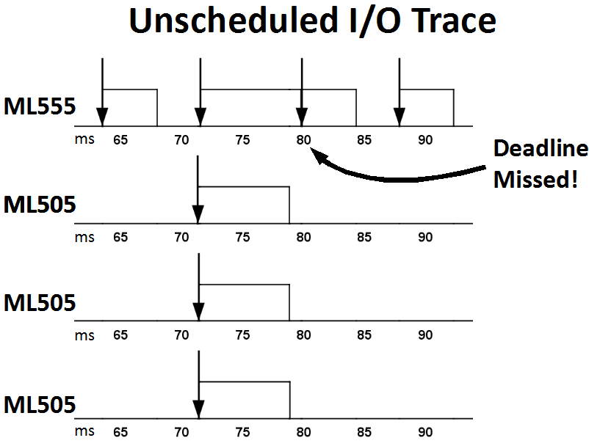
Evaluation
Experiments based on Intel 975X motherboard with 4 PCIe slots.
3 x Real-Time Bridges, 1 x Traffic Generator with synthetic traffic.
Rate Monotonic with Sporadic Servers.
Peripheral | Transfer Time | Budget | Period
RT Bridge | 7.5ms | 9ms | 72ms
Generator | 4.4ms | 5ms | 8ms
Utilization 1, harmonic periods.
Generator
RT-Bridge
Scheduling flows without reservation controller (block always low) leads to deadline misses!
RT-Bridge
RT-Bridge
17/19

Slide 19
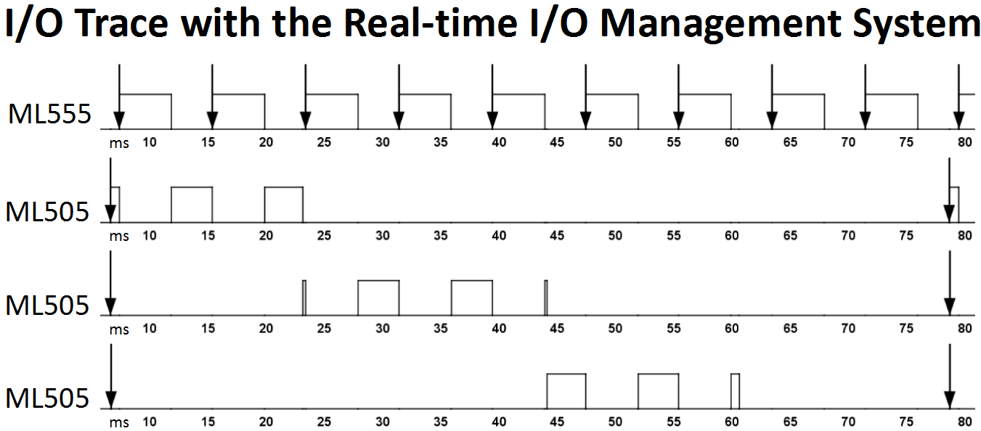
Evaluation
Experiments based on Intel 975X motherboard with 4 PCIe slots.
3 x Real-Time Bridges, 1 x Traffic Generator with synthetic traffic.
Rate Monotonic with Sporadic Servers.
Peripheral | Transfer Time | Budget | Period
RT Bridge | 7.5ms | 9ms | 72ms
Generator | 4.4ms | 5ms | 8ms
No deadline misses with reservation controller
Generator
RT-Bridge
RT-Bridge
RT-Bridge
17/19

Slide 20
Reconfigurable Devices and Real-Time
Great deal of attention on reconfigurable FPGA for embedded and real-time systems
  Pro: HW logic is (often) more predictable than SW executing on complex microarchitectures
  Pro: HW logic is more efficient (per unit of chip area/power consumption) compared to GP CPU on parallel math crunching applications – somehow negated by GPU nowadays
  Cons: Programming the HW is more complex
Huge amount of research on synthesis of FPGA logic from high-level specification (ex: SystemC).
How to use it: static design
  Implement I/O, interconnects and all other PE on ASIC
  Use some portion of the chip for a programmable FPGA processor

Slide 21
Reconfigurable FPGA
How to use it: dynamic design
  Implement I/O and interconnects as fixed logic on FPGA.
  Use the rest of the FPGA area for reconfigurable HW tasks.
HW Task
  Period, deadline, wcet as SW tasks.
  Additionally has an area requirement.
  Requirement depends on the area model.

Slide 22
Area Model
2D model
  HW Tasks with variable width and height.
1D model
  HW Tasks have variable width, fixed height.
  Easier implementation, but possibly more fragmentation.
5/ 18

Slide 23
Example: Sonic-on-a-Chip
Slotted area
  Fixed-area slots
Reconfigurable design targeted at image processing.
Dataflow application.
Some or all dataflow nodes are implemented as HW tasks.

Slide 24
Main Constraints
Interconnects constraints
  HW tasks must be interfaced to the interconnects.
  Fixed wire connections: bus macros.
  The 2D model is very hard to implement.
Reconfiguration constraints
  With dynamic reconfiguration a HW task can be reconfigured at run-time, but…
  … reconfiguration takes a long time.
  Solution: no HW task preemption.
  However, we can still activate/deactivate HW tasks based on current application mode.

Slide 25
The Management Problem
FPGA management problem
  Assume each task can be HW or SW
  Given a set of area/timing constraints, decide how to implement each task.
Additional trick: HW/SW migration
  Run-time state transfer between HW/SW implementation
0. migrateSWtoHW
CPU
1. program ICAP
2. ICAP int
3. CMD_START
4. CMD_DOWNLOAD
HW
reconfiguration
data load
HW job
SW period
HW period
t

Slide 26
The Allocation Problem
If HW tasks have different areas (width or #slots), then the allocation problem is an instance of a bin-packing problem.
  Dynamic reconfiguration: additional fragmentation issues.
  Not too dissimilar from memory/disk block management..
Wealth of results for various area/execution models…
9/9
6/9
FPGA
3/9
0/9
CPU
0
1
2
3
4
5
6
7
8
9

