Slide 1
PRET DRAM Controller: Bank Privatization for Predictability and Temporal Isolation
By Edward A. Lee, J.Reineke, I.Liu, H.D.Patel, S.Kim
Presented by: Michael Guo

Slide 2
Outline
DRAM background information
Design Requirement
DRAM controller architecture
Frontend
Backend
Design Evaluation
Experiment
Further Improvement

Slide 3
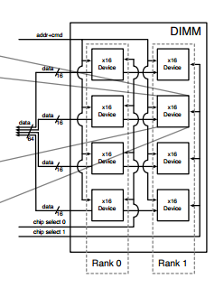
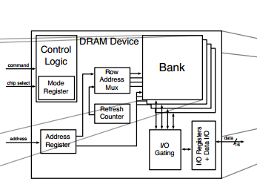
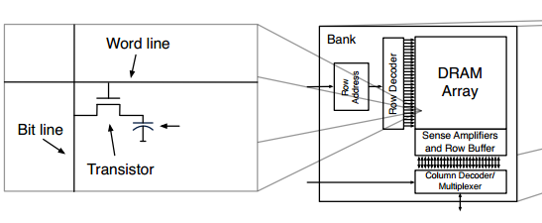
DRAM Memory Architecture

Slide 4
DRAM Memory Architecture
DRAM Cell
Consists of a capacitor and a transistor
Charge of Capacitor determines the value of the bit
Leak charge over time
DRAM Array
Phase1: Row access followed by column access
Phase2: Row access move one rows of array into row buffer

Slide 5
DRAM Memory Architecture
DRAM Device and DRAM module
Sharing of I/O gating and control logic
Sharing of data/address/command buses

Slide 6
Challenges for embedded hard-real time system
The platform should be timing predictable to make the verification of timing constraints possible.
DRAM: The DRAM cells have to be refreshed periodically
Different functions integrated on the platform should be temporally isolated.
DRAM: The latency of one task has high dependency on the previous access to the memory.

Slide 7
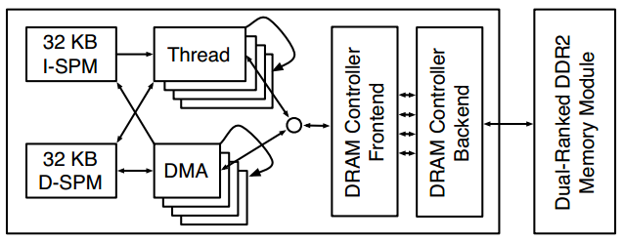
PTARM PRET architecture
Implemented the controller on the PTARM PRET architecture proposed in [4]
Figure4: Integration of PTARM core with DMA units, PRET memory controller and dual-ranked DIMM

Slide 8
PTARM PRET architecture
Thread-interleaved implementation of ARM instruction set
Four pipeline stages and four hardware thread
Each thread has access to an shared instruction scratchpad and data scratchpad
Thread can interact with DRAM directly or transferring data to and from the scratchpad
Summary: no dependencies between pipeline stages, and the execution time of each thread is independent from each other

Slide 9
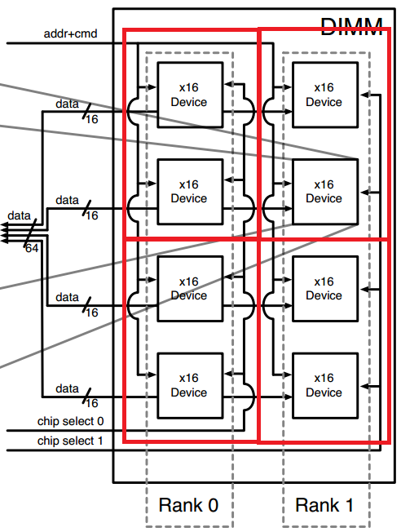
DRAM Module
General structure
One resource
Proposed structure
Independent resources

Slide 10
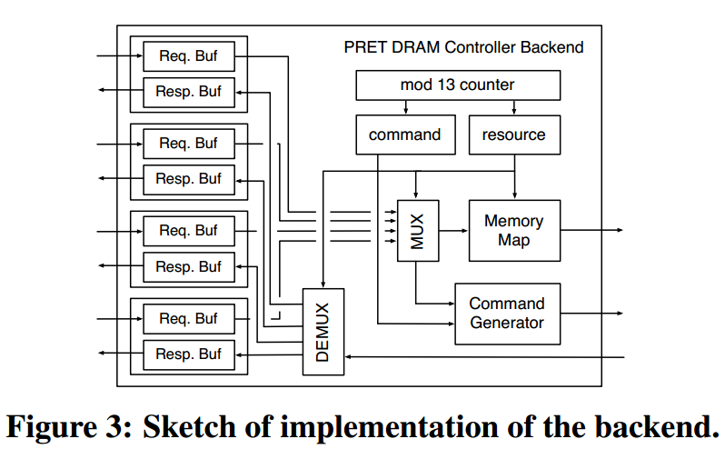
DRAM Controller Backend
Issues commands
Implementation

Slide 11
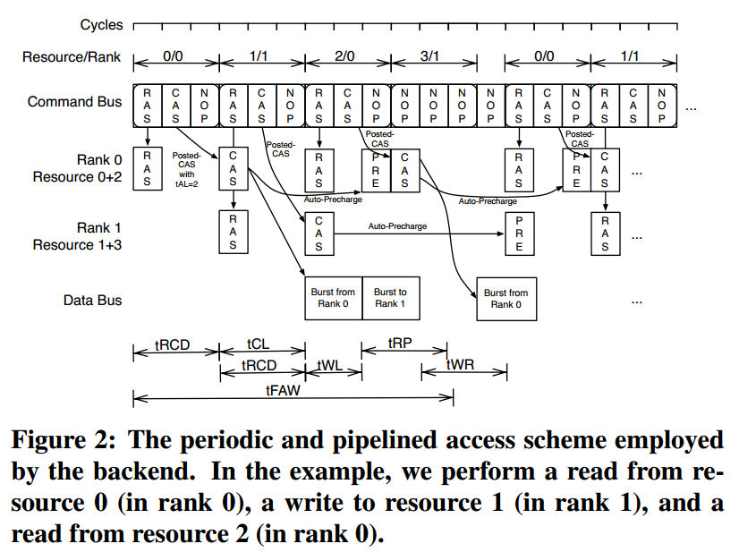
Access Scheme

Slide 12
DRAM Controller Frontend
Connects to the Processor
PURPOSE: route requests to the right request buffer in the backend and to insert a sufficient amount of refresh commands

Slide 13
Scheduling of Refreshes
64ms timing constrain for the DRAM to refresh all the cells to restore the value
Issue a hardware refresh command
refresh several rows of a device at once
ISSUE: increasing refresh latency
Individual row accesses
Each refresh accesses one row
Advantage: single row access takes less time than the execution of a hardware refresh command
Disadvantage: more manual row accesses have to be performed, lead a hit in bandwidth

Slide 14
Store Buffer
Does not have to wait until the store has been performed in the memory
Hide the store latency from the pipeline
Single thread cycle if no preceded store
Bigger store buffer could hid latencies of successive stores at the expense of increased complexity in timing analysis.

Slide 15
Latency of Load Instruction
Backend latency: BEL
Time a command spends in the command buffer before the RAS command has been sent out
DRAM Read latency: DRL
After RAS sent to the DRAM module, it takes time until the request data is on the data bus
Constant, 10+BL/2 cycles (to isolate from other effect)
Thread Alignment Latency: TAL
Time that the data is buffered in the memory controller
Requesting thread can only receive the data in its write-back stage
Read latency: RL
RL = BEL + DRL + TAL

Slide 16
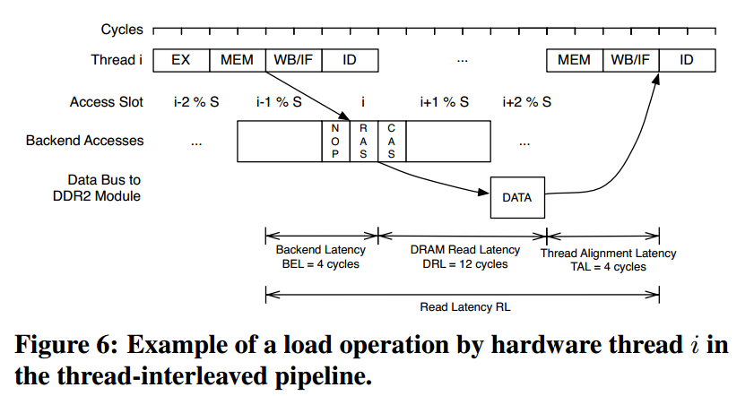
Latency of Load Instruction
By delaying refreshes until a load has been performed, they do not have an impact on the load latency.

Slide 17
Compare with Predator
DRAM as one resource
Use standard refresh mechanism
Pre-computed sequences of SDRAM commands

Slide 18
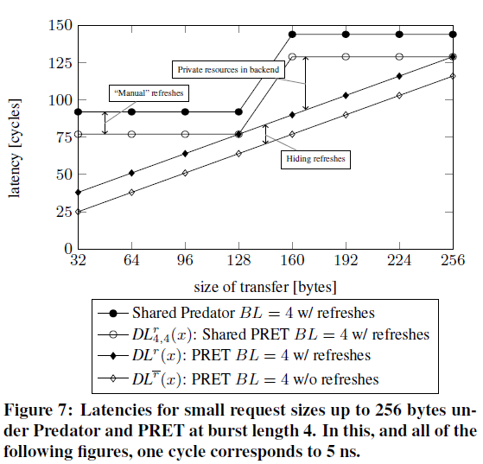
Latency of DMA Transfer (Small size)

Slide 19
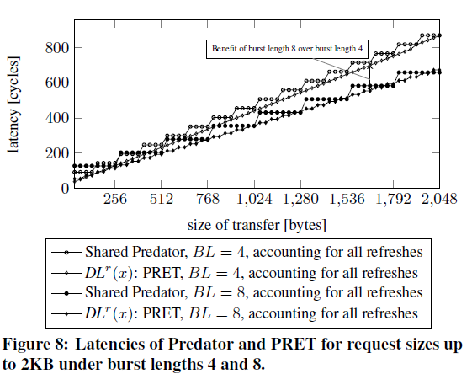
Latency of DMA Transfer (Large size)

Slide 20
EXPERIMENTAL EVALUATION
PTARM simulator to interface with both controller to run synthetic benchmark to compare memory access latency
Show the effects of interference on memory access latency with a combination of two programs on the other hardware threads.

Slide 21
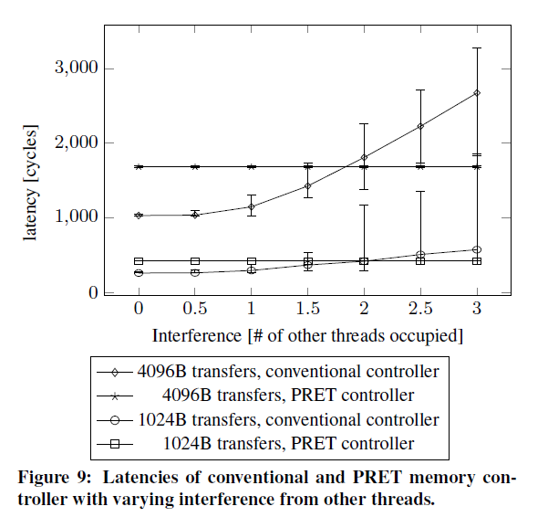
Demonstrate the temporal isolation achieved by the PRET DRAM controller

Slide 22
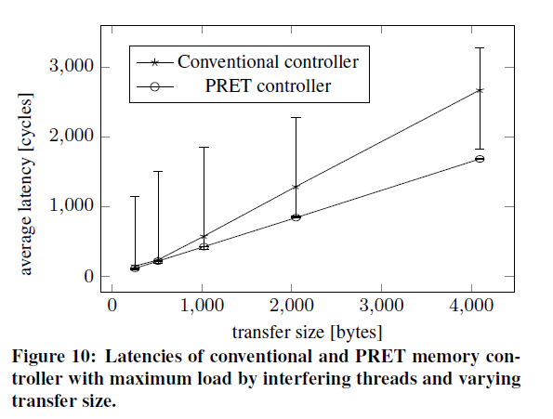
Full load

Slide 23
Conclusion and Limitation
The controller reduced the worst-case latency at a slight loss of bandwidth
Proposed solution has the same amount of hardware thread as the pipeline stages. If there is many thread, there has to many memory partitions
The consumption of bandwidth is not well analyzed

Slide 24
Integration with other multiprocessor
Challenge
Most multi-core processors use DRAM to share data, while local scratchpad are private
Approach
Consider the four separate resource as one. An access to the single resource would result in four smaller accesses to the resources

Slide 25
QUESTION

