Slide 1
Interrupt Management
In Real-time Systems
This presentation is based on J. Regehr's work titled
“Preventing Interrupt Overload”.
Saud Wasly

Slide 2
Lecture Agenda
Introduction
What is Interrupt Overload
Why it is a problem
How to avoid it
Introduce some solutions and their results
Discussion
Extra topic

Slide 3
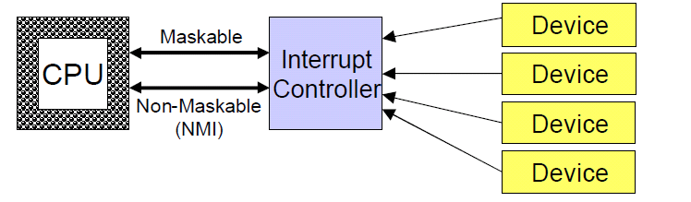
Introduction
Interrupt driven systems are much more power efficient than polling based systems.
In normal cases Interrupts save CPU time, allowing it to do more works while waiting for interrupt signals. Better Utilization
Interrupts preempt the current execution flow, disrupting CPU scheduling.
Interrupts introduce some overhead

Slide 4
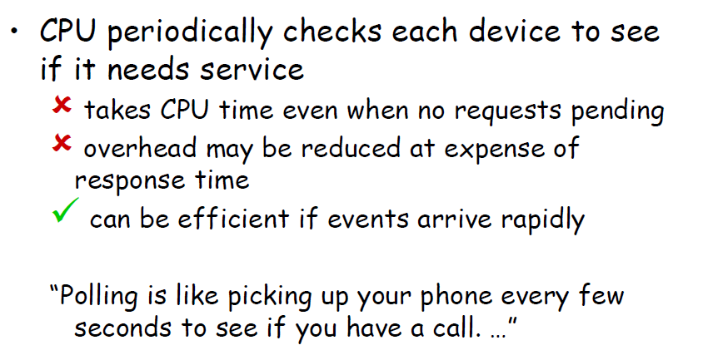
Polling
Consume much more power
Polling is 100% under control of CPU scheduler

Slide 5
Interrupts VS Polling
“Polling is like picking up your phone every few
seconds to see if you have a call. Interrupts are like waiting for the phone to ring.”
Interrupts win if processor has other work
to do and event response time is not critical
Polling can be better if processor has to
respond to an event as soon as possible

Slide 6
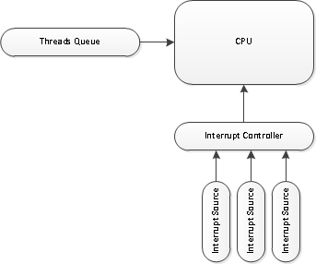
What is Interrupt Overload?
Excessive arrival of interrupts can delay the execution of the current running task.
When Interrupts arrival rate it to high livelock can happen
Livelock:
A situation in which some critical stage of a task is unable to finish because its clients perpetually create more work for it to do after they have been serviced but before it can clear its queue.
Differs from deadlock in that the process is not blocked or waiting for anything, but has a virtually infinite amount of work to do and can never catch up.

Slide 7
Interrupt Overload
High Interrupt load may not cause an overload. Why ?
Unexpected high interrupt load can cause the overload
Example: loose wire, broken equipment, blabbing idiot, etc..

Slide 8
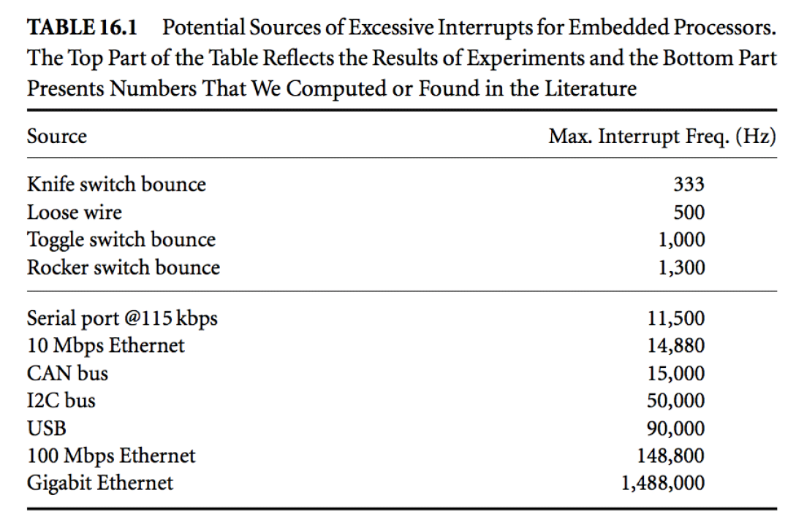
Interrupt Overload

Slide 9
Why is it a problem?
Interrupts are implicitly given higher priority than processing done in other contexts such as threads.
In real-time systems tasks have to run in predicted schedule to meet their deadlines
Unexpected events can shift the schedule of the tasks to end up with unpredictable system

Slide 10
How to avoid it?
First of all, at design time, every interrupt source (e.g. IO devices) has to respect the system limits (capacity of handling interrupts). Application Dependant
The system suppose to be able to handle all interrupts in predictable manner according to design rules, since no interrupt source violates the rules.
However, Interrupt sources may violate the rules !!!

Slide 11
How to avoid it?
Is to prevent the CPU from handling interrupt when developer-specified conditions are met.

Slide 12
Motivations
Embedded systems are often highly resource-limited.
Embedded systems tend to have strict timing (e.g. sensor/actuator feedback loops).
Embedded systems are extremely cost sensitive. (use cheap peripherals )

Slide 13
The Proposed Interrupt Scheduler
Average processor load must be proportional to the interrupt arrival rate during under-load.
Average processor load must be bounded by a constant during overload.
It must be possible to quantify the worst-case delays incurred by low-priority interrupts and non-interrupt work to give them performance guarantees.
The schedulers should be dynamically parameterizable in order to permit systems to flexibly choose appropriate levels of protection from interrupt overload.
Overhead must be reasonable.

Slide 14
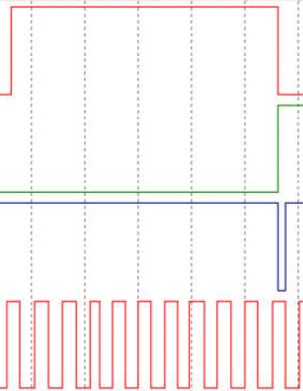
Solution #1 – Strict Software Scheduler
It enforces a minimum interarrival time between interrupts.
The algorithm is simple: Disable the interrupt, set a timer, upon expiry enable the interrupt.
The overhead: doubling the number of interrupts handled.

Slide 15
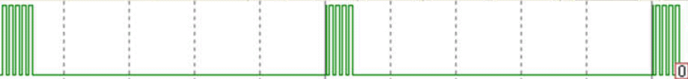
Solution #1 – Bursty Software Scheduler
It enforces a minimum inter-arrival time between bursts.
The algorithm: needs maximum burst size, maximum arrival rate; use a counter to count interrupts and, after a burst completed, force the delay with the timer.
What if the burst size if variable ?
The overhead: Less than Strict Scheduler
Burst Size and burst arrival rate trade of

Slide 16
Solution #3 – Hardware Scheduler
A hardware-based implementation can simply filter undesirable signals out of the wire.
The overhead: No CPU overhead
The algorithm: Fixed-rate decrementing Counter, pass interrupt signal to CPU when counter is zero, reset the counter.
Only one signal get propagated in one counting period.

Slide 17
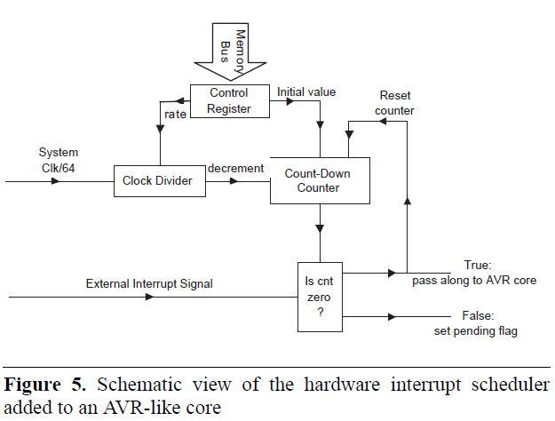
Solution #3 – Hardware Scheduler

Slide 18
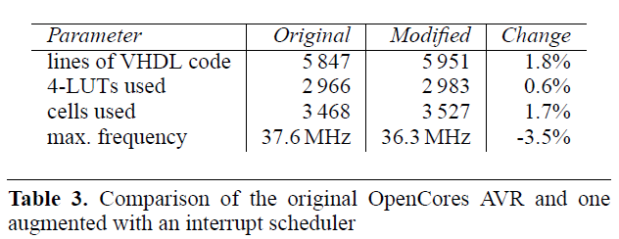
Solution #3 – Hardware Scheduler
VHDL Implementation saves more space than external microcontroller

Slide 19
Scheduling multiple interrupt sources
Strict scheduler: replicate the hardware or software for each interrupt source
The Bursty scheduler, on the other hand, presents interesting opportunities for optimization by using a single periodic timer to clear the counters for multiple interrupt sources. Timer rate can be set to LCM of burst arrival rate with some rounding up.
More optimization: We can round up the maximum allowed rates to some multiples of a large number, allowing a single slow timer to service them all and still maintain reasonable protection.

Slide 20
Some Issues
What will happen when programmers need to disable one of the interrupt sources?
There must be two enable bits for a source.
one for scheduler and the other for programmer
What are the Implications of dropping interrupts

Slide 21
The Experiment Setup
The experiment has conducted with Mica motes based on ATmega103L, 4MHz, 4KB of SRAM
Interrupt frequencies from 0.26kHZ to 16kHZ
Interrupt schedulers enforce a maximum arrival rate of 4kHz
Chosen measure is the processor load.

Slide 22
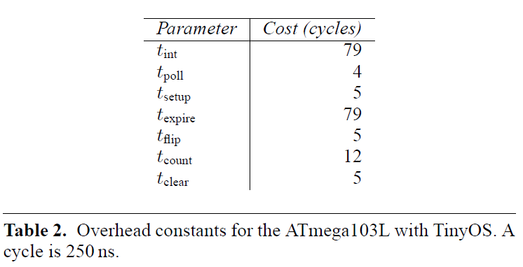
The Platform Constants

Slide 23
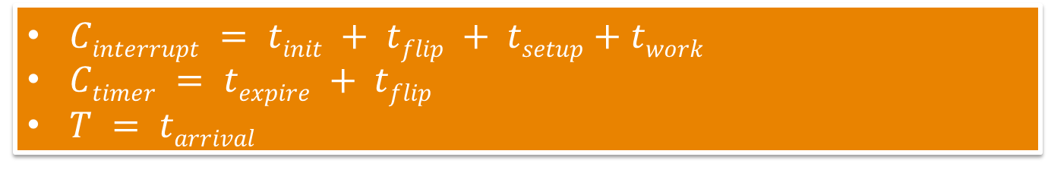
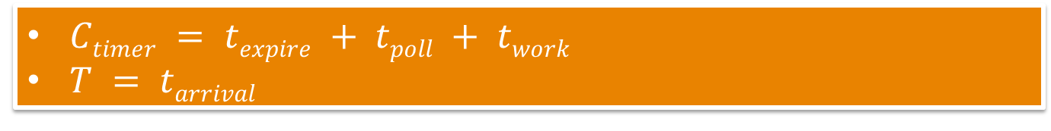

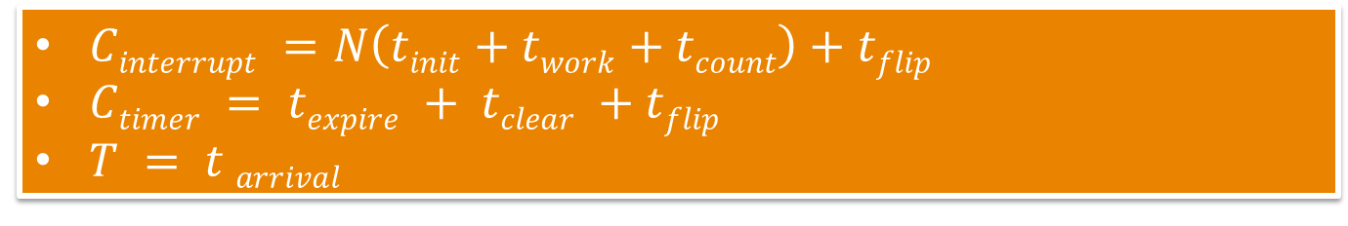
Calculating WCET
$Ctimer = texpire + tpoll + twork$
$T = tarrival$
Polling
$Cinterrupt = tinit + tflip + tsetup+twork$
$Ctimer = texpire + tflip$
$T = tarrival$
Strict
$Cinterrupt =N\left(tinit+twork+tcount\right)+tflip$
$Ctimer = texpire + tclear +tflip$
$T = t arrival$
Bursty
$Cinterrupt = tinit+ twork$
$T = t arrival$
Hardware

Slide 24
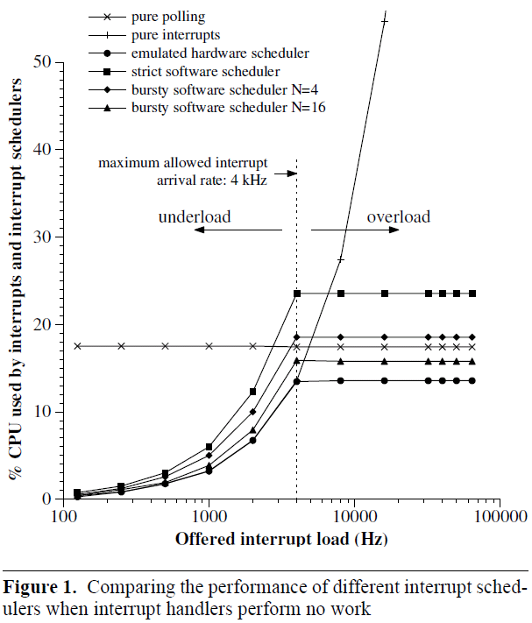
Experiment-1 an empty ISR

Slide 25
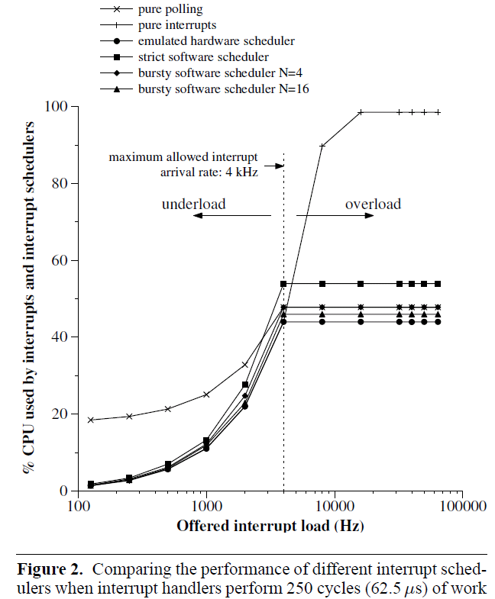
Experiment-2 a 250 computation cycle ISR

Slide 26
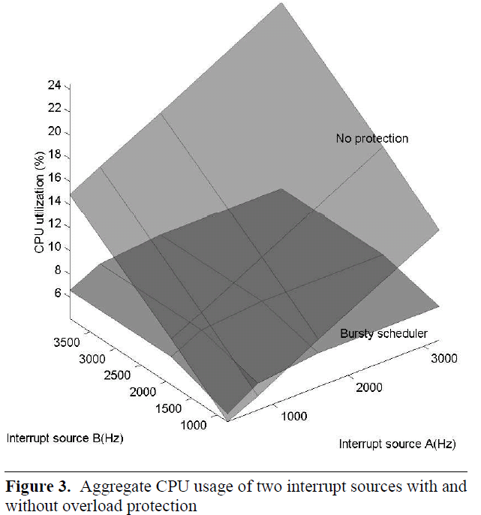
Experiment-3 two interrupt sources

Slide 27
Case Study
The Ethernut board version 1.3f
10 Mbps Ethernet interface and an AVR ATmega128 processor running at 16 MHz
The Nut/OS with TCP/IP Stack to build a Web Server.
Start with few hundreds PPS
Generate Sound at 250 Hz at thread level with maximum priority.
increasing packet loads up to 1500, 1600 PPS, Sound stopped.
Appling bursty scheduler at T_{arrival} = 25 ms and Burst size = 15 (typical small web transaction generates 14 interrupts)
Sound continue to play even with 10,000 PPS

Slide 28
Small Addition
In case of a system with multi-interrupt sources.
For debugging even in production Environment, it will be helpful to tag any faulty source of interrupt
At ISR, if the source exceeds the limit (e.g. burst size) tag it as faulty.
Then make use of this information, such as repair the wire

Slide 29
Demand-Based Schedulability Analysis
Demand-based schedulability analysis views the schedulability analysis problem in terms of supply and demand.
If demand in any time interval cannot exceed the computational capacity then the system is schedulable
Aperiodic device-driver tasks present a special challenge for demand-based schedulability
??

Slide 30
Demand-Based Schedulability Analysis
Device Drivers generate variable workload for the system
Usually, they run on higher priority than the other working threads
How to bound their workload to the benefit of the other task without compromising the quality of I/O service

Slide 31
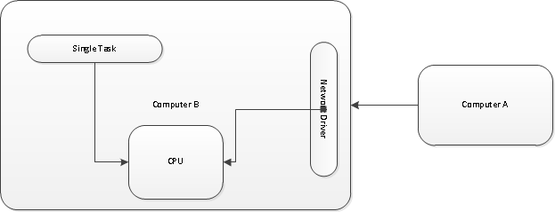
Demand-Based Schedulability Analysis
Can we know the maximum interference of a device driver to the running task?
The Task knows how long it has been preempted

Slide 32
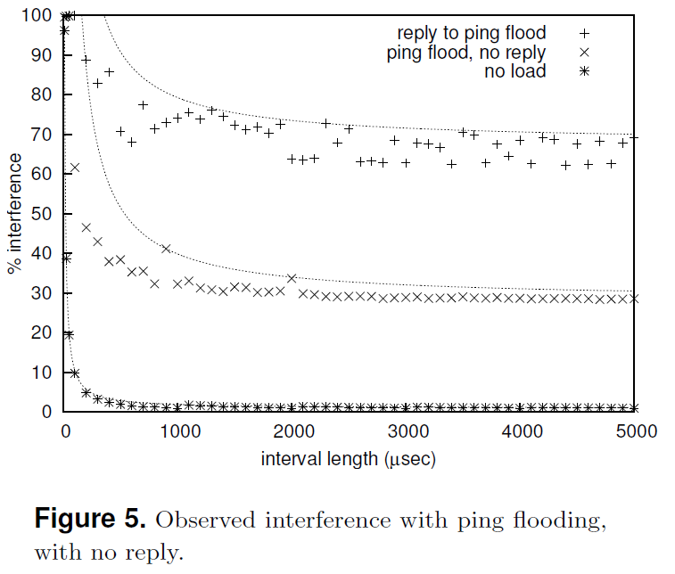
Model WC Interference by Hyperbolic Load-Bound Function
Empirical Performance data
Use the Load-Bound function in
demand-based schedulability analysis.

Slide 33
Thank you
Questions Are Welcomed

Slide 34
References
In proceedings(regehr2005preventing) Regehr, J. & Duongsaa, U. Preventing interrupt overload ACM SIGPLAN Notices 2005, Vol. 40(7), pp. 50-58
http://www.cs.toronto.edu/~demke/469F.06/Lectures/Lecture6.pdf
In proceedings(lewandowski2007modeling) Lewandowski, M., Stanovich, M., Baker, T., Gopalan, K. & Wang, A. Modeling device driver effects in real-time schedulability analysis: Study of a network driver Real Time and Embedded Technology and Applications Symposium, 2007. RTAS'07. 13th IEEE 2007, pp. 57-68

