Slide 1
Real-Time Communication Analysis for NoCs with Wormhole Switching
09/11/2011
Presented by Sina Gholamian, sgholamian@uwaterloo.ca

Slide 2
Paper Overview
Zheng Shi and Alan Burns. 2008. Real-Time Communication Analysis for On-Chip Networks with Wormhole Switching. In Proceedings of the Second ACM/IEEE International Symposium on Networks-on-Chip (NOCS '08). IEEE Computer Society, Washington, DC, USA, 161-170
Zheng Shi and Alan Burns. 2010. Schedulability analysis and task mapping for real-time on-chip communication. Real-Time Syst. 46, 3 (December 2010), 360-385. DOI=10.1007/s11241-010-9108-3 http://dx.doi.org/10.1007/s11241-010-9108-3
Real-Time Research Group, University of York, UK

Slide 3
Outline
Introduction and Motivation
QoS in NoC
Priority based wormhole switching
Worst case network latency analysis
Mapping Algorithm
Conclusions

Slide 4
Motivation
Networks on Chip(NoC) is an emerging architecture
Solving the issue of communication in SoCs
Scalability
Traditional bus system is not good at scalability
High level of parallelism could be achieved
All links could operate simultaneously on different data packets

Slide 5
Why RT-NoC ?
Today trend for designing multiprocessor system is NoC-based
NoC is a promising solution to design multi-core system
Real-time applications have a great share in today computer systems
So, We need a real-time NoC architecture to support the real-time application requirements for multi-core systems

Slide 6
Networks on Chip (NoC)
On-chip Communication:
Point-to-Point
Bus
NoC: packet-switched, shared, optimized for communications
Resource efficiency
High scalability
IP reusability
High performance

Slide 7
NoC needs QoS
Differentiated Service Requirement
Best Effort
Guaranteed Service
Performance parameters:
latency, bandwidth, bounded jitter and loss probability, in-order data, etc.
Real-Time Service:
The correctness relies on not only the communication result but also the completion time bound (deadline).
For hard real-time service, it is necessary that all the packets must be delivered before their deadlines even under worst case scenario.

Slide 8
Several Solutions
Contradiction: The network gives more efficiency and flexibility
However, introduces the unpredictable delay due to the contention
Real-time service, requires the timing to be predictable even under the worst case situation
Contention avoidable
Circuit Switching : aSoC
TDM : AEtheral, Nostrum
Inefficient use of network resources
Higher worst-case communication time
Contention acceptable
Priority based Wormhole Switching

Slide 9
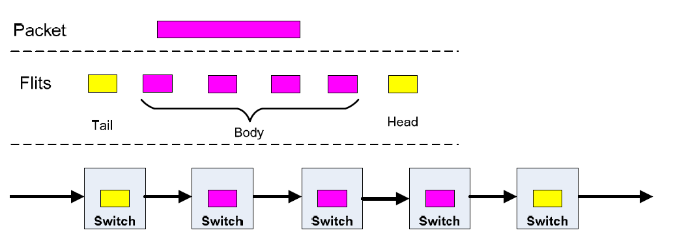
Wormhole Switching
Advantages (with Virtual Channels)
Small Buffer Size
High Throughput
Low Average Latency

Slide 10
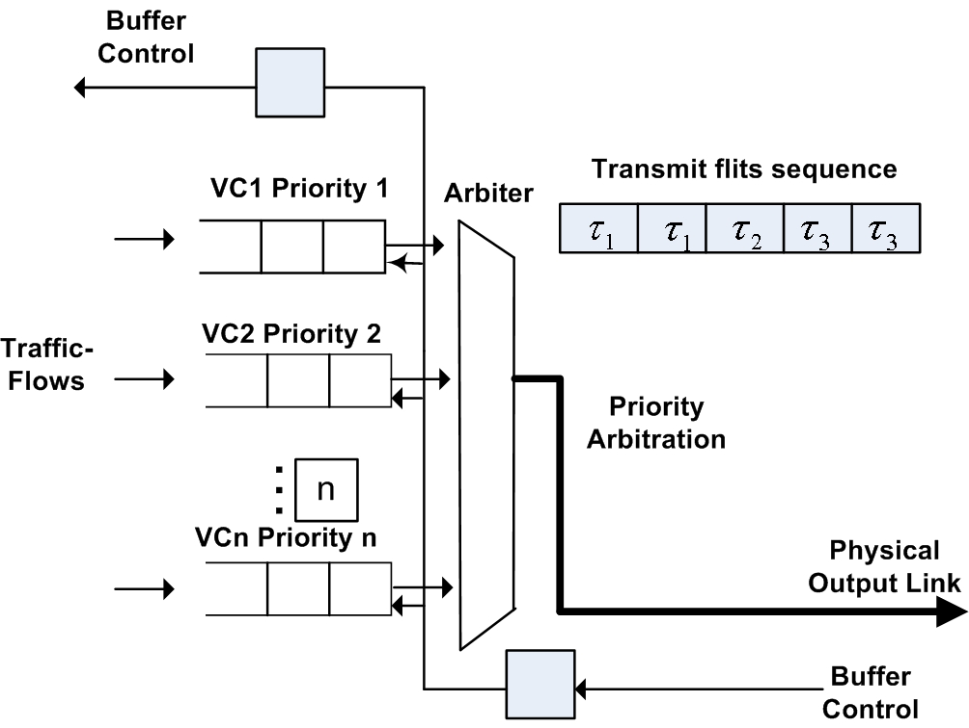
Priority Router Structure
There are sufficient VCs at each router
Each VC is assigned distinct global priority
Each flow also has a distinct priority
Flow only requests the VC with the same priority
At any time, only the flit with highest priority can access the output link
Flit-level priority preemption between different VCs

Slide 11
System Model
Characterize traffic-flow
A traffic-flow is packet stream which traverses the same route from source to destination and requires the same grade of service.
Attribute
P : Priority
C : Basic network latency
T : Period for periodic flow or minimal interval for sporadic flow
D : Deadline
J^{R}: Release Jitter

Slide 12
Interrelationship
Direct competing:
direct interference set:
Indirect competing:
indirect interference

Slide 13
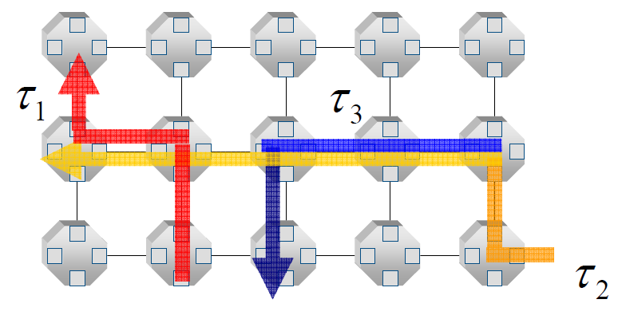
Wormhole Switching- A Case
Priority ordering:

Slide 14
Characterize Network Latency
Worst case network latency R:
The maximum length of time the packet could take to travel from source to destination
The flow is schedulable if R<=D
Basic network latency C:
the network latency happens when there is no traffic-flow contention.

Slide 15
Model and Assumption
The physical communication links are treated as shared competition resource
At any time, only one traffic-flow is permitted to access the shared path
The packet moves ahead when gets highest priority along the path
The arrivals of higher priority flows are considered as preemption interference
The allowable service time for a flow is all the time interval at which no higher priority flow competes for the same physical link

Slide 16
Network Latency Evaluation(1)
Worst Case Network Latency:
R_{i} = C_{i} + I_{i}
R_{i}: worst case latency:
I_{i:} maximum interference the packets is supposed with maximum length and released at maximum rate

Slide 17
Network Latency Evaluation(2)
Worst case network latency equation
The equation is solved using iterative technique
Iterative starts with
and terminates when
Or which denotes the deadline miss for this flow

Slide 18
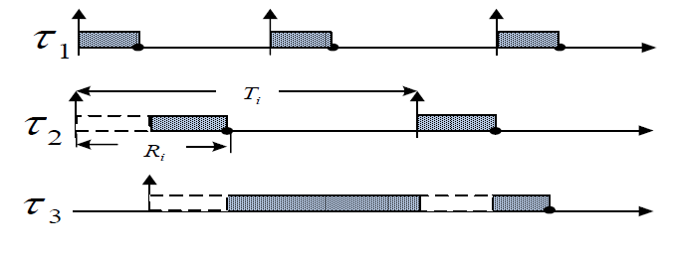
Consider Indirect Interference (1)
Minimal interval between subsequent preemption is less than period
This could happen only when indirect interference is considered.

Slide 19
Consider Indirect Interference (2)
Preemption interference upper bound
Worst case latency:

Slide 20
Case Example (1)
Flow | C | P | T | D
 | 2 | 1 | 6 | 6
 | 3 | 2 | 7 | 7
 | 3 | 3 | 13 | 13
For : there is no higher priority than , so
For : shares the physical link with higher priority flow
and

Slide 21
Case Example (2)
suffers both direct and indirect interference with
The interference jitter of referred to equals
so
Which stops at
Just analysis, no experimentation

Slide 22
Pessimistic Analysis
Considers the flow level interference
The higher level priority flow:
blocks the lower level time for whole communication time
No routing scheme has been provided
By help of communication upper bounds:
Routing paths should be chosen to meet all the dead lines

Slide 23
Tighter Analysis
Link level analysis
Instead of blocking the low level priority flow
Block it if the exact routing link is common
Result:

Slide 24
NoC Design
Generally, NoC design starts with an application specification which can be expressed as a set of communicating tasks
The second step is to partition and map these tasks onto the IPs of a NoC
With a mapping, the communications between the applications are done through the on-chip network

Slide 25
Mapping
For a given network topology and traffic pattern:
find a solution which maps a set of tasks onto an on-chip network, and assigns priority to each traffic-flow,
The timing bounds can be met with the minimal resource cost
The mapping/assignment problem is a kind of constraint based global optimization problem which is NP-hard

Slide 26
Mapping Algorithm
The cost function is:
w₁ and w₂ weights for f₁ and f₂
f₁: schedulability, f₂: priority and virtual channel overhead

Slide 27
Schedulability
if all flows meet the deadline, f₁ = 0

Slide 28
Algorithm(1)
The algorithm begins with an initial solution of a set of task mappings and traffic flow priority assignments
Randomly selects a single task or a traffic-flow
Reduce the cost by changing the location of the task or the priority of the traffic-flow
Repeat this process for all the tasks and flows

Slide 29
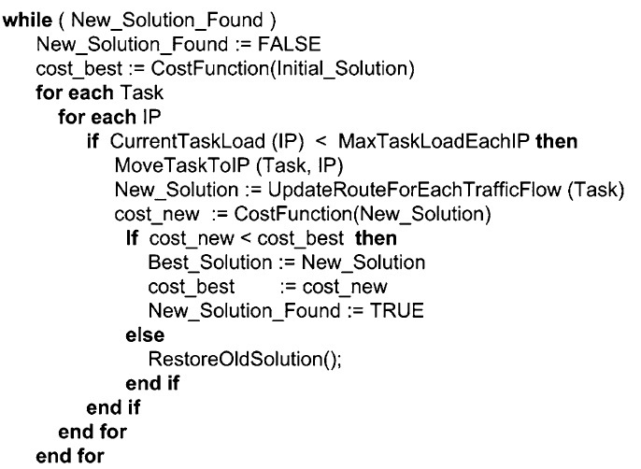
Algorithm(2)

Slide 30
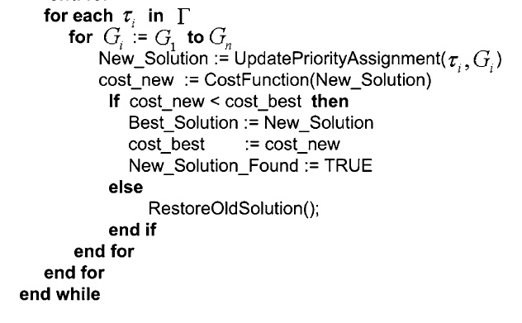
Algorithm(3)

Slide 31
Algorithm(4)
The algorithm stops when no single change (either tasks mapping or flow priority) can reduce the cost further.
The solution obtained is not guaranteed to be optimal because
it is possible that a better solution may be obtained by simultaneously changing a task mapping and a flow priority
The algorithm does not consider the computation at source and destination

Slide 32
Conclusions
Real time communication service can be supported by priority based wormhole switching technique
The schedulable test is derived by worst case network latency analysis
Both direct and indirect interferences are taken into account
Mapping algorithm finds a mapping to make the flow set schedulable

Slide 33
References
Zheng Shi and Alan Burns. 2008. Real-Time Communication Analysis for On-Chip Networks with Wormhole Switching. In Proceedings of the Second ACM/IEEE International Symposium on Networks-on-Chip (NOCS '08). IEEE Computer Society, Washington, DC, USA, 161-170
Zheng Shi and Alan Burns. 2010. Schedulability analysis and task mapping for real-time on-chip communication. Real-Time Syst. 46, 3 (December 2010), 360-385. DOI=10.1007/s11241-010-9108-3 http://dx.doi.org/10.1007/s11241-010-9108-3

Slide 34
Questions?

