Slide 1
Timing Analysis of Concurrent Programs Running on Shared Cache Multi-Cores
Zheng Wu

Slide 2
Outline
Background
Motivation
Analysis Framework
Intra-Core Cache Analysis
Cache Conflict Analysis
Optimization Techniques
WCRT Analysis
Experiment Setup
Experiment Results
Contribution
Conclusion

Slide 3
Background
Hard Real-time Systems
Worst case execution time: essential input for schedulability analysis
Static Program Analysis
Program path modeling: infeasible path/ loop bound detection
Micro-architecture modeling: instruction/data cache, branch prediction, out-of-order pipeline.
Actual WCET
Distribution
Observed WCET
Actual
Observed
Execution Time

Slide 4
Background
Concurrent Programs
Task interaction: control/data dependency, preemption.
Resource contention: Shared cache multi-core architectures
Problem: shared L2 instruction cache contention.
Core 1
Core n
CPU
……
CPU
L1 Cache
L1 Cache
L2 Cache

Slide 5
System Model
Message Sequence Chart (MSC)
Process 1
Process 2
Process 3
fm₁
task
Message communication
fm₂
fr₀
time
fs₀
fr₁
fm₄
Core 1
Core 2

Slide 6
Problem: Shared L2 cache conflicts
Different cores conflict in L2 Shared cache.
Core 1
Core 2
Set 0
Process 1
Process 2
Process 3
fm₁
concurrent
Set 1
fr₀
fm₂
m
m’
Set 2
fs₀
fr₁
Set 3
fm₄
L2 Cache

Slide 7
Related Work
J. Yan and W. Zhang RTAS 2008
T, T’ are from different cores and they conflict for cache set C.
All the accesses from T and T’ to C are cache misses in the worst case.
Core 1
Core 2
Process 1
Process2
Process3
Set C - 1
fm₁
fr₀
fm₂
m₁, …, m_{k}
m’₁, …, m’_{k}
Set C
fs₀
fr₁
Set C + 1
misses
misses
fm₄
L2 Cache

Slide 8
Motivation
Task Execution Lifetime
Scenario 1: overlap lifetime
Scenario 2: disjoint lifetime
Core 1
Core 2
Core 1
Core 2
Task 1
Task 2
Task 1
Task 2
Start time
Start time
End time
End time
conflicts
No conflicts

Slide 9
Analysis Framework
Core 1
Intra Core Cache Analysis
Core n
Intra Core Cache Analysis
……
Initial task interference
L2 cache conflict analysis
Estimated WCRT
WCRT Analysis
yes
no
Task Interference changes ?

Slide 10
Analysis Framework
Core 1
Intra Core Cache Analysis
Core n
Intra Core Cache Analysis
……
Initial task interference
L2 cache conflict analysis
Estimated WCRT
WCRT Analysis
yes
no
Interference changes ?
Modified task
interference

Slide 11
Intra-core Cache Analysis
H. Theiling, C. Ferdinand. and R. Wilheml. Fast and precise WCET prediction by separated cache and path analyses. RTS 2000.
Must Analysis: Always Hit (AH)
Memory blocks guaranteed to be present in the cache
May Analysis: Always Miss (AM)
Memory blocks may be present in the cache.
Persistence Analysis
Never evicted from cache after first iteration.
Others: Non Classified (NC)

Slide 12
Intra-core Cache Analysis
L1 Intra-core Cache Analysis.
Always Hit (AH), Always Miss (AM), Non Classified (NC)
L2 Intra-core Cache Analysis
L1 cache
analysis
AH
AM
NC
access
not access
L2 cache
analysis
AH
AM
NC

Slide 13
Analysis Framework
Core 1
Intra Core Cache Analysis
Core 2
Intra Core Cache Analysis
Initial task interference
L2 cache conflict analysis
Estimated WCRT
Modified task
interference
WCRT Analysis
yes
no
Interference changes ?

Slide 14
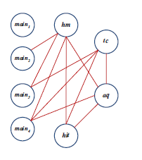
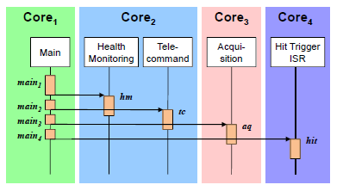
L2 Cache Conflict Analysis
Initial Task interference graph

Slide 15
L2 Cache Conflict Analysis
Analyze each cache set individually
Intra core L2 analysis
Always miss
Non classified
Always hit
Task T
conflicting tasks
Set i
m₀, m₁
Non classified
m’₀, m’₁
Set j
m₂, m₃
Always hit
L2 cache

Slide 16
Optimization for Set Associativity
Consider memory block age: LRU replacement
age(m): maximal/upper bound of age of m.
Task T
Conflicting tasks
Age: 1
m₀
Always hit
2
m₁
Always hit
m’₀, m’₁
2 memory blocks
3
m₂
Always hit
4
w/o optimization
with optimization
Age: 1
m₀
Non classified
Age: 1
m₀
Always hit
2
m₁
Non classified
2
m₁
Always hit
3
m₂
Non classified
3
m₂
Non classified
4
4

Slide 17
Analysis Framework
Core 1
Intra Core Cache Analysis
Core 2
Intra Core Cache Analysis
Initial task interference
L2 cache conflict analysis
Estimated WCRT
Modified task
interference
WCRT Analysis
yes
no
Interference changes ?

Slide 18
BCET and WCET Analysis
BCET and WCET
Access Latency for best case and worst case.
Assumption: no timing anomalies with other architecture features
Shortest (longest) path
L1 cache | L2 cache | Best-Case | Worst-Case
AH | --- | L1 hit | L1 hit
AM | AH | L2 hit | L2 hit
AM | AM | L2 miss | L2 miss
AM | NC | L2 hit | L2 miss
NC | AH | L1 hit | L2 hit
NC | AM | L1 hit | L2 miss
NC | NC | L1 hit | L2 miss

Slide 19
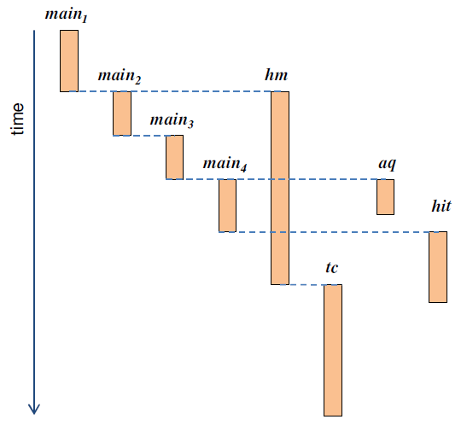
WCRT Analysis
Compute earliest, latest ready and finish time

Slide 20
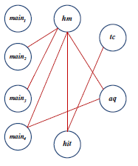
Putting Together
L2 cache conflict analysis and WCRT analysis
Interference graph
Initial task interference
Yes
Change ?
No
Estimated
WCRT

Slide 21
Experiments Parameters
Cache access latency
L1 hit: 1 cycle, L2 hit: 10 cycle, Memory access: 100 cycle
Various core numbers
1 core, 2 cores and 4 cores
Various cache configurations
cache size, block size, associativity
Real-World Benchmarks: DEBIE.

Slide 22
Experiments Parameters
Real-World Benchmarks: DEBIE.
Space Debris Monitoring Software
8 MSC, 35 tasks.

Slide 23
Experimental Results
Comparison with Yan-Zhang RTAS 2008.
Direct mapped cache only.
(a) WCRT Comparison
(b) Inter-core Eviction Comparison
Notes:
Yan-Zhang is restricted to direct mapped cache, so their method is also for direct mapped cache
L1 is 2KB with 16 byte block size; L2 is 32 byte block size, L2 size is doubled with the doubling of # of cores
L1 hit: 1 cycle, L2 hit: 10 cycle, Memory access: 100 cycle
-With only one core, the task is executed non-preemptively without any interference, therefore there is no difference
-with more cores, their method achieve up to 15% more accuracy over yan-zhang method

Slide 24
Experimental Results
Vary L1 and L2 Size.
(a) Varying L1 Size
(b) Varying L2 Size
(b) Varying L2 Size
Notes:
L1 & L2 as direct mapped because of yan-zhang
Able to achieve up to 20% more accuraccy with yan-zhang’s method

Slide 25
Experimental Results
Set associative cache optimizations
w/o optimization
w/o optimization
Age:
Non classified
Always hit
1
m₀
m₀
2
m₁
Non classified
m₁
Always hit
3
m₂
Non classified
m₂
Non classified
4
Notes:
L1 is configured as direct-mapped cache; L2 is 32KB set associative
With 1 way, which is direct mapped, there is no advantage

Slide 26
Experimental Results
Runtime of our iterative analysis

Slide 27
Conclusion
WCRT analysis of concurrent programs running on Shared cache multi-cores.
Use task lifetime to indentify real conflicts.
Optimizations for set associative cache.
Experiments: tighter WCET than state of the art.
Future work: data cache, other replacement policy

Slide 28
Thank You!

