Slide 1
ECE 720T5 Fall 2011 Cyber-Physical Systems
Rodolfo Pellizzoni

Slide 2
Topic Today: Verification and Monitoring
Remember verification: ensuring that a subsystem (or step in the design) meets the objectives for that subsystem, i.e. it does what we want it to do.
How do verify a system/subsystem?
  (Exhaustive) testing
  Formal verification

Slide 3
Formal Verification: Key Issues
Modeling
  Formal verification verifies a model of the system, not the system implementation!
  What happens if a subsystem developer does not provide a model?
  How can different models (ex: differential equations and automata) interact?
Complexity
  Most applicable techniques scale poorly – allows only for verification of limited-scale subsystems.

Slide 4
An Alternative Solution:
Run-Time Monitoring
Divide the system is a set of simple, verifiable safety-critical components and a set of complex, untrusted components.
A formal requirement specification is attached to each unverified component.
The specification acts as a certificate: if the component behaves according to the specification, the system remain safe.
At run-time, we monitor (check) the actual component behavior against its requirement specification expressed as a set of properties.
If a requirement violation is detected, we perform a recovery action to restore the system to a safe state.
Key idea: it is simpler to check the certificate that to verify the inner working of the unverified component.

Slide 5
The Big Picture: Event-Based Monitoring
The system to be
monitored (HW/SW)
Event Specification
2. User specifies a set of events.
Ex: a specified variable is modified
3. Event Generator generates a
trace of observed events over time.
System
Event Generator
E1
-
E2
-
E1
E3
-
t
4. User specifies a formula
using defined events.
Ex: (E1 E2) *
Formula
Monitor
5. Monitor checks if formula is
validated / violated based on
event trace.
Violation /
Validation
6. A recovery handler is
called if a validation /
violation is detected.
Handler (Recovery)

Slide 6
Monitoring Overhead
Two main issues:
  How do we generate the events? Answer – architecture specific.
  Where do we run the monitors?
Most available frameworks use software-based solutions.
  Event generation hooks are inserted by the compiler into the code.
  Monitors are run in SW either on the same processor or a separate processor.
Problem: the overhead is typically not predictable – how many events gets generated?

Slide 7
Predictable Monitoring Solutions
Sampling-based monitoring
  Instead of running the monitor every time an event is generated, sample the system periodically.
  Analysis is required to ensure that the sampling happens often enough to capture the properties of interest.
Hardware-base monitoring
  Required for HW components with no corresponding SW code
  Run both the event generator and the monitors in HW
  Potentially zero timing overhead (if done right)

Slide 8
Sampling-based Runtime Verification

Slide 9
Sampling-based Runtime Verification
Key ideas:
  Build a CFG for the program
  To catch a property violation, we need to be able to reconstruct the state of the system (based on variables of interest) at all times.
  Solution: set the minimum sampling time as the minimum best-case computation time between writes to variables of interest
  If the computed sampling time is too short, then introduce auxiliary variables to store values – equivalent to removing writes from the CFG
  Use an ILP formulation to determine minimum number of auxiliary variables to satisfy sampling time constraint.

Slide 10
Sampling-based Runtime Verification
SAMPLE
Write X
ERROR!
We lost the first write.
Write X
SAMPLE
Save X in aux memory.
Write X
t

Slide 11
Sampling-based Runtime Verification
SAMPLE
Write X
OK!
We can recover the first write.
Save X in aux memory.
Write X
SAMPLE
Save X in aux memory.
Write X
t

Slide 12
CFG and Transformations

Slide 13
Results: Dijkstra

Slide 14
Results: Memory Usage and
Execution Time

Slide 15
Hardware-based Runtime Monitoring

Slide 16
HW MoP
Example: Mixed-criticality design flow for Systems-on-Chip based on the MOP (Monitored-Oriented Programming) Framework (Illinois)
  Decouples event specification (architecture specific) from formula specification (formal language specific).
  Automatically generated monitors in C, Java, VHDL
Main idea:
  Designer provides a functional specification detailing communication among functions.
  Functional components are mapped on top of architectural components.
  The mapping creates the certificate.
  HW wrappers enforce the certificate.

Slide 17
Mapping
Thread
Process
Thread
SW Processor
(CPU)
Process
Thread
HW Processor
(Custom Logic)
Thread
Process
Thread
Data
Memory
Data
Bus

Slide 18
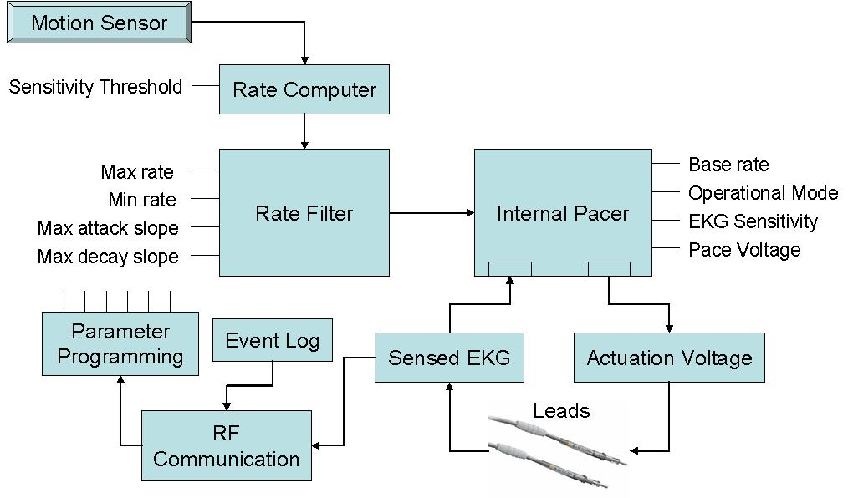
Case Study
Medical Pacemaker.
HW/SW partitioning preserves correctness of interaction between base pacing and rate adaptation.
S. Bak , M. Caccamo et al.: The System-Level Simplex Architecture for Improved Real-Time Embedded System Safety, RTAS‘09

Slide 19
Component Implementation
HW Wrapper
Manually written
Provided IP
External Memory (SRAM)
Process Logic
Control Module
Process Scheduler
Designer specified
Automatically
generated
clk_en
Interface
Module
Monitoring
Engine
Memory Controller
Data
Scratchpad
frame_signal
frame_grant
Communication Interconnection
Process 1
Code
Interface
Module
Communication
Scheduler
Data
Scratchpad
frame_grant
Control Module
. .
Control
Module
CPU Scheduler
Process N
Code
frame_signal
Frame Generator
Instruction
Scratchpad
CPU
(uBlaze)
Monitoring Engine
OS
Code
clk_en
Power Manager
CPU Wrapper
Wrappers composed of Interface Module and Control Module.
HW Wrappers provided with data scratchpad.
CPU Wrappers also provided with instruction scratchpad.

Slide 20
Interface Module
All I/O communication by the processor is mediated by the interface module.
Provides two types of communication services:
  Message passing through FIFO queues
  Shared memory through DMA.
Processor Interface
proc_clk
Data
Scratchpad
FIFO Queues
Request Queue
Completion Queue
Monitoring
signals
system_clk
DMA engine
Message Path
Command Path
Transmission Queue
Reception Path
communication
clock
Communication Interface
frame_grant

Slide 21
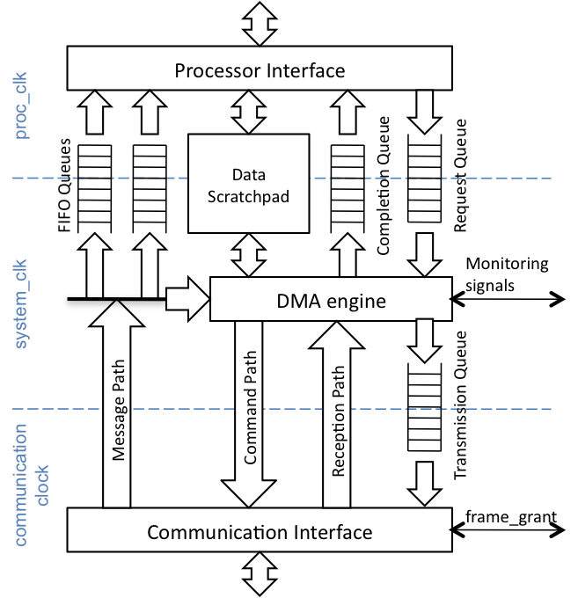
The Big Picture, Revisited
All communication goes
through the interface module
Event Specification
2. Certificate specifies a set of events.
Ex: write in logbuffer value in 101
3. Event Generator generates a
trace of observed events over time.
Event Generator
E1
-
E2
-
E1
E3
-
t
4. Certificate specifies a formula
in ERE or PTLTL using events.
Ex: (E1 E2) *
Formula
Monitor
5. Monitor checks if formula is
validated / violated based on
event trace.
Violation /
Validation
6. User written handler performs
recovery if a validation / violation
is detected.
Handler (Recovery)

Slide 22
The Big Picture, Revisited
Event Specification
Event Generator
E1
-
E2
-
E1
E3
-
t
Formula
Monitor
: specified in certificate
Violation /
Validation
: synthesized by tools
Handler (Recovery)

Slide 23
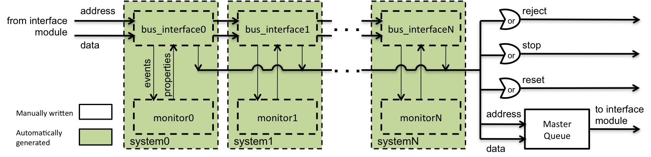
Monitoring Logic
Four possible recovery actions:
  Reject a transmission (reads can not cause side effects).
  Stop the process.
  Reset the process.
  Send a word on the bus.

Slide 24
Case Study: Safe Programmer Behavior
Programmer updates critical parameters in both the Pacer and Rate Adapter processes.
Parameter updates follows a commit protocol:
  Programmer sends parameters followed by check command.
  Pacer and Rate Adapter provides success / failure reply.
  If both are successful, Programmer sends commit command.
Problem: Programmer is an unverified process. It could crash after sending the commit to one process only.
Solution: commit sent by monitor.

Slide 25
SendPacerCommit Property
Events capture check/commit commands and success/failure replies at the Programmer.
Success received from
Pacer and Rate Adapter…
… and I have not received
2 Pacer success in a row…
… and I have received a Rate
Adapter success since last failure.
If property becomes true, send
commit to Pacer.

Slide 26
Cyberphysical System Runtime Verification

Slide 27
Simplex Model
Run-time verification for Control Systems.
Under normal conditions, run a complex controller.
If the complex controller fails, switch to a simpler, verified one.

Slide 28
Model: Hybrid Automata
Similar to timed automata + continuous state
  Discrete states and transitions
  Timers, guards on transitions, invariants on states
  New: continuous-state variables (ex: position, velocity, …)
  New: dynamic in each state (differential equations)

Slide 29
Model: Hybrid Automata
Similar to timed automata + continuous state
  Discrete states and transitions
  Timers, guards on transitions, invariants on states
  New: continuous-state variables (ex: position, velocity, …)
  New: dynamic in each state (differential equations)

Slide 30
How does it work?
Discretize the continuous state space.
From each discretized state space, compute the set of all reachable states in Delta time.

Slide 31
How does it work?
Discretize the continuous state space.
From each discretized state space, compute the set of all reachable states in Delta time.

Slide 32
How does it work?
Discretize the continuous state space.
From each discretized state space, compute the set of all reachable states in Delta time.

Slide 33
Model Checking the System
Result: we reduce the model to a discrete system (automata).
  The automata does not need to keep implicit track of time – time is encoded in the transition overapproximation.
We can then apply standard model checking to check that safety is guaranteed – the system can never reach an unsafe state.
There are some constraints on the modeled dynamics…
  Most importantly, no cyclic dependencies among variables in the dynamic of the system modeled by dx/dt = F(x).
  Can you think of a case where this is violated?
  Follow-up paper solves the problem…

Slide 34
Case Study
Autonomous off-road vehicle.
John Deere is largest manufacturer of agricultural machinery.
Over 30 parameters in the vehicle model.
Goal: avoid roll-over.
Automatic generation of Decision Module in VHDL.

