Slide 1
ECE 720T5 Fall 2011 Cyber-Physical Systems
Rodolfo Pellizzoni

Slide 2
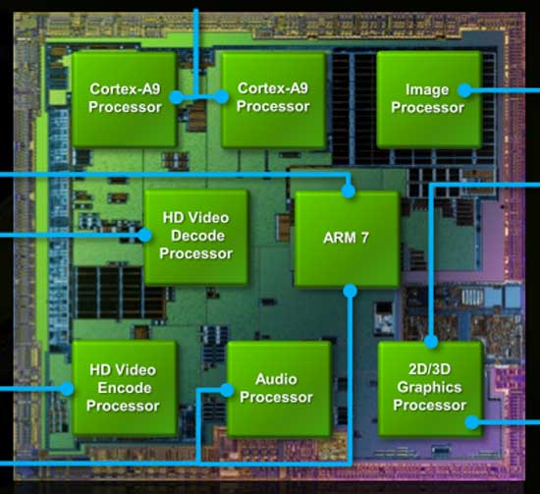
Topic Today: Heterogeneous Systems
Modern SoC devices are highly heterogeneous systems - use the best type of processing element for each job
Good for CPS – processing elements are often more predictable than GP CPU!
Challenge #1: schedule computation among all processing units.
Challenge #2: I/O & interconnects as shared resources.
NVIDIA Tegra 2 SoC

Slide 3
Processing Elements
Trade-offs of programmability vs performance/power consumption/area.
Not always in this order…
Application-Specific Instruction Processors
Graphics Processing Unit
Reconfigurable Field-Programmable Gate Array
Coarse-Grained Reconfigurable Device
I/O Processors
HW Coprocessors

Slide 4
Processing Elements
Application-Specific Instruction Processors
  The ISA and microarchitecture is tailored for a specific application.
  Ex: Digital Signal Processor.
  Sometimes “instructions” invoke HW coprocessors.
Graphics Processing Unit
  Delegate graphics computation to a separate processor
  First appear in the ’80, until the turn of the century GPUs were HW processors (fixed functions)
  Now GPUs are ASIP – execute shader programs.
  New trend: GPGPU – execute computation on GPU.

Slide 5
Processing Elements
Reconfigurable FPGA
  Logic circuits that can be programmed after production
  Static reconfiguration: configure FPGA before booting
  Dynamic reconfiguration: change logic at run-time
  More on this later if we have time…
Coarse-Grained Devices
  Similar to FPGA, but the logic is more constrained.
  Device typically composed of word-wide reconfigurable blocks implementing ALU operations, together with registers, mux/demux and programmable interconnects.

Slide 6
Processing Elements
HW Processors
  ASIC logic block executing a specific function.
  Directly connected to the global system interconnects.
  Typically an active device (i.e., DMA capable).
  Can be more or less programmable.
  Ex#1: cellular baseband decoders – not programmable
  Ex#2: video decoder – often highly programmable (sometimes more of an ASIP)
I/O Processor
  Same as before, but dedicated to I/O processing.
  Ex: accelerated Ethernet NICs – move some portion of the TPC/IP stack in HW.

Slide 7
GPU for Computation
Next: computation on GPU.

Slide 8
I/O and Peripherals
What about peripherals and I/O?
Standardized Off-Chip Interconnects are popular
  PCI Express
  USB
  SATA
  Etc.
Peripherals can interfere with each other on off-chip interconnects!
  Dangerous if assigned different criticalities
  We can not schedule peripherals like we do for tasks

Slide 9
Real-Time Control of I/O COTS Peripherals for Embedded Systems
Stanley Bak, Emiliano Betti, Rodolfo Pellizzoni, Marco Caccamo, Lui Sha
University of Illinois at Urbana-Champaign

Slide 10
COTS HW & RT Embedded Systems
Embedded systems are increasingly built by using Commercial Off-The-Shelf (COTS) components to reduce costs and time-to-market
This trend is true even for companies in the safety-critical avionic market such as Lockheed Martin Aeronautics, Boeing and Airbus
COTS components usually provide better performance:
  SAFEbus used in the Boing777 transfers data up to 60 Mbps, while a COTS interconnection such as PCI Express can reach higher transfer speeds (over three orders of magnitude)
COTS components are mainly optimized for the average case performance and not for the worst-case scenario.
2

Slide 11
ARINC 653 and unpredictable I/O behaviors
According to ARINC 653 avionic standard, different computational components should be put into isolated partitions (cyclic time slices of the CPU).
ARINC 653 does not provide any isolation from the effects of I/O bus traffic. A peripheral is free to interfere with cache fetches while any partition (not requiring that peripheral) is executing on the CPU.
To provide true temporal partitioning, enforceable specifications must address the complex dependencies among all interacting resources.
➔ See Aeronautical Radio Inc. ARINC 653 Specification. It defines the Avionics Application Standard Software Interface.
3

Slide 12
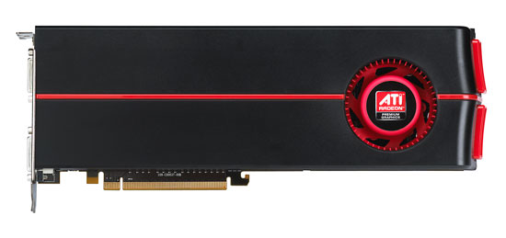
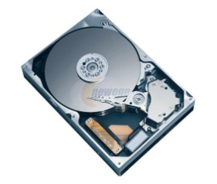
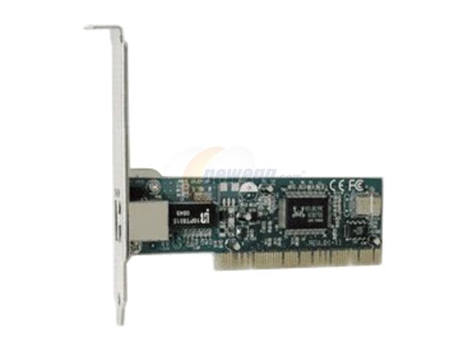
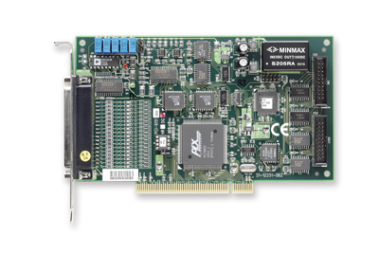
Example: Bus Contention (1/2)
CPU
Modern COTS system comprising multiple buses.
High-performance DMA peripherals autonomously transfer data to/from Main Memory.
Multiple possible bottlenecks.
RAM
North
Bridge
PCIe
ATA
South
Bridge
PCI-X
2/19

Slide 13
Example: Bus Contention (1/2)
CPU
Modern COTS system comprising multiple buses.
High-performance DMA peripherals autonomously transfer data to/from Main Memory.
Multiple possible bottlenecks.
RAM
2/19

Slide 14
Example: Bus Contention (2/2)
Two DMA peripherals transmitting at full speed on PCI-X bus.
Round-robin arbitration does not allow timing guarantees.
CPU
RAM
Transaction Length | Bandwidth (256B)
No interference | 596MB/s (100%)
128 bytes | 441MB/s (74%)
256 bytes | 346MB/s (58%)
512 bytes | 241MB/s (40%)
3/19

Slide 15
Example: Bus Contention (2/2)
Two DMA peripherals transmitting at full speed on PCI-X bus.
Round-robin arbitration does not allow timing guarantees.
CPU
RAM
NO BUS SHARING
3
t
6
t
0
8
16
3/19

Slide 16
Example: Bus Contention (2/2)
Two DMA peripherals transmitting at full speed on PCI-X bus.
Round-robin arbitration does not allow timing guarantees.
CPU
RAM
BUS CONTENTION, 50% / 50%
6
4
t
10
t
0
8
16
3/19

Slide 17
Example: Bus Contention (2/2)
Two DMA peripherals transmitting at full speed on PCI-X bus.
Round-robin arbitration does not allow timing guarantees.
CPU
RAM
BUS CONTENTION, 33% / 66%
9
t
9
t
0
8
16
3/19

Slide 18
The Need for an Engineering Solution
Analysis is possible but bounds are pessimistic and require the specification of many parameters.
Average case significantly lower than worst case.
  Main issue: COTS arbiters are not designed for predictability.
We propose engineering solutions to control peripheral traffic.
Main idea: we need to provide traffic isolation by scheduling peripherals on the bus, like we schedule tasks on CPU.
26

Slide 19
The Main Idea: Implicit Schedule
Problem: COTS arbiters optimized for average case, not worst case.
Solution: do not rely on COTS arbiter, enforce implicit schedule: high-level agreement among peripherals.
CPU
RAM
BUS CONTENTION, 33% / 66%
9
t
9
t
0
8
16
5/19

Slide 20
The Main Idea: Implicit Schedule
Problem: COTS arbiters optimized for average case, not worst case.
Solution: do not rely on COTS arbiter, enforce implicit schedule: high-level agreement among peripherals.
CPU
RAM
IMPLICIT SCHEDULE ENFORCEMENT
3
t
BLOCK
BLOCK
t
0
8
16
5/19
Notes:
Say enforce macro schedule despite the fact low-level transactions just go throught with no contention.

Slide 21
The Main Idea: Implicit Schedule
Problem: COTS arbiters optimized for average case, not worst case.
Solution: do not rely on COTS arbiter, enforce implicit schedule: high-level agreement among peripherals.
CPU
CHALLENGE: How can we enforce the implicit schedule with minimal hardware modifications?
RAM
IMPLICIT SCHEDULE ENFORCEMENT
3
t
BLOCK
BLOCK
t
0
8
16
5/19

Slide 22
Real-Time I/O Management System
A Real-Time Bridge is interposed between each high-throughput peripheral and COTS bus.
The Real-Time Bridge buffers incoming/outgoing data and delivers it predictably.
Reservation Controller enforces global implicit schedule.
Assumption: all flows share main memory…
… only one peripheral transmit at a time.
Reservation
Controller
CPU
RAM
North
Bridge
RT
Bridge
PCIe
RT
Bridge
ATA
South
Bridge
RT
Bridge
PCI-X
RT
Bridge
6/19

Slide 23
Reservation Controller
Reservation Controller receives data_rdy_{i} information from Real-Time Bridges and outputs block_{i} signals.
Since only one peripheral is allowed to transmit at a time, I/O flow scheduling is equivalent to monoprocessor scheduling!
Question: can any monoprocessor scheduling algorithm be implemented?
Reservation Controller
data_rdy₁
block₁
data_rdy₂
block₂
. . .
data_rdy_{i}
block_{i}
. . .
9/19
Notes:
Before SW stack

Slide 24

Scheduling Framework
We consider a general framework composed of a scheduler and multiple scheduling servers.
Each server computes scheduling parameters for a flow. The scheduler decides which server to execute.
We show that we can implement the class of active dynamic servers: server behavior depends only on task data_rdy information.
Scheduler (FP)
EXEC₁
data_rdy₁
FP + Sporadic Server
EDF + Constant Bandwidth Server
EDF + Total Bandwidth Server
Server₁
EXEC₁ = READY₁
READY₁
block₁
EXEC₂ = READY₂ and
not EXEC₁
EXEC₂
data_rdy₂
Server₂
READY₂
block₂
. . .
EXEC_{i} = READY_{i} and
not EXEC₁ … and not EXEC_{i-1}
. . .
EXEC_{i}
data_rdy_{i}
Server_{i}
. . .
READY_{i}
block_{i}
. . .
10/19

Slide 25
Real-Time Bridge
FPGA System-on-Chip design with CPU, external memory, and custom DMA Engine.
Connected to main system and peripheral through available PCI/PCIe bridge modules.
Host CPU
FPGA
FPGA CPU
Interrupt
Controller
IntFPGA
Controlled
Peripheral
System + PCI
PCI Bridge
PLB
PCI Bridge
PCI
DMA Engine
Memory
Controller
Main Memory
IntMain
block
data_rdy
Local RAM
8/19

Slide 26
Real-Time Bridge
The controlled peripheral reads/writes to/from Local RAM instead of Main Memory (completely transparent to the peripheral).
DMA Engine transfers data from/to Main Memory to/from Local RAM.
Host CPU
FPGA
FPGA CPU
Interrupt
Controller
IntFPGA
Controlled
Peripheral
System + PCI
PCI Bridge
PLB
PCI Bridge
PCI
DMA Engine
Memory
Controller
Main Memory
IntMain
block
data_rdy
Local RAM
8/19

Slide 27
Real-Time Bridge
DMA Engine connection to the Reservation Controller:
  data_rdy: active if the peripheral has buffered data to transmit.
  block: used by reservation controller to control data transfers.
Host CPU
FPGA
FPGA CPU
Interrupt
Controller
IntFPGA
Controlled
Peripheral
System + PCI
PCI Bridge
PLB
PCI Bridge
PCI
DMA Engine
Memory
Controller
Main Memory
IntMain
block
data_rdy
Local RAM
8/19

Slide 28
Example: Download
FPGA/Host Driver maintains packet buffer lists with addresses in Source/Destination FIFO.
Host CPU
FPGA
FPGA CPU
Interrupt
Controller
IntFPGA
TEMAC
NIC
System + PCI
PCI Bridge
PLB
DMA Engine
Local RAM
Main Memory
IntMain
Source
FIFO
Dest
FIFO
Notes:
Move after

Slide 29
Example: Download
Incoming packets are written in source buffers.
Host CPU
FPGA
FPGA CPU
Interrupt
Controller
IntFPGA
TEMAC
NIC
System + PCI
PCI Bridge
PLB
DMA Engine
Local RAM
Main Memory
IntMain
Source
FIFO
Dest
FIFO

Slide 30
Example: Download
DMAEngine transfers packets while not blocked.
Host CPU
FPGA
FPGA CPU
Interrupt
Controller
IntFPGA
TEMAC
NIC
System + PCI
PCI Bridge
PLB
DMA Engine
Local RAM
Main Memory
IntMain
Source
FIFO
Dest
FIFO

Slide 31
Example: Download
Host Driver processes packets (ex: TCP/IP stack).
Host CPU
FPGA
FPGA CPU
Interrupt
Controller
IntFPGA
TEMAC
NIC
System + PCI
PCI Bridge
PLB
DMA Engine
Local RAM
Main Memory
IntMain
Source
FIFO
Dest
FIFO

Slide 32
Example: Download
After transfer, used source and destination buffers are cleared and new buffers are inserted.
Host CPU
FPGA
FPGA CPU
Interrupt
Controller
IntFPGA
TEMAC
NIC
System + PCI
PCI Bridge
PLB
DMA Engine
Local RAM
Main Memory
IntMain
Source
FIFO
Dest
FIFO

Slide 33
Example: Download
After transfer, used source and destination buffers are cleared and new buffers are inserted.
Host CPU
FPGA
FPGA CPU
Interrupt
Controller
IntFPGA
TEMAC
NIC
System + PCI
PCI Bridge
PLB
DMA Engine
Local RAM
Main Memory
IntMain
Source
FIFO
Dest
FIFO

Slide 34
Example: Download
At all steps, interrupt coalescing is used to improve performance.
Host CPU
FPGA
FPGA CPU
Interrupt
Controller
IntFPGA
TEMAC
NIC
System + PCI
PCI Bridge
PLB
DMA Engine
Local RAM
Main Memory
IntMain
Source
FIFO
Dest
FIFO

Slide 35
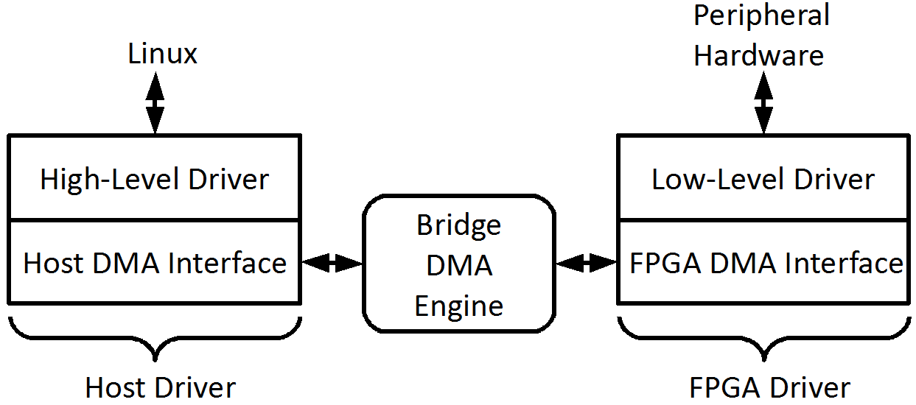
Software Stack
FPGA CPU used to run OS and peripheral driver.
System based on two drivers, running on FPGA and host system.
FPGA driver:
  Controls the peripherals.
  Low-level driver based on available peripheral driver (only minor modifications needed).
  FPGA DMA Interface reused across different peripherals.
11/19
Notes:
Usable on Point to Point bus

Slide 36
Software Stack
FPGA CPU used to run OS and peripheral driver.
System based on two drivers, running on FPGA and host system.
Host driver:
  Forwards the data buffered on the FPGA to/from the Host OS.
  Host DMA Interface can be reused across different peripherals and is host OS independent.
  High-Level Driver is host OS dependent.
11/19

Slide 37
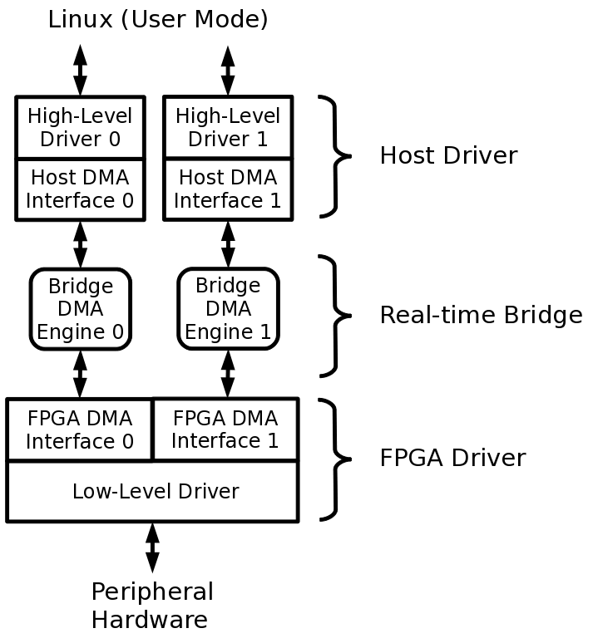
Peripheral Virtualization
RT-Bridge supports peripheral virtualization.
Single peripheral (ex: Network Interface Card) can service different software partitions.
HW virtualization enforces strict timing isolation.
33

Slide 38
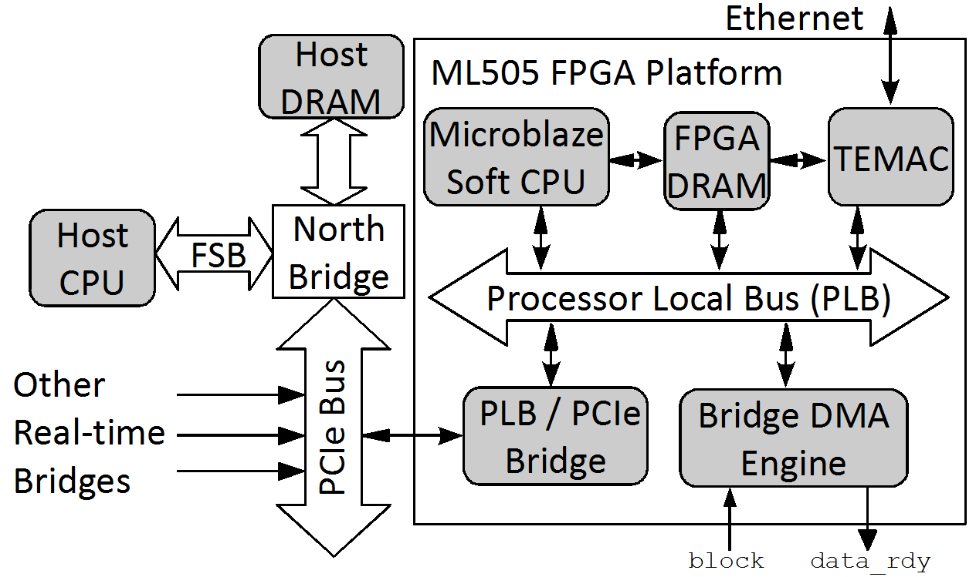
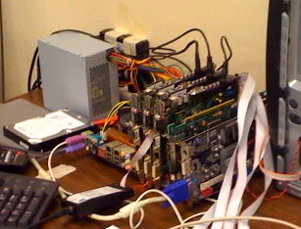
Implemented Prototype
Host OS: Linux 2.6.29, FPGA OS: Petalinux (2.6.20 kernel).
Xilinx TEMAC 1Gb/s ethernet card (integrated on FPGA).
3 Smart Bridges, PCIe 250MB/s; contention at main memory level.
Optimized driver implementation with no software packet copy.
12/19
Notes:
Say contention at memory level even with PCIe

Slide 39
Flow Analysis
Main advantage: bus feasibility checked using well-known monoprocessor schedulability tests.
Servers are used to enforce transmission budgets for aperiodic traffic.
However, we pay in term of flow delay and on-bridge memory.
While a Real-Time Bridge is blocked, incoming network packets must be buffered in the FPGA RAM.
  How much buffer space is needed (backlog)?
  What is the maximum buffer time (delay)?
We devised a methodology based on real-time calculus to compute bounds on delay and buffer size.
13/19

Slide 40
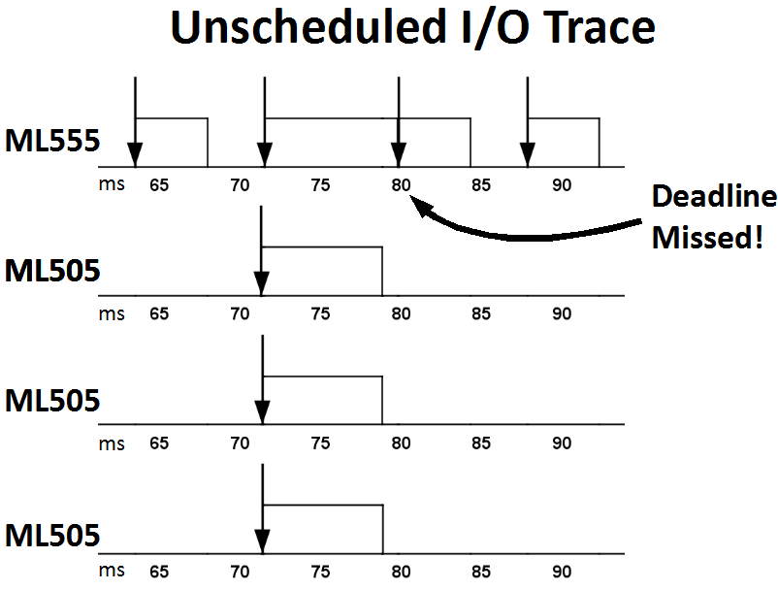
Evaluation
Experiments based on Intel 975X motherboard with 4 PCIe slots.
3 x Real-Time Bridges, 1 x Traffic Generator with synthetic traffic.
Rate Monotonic with Sporadic Servers.
Peripheral | Transfer Time | Budget | Period
RT Bridge | 7.5ms | 9ms | 72ms
Generator | 4.4ms | 5ms | 8ms
Utilization 1, harmonic periods.
Generator
RT-Bridge
Scheduling flows without reservation controller (block always low) leads to deadline misses!
RT-Bridge
RT-Bridge
17/19

Slide 41
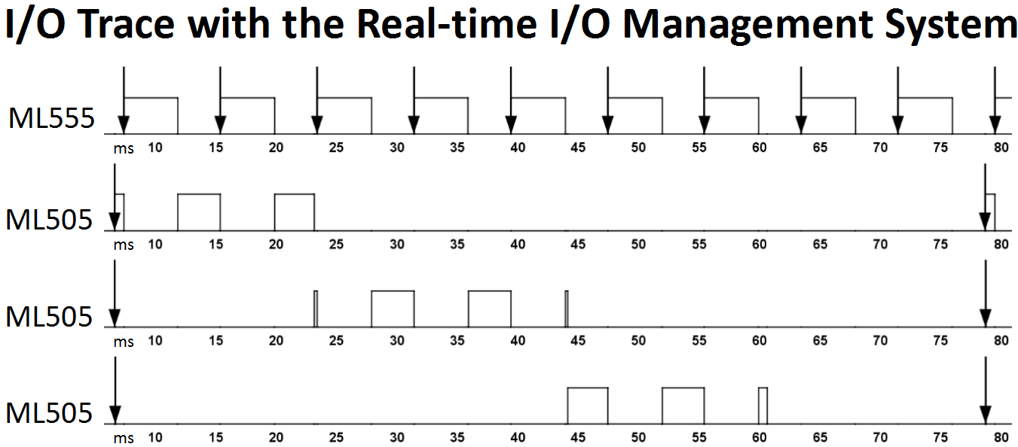
Evaluation
Experiments based on Intel 975X motherboard with 4 PCIe slots.
3 x Real-Time Bridges, 1 x Traffic Generator with synthetic traffic.
Rate Monotonic with Sporadic Servers.
Peripheral | Transfer Time | Budget | Period
RT Bridge | 7.5ms | 9ms | 72ms
Generator | 4.4ms | 5ms | 8ms
No deadline misses with reservation controller
Generator
RT-Bridge
RT-Bridge
RT-Bridge
17/19

Slide 42
Reconfigurable Devices and Real-Time
Great deal of attention on reconfigurable FPGA for embedded and real-time systems
  Pro: HW logic is (often) more predictable than SW executing on complex microarchitectures
  Pro: HW logic is more efficient (per unit of chip area/power consumption) compared to GP CPU on parallel math crunching applications – somehow negated by GPU nowadays
  Cons: Programming the HW is more complex
Huge amount of research on synthesis of FPGA logic from high-level specification (ex: SystemC).
How to use it: static design
  Implement I/O, interconnects and all other PE on ASIC.
  Use some portion of the chip for a programmable FPGA processor.

Slide 43
Reconfigurable FPGA
How to use it: dynamic design
  Implement I/O and interconnects as fixed logic on FPGA.
  Use the rest of the FPGA area for reconfigurable HW tasks.
HW Task
  Period, deadline, wcet as SW tasks.
  Additionally has an area requirement.
  Requirement depends on the area model.

Slide 44
Area Model
2D model
  HW Tasks with variable width and height.
1D model
  HW Tasks have variable width, fixed height.
  Easier implementation, but possibly more fragmentation.
5/ 18

Slide 45
Example: Sonic-on-a-Chip
Slotted area
  Fixed-area slots
Reconfigurable design targeted at image processing.
Dataflow application.
Some or all dataflow nodes are implemented as HW tasks.

Slide 46
Main Constraints
Interconnects constraints
  HW tasks must be interfaced to the interconnects.
  Fixed wire connections: bus macros.
  The 2D model is very hard to implement.
Reconfiguration constraints
  With dynamic reconfiguration a HW task can be reconfigured at run-time, but…
  … reconfiguration takes a long time.
  Solution: no HW task preemption.
  However, we can still activate/deactivate HW tasks based on current application mode.

Slide 47
The Management Problem
FPGA management problem
  Assume each task can be HW or SW
  Given a set of area/timing constraints, decide how to implement each task.
Additional trick: HW/SW migration
  Run-time state transfer between HW/SW implementation
0. migrateSWtoHW
CPU
1. program ICAP
2. ICAP int
3. CMD_START
4. CMD_DOWNLOAD
HW
reconfiguration
data load
HW job
SW period
HW period
t

Slide 48
The Allocation Problem
If HW tasks have different areas (width or #slots), then the allocation problem is an instance of a bin-packing problem.
  Dynamic reconfiguration: additional fragmentation issues.
  Not too dissimilar from memory/disk block management..
Wealth of results for various area/execution models…
9/9
6/9
FPGA
3/9
0/9
CPU
0
1
2
3
4
5
6
7
8
9

Slide 49
Assignments
Next Monday 8:00AM: literature review.
Fix/extend the introduction and project plan based on provided comments.
Include an extended comparison with related work.
  How each related work tackled your research problem.
  How you are going to tackle the problem.
  Why your approach is worthwhile compared to related work.
  What are the limits of your approach compared to related work.
  You do not need to describe your complete solution (or results), but do include some technical details – you need to show that you have a clear direction for the project.
  Of course you also need to show that you read the related work…

Slide 50
Final
Final: scheduled for December 12
Let me know if you have any conflict.

