Slide 1
Mean Squared Error:
Love It or Leave It?
A New Look at Signal Fidelity Measures
Zhou Wang and Alan C. Bovik
Published in
IEEE Signal Processing Magazine
vol. 26, no. 1, pp. 98-117, Jan. 2009

Slide 2
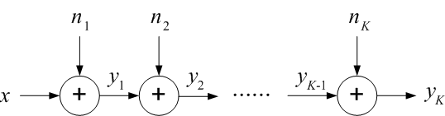
Fig. 1

Slide 3
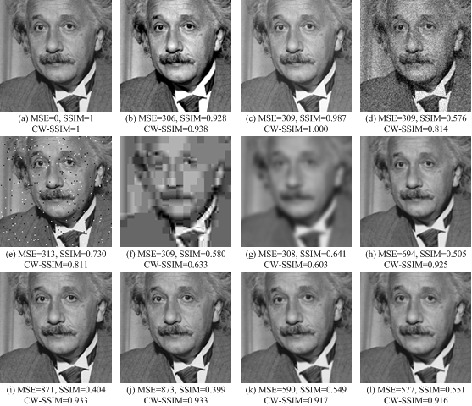
Fig. 2

Slide 4
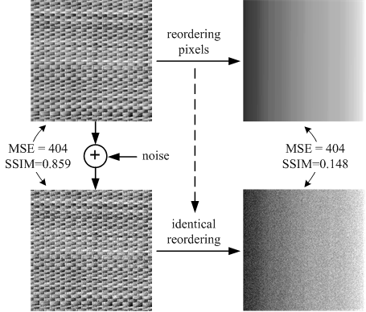
Fig. 3(a)

Slide 5
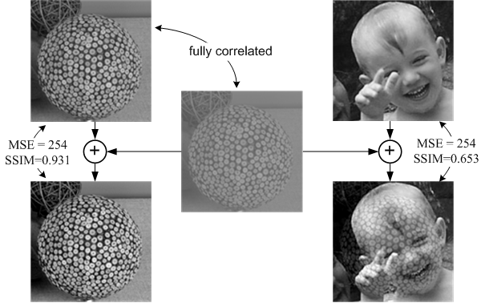
Fig. 3(b)

Slide 6
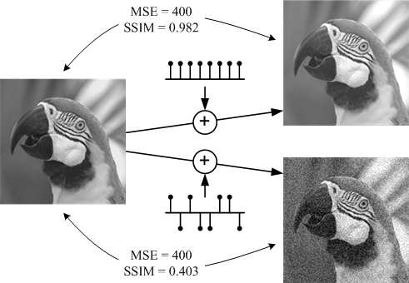
Fig. 3(c)

Slide 7
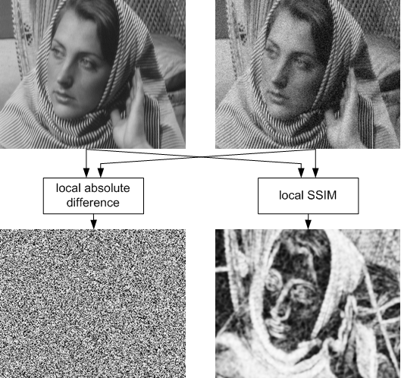
Fig. 3(d)

Slide 8
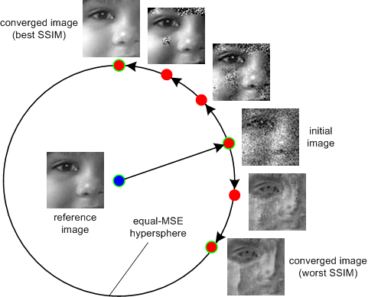
Fig. 4

Slide 9
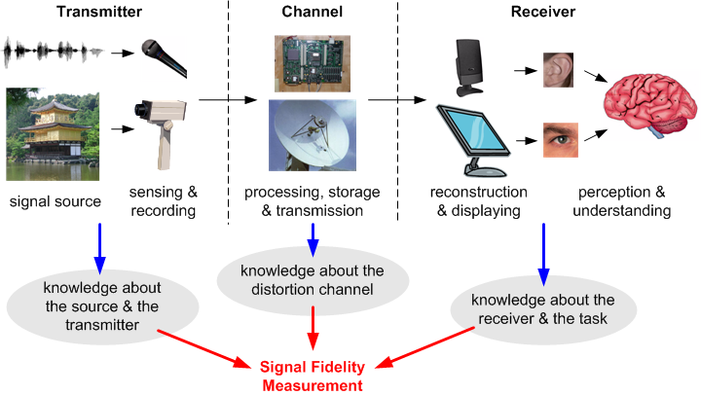
Fig. 5

Slide 10
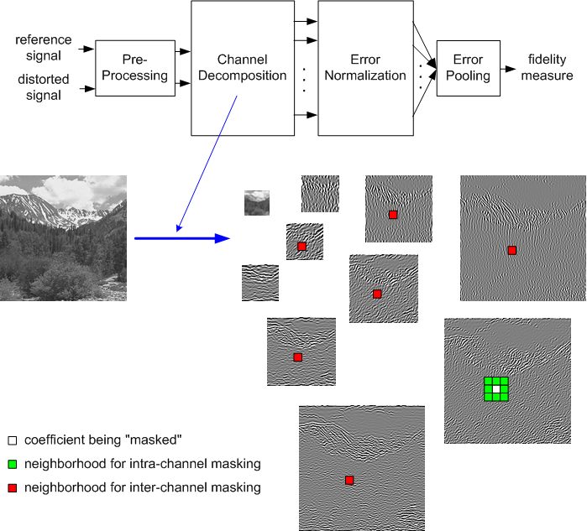
Fig. 6

Slide 11
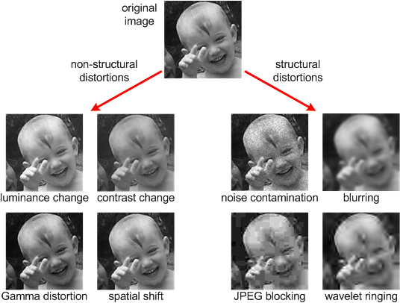
Fig. 7

Slide 12
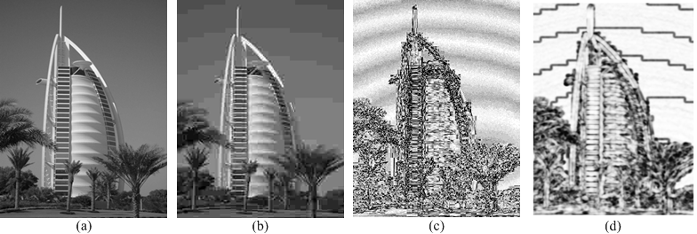
Fig. 8

Slide 13
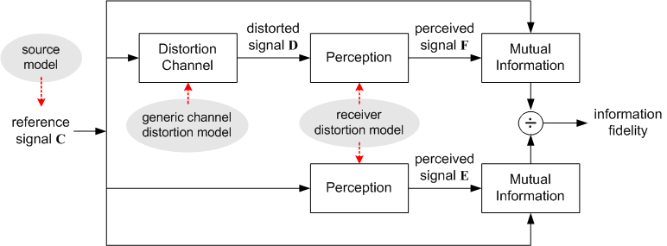
Fig. 9

Slide 14
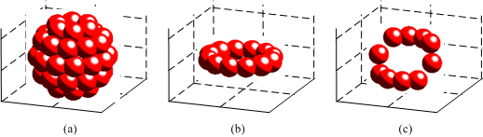
Fig. 10

Slide 15
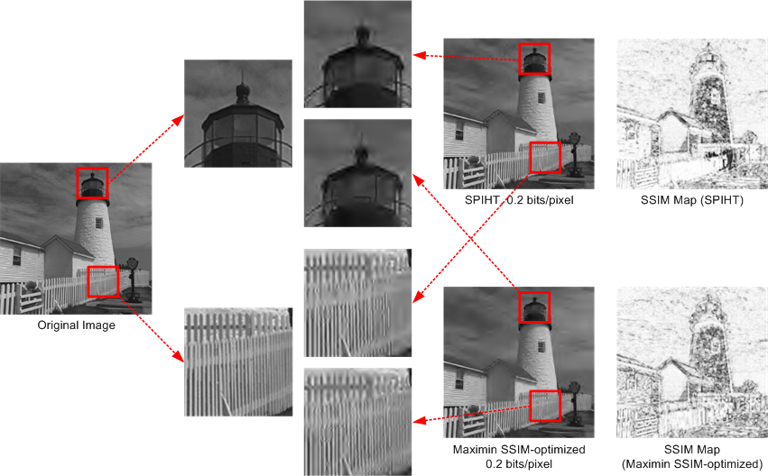
Fig. 11

Slide 16
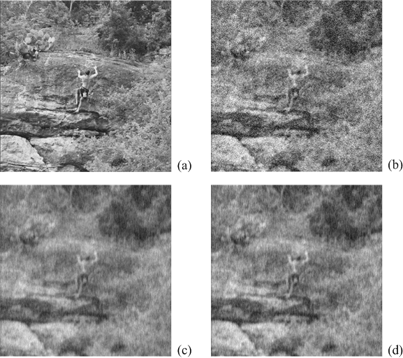
Fig. 12

Slide 17
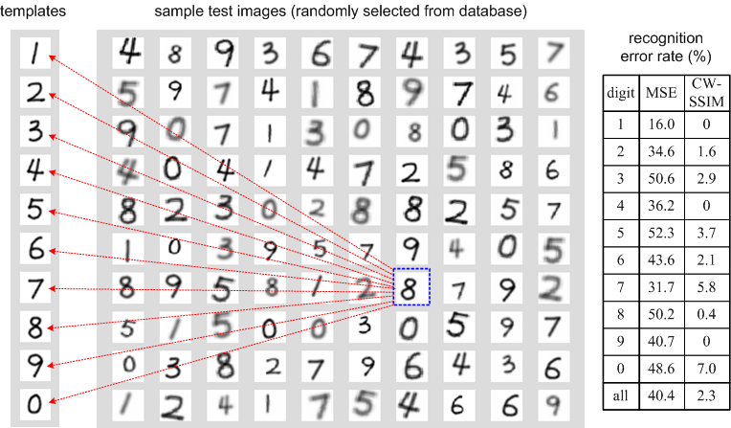
Fig. 13

Slide 18
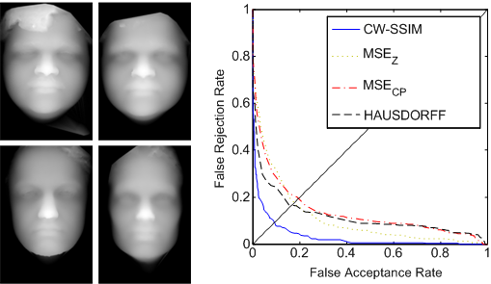
Fig. 14

Slide 19
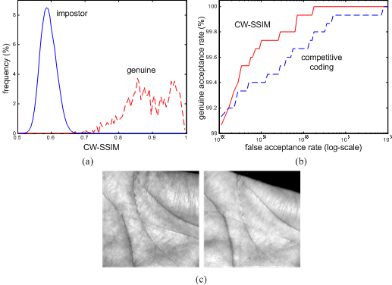
Fig. 15

