Slide 1
On technical presentations Part 1
TPM Technical Presentation Milestone
Douglas Wilhelm Harder
Department of Electrical and Computer Engineering
http://ece.uwaterloo.ca/~tppe000/ University of Waterloo
February 2, 2016
Copyright © 2008-13 by Douglas Wilhelm Harder. Some rights reserved.

Slide 2
Outline
This two-session presentation covers:
Background
The milestone
Bad presentations
Aspects of a good presentation:
Interest and knowledge
Organization
Visual aids
Presentation skills
Responding to questions
Consequences of failures

Slide 3
Background
Why do you care?
Engineers, in general, work together
However, on any project, the individual presenting is always perceived as having given the greatest contribution
Self Leadership International http://www.selfleadership.com/
Public Relations Society of America http://http://prsareno.org/

Slide 4
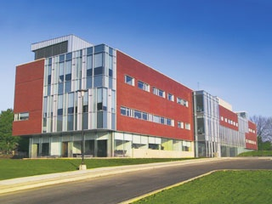
Background
The University of Waterloo has always had a co-op program
Our employers told us:
“Your students cannot give presentations...”
We introduced the Technical Presentation Milestone
Two evaluators and a peer audience
A 12-15 minute slide-based presentation
A questions-and-answers session follows
http://www.uwaterloo.ca/

Slide 5
Background
Two primary means of technical communication:
Written reports
Oral presentations
Each has its own distinctive characteristics
Time scale, references, feedback, ...

Slide 6
Background
The benefits of presentations:
The focus is on the speaker
It’s interactive
Emphasis of key points is easier
The flow is dynamic
You can gauge if the audience is interested, confused or bored
Live personalities command attention
Presentations use many senses
The audience is guaranteed to have been exposed to the material

Slide 7
Background
The benefits of reports:
The focus is on the information with more details
There is no reliance on personalities and no time coordination
Readers can
Review relevant background at their own leisure
Read at their own pace
Review the material multiple times

Slide 8
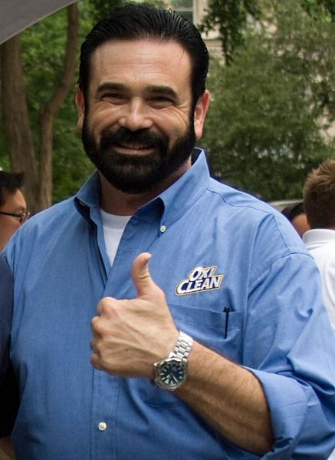
Background
A technical presentation
Informs
Persuades
A technical presentation does not
Sell/pitch
Teach/lecture
Sharese Ann Frederick

Slide 9
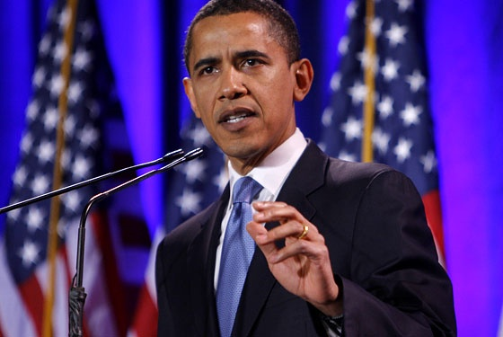
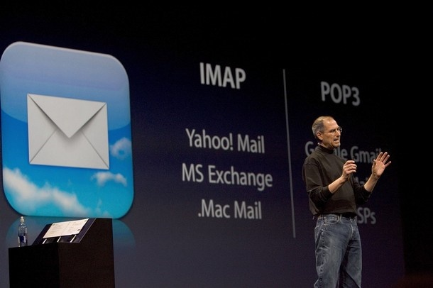
Background
Presentations may be with or without supporting visual aids
Each choice has advantages and disadvantages
Without visual aids, the speaker is the focus
Dynamic and enthusiastic
Requires significant preparation
Difficult for presenting technical data
http://www.nymag.com/
Visual aids take attention from the speaker
Greater focus on the data
Helps the speaker recall the flow
Not meant to be dynamic
http://www.daylive.com/

Slide 10
The Technical Presentation Milestone
2B students are scheduled in 3-hour sessions with five other students
TPM 1X000
Each 2B student will:
Bring a .ppt or .pptx presentation on a USB key
Bring two copies of the TPM Evaluation Form
Be present for all presentations (2-3 hours)
Ask at least one question of another presenter
Bring your own computer if you choose a different format
Your responsibility—and bring an analogue VGA adapter…

Slide 11
The Technical Presentation Milestone
Information available at:
http://ece.uwaterloo.ca/~tppe000/
This site includes:
Requirements and Evaluation
Conduct
Guidelines
Example Talks
FAQ
Check List
Schedule

Slide 12
The Technical Presentation Milestone
Grading is based on four aspects:
Organization
Visual aids
Presentation skills
Questions
Each is equally weighted
A pass is 75%

Slide 13
The Technical Presentation Milestone
Statistics:
Failure rates fluctuate between 2% and 25%
Based on the attitude of the class—the evaluators don’t change
Numerous students have ignored this milestone and were surprised when they were not enrolled in 4A (previously 3B)
Question: How do they fail?

Slide 14
The 10 Commendments
The 10 Commendments for giving badly presentations by David Patterson
Computer Science Division, University of California-Berkeley
I. Thou shalt not be neat
Why waste research time preparing slides? Ignore spelling, grammer and legibility. Who cares hat 50 people think?
II. Thou shalt not waste space
Don’t waste time changing slides. Your audience will understand the big picture better if they see all the information
simultaneously.
III. Thou shalt not covet brevity
Do you want to continue the stereotype that engineers can't write? Always use complete sentences, never just key words. If
possible, use whole paragraphs and read every word.
IV. Thou shalt not expose thy naked slides
You need the suspense! Expose only one point at at a time.
V. Thou shalt not write large
Be humble: use a small font. You can fit more information into a slide. Importantpeople sit in front. Who cares about the riff-raff?
VI. Thou shalt not use color
Flagrant use of color indicates imprecise research. It's also unfair to emphasize some words over others.
VII. Thou shalt not illustrate
Confucius says “A picture equals a thousand words.”
Dijkstra says “Pictures are for weak minds.”
VIII. Thou shalt not make eye contact
You should avert eyes to show respect. Blocking screen can also add mystery.
IX. Thou shalt not skip slides in a long talk
You prepared the slides; people came for your whole talk; so just talk faster. Skip your summary and conclusions if necessary. If you pack
enough information onto each slide,

Slide 15
The 10 Commendments
X. THOU SHALT NOT PRACTISE
THIS COMMENDMENT IS CRITICAL TO YOUR SUCCESS IN GIVING A BAD PRESENTATION

Slide 16
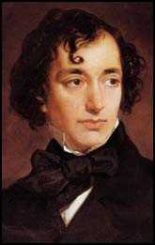
Aspects of good presentations
It is easy to say what not to do during a presentation
Don’t read the screen with your back facing the audience
Don’t play with your zippers
It is difficult to describe how to give a good presentation
“How much easier it is to be critical than to be correct.”
Benjamin Disraeli .
http://www.spartacus.schoolnet.co.uk/

Slide 17
Aspects of good presentations
We will look at five aspects of a presentation:
Interest and knowledge
Organization
Visual aids
Presentation skills
Responding to questions

Slide 18
Aspects of good presentations
We will begin with the fundamentals:
Interest and knowledge
Organization
Visual aids
Presentation skills
Responding to questions

Slide 19
Interest and knowledge
Aspects of interest and knowledge:
Interest and enthusiasm
Knowledge and expertise

Slide 20
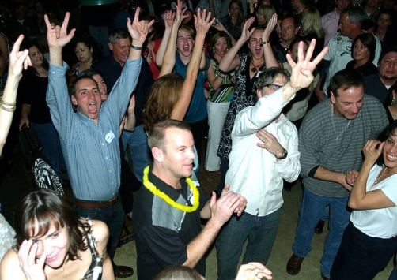
Interest
Interest and knowledge
“Nothing great has been accomplished without passion.”
Georg Hegel
19th-century philosopher
You must be interested in your topic
Enthusiasm is contagious
So is boredom
David Shankbone
Photo by Adam Jones adamjones.freeservers.com

Slide 21
Knowledge
Interest and knowledge
Technical presentations require knowledge and expertise
Speaker must not present to the limit of their knowledge
Requirements:
A general understanding of the broader scope
A solid understanding of the topic
A general understanding of relevant specific details

Slide 22
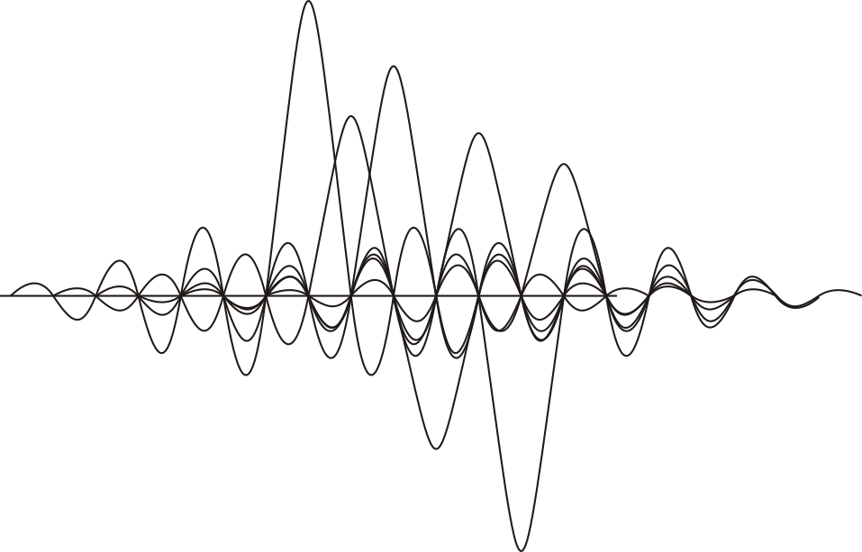
Knowledge
Interest and knowledge
Example: Wireless Local Area Networks standards
Must have a general knowledge of wireless and modulation
Must have an in-depth knowledge of IEEE 802.11a, b, and g
Must have a general understanding of modulation techniques
E.g., Direct-sequence spread spectrum
Orthogonal frequency-division multiplexing

Slide 23
Interest and knowledge
Interest and knowledge are the foundation
The topic interests you
Take time to investigate and research the topic
Next, we will organize the talk…

Slide 24
Aspects of good presentations
Our second topic:
Interest and knowledge
Organization
Visual aids
Presentation skills
Responding to questions

Slide 25
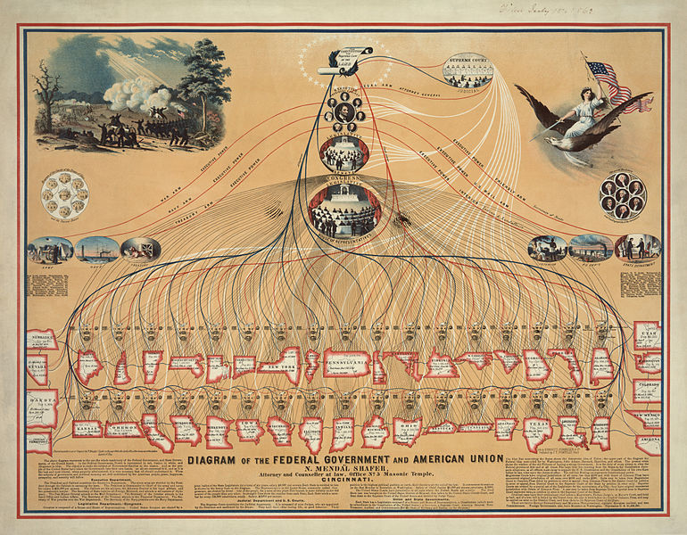
Organization
You must now organize your thoughts
Five aspects of organization:
Situation
Objective
Structure
Scalability and flow
Timing

Slide 26
Situation
Organization
What is your situation?
What is the motivation?
Who is the audience?
What is their technical level?
What are their expectations?
What are your expectations of them?
How much time do you have?
Any preconceived notions or misinformation?
What time of the day will it be?
Should I bring coffee?
Pedro Cardoso, “Stop Death By PowerPoint - Make Your Presentations "suck" Less”

Slide 27
Objective statement
Organization
You should summarize the objective in one sentence:
“To introduce technical presentations and the milestone; and to give an overview of guidelines for a good technical presentation.”
This helps focus your talk:
For any slide, image, bullet point: “Does it help me reach my objective?”
If “no”, then save that gem for it for later
http://www.anniversaryrings.net/

Slide 28
Structure
Organization
We have our objective; we must now structure the talk:
The speaker has one opportunity to present
The audience has one opportunity to observe
There is no opportunity for reviewing relevant background
“Tell them what you’ll tell them, tell them, and tell them what you told them”
We will consider:
Framing your talk
The components of the talk

Slide 29
Framing
Organization
– Structure
The presentation must be appropriately framed
This requires an introduction and conclusion
The talk must start with a point of reference:
Introduction to the topic and speaker
An brief overview
The talk must finish with a reinforcement:
A summary and conclusions

Slide 30
Framing
Organization
– Structure
This framework is supported by three slides:
A title slide
An outline
A summary and conclusions
All three are required in any presentation

Slide 31
Framing
Organization
– Structure
The Title Slide contains:
A descriptive title
The speaker’s name and affiliation
Today’s date
At this point:
Introduce yourself and your affiliation and collaborators
Give a one- or two-sentence summary

Slide 32
Framing
Organization
– Structure
The second slide is the outline
It is the framework for the talk
Anticipation
Familiarity
The second-last slide summarizes your thoughts
Numerous ideas have been presented
Emphasize the most significant
You may have one final slide with:
“Questions?” or “Any questions?”
A memorable and relevant quote or image
Your references

Slide 33
Components
Organization
– Structure
The Title, Outline, and Summary frame the talk
The presentation interpolates these with
An introductory section
Outline, background and introduction
“The big picture”
A body
Your main arguments
Concluding remarks
Conclusions, recommendations and then a summary
Discuss the scope within the bigger picture

Slide 34
Components
Organization
– Structure
The introduction includes:
The title and outline slides
The big picture: why is the audience here?
Necessary background information
The introduction of the topic
The introduction should be:
Memorized
Free of new information and facts

Slide 35
Background
Organization
– Structure
Background information should not be detailed
Give sufficient information for the audience to follow the presentation
Understand the level of your audience
Assume they are intelligent

Slide 36
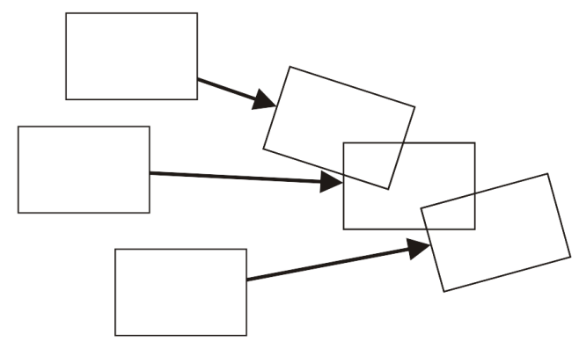
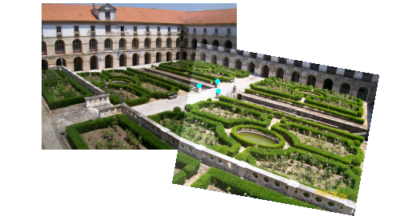
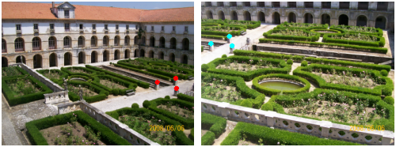
Background
Organization
– Structure
E.g., consider presenting software which merges images
The wrong background: a discussion of linear algebra
The right background: an example

Slide 37
Body
Organization
– Structure
Next, the body supports the objective
You will have a number of supporting ideas
Some ideas may support other ideas
Initially brainstorm these ideas
Write down all your ideas

Slide 38
Groupings ideas
Organization
– Structure
Group the ideas under 3-5 main points
Secondary points support main points
Time permitting, tertiary points support secondary points
Question whether outliers actually support the talk
All points should be mutually exclusive
The same aspect should not be discussed multiple times

Slide 39
Ordering your thoughts
Organization
– Structure
Next we must order the main points:
Chronologically
Problem-Solution-Justification
Problem-Reasoning-Solution
Spatial
Importance
This talk is presented chronologically

Slide 40
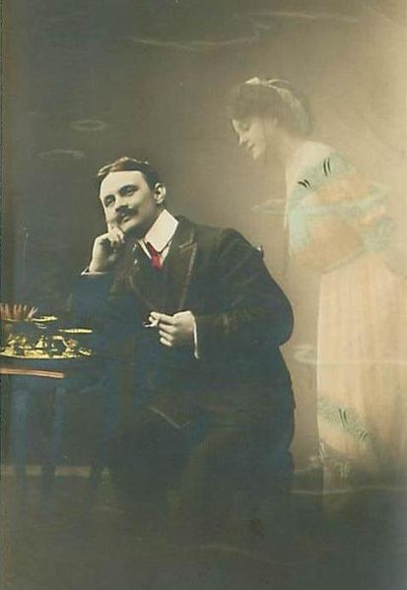
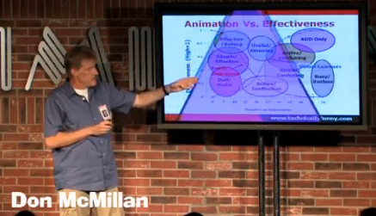
Finishing
Organization
– Structure
Finally, you’ve been presenting for 15 minutes
Your audience has thought of a lot of things
Various distractions
Their vacation (or lack thereof)
What they’re doing this weekend
The next meeting
All the small problems with your talk...

Slide 41
Finishing
Organization
– Structure
It is now your responsibility to summarize and conclude
Tell them what they must remember
Flag what you think is important
These will be your last words in the presentation

Slide 42
Scalability and flow
Organization
A good report is broken into sections
Sections broken into sub-sections
Sub-sections broken into sub-sub-sections
A presentation should be similar
Main points should be supported by secondary points
Secondary points may be supported by tertiary points
This allows scalability
Dynamics
Grouping
Flow between ideas and flow within ideas

Slide 43
Dynamics
Organization
– Scalability and flow
Scalable allows dynamic changes to the pace:
For example, tertiary points may be
Glossed over if time is short
Expanded upon if the audience is interested

Slide 44
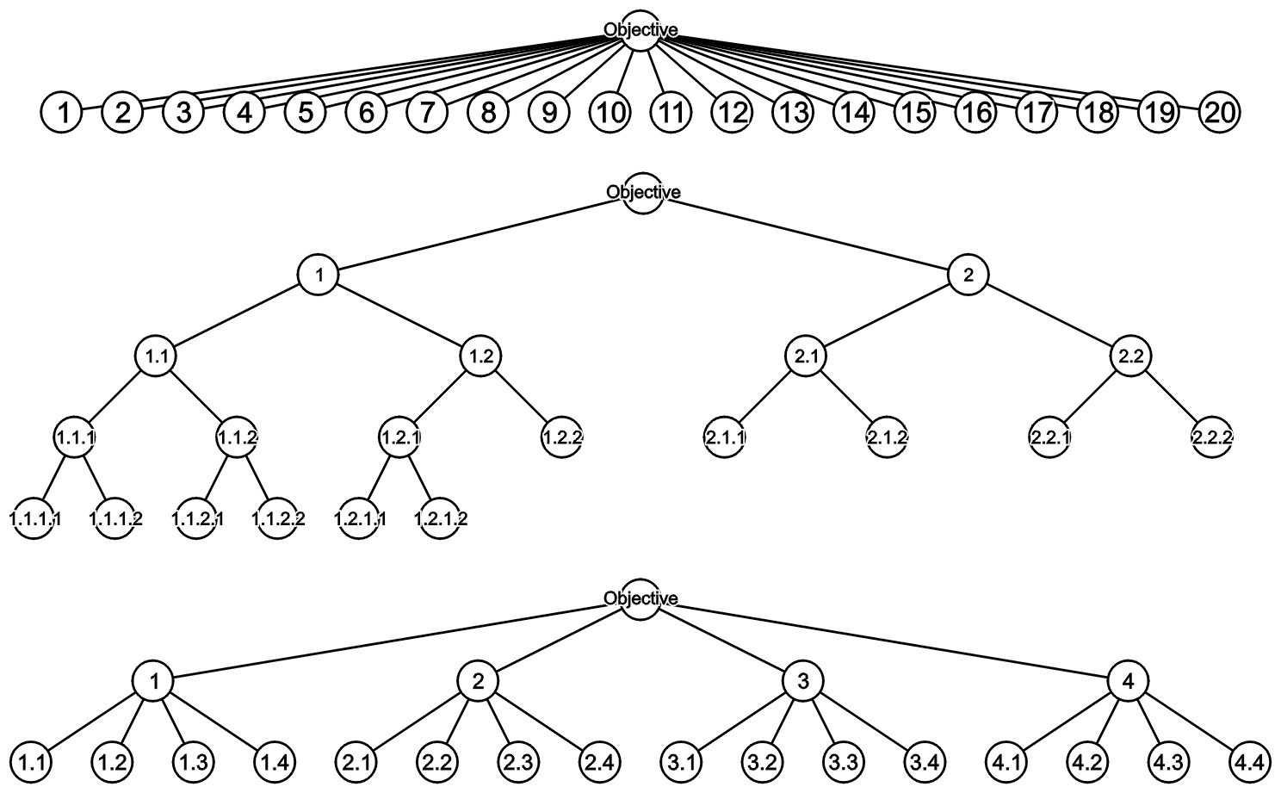
Grouping
Organization
– Scalability and flow
Consider grouping 20 points as follows:
Linear and binary groupings are awkward
Easier to visualize groupings of 4-6 points

Slide 45
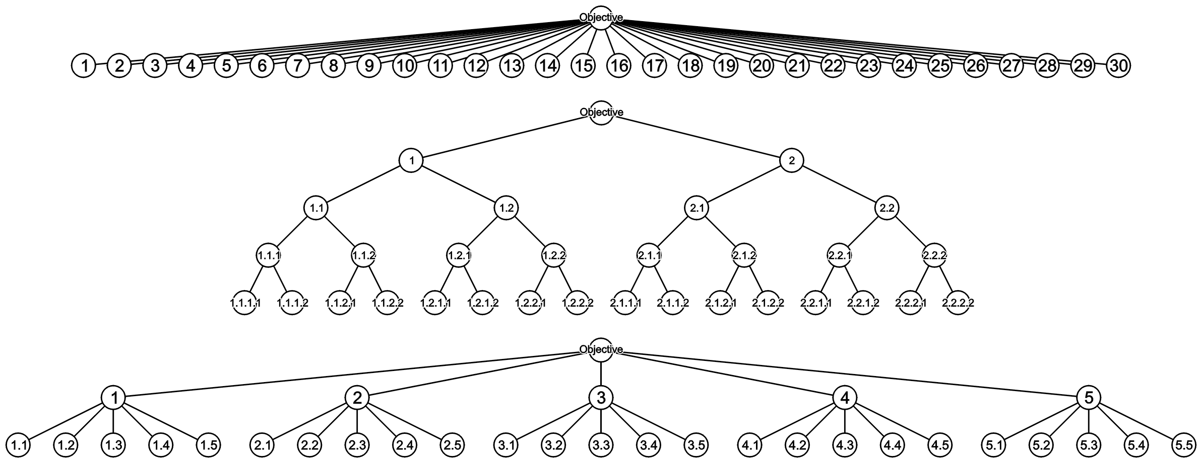
Grouping
Organization
– Scalability and flow
As the number of points grows, scalability is critical

Slide 46
Flow between topics
Organization
– Scalability and flow
The sequence of topics in a talk must flow:
Each idea must transition to the next
The audience expects a logical flow
You have to describe the transitions
Changes or discontinuity distract the audience

Slide 47
Flow within topics
Organization
– Scalability and flow
Suppose you are discussing a number of options or alternatives
These items are introduced in a specific order
Maintain a similar order throughout the presentation
Example: you describe Windows, GNU/Linux and then OS X
Subsequent slides and tables should keep that order
 | Windows | GNU/Linux | OS X
1 | ··· | ··· | ···
2 | ··· | ··· | ···
3 | ··· | ··· | ···
4 | ··· | ··· | ···
5 | ··· | ··· | ···
 | A | B | C | D
Windows | ··· | ··· | ··· | ···
GNU/Linux | ··· | ··· | ··· | ···
OS X | ··· | ··· | ··· | ···

Slide 48
Timing
Organization
You are interested and prepared
You know what you’re going to say and wow you’re going to say it
However, the main question is How much time do you have to say it in?
We will look at a number of aspects with respect to the timing of a presentation
Justification
Requirements
Planning
Racing against the clock
The timer

Slide 49
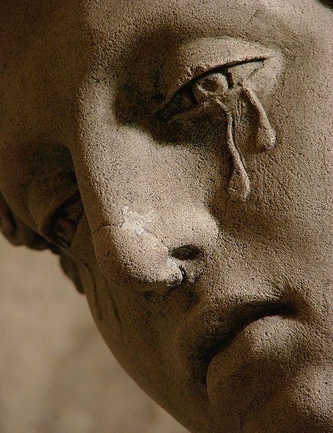
Justification
Organization
– Timing
A story from a co-op placement:
A remote sales presentation scheduled for 50 min went on for 80 min
Only the co-op was left watching
The product was not purchased...
User: Vassil

Slide 50
Requirements
Organization
– Timing
You are required to speak for 12-15 min
Timing is important:
Audience members have schedules
Executives are even less tolerant
But don’t finish too early
You will fail for < 12:00 or ≥ 15:30

Slide 51
Planning
Organization
– Timing
The three slide occupy 30-60 s each
This leaves 11-14 min

Slide 52
Planning
Organization
– Timing
Timing should be planned as follows:
Introduction 15-25%
Welcome and Outline minimal
Background 10-15%
Introduction of topic 5-10%
Body 60-70%
Conclusions 10-15%
Questions left for after...

Slide 53
Racing against the clock
Organization
– Timing
Ultimately, a presentation is a race against the clock
All enthused speakers love to talk
Other factors affect time
You can dynamically change the pace of your presentation if:
Your talk is scalable and you practiced

Slide 54
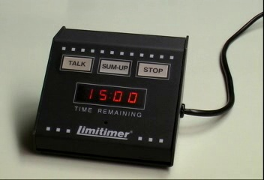
The timer
Organization
– Timing
A timer counts down from 15:00 to 0:00
The clock is started when you begin talking

Slide 55
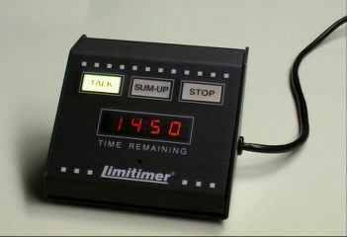
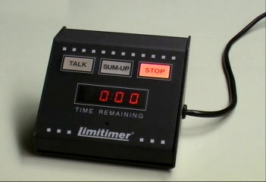
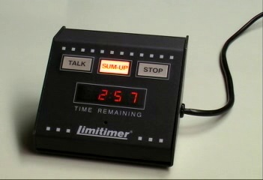
The timer
Organization
– Timing
When the timer starts: TALK
As long as the light is green, keep talking
After 12 minutes: SUM-UP
3 minutes left
After 15 minutes: STOP
Maximum 1 for organization
Listen to the given advice!

Slide 56
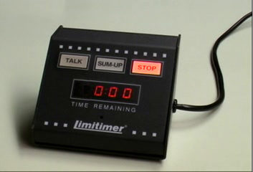
The timer
Organization
– Timing
If you talk for another 30 s
The red light flashes
The timer beeps
You have failed
A bad talk cannot be saved in 30 s...

Slide 57
Organization
We have seen how to organize a presentation through
Your situation
Defining the objective
Structuring the talk
Scalability and flow
Timing

Slide 58
Aspects of good presentations
You are now interested and organized
Interest and knowledge
Organization
Visual aids
Presentation skills
Responding to questions
Our theoretical foundation…

Slide 59
Aspects of good presentations
The next session:
Interest and knowledge
Organization
Visual aids
Presentation skills
Responding to questions

Slide 60
Summary
In this presentation, we have seen:
Background
The Milestone
10 Commandments of Bad Presentations
Two foundational aspects of a good presentation:
Interest and knowledge
Organization
Homework assignment

Slide 61
Summary
The next session will:
Take-up of homework
Consider those aspects which make a presentation out of interest and organization:
Visual aids
Presentation skills
Responding to questions
Consequences of failure

Slide 62
Questions?
“How much easier it is to be critical than to be correct.”
Benjamin Disraeli
References
All references are listed on
http://ece.uwaterloo.ca/~tppe000/
http://ece.uwaterloo.ca/~dwharder/TechnicalPresentations/
All unreferenced images are the work of the author
Some images are published under the GFDL
http://www.gnu.org/copyleft/fdl.html

