Slide 1
Balanced Trees

Slide 2
Outline
In this topic, we will:
Introduce the idea of balance
We will introduce a few examples

Slide 3
Background
Run times depend on the height of the trees
As was noted in the previous section:
The best case height is Θ(ln(n))
The worst case height is Θ(n)
The average height of a randomly generated binary search tree is actually Θ(ln(n))
However, following random insertions and erases, the average height tends to increase to

Slide 4
Requirement for Balance
4.9.1
We want to ensure that the run times never fall into ω(ln(n))
Requirement:
We must maintain a height which is Θ(ln(n))
To do this, we will define an idea of balance

Slide 5
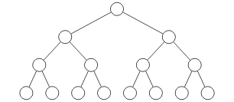
Examples
4.9.1
For a perfect tree, all nodes have the same number of descendants on each side
Perfect binary trees are balanced while linked lists are not

Slide 6
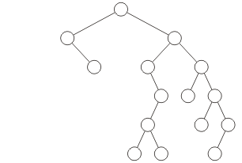
Examples
4.9.1
This binary tree would also probably not be considered to be “balanced” at the root node

Slide 7
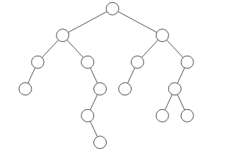
Examples
4.9.1
How about this example?
The root seems balanced, but what about the left sub-tree?

Slide 8
Definition for Balance
4.9.1
We must develop a quantitative definition of balance which can be applied
Balanced may be defined by:
Height balancing: comparing the heights of the two sub trees
Null-path-length balancing: comparing the null-path-length of each of the two sub-trees (the length to the closest null sub-tree/empty node)
Weight balancing: comparing the number of null sub-trees in each of the two sub trees
We will have to mathematically prove that if a tree satisfies the definition of balance, its height is Θ(ln(n))

Slide 9
Definition for Balance
4.9.2
We will see one definition of height balancing:
AVL trees
We will also look at B+-trees
Balanced trees, but not binary trees

Slide 10
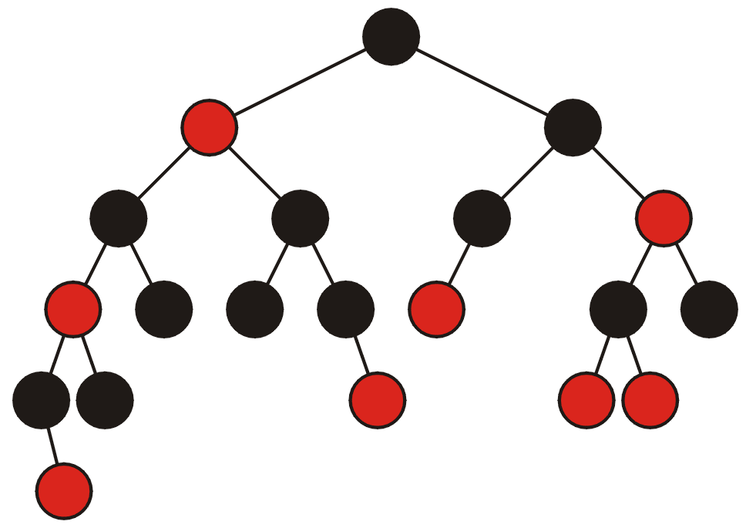
Red-Black Trees
4.9.2.1
Red-black trees maintain balance by
All nodes are colored red or black (0 or 1)
Requirements:
The root must be black
All children of a red node must be black
Any path from the root to an empty node must have the same number of black nodes

Slide 11
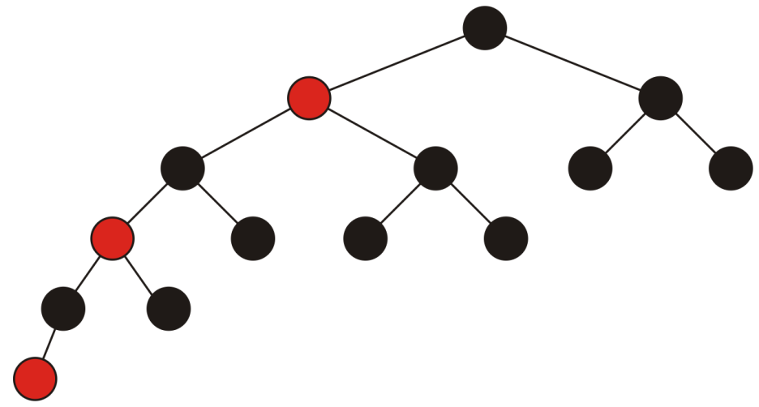
Red-Black Trees
4.9.2.1
Red-black trees are null-path-length balanced in that the null-path length going through one sub-tree must not be greater than twice the null-path length going through the other
A perfect tree of height h has a null-path length of h + 1
Any other tree of height h must have a null-path-length less than h + 1

Slide 12
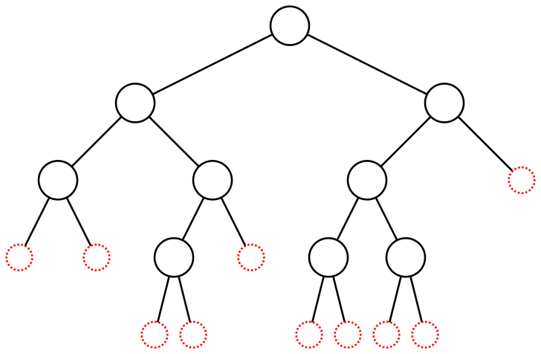
Weight-Balanced Trees
4.9.2.2
Recall: an empty node/null subtree is any position within a binary tree that could be filled with the next insertion:
This tree has 9 nodes and 10 empty nodes:

Slide 13
Weight-Balanced Trees
4.9.2.2
The ratios of the empty nodes at the root node are 5/10 and 5/10

Slide 14
Weight-Balanced Trees
4.9.2.2
The ratios of the empty nodes at this node are 2/5 and 3/5

Slide 15
Weight-Balanced Trees
4.9.2.2
The ratios of the empty nodes at this node, however, are 4/5 and 1/5

Slide 16
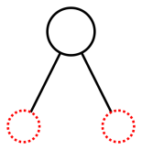
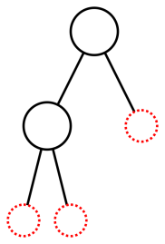
Weight-Balanced Trees
4.9.2.2
BB(α) trees (0 < α ≤ 1/3) maintain weight balance requiring that neither side has less than a α proportion of the empty nodes, i.e., both proportions fall in [α, 1 – α]
With one node, both are 0.5
With two, the proportions are 1/3 and 2/3

Slide 17
Weight-Balanced Trees
4.9.2.2
If α is bounded by
then it will be possible to perform all operations in Θ(ln(n)) time
If α is smaller than 0.25 (larger range) the height of the tree may be ω(ln(n))
If α is greater than , the operations required to maintain balance may be ω(ln(n))

Slide 18
Summary
In this talk, we introduced the idea of balance
We require O(ln(n)) run times
Balance will ensure the height is Θ(ln(n))
There are numerous definitions:
AVL trees use height balancing
Red-black trees use null-path-length balancing
BB(a) trees use weight balancing

Slide 19
References
Blieberger, J., Discrete Loops and Worst Case Performance, Computer Languages, Vol. 20, No. 3, pp.193-212, 1994.

Slide 20
Usage Notes
These slides are made publicly available on the web for anyone to use
If you choose to use them, or a part thereof, for a course at another institution, I ask only three things:
that you inform me that you are using the slides,
that you acknowledge my work, and
that you alert me of any mistakes which I made or changes which you make, and allow me the option of incorporating such changes (with an acknowledgment) in my set of slides
Sincerely,
Douglas Wilhelm Harder, MMath
dwharder@alumni.uwaterloo.ca

