Slide 1
AVL Trees

Slide 2
Outline
Background
Define height balancing
Maintaining balance within a tree
  AVL trees
  Difference of heights
  Maintaining balance after insertions and erases
  Can we store AVL trees as arrays?

Slide 3
Background
From previous lectures:
  Binary search trees store linearly ordered data
  Best case height: Θ(ln(n))
  Worst case height: O(n)
Requirement:
  Define and maintain a balance to ensure Θ(ln(n)) height

Slide 4
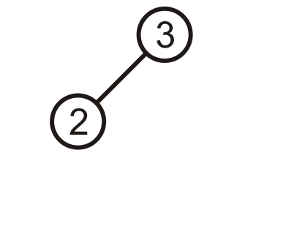
Prototypical Examples
These two examples demonstrate how we can correct for imbalances: starting with this tree, add 1:

Slide 5
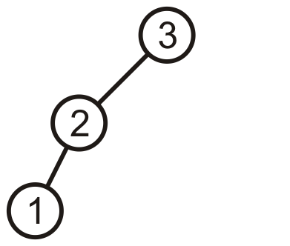
Prototypical Examples
This is more like a linked list; however, we can fix this…

Slide 6
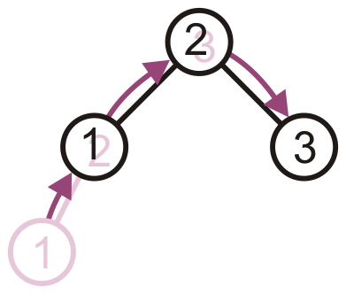
Prototypical Examples
Promote 2 to the root, demote 3 to be 2’s right child, and 1 remains the left child of 2

Slide 7
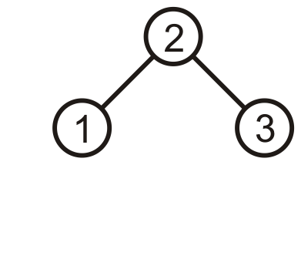
Prototypical Examples
The result is a perfect, though trivial tree

Slide 8
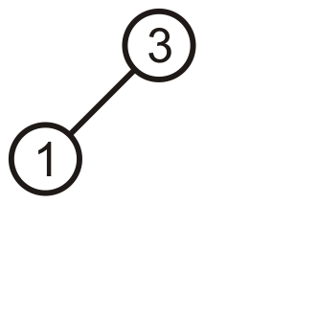
Prototypical Examples
Alternatively, given this tree, insert 2

Slide 9
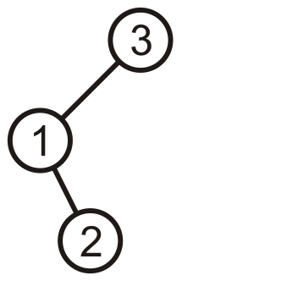
Prototypical Examples
Again, the product is a linked list; however, we can fix this, too

Slide 10
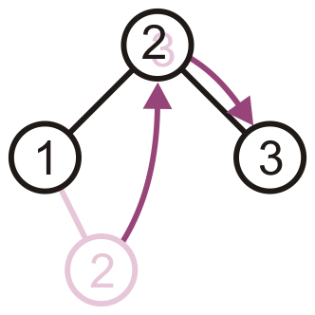
Prototypical Examples
Promote 2 to the root, and assign 1 and 3 to be its children

Slide 11
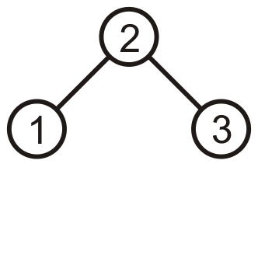
Prototypical Examples
The result is, again, a perfect tree
These examples may seem trivial, but they are the basis for the corrections in the next data structure we will see: AVL trees

Slide 12
AVL Trees
We will focus on the first strategy: AVL trees
  Named after Adelson-Velskii and Landis
Balance is defined by comparing the height of the two sub-trees
Recall:
  An empty tree has height –1
  A tree with a single node has height 0

Slide 13
AVL Trees
A binary search tree is said to be AVL balanced if:
  The difference in the heights between the left and right sub-trees is at most 1, and
  Both sub-trees are themselves AVL trees

Slide 14
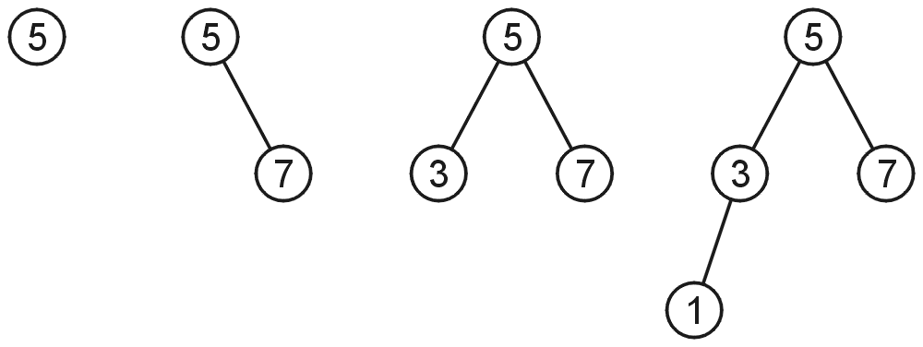
AVL Trees
AVL trees with 1, 2, 3, and 4 nodes:

Slide 15
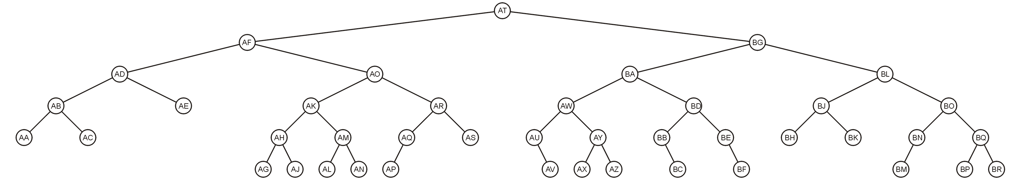
AVL Trees
Here is a larger AVL tree (42 nodes):

Slide 16
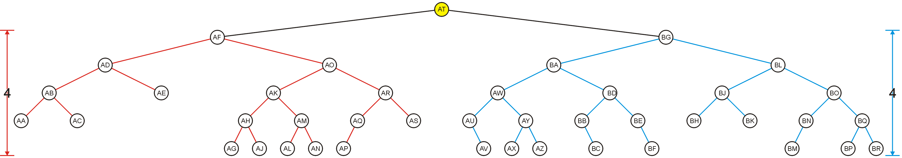
AVL Trees
The root node is AVL-balanced:
  Both sub-trees are of height 4:

Slide 17
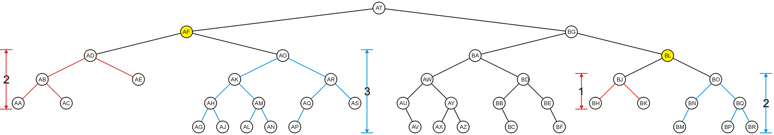
AVL Trees
All other nodes (e.g., AF and BL) are AVL balanced
  The sub-trees differ in height by at most one

Slide 18
Height of an AVL Tree
By the definition of complete trees, any complete binary search tree is an AVL tree
Thus an upper bound on the number of nodes in an AVL tree of height h a perfect binary tree with 2^{h + 1} – 1 nodes
  What is an lower bound?

Slide 19
Height of an AVL Tree
Let F(h) be the fewest number of nodes in a tree of height h
From a previous slide:
  F(0) = 1
  F(1) = 2
  F(2) = 4
Can we find F(h)?

Slide 20
Height of an AVL Tree
The worst-case AVL tree of height h would have:
  A worst-case AVL tree of height h – 1 on one side,
  A worst-case AVL tree of height h – 2 on the other, and
  The root node
We get: F(h) = F(h – 1) + 1 + F(h – 2)

Slide 21
Height of an AVL Tree
This is a recurrence relation:
The solution?
  Note that F(h) + 1 = (F(h – 1) + 1) + (F(h – 2) + 1)
  Therefore, F(h) + 1 is a Fibonacci number:
  F(0) + 1 = 2 → F(0) = 1
  F(1) + 1 = 3 → F(1) = 2
  F(2) + 1 = 5 → F(2) = 4
  F(3) + 1 = 8 → F(3) = 7
  F(4) + 1 = 13 → F(4) = 12
  F(5) + 1 = 21 → F(5) = 20
  F(6) + 1 = 34 → F(6) = 33

Slide 22
Height of an AVL Tree
Alternatively, if it wasn’t so simple:
> rsolve( {F(0) = 1, F(1) = 2,
F(h) = 1 + F(h - 1) + F(h - 2)}, F(h) );
> asympt( %, h );

Slide 23
Height of an AVL Tree
This is approximately
F(h) ≈ 1.8944 φ ^{h} – 1
where φ ≈ 1.6180 is the golden ratio
  That is, F(h) = Ω(φ ^{h})
Thus, we may find the maximum value of h for a given n:
  Recall that the height of a complete tree is h = ⌊lg(n)⌋
    The floor function makes the analysis interesting
    With n = 3 nodes, it can be twice the height
    For n ≥ 4096, 45% worse is an upper bound
Notes:
In actuality, the floor on the log function causes some fluctuation, but 44 % is quite reasonable…

Slide 24
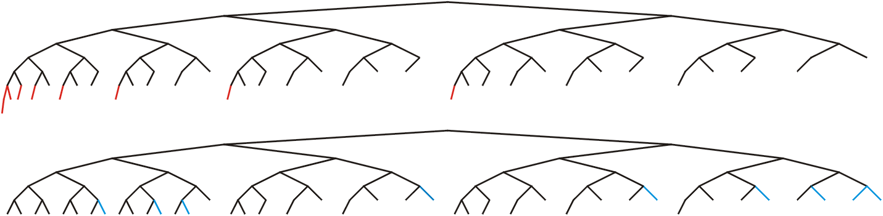
Height of an AVL Tree
In this example, n = 88, the worst- and best-case scenarios differ in height by only 2

Slide 25
Height of an AVL Tree
If n = 10⁶, the bounds on h are:
  The minimum height: log₂( 10⁶ ) – 1 ≈ 19
  the maximum height : log_{φ}( 10⁶ / 1.8944 ) < 28

Slide 26
Maintaining Balance
To maintain AVL balance, observe that:
  Inserting a node can increase the height of a tree by at most 1
  Removing a node can decrease the height of a tree by at most 1

Slide 27
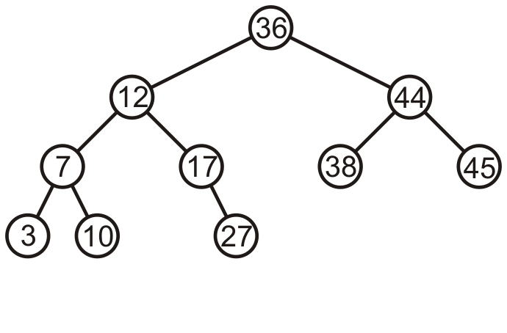
Maintaining Balance
Consider this AVL tree

Slide 28
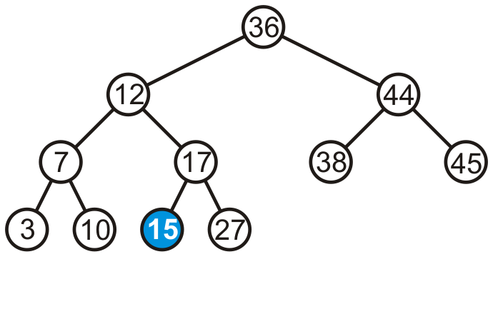
Maintaining Balance
Consider inserting 15 into this tree
  In this case, the heights of none of the trees change

Slide 29
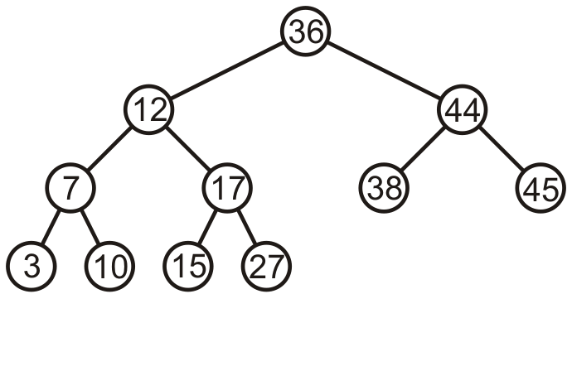
Maintaining Balance
The tree remains balanced

Slide 30
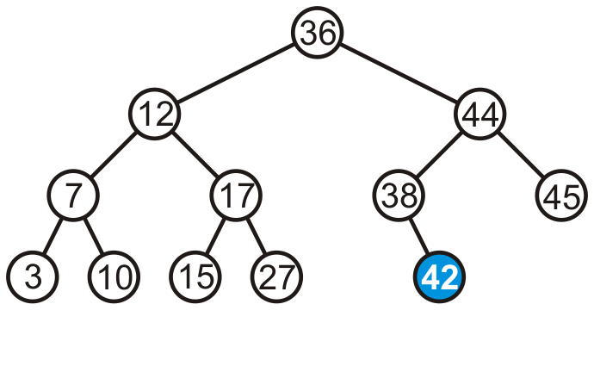
Maintaining Balance
Consider inserting 42 into this tree
  In this case, the heights of none of the trees change

Slide 31
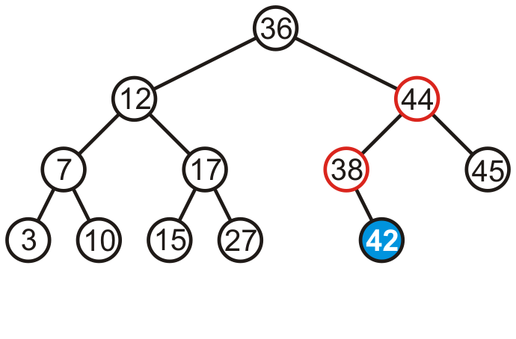
Maintaining Balance
Consider inserting 42 into this tree
  Now we see the heights of two sub-trees have increased by one
  The tree is still balanced

Slide 32
Maintaining Balance
To calculate changes in height, the member function must run
in Θ(1) time
  Our implementation of height is Θ(n):
int Binary_node<Type>::height() const {
if ( left() == nullptr ) {
return ( right() == nullptr ) ? 0 : 1 + right()->height();
} else {
return ( right() == nullptr ) ?
1 + left()->height() :
1 + left()->height() + right()->height();
}

Slide 33
Maintaining Balance
Introduce a member variable
int tree_height;
The member function is now:
template <typename Type>
int AVL_node<Type>::height() const {
return tree_height;
}

Slide 34
Maintaining Balance
Only insert and erase may change the height
  This is the only place we need to update the height
  These algorithms are already recursive

Slide 35
Insert
template <typename Type>
bool AVL_node<Type>::insert( const Type & obj ) {
if ( obj < value() ) {
if ( left() == nullptr ) {
p_left_tree = new AVL_node( obj );
tree_height = 1; // the height must be 1 for an AVL tree (why?)
else if ( left()->insert( obj, p_left_tree ) ) {
tree_height = max( height(), 1 + left()->height() );
return true;
} else {
return false;
}
} else if ( obj > value() ) {
// ...
} else {
return false;
}
}

Slide 36
Maintaining Balance
If a tree is AVL balanced, for an insertion to cause an imbalance:
  The heights of the sub-trees must differ by 1
  The insertion must increase the height of the deeper sub-tree by 1

Slide 37
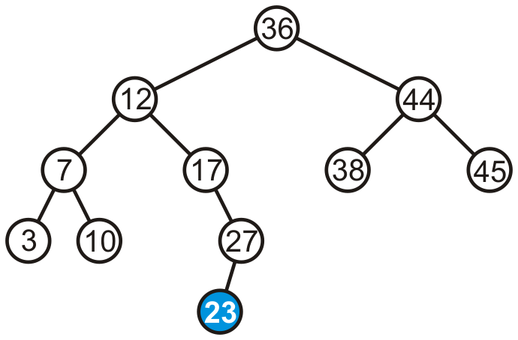
Maintaining Balance
Suppose we insert 23 into our initial tree

Slide 38
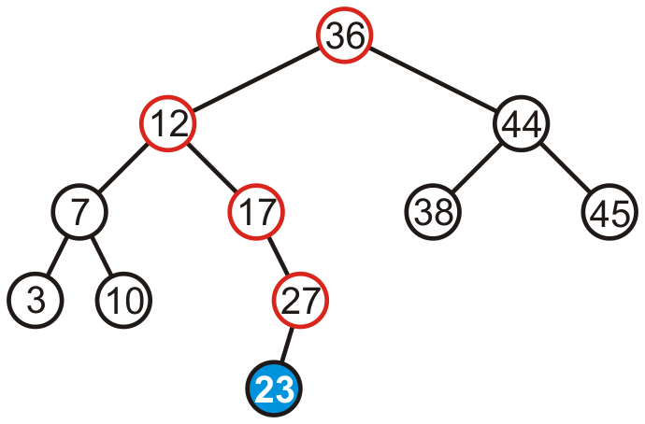
Maintaining Balance
The heights of each of the sub-trees from here to the root are increased by one

Slide 39
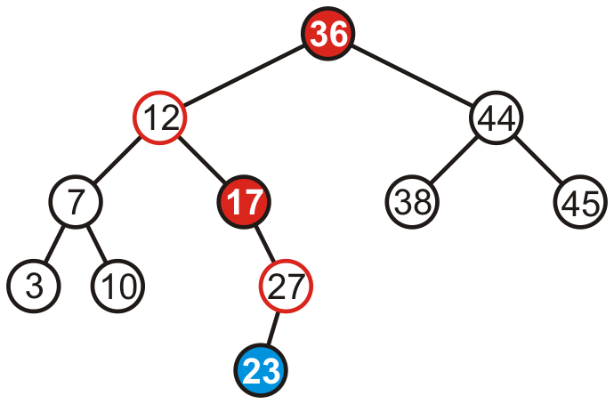
Maintaining Balance
However, only two of the nodes are unbalanced: 17 and 36

Slide 40
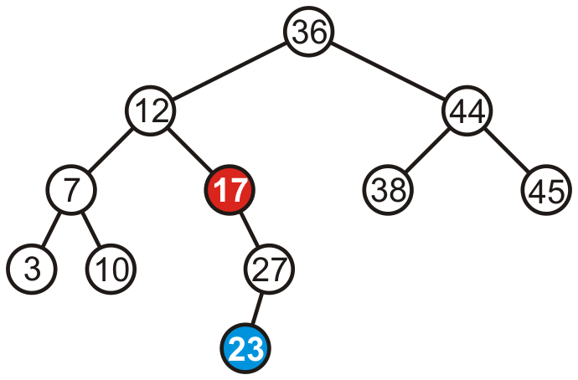
Maintaining Balance
However, only two of the nodes are unbalanced: 17 and 36
  We only have to fix the imbalance at the lowest node

Slide 41
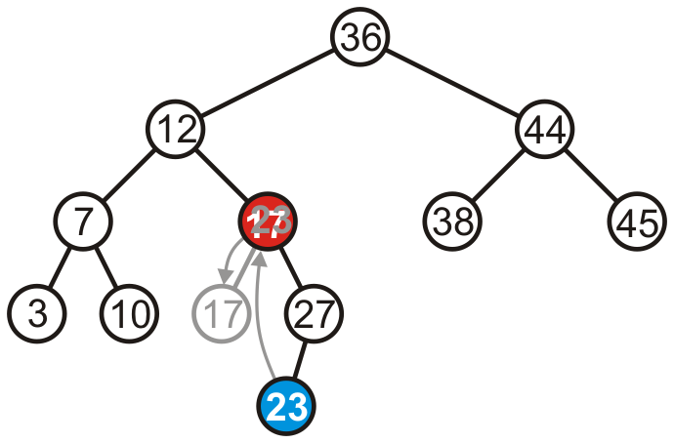
Maintaining Balance
We can promote 23 to where 17 is, and make 17 the left child of 23

Slide 42
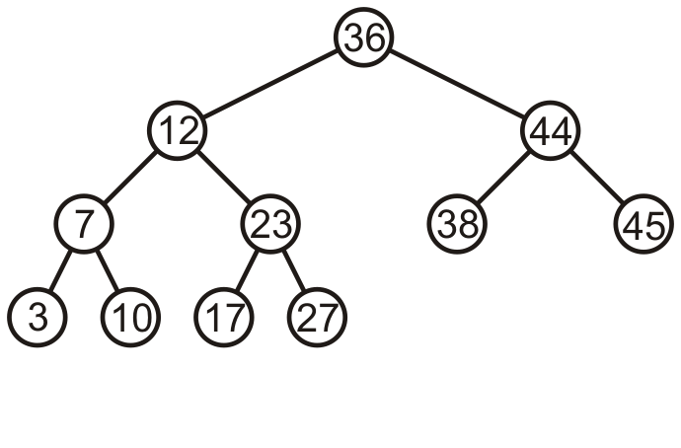
Maintaining Balance
Thus, that node is no longer unbalanced
  Incidentally, neither is the root now balanced again, too

Slide 43
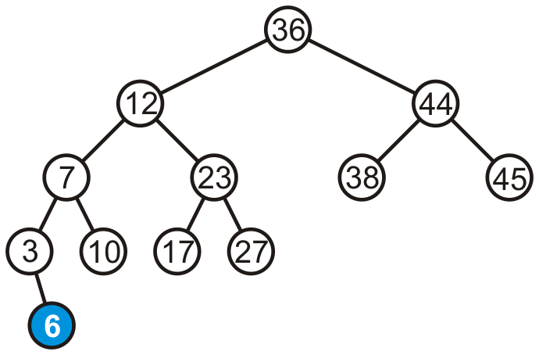
Maintaining Balance
Consider adding 6:

Slide 44
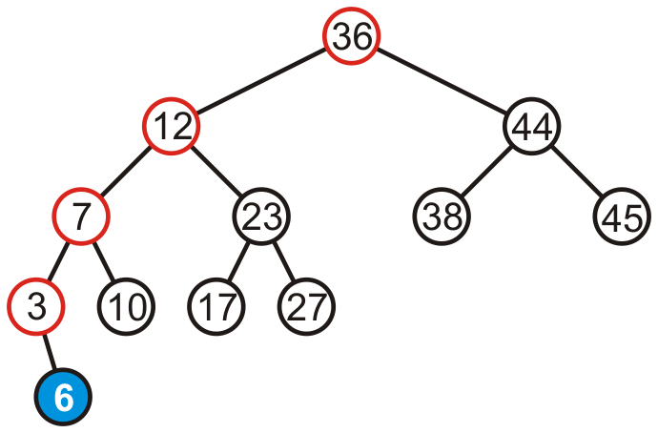
Maintaining Balance
The height of each of the trees in the path back to the root are increased by one

Slide 45
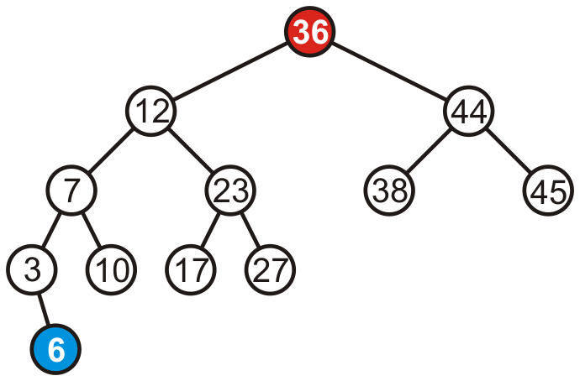
Maintaining Balance
The height of each of the trees in the path back to the root are increased by one
  However, only the root node is now unbalanced

Slide 46
Maintaining Balance
To fix this, we will look at the general case…

Slide 47
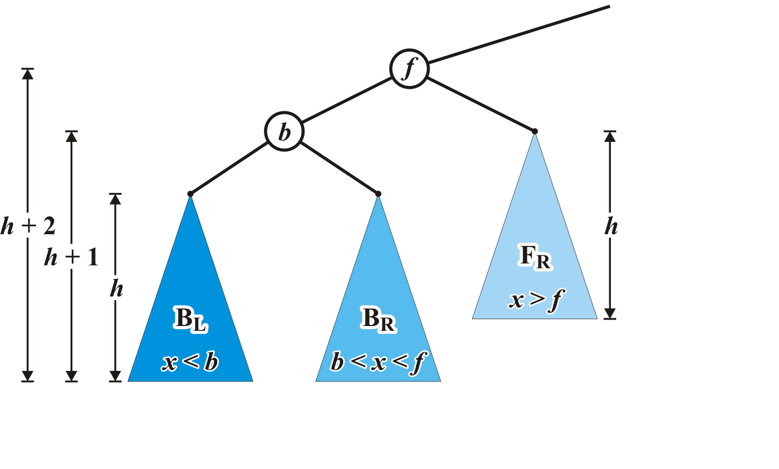
Maintaining Balance: Case 1
Consider the following setup
  Each blue triangle represents a tree of height h

Slide 48
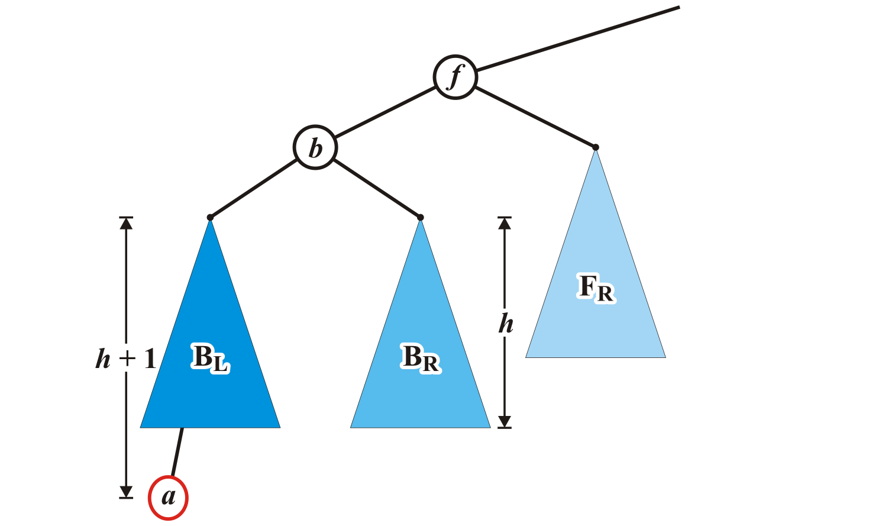
Maintaining Balance: Case 1
Insert a into this tree: it falls into the left subtree B_{L} of b
  Assume B_{L} remains balanced
  Thus, the tree rooted at b is also balanced

Slide 49
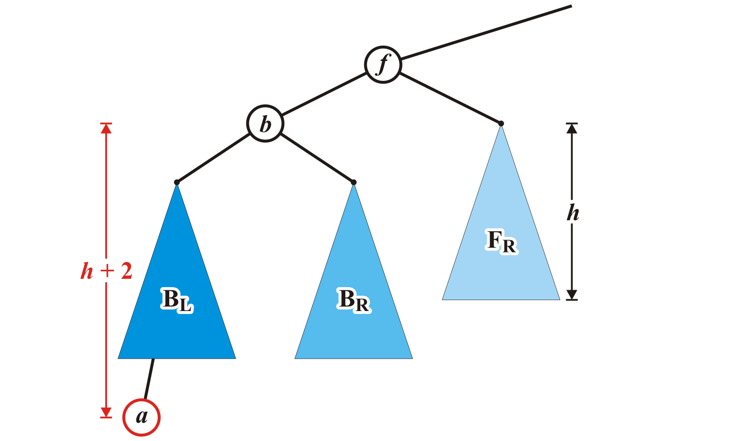
Maintaining Balance: Case 1
The tree rooted at node f is now unbalanced
  We will correct the imbalance at this node

Slide 50
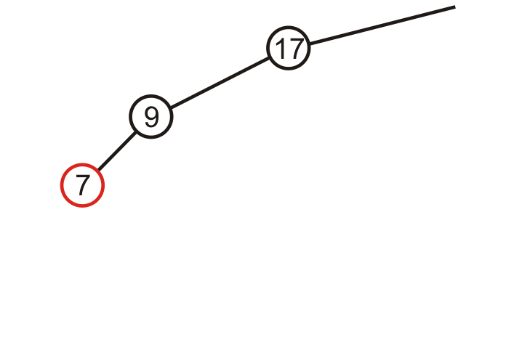
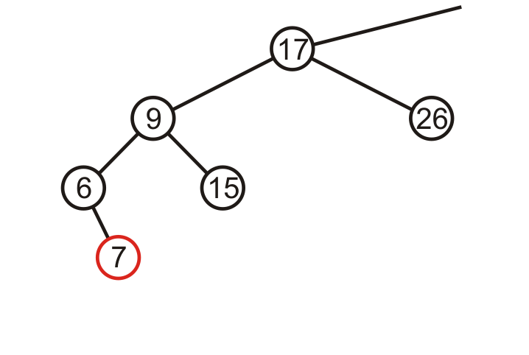

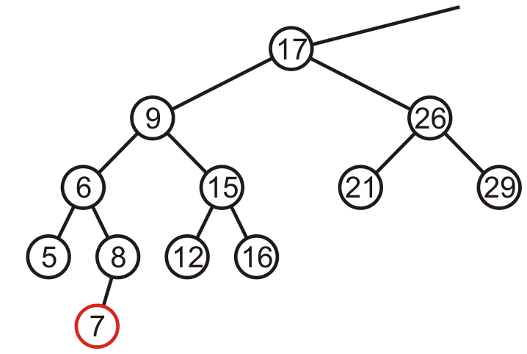
Maintaining Balance: Case 1
Here are examples of when the
insertion of 7 may cause this
situation when h = –1, 0, and 1

Slide 51
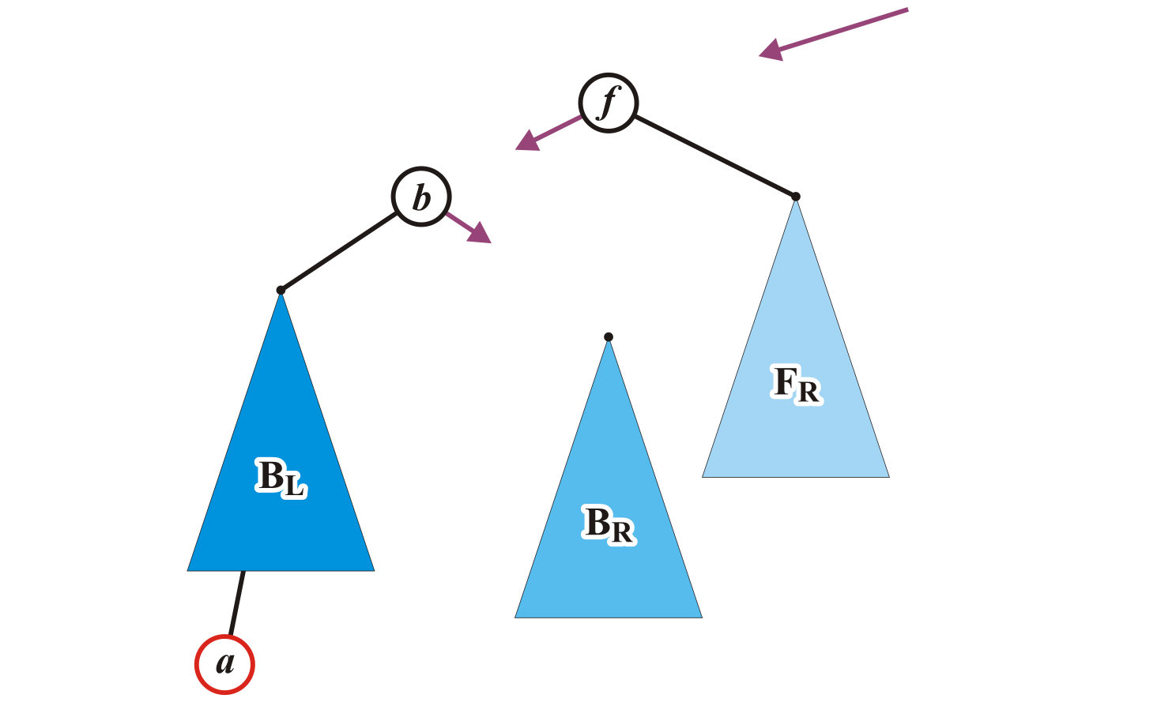
Maintaining Balance: Case 1
We will modify these three pointers
  At this point, this references the unbalanced root node f

Slide 52
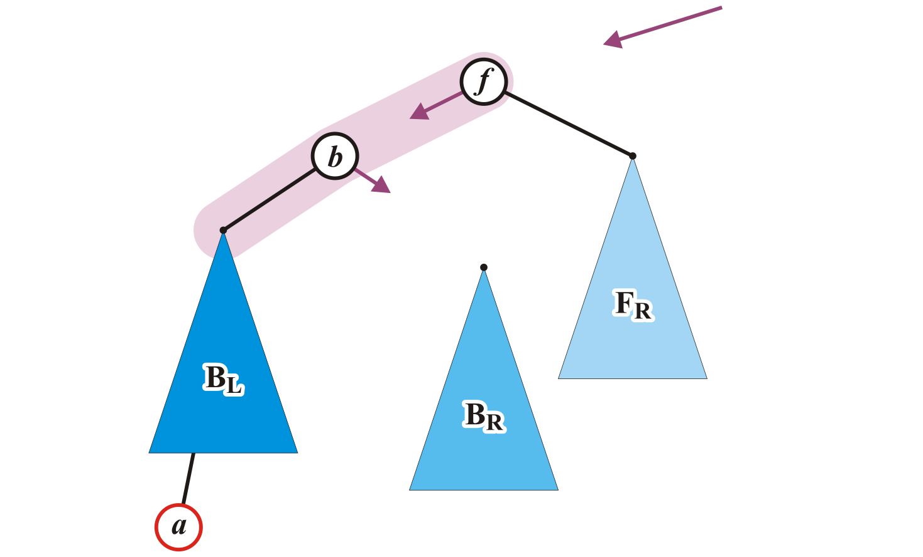
Maintaining Balance: Case 1
Specifically, we will rotate these two nodes around the root:
  Recall the first prototypical example
  Promote node b to the root and demote node f to be the right child of b
AVL_node<Type> *b = left(),
*BR = b->right();

Slide 53
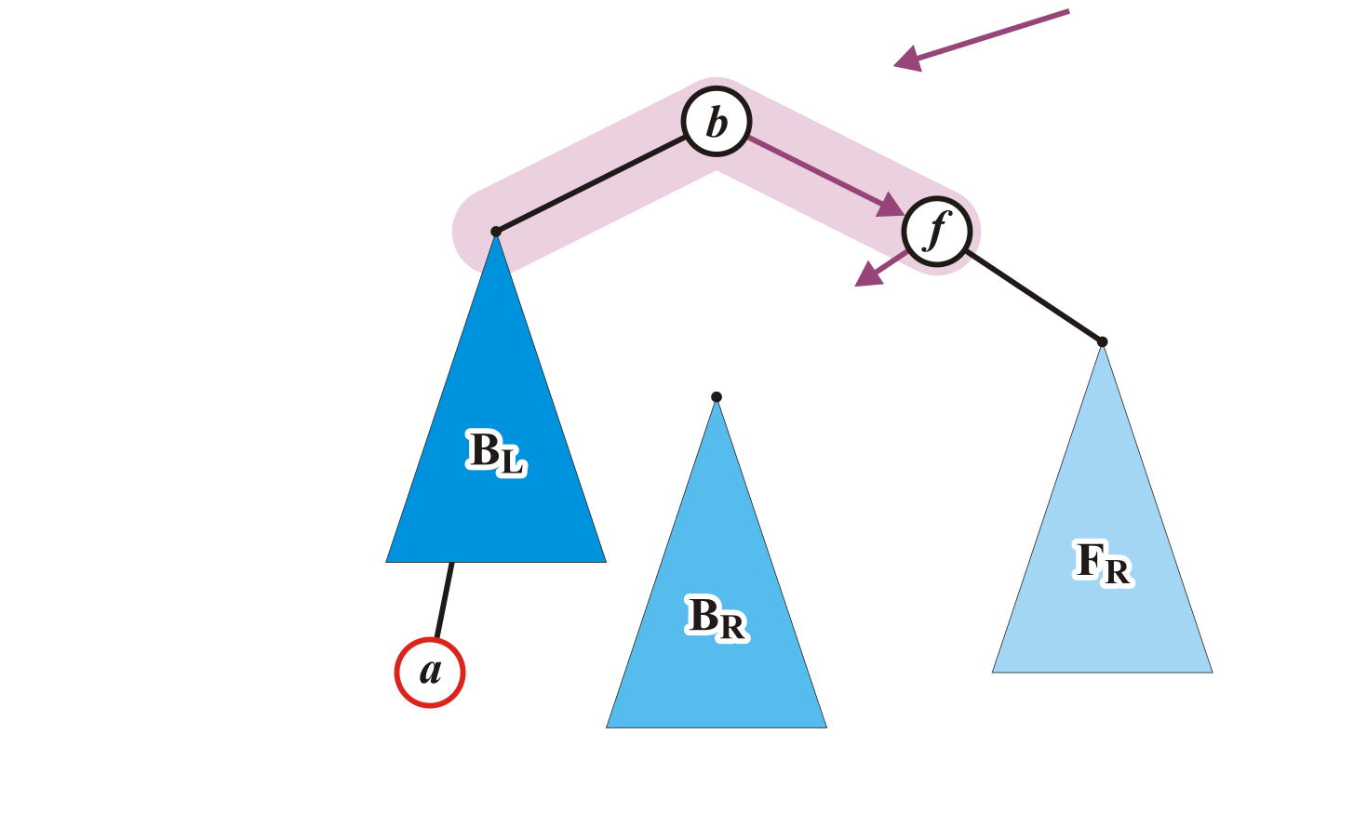
Maintaining Balance: Case 1
This requires the address of node f to be assigned to the p_right_tree member variable of node b
AVL_node<Type> *b = left(),
*BR = b->right();
b->p_right_tree = this;

Slide 54
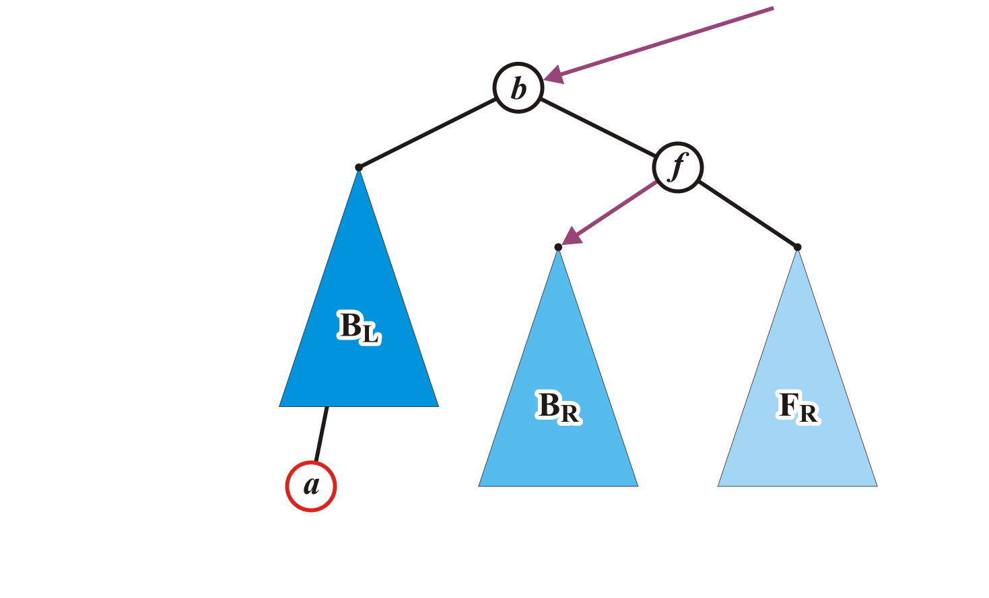
Maintaining Balance: Case 1
Assign any former parent of node f to the address of node b
Assign the address of the tree B_{R} to p_left_tree of node f
p_to_this = b;
p_left_tree = BR;
AVL_node<Type> *b = left(),
*BR = b->right();
b->p_right_tree = this;

Slide 55
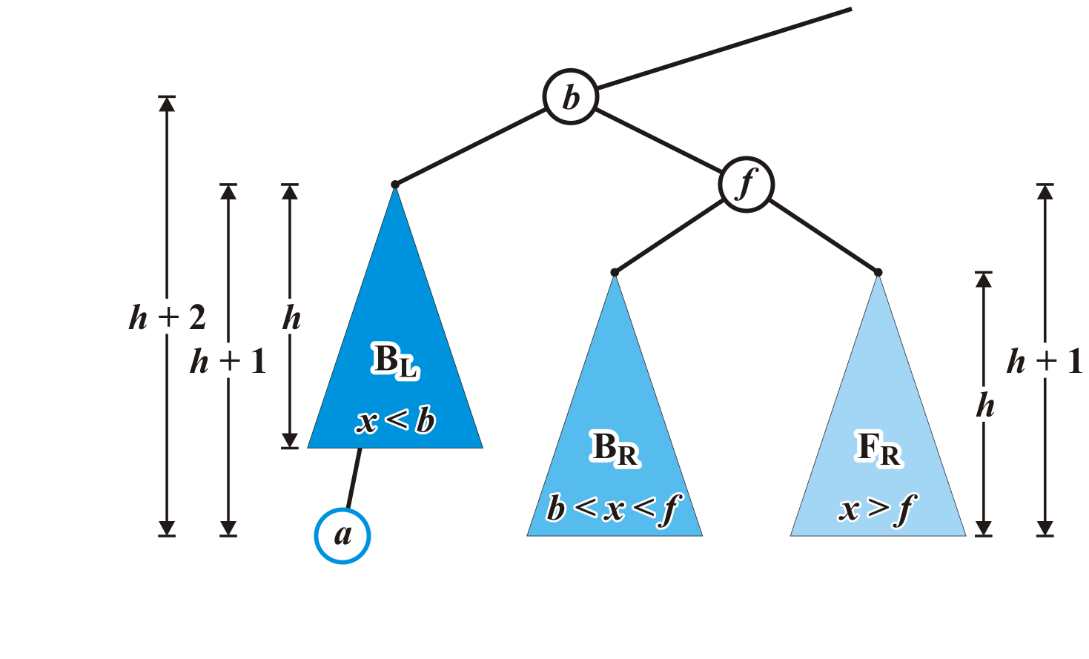
Maintaining Balance: Case 1
The nodes b and f are now balanced and all remaining nodes of the subtrees are in their correct positions
  The height of f is now h + 1 while b remains at height h + 2

Slide 56
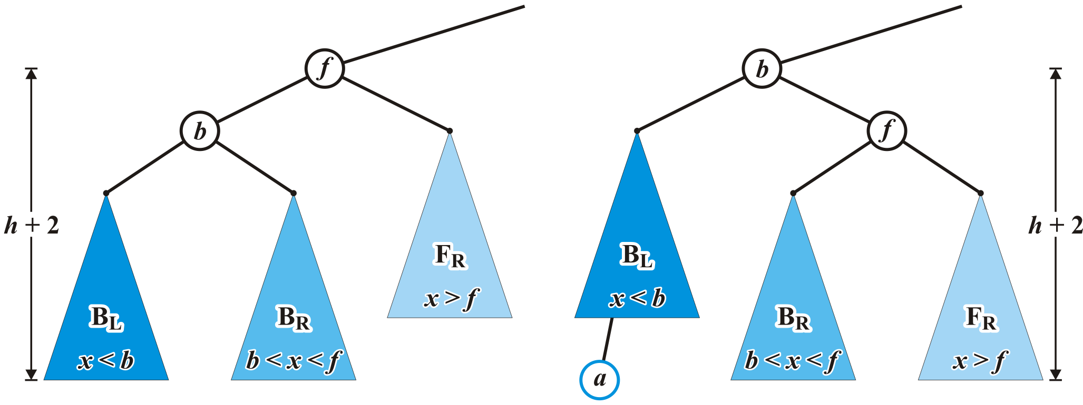
Maintaining Balance: Case 1
Additionally, height of the corrected tree rooted at b equals the original height of the tree rooted at f
  Thus, this insertion will no longer affect the balance of any ancestors all the way back to the root

Slide 57
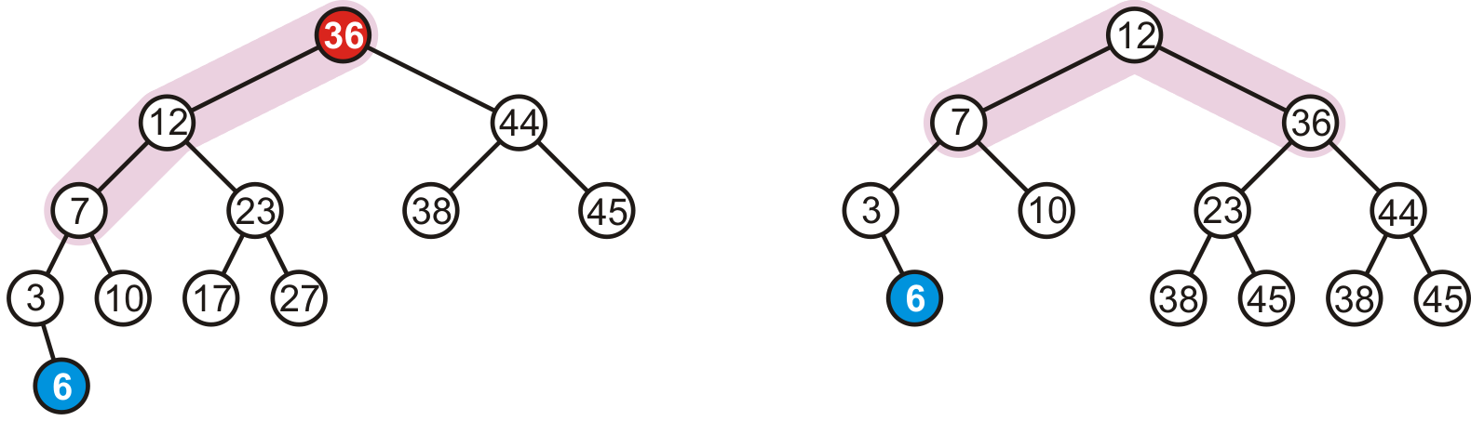
Maintaining Balance: Case 1
In our example case, the correction

Slide 58
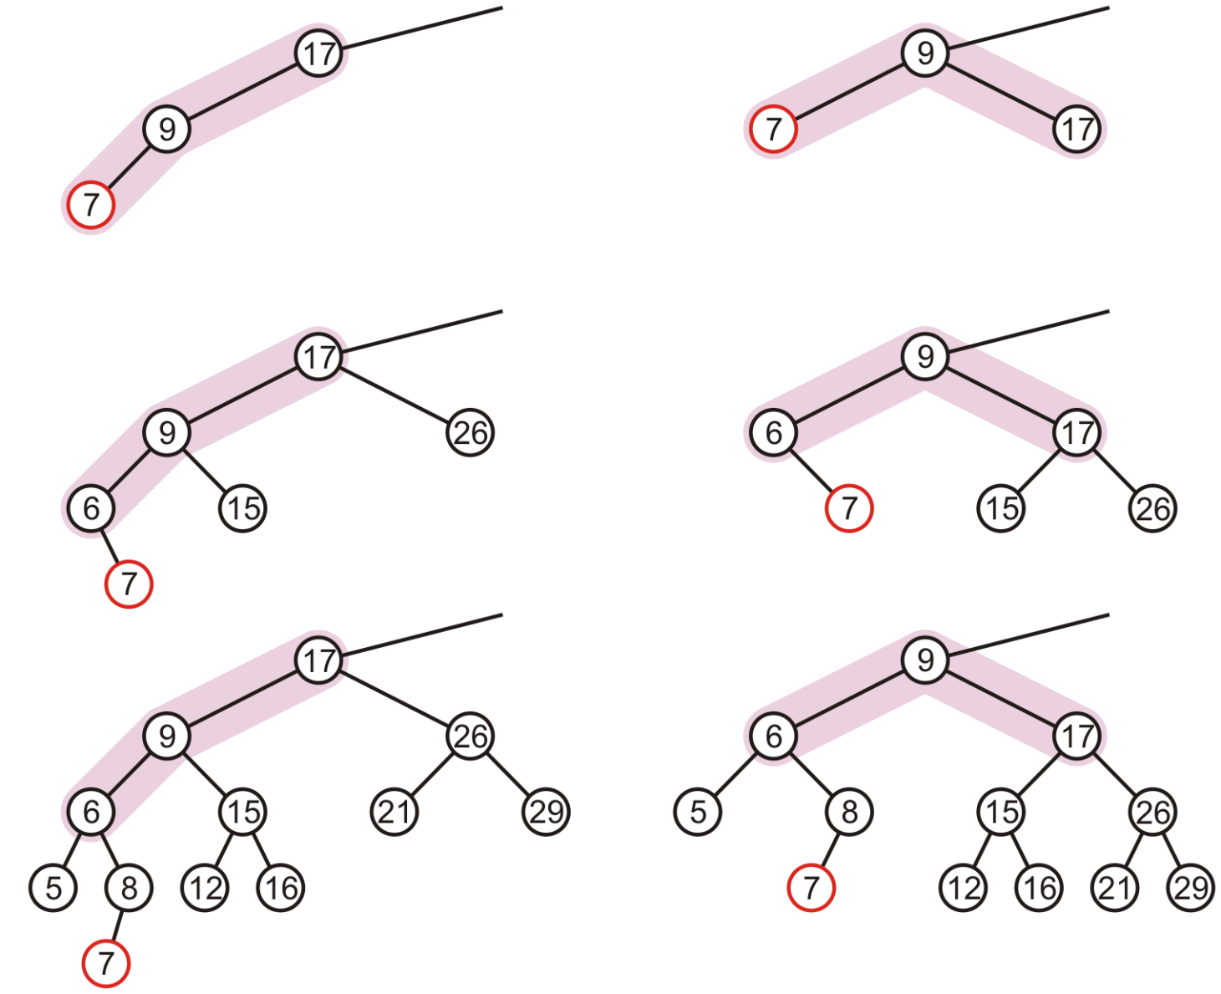
Maintaining Balance: Case 1
In our three sample cases
with h = –1, 0, and 1, the
node is now balanced
and the same height
as the tree before the
insertion

Slide 59
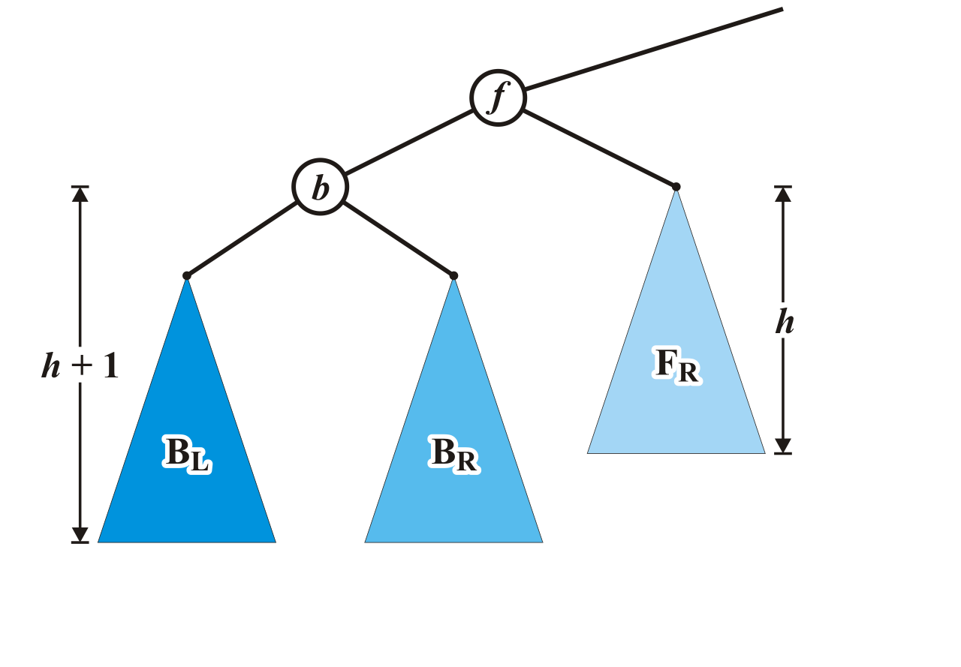
Maintaining Balance: Case 2
Alternatively, consider the insertion of c where b < c < f into our original tree

Slide 60
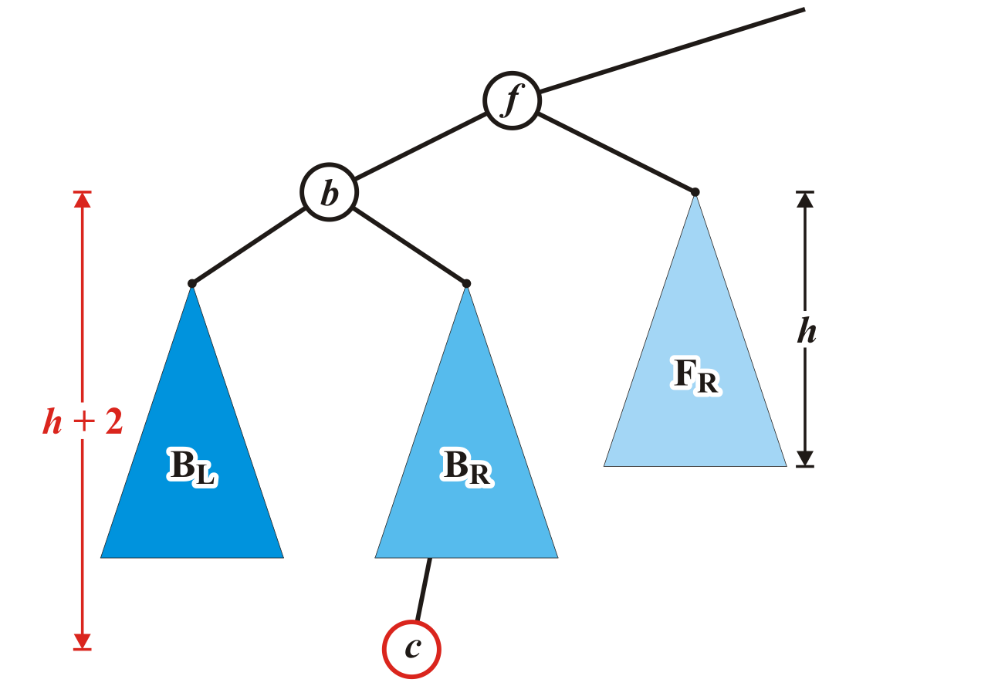
Maintaining Balance: Case 2
Assume that the insertion of c increases the height of B_{R}
  Once again, f becomes unbalanced

Slide 61
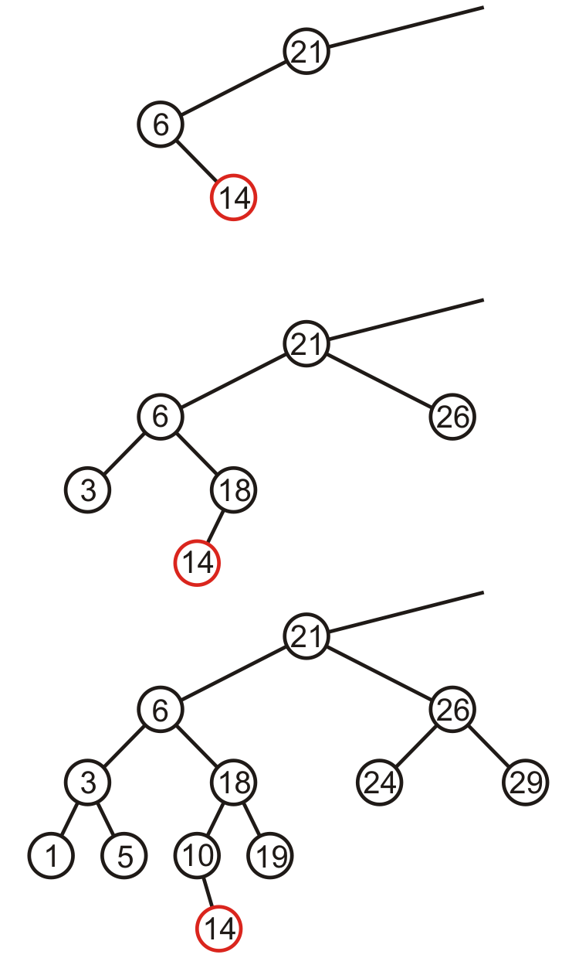
Maintaining Balance: Case 2
Here are examples of when the
insertion of 14 may cause this
situation when h = –1, 0, and 1

Slide 62
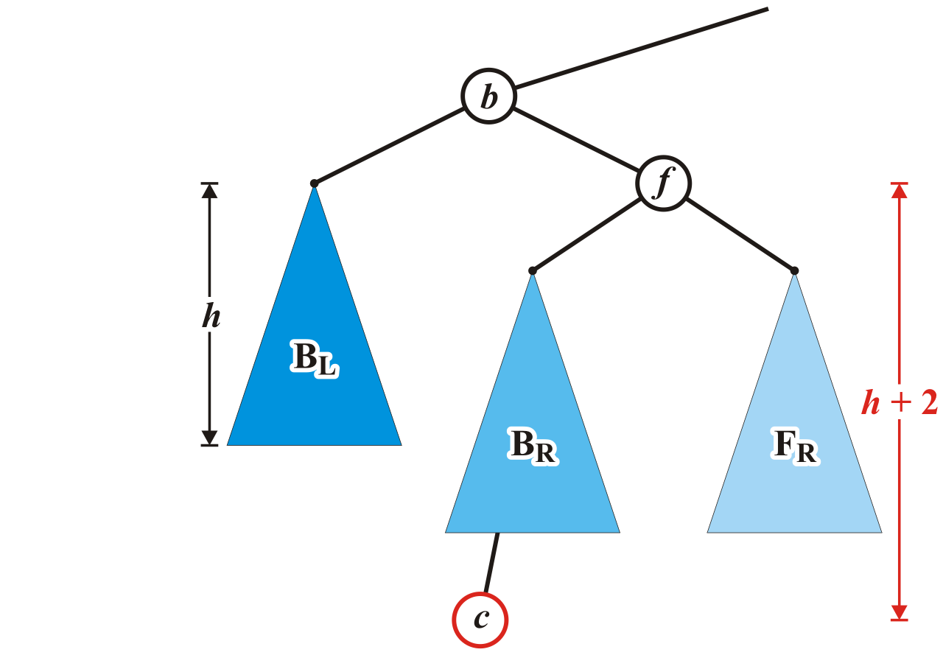
Maintaining Balance: Case 2
Unfortunately, the previous correction does not fix the imbalance at the root of this sub-tree: the new root, b, remains unbalanced

Slide 63
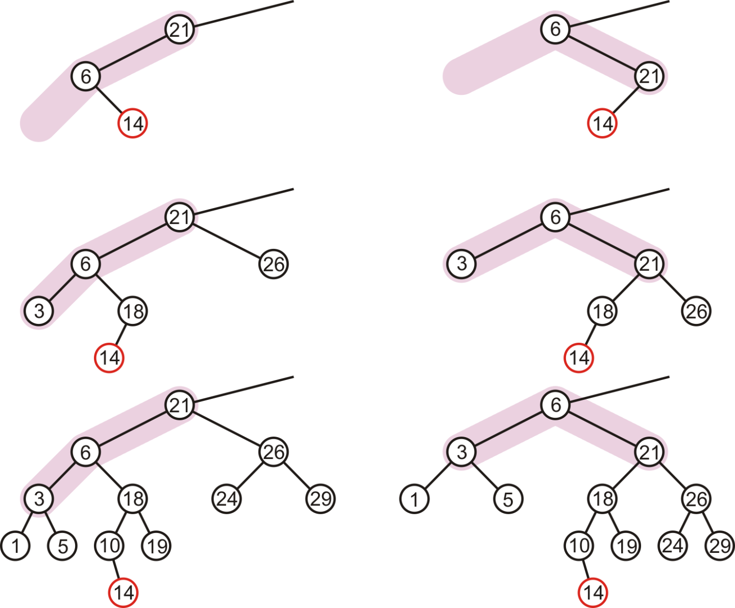
Maintaining Balance: Case 2
In our three sample cases
with h = –1, 0, and 1,
doing the same thing
as before results in
a tree that is still
unbalanced…
  The imbalance is just
  shifted to the other
  side

Slide 64
Maintaining Balance: Case 2
Unfortunately, this does not fix the imbalance at the root of this subtree

Slide 65
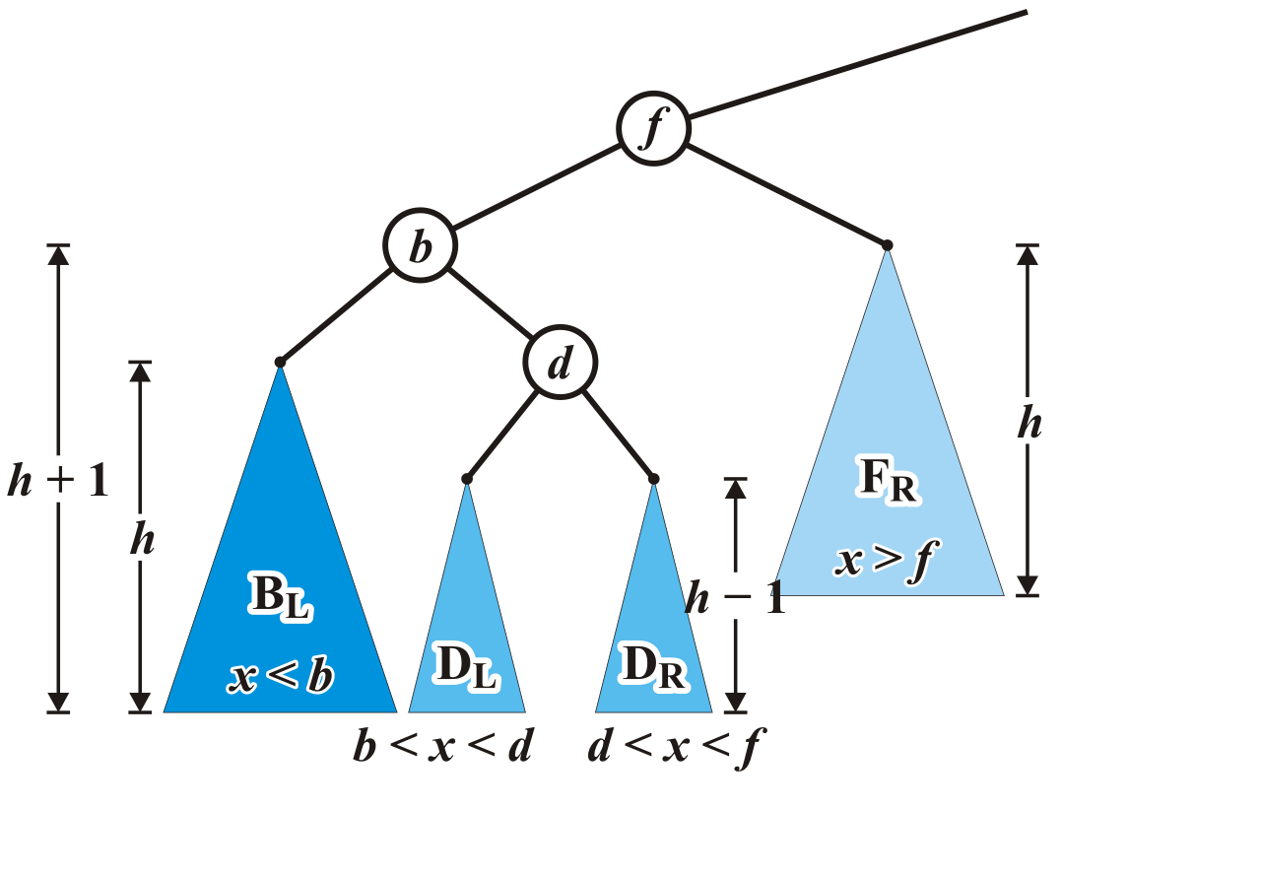
Maintaining Balance: Case 2
Re-label the tree by dividing the left subtree of f into a tree rooted at d with two subtrees of height h – 1

Slide 66
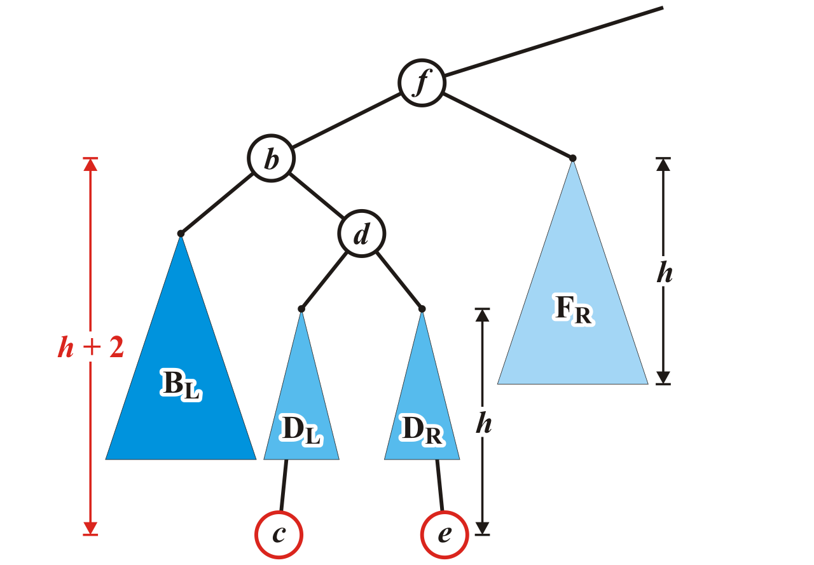
Maintaining Balance: Case 2
Now an insertion causes an imbalance at f
  The addition of either c or e will cause this

Slide 67
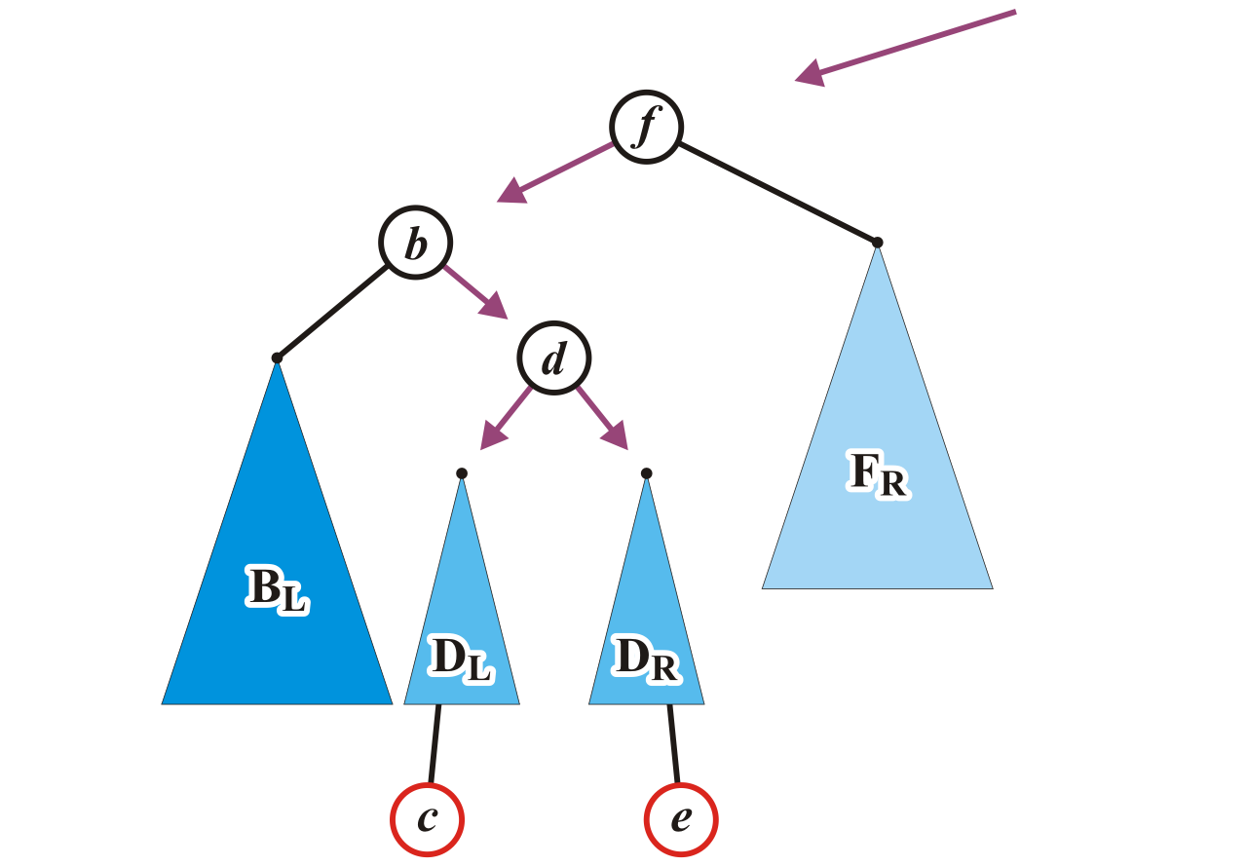
Maintaining Balance: Case 2
We will reassign the following pointers
AVL_node<Type> *b = left(),
*d = b->right(),
*DL = d->left(),
*DR = d->right();

Slide 68
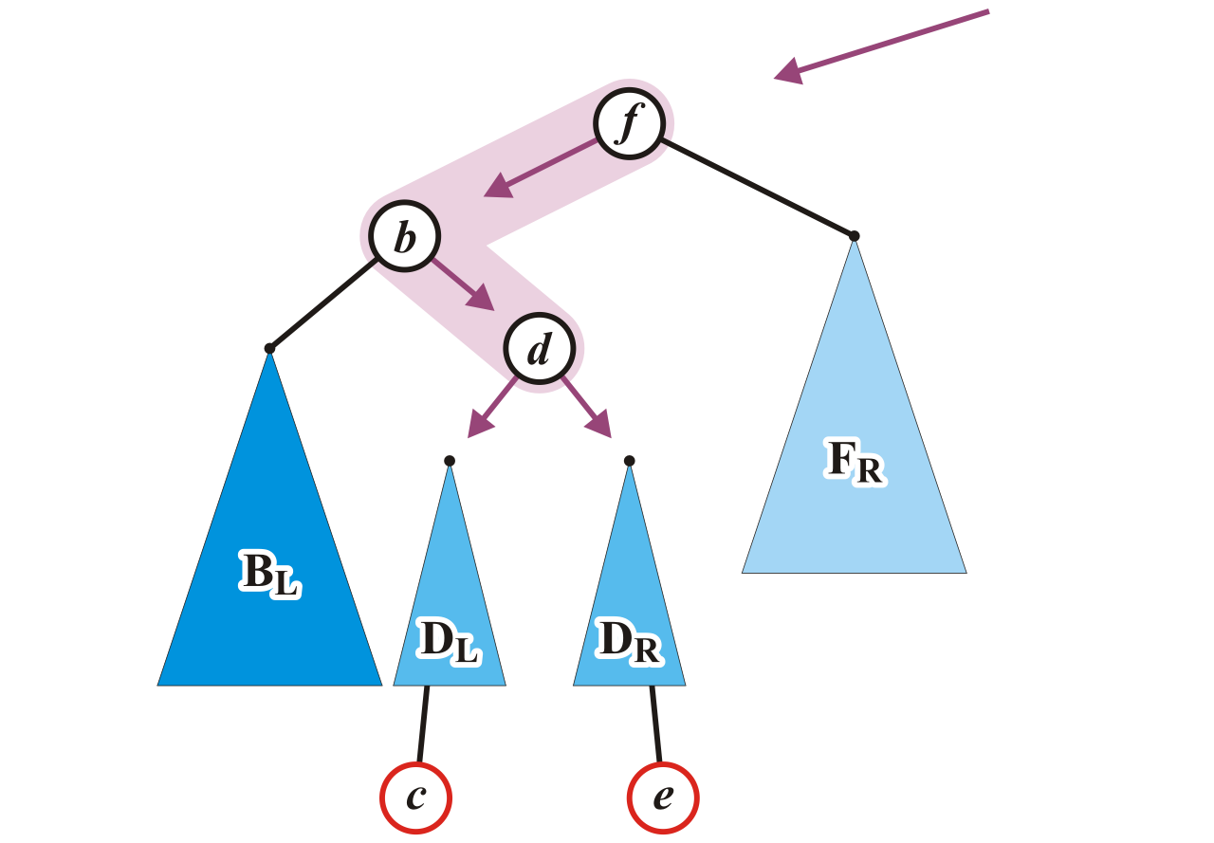
Maintaining Balance: Case 2
Specifically, we will order these three nodes as a perfect tree
  Recall the second prototypical example
AVL_node<Type> *b = left(),
*d = b->right(),
*DL = d->left(),
*DR = d->right();

Slide 69

Maintaining Balance: Case 2
To achieve this, b and f will be assigned as children of the new root d
AVL_node<Type> *b = left(),
*d = b->right(),
*DL = d->left(),
*DR = d->right();
d->p_left_tree = b;
d->p_right_tree = this;

Slide 70

Maintaining Balance: Case 2
We also have to connect the two subtrees and original parent of f
AVL_node<Type> *b = left(),
*d = b->right(),
*DL = d->left(),
*DR = d->right();
d->p_left_tree = b;
d->p_right_tree = this;
p_to_this = d;
b->p_right_tree = DL;
p_left_tree = DR;

Slide 71

Maintaining Balance: Case 2
Now the tree rooted at d is balanced
  After the correction, height of b and f become h + 1 and d is h + 2

Slide 72

Maintaining Balance: Case 2
Again, the height of the root did not change
  The heights of all three nodes changed in this process

Slide 73

Maintaining Balance: Case 2
In our three sample cases
with h = –1, 0, and 1, the
node is now balanced
and the same height
as the tree before the
insertion

Slide 74


Maintaining balance: Summary
There are two symmetric cases to those we have examined:
  Insertions into the right-right sub-tree
  Insertions into either the right-left sub-tree

Slide 75
Insert (Implementation)
template <typename Type>
void AVL_node<Type>::insert( const Type & obj, AVL_node<Type> *p_to_this ) {
if ( obj < value() ) {
if ( left() == nullptr ) {
p_left_tree = new AVL_node( obj );
tree_height = 1; // the height must be 1 for an AVL tree
// no balancing necessary (why?)
else if ( left()->insert( obj, p_left_tree ) ) {
if ( (right() == nullptr) || (left()->height() - right()->height() == 2) ) {
// determine if it is a left-left or left-right insertion
// perform the appropriate correction
// - update heights as necessary
}
tree_height = std::max( height(), 1 + left()->height() );
return true;
} else {
return false;
}
} else if ( obj > value() ) {
// ...
} else {
return false;
}

Slide 76
Insertion (Implementation)
Comments:
  Both balances are Θ(1)
  All insertions are still Θ(ln(n))
  It is possible to tighten the previous code
  Aside
    if you want to explicitly rotate the nodes A and B, you must also pass a reference to the parent pointer as an argument:
    insert( Type obj, AVL_node<Type> * & parent )

Slide 77

Insertion
Consider this AVL tree

Slide 78

Insertion
Insert 73

Slide 79

Insertion
The node 81 is unbalanced
  A left-left imbalance

Slide 80
Insertion
The node 81 is unbalanced
  A left-left imbalance

Slide 81
Insertion
The node 81 is unbalanced
  A left-left imbalance
  Promote the intermediate node to the imbalanced node

Slide 82
Insertion
The node 81 is unbalanced
  A left-left imbalance
  Promote the intermediate node to the imbalanced node
  75 is that node

Slide 83

Insertion
The node 81 is unbalanced
  A left-left imbalance
  Promote the intermediate node to the imbalanced node
  75 is that node

Slide 84

Insertion
The tree is AVL balanced

Slide 85

Insertion
Insert 77

Slide 86

Insertion
The node 87 is unbalanced
  A left-right imbalance

Slide 87
Insertion
The node 87 is unbalanced
  A left-right imbalance

Slide 88
Insertion
The node 87 is unbalanced
  A left-right imbalance
  Promote the intermediate node to the imbalanced node

Slide 89
Insertion
The node 87 is unbalanced
  A left-right imbalance
  Promote the intermediate node to the imbalanced node
  81 is that value

Slide 90

Insertion
The node 87 is unbalanced
  A left-right imbalance
  Promote the intermediate node to the imbalanced node
  81 is that value

Slide 91

Insertion
The tree is balanced

Slide 92

Insertion
Insert 76

Slide 93

Insertion
The node 78 is unbalanced
  A left-left imbalance

Slide 94

Insertion
The node 78 is unbalanced
  Promote 77

Slide 95

Insertion
Again, balanced

Slide 96

Insertion
Insert 80

Slide 97

Insertion
The node 69 is unbalanced
  A right-left imbalance
  Promote the intermediate node to the imbalanced node

Slide 98

Insertion
The node 69 is unbalanced
  A left-right imbalance
  Promote the intermediate node to the imbalanced node
  75 is that value

Slide 99

Insertion
Again, balanced

Slide 100

Insertion
Insert 74

Slide 101

Insertion
The node 72 is unbalanced
  A right-right imbalance
  Promote the intermediate node to the imbalanced node
  75 is that value

Slide 102

Insertion
The node 72 is unbalanced
  A right-right imbalance
  Promote the intermediate node to the imbalanced node

Slide 103

Insertion
Again, balanced

Slide 104

Insertion
Insert 64

Slide 105
Insertion
This causes no imbalances

Slide 106

Insertion
Insert 55

Slide 107

Insertion
The node 69 is imbalanced
  A left-left imbalance
  Promote the intermediate node to the imbalanced node

Slide 108

Insertion
The node 69 is imbalanced
  A left-left imbalance
  Promote the intermediate node to the imbalanced node
  63 is that value

Slide 109

Insertion
The tree is now balanced

Slide 110

Insertion
Insert 70

Slide 111

Insertion
The root node is now imbalanced
  A right-left imbalance
  Promote the intermediate node to the root
  75 is that value

Slide 112

Insertion
The root node is imbalanced
  A right-left imbalance
  Promote the intermediate node to the root
  63 is that node

Slide 113

Insertion
The result is AVL balanced

Slide 114
Erase
Removing a node from an AVL tree may cause more than one AVL imbalance
  Like insert, erase must check after it has been successfully called on a child to see if it caused an imbalance
  Unfortunately, it may cause O(h) imbalances that must be corrected
    Insertions will only cause one imbalance that must be fixed
  The movement of trees, however, may require that more than one node within the triplet has its height corrected

Slide 115

Erase
Consider the following AVL tree

Slide 116

Erase
Suppose we erase the front node: 1

Slide 117

Erase
While its previous parent, 2, is not unbalanced, its grandparent 3 is
  The imbalance is in the right-right subtree

Slide 118

Erase
We can correct this with a simple balance

Slide 119

Erase
The node of that subtree, 5, is now balanced

Slide 120

Erase
Recursing to the root, however, 8 is also unbalanced
  This is a right-left imbalance

Slide 121

Erase
Promoting 11 to the root corrects the imbalance

Slide 122

Erase
At this point, the node 11 is balanced

Slide 123

Erase
Still, the root node is unbalanced
  This is a right-right imbalance

Slide 124

Erase
Again, a simple balance fixes the imbalance

Slide 125

Erase
The resulting tree is now AVL balanced
  Note, few erases will require one balance, even fewer will require more than one

Slide 126
AVL Trees as Arrays?
We previously saw that:
  Complete tree can be stored using an array using Θ(n) memory
  An arbitrary tree of n nodes requires O(2^{n}) memory
Is it possible to store an AVL tree as an array and not require exponentially more memory?

Slide 127
AVL Trees as Arrays?
Recall that in the worst case, an AVL tree of n nodes has a height at most
log_{φ}(n) – 1.3277
Such a tree requires an array of size
2^{logφ(n) – 1.3277 + 1} – 1
We can rewrite this as
2^{–0.3277} n^{logφ(2)} ≈ 0.7968 n^{1.44}
Thus, we would require O(n^{1.44}) memory
Notes:
Recall that a^{log[b](c)} = c^{log[b](a)} for all values of a, b, and c.
Here, log[b](c) is the logarithm base ‘b’ of c.

Slide 128

AVL Trees as Arrays?
While the polynomial behaviour of n^{1.44} is not as bad as exponential behaviour, it is still reasonably sub-optimal when compared to the linear growth associated with link-
allocated trees
Here we see n and n^{1.44} on [0, 1000]

Slide 129
Summary
In this topic we have covered:
  AVL balance is defined by ensuring the difference in heights is 0 or 1
  Insertions and erases are like binary search trees
  Each insertion requires at least one correction to maintain AVL balance
  Erases may require O(h) corrections
  These corrections require Θ(1) time
  Depth is Θ( ln(n) )
  ∴ all O(h) operations are O( ln(n) )

Slide 130
Usage Notes
These slides are made publicly available on the web for anyone to use
If you choose to use them, or a part thereof, for a course at another institution, I ask only three things:
  that you inform me that you are using the slides,
  that you acknowledge my work, and
  that you alert me of any mistakes which I made or changes which you make, and allow me the option of incorporating such changes (with an acknowledgment) in my set of slides
  Sincerely,
  Douglas Wilhelm Harder, MMath
  dwharder@alumni.uwaterloo.ca

