Slide 1
Chained hash tables

Slide 2
Outline
We have:
Discussed techniques for hashing
Discussed mapping down to a given range 0, ..., M – 1
Now we must deal with collisions
Numerous techniques exist
Containers in general
Specifically linked lists

Slide 3
Background
First, a review:
We want to store objects in an array of size M
We want to quickly calculate the bin where we want to store the object
We came up with hash functions—hopefully Θ(1)
Perfect hash functions (no collisions) are difficult to design
We will look at some schemes for dealing with collisions

Slide 4
Implementation
Consider associating each bin with a linked list:
template <class Type>
class Chained_hash_table {
private:
int table_capacity;
int table_size;
Single_list<Type> *table;
unsigned int hash( Type const & );
public:
Chained_hash_table( int = 16 );
int count( Type const & ) const;
void insert( Type const & );
int erase( Type const & );
// ...
};

Slide 5
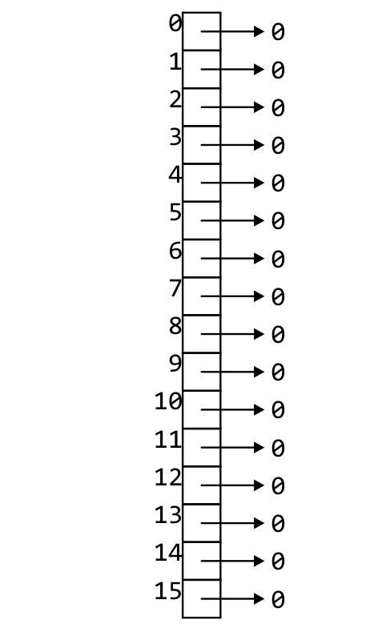
Implementation
The constructor creates an array of n linked lists
template <class Type>
Chained_hash_table::Chained_hash_table( int n ):
table_capacity( std::max( n, 1 ) ),
table_size( 0 ),
table( new Single_list<Type>[table_capacity] ) {
// empty constructor
}

Slide 6
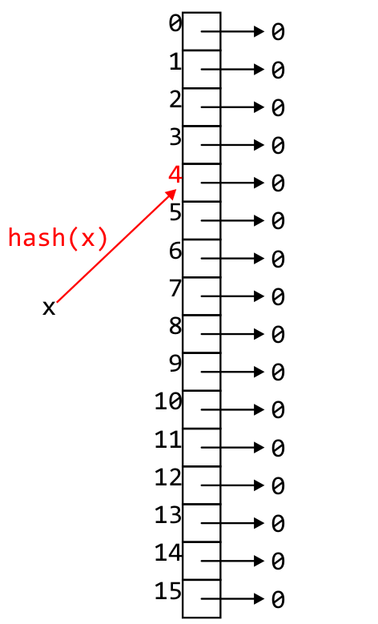
Implementation
The function hash will determine the bin of an object:
template <class Type>
int Chained_hash_table::hash( Type const &obj ) {
return hash_M( obj.hash(), capacity() );
}
Recall:
obj.hash() returns a 32-bit non-negative integer
unsigned int hash_M( obj, M ) returns a value in 0, …, M – 1

Slide 7
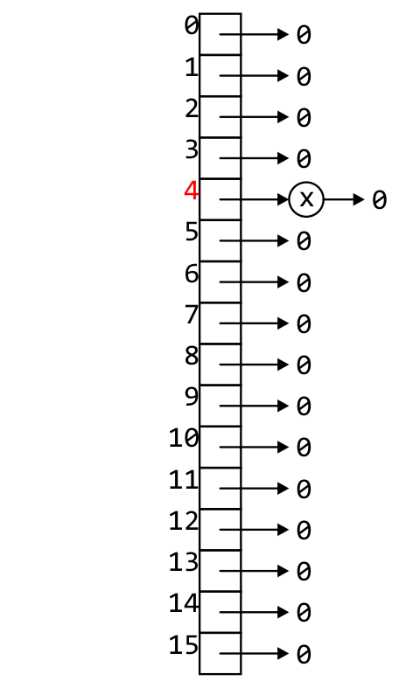
Implementation
Other functions mapped to corresponding linked list functions:
template <class Type>
void Chained_hash_table::insert( Type const &obj ) {
unsigned int bin = hash( obj );
if ( table[bin].count( obj ) == 0 ) {
table[bin].push_front( obj );
++table_size;
}
}

Slide 8
Implementation
template <class Type>
int Chained_hash_table::count( Type const &obj ) const {
return table[hash( obj )].count( obj );
}

Slide 9
Implementation
template <class Type>
int Chained_hash_table::erase( Type const &obj ) {
unsigned int bin = hash( obj );
if ( table[bin].erase( obj ) ) {
--table_size;
return 1;
} else {
return 0;
}
}

Slide 10
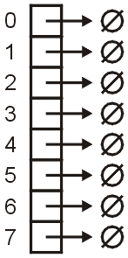
Example
As an example, let’s store hostnames and allow a fast look-up of the corresponding IP address
We will choose the bin based on the host name
Associated with the name will be the IP address
E.g., ("optimal", 129.97.94.57)

Slide 11
Example
We will store strings and the hash value of a string will be the last 3 bits of the first character in the host name
The hash of "optimal" is based on "o"

Slide 12
Example
The following is a list of the binary representation of each letter:
"a" is 1 and it cycles from there…
a 01100001 n 01101110
b 01100010 o 01101111
c 01100011 p 01110000
d 01100100 q 01110001
e 01100101 r 01110010
f 01100110 s 01110011
g 01100111 t 01110100
h 01101000 u 01110101
i 01101001 v 01110110
j 01101010 w 01110111
k 01101011 x 01111000
l 01101100 y 01111001
m 01101101 z 01111010

Slide 13
Example
Our hash function is
unsigned int hash( string const &str ) {
// the empty string "" is hashed to 0
if str.length() == 0 ) {
return 0;
}
return str[0] & 7;
}

Slide 14
Example
Starting win an array of 8 empty linked lists

Slide 15
Example
The pair ("optimal", 129.97.94.57) is entered into bin 01101111 = 7

Slide 16
Example
Similarly, as "c" hashes to 3
The pair ("cheetah", 129.97.94.45) is entered into bin 3

Slide 17
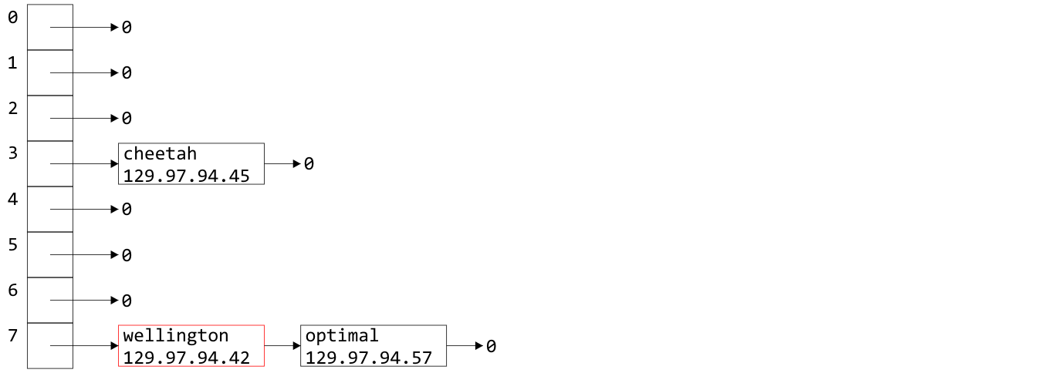
Example
The "w" in Wellington also hashes to 7
("wellington", 129.97.94.42) is entered into bin 7

Slide 18
Example
Why did I use push_front from the linked list?
Do I have a choice?
A good heuristic is
“unless you know otherwise, data which has been
accessed recently will be accessed again in the near future”
It is easiest to access data at the front of a linked list
Heuristics include rules of thumb, educated guesses, and intuition

Slide 19
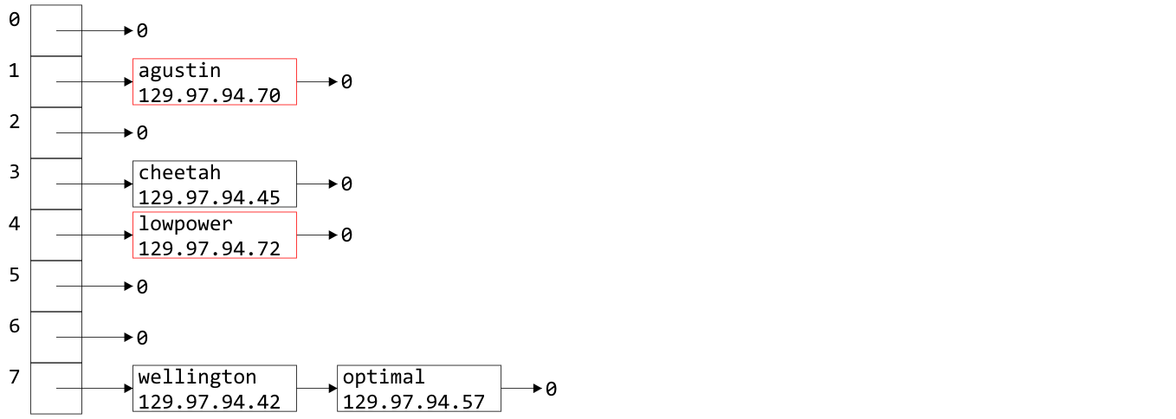
Example
Similarly we can insert the host names "augustin" and "lowpower"

Slide 20
Example
If we now wanted the IP address for "optimal", we would simply hash "optimal" to 7, walk through the linked list, and access 129.97.94.57 when we access the node containing the relevant string

Slide 21
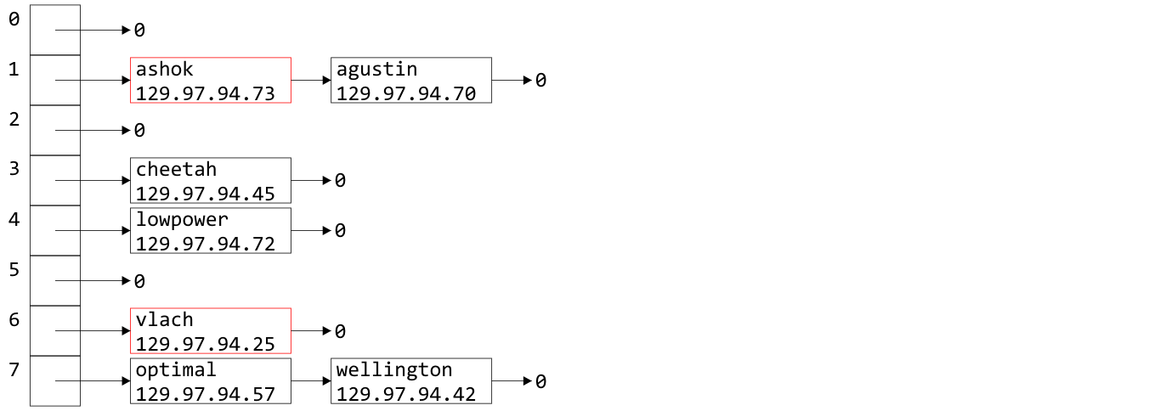
Example
Similarly, "ashok" and "vlach" are entered into bin 7

Slide 22
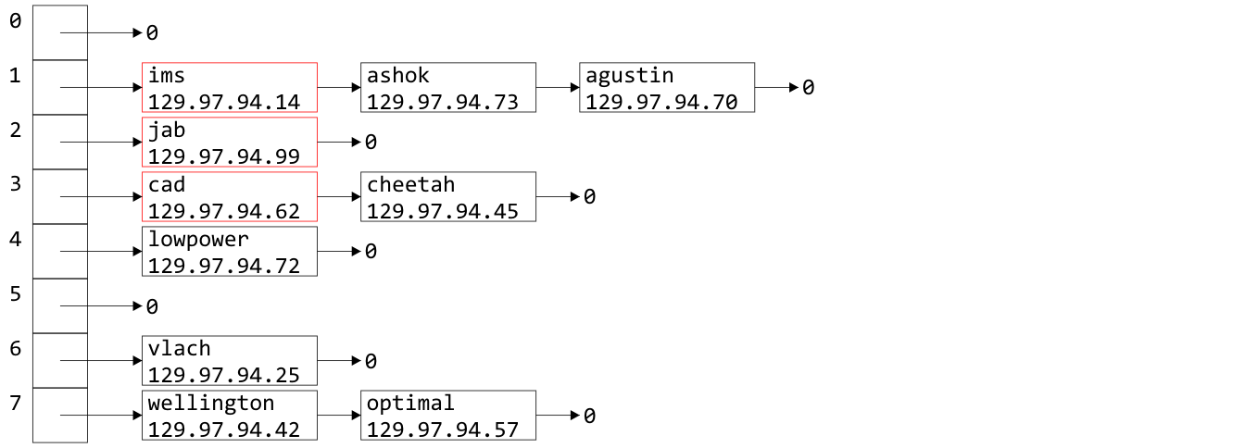
Example
Inserting "ims", "jab", and "cad" doesn’t even out the bins

Slide 23
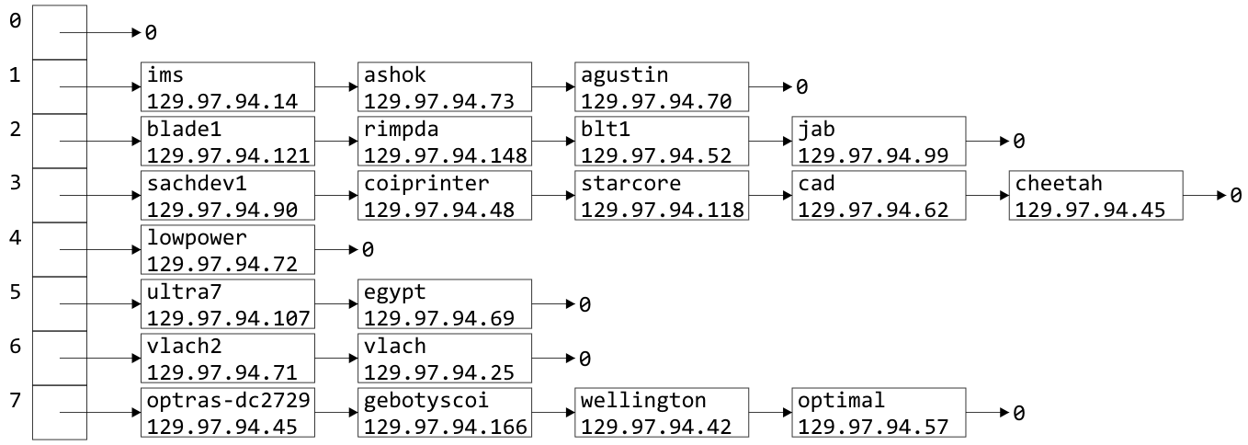
Example
Indeed, after 21 insertions, the linked lists are becoming rather long
We were looking for Θ(1) access time, but accessing something in a linked list with k objects is O(k)

Slide 24
Load Factor
To describe the length of the linked lists, we define the load factor of the hash table:
This is the average number of objects per bin
This assumes an even distribution
Right now, the load factor is λ = 21/8 = 2.625
The average bin has 2.625 objects

Slide 25
Load Factor
If the load factor becomes too large, access times will start to increase: O(λ)
The most obvious solution is to double the size of the hash table
Unfortunately, the hash function must now change
In our example, the doubling the hash table size requires us to take, for example, the last four bits

Slide 26
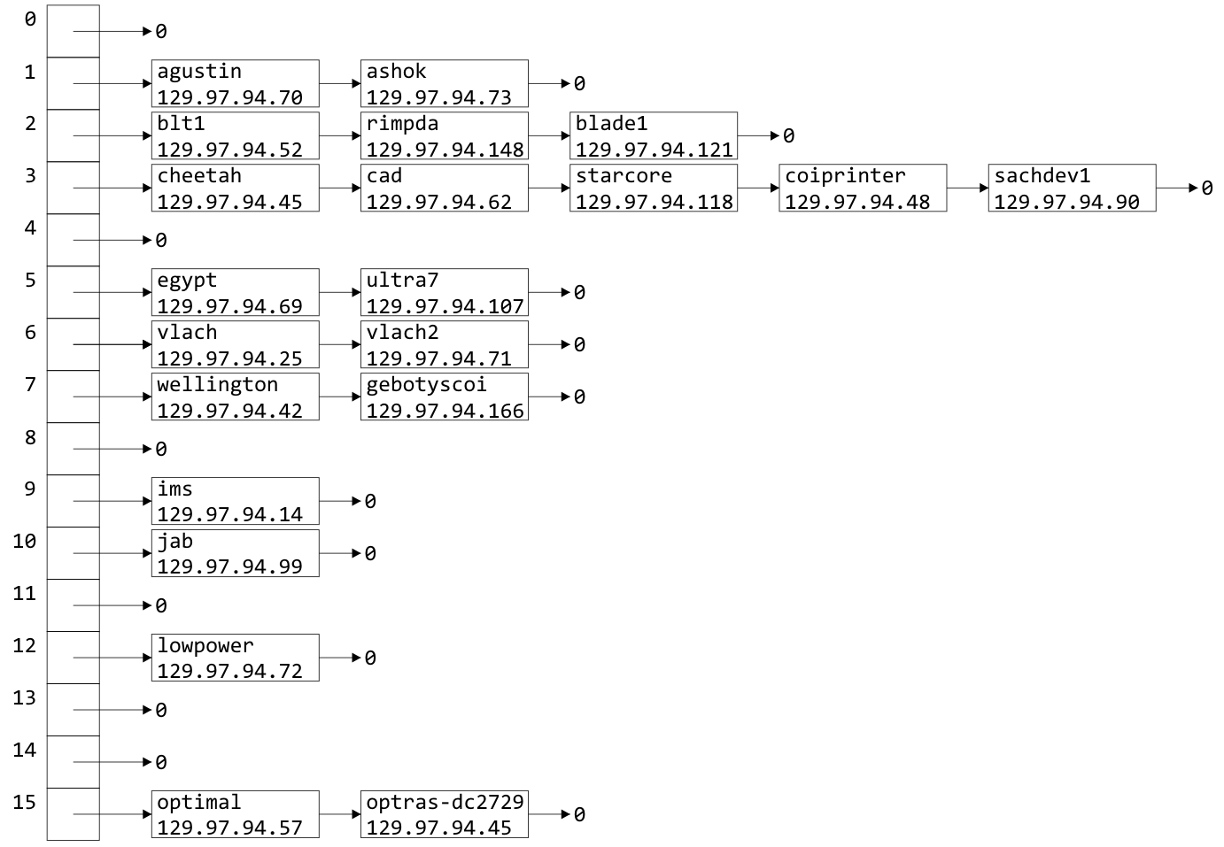
Doubling Size
The load factor is now λ = 1.3125
Unfortunately, the distribution hasn’t improved much

Slide 27
Doubling Size
There is significant clustering in bins 2 and 3 due to the choice of host names

Slide 28
Choosing a Good Hash Function
We choose a very poor hash function:
We looked at the first letter of the host name
Unfortunately, all these are also actual host names:
ultra7 ultra8 ultra9 ultra10 ultra11
ultra12 ultra13 ultra14 ultra15 ultra16 ultra17
blade1 blade2 blade3 blade4 blade5
This will cause clustering in bins 2 and 5
Any hash function based on anything other than every letter will cause clustering

Slide 29
Choosing a Good Hash Function
Let’s go back to the hash function defined previously:
unsigned int hash( string const &str ) {
unsigned int hash_value = 0;
for ( int k = 0; k < str.length(); ++k ) {
hash_value = 12347*hash_value + str[k];
}
return hash_value;
}

Slide 30
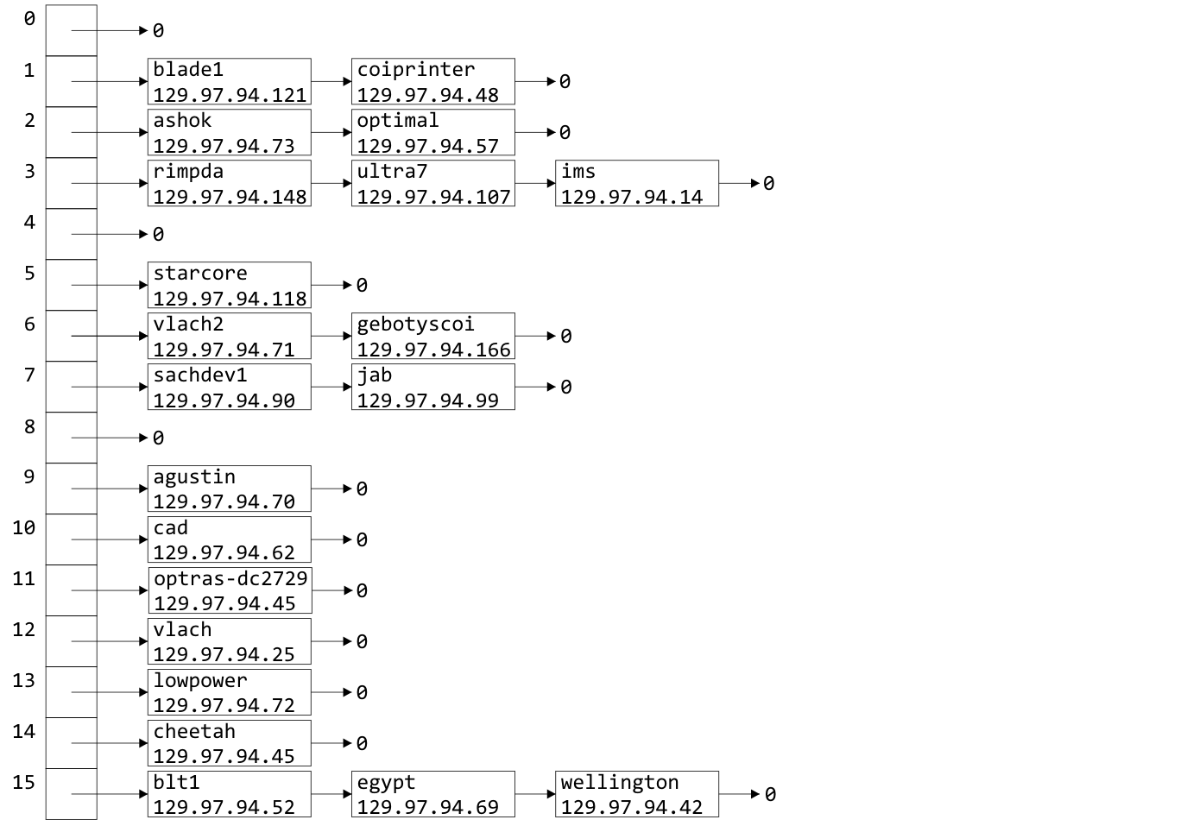
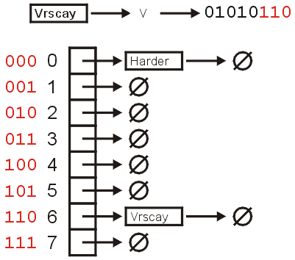
Choosing a Good Hash Function
This hash function yields a much nicer distribution:

Slide 31
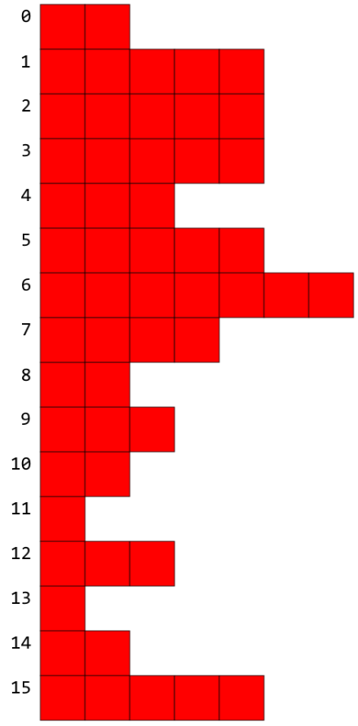
Choosing a Good Hash Function
When we insert the names of all 55 names, we would have a load factor λ = 3.4375
Clearly there are not exactly 3.4375 objects per bin
How can we tell if this is a good hash function?
Can we expect exactly 3.4375 objects per bin?
Clearly no…
The answer is with statistics…

Slide 32
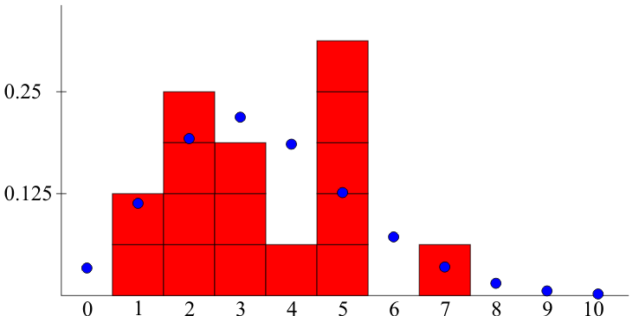
Choosing a Good Hash Function
We would expect the number of bins which hold k objects to approximately follow a Poisson distribution
k

Slide 33
Problems with Linked Lists
One significant issue with chained hash tables using linked lists
It requires extra memory
It uses dynamic memory allocation
Total memory:
16 bytes
A pointer to an array, initial and current number of bins, and the size
+ 12M bytes (8M if we remove count from Single_list)
+ 8n bytes if each object is 4 bytes

Slide 34
Problems with linked lists
For faster access, we could replace each linked list with an AVL tree (assuming we can order the objects)
The access time drops to O(ln(λ))
The memory requirements are increased by Θ(n), as each node will require two pointers
We could look at other techniques:
Scatter tables: use other bins and link the bins
Use an alternate memory allocation model

Slide 35
Black Board Example
Use the hash function unsigned int hash( unsigned int n ) { return n % 10; }
to enter the following 15 numbers into a hash table with 10 bins:
534, 415, 465, 459, 869, 442, 840, 180, 450, 265, 23, 946, 657, 3, 29

Slide 36
Summary
The easiest way to deal with collisions is to associate each bin with a container
We looked at bins of linked lists
The example used host names and IP addresses
We defined the load factor λ = n/M
Discussed doubling the number of bins
Our goals are to choose a good hash function and to keep the load factor low
We discussed alternatives
Next we will see a different technique using only one array of bins: open addressing

Slide 37
References
Wikipedia, http://en.wikipedia.org/wiki/Hash_function
[1] Cormen, Leiserson, and Rivest, Introduction to Algorithms, McGraw Hill, 1990.
[2] Weiss, Data Structures and Algorithm Analysis in C++, 3rd Ed., Addison Wesley.
These slides are provided for the ECE 250 Algorithms and Data Structures course. The material in it reflects Douglas W. Harder’s best judgment in light of the information available to him at the time of preparation. Any reliance on these course slides by any party for any other purpose are the responsibility of such parties. Douglas W. Harder accepts no responsibility for damages, if any, suffered by any party as a result of decisions made or actions based on these course slides for any other purpose than that for which it was intended.

