Slide 1
Quadratic probing

Slide 2
Outline
This topic covers quadratic probing
  Similar to linear probing
    Does not step forward one step at a time
  Primary clustering no longer occurs
  Affected by secondary clustering

Slide 3
Background
Linear probing:
  Look at bins k, k + 1, k + 2, k + 3, k + 4, …
  Primary clustering

Slide 4
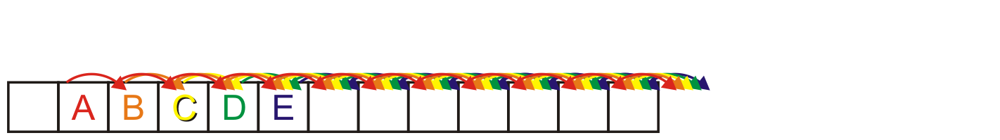
Background
Linear probing causes primary clustering
  All entries follow the same search pattern for bins:
  int initial = hash_M( x.hash(), M );
  for ( int k = 0; k < M; ++k ) {
  bin = (initial + k) % M;
  // ...
  }

Slide 5
Description
Quadratic probing suggests moving forward by different amounts
For example,
  int initial = hash_M( x.hash(), M );
  for ( int k = 0; k < M; ++k ) {
  bin = (initial + k*k) % M;
  }

Slide 6
Description
Problem:
  Will initial + k*k step through all of the bins?
  Here, the array size is 10:
  M = 10;
  initial = 5
  for ( int k = 0; k <= M; ++k ) {
  std::cout << (initial + k*k) % M << ' ';
  }
  The output is
  5 6 9 4 1 0 1 4 9 6 5

Slide 7
Description
Problem:
  Will initial + k*k step through all of the bins?
  Now the array size is 12:
  M = 12;
  initial = 5
  for ( int k = 0; k <= M; ++k ) {
  std::cout << (initial + k*k) % M << ' ';
  }
  The output is now
  5 6 9 2 9 6 5 6 9 2 9 6 5

Slide 8
Making M Prime
If we make the table size M = p a prime number quadratic probing
is guaranteed to iterates through entries
Problems:
  All operations must be done using %
    Cannot use &, <<, or >>
    The modulus operator % is relatively slow
  Doubling the number of bins is difficult:
    What is the next prime after 2 × 263?
Warning: most text books stop here!
– Never use a prime table size if at all possible

Slide 9
Generalization
More generally, we could consider an approach like:
  int initial = hash_M( x.hash(), M );
  for ( int k = 0; k < M; ++k ) {
  bin = (initial + c1*k + c2*k*k) % M;
  }

Slide 10
Using M = 2^{m}
If we ensure M = 2^{m} then choose
  c₁ = c₂ = ½
  int initial = hash_M( x.hash(), M );
  for ( int k = 0; k < M; ++k ) {
  bin = (initial + (k + k*k)/2) % M;
  }
  Note that k + k*k is always even
  The growth is still Θ(k²)
  This guarantees that all M entries are visited before the pattern repeats
    This only works for powers of two

Slide 11
Using M = 2^{m}
For example:
  Use an array size of 16:
  M = 16;
  initial = 5
  for ( int k = 0; k <= M; ++k ) {
  std::cout << (initial + (k + k*k)/2) % M << ' ';
  }
  The output is now
  5 6 8 11 15 4 10 1 9 2 12 7 3 0 14 13 13

Slide 12
Using M = 2^{m}
There is an even easier means of calculating this approach
  int bin = hash_M( x.hash(), M );
  for ( int k = 0; k < M; ++k ) {
  bin = (bin + k) % M;
  }
  Recall that , so just keep adding the next highest value

Slide 13
Example
Consider a hash table with M = 16 bins
Given a 2-digit hexadecimal number:
  The least-significant digit is the primary hash function (bin)
  Example: for 6B7A₁₆ , the initial bin is A

Slide 14
Example
Insert these numbers into this initially empty hash table
  9A, 07, AD, 88, BA, 80, 4C, 26, 46, C9, 32, 7A, BF, 9C
0 | 1 | 2 | 3 | 4 | 5 | 6 | 7 | 8 | 9 | A | B | C | D | E | F

Slide 15
Example
Start with the first four values:
  9A, 07, AD, 88
0 | 1 | 2 | 3 | 4 | 5 | 6 | 7 | 8 | 9 | A | B | C | D | E | F

Slide 16
Example
Start with the first four values:
  9A, 07, AD, 88
0 | 1 | 2 | 3 | 4 | 5 | 6 | 7 | 8 | 9 | A | B | C | D | E | F
 |  |  |  |  |  |  | 07 | 88 |  | 9A |  |  | AD

Slide 17
Example
Next we must insert BA
0 | 1 | 2 | 3 | 4 | 5 | 6 | 7 | 8 | 9 | A | B | C | D | E | F
 |  |  |  |  |  |  | 07 | 88 |  | 9A |  |  | AD

Slide 18
Example
Next we must insert BA
  The next bin is empty
0 | 1 | 2 | 3 | 4 | 5 | 6 | 7 | 8 | 9 | A | B | C | D | E | F
 |  |  |  |  |  |  | 07 | 88 |  | 9A | BA |  | AD

Slide 19
Example
Next we are adding 80, 4C, 26
0 | 1 | 2 | 3 | 4 | 5 | 6 | 7 | 8 | 9 | A | B | C | D | E | F
 |  |  |  |  |  |  | 07 | 88 |  | 9A | BA |  | AD

Slide 20
Example
Next we are adding 80, 4C, 26
  All the bins are empty—simply insert them
0 | 1 | 2 | 3 | 4 | 5 | 6 | 7 | 8 | 9 | A | B | C | D | E | F
80 |  |  |  |  |  | 26 | 07 | 88 |  | 9A | BA | 4C | AD

Slide 21
Example
Next, we must insert 46
0 | 1 | 2 | 3 | 4 | 5 | 6 | 7 | 8 | 9 | A | B | C | D | E | F
80 |  |  |  |  |  | 26 | 07 | 88 |  | 9A | BA | 4C | AD

Slide 22
Example
Next, we must insert 46
  Bin 6 is occupied
  Bin 6 + 1 = 7 is occupied
  Bin 7 + 2 = 9 is empty
0 | 1 | 2 | 3 | 4 | 5 | 6 | 7 | 8 | 9 | A | B | C | D | E | F
80 |  |  |  |  |  | 26 | 07 | 88 | 46 | 9A | BA | 4C | AD

Slide 23
Example
Next, we must insert C9
0 | 1 | 2 | 3 | 4 | 5 | 6 | 7 | 8 | 9 | A | B | C | D | E | F
80 |  |  |  |  |  | 26 | 07 | 88 | 46 | 9A | BA | 4C | AD

Slide 24
Example
Next, we must insert C9
  Bin 9 is occupied
  Bin 9 + 1 = A is occupied
  Bin A + 2 = C is occupied
  Bin C + 3 = F is empty
0 | 1 | 2 | 3 | 4 | 5 | 6 | 7 | 8 | 9 | A | B | C | D | E | F
80 |  |  |  |  |  | 26 | 07 | 88 | 46 | 9A | BA | 4C | AD |  | C9

Slide 25
Example
Next, we insert 32
  Bin 2 is unoccupied
0 | 1 | 2 | 3 | 4 | 5 | 6 | 7 | 8 | 9 | A | B | C | D | E | F
80 |  | 32 |  |  |  | 26 | 07 | 88 | 46 | 9A | BA | 4C | AD |  | C9

Slide 26
Example
Next, we insert 7A
  Bin A is occupied
  Bins A + 1 = B, B + 2 = D and D + 3 = 0 are occupied
  Bin 0 + 4 = 4 is empty
0 | 1 | 2 | 3 | 4 | 5 | 6 | 7 | 8 | 9 | A | B | C | D | E | F
80 |  | 32 |  | 7A |  | 26 | 07 | 88 | 46 | 9A | BA | 4C | AD |  | C9

Slide 27
Example
Next, we insert BF
  Bin F is occupied
  Bins F + 1 = 0 and 0 + 2 = 2 are occupied
  Bin 2 + 3 = 5 is empty
0 | 1 | 2 | 3 | 4 | 5 | 6 | 7 | 8 | 9 | A | B | C | D | E | F
80 |  | 32 |  | 7A | BF | 26 | 07 | 88 | 46 | 9A | BA | 4C | AD |  | C9

Slide 28
Example
Finally, we insert 9C
  Bin C is occupied
  Bins C + 1 = D, D + 2 = F, F + 3 = 2, 2 + 4 = 6 and 6 + 5 = B are occupied
  Bin B + 6 = 1 is empty
0 | 1 | 2 | 3 | 4 | 5 | 6 | 7 | 8 | 9 | A | B | C | D | E | F
80 | 9C | 32 |  | 7A | BF | 26 | 07 | 88 | 46 | 9A | BA | 4C | AD |  | C9

Slide 29
Example
Having completed these insertions:
  The load factor is λ = 14/16 = 0.875
  The average number of probes is 32/14 ≈ 2.29
0 | 1 | 2 | 3 | 4 | 5 | 6 | 7 | 8 | 9 | A | B | C | D | E | F
80 | 9C | 32 |  | 7A | BF | 26 | 07 | 88 | 46 | 9A | BA | 4C | AD |  | C9

Slide 30
Resizing the array
To double the capacity of the array, each value must be rehashed
  80, 9C, 32, 7A, BF, 26, 07, 88 may be immediately placed
    We use the least-significant five bits for the initial bin
  If the next least-significant digit is
    Even, use bins 0 – F
    Odd, use bins 10 – 1F
0 | 1 | 2 | 3 | 4 | 5 | 6 | 7 | 8 | 9 | A | B | C | D | E | F | 10 | 11 | 12 | 13 | 14 | 15 | 16 | 17 | 18 | 19 | 1A | 1B | 1C | 1D | 1E | 1F
80 |  |  |  |  |  | 26 | 07 | 88 |  |  |  |  |  |  |  |  |  | 32 |  |  |  |  |  |  |  | 7A |  | 9C |  |  | BF

Slide 31
Resizing the array
To double the capacity of the array, each value must be rehashed
  46 results in a collision
    We place it in bin 9
0 | 1 | 2 | 3 | 4 | 5 | 6 | 7 | 8 | 9 | A | B | C | D | E | F | 10 | 11 | 12 | 13 | 14 | 15 | 16 | 17 | 18 | 19 | 1A | 1B | 1C | 1D | 1E | 1F
80 |  |  |  |  |  | 26 | 07 | 88 | 46 |  |  |  |  |  |  |  |  | 32 |  |  |  |  |  |  |  | 7A |  | 9C |  |  | BF

Slide 32
Resizing the array
To double the capacity of the array, each value must be rehashed
  9A results in a collision
    We place it in bin 1B
0 | 1 | 2 | 3 | 4 | 5 | 6 | 7 | 8 | 9 | A | B | C | D | E | F | 10 | 11 | 12 | 13 | 14 | 15 | 16 | 17 | 18 | 19 | 1A | 1B | 1C | 1D | 1E | 1F
80 |  |  |  |  |  | 26 | 07 | 88 | 46 |  |  |  |  |  |  |  |  | 32 |  |  |  |  |  |  |  | 7A | 9A | 9C |  |  | BF

Slide 33
Resizing the array
To double the capacity of the array, each value must be rehashed
  BA also results in a collision
    We place it in bin 1D
0 | 1 | 2 | 3 | 4 | 5 | 6 | 7 | 8 | 9 | A | B | C | D | E | F | 10 | 11 | 12 | 13 | 14 | 15 | 16 | 17 | 18 | 19 | 1A | 1B | 1C | 1D | 1E | 1F
80 |  |  |  |  |  | 26 | 07 | 88 | 46 |  |  |  |  |  |  |  |  | 32 |  |  |  |  |  |  |  | 7A | 9A | 9C | BA |  | BF

Slide 34
Resizing the array
To double the capacity of the array, each value must be rehashed
  4C and AD don’t cause collisions
0 | 1 | 2 | 3 | 4 | 5 | 6 | 7 | 8 | 9 | A | B | C | D | E | F | 10 | 11 | 12 | 13 | 14 | 15 | 16 | 17 | 18 | 19 | 1A | 1B | 1C | 1D | 1E | 1F
80 |  |  |  |  |  | 26 | 07 | 88 | 46 |  |  | 4C | AD |  |  |  |  | 32 |  |  |  |  |  |  |  | 7A | 9A | 9C | BA |  | BF

Slide 35
Resizing the array
To double the capacity of the array, each value must be rehashed
  Finally, C9 causes a collision
    We place it in bin A
0 | 1 | 2 | 3 | 4 | 5 | 6 | 7 | 8 | 9 | A | B | C | D | E | F | 10 | 11 | 12 | 13 | 14 | 15 | 16 | 17 | 18 | 19 | 1A | 1B | 1C | 1D | 1E | 1F
80 |  |  |  |  |  | 26 | 07 | 88 | 46 | C9 |  | 4C | AD |  |  |  |  | 32 |  |  |  |  |  |  |  | 7A | 9A | 9C | BA |  | BF

Slide 36
Resizing the array
To double the capacity of the array, each value must be rehashed
  The load factor is λ = 14/32 = 0.4375
  The average number of probes is 20/14 ≈ 1.43
0 | 1 | 2 | 3 | 4 | 5 | 6 | 7 | 8 | 9 | A | B | C | D | E | F | 10 | 11 | 12 | 13 | 14 | 15 | 16 | 17 | 18 | 19 | 1A | 1B | 1C | 1D | 1E | 1F
80 |  |  |  |  |  | 26 | 07 | 88 | 46 | C9 |  | 4C | AD |  |  |  |  | 32 |  |  |  |  |  |  |  | 7A | 9A | 9C | BA |  | BF

Slide 37
Erase
Can we erase an object like we did with linear probing?
  Consider erasing 9A from this table
  There are M – 1 possible locations where an object which could have occupied a position could be located
Instead, we will use the concept of lazy deletion
  Mark a bin as ERASED; however, when searching, treat the bin as occupied and continue
    We must have a separate ternary-valued flag for each bin
0 | 1 | 2 | 3 | 4 | 5 | 6 | 7 | 8 | 9 | A | B | C | D | E | F
80 | 21 |  | 43 |  |  | 76 |  |  |  | 9A |  |  |  |  | 50

Slide 38
Erase
If we erase AD, we must mark that bin as erased
0 | 1 | 2 | 3 | 4 | 5 | 6 | 7 | 8 | 9 | A | B | C | D | E | F
80 | 9C | 32 |  | 7A | BF | 26 | 07 | 88 | 46 | 9A | BA | 4C | AD |  | C9

Slide 39
Find
When searching, it is necessary to skip over this bin
  For example, find AD: D, E
  find 5C: C, D, F, 2, 5, 9, F, 6, E
0 | 1 | 2 | 3 | 4 | 5 | 6 | 7 | 8 | 9 | A | B | C | D | E | F
80 | 9C | 32 |  | 7A | BF | 26 | 07 | 88 | 46 | 9A | BA | 4C | AD |  | C9

Slide 40
Modified insertion
We must modify insert, as we may place new items into either
  Unoccupied bins
  Erased bins

Slide 41
Implementation
Storing three states can be achieved using an enumerated type:
enum bin_state_t {
UNOCCUPIED,
OCCUPIED,
ERASED
};
Now we can declare and initialize arrays:
bin_state_t state[M];
for ( int i = 0; i < M; ++i ) {
state[i] = UNOCCUPIED;
}

Slide 42
Multiple insertions and erases
One problem which may occur after multiple insertions and removals is that numerous bins may be marked as ERASED
  In calculating the load factor, an ERASED bin is equivalent to an OCCUPIED bin
This will increase our run times…

Slide 43
Multiple insertions and erases
We can easily track the number of bins which are:
  UNOCCUPIED
  OCCUPIED
  ERASED
by updating appropriate counters
If the load factor λ grows too large, we have two choices:
  If the load factor due to occupied bins is too large, double the table size
  Otherwise, rehash all of the objects currently in the hash table

Slide 44
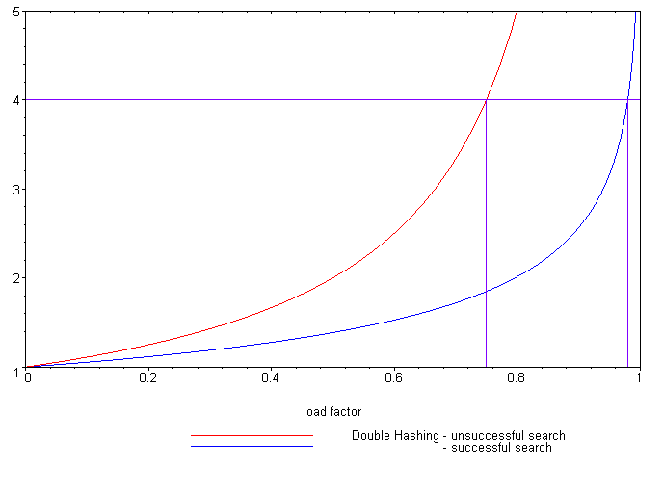
Expected number of probes
Load Factor (λ)
Unsuccessful search
Successful search
Reference: Knuth, The Art of Computer Programming,
Vol. 3, 2nd Ed., 1998, Addison Wesley, p. 530.
It is possible to calculate the expected number of probes for quadratic probing, again, based on the load factor:
  Successful searches:
  Unsuccessful searches:
When λ = 2/3, we requires
1.65 and 3 probes, respectively
  Linear probing required
  3 and 5 probes, respectively

Slide 45
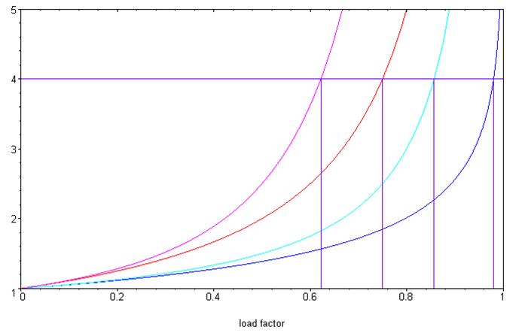
Quadratic probing versus linear probing
Comparing the two:
Linear probing
Unsuccessful search
Successful search
Quadratic probing
Unsuccessful search
Successful search
Examined Bins
Load Factor (λ)

Slide 46
Cache misses
One benefit of quadratic probing:
  The first few bins examined are close to the initial bin
  It is unlikely to reference a section of the array far from the initial bin
Modern computers use caches
  4 KiB pages of main memory are copied into faster caches
  Pages are only brought into the cache when referenced
  Accesses close to the initial bin are likely to reference the same page

Slide 47
Secondary clustering
One weakness with quadratic problem
  It reverts to linear probing if many of the hash function is not random
  Objects placed in the same bin will follow the same sequence

Slide 48
Summary
In this topic, we have looked at quadratic probing:
  An open addressing technique
  Steps forward by a quadratically growing steps
  Insertions and searching are straight forward
  Removing objects is more complicated: use lazy deletion
  Still subject to secondary probing

Slide 49
References
Wikipedia, http://en.wikipedia.org/wiki/Quadratic_probing
[1] Cormen, Leiserson, and Rivest, Introduction to Algorithms, McGraw Hill, 1990.
[2] Weiss, Data Structures and Algorithm Analysis in C++, 3rd Ed., Addison Wesley.
These slides are provided for the ECE 250 Algorithms and Data Structures course. The material in it reflects Douglas W. Harder’s best judgment in light of the information available to him at the time of preparation. Any reliance on these course slides by any party for any other purpose are the responsibility of such parties. Douglas W. Harder accepts no responsibility for damages, if any, suffered by any party as a result of decisions made or actions based on these course slides for any other purpose than that for which it was intended.

