Slide 1
Minimum spanning tree

Slide 2
Outline
In this topic, we will
Define a spanning tree
Define the weight of a spanning tree in a weighted graph
Define a minimum spanning tree
Consider applications
List possible algorithms

Slide 3
Spanning trees
Given a connected graph with |V| = n vertices, a spanning tree is defined a collection of n – 1 edges which connect all n vertices
The n vertices and n – 1 edges define a connected sub-graph
A spanning tree is not necessarily unique

Slide 4
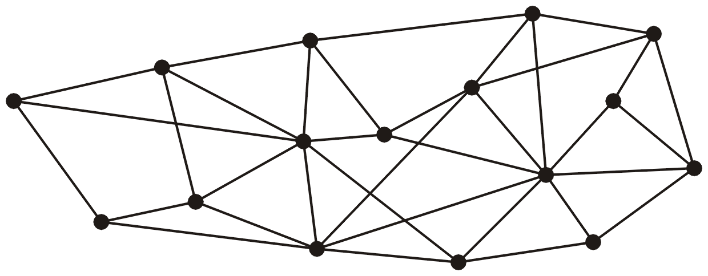
Spanning trees
This graph has 16 vertices and 35 edges

Slide 5
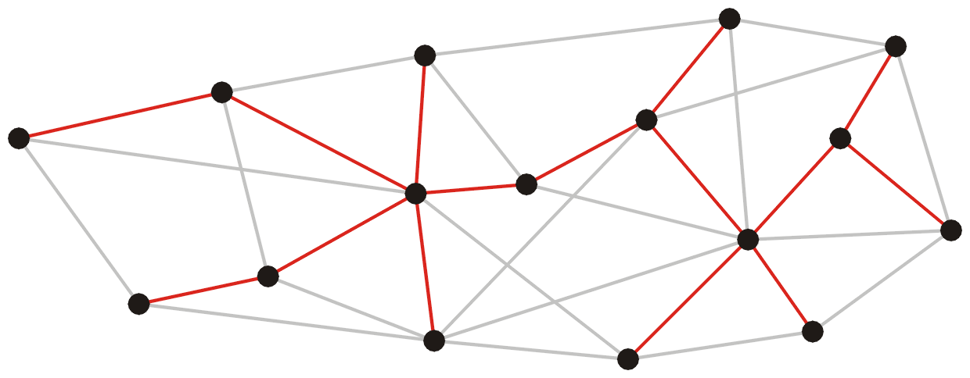
Spanning trees
These 15 edges form a minimum spanning tree

Slide 6
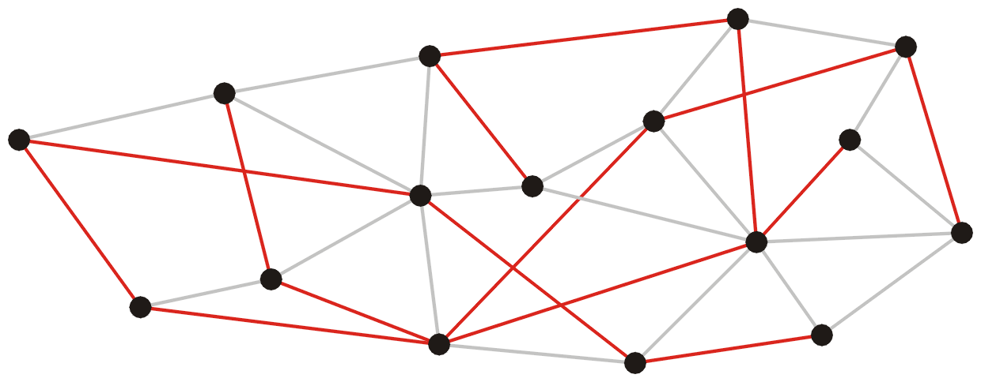
Spanning trees
As do these 15 edges:

Slide 7
Spanning trees
Such a collection of edges is called a tree because if any vertex is taken to be the root, we form a tree by treating the adjacent vertices as children, and so on...

Slide 8
Spanning trees
Nor do they necessarily have nice properties

Slide 9
Spanning trees on weighted graphs
The weight of a spanning tree is the sum of the weights on all the edges which comprise the spanning tree
The weight of this spanning tree is 20

Slide 10
Minimum Spanning Trees
Which spanning tree which minimizes the weight?
Such a tree is termed a minimum spanning tree
The weight of this spanning tree is 14

Slide 11
Minimum Spanning Trees
If we use a different vertex as the root, we get a different tree, however, this is simply the result of one or more rotations

Slide 12
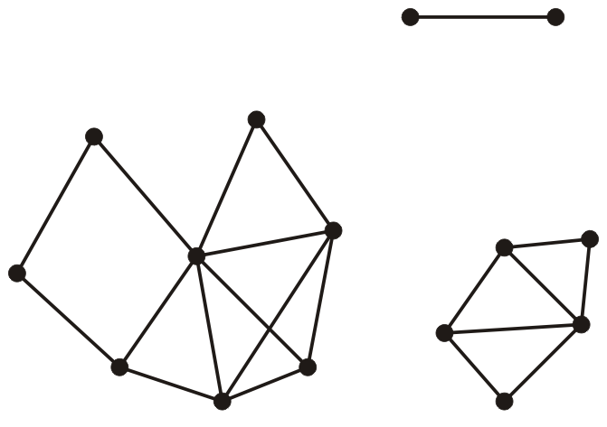
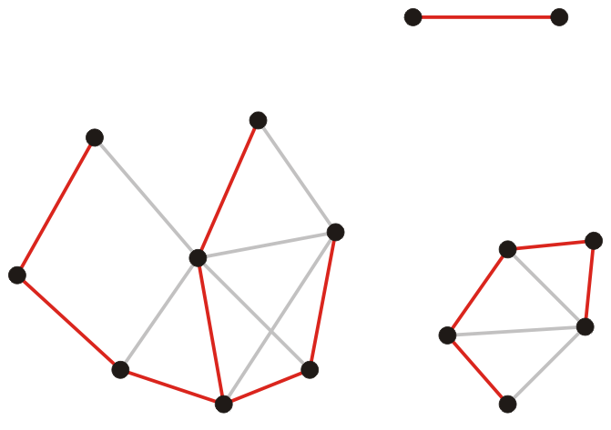
Spanning forests
Suppose that a graph is composed of N connected vertex-induced sub-graphs
In this case, we may define a spanning forest as a collection of N spanning trees, one for each connected vertex-induced sub-graph
A minimum spanning forest is therefore a collection of N minimum spanning trees, one for each connected vertex-induced sub-graph

Slide 13
Unweighted graphs
Observation
In an unweighted graph, we nominally give each edge a weight of 1
Consequently, all minimum spanning trees have weight |V| – 1

Slide 14
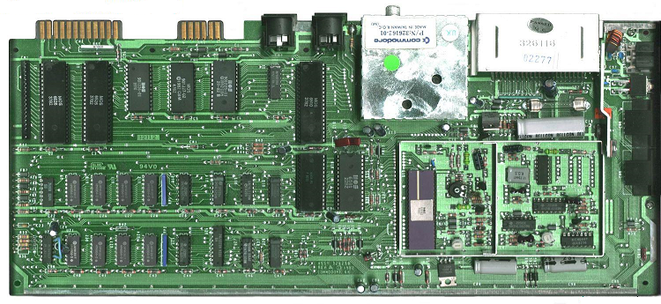
Application
Consider supplying power to
All circuit elements on a board
A number of loads within a building
A minimum spanning tree will give the lowest-cost solution
www.kpmb.com
www.commedore.ca

Slide 15
Application
The first application of a minimum spanning tree algorithm was by the Czech mathematician Otakar Borůvka who designed electricity grid in Morovia in 1926
www.kpmb.com
www.commedore.ca

Slide 16
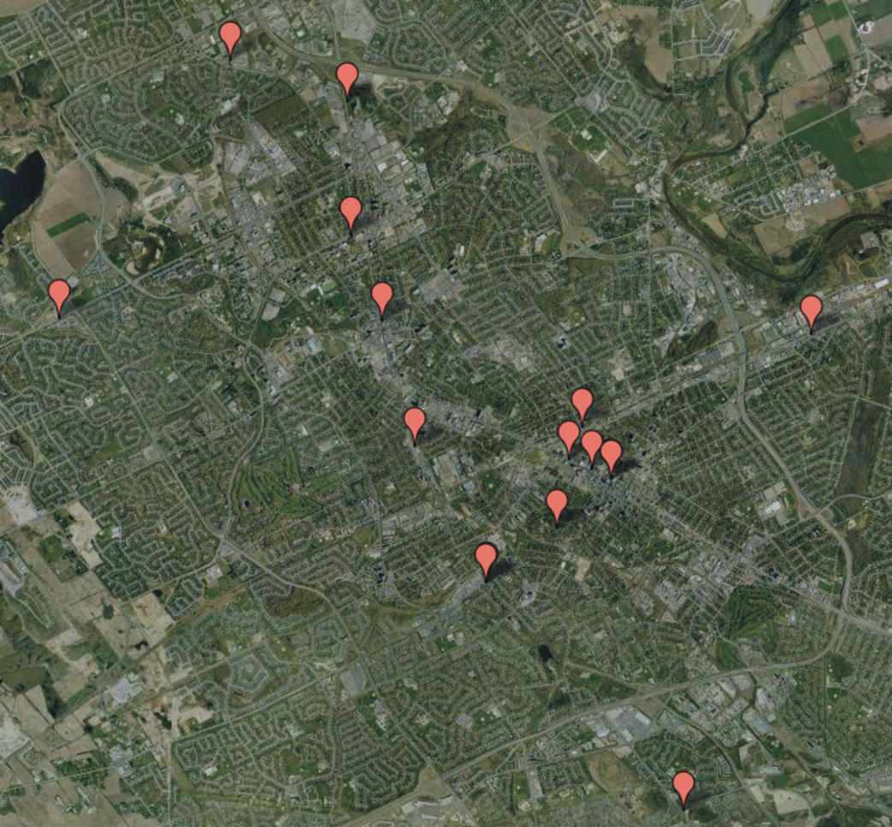
Application
Consider attempting to find the best means of connecting a number of LANs
Minimize the number of bridges
Costs not strictly dependant on distances

Slide 17
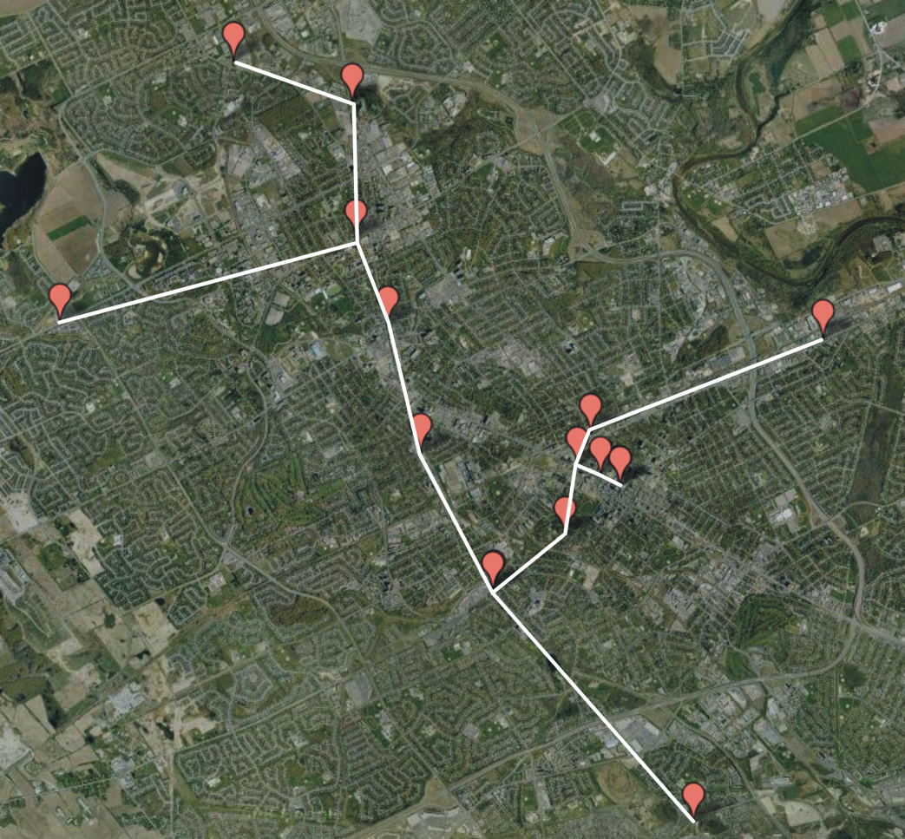
Application
A minimum spanning tree will provide the optimal solution

Slide 18
Application
Consider an ad hoc wireless network
Any two terminals can connect with any others
Problem:
Errors in transmission increase with transmission length
Can we find clusters of terminals which can communicate safely?

Slide 19
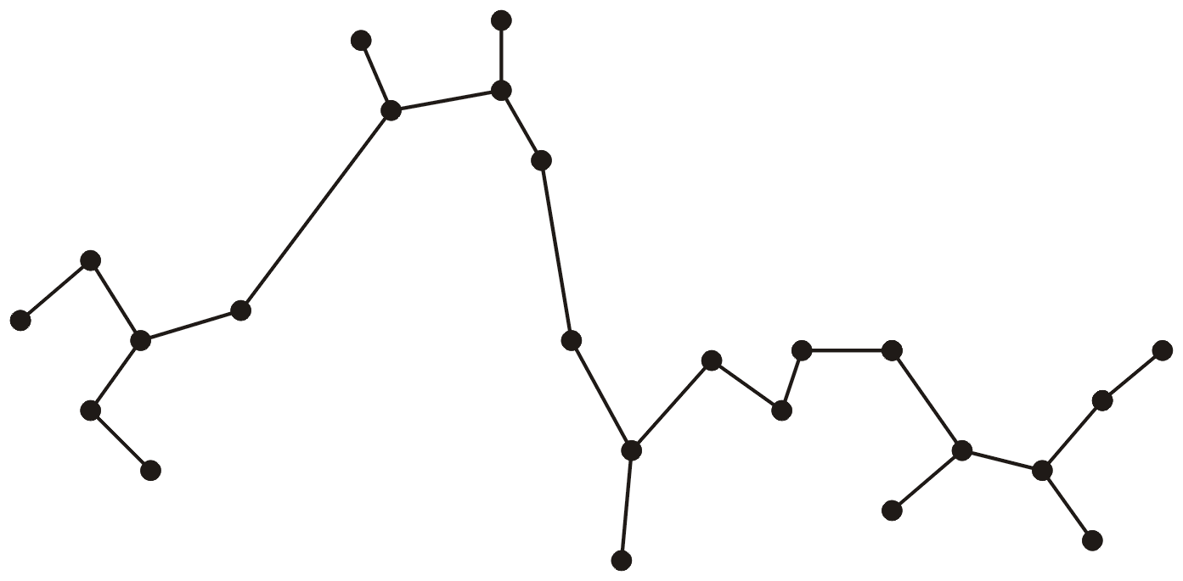
Application
Find a minimum spanning tree

Slide 20
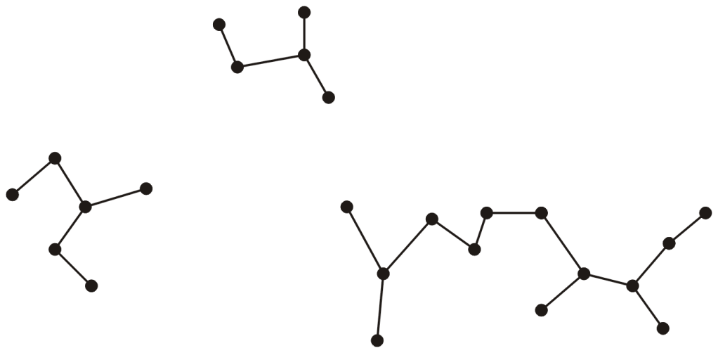
Application
Remove connections which are too long
This clusters terminals into smaller and more manageable sub-networks

Slide 21
Algorithms
Two common algorithms for finding minimum spanning trees are:
Prim’s algorithm
Kruskal’s algorithm

Slide 22
Summary
This topic covered
The definition of spanning trees, weighted graphs, and minimum spanning trees
Applications generally involve networks (electrical or communications)
Two algorithms are Prim’s and Kruskal’s

Slide 23
References
Wikipedia, http://en.wikipedia.org/wiki/Minimum_spanning_tree
These slides are provided for the ECE 250 Algorithms and Data Structures course. The material in it reflects Douglas W. Harder’s best judgment in light of the information available to him at the time of preparation. Any reliance on these course slides by any party for any other purpose are the responsibility of such parties. Douglas W. Harder accepts no responsibility for damages, if any, suffered by any party as a result of decisions made or actions based on these course slides for any other purpose than that for which it was intended.

