Slide 1
d-ary heaps

Slide 2
Outline
In this topic, we will:
Definition of a d-ary min heap
Implementation as a complete tree
Examples of binary, ternary, quaternary, and quinary min heaps
Properties
Relative speeds
Optimal choice is a quaternary heap

Slide 3
Definition
The relationship between a binary min heap and a d-ary min heap is the same as a binary tree and an N-ary tree
Every node has up to d children
The relationship is the same—all children are greater than their parent

Slide 4
d-ary heaps as complete N-ary trees
The implementation of a d-ary heap is similar to that of a binary heap: use a complete N-ary tree which can be stored as an array
Observation:
With binary heaps, we started at index 1, and for the entry at index k:
The parent is at k/2
The children are at 2*k and 2*k + 1
Recall the form:
parent = k >> 1;
left_child = k << 1;
right_child = left_child | 1;

Slide 5
d-ary heaps as complete N-ary trees
Initial index | Calculations | Operations
1 | parent = (k - 2) >> 2; third_child = k << 2; first_child = third_child - 2; second_child = third_child - 1; fourth_child = third_child | 1; | 3 arithmetic 3 logic
0 | parent = (k - 1) >> 2; first_child = k << 2; second_child = first_child | 2; third_child = first_child | 3; fourth_child = first_child + 4; first_child |= 1; | 2 arithmetic 5 logic
-1 | parent = (k << 4) - 1; first_child = (k + 1) >> 2; second_child = first_child | 1; third_child = first_child | 2; fourth_child = first_child | 3; | 2 arithmetic 5 logic

Slide 6
d-ary heaps as complete N-ary trees
Finally, if we start at -1, our calculations are:
parent = (k < 4 ? -1 : k << 4;
first_child = (k + 1) >> 2;
second_child = first_child | 1;
third_child = first_child | 1;
fourth_child = first_child | 1;
Now, if we start at index 0, our calculations are:
parent = (k - 1) >> 2;
first_child = k << 2;
second_child = first_child | 2;
third_child = first_child | 3;
fourth_child = first_child + 4;
first_child |= 1;

Slide 7
d-ary heaps as complete N-ary trees
The implementation of a d-ary heap is similar to that of a binary heap: we use a complete N-ary tree which can be stored as an array
To find the root, children, and parent:
The root is at 0 (not 1 like a binary heap)
The children of k are at:
dk + 1, dk + 2, ..., dk + d
The parent of k is at for k > 0

Slide 8
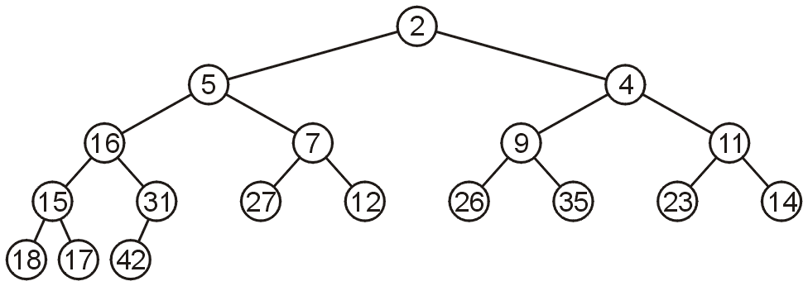
Examples
Example of a binary min-heap:
0 | 1 | 2 | 3 | 4 | 5 | 6 | 7 | 8 | 9 | 10 | 11 | 12 | 13 | 14 | 15 | 16 | 17
2 | 5 | 4 | 16 | 7 | 9 | 11 | 15 | 31 | 27 | 12 | 26 | 35 | 23 | 14 | 18 | 17 | 42

Slide 9
Examples
The same 18 elements in a ternary min-heap:
0 | 1 | 2 | 3 | 4 | 5 | 6 | 7 | 8 | 9 | 10 | 11 | 12 | 13 | 14 | 15 | 16 | 17
2 | 11 | 4 | 5 | 12 | 17 | 14 | 18 | 31 | 27 | 7 | 9 | 35 | 23 | 16 | 15 | 26 | 42

Slide 10
Examples
In a quaternary min-heap:
0 | 1 | 2 | 3 | 4 | 5 | 6 | 7 | 8 | 9 | 10 | 11 | 12 | 13 | 14 | 15 | 16 | 17
2 | 16 | 4 | 7 | 12 | 26 | 14 | 18 | 31 | 27 | 5 | 9 | 35 | 23 | 11 | 15 | 17 | 42

Slide 11
Examples
And a quinary heap:
0 | 1 | 2 | 3 | 4 | 5 | 6 | 7 | 8 | 9 | 10 | 11 | 12 | 13 | 14 | 15 | 16 | 17
2 | 5 | 4 | 7 | 12 | 26 | 16 | 18 | 31 | 27 | 14 | 9 | 35 | 23 | 11 | 15 | 17 | 42

Slide 12
Properties
The properties of a complete d-ary heap are:
The average depth of a node is given by the formula
The proportion of leaf nodes to the full number of nodes is approximately

Slide 13
Properties
For example, in a complete quaternary heap:
The average height of a node is h – ⅓, and
The leaf nodes comprise ¾ of all nodes
Therefore:
A push will require approximately 1⅓ comparisons and ⅓ copies
A pop will require almost 4h comparisons (= (3 + 1)h) and h + 1 copies

Slide 14
Relative Speed
In general, d-ary heaps have different performance versus binary heaps:
A d-ary heap makes log_{d}(n) comparisons for each push (worst case)
Percolating up compares only the parent
A d-ary heap must, however, make d log_{d}(n) comparisons for each pop
Percolating down compares a node with all d children
Assuming an equal number of pushes and pops:
log_{d} (n) + d log_{d} (n) = (d + 1) log_{d}(n)

Slide 15
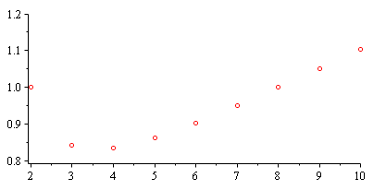
Relative Speed
Calculating the relative number of comparisons with a binary heap
The comparisons are minimized when d = 4:
83 %
d

Slide 16
Relative Speed
A quaternary heap requires
of the comparisons required for a binary heap
It should be 16.67 % faster

Slide 17
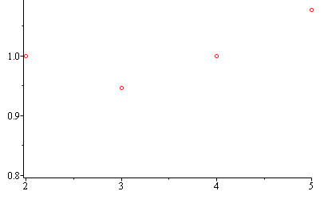
Relative Speed
From binary heaps, however, a push was Θ(1) on average
At least half the entries are stored in leaf nodes
Assuming an equal number of pushes and pops, we expect a run time of d log_{d} (n)
Thus,
This suggests using a ternary heap—not a quaternary heap
94 %
d

Slide 18
Relative Speed
In order to test this, 1.5 billion pushes and pops were performed on similar implementations of binary, ternary, quaternary, and quinary min heaps with two cases
http://ece.uwaterloo.ca/~dwharder/aads/Algorithms/d-ary_heaps/

Slide 19
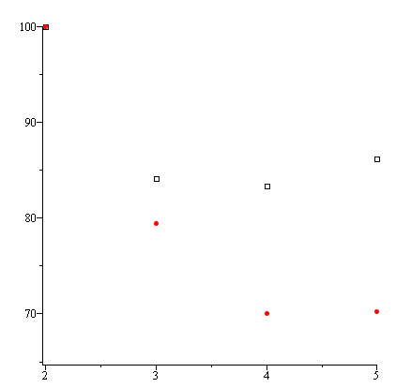
Relative Speed
Using the worst-case insertions: every newly inserted entry has higher priority than all other entries in the heap:
The time closely follows the pattern we expect
Percent relative to a binary heap
Expected time
Actual time

Slide 20
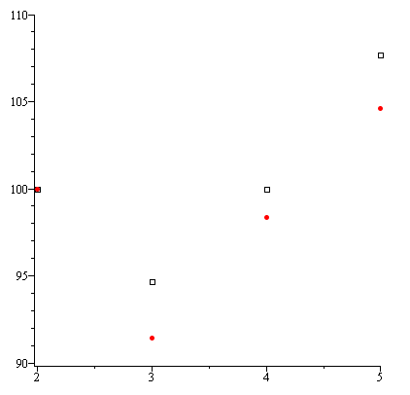
Relative Speed
However, if we make random insertions, we get closer to the other expected pattern—a ternary tree appears to be better
Percent relative to a binary heap
Expected time
Actual time

Slide 21
Cache
Why are the run-times better than expected?
Recall that the cache is faster than main memory:
Cache 1 GHz
Main memory (SDRAM): 100 MHz
Recall that the cache is faster than main memory but not every page can be cached simultaneously
Fewer memory accesses may result in fewer cache misses

Slide 22
Summary
In this topic, we:
Defined d-ary min heaps
n-ary trees interpreted as heaps
Similar array implementation for complete d-ary heaps
Saw some examples
Properties of the complete heaps
Ternary heaps are apparently optimal
Actual tests partially confirms the theoretical limits

Slide 23
References
[1] Cormen, Leiserson, and Rivest, Introduction to Algorithms, McGraw Hill, 1990, §7.1-3, p.152.
[2] Weiss, Data Structures and Algorithm Analysis in C++, 3rd Ed., Addison Wesley, §6.5-6, p.215-25.

Slide 24
Usage Notes
These slides are made publicly available on the web for anyone to use
If you choose to use them, or a part thereof, for a course at another institution, I ask only three things:
that you inform me that you are using the slides,
that you acknowledge my work, and
that you alert me of any mistakes which I made or changes which you make, and allow me the option of incorporating such changes (with an acknowledgment) in my set of slides
Sincerely,
Douglas Wilhelm Harder, MMath
dwharder@alumni.uwaterloo.ca

