Slide 1
Bre-X, Geoscience, and Regulation
Douglas Wilhelm Harder, M.Math. LEL
Department of Electrical and Computer Engineering
University of Waterloo
Waterloo, Ontario, Canada
ece.uwaterloo.ca
dwharder@alumni.uwaterloo.ca
© 2012 by Douglas Wilhelm Harder. Some rights reserved.

Slide 2
Outline
An introduction to the engineering profession, including:
Standards and safety
Law: Charter of Rights and Freedoms, contracts, torts, negligent malpractice, forms of carrying on business
Intellectual property (patents, trade marks, copyrights and industrial designs)
Professional practice
Professional Engineers Act
Professional misconduct and sexual harassment
Alternative dispute resolution
Labour Relations and Employment Law
Environmental Law

Slide 3
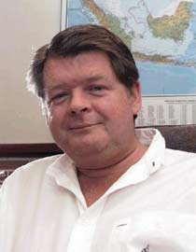
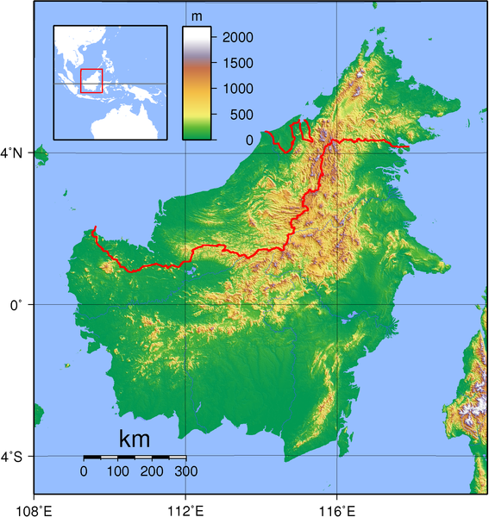
Bre-X
Canadian Press/David Lazarowych
In 1993, Bre-X was a penny-stock mining company with stocks selling at 27 cents
The owner, David Walsh, was interested in purchasing a gold claim in Busang, Indonesia
The highlands were formed by a massive volcano
Prior to this, numerous Australian companies had already prospected the island
They were only able to establish a single viable mine
The Grasberg Gold Mine in New Guinea is the largest in the world

Slide 4
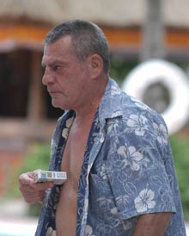
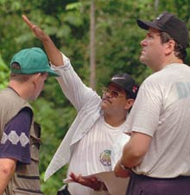
Bre-X
Associated Press/Firdia Lisnawati
David Walsh was wined-and-dined by two geologists:
John Felderhof
Michael de Guzman
Walsh committed $80,000 to the Busang project
De Guzman was an engineer with a colourful character:
At the top of his class
As a Filipino, he was, however, subject to a low glass ceiling
He had four wives with families, simultaneously, all of whom were unaware of each other
Associated Press/Gatra Magazine

Slide 5
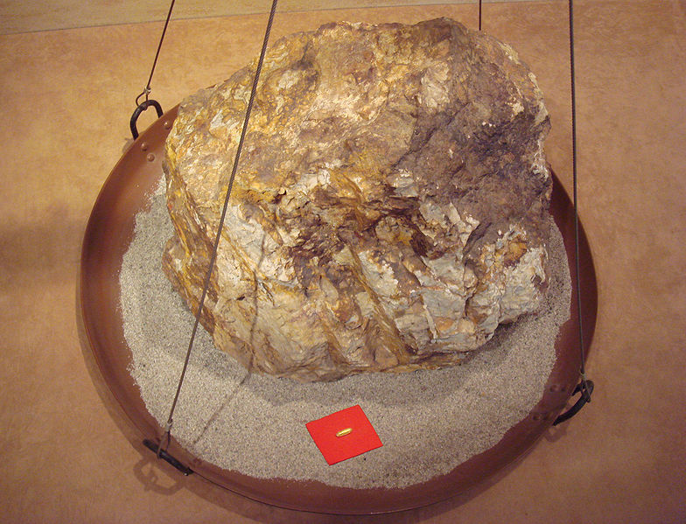
Bre-X: 1994
First they had to “partner” with an Indonesian
They found Sigit Hardjojudanto, Suharto’s son
They began to find gold
Early 1994: 2 million oz
Mid 1994: 3 million oz
Late 1994: 8 million oz
Stocks were trading at $2.05
User: PHGCOM

Slide 6
Bre-X: 1995
1995 continued to be a good year
The stock price was $14.87 by the end of July
The reserves only increased:
1995: 10 million oz
Speculation: 30 million oz
The stock was now at $50 per share

Slide 7
Bre-X: 1996
Normal practice is to store half of a core sample for verification
De Guzman was crushing the entire core claiming the nugget effect
An auditor noted that the gold in the samples were rounded—more like alluvial gold
De Guzman gave a volcanic pool theory accounted the rounded corners of the gold found in the core samples

Slide 8
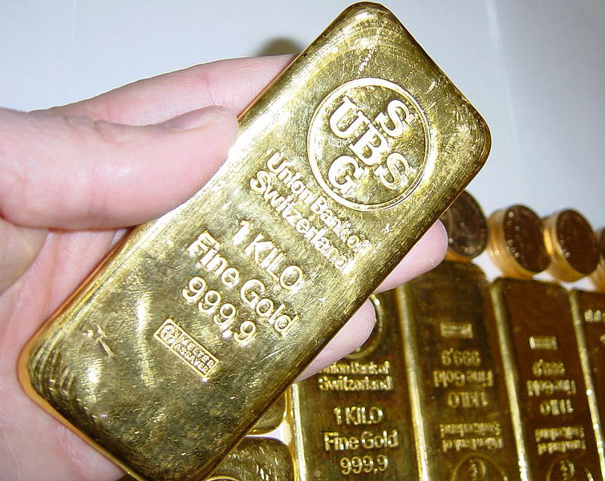
Bre-X: 1996
Bre-X is now traded on the TSX:
April: $180
Early May: $200
Late May: $286.50
New announcements:
June: 39 million oz
Early July: 42.6 million oz
Late July: 47 million oz
Numerous mining companies—mostly Canadian—were headed off to Borneo staking other claims…
Felderhof sold $84 million worth of stocks

Slide 9
Bre-X: 1996
At this time, Trevor Cavicchi was Canadian geologist who had just graduated from university
He was hired by Bre-X and, in Borneo, had noted numerous core samples lying open—something that would not be considered among best practices
He asked a few questions but was quickly told off
As a junior geologist, he didn’t pursue the issue

Slide 10
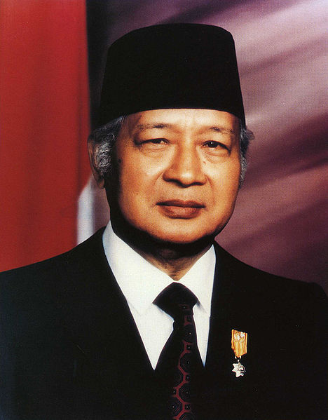
Bre-X: 1996
Now, Bre-X was attracting the attention of the Indonesian strongman Suharto
Indonesia revoked Bre-X’s explorations rights claiming irregularities
Freeport McMoRan Copper & Gold Inc. was brought in by Indonesia to exploit the mine
A company employing one of Suharto’s daughters would be building the infrastructure
Following a resolution to a 10-month dispute:
Bre-X 45 %
Freeport 15 %
The Indonesian government 40 %

Slide 11
Bre-X: 1997
Bre-X’s stock was dropping: to prop it up, they found more gold
February 17 71 million oz
February 19 Claims of 200 million oz
The stock prices recovered and Felderhof is awarded the “Man of the Year Award” from the Prospectors & Developers Association of Canada
De Guzman’s office at Busang is destroyed by fire
republicofmining.com

Slide 12
Bre-X: 1997
Unfortunately, Freeport was digging its own cores
They dug a sample only 1.5 m away from Bre-X site
Their core found 0.01 grams per tonne
Bre-X had found 4.39 grams per tonne
De Guzman was in Toronto addressing shareholders but is called back to explain the discrepancy in Freeport’s findings
During the helicopter flight, he appears to have jumped into the Indonesian jungle
What appears to be his body, badly decomposed, was found days later

Slide 13
Bre-X: 1997
The stock price of Bre-X dropped to almost nothing…
All involved blamed everything on de Guzman
Walsh moves to the Bahamas
Felderhof moves to the Cayman Islands
No one is found guilty of this fraud
Joe Groia, who successfully defended Felderhoff, was found guilty of professional misconduct in June 2012 by the Law Society of Upper Canada for his conduct during the trial

Slide 14
Salting
De Guzman had been salting the core samples
He used gold from one of his wedding bands
Initially, it was 3 oz per tonne—a modest amount—but this rose over the years
Later, de Guzman ended up purchasing $61,000 of alluvial gold
He was very intelligent in measuring plausible quantities of gold into each sample—never more than could have been believable given the current hype

Slide 15
Response
The Canadian mining industry is seen as the laughing stock of the world
Prior to this, the industry was not regulated
Regulation similar to that of engineering was introduced

Slide 16
Response
In Ontario, the Professional Geoscientists Act was passed in 2000
Geosciences would now be a self-regulating profession
Modeled on the Professional Engineers Act
The Act established the Association of Professional Geoscientists of Ontario (APGO)
Following a three-year transitional council, the first elected council was formed in 2003
Students graduating from geological engineering at UW satisfy the requirements of both PEO and the APGO

Slide 17
Response
In Alberta, the professions of engineering and geoscience form one association:
Engineering and Geoscience Professions Act
Association of Professional Engineers and Geoscientists of Alberta (APEGA),

Slide 18
Response
One silver lining: Trevor Cavicchi has since gone on to become a successful geologist today and he has apparently gained a reputation for stating the facts and not attempting to manipulate them to satisfy the wants or desires of others

Slide 19
References
[1] “Ten years, ten lives: The Bre-X fallout”, the Calgary Herald, May 24, 2007.
[2] “Bre-X timeline: From boom to bust”, CBC News, July 31, 2007.
[3] Sam Ro, “BRE-X: Inside The $6 Billion Gold Fraud That Shocked The Mining Industry”, The Business Insider, July 1, 2012.
[4] Masterminds: Fool’s Gold
http://www.youtube.com/watch?v=pNvixeqlKdQ
http://www.youtube.com/watch?v=0YNnjitbcaE
http://www.youtube.com/watch?v=-2hTKWZZz74
[5] Wikipedia, http://www.wikipedia.org/
These course slides are provided for the ECE 290 class. The material in it reflects Douglas Harder’s best judgment in light of the information available to him at the time of preparation. Any reliance on these course slides by any party for any other purpose are the responsibility of such parties. Douglas W. Harder accepts no responsibility for damages, if any, suffered by any party as a result of decisions made or actions based on these course slides for any other purpose than that for which it was intended.

