Slide 1
Contract Law: An Introduction
Douglas Wilhelm Harder, M.Math. LEL
Department of Electrical and Computer Engineering
University of Waterloo
Waterloo, Ontario, Canada
ece.uwaterloo.ca
dwharder@alumni.uwaterloo.ca
© 2013 by Douglas Wilhelm Harder. Some rights reserved.

Slide 2
Outline
An introduction to the engineering profession, including:
Standards and safety
Law: Charter of Rights and Freedoms, contracts, torts, negligent malpractice, forms of carrying on business
Intellectual property (patents, trade marks, copyrights and industrial designs)
Professional practice
Professional Engineers Act
Professional misconduct and sexual harassment
Alternative dispute resolution
Labour Relations and Employment Law
Environmental Law

Slide 3
Agreements
What is an agreement?
Agreement, n
An arrangement made between two or more parties and agreed by mutual consent. Also: a document or instrument embodying this; the phraseology used in it.
Reference: Oxford English Dictionary (www.oed.com)

Slide 4
Agreements
When is an agreement legally binding?
That is, when can you take a legal person to court and sue them for not upholding their part of an agreement?

Slide 5
Contracts
Contract, n
A mutual agreement between two or more parties that something shall be done or forborne by one or both; a compact, covenant, bargain; especially such as has legal effects; a convention between states.
A business agreement for the supply of certain articles or the performance of specified work at a certain price, rate, or commission.
An agreement enforceable by law.
Reference: Oxford English Dictionary (www.oed.com)

Slide 6
Contracts
Consequently, a contract is a legally enforceable agreement
How do you differentiate between an agreement that is legally enforceable and one that is not?

Slide 7
Contracts
“I’ll give you $999 for that Z10.”
“Hey, kid, I’ll buy your trike off you for $3.”
“I’ll give you my vinyl record collection for free.”
“Here’s $50, now give me your iPod.”
“
How do you differentiate between an agreement that is legally enforceable and one that is not?

Slide 8
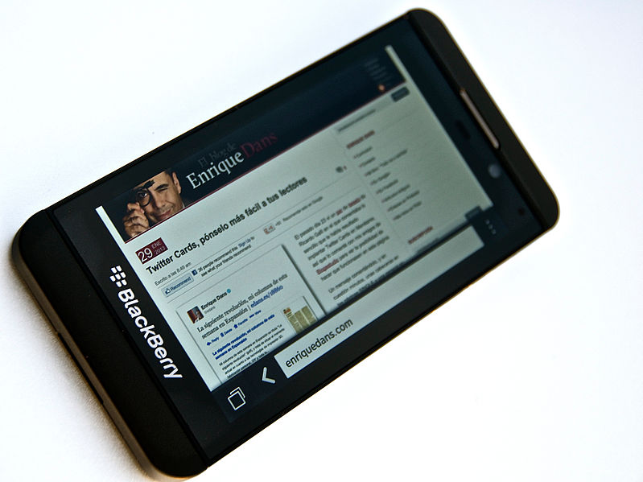
Contracts
“I’ll give you $999 for that Z10.”
“Here you go...”
Enrique Dans

Slide 9
Contracts
“Hey, kid, I’ll buy your new skateboard for a whole $3 so you can go buy some candy.”
Bengt Nyman

Slide 10
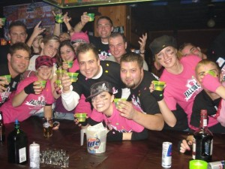
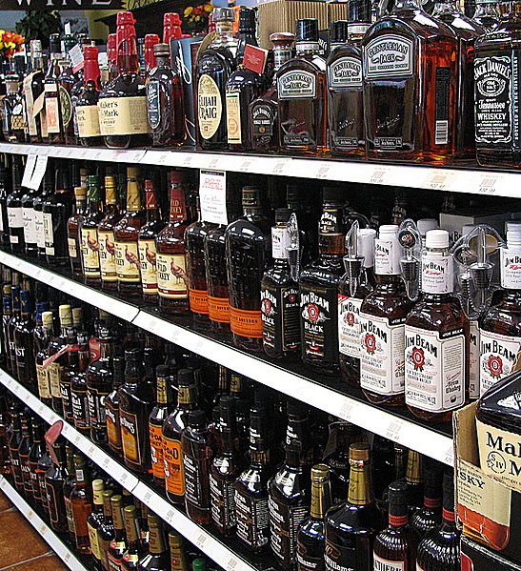
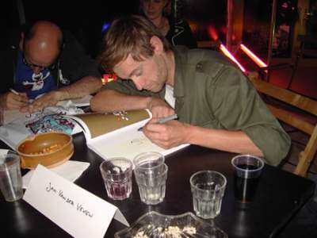
Contracts
“Sure, I’ll sell you my seven-year old Toyota for another bottle of scotch...”
Tastethebacon
Jan Van der Veken
http://www.decaturspirits.com

Slide 11
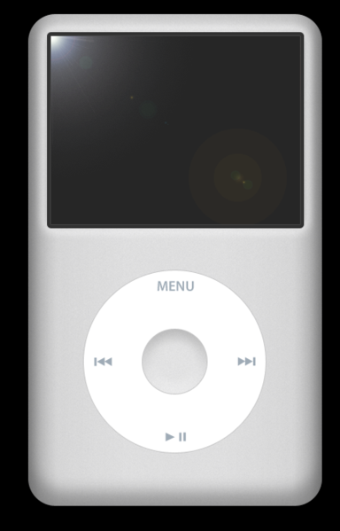
Contracts
“Here’s $50, give me that 160 GB iPod now: I paid you.”
Kyro

Slide 12
Contracts
“Here’s $50, give me that iPod Touch.”
“Yah, right...”
“Okay, here you go! Now give me the iPod...”
Domaina

Slide 13
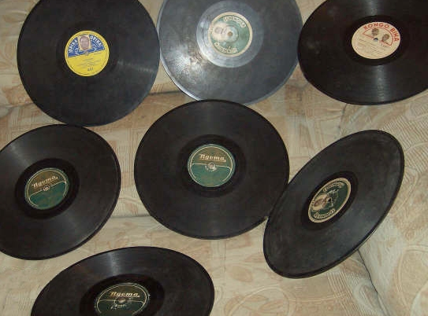
Contracts
“Okay, sure... I’ll give you my entire vinyl record collection for free. I really don’t want it.”

Slide 14
Contracts
“My dealer’s crack was wacked. It’s sugar but he’s keeping my $40! Make him give me my crack!”
http://www.thesmokinggun.com/buster/woman-complains-about-crack-dealer-765412

Slide 15
Contract Law
A significant component of contract law is based in common-law precedence
Over the years, judges had to decide when an agreement was legally enforceable
The word contract is derived from Latin:
tractare to handle, manage, perform
contrahere to draw together, assemble

Slide 16
Contract Law
Over time, the following elements were deemed essential for any agreement to be legally enforceable
That is, for an agreement to form a contract
An offer is made and accepted
There is mutual intent to enter into the contract
Consideration
Capacity to contract
Lawful purpose

Slide 17
Contract Law
Any agreement having all five elements is legally enforceable
This is, regardless of how unfair the agreement is
Any agreement missing even one element will not be legally enforceable—the courts will not intervene to rectify an injury

Slide 18
Contract Law
The terms in a contract include any benefits and obligations usually arrived at through negotiation and then agreement
The courts will be willing to step in if a party to a contract does not fulfill its obligations under the terms
Courts will not, however, alter the terms of a contract in favour of more fair or just terms than those that were decided upon
The courts may, however, declare a contract void, voidable, or unenforceable

Slide 19
Contract Law
Consequently, if you, as an engineer, negotiate a bad deal for yourself, you are legally required to fulfill your obligations under the contract
On the other hand, once a contract has been entered into, the parties to the contract—through mutual agreement—may, up to a point, alter the terms
Any changes must fall within the scope of the original contract
A contract to build a house can have the design changed or even include a shed
A contract to design an apartment cannot be modified to include a design for a house for one of the owners

Slide 20
Contract Law
The benefits of a contract can be assigned unilaterally by one party to another independent party
The contract must contain a term forbidding this if one of the parties does not wish such an assignment of rights

Slide 21
Contract Law
When a party does not fulfill one of its obligations under the contract, that party is said to have breached a term of the contract
The party that is to benefit from a breached term in a contract is said to be the injured party
The injured party can approach a judge to remedy the injury

Slide 22
References
[1] D.L. Marston, Law for Professional Engineers, 4th Ed., McGraw Hill, 2008.
[2] Julie Vale, ECE 290 Course Notes, 2011.
[3] Wikipedia, http://www.wikipedia.org/
These course slides are provided for the ECE 290 class. The material in it reflects Douglas Harder’s best judgment in light of the information available to him at the time of preparation. Any reliance on these course slides by any party for any other purpose are the responsibility of such parties. Douglas W. Harder accepts no responsibility for damages, if any, suffered by any party as a result of decisions made or actions based on these course slides for any other purpose than that for which it was intended.

