Slide 1
ECE 720T5 Fall 2012 Cyber-Physical Systems
Rodolfo Pellizzoni

Slide 2
Assignments – Research Track
Saturday Oct 13 8:00AM: Project proposal
  Max 2 pages document.
  Describe what you want to do, why is it relevant, what will be the contribution, and a brief summary of your work plan.
  Please pick a title for the project.
  I would suggest using a ACM/IEEE double-column conference format. This way, it is easier for you to re-use the proposal text when you create the final report.
  Please send me the proposal by email in pdf or word format.
If you want to further discuss the project, I will be available this afternoon, tomorrow morning and Friday morning this week.

Slide 3
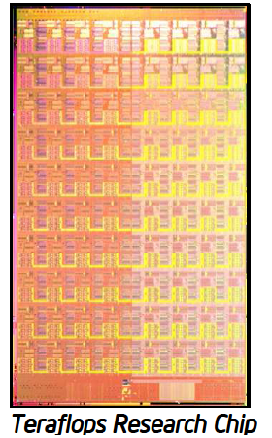
Topic Today: Interconnects
On-chip bandwidth wall.
  We need scalable communication between cores in a multi-core system
  How can we provide isolation?
Delay on the interconnects compounds cache/memory access delay
Interconnects links are a shared resource – tasks suffer timing interference.

Slide 4
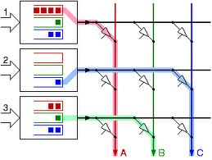
Interconnects Types
Shared bus
  Single resource – each data transaction interferes with every other transaction
  Not scalable
Crossbar
  N input ports, M output ports
  Each input connected to each output
  Usually employs virtual input buffers
  Problem: still scales poorly. Wire delay increases with N, M.

Slide 5
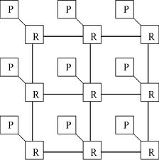
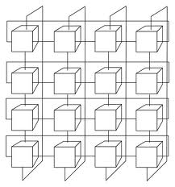
Interconnects Types
Network-on-Chip
  Interconnects comprises on-chip routers connected by (usually full-duplex) links
  Topologies include linear, ring, 2D mesh, 2D torus

Slide 6
Off-Chip vs On-Chip Networks
Several key differences…
Synchronization
  It is much easier to synchronize on-chip routers
Link Width
  Wires are relatively inexpensive in on-chip networks – this means links are typically fairly wide.
  On the other hand, many off-chip networks (ex: PCI express, SATA) moved to serial connections years ago.
Buffers
  Buffers are relatively inexpensive in off-chip networks (compared to other elements).
  On the other hand, buffers are the main cost (area and power) in on-chip networks.

Slide 7
Other Details
Wormhole routing (flit switches)
  Instead of buffering the whole packet, buffer only part of it
  Break packet into blocks (flits) – usually of size equal to link width
  Flits propagate in sequence through the network
Virtual Channels
  Problem: packet now occupies multiple flit switches
  If the packet becomes blocked due to contention, all switches are blocked
  Solution: implement multiple flit buffers (virtual channels) inside each router
  Then assign different packets to different virtual channels

Slide 8
AEthereal Network on Chip

Slide 9
AEthereal
Real interconnects architecture implemented by Philips (now NXP semiconductors)
Key idea: NoC comprises both Best Effort and Guaranteed Service routers.
GS routers are contentionless
  Synchronize routers
  Divide time into fixed-size slot
  Table dictates routing in each time slot
  Tables build so that blocks never wait – one-block queuing

Slide 10
Routing Table

Slide 11
Combined GS-BE Router

Slide 12
Alternative: Centralized Model
A central scheduling node receives requests for channel creation
Central scheduler updates transmission tables in network interfaces (end node -> NoC).
Packet injection is regulated only by the network interfaces – no scheduling table in the router.

Slide 13
Centralized Mode Router

Slide 14
Results: Buffers are Expensive

Slide 15
The Big Issue
How do you compute the scheduling table?
No clear idea in the paper!
  In the distributed model, you can request slots until successful.
  In the centralized model, the central scheduler should run a proper admission control + scheduling algorithm!
  How do you decide the length (slot numbers) of the routing tables?
Simple idea: treat the network as a single resource.
  Problem: can not exploit NoC parallelism.

Slide 16
Computing the Schedule
Real-Time Communication for Multicore Systems with Multi-Domain Ring Buses.
Scheduling for the ring bus implemented in Cell BE processor
  12 flit-switches
  Full-duplex
  SPE units use scratchpad with programmable DMA unit
Main assumptions:
  Scheduling controlled by software on the SPEs
  Transfers large data chunks (unit transactions) using DMA
  All switches on the path are considered occupied during the unit transfer
  Periodic data transactions with deadline = period.

Slide 17
Transaction Sets And Linearization

Slide 18
Results
Overlap set: maximal set of overlapping transactions.
  Two overlapping transactions can not transmit at the same time…
If the periods are all the same, then U <=1 for each overlapping set is a necessary and sufficient schedulability condition.
Otherwise, U <= (L-1)/L is a sufficient condition (where L is the GCD of the periods in unit transactions).
Implementation transfers 10KB in a time unit of 537.5ns – if periods are multiples of ms, L is large.

Slide 19
Same Periods – Greedy Algorithm

Slide 20
Different Periods
Divide time into intervals of length L.
Define lag for a job of task i as: U_{i} * t - #units_executed
  Schedulable if lag at the deadline = 0.
  Lag of a overlap set: sum of the lags of tasks in the set.
Key idea: compute the number of time units that each job executes in the interval such that:
  The number of time units for each overlap set is not greater than L (this makes it schedulable in the interval)
  The lag of the job is always > -1 and < 1 (this means the job meets the deadline)
How is it done? Complex graph-theoretical proof.
  Solve a max flow problem at each interval.

Slide 21
What about mesh networks?
A Slot-based Real-time Scheduling Algorithm for Concurrent Transactions in NoC
Same result as before, but usable on 2D mesh networks.
Unfortunately, requires some weird assumptions on the transaction configuration…

Slide 22
NoC Predictability: Other Directions
Fixed-Priority Arbitration
  Let packets contend at each router, but arbitrate according to strict fixed-priority
  Then build a schedulability analysis for all flows
  Issue #1: not really composable
  Issue #2: do we have enough priorities (i.e. do we have buffers)?
Routing
  So far we have assumed that routes are predetermined
  In practice, we can optimize the routes to reduce contention
  Many general-purpose networks use on-line rerouting
  Off-line routes optimization probably more suitable for real-time systems.

Slide 23
Putting Everything Together…
In practice, timing interference in a multicore system depends on all shared resources:
  Caches
  Interconnects
  Main Memory
A predictable architecture should consider the interplay among all such resources
  Arbitration: the order in which cores access one resource will have an effect on the next resource in the chain
  Latency: access latency for a slower resource can effectively hide the latency for access to a faster resource
Let’s see some examples…

Slide 24
HW Support for WCET Analysis of Hard Real-Time Multicore Systems

Slide 25
Intra-Core and Inter-Core Arbiters

Slide 26
Timing Interference

Slide 27
WCET Using Different Cache Banks

Slide 28
Bankization vs Columnization (Cache-Way Partitioning)

Slide 29
Non-Real Time Tasks

Slide 30
Optimizing the Bus Schedule
The previous paper assumed RR inter-core arbitration.
Can we do better?
Yes! Bus scheduling optimization
  Use TDMA instead of RR – same worst-case behavior
  Analyze the tasks
  Determine optimal TDMA schedule
  Ex: Predictable Implementation of Real-Time Applications on Multiprocessor Systems-on-Chip

Slide 31
Example

