Slide 1
ECE 720T5 Fall 2012 Cyber-Physical Systems
Rodolfo Pellizzoni

Slide 2
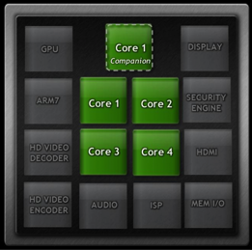
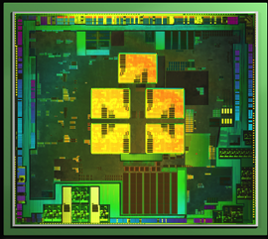
Topic Today: Heterogeneous Systems
Modern SoC devices are highly heterogeneous systems - use the best type of processing element for each job
Good for CPS – processing elements are often more predictable than GP CPU!
Challenge #1: schedule computation among all processing units.
Challenge #2: I/O & interconnects as shared resources.
NVIDIA Tegra 3 SoC

Slide 3
Processing Elements
Trade-offs of programmability vs performance/power consumption/area.
Not always in this order…
Application-Specific Instruction Processors
Graphics Processing Unit
Reconfigurable Field-Programmable Gate Array
Coarse-Grained Reconfigurable Device
I/O Processors
HW Coprocessors

Slide 4
Processing Elements
Application-Specific Instruction Processors
  The ISA and microarchitecture is tailored for a specific application.
  Ex: Digital Signal Processor.
  Sometimes “instructions” invoke HW coprocessors.
Graphics Processing Unit
  Delegate graphics computation to a separate processor
  First appear in the ’80, until the turn of the century GPUs were HW processors (fixed functions)
  Now GPUs are ASIP – execute shader programs.
  New trend: GPGPU – execute computation on GPU.

Slide 5

Ex: Real-Time Traffic Prediction Algorithms on GPU
2
Real-Time Congestion Prediction
On-line Vehicle Traffic Congestion Probing
1
3
Real-Time Route Assignment
[MAIN FOCUS]
Historic Traffic Data
Datacenter
Large Number of Vehicles

Slide 6
Processing Elements
Reconfigurable FPGA
  Logic circuits that can be programmed after production
  Static reconfiguration: configure FPGA before booting
  Dynamic reconfiguration: change logic at run-time
Coarse-Grained Devices
  Similar to FPGA, but the logic is more constrained.
  Device typically composed of word-wide reconfigurable blocks implementing ALU operations, together with registers, mux/demux and programmable interconnects.

Slide 7
Processing Elements
HW Processors
  ASIC logic block executing a specific function.
  Directly connected to the global system interconnects.
  Typically an active device (i.e., DMA capable).
  Can be more or less programmable.
  Ex#1: cellular baseband decoders – not programmable
  Ex#2: video decoder – often highly programmable (sometimes more of an ASIP)
I/O Processor
  Same as before, but dedicated to I/O processing.
  Ex: accelerated Ethernet NICs – move some portion of the TPC/IP stack in HW.

Slide 8
I/O and Peripherals
What about peripherals and I/O?
Standardized Off-Chip Interconnects are popular
  PCI Express
  USB
  SATA
  Etc.
Peripherals can interfere with each other on off-chip interconnects and with cores in memory!
  Dangerous if assigned different criticalities
  We can not schedule peripherals like we do for tasks

Slide 9
I/O and Peripherals
Solution 1: analysis
  Build a model of data transfers (i.e., how much data is transferred over an interval of time).
  Perform analysis to derive delay on the interconnect.
  Perform analysis to derive task delay in memory
  More on this next lecture…
Solution 2: controlled DMA
  Ex: Real-Time Control of I/O COTS Peripherals for Embedded Systems
  Idea: use a controllable DMA engine
  DMA transfers are synchronized with each other and with core data transfers.
  Implicit schedule of memory transfers.

Slide 10
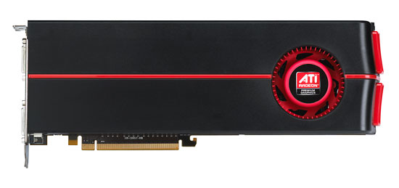
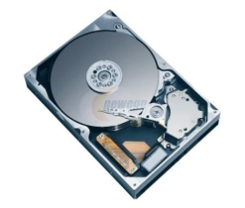
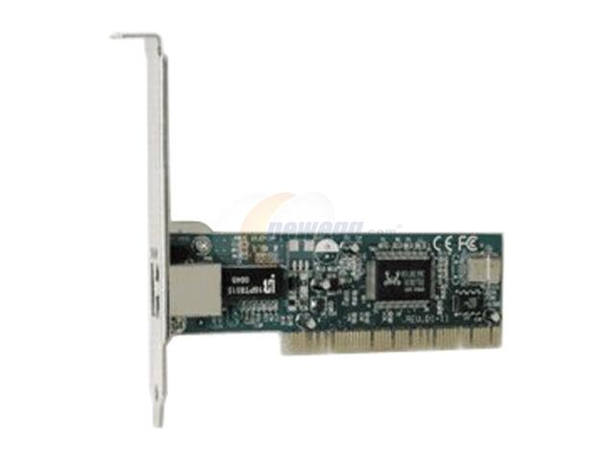
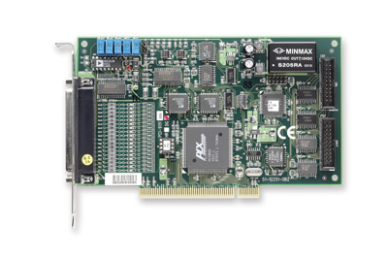
Real-Time Control of I/O COTS Peripherals for Embedded Systems
A Real-Time Bridge is interposed between each high-throughput peripheral and COTS bus.
The Real-Time Bridge buffers incoming/outgoing data and delivers it predictably.
Reservation Controller enforces global implicit schedule.
Assumption: all flows share main memory…
… only one peripheral transmit at a time.
Reservation
Controller
CPU
RAM
North
Bridge
RT
Bridge
PCIe
RT
Bridge
ATA
South
Bridge
RT
Bridge
PCI-X
RT
Bridge
6/19

Slide 11
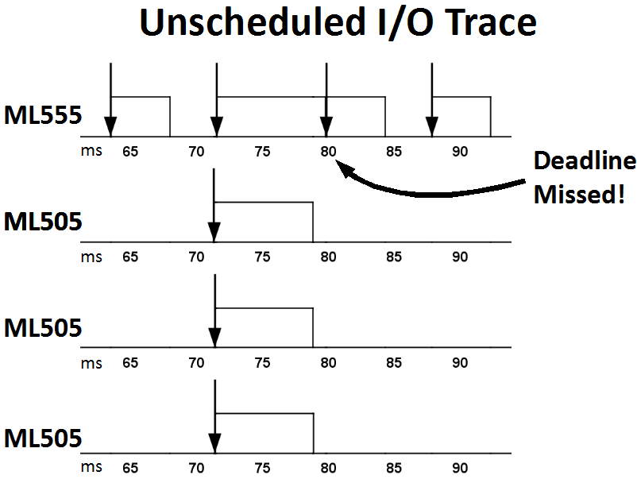
Evaluation
Experiments based on Intel 975X motherboard with 4 PCIe slots.
3 x Real-Time Bridges, 1 x Traffic Generator with synthetic traffic.
Rate Monotonic with Sporadic Servers.
Peripheral | Transfer Time | Budget | Period
RT Bridge | 7.5ms | 9ms | 72ms
Generator | 4.4ms | 5ms | 8ms
Utilization 1, harmonic periods.
Generator
RT-Bridge
Scheduling flows without reservation controller (block always low) leads to deadline misses!
RT-Bridge
RT-Bridge
17/19

Slide 12
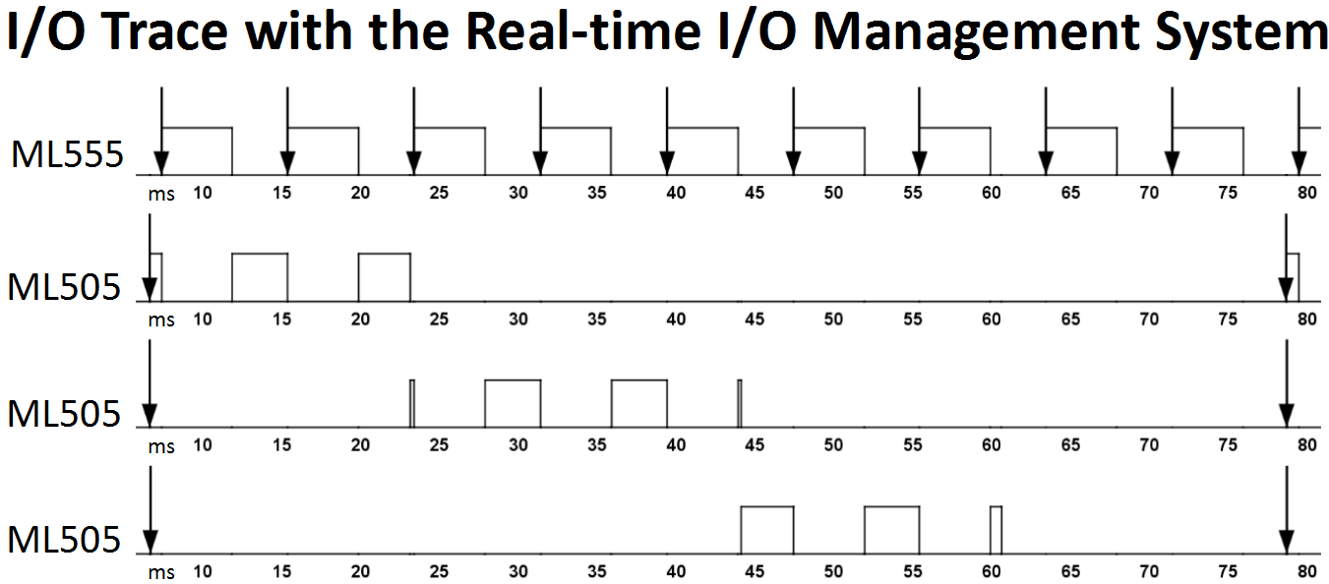
Evaluation
Experiments based on Intel 975X motherboard with 4 PCIe slots.
3 x Real-Time Bridges, 1 x Traffic Generator with synthetic traffic.
Rate Monotonic with Sporadic Servers.
Peripheral | Transfer Time | Budget | Period
RT Bridge | 7.5ms | 9ms | 72ms
Generator | 4.4ms | 5ms | 8ms
No deadline misses with reservation controller
Generator
RT-Bridge
RT-Bridge
RT-Bridge
17/19

Slide 13
Reconfigurable Devices and Real-Time
Great deal of attention on reconfigurable FPGA for embedded and real-time systems
  Pro: HW logic is (often) more predictable than SW executing on complex microarchitectures
  Pro: HW logic is more efficient (per unit of chip area/power consumption) compared to GP CPU on parallel math crunching applications – somehow negated by GPU nowadays
  Cons: Programming the HW is more complex
Huge amount of research on synthesis of FPGA logic from high-level specification (ex: SystemC).

Slide 14
Reconfigurable FPGA
How to use it: static design
  Implement I/O, interconnects and all other PE on ASIC.
  Use some portion of the chip for a programmable FPGA processor.
How to use it: dynamic design
  Implement I/O and interconnects as fixed logic on FPGA.
  Use the rest of the FPGA area for reconfigurable HW tasks.
HW Task
  Period, deadline, wcet as SW tasks.
  Additionally has an area requirement.
  Requirement depends on the area model.

Slide 15
Example: Sonic-on-a-Chip
Slotted area
  Fixed-area slots
Reconfigurable design targeted at image processing.
Dataflow application.
Some or all dataflow nodes are implemented as HW tasks.

