Slide 1
ECE 720T5 Winter 2014 Cyber-Physical Systems
Rodolfo Pellizzoni

Slide 2
Topic Today: Memory architectures
Memory wall problem: cpu speed (in the past) / number of cores (in the present/future) increases faster than memory bandwidth.
Memory elements shared among multiple tasks/cores create unpredictability.
Furthermore, cache is hard to analyze even for a single task…
CORE#1
CORE#M
…
PRIVATE CACHE
PRIVATE CACHE
SHARED CACHE#1
SHARED CACHE#K
…
MAIN MEMORY#1
MAIN MEMORY #K

Slide 3
What is the problem with cache?
To compute WCET, we need to determine which accesses can result in a cache miss.
To obtain a safe bound, we need to determine the worst-case.
Problem: the worst-case can be very pessimistic in the presence of pointers.
  Example: consider direct-mapped cache, multiple dynamic arrays with the same size.
  In the worst case, all arrays have the same indexes in cache –> huge number of conflict misses.
  In practice it will likely never happen…

Slide 4
Best vs Worst Case Cache Behavior

Slide 5
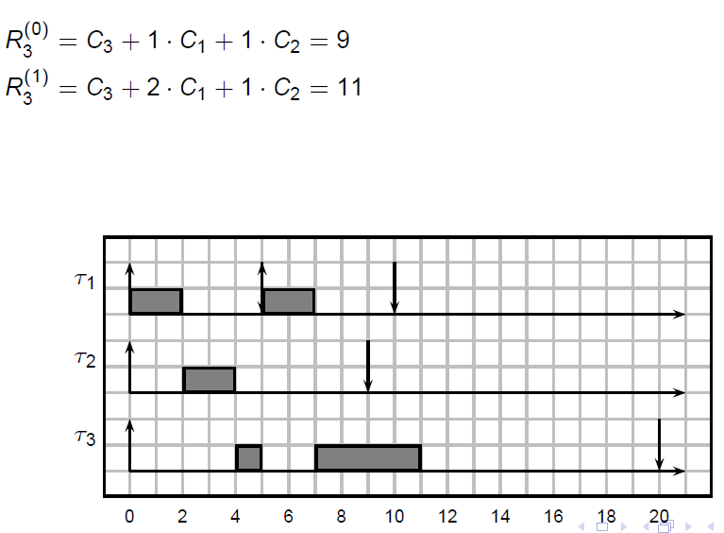
Shared Memory Resources: Issues
Multi-tasking allocation (storage) interference.
Assume one task preempts another.
What happens to the cache content?

Slide 6
Shared Memory Resources: Issues
Multi-tasking allocation (storage) interference.
Assume one task preempts another.
What happens to the cache content?
Example:

Slide 7
Shared Memory Resources: Issues
Multi-tasking allocation (storage) interference.
Assume one task preempts another.
What happens to the cache content?
The problem is especially bad for the case of partitioned (mixed-criticality) systems.
Ex: avionics ARINC 653.
  Software partitions are assigned fixed time slices.
  When the partition change, huge increase in cache miss ratio – must be accounted for in the timing budget.

Slide 8
Shared Memory Resources: Issues
Shared cache allocation (storage) interference.
Similar to before, except now multiple cores compete for cache space.
One core can evict cache lines belonging to another core.
Very dangerous if different cores execute partitions with different criticalities!

Slide 9
Shared Memory Resources: Issues
Shared memory timing interference.
Multiple cores can try to access the shared resource simultaneously (in particular – main memory).
One core is granted the resource, the other cores wait.
I.e., each core can potentially delay the others.
Note: it’s not just cores – DMA peripherals can also content for main memory access.
How bad it is?

Slide 10
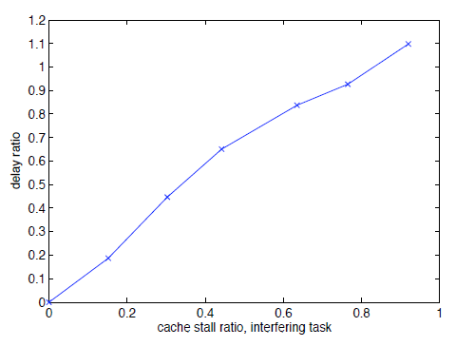
Timing Interference, 2 cores
Task A suffers max number of cache misses (92% stall time).
Task B has variable cache stall time
Adding PCI-E peripheral interference -> 196% WCET increase!
Max WCET increase ~= cache stall time of task A
Wcet increase proportional to cache stall time
3/20

Slide 11
Timing Interference, 8 Cores Sim
7 Interfering cores.
Almost 300% WCET increase!
19/20

Slide 12
Solutions
Remember: there are three general solutions…
Analysis
  We will see it later
Modify the architecture
Redesign the architecture

Slide 13
Solutions: allocation interference
Cache partitioning
  Partition the cache either among multiple tasks or multiple cores.
  Pros: no allocation interference
  Cons: each task/core gets a smaller portion of the cache
How to do it?
  Compiler-based (coloring): modify linkage (and malloc) such that different tasks/cores occupy different cache lines.
  OS-based (coloring): modify the page allocation mechanisms such that different tasks/cores occupy different cache lines.
  HW-based (way-partitioning): partition cache ways among tasks/cores.
Note that 1 (possibly 2) can also help single-task analysis.

Slide 14
OS-based partitioning
virtual mem space
physical mem space
line
index
0
page 1
1
2
cache way
3
page 2
0
1
cache
line
2
3
page 3
0
1

Slide 15
Solutions: allocation interference
Scratchpad
  A programmable cache
  Software is responsible for loading/unloading the scratchpad
The main idea is to divide memory accesses in two categories:
  Accesses to scratchpad
  Everything else goes to main memory
Problem: how do we determine what to load into the scratchpad?
Usually determined off-line by a scratchpad allocation algorithm.
Scratchpad content can be updated while task/s is/are running.

Slide 16
Solutions: allocation interference
Scratchpad Alternatives
As we will see, there are cache-based solutions that provide similar functionalities…

Slide 17
Solution: timing interference
This is trickier…
Solution #1: modify the arbitration
  Works better when the different contending agents have different requirements in terms of latency and/or bandwidth
  Ex: DMA peripherals and cores contending for main memory access. Give higher priority to cores.
  Ex #2: read vs write operations. Give higher priority to reads.
Solution #2: schedule the resource accesses
  Schedule agents’ activities so that there is no contention for access to the shared resource.
  More on this later…

Slide 18
Implementing Time-Predictable Load and Store Operations

Slide 19
Example Code Fragment

Slide 20
Scratchpad MMU
Problem: if I copy pointer-based data structures from main memory to scratchpad, all pointers are now off!
  Pointer aliasing issues
  Pointer invalidation issues
Solution: scratchpad MMU
  Similar to segmentation
  Store base address, length and offset (remap) for each object in the scratchpad rather than segment
  Objects can be placed anywhere in the scratchpad – implementation similar to fully associative cache!

Slide 21
Implementation

Slide 22
Open/Close Functions
OPEN copies memory -> scratchpad
CLOSE removes from scratchpad
Ideally, added by a scratchpad allocation algorithm
What about dynamic allocation?

Slide 23
CPU Speed vs Object # in SMMU

Slide 24
Results: “Good” Function

Slide 25
Results: Not So Good Program
Compare with perfect cache:

Slide 26
Alternative: Cache Locking
Fetch cache line into cache.
Lock the cache line – cannot be replaced.
Pros:
  Implemented on several embedded architectures
  You can fetch a portion of an object rather than the entire object – very important.
Cons (because we cannot use full associativity…)
  There can be conflicts
  We can waste some space

Slide 27
Cache vs Scratchpad

Slide 28
Cache vs Scratchpad: Case Study
Scratchpad memories vs locked caches in hard real-time systems: a quantitative comparison.
Study on instruction cache only.
Analyze the task control-flow graph.
Select reload points
  cache/scratchpad content is modified
  For scratchpad, select the objects (code for each Basic Block) to load into scratchpad
  For cache, select the content of each cache block

Slide 29
Cache vs Scratchpad: Comparison
Cache:
  Transparent
  No external fragmentation, but internal fragmentation
  Conflict misses are possible
Scratchpad
  Might require additional jump instructions (without translation unit)
  No internal fragmentation, but external fragmentation
  Implementation is problematic with large number of BB

Slide 30
Comparison

Slide 31
Object Size is a Problem…

Slide 32
Explicit Reservation of Local Memory in a Predictable, Preemptive Multitasking Real-Time System

Slide 33
Which task pays for allocation interference?

Slide 34
Carousel as a Stack

Slide 35
Starting a Task - Preemption

Slide 36
Ending a Task - Restore

Slide 37
Task Invocation
Open, Close responsible for DMA operations for the active task in use.
Note: core is stalled while all such operations are performed!

Slide 38
WCET Benchmarks

Slide 39
Vs Cache

Slide 40
Somehow cheating…
Comparison based on write-back cache…

Slide 41
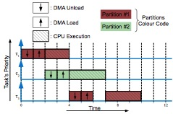
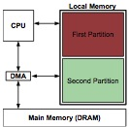
Why don’t we do better?
Main issue: core is stalled while swapping blocks in/out of scratchpad.
Solution: use DMA instead.
Hiding memory latency through fix-priority scheduling.

Slide 42
Vs Carousel,
Percentage of schedulable task sets, RM scheduling, loading time 5-10%.

Slide 43
Cache Partitioning vs Locking/Scratchpad
More widely applicable. Compiler/OS techniques can be used on any platform.
No need to change application code.
The same techniques can also alleviate conflict misses within each task (difficult for dynamic data).
WCET estimation is difficult in standard cache – but with locking/scratchpad each access is either a hit or a miss.
  In practice, industry prefers to perform extensive testing in this case – at least for the single task case.

Slide 44
Selecting Cache Partition Sizes
Impact of cache partitioning on multi-tasking real time embedded systems
Single-core system running multiple tasks.
Basic idea: partition last level cache into a unique shared area and multiple private areas.
Each task can be assigned to either the shared area or a private area.
Optimize system utilization.

Slide 45
Shared Caches
What about shared cache allocation interference?
Hard problem.
  While a task runs on a core, we need to know which tasks run on all other cores
  If the schedule of all cores is not synchronized, then analysis is either 1. exponential or 2. highly pessimistic
Alternative solution: partition the cache among cores.
If we have to partition it… does it makes sense to have a shared last-level cache?

Slide 46
Shared Cache Partitioning
Answer: sometimes yes.
If we have no shared last-level cache, the amount of per-core cache is fixed and equal.
If we partition the last-level cache, we can vary the size of each partition (see optimization before).
What about access interference?
  Many last-level caches are divided into banks that can be accessed in parallel.
  If possible, assign each bank to a single core.
  Problem: number of banks or data ports (i.e. max number of parallel data transfers) might be insufficient for all cores.

Slide 47
Topic 2: Memory Controllers
Main memory is a not really a unique shared resource – instead, composed of multiple parallel components (banks).
The way main memory is addressed and accessed can greatly influence the system performance!
We will see:
  Summary of DRAM operation
  Examples of predictable DRAM controllers

Slide 48
DRAM Basics
Each memory device (chip) is composed of multiple banks.
Each bank has a row buffer (dram page) – typically few kbytes.
A DRAM row must be loaded (opened/activated) in the row buffer before read/write is possible, and then precharged back (closed) before we can load another page.
Banks can operate in parallel, but there is a shared command bus and a shared data bus.

Slide 49
DRAM Basics
: command bus
: data bus
data transfer usually corresponds
to one 64 bytes cache block
commands
ACT
READ
DATA
PRE
multiple
timing
constraints

Slide 50
DRAM Basics
Multiple DRAM devices arranged together to form a DRAM module.
In-line devices used to increase data width (usually to 64 bits).
Different lines form independent ranks.
Remember that devices within a rank have multiple banks.

Slide 51
How Page Works
Latency for the first request to a given page is very long.
Successive requests to the same page operate efficiently (open page policy).
REQUEST #1
COMPLETES,
REQUEST #2
ARRIVES
REQUEST #1
ARRIVES
close the previous page
and load new one
PRE
ACT
READ
DATA
REQUEST #2
COMPLETES
Latency of Request #1
READ
DATA
page is already open,
just issue read command
Latency of Request #2
(with open page)

Slide 52
How Page Works
REQUEST #1
COMPLETES,
REQUEST #2
ARRIVES
REQUEST #1
ARRIVES
close the previous page
and load new one
PRE
ACT
READ
DATA
REQUEST #2
COMPLETES
Latency of Request #1
READ
DATA
page is already open,
just issue read command
Latency of Request #2
(with open page)
* | Latency – First Access | Latency – Further Accesses | Data Cycles for each core
Single Core | 35 | 9 | 4
in clock cycles on a JEDEC-compliant
DDR3 module

Slide 53
Effects of Contention
So far we considered one request at a time produced by one core.
In practice multiple cores can contend for access to the same memory module (plus possibly peripherals, multiple load/store units within the same core, etc.) -> multiple requests for read/write sent to the memory controller at the same time.
A typical memory controller selects the read/write command to execute based on the following three rules (in decreasing order of importance):
Give higher priority to commands that can be executed right now.
Serve commands in round-robin order of the targeted rank/bank.
First-come-first-serve.

Slide 54
Effects of Contention
Contention depends on which bank and rank is accessed by each core.
All cores access the same bank and rank – disaster!
  Assume each of N cores produces a request for one cache block at the same time.
  Must close and open the page N times…
ALL REQUESTS ARRIVE AT THE SAME TIME,
TARGETED AT SAME BANK AND RANK
P
A
R
D
P
A
R
D
P
A
R
D

Slide 55
Effects of Contention
ALL REQUESTS ARRIVE AT THE SAME TIME,
TARGETED AT SAME BANK AND RANK
P
A
R
D
P
A
R
D
P
A
R
D
* | Latency – First Access | Latency – Further Accesses | Data Cycles for each core
Single Core | 35 | 9 | 4
Multiple Cores – same bank/rank | 35*N | 35*N | 4

Slide 56
Effects of Contention
However, different ranks/banks can operated in parallel!
  Each rank/bank has a different page, so we do not need to close a page before opening the next one.
  We can actually open all pages in parallel (up to 4 ranks/banks to avoid conflicts on the command bus).
ALL REQUESTS ARRIVE AT THE SAME TIME,
TARGETED AT DIFFERENT RANKS
PRE
ACT
R
DATA
PRE
ACT
R
DATA
PRE
ACT
R
DATA

Slide 57
Effects of Contention
ALL REQUESTS ARRIVE AT THE SAME TIME,
TARGETED AT DIFFERENT RANKS
PRE
ACT
R
DATA
PRE
ACT
R
DATA
PRE
ACT
R
DATA
* | Latency – First Access | Latency – Further Accesses | Data Cycles used by each access
Single Core | 35 | 9 | 4
N Cores – same bank/rank | 35 + 35*(N-1) | 35 + 35*(N-1) | 4
N Cores – different ranks | 35 + 4*(N-1) | 9 + 4*(N-1) | 4

Slide 58
Effects of Contention
Final case: same rank, but different banks.
Intermediate result.
  Different banks within the same rank have different pages that can be opened in parallel.
  However banks within the rank share I/O gating, which introduces additional constraints on switching between writes and reads.
* | Latency – First Access | Latency – Further Accesses | Data Cycles used by each access
Single Core | 35 | 9 | 4
N Cores – same bank/rank | 35 + 35*(N-1) | 35 + 35*(N-1) | 4
N Cores – same rank different banks | 35 + 4*(N-1) + 10*(N/2) | 9 + 4*(N-1) + 10*(N/2) | 4
N Cores – different ranks | 35 + 4*(N-1) | 9 + 4*(N-1) | 4

Slide 59
Summary
Latency for first access is high, further accesses – better.
Same bank and rank – we can not optimize further accesses and no pipelining effect.
Different ranks – perfect pipeline (each core causes an amount of contention equal to used data cycles).
Different banks same rank – as above but with some additional overhead due to write/read alternation.
There is additional latency for refresh operations!

Slide 60
Trade-offs
Memory controller typically supports multiple configurations.
Interleaved: each task/core uses all banks/ranks
  Best performance
  Worst isolation
Bank1 | Bank2 | … | Bank8
8kB
0x0000
0x3FFF
0x4000
0x7FFF
0x8000
0x1FFFF
Pages (really 8192)

Slide 61
Trade-offs
Memory controller typically supports multiple configurations.
Interleaved: each task/core uses all banks/ranks
  Best performance
  Worst isolation
Bank1 | Bank2 | … | Bank8
8kB
. . .
Task 1 (Core 1)
. . .
Pages
. . .
Task 2 (Core 2)

Slide 62
Trade-offs
Memory controller typically supports multiple configurations.
Private banks: each task/core has a set of banks/ranks
  Worst performance
  Best isolation
Bank1 | Bank2 | … | Bank8
8kB
Task 1
(Core 1)
Task 2
(Core 2)
Pages
. . .
. . .
Core 1
Core 2

Slide 63
Predictability vs Isolation trade-off
Interleaved has better performance…
DRAM delay for a single core running in isolation
Notes:
Note: this is typical of any partitioning system
Note2: redraw this graph with just interleaved and diff bank.

Slide 64
Predictability vs Isolation trade-off
… but Diff Bank has much better isolation.
DRAM delay with 3 concurrent cores

Slide 65
Predator: A Predictable SDRAM Memory Controller

Slide 66
Worst-Case For Single-Bank: Horrible

Slide 67
Bank Interleaving and Groups

Slide 68
Does it always work?
Depends on timing parameters…

Slide 69
Arbitration: CCSP

Slide 70
Controller Architecture

Slide 71
Results

Slide 72
Alternative #1: Round-Robin
An Analyzable Memory Controller for Hard Real-Time CMPs
CCSP is good for tasks that exhibits different latency requirements.
Not so good if they are all real-time tasks generating cache fetch requests.
Keep it simple:
  Hard real-time tasks are assigned higher prio than soft/non real-time tasks
  Use round-robin arbitration among real-time tasks.

Slide 73
Results: running with 3 “opponents”
Notes:
PR_MC = private memory_controllers
MOET = measured
AMC = what they get

Slide 74
VS Predator

Slide 75
Alternative #2: TDMA
PRET DRAM Controller.
Instead of building a RR schedule where each task accesses all banks/ranks (interleaved), build a Time-Division Multiple Access (TDMA) schedule where each task has a set of private banks/ranks.

