Slide 1
ECE 720T5 Fall 2011 Cyber-Physical Systems
Rodolfo Pellizzoni

Slide 2
Topic Today: OS
Key traditional requirements of Real-Time OS:
  OS Predictability
  User Configurability
  Reliability
Additional requirement – OS should efficiently support the underlying HW platform.
Especially important for multicore!
Unfortunately, traditional OS design is far from predictable…

Slide 3
LITMUS

Slide 4
LITMUS
Linux Testbed for Multiprocessor Scheduling in Real-Time
Essentially, a soft-real time multiprocessor tested
Implements a variety of different scheduling algorithm and synchronization mechanisms
Many papers for different platforms…

Slide 5
Implementation Issues…
Scheduling plug-ins
System calls API
Scheduling Classes
Locks and Run-Queues
Migration and race conditions
Timers implementation
Quantum implementation
Run queue implementation
Debugging

Slide 6
Other Common Issues
Interrupts
  More on this next week
  In Linux, typically divided in top and bottom handler
  Top (ISR): creates unpredictable interference
  Bottom (kernel thread): must be properly scheduled
Priority Inversions in the Kernel
Virtual Memory
  Paging has no concept of task priority
  Global replacement decisions do not guarantee isolation
I/O Scheduling
  Similar to virtual memory, except the OS often has less control

Slide 7
Refresh: Multiprocessor Scheduling

Slide 8
Measured Overheads: Niagara

Slide 9
Results: Niagara, HR light tasks

Slide 10
Results: Niagara, HR medium tasks

Slide 11
Results: Niagara, HR heavy tasks

Slide 12
Results: Niagara, SR light tasks

Slide 13
Results: Niagara, SR medium tasks

Slide 14
Results: Niagara, SR heavy tasks

Slide 15
Other Platforms…
An Empirical Comparison of Global, Partitioned, and Clustered Multiprocessor EDF Schedulers
Intel Xeon, 8 sockets, 6 cores per socket (total 24 cores).
LVL2 shared among 2 cores, LVL3 shared among 6 cores.
Abandoned P-fair…
Weighted schedulability:
  D: cache-induced delay
  S(U,D): percentage schedulable task sets for utilization U and cache delay D

Slide 16
Scheduling Overhead, Intel

Slide 17
Cache-Induced Delay, Intel

Slide 18
Results: Intel, HR light tasks

Slide 19
Results: Intel, HR medium tasks

Slide 20
Results: Intel, HR heavy tasks

Slide 21
Results: Intel, SR light tasks

Slide 22
Results: Intel, SR medium tasks

Slide 23
Results: Intel, SR heavy tasks

Slide 24
Resource Sharing In Multicore
Real-Time Synchronization on Multiprocessor: To Block or Not to Block, to Suspend or Spin?
General solution adopted by the authors:
  If resource is shared only by tasks within the same run-queue, use priority inheritance (GEDF) or SRP (PEDF)
  If resource is shared among tasks in multiple run-queues, simply run the task non-preemptively.

Slide 25
Alternative?
Spin-lock
  Busy-waiting until you get the resource; supports FIFO ordering to prevent starvation
Lock-free
  Try to perform an operation on the object; if it fails, retry until success.
  If multiple tasks try at the same time, at least one will succeed.
Wait-free
  No retry, every task succeeds after fixed number of instructions (can be large).

Slide 26
Examples…

Slide 27
Overheads

Slide 28
Spinning is better than suspending…

Slide 29
… unless you care about background computation

Slide 30
Simple Resource

Slide 31
Complex Resource

Slide 32
Interrupt Management

Slide 33
Interrupt Management
See presentation on “Preventing Interrupt Overload”
Other solution: server-based scheduling
  Non-preemptive interrupt scheduling for safe reuse of legacy drivers in real-time systems
U_{s}
1-U_{s}

Slide 34
Interrupt Server - Results
Burst window duration – 30% time, each burst window – 20% to 100% utilization

Slide 35
Other Solution – Gigabit Ethernet
Modeling device driver effects in real-time schedulability analysis: Study of a network driver
Measure CPU interference for a given network bandwidth
Compute a load bound approximating a periodic task

Slide 36
Results – Missed Deadlines for tau₂

Slide 37
Results –Received Packets for tau₁

Slide 38
Predictable Execution Model

Slide 39
Predictable Execution Model (PREM)
The key idea: traditional scheduling algorithms and resource sharing mechanisms are not sufficient to guarantee predictable execution – it is all about shared resources such as caches/memory/interconnect.
PREM: give the compiler/OS the flexibility required to control resource accesses performed by tasks.

Slide 40
PREM and multicore scheduling
Partitioned scheduling on multicore.
Each core is scheduled according to fixed priority.
Coarse-grained TDMA arbitration with fixed-size slots for access to main memory – guarantees core isolation.
Optimized execution for memory-demanding applications.
  Tasks accessing main memory are given higher priority.
  Memory phases are not preemptive.

Slide 41
Memory-Centric Scheduling

Slide 42
How The Analysis Works

Slide 43
Results – 8 Cores
Line is 50% probability of being schedulable

Slide 44
PREM and Cache Coherency
Cache coherency is required to ensure that cores have a consistent view of shared data.
  Most commonly implemented using the MESI protocol.
Plenty of shared data…
  In all cases: Hypervisor data
  SMP case: OS data, I/O, possibly application data.

Slide 45
MESI State Transitions

Slide 46
Cache Coherency and Interference
Cache Coherency creates two types of interference.
Storage (allocation) interference: a remote core can invalidate a cache line used by the local core
  Ping-pong effect: core#0 modifies the cache line. Core#1 reloads the cache line and modifies it again. Core#0 then reloads it…
Access interference: concurrent requests for cache access (same bank) cannot proceed in parallel
  A remote core misses and fetches a cache line from local LVL2. The local core tries to access LVL2 cache at the same time…

Slide 47
The Goal
In general, coherency negatively impacts predictability.
PREM can be used to improve performance in a predictable manner
  Key idea #1: remove the described interferences
  Key idea #2: use cache-to-cache transfer to reduce main memory accesses

Slide 48
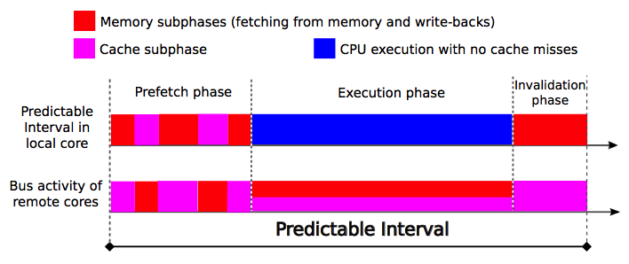
CC-PREM
Application composed of multiple predictable intervals.
CC-PREM: extends PREM to handle Cache Coherency.
Key idea: prefetch/invalidate data as needed to control the content of LVL2 cache.
Try to keep data in LVL2 cache if it will be used by the same or other cores in the future

Slide 49
CC-PREM
Prefetch phase: load required code/data not yet available in cache.
  Split into memory and cache subphases.
Invalidate: evict some code/data to make space for next interval.
Execution: execute without cache misses.

Slide 50
CC-PREM
No storage interference – control the timing of remote invalidations.
No timing interference in main memory - no two memory transfers at the same time.
Cache-to-cache transfer and main memory transfer can proceed concurrently.

Slide 51
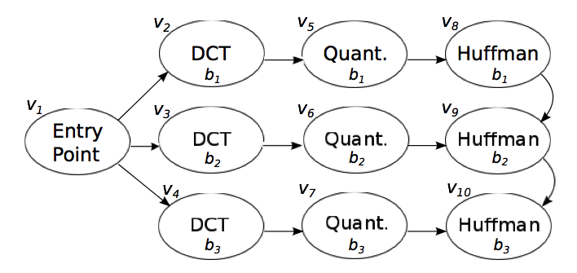
Application
JPEG application as a representative image processing benchmark.
Encodes multiple images in parallel – each image on 2 cores.

Slide 52
Automated Mapping and Scheduling
Automated mapping & scheduling framework.
Mapping assigns intervals to cores to minimize length of worst-case path.
Scheduling determines the order and starting time for all prefetch/write-back operations.
  Use timers to enforce constant-time for all phases as in the original PREM.
Also computes a memory mapping for buffers and other shared data structures.

Slide 53
Assumptions
M cores with private LVL1/LVL2 caches.
128KB LVL2.
No LVL3.
One memory controller.
1Ghz core (Intel), 1.6GB/s main memory bandwidth.
Cache latency is 1/10 of main memory latency.
Interconnects is shared bus.
  Larger advantage for NoC-based directory mechanism

Slide 54
Results – 8 Cores 4 Images

Slide 55
Results – Variable Core Number
What’s the trick? Cache-to-cache transfer is much faster than main memory access

