Slide 1

ECE700.07: Game Theory with
Engineering Applications
Lecture 1: Introduction
Seyed Majid Zahedi

Slide 2
K-Beauty Contest Game
Let’s start with playing game
Everyone writes down a number between 0 and 100
Person closest to k = 2/3 of the average wins
Example:
  A says 50 - B says 10 - C says 90
  2/3 of average(50, 10, 90) = 2/3 * 50 = 33.33
  A is closest (|50-33.33| = 16.67), so A wins

Slide 3
Overview
Course mechanics
Outline and topics
What is game theory?
What is mechanism design?
Examples

Slide 4
Course Mechanics
Course website
  https://ece.uwaterloo.ca/~smzahedi/crs/ece700t7
  All class information, lecture notes, assignments, etc.
Office hour
  W 16:00 to 17:00, or catch me after class, or send me email to setup meeting
Prerequisites
  Basic knowledge of algorithms, probability, and optimization would be helpful

Slide 5
Course Requirements
Participation and pop quizzes 10%
Assignments 20%
  Should be done individually, no group discussions
Midterm 30% (date TBD)
Project 40%
  Could be done individually or in groups of 2
  Should be on applications of game theory to engineering research problem
    Experimental study via simulation of game-theoretic mechanisms
    Theoretical analysis of game-theoretic models

Slide 6
Text and References
There is no required textbook, here are useful references
  Multi-agent Systems by Shoham and Leyton-Brown (freely available online)
  Game Theory by Fudenberg and Tirole,
  A Course in Game Theory by Osborne and Rubinstein (freely available onliene)
  Microeconomic Theory by Mas-Colell, Whinston, and Green
  Algorithmic Game Theory by Nisan, Roughgarden, Tardos, and Vazirani

Slide 7
Course Information
Introduce fundamentals of game theory and mechanism design
Emphasize on theory, mathematical models, and equilibrium notions
Study examples from engineered systems
  E.g., routing games, resource allocation, strategies in electricity markets, etc.

Slide 8
Tentative Topics
Strategic form games
Extensive games with perfect information
Repeated games
Games with incomplete information
Mechanism design
Learning in games

Slide 9

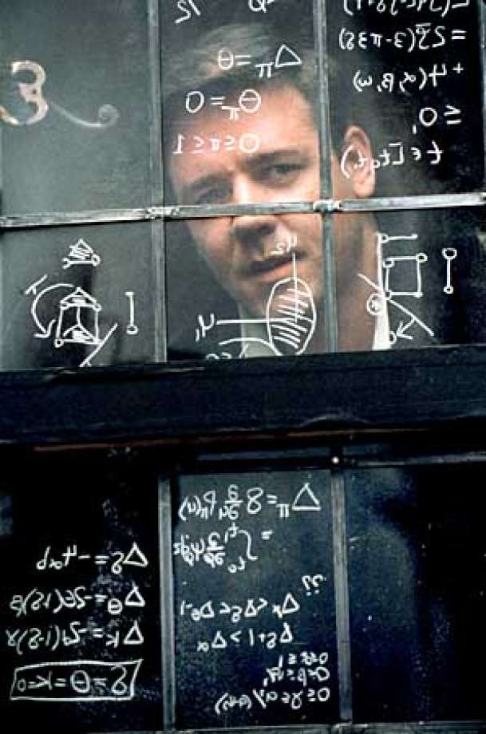
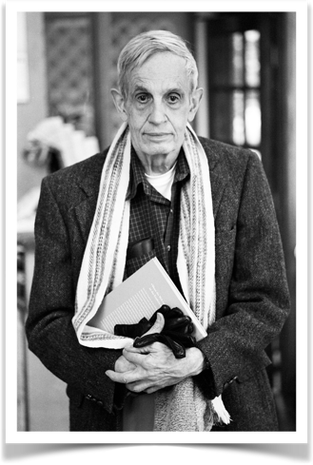
Game Theory
Study of mathematical models of conflict and cooperation between intelligent rational decision-makers
[Roger Myerson, Game Theory: Analysis of Conflict]
John Forbes Nash Jr.
1928-2015
Fig. A Beautiful Mind, from s.hdnux.com

Slide 10
Game Theory
Optimization theory: optimize single objective
Game theory: study multi-agent decision making to understand
  Competition, coordination, and cooperation among self-interested agents

Slide 11
Mechanism Design
Mechanism design is a field in economics and game theory that takes an engineering approach to designing economic mechanisms or incentives, toward desired objectives, in strategic settings, where players act rationally
[Wikipedia Aug. 2018]

Slide 12

Example I: Resource Allocation
Design resource management systems robust to strategic behavior
Agents manipulate management systems
Real-life Examples
  Yahoo! MapReduce datacenter [A. Ghodsi et al. 2011]
  Map slots were congested, users ran long reduce tasks
  Google Borg [A. Verma et al. ‎2015]
  Users inflated demands to avoid colocated tasks
  Users deflated demands to fit in on any machine

Slide 13

Example II: Electricity Markets
Generators supply energy into grid
Operator balances demand/supply
Generators can strategically curtail generation to manipulate prices
Electricity markets should be carefully studied, designed and regulated
www.euneighbours.eu

Slide 14

Example III: Blockchains
www.blockchains-expert.com
Design protocols that guarantee
  No coalition has incentives to deviate
  If some coalition deviates, then no participating agent is worse of

Slide 15
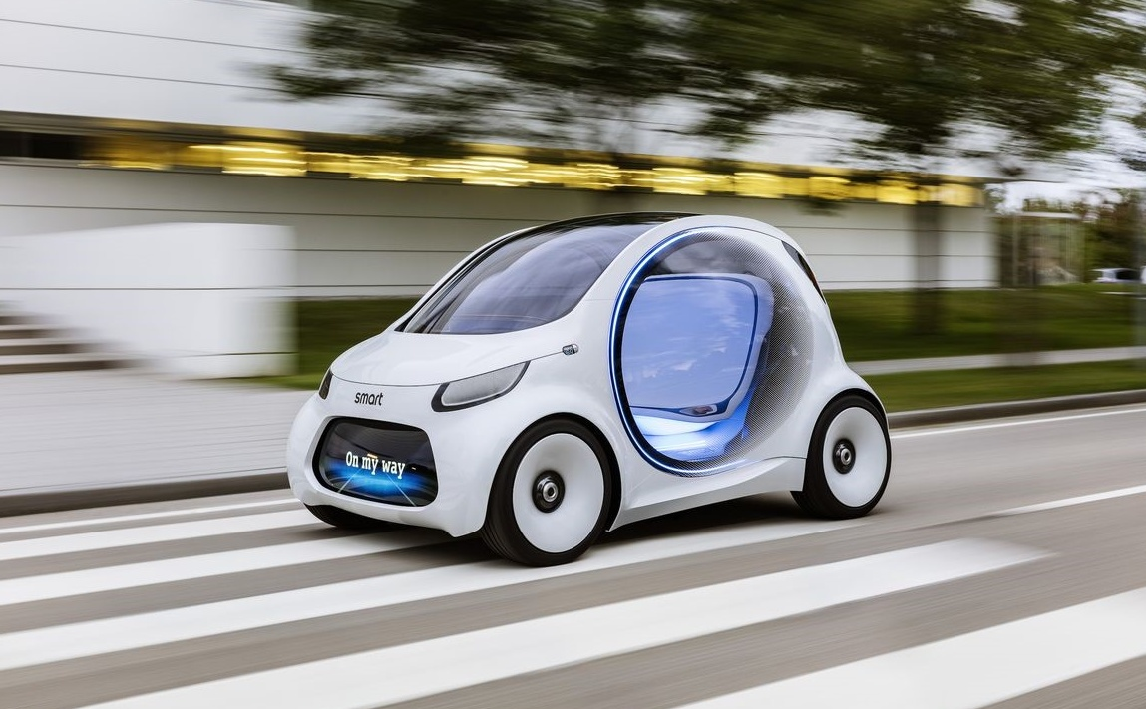
Example IV: Autonomous Cars
Autonomous cars constantly interact with other drivers
Different drivers deploy different decision making policies
Safety needs to be verified
  Requires 275 million miles of driving
Game-theoretic traffic models could be used to test, compare, and calibrate control systems
assets.aspeninstitute.org

Slide 16

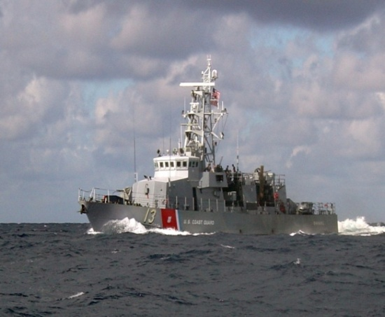

Example V: Real-world Security [TEAMCORE group (USC)]
Airport security: where to put checkpoints?
  Deployed at LAX
Federal Air Marshals: which flights get FAM?
USA Coast Guard: which routs should be followed?
  Deployed in Boston Harbor

Slide 17
Questions?

Slide 18
Acknowledgement
This lecture is a slightly modified version of ones prepared by
  Asu Ozdaglar [MIT 6.254]
  Vincent Conitzer [Duke CPS 590.4]

