Slide 1

ECE700.07: Game Theory with
Engineering Applications
Lecture 3: Games in Normal Form
Seyed Majid Zahedi

Slide 2
Outline
Strategic form games
Dominant strategy equilibrium
Pure and mixed Nash equilibrium
Iterative elimination of strictly dominated strategies
Price of anarchy
Correlated equilibrium
Readings:
  MAS Sec. 3.2 and 3.4, GT Sec. 1 and 2

Slide 3
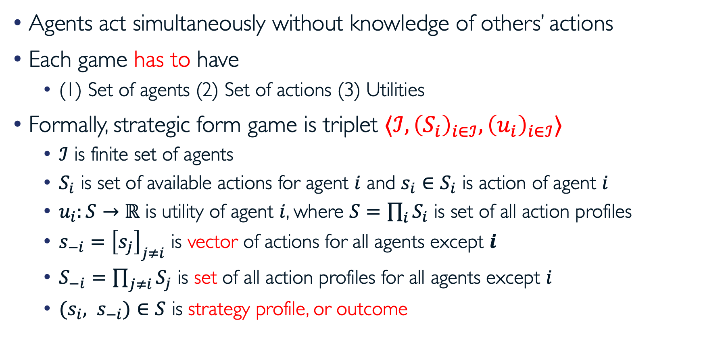
Strategic Form Games
Agents act simultaneously without knowledge of others’ actions
Each game has to have
  (1) Set of agents (2) Set of actions (3) Utilities
Formally, strategic form game is triplet $⟨ℐ, {\left(S_{i}\right)}_{i∈ℐ},{\left(u_{i}\right)}_{i∈ℐ}⟩$
  $ℐ$ is finite set of agents
  $S_{i}$ is set of available actions for agent $i$ and $s_{i}∈S_{i}$ is action of agent $i$
  $u_{i}:S→ℝ$ is utility of agent $i$, where $S=\prod_{i}{S_{i}}$ is set of all action profiles
  $s_{−i}={\left[s_{j}\right]}_{j≠i}$ is vector of actions for all agents except $i$
  $S_{−i}=\prod_{j≠i}{S_{j}}$ is set of all action profiles for all agents except $i$
  ${(s_{i}, s}_{−i})∈S$ is strategy profile, or outcome

Slide 4
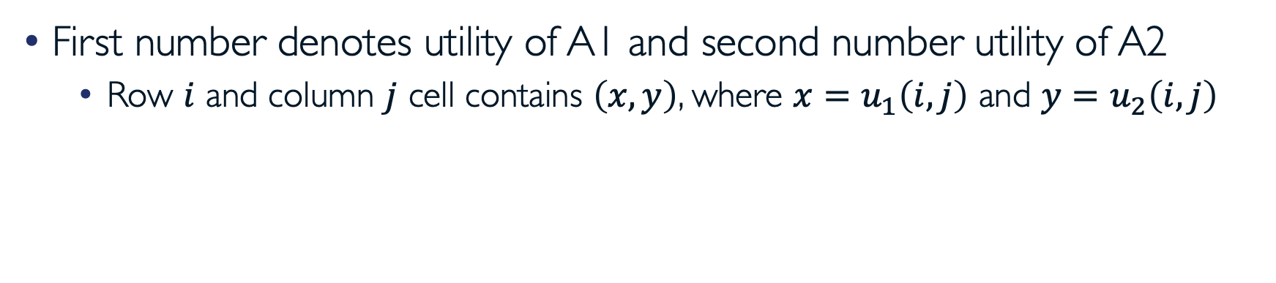
Example: Prisoner’s Dilemma
Prisoner 2 Prisoner 1 | Stay Silent | Confess
Stay Silent | (-1, -1) | (-3, 0)
Confess | (0, -3) | (-2, -2)
First number denotes utility of A1 and second number utility of A2
  Row $i$ and column $j$ cell contains $\left(x,y\right)$, where $x=u_{1}\left(i,j\right)$ and $y=u_{2}\left(i,j\right)$
Notes:
Two people arrested for a crime, placed in separate rooms, and the authorities are trying to extract a confession. What should each agent play?

Slide 5
Strategies
Strategy is complete description of how to play
It requires full contingent planning
  As if you have to delegate play to “computer”
  You would have to spell out how game should be played in every contingency
  In chess, for example, this would be an impossible task
In strategic form games, there is no difference between action and strategy (we will use them interchangeably)

Slide 6
Finite Strategy Spaces
When $S_{i}$ is finite for all $i$, game is called finite game
For 2 agents and small action sets, it can be expressed in matrix form
Example: matching pennies
  Game represents pure conflict; one player’s utility is negative other player’s utility; thus, zero sum game
Agent 2 Agent 1 | Heads | Tails
Heads | (-1, 1) | (1, -1)
Tails | (1, -1) | (0, 0)

Slide 7
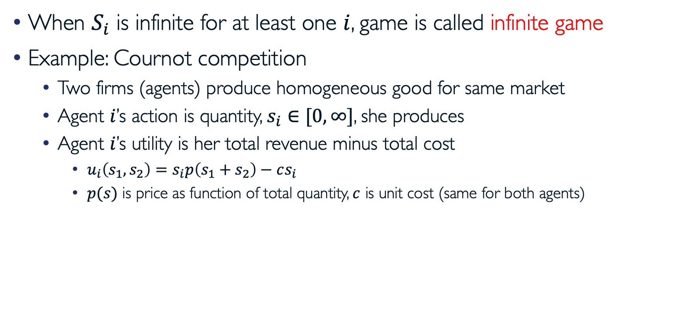
Infinite Strategy Spaces
When $S_{i}$ is infinite for at least one $i$, game is called infinite game
Example: Cournot competition
  Two firms (agents) produce homogeneous good for same market
  Agent $i$’s action is quantity, $s_{i}∈[0,∞]$, she produces
  Agent $i$’s utility is her total revenue minus total cost
    $u_{i}\left(s_{1}, s_{2}\right)=s_{i}p\left(s_{1}+s_{2}\right)−cs_{i}$
    $p(s)$ is price as function of total quantity, $c$ is unit cost (same for both agents)

Slide 8
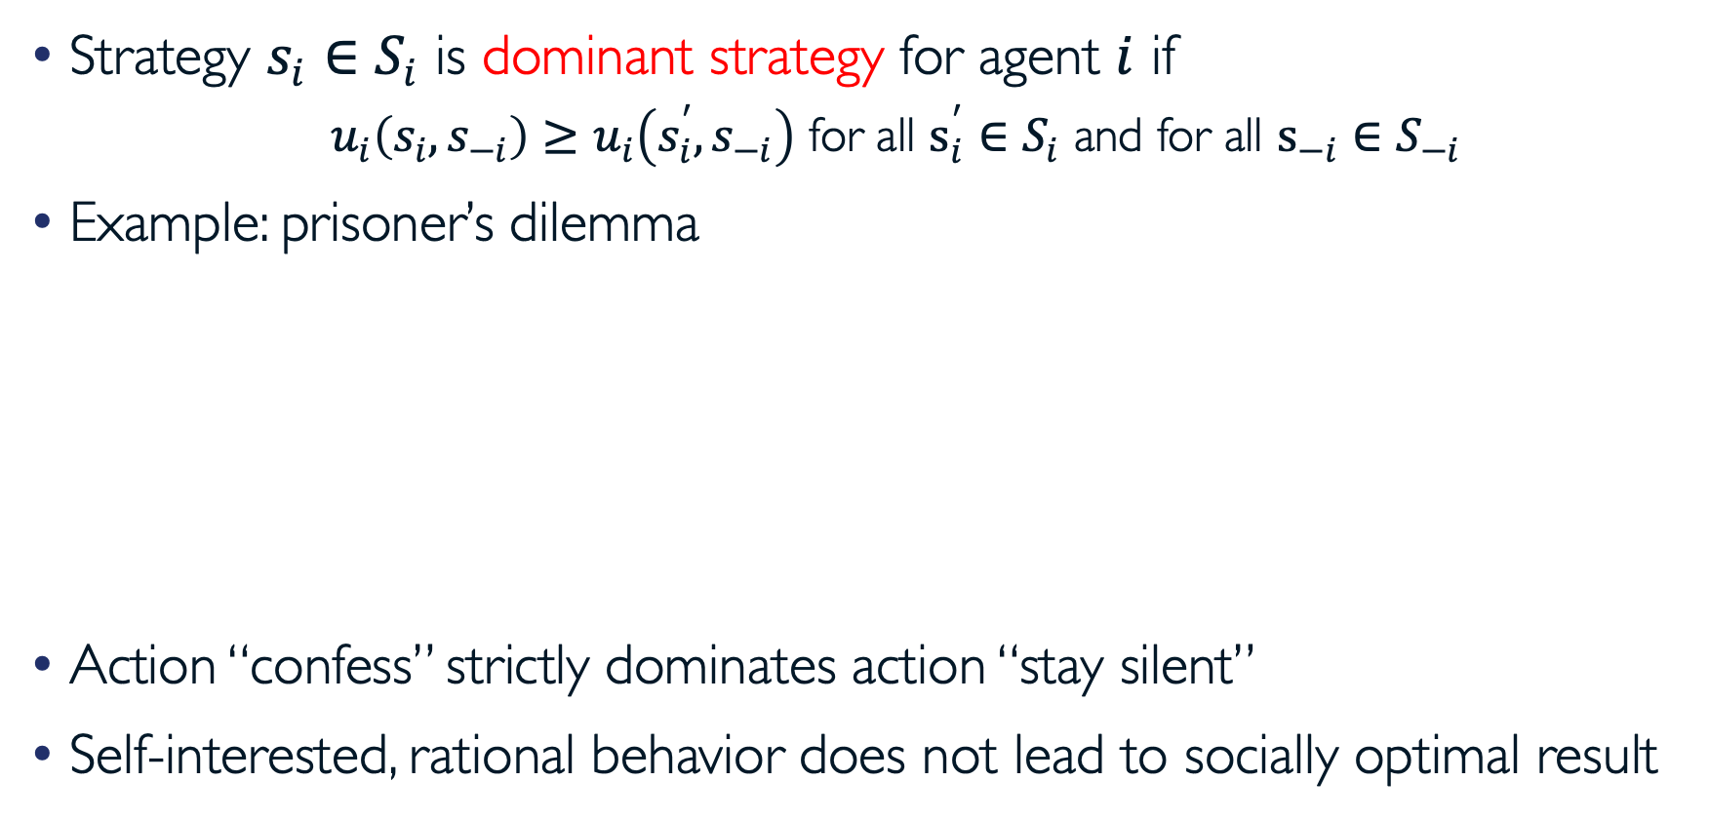
Dominant Strategy
Strategy $s_{i}∈S_{i}$ is dominant strategy for agent $i$ if
  $u_{i}\left(s_{i}, s_{−i}\right)≥u_{i}\left(s_{i}^{′},s_{−i}\right)$ for all $s_{i}^{′}∈S_{i}$ and for all $s_{−i}∈S_{−i}$
Example: prisoner’s dilemma
Action “confess” strictly dominates action “stay silent”
Self-interested, rational behavior does not lead to socially optimal result
Prisoner 2 Prisoner 1 | Stay Silent | Confess
Stay Silent | (-1, -1) | (-3, 0)
Confess | (0, -3) | (-2, -2)

Slide 9
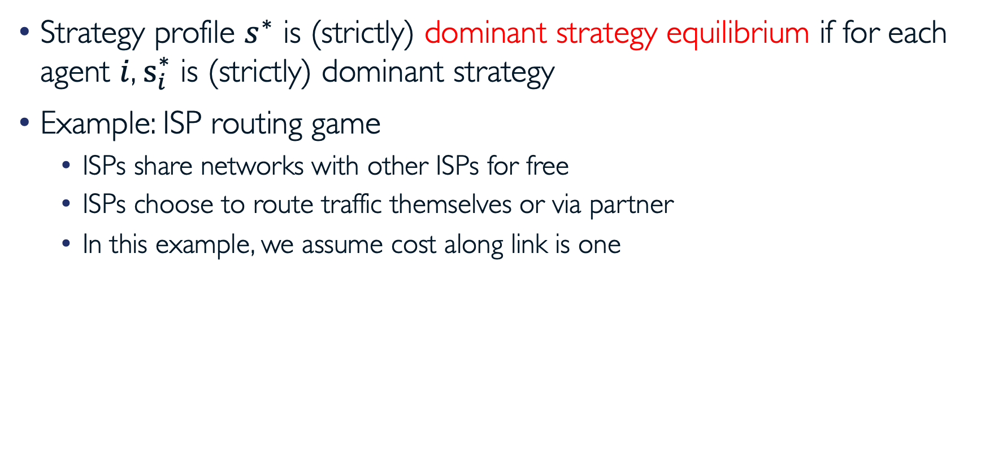
Dominant Strategy Equilibrium
Strategy profile $s^{∗}$ is (strictly) dominant strategy equilibrium if for each agent $i$, $s_{i}^{∗}$ is (strictly) dominant strategy
Example: ISP routing game
  ISPs share networks with other ISPs for free
  ISPs choose to route traffic themselves or via partner
  In this example, we assume cost along link is one
ISP 2 ISP 1 | Route Yourself | Route via Partner
Route Yourself | (-3, -3) | (-6, -2)
Route via Partner | (-2, -6) | (-5, -5)

Slide 10
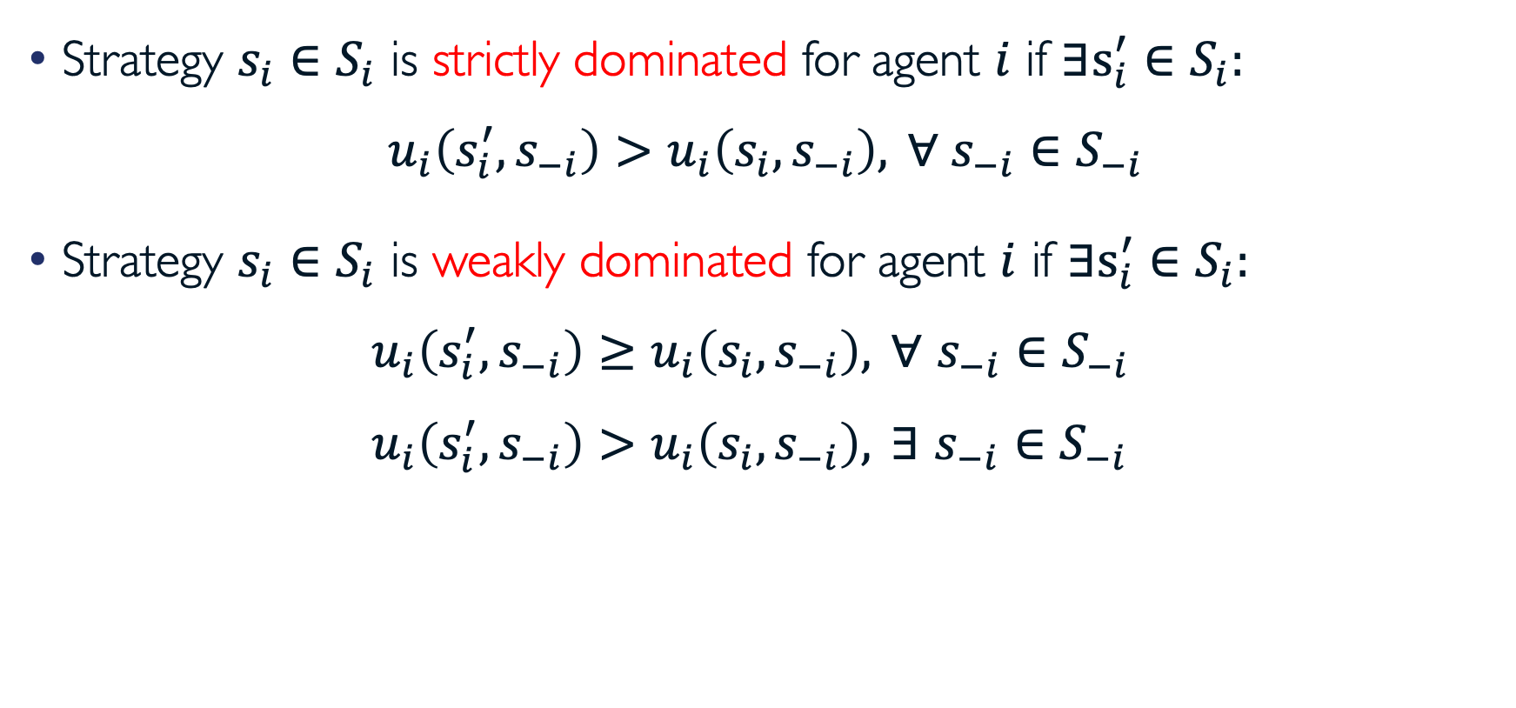
Dominated Strategies
Strategy $s_{i}∈S_{i}$ is strictly dominated for agent $i$ if $∃s_{i}^{′}∈S_{i}:$
$u_{i}\left(s_{i}^{′},s_{−i}\right)>u_{i}\left(s_{i},s_{−i}\right), ∀ s_{−i}∈S_{−i}$
Strategy $s_{i}∈S_{i}$ is weakly dominated for agent $i$ if $∃s_{i}^{′}∈S_{i}:$
$u_{i}\left(s_{i}^{′},s_{−i}\right)≥u_{i}\left(s_{i},s_{−i}\right), ∀ s_{−i}∈S_{−i}$
$u_{i}\left(s_{i}^{′},s_{−i}\right)>u_{i}\left(s_{i},s_{−i}\right), ∃ s_{−i}∈S_{−i}$
Notes:
No agent should play a strictly dominated strategy
Common knowledge of payoffs and rationality results in iterated elimination of strictly dominated strategies
what if an action is dominated by different strategies

Slide 11
Rationality and Strictly Dominated Strategies
Prisoner 2 Prisoner 1 | Stay Silent | Confess | Suicide
Stay Silent | (-1, -1) | (-3, 0) | (0, -10)
Confess | (0, -3) | (-2, -2) | (-1, -10)
Suicide | (-10, 0) | (-10, -1) | (-10, -10)
There is no DS because of additional “suicide” strategy
  Strictly dominated strategy for both prisoners
No “rational” agent would choose “suicide”
  No agent should play strictly dominated strategy

Slide 12
Rationality and Strictly Dominated Strategies (cont.)
If A1 knows that A2 is rational, then she can eliminate A2’s “suicide” strategy, and likewise for A2
After one round of elimination of strictly dominated strategies, we are back to prisoner’s dilemma game
Iterated elimination of strictly dominated strategies leads to unique outcome, “confess, confess”
Game is dominance solvable (We will come back to this later)

Slide 13
How Reasonable is Dominance Solvability?
Consider k-beauty contest game is dominance solvable!
100
dominated
(2/3)*100
dominated after removal of (originally) dominated strategies
(2/3)*(2/3)*100
…
0

Slide 14
Existence of Dominant Strategy Equilibrium
Does matching pennies game have DSE?
Dominant strategy equilibria do not always exist
Agent 2 Agent 1 | Heads | Tails
Heads | (-1, 1) | (1, -1)
Tails | (1, -1) | (-1, 1)

Slide 15
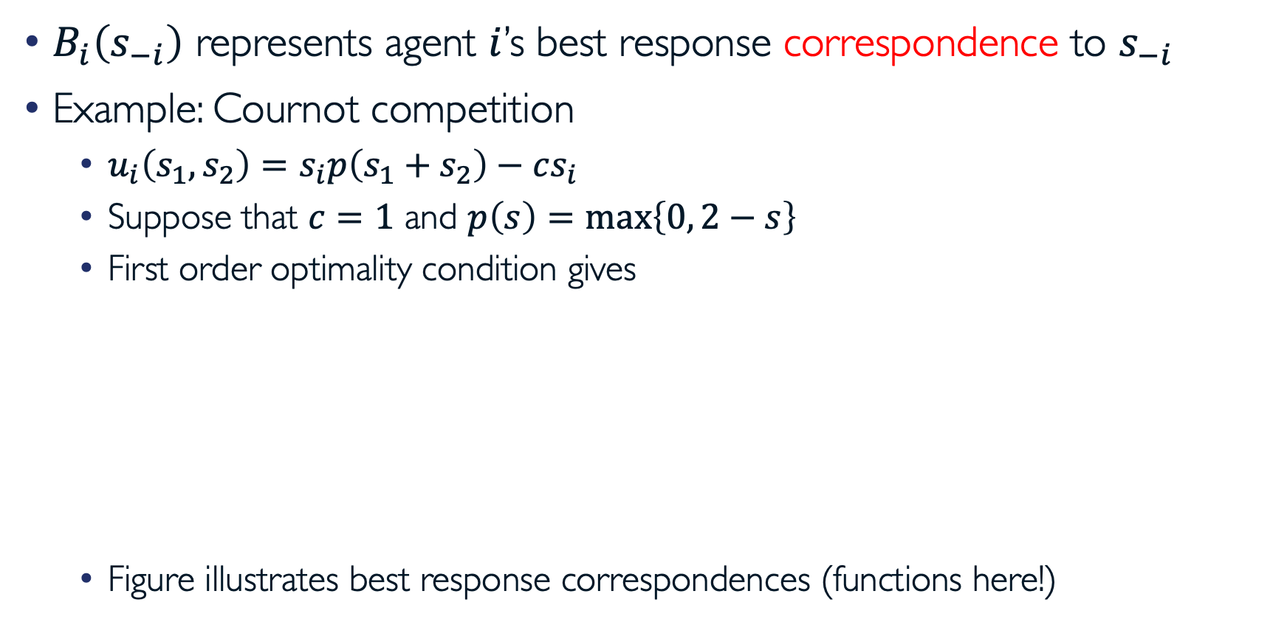
Best Response
$B_{i}\left(s_{−i}\right)$ represents agent $i$’s best response correspondence to $s_{−i}$
Example: Cournot competition
  $u_{i}\left(s_{1}, s_{2}\right)=s_{i}p\left(s_{1}+s_{2}\right)−cs_{i}$
  Suppose that $c=1$ and $p\left(s\right)=\max\left\{0, 2−s\right\}$
  First order optimality condition gives
  Figure illustrates best response correspondences (functions here!)

Slide 16
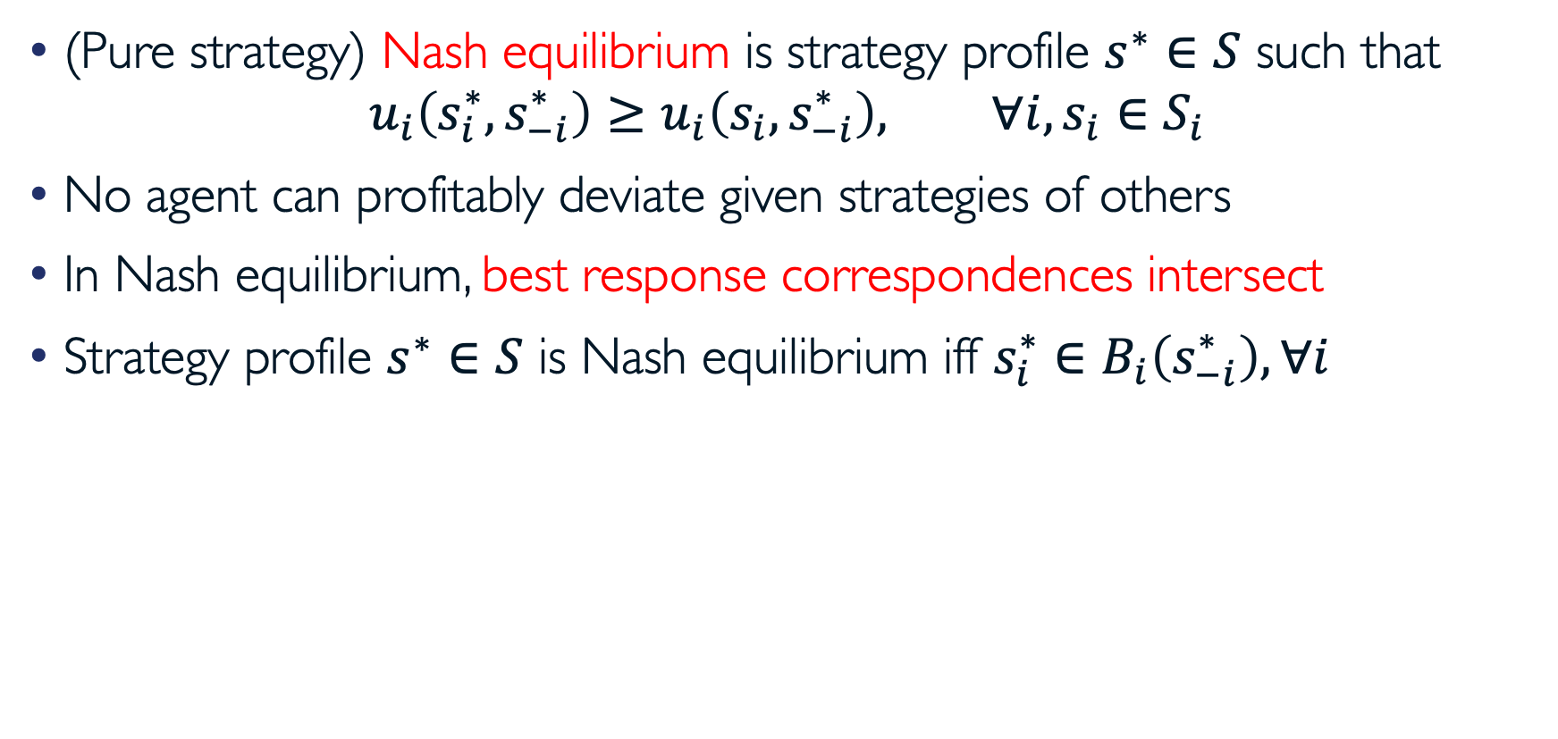
Pure Strategy Nash Equilibrium
(Pure strategy) Nash equilibrium is strategy profile $s^{∗}∈S$ such that
$$u_{i}\left(s_{i}^{∗},s_{−i}^{∗}\right)≥u_{i}\left(s_{i},s_{−i}^{∗}\right), ∀i, s_{i}∈S_{i}$$
No agent can profitably deviate given strategies of others
In Nash equilibrium, best response correspondences intersect
Strategy profile $s^{∗}∈S$ is Nash equilibrium iff ${s_{i}^{∗}∈B}_{i}\left(s_{−i}^{∗}\right), ∀i$

Slide 17
Example: Battle of the Sexes
Wife Husband | Football | Opera
Football | (4, 1) | (-1, -1)
Opera | (-1, -1) | (1, 4)
Couple agreed to meet this evening
They cannot recall if they will be attending opera or football
Husband prefers football, wife prefers opera
Both prefer to go to same place rather than different ones

Slide 18
Existence of Pure Strategy Nash Equilibrium
Does matching pennies game have pure strategy NE?
Pure strategy Nash equilibria do not always exist
Agent 2 Agent 1 | Heads | Tails
Heads | (-1, 1) | (1, -1)
Tails | (1, -1) | (-1, 1)

Slide 19
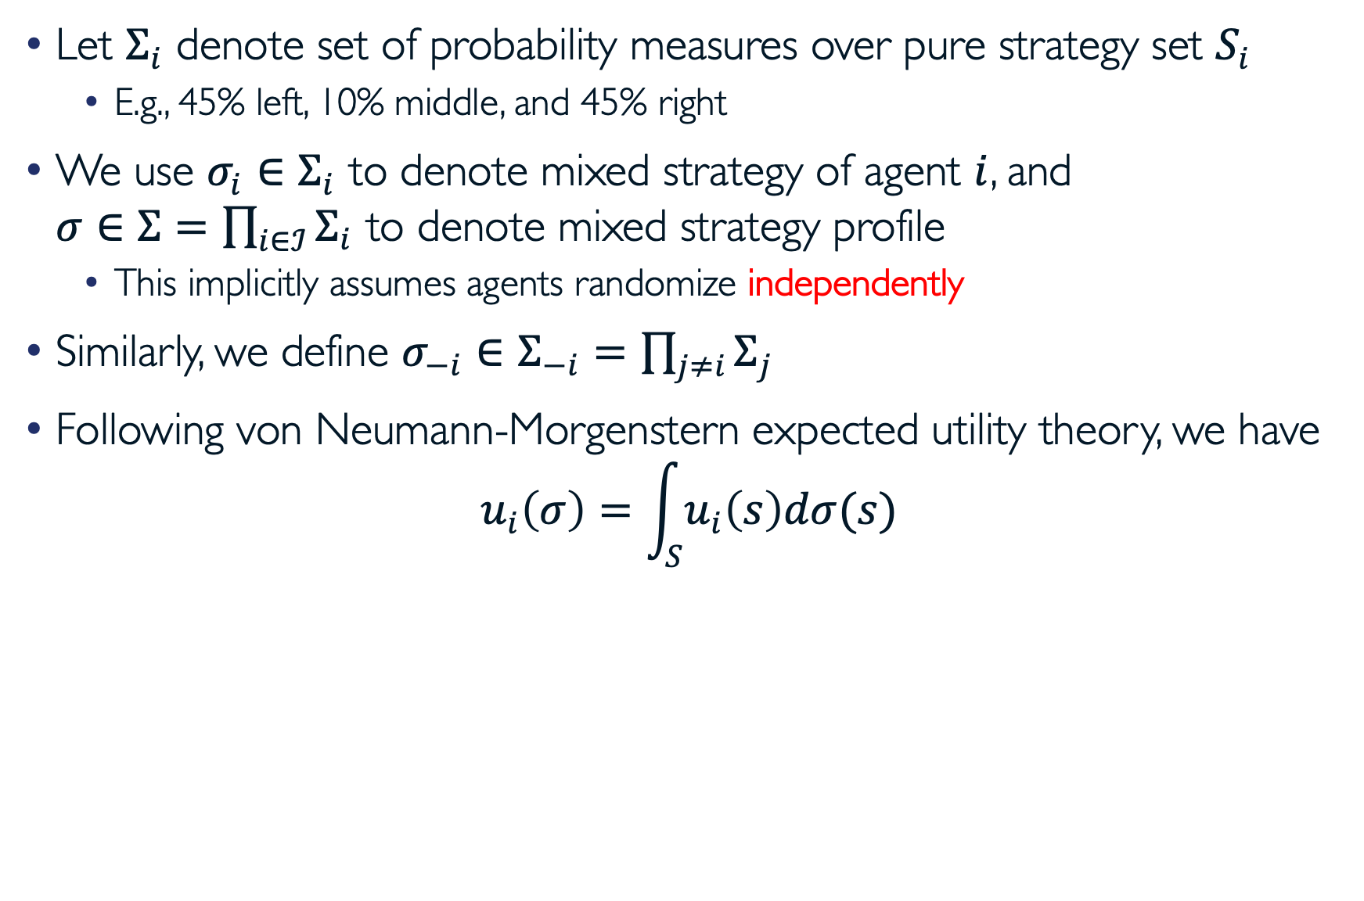
Mixed Strategies
Let $Σ_{i}$ denote set of probability measures over pure strategy set $S_{i}$
  E.g., 45% left, 10% middle, and 45% right
We use $σ_{i}∈Σ_{i}$ to denote mixed strategy of agent $i$, and
$σ∈Σ=\prod_{i∈ℐ}{Σ_{i}}$ to denote mixed strategy profile
  This implicitly assumes agents randomize independently
Similarly, we define $σ_{−i}∈Σ_{−i}=$ $\prod_{j≠i}{Σ_{j}}$
Following von Neumann-Morgenstern expected utility theory, we have
$$u_{i}\left(σ\right)=\int_{S}{u_{i}\left(s\right)dσ(s)}$$

Slide 20
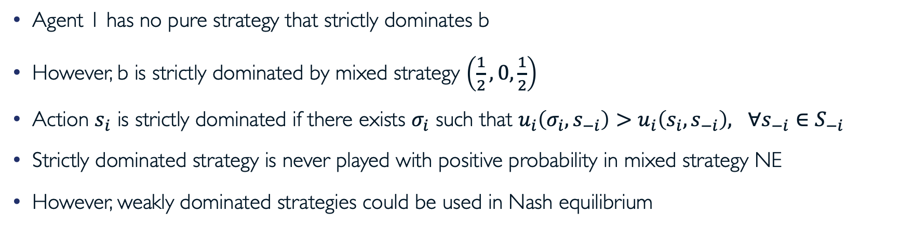
Strict Dominance by Mixed Strategy
Agent 2 Agent 1 | a | b
a | (2, 0) | (-1, 0)
b | (0, 0) | (0, 0)
c | (-1, 0) | (2, 0)
Agent 1 has no pure strategy that strictly dominates b
However, b is strictly dominated by mixed strategy $\left(\frac{1}{2},0,\frac{1}{2}\right)$
Action $s_{i}$ is strictly dominated if there exists $σ_{i}$ such that $u_{i}\left(σ_{i},s_{−i}\right)>u_{i}\left(s_{i}, s_{−i}\right), ∀s_{−i}∈S_{−i}$
Strictly dominated strategy is never played with positive probability in mixed strategy NE
However, weakly dominated strategies could be used in Nash equilibrium

Slide 21
Iterative Elimination of Strictly Dominated Strategies
Let $S_{i}^{0}=S_{i}$ and $Σ_{i}^{0}=Σ_{i}$
For each agent $i$, define
  $S_{i}^{n}=\left\{s_{i}∈S_{i}^{n−1}| ∄σ_{i}∈Σ_{i}^{n−1}: u_{i}\left(σ_{i},s_{−i}\right)>u_{i}\left(s_{i},s_{−i}\right) ∀s_{−i}∈S_{−i}^{n−1}\right\}$
And define
  $Σ_{i}^{n}=\left\{σ_{i}∈Σ_{i}|σ_{i}\left(s_{i}\right)>0 \text{only} \text{if} s_{i}∈S_{i}^{n}\right\}$
Finally, define $S_{i}^{∞}$ as set of agent $i$’s strategies that survive IESDS
  $S_{i}^{∞}=\bigcap_{n=1}^{∞}{S_{i}^{n}}$

Slide 22
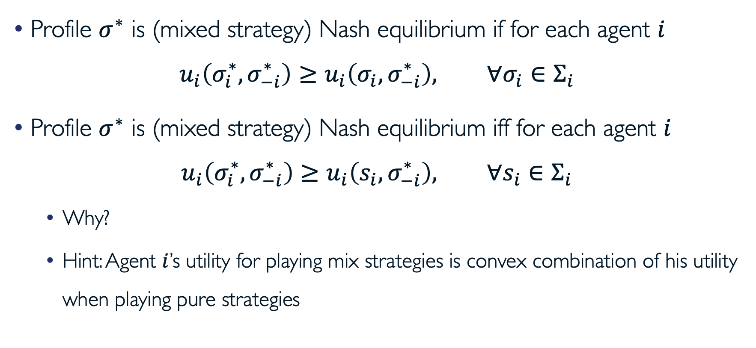
Mixed Strategy Nash Equilibrium
Profile $σ^{∗}$ is (mixed strategy) Nash equilibrium if for each agent $i$
$u_{i}\left(σ_{i}^{∗},σ_{−i}^{∗}\right)≥u_{i}\left(σ_{i},σ_{−i}^{∗}\right), ∀σ_{i}∈Σ_{i}$
Profile $σ^{∗}$ is (mixed strategy) Nash equilibrium iff for each agent $i$
$u_{i}\left(σ_{i}^{∗},σ_{−i}^{∗}\right)≥u_{i}\left(s_{i},σ_{−i}^{∗}\right), ∀s_{i}∈Σ_{i}$
  Why?
  Hint: Agent $i$’s utility for playing mix strategies is convex combination of his utility when playing pure strategies

Slide 23
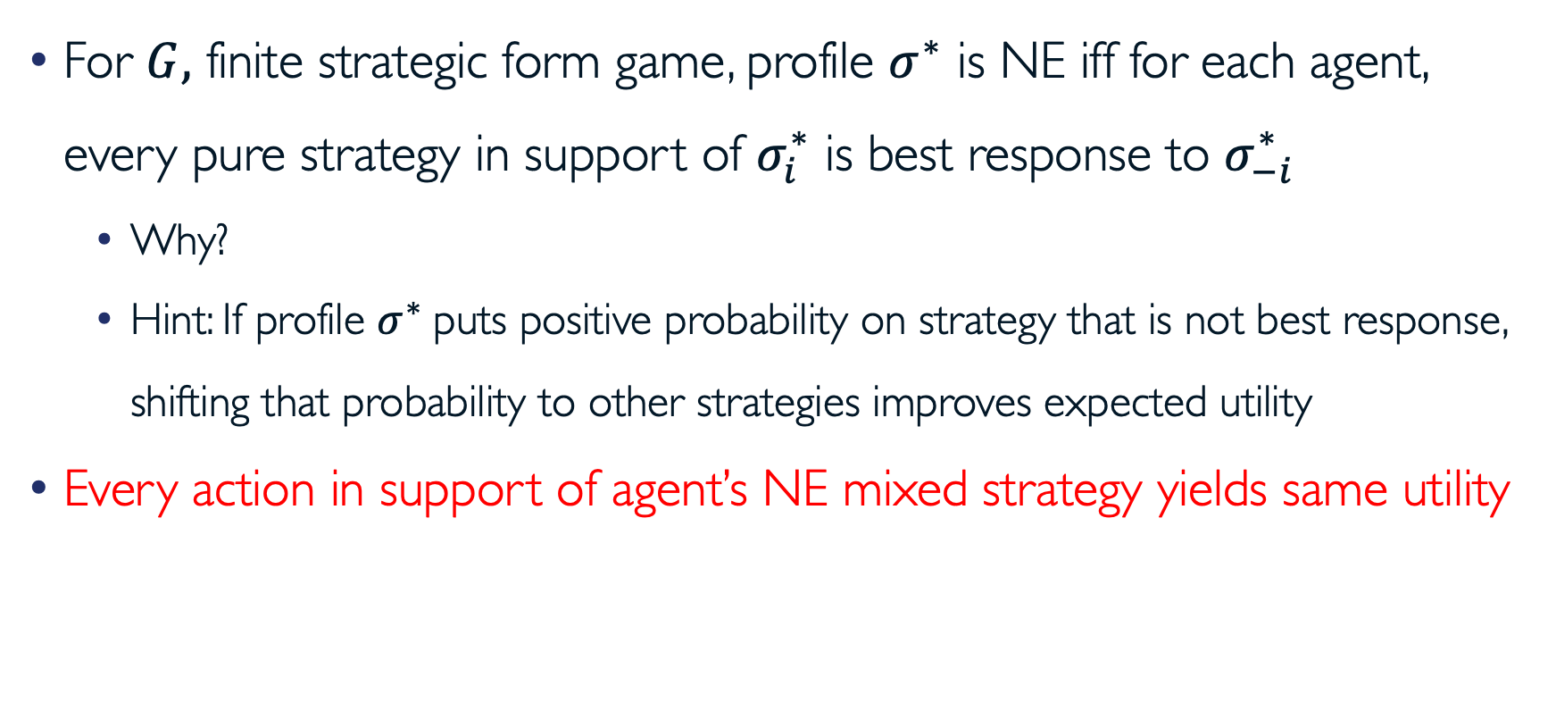
Mixed Strategy Nash Equilibria (cont.)
For $G,$ finite strategic form game, profile $σ^{∗}$ is NE iff for each agent, every pure strategy in support of $σ_{i}^{∗}$ is best response to $σ_{−i}^{∗}$
  Why?
  Hint: If profile $σ^{∗}$puts positive probability on strategy that is not best response, shifting that probability to other strategies improves expected utility
Every action in support of agent’s NE mixed strategy yields same utility

Slide 24
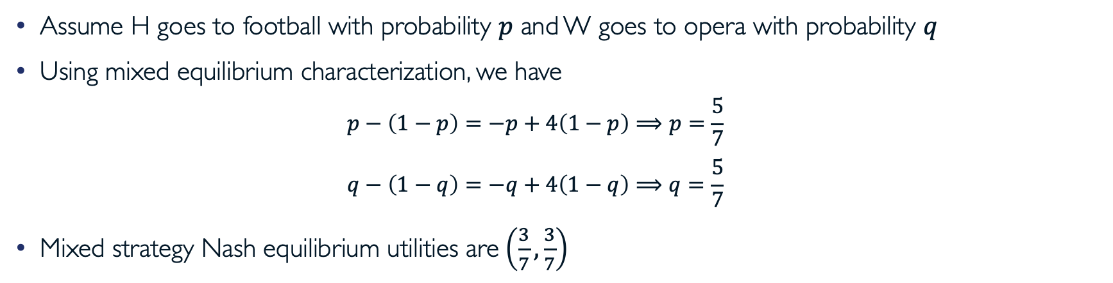
Finding Mixed Strategy Nash Equilibrium
Wife Husband | Football | Opera
Football | (4, 1) | (-1, -1)
Opera | (-1, -1) | (1, 4)
Assume H goes to football with probability $p$ and W goes to opera with probability $q$
Using mixed equilibrium characterization, we have
  $$p−\left(1−p\right)=−p+4\left(1−p\right)⟹p=\frac{5}{7}$$
  $$q−\left(1−q\right)=−q+4\left(1−q\right)⟹q=\frac{5}{7}$$
Mixed strategy Nash equilibrium utilities are$\left(\frac{3}{7},\frac{3}{7}\right)$

Slide 25
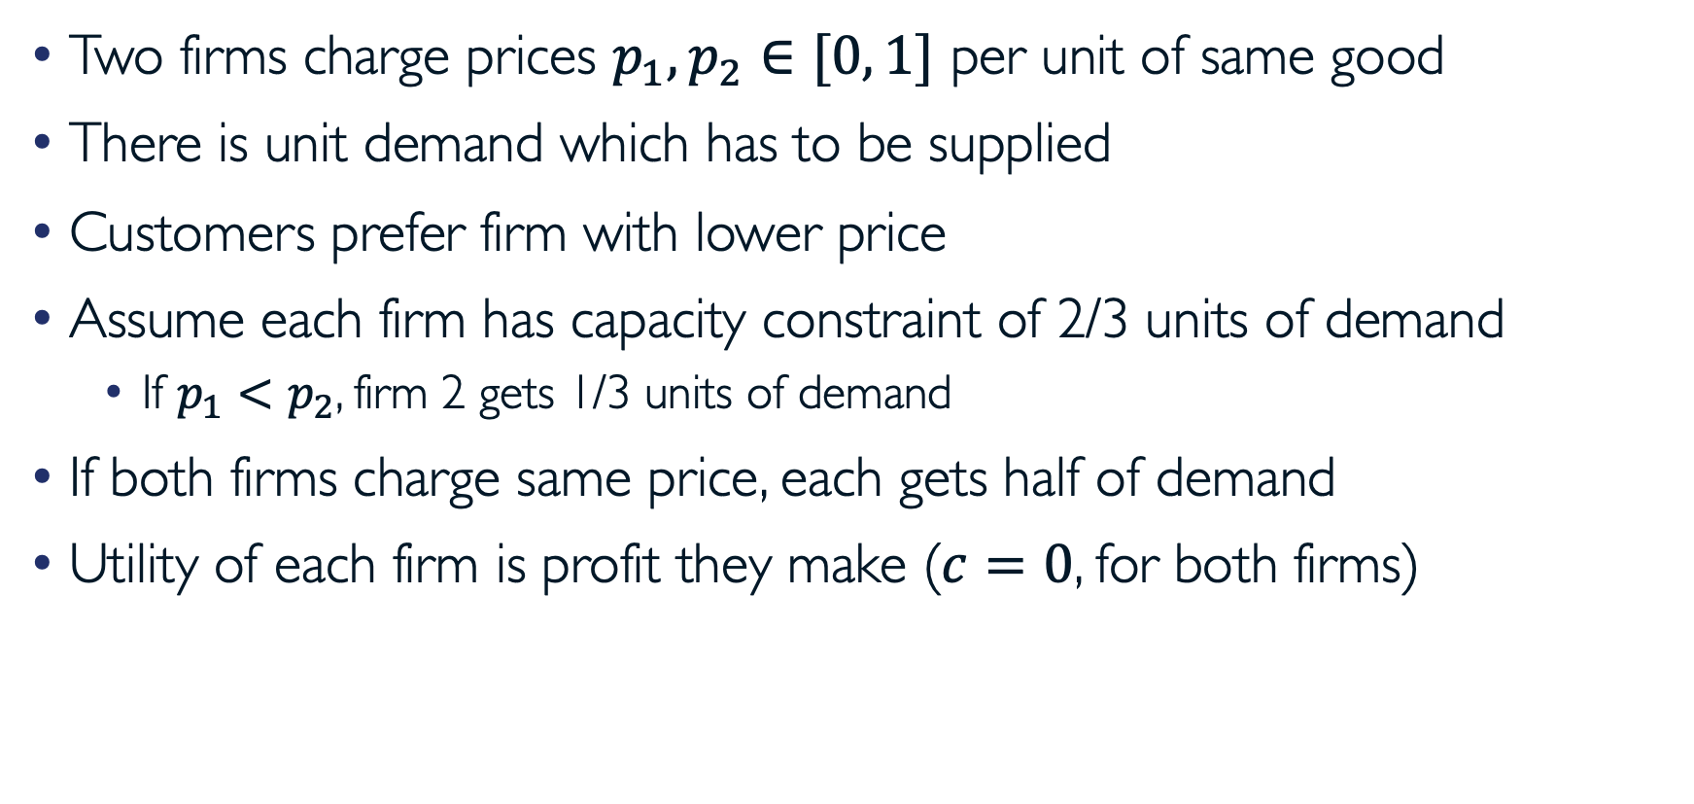
Example: Bertrand Competition with Capacity Constraints
Two firms charge prices $p_{1}, p_{2}∈[0, 1]$ per unit of same good
There is unit demand which has to be supplied
Customers prefer firm with lower price
Assume each firm has capacity constraint of 2/3 units of demand
  If $p_{1}<p_{2}$, firm 2 gets 1/3 units of demand
If both firms charge same price, each gets half of demand
Utility of each firm is profit they make ($c=0$, for both firms)

Slide 26
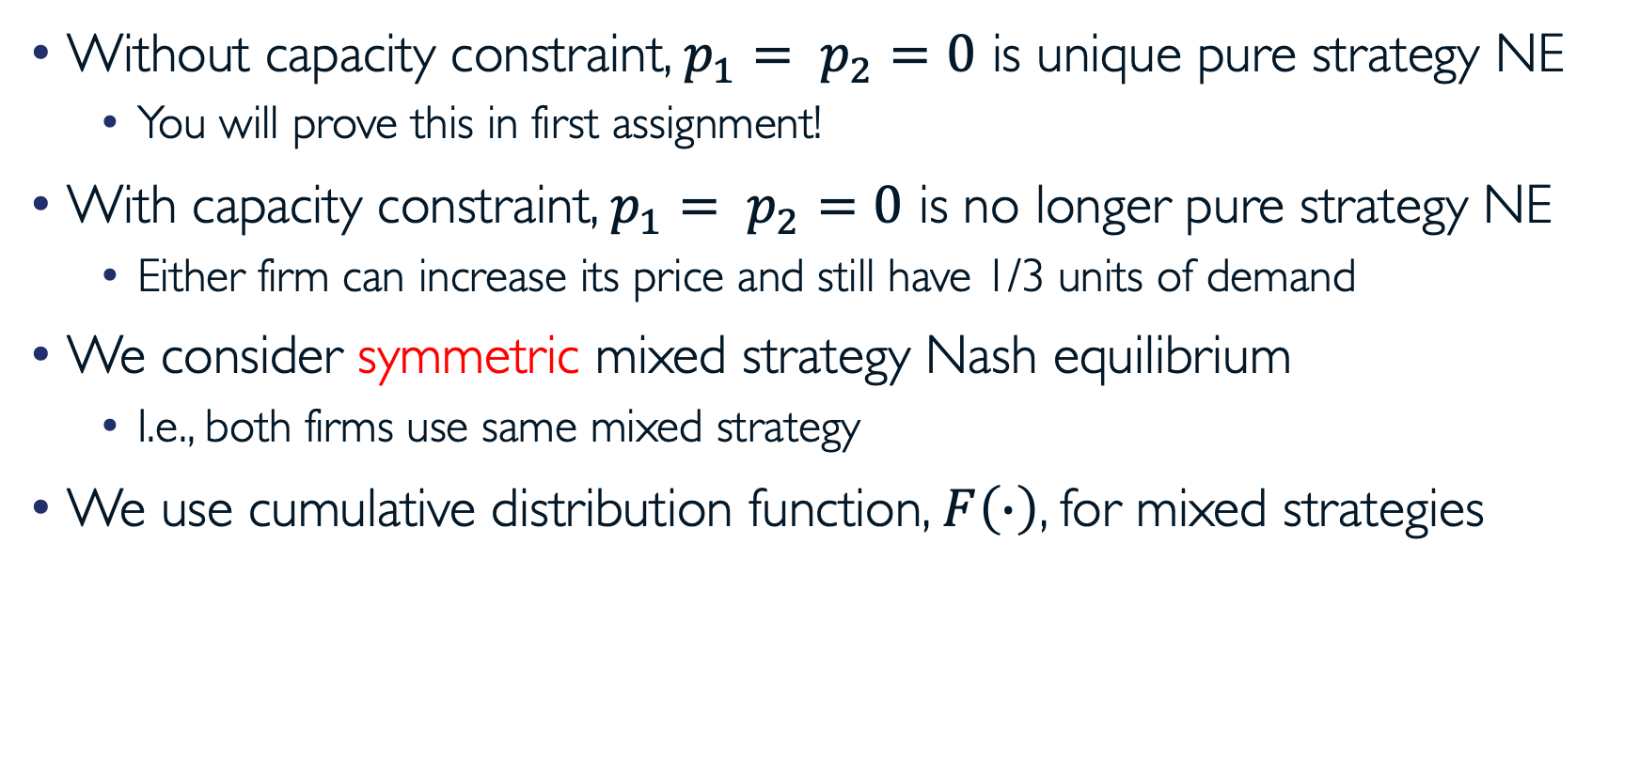
Example: Bertrand Competition with Capacity Constraints (cont.)
Without capacity constraint, $p_{1}= p_{2}=0$ is unique pure strategy NE
  You will prove this in first assignment!
With capacity constraint, $p_{1}= p_{2}=0$ is no longer pure strategy NE
  Either firm can increase its price and still have 1/3 units of demand
We consider symmetric mixed strategy Nash equilibrium
  I.e., both firms use same mixed strategy
We use cumulative distribution function, $F\left(∙\right)$, for mixed strategies

Slide 27
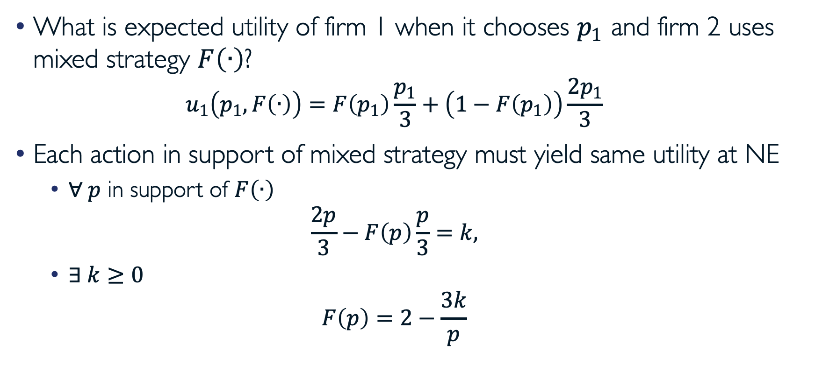
Example: Bertrand Competition with Capacity Constraints (cont.)
What is expected utility of firm 1 when it chooses $p_{1}$ and firm 2 uses mixed strategy $F\left(∙\right)$?
  $$u_{1}\left(p_{1}, F\left(∙\right)\right)=F\left(p_{1}\right)\frac{p_{1}}{3}+\left(1−F\left(p_{1}\right)\right)\frac{2p_{1}}{3}$$
Each action in support of mixed strategy must yield same utility at NE
  $∀ p$ in support of $F\left(∙\right)$
  $$\frac{2p}{3}−F\left(p\right)\frac{p}{3}=k,$$
  $∃ k≥0$
  $$F\left(p\right)=2−\frac{3k}{p}$$

Slide 28
Example: Bertrand Competition with Capacity Constraints (cont.)
Note that upper support of mixed strategy must be at $p=1$, which implies that $F(1)=1$
Combining with preceding, we obtain

Slide 29
Nash’s Theorem
Theorem (Nash): Every finite game has mixed strategy NE
Why is this important?
  Without knowing the existence of equilibrium, it is difficult (perhaps meaningless) to try to understand its properties
  Armed with this theorem, we also know that every finite game has at least one equilibrium, and thus we can simply try to locate equilibria
  Knowing that there might be multiple equilibria, we should study efficiency/inefficiency of games’ equilibria

Slide 30
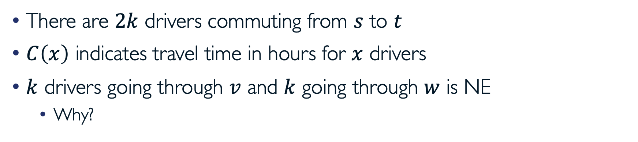
Example: Braess’s Paradox
There are $2k$ drivers commuting from $s$ to $t$
$C\left(x\right)$ indicates travel time in hours for $x$ drivers
$k$ drivers going through $v$ and $k$ going through $w$ is NE
  Why?
T. Roughgarden, Lectures Notes on Algorithmic Game Theory

Slide 31
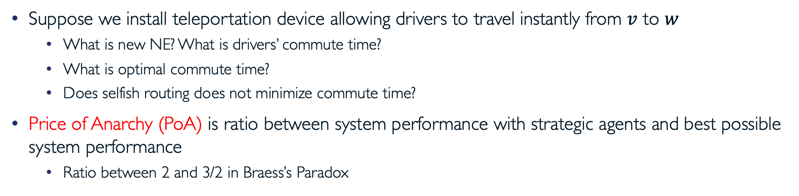
Example: Braess’s Paradox (cont.)
Suppose we install teleportation device allowing drivers to travel instantly from $v$ to $w$
  What is new NE? What is drivers’ commute time?
  What is optimal commute time?
  Does selfish routing does not minimize commute time?
Price of Anarchy (PoA) is ratio between system performance with strategic agents and best possible system performance
  Ratio between 2 and 3/2 in Braess’s Paradox

Slide 32
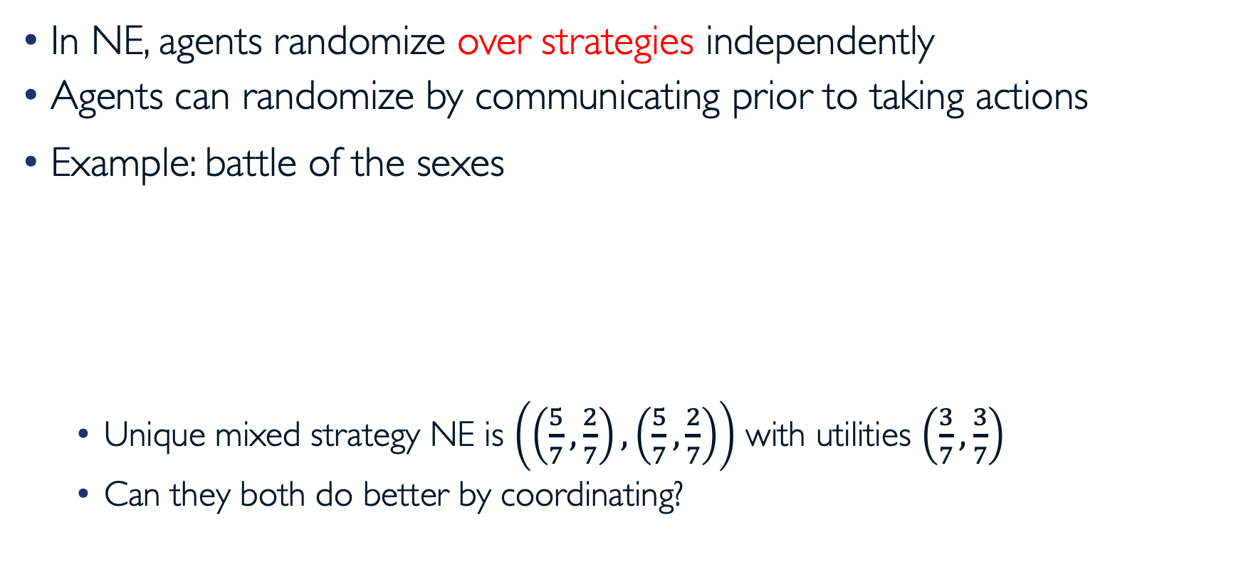
Correlated Strategies
In NE, agents randomize over strategies independently
Agents can randomize by communicating prior to taking actions
Example: battle of the sexes
  Unique mixed strategy NE is $\left(\left(\frac{5}{7},\frac{2}{7}\right),\left(\frac{5}{7},\frac{2}{7}\right)\right)$ with utilities $\left(\frac{3}{7},\frac{3}{7}\right)$
  Can they both do better by coordinating?
Wife Husband | Football | Opera
Football | (4, 1) | (-1, -1)
Opera | (-1, -1) | (1, 4)

Slide 33
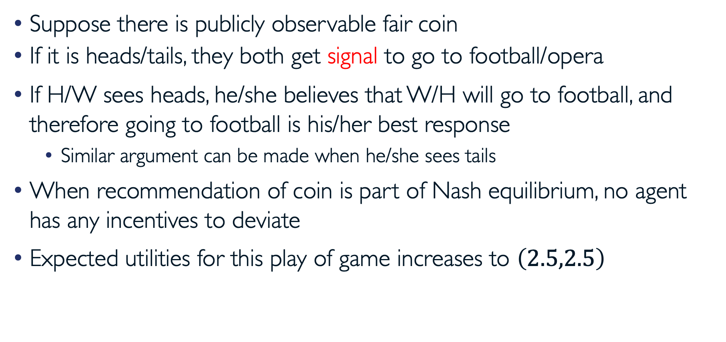
Correlated Strategies (cont.)
Suppose there is publicly observable fair coin
If it is heads/tails, they both get signal to go to football/opera
If H/W sees heads, he/she believes that W/H will go to football, and therefore going to football is his/her best response
  Similar argument can be made when he/she sees tails
When recommendation of coin is part of Nash equilibrium, no agent has any incentives to deviate
Expected utilities for this play of game increases to $\left(2.5,2.5\right)$

Slide 34
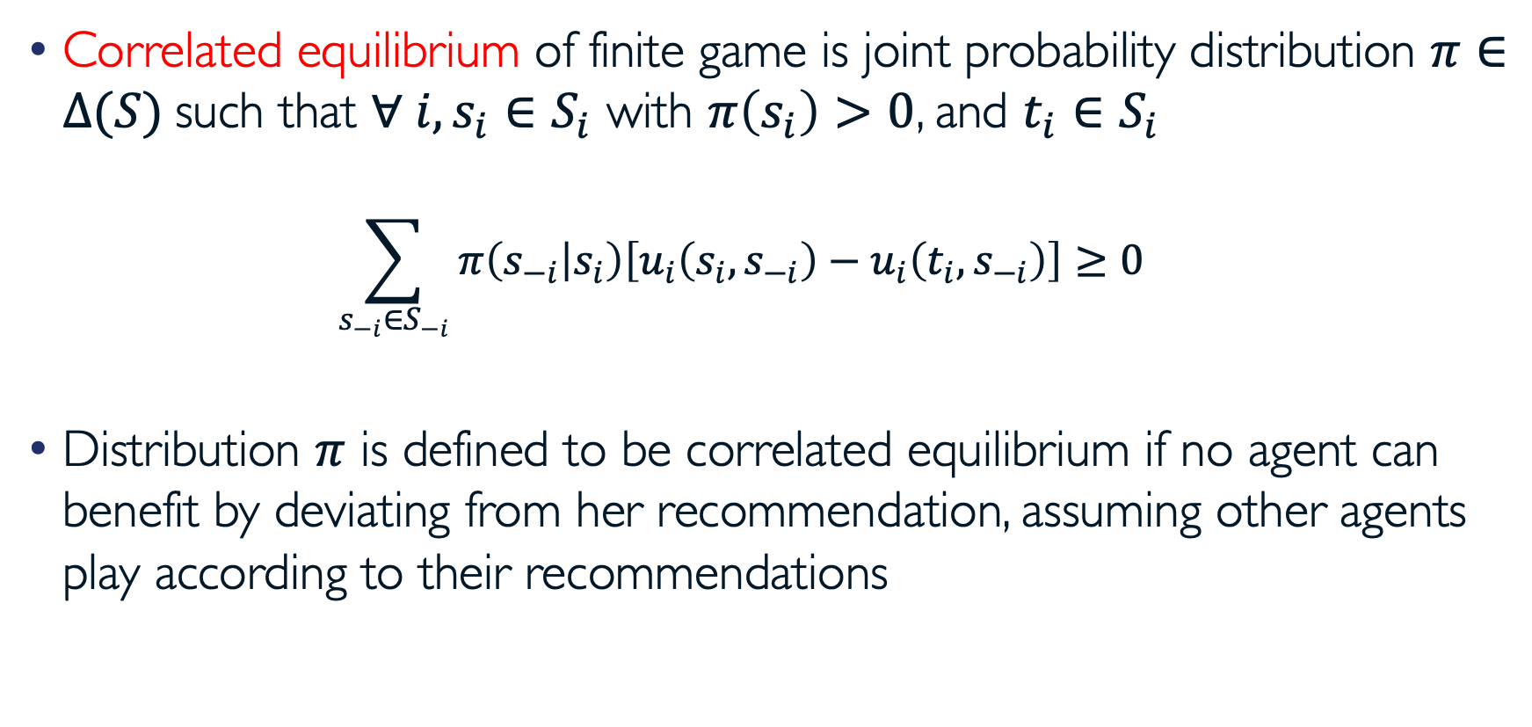
Correlated Equilibrium
Correlated equilibrium of finite game is joint probability distribution $π∈Δ(S)$such that $∀ i, s_{i}∈S_{i}$ with $π\left(s_{i}\right)>0$, and $t_{i}∈S_{i}$
  $$\sum_{s_{−i}∈S_{−i}}{π\left(s_{−i} | s_{i}\right)\left[u_{i}\left(s_{i}, s_{−i}\right)−u_{i}\left(t_{i}, s_{−i}\right)\right]}≥0$$
Distribution $π$ is defined to be correlated equilibrium if no agent can benefit by deviating from her recommendation, assuming other agents play according to their recommendations

Slide 35
Example: Game of Chicken
D
D
S
S
Driver 2 Driver 1 | S | D
S | (-5, -5) | (1, -1)
D | (-1, 1) | (0, 0)
(D, S) and (S, D) are Nash equilibria
  They are pure-strategy Nash equilibria: nobody randomizes
  They are also strict Nash equilibria: changing strategy will make agents strictly worse off

Slide 36
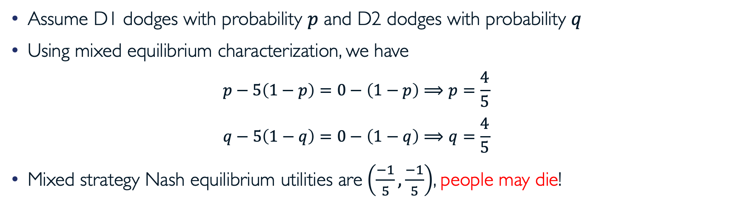
Example: Game of Chicken (cont.)
Driver 2 Driver 1 | S | D
S | (-5, -5) | (1, -1)
D | (-1, 1) | (0, 0)
Assume D1 dodges with probability $p$ and D2 dodges with probability $q$
Using mixed equilibrium characterization, we have
  $$p−5\left(1−p\right)=0−\left(1−p\right)⟹p=\frac{4}{5}$$
  $$q−5\left(1−q\right)=0−\left(1−q\right)⟹q=\frac{4}{5}$$
Mixed strategy Nash equilibrium utilities are$\left(\frac{−1}{5},\frac{−1}{5}\right)$, people may die!

Slide 37
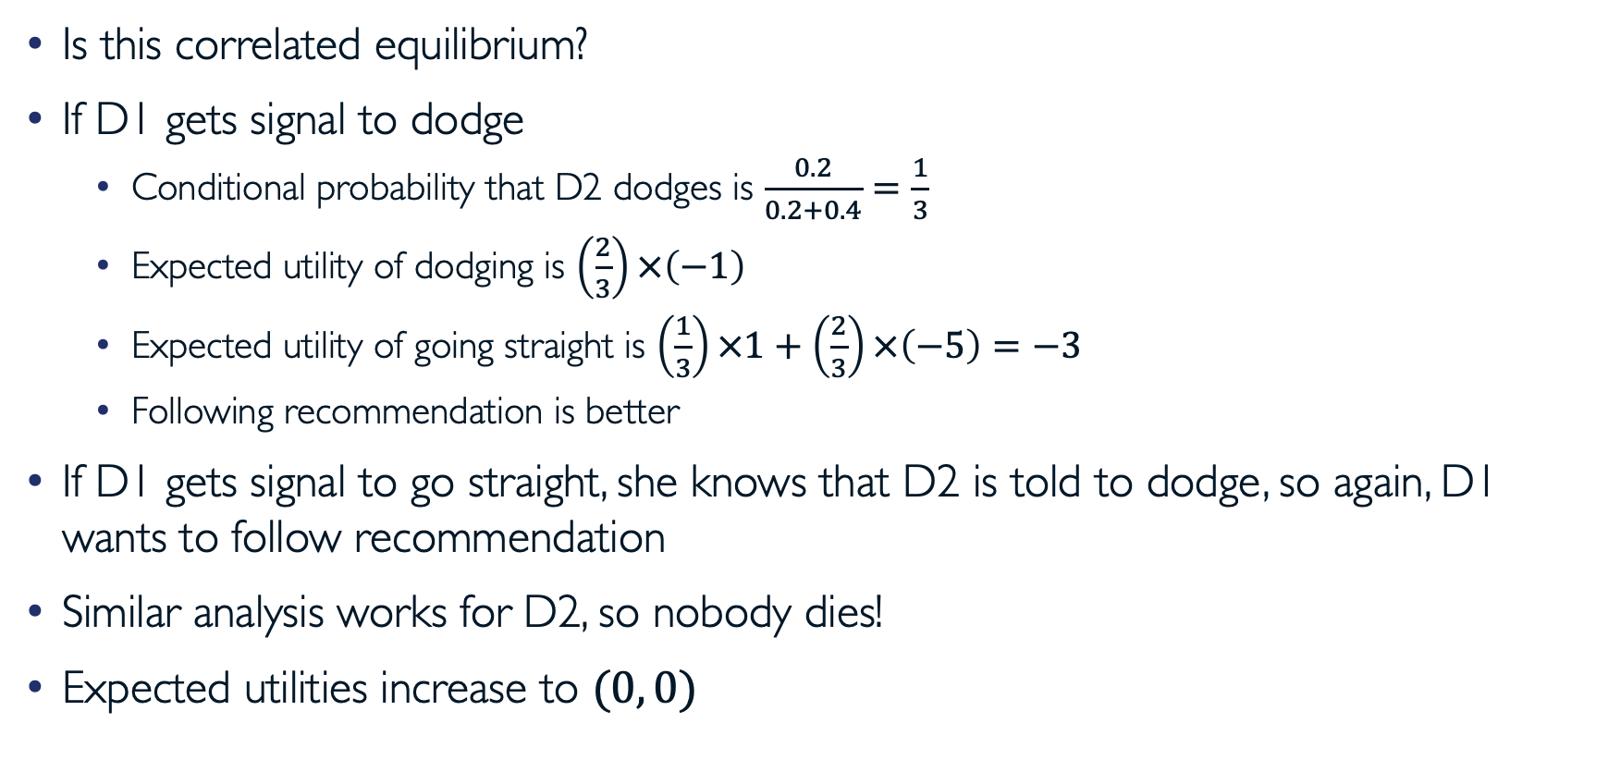
Example: Game of Chicken (cont.)
Is this correlated equilibrium?
If D1 gets signal to dodge
  Conditional probability that D2 dodges is $\frac{0.2}{0.2+0.4}=\frac{1}{3}$
  Expected utility of dodging is $\left(\frac{2}{3}\right)×\left(−1\right)$
  Expected utility of going straight is $\left(\frac{1}{3}\right)×1+\left(\frac{2}{3}\right)×\left(−5\right)=−3$
  Following recommendation is better
If D1 gets signal to go straight, she knows that D2 is told to dodge, so again, D1 wants to follow recommendation
Similar analysis works for D2, so nobody dies!
Expected utilities increase to $(0, 0)$
Driver 2 Driver 1 | S | D
S | (-5, -5) 0% | (1, -1) 40%
D | (-1, 1) 40% | (0, 0) 20%

Slide 38
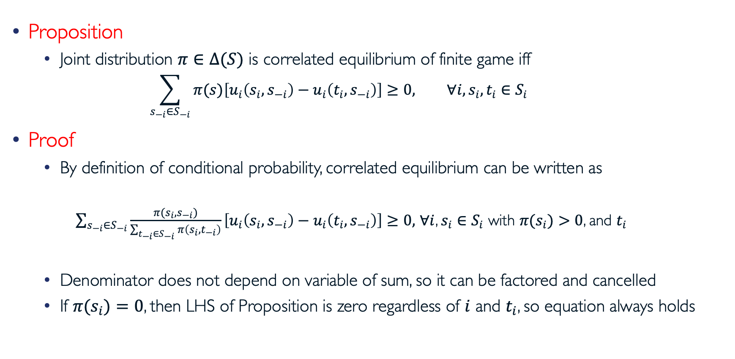
Characterization of Correlated Equilibrium
Proposition
  Joint distribution $π∈Δ(S)$ is correlated equilibrium of finite game iff
    $$\sum_{s_{−i}∈S_{−i}}{π(s)\left[u_{i}\left(s_{i}, s_{−i}\right)−u_{i}\left(t_{i}, s_{−i}\right)\right]}≥0, ∀i,s_{i}, t_{i}∈S_{i}$$
Proof
  By definition of conditional probability, correlated equilibrium can be written as
    $\sum_{s_{−i}∈S_{−i}}{\frac{π({s_{i}, s}_{−i})}{\sum_{t_{−i}∈S_{−i}}{π\left(s_{i},t_{−i}\right)}}\left[u_{i}\left(s_{i}, s_{−i}\right)−u_{i}\left(t_{i}, s_{−i}\right)\right]}≥0,$ $∀i$, $s_{i}∈S_{i}$ with $π(s_{i})>0$, and $t_{i}$
  Denominator does not depend on variable of sum, so it can be factored and cancelled
  If $π(s_{i})=0$, then LHS of Proposition is zero regardless of $i$ and $t_{i}$, so equation always holds

Slide 39
Questions?

Slide 40
Acknowledgement
This lecture is a slightly modified version of ones prepared by
  Asu Ozdaglar [MIT 6.254]
  Vincent Conitzer [Duke CPS 590.4]

