Slide 1
ECE700.07: Game Theory with Engineering Applications
Lecture 4: Computing Solution Concepts of Normal Form Games
Seyed Majid Zahedi

Slide 2
Outline
Brief overview of (mixed integer) linear programs
Solving for
Dominated strategies
Minimax and maximin strategies
Nash equilibrium
Correlated NE
Readings:
MAS Appendix B, and Sec. 4

Slide 3
Linear Program Example: Reproduction of Two Paintings
Painting 1 sells for $30
Painting 2 sells for $20
We have 16 units of blue, 8 green, 5 red
Painting 1 requires 4 blue, 1 green, 1 red
Painting 2 requires 2 blue, 2 green, 1 red

Slide 4
Solving Linear Program Graphically
8
6
Optimal solution: $x=3$, $y=2$
(objective: 13)
4
2
0
2
4
6
8

Slide 5
Modified LP
Optimal solution: x = 2.5, y = 2.5
Objective = 7.5 + 5 = 12.5
Can we sell half paintings?

Slide 6
Integer Linear Program
8
Optimal ILP solution: $x=2$, $y=3$
(objective 12)
6
Optimal LP solution: $x=2.5$, $y=2.5$
(objective 12.5)
4
2
0
2
4
6
8

Slide 7
Mixed Integer Linear Program
8
Optimal ILP solution: $x=2$, $y=3$
(objective 12)
6
Optimal LP solution: $x=2.5$, $y=2.5$
(objective 12.5)
4
Optimal MILP solution: x=2.75, y=2
(objective 12.25)
2
0
2
4
6
8

Slide 8
Solving Mixed Linear/Integer Programs
Linear programs can be solved efficiently
Simplex, ellipsoid, interior point methods, etc.
(Mixed) integer programs are NP-hard to solve
Many standard NP-complete problems can be modelled as MILP
Search type algorithms such as branch and bound
Standard packages for solving these
Gurobi, MOSEK, GNU Linear Programming Kit, CPLEX, CVXPY, etc.
LP relaxation of (M)ILP: remove integrality constraints
Gives upper bound on MILP (~admissible heuristic)

Slide 9
Exercise I in Modeling: Knapsack-type Problem
We arrive in room full of precious objects
Can carry only 30kg out of the room
Can carry only 20 liters out of the room
Want to maximize our total value
Unit of object A: 16kg, 3 liters, sells for $11 (3 units available)
Unit of object B: 4kg, 4 liters, sells for $4 (4 units available)
Unit of object C: 6kg, 3 liters, sells for $9 (1 unit available)
What should we take?

Slide 10
Exercise II in Modeling: Cell Phones (Set Cover)
We want to have a working phone in every continent (besides Antarctica) but we want to have as few phones as possible
Phone A works in NA, SA, Af
Phone B works in E, Af, As
Phone C works in NA, Au, E
Phone D works in SA, As, E
Phone E works in Af, As, Au
Phone F works in NA, E

Slide 11
Exercise III in Modeling: Hot-dog Stands
We have two hot-dog stands to be placed in somewhere along beach
We know where groups of people who like hot-dogs are
We also know how far each group is willing to walk
Where do we put our stands to maximize #hot-dogs sold? (price is fixed)
Group 1
location: 1
#customers: 2
willing to walk: 4
Group 2
location: 4
#customers: 1
willing to walk: 2
Group 3
location: 7
#customers: 3
willing to walk: 3
Group 4
location: 9
#customers: 4
willing to walk: 3
Group 5
location: 15
#customers: 3
willing to walk: 2

Slide 12
Checking for Strict Dominance by Mixed Strategies
LP for checking if strategy $t_{i}$ is strictly dominated by any mixed strategy

Slide 13
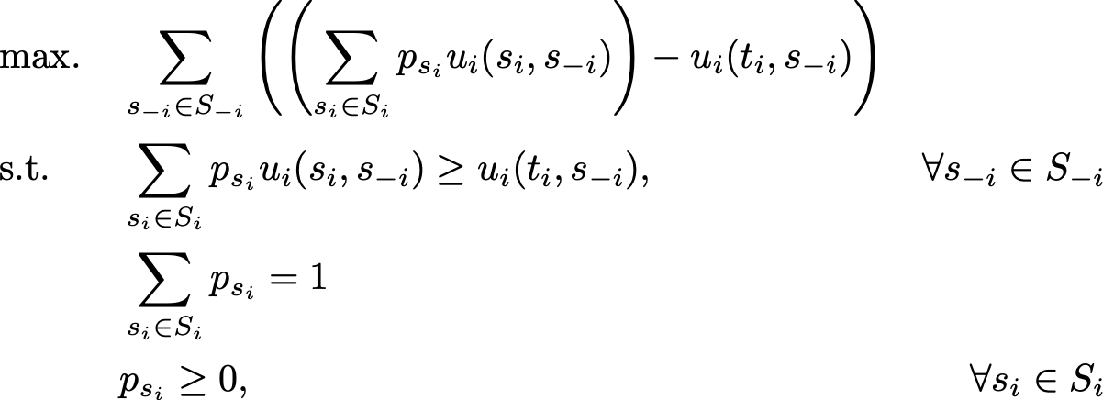
Checking for Weak Dominance by Mixed Strategies
LP for checking if strategy $t_{i}$ is weakly dominated by any mixed strategy

Slide 14
Path Dependency of Iterated Dominance
Iterated weak dominance is path-dependent
Sequence of eliminations may determine which solution we get (if any)
Iterated strict dominance is path-independent:
Elimination process will always terminate at the same point
0, 1 | 1, 0
1, 0 | 1, 0
1, 0 | 0, 1
0, 1 | 1, 0
1, 0 | 1, 0
1, 0 | 0, 1
1, 1 | 0, 0
1, 0 | 1, 0
0, 0 | 1, 1

Slide 15
Two Computational Questions for Iterated Dominance
1. Can any given strategy be eliminated using iterated dominance?
2. Is there some path of elimination by iterated dominance such that only one strategy per player remains?
For strict dominance (with or without dominance by mixed strategies), both can be solved in polynomial time due to path-independence
Check if any strategy is dominated, remove it, repeat
For weak dominance, both questions are NP-hard (even when all utilities are 0 or 1), with or without dominance by mixed strategies [Conitzer, Sandholm 05], and weaker version proved by [Gilboa, Kalai, Zemel 93]

Slide 16
Minimax and Maximin Values
Maximin strategy for agent $i$ (leading to maximin value for agent $i$)
Minimax strategy of other agents (leading to minimax value for agent $i$)

Slide 17
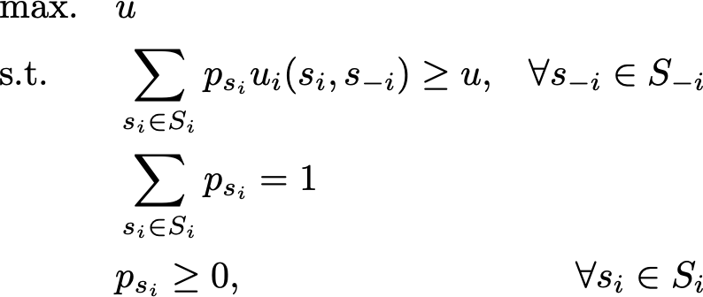
LP for Calculating Maximin Strategy and Value
Objective of this LP, $u$, is maximin value of agent $i$
Given $p_{s_{i}}$, first constraint ensures that $u$ is less than any achievable expected utility for any pure strategies of opponents

Slide 18
Minimax Theorem [von Neumann 1928]
Each player’s NE utility in any finite, two-player, zero-sum game is equal to her maximin value and minimax value
Minimax theorem does not hold with pure strategies only (example?)

Slide 19
Example
Agent 2 Agent 1 | Left | Right
Up | (20, -20) | (0, 0)
Down | (0, 0) | (10, -10)
What is maximin value of agent 1 with and without mixed strategies?
What is minimax value of agent 1 with and without mixed strategies?
What is NE of this game?

Slide 20
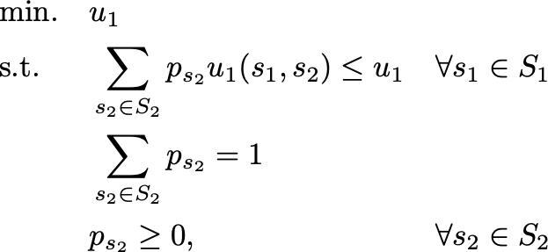
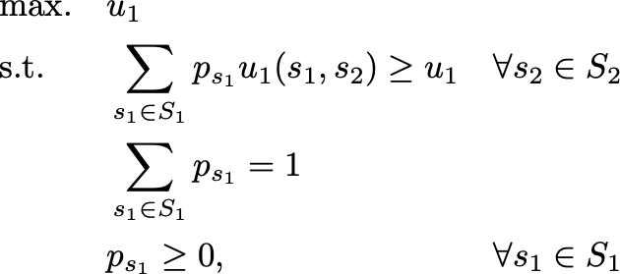
Solving NE of Two-Player, Zero-Sum Games
Minimax value of agent 1
Maximin value of agent 1
NE is expressed as LP, which means equilibria can be computed in polynomial time

Slide 21
Maximin Strategy for General-Sum Games
Agents could still play minimax strategy in general-sum games
I.e., pretend that the opponent is only trying to hurt you
But this is not rational:
If A2 was trying to hurt A1, she would play Left, so A1 should play Down
In reality, A2 will play Right (strictly dominant), so A1 should play Up
Agent 2 Agent 1 | Left | Right
Up | (0, 0) | (3, 1)
Down | (1, 0) | (2, 1)

Slide 22
Hardness of Computing NE for General-Sum Games
Complexity was open for long time
“together with factoring […] the most important concrete open question on the boundary of P today” [Papadimitriou STOC’01]
Sequence of papers showed that computing any NE is PPAD-complete (even in 2-player games) [Daskalakis, Goldberg, Papadimitriou 2006; Chen, Deng 2006]
All known algorithms require exponential time (in worst case)

Slide 23
Hardness of Computing NE for General-Sum Games (cont.)
What about computing NE with specific property?
NE that is not Pareto-dominated
NE that maximizes expected social welfare (i.e., sum of all agents’ utilities)
NE that maximizes expected utility of given agent
NE that maximizes expected utility of worst-off player
NE in which given pure strategy is played with positive probability
NE in which given pure strategy is played with zero probability
…
All of these are NP-hard (and the optimization questions are inapproximable assuming P != NP), even in 2-player games [Gilboa, Zemel 89; Conitzer & Sandholm IJCAI-03/GEB-08]

Slide 24
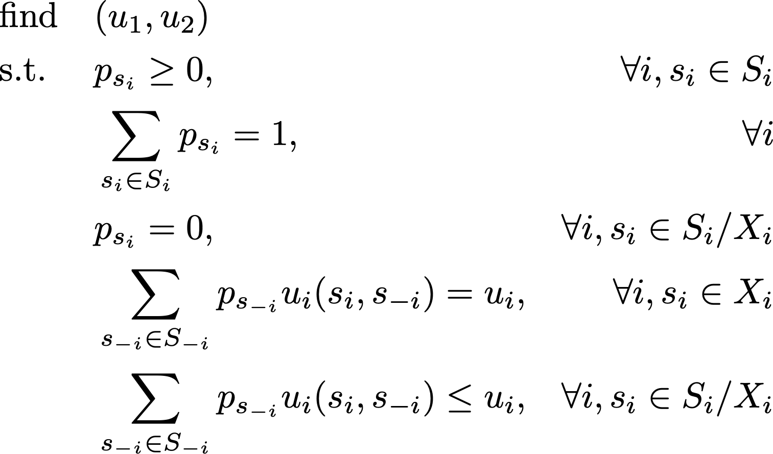
Search-Based Approaches (for Two-Player Games)
We can use (feasibility) LP, if we know support $X_{i}$ of each player $i$’s mixed strategy
I.e., we know which pure strategies receive positive probability
Thus, we can search over possible supports, which is basic idea underlying methods in [Dickhaut & Kaplan 91; Porter, Nudelman, Shoham AAAI04/GEB08]

Slide 25
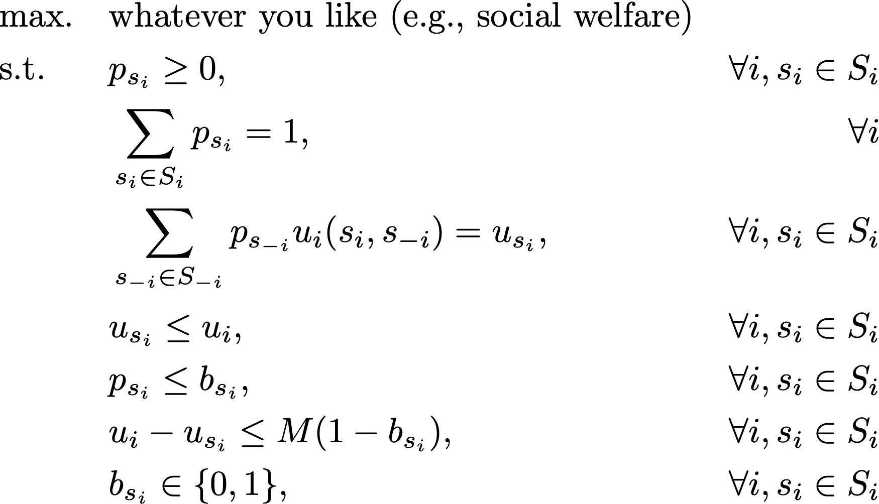
Solving for NE using MILP (for Two-Player Games) [Sandholm, Gilpin, Conitzer AAAI05]
$b_{s_{i}}$ is binary variable indicating if $s_{i}$ is in support of $i$’s mixed strategy, and $M$ is large number

Slide 26
Solving for Correlated Equilibrium using LP (N-Player Games!)
Variables are now $p_{s}$ where $s$ is profile of pure strategies (i.e., outcome)

Slide 27
Questions?

Slide 28
Acknowledgement
This lecture is a slightly modified version of ones prepared by
Vincent Conitzer [Duke CPS 590.4]

