Slide 1

ECE700.07: Game Theory with
Engineering Applications
Lecture 6: Repeated Games
Seyed Majid Zahedi

Slide 2
Outline
Finitely and infinitely repeated games w/ and w/o perfect monitoring
Trigger strategies
Folk theorems
Readings:
  MAS Sec. 6.1, GT Sec. 5.1 and 5.5

Slide 3
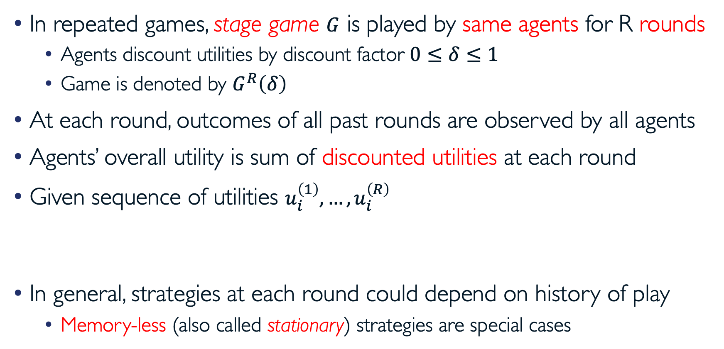
Finitely Repeated Games (with Perfect Monitoring)
In repeated games, stage game $G$ is played by same agents for R rounds
  Agents discount utilities by discount factor $0≤δ≤1$
  Game is denoted by $G^{R}\left(δ\right)$
At each round, outcomes of all past rounds are observed by all agents
Agents’ overall utility is sum of discounted utilities at each round
Given sequence of utilities $u_{i}^{\left(1\right)},…,u_{i}^{\left(R\right)}$
In general, strategies at each round could depend on history of play
  Memory-less (also called stationary) strategies are special cases

Slide 4
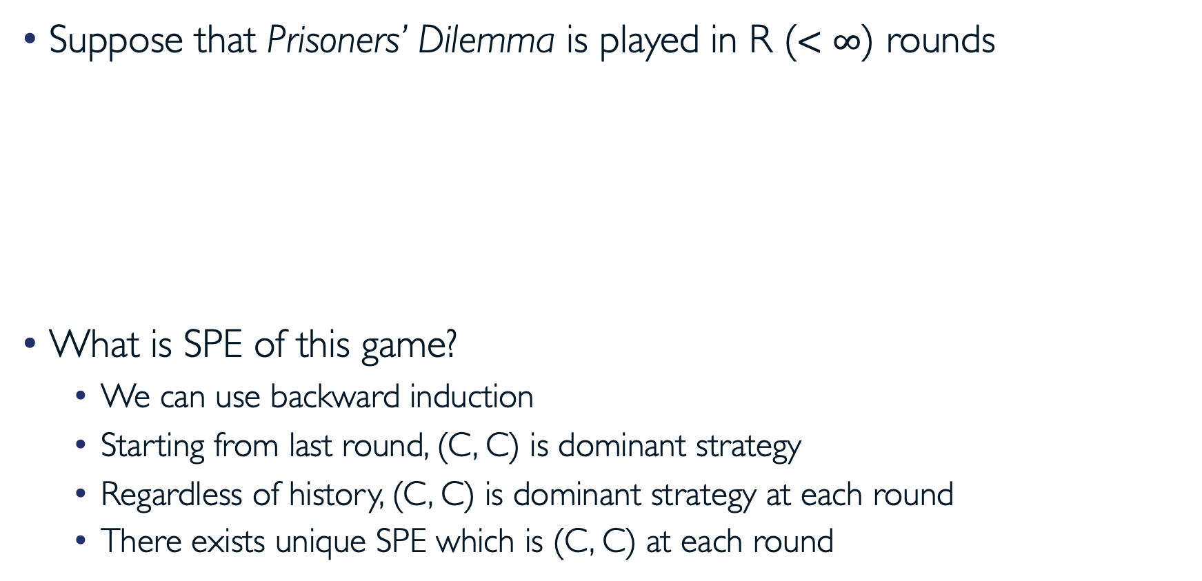
Example: Finitely-Repeated Prisoners’ Dilemma
Suppose that Prisoners’ Dilemma is played in R ($<∞$) rounds
What is SPE of this game?
  We can use backward induction
  Starting from last round, (C, C) is dominant strategy
  Regardless of history, (C, C) is dominant strategy at each round
  There exists unique SPE which is (C, C) at each round
Prisoner 2 Prisoner 1 | Stay Silent | Confess
Stay Silent | (-1, -1) | (-3, 0)
Confess | (0, -3) | (-2, -2)

Slide 5
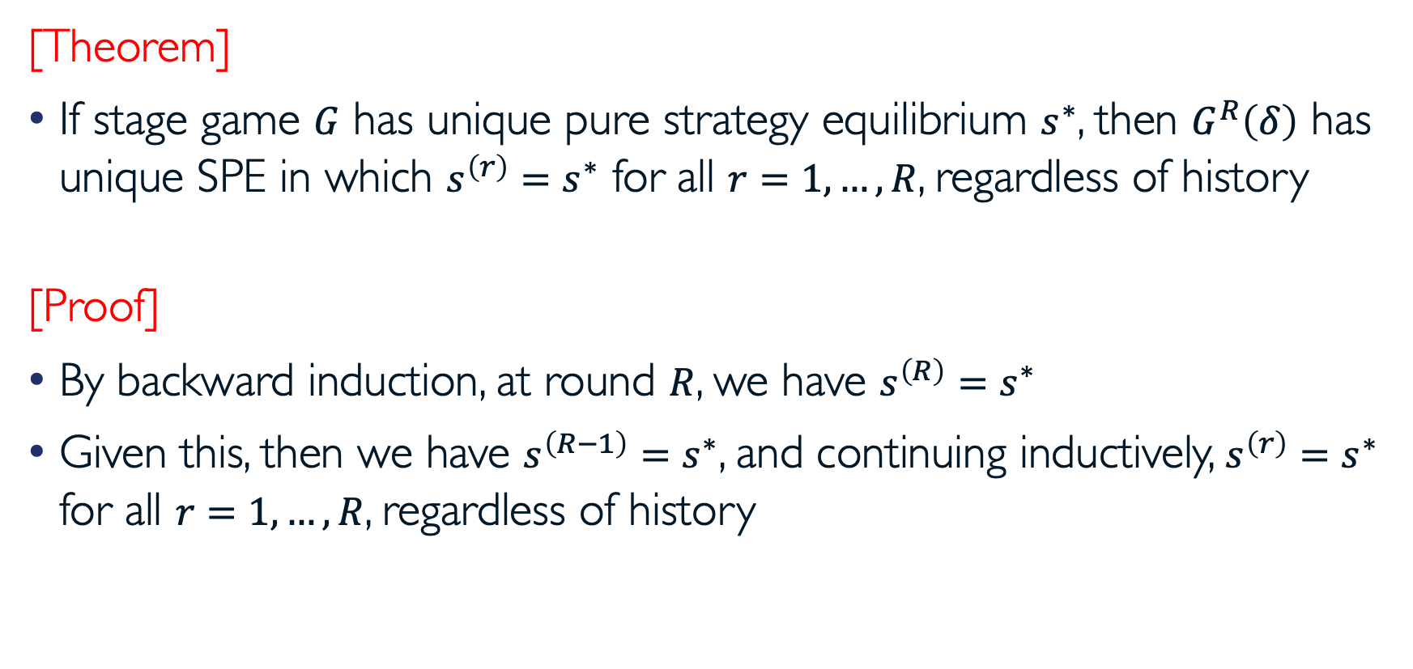
SPE in Finitely Repeated Games
[Theorem]
If stage game $G$ has unique pure strategy equilibrium $s^{∗}$, then $G^{R}\left(δ\right)$ has unique SPE in which $s^{\left(r\right)}=s^{∗}$ for all $r=1,…,R$, regardless of history
[Proof]
By backward induction, at round $R$, we have $s^{\left(R\right)}=s^{∗}$
Given this, then we have $s^{\left(R−1\right)}=s^{∗}$, and continuing inductively, $s^{\left(r\right)}=s^{∗}$ for all $r=1,…,R$, regardless of history

Slide 6
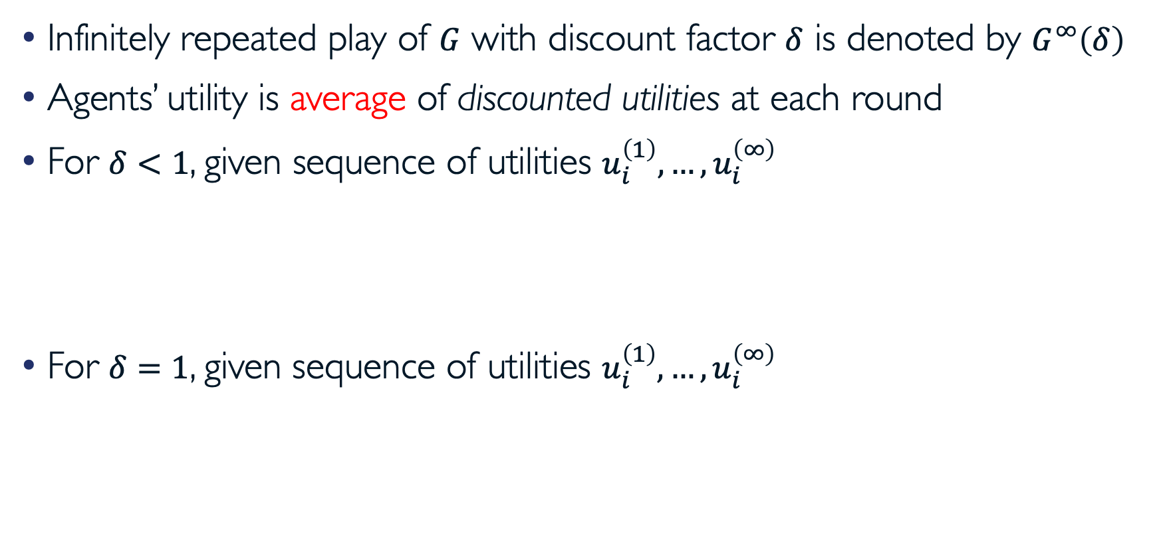
Infinitely Repeated Games
Infinitely repeated play of $G$ with discount factor $δ$ is denoted by $G^{∞}\left(δ\right)$
Agents’ utility is average of discounted utilities at each round
For $δ<1$, given sequence of utilities $u_{i}^{\left(1\right)},…,u_{i}^{\left(∞\right)}$
For $δ=1$, given sequence of utilities $u_{i}^{\left(1\right)},…,u_{i}^{\left(∞\right)}$

Slide 7
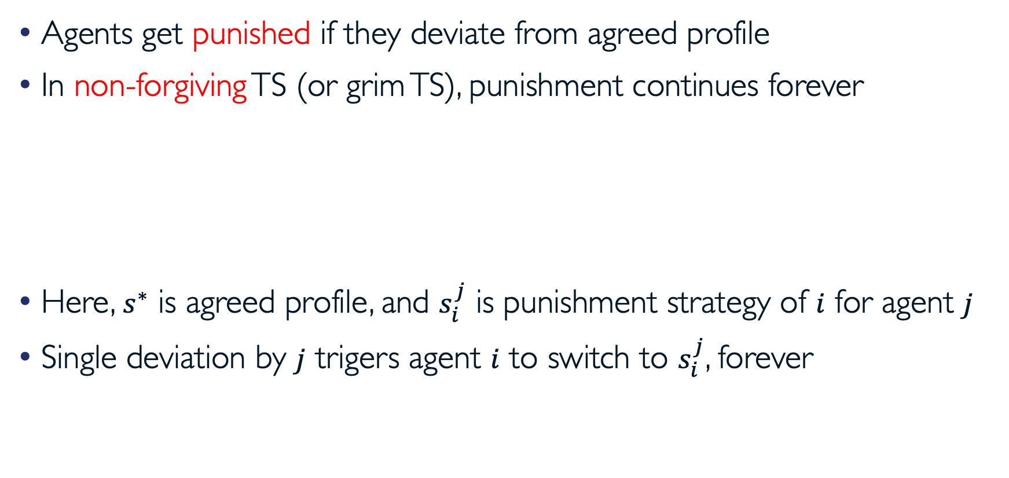
Trigger Strategies (TS)
Agents get punished if they deviate from agreed profile
In non-forgiving TS (or grim TS), punishment continues forever
Here, $s^{∗}$ is agreed profile, and $s_{i}^{j}$ is punishment strategy of $i$ for agent $j$
Single deviation by $j$ trigers agent $i$ to switch to $s_{i}^{j}$, forever

Slide 8
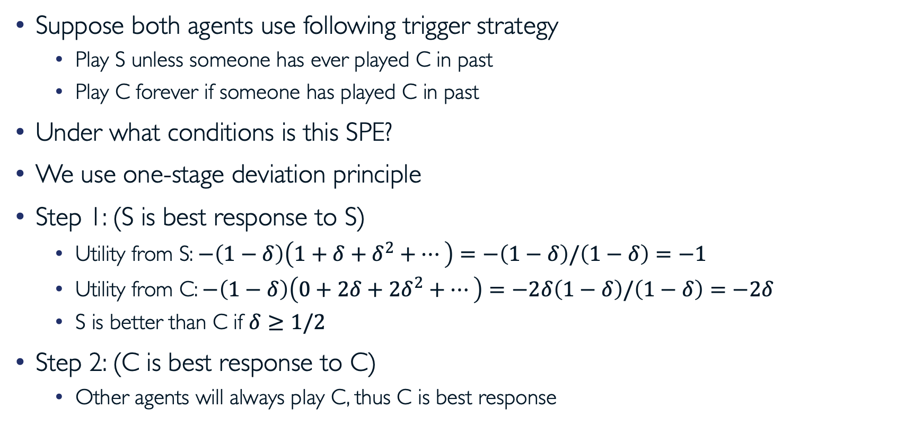
Trigger Strategies in Repeated Prisoners’ Dilemma
Suppose both agents use following trigger strategy
  Play S unless someone has ever played C in past
  Play C forever if someone has played C in past
Under what conditions is this SPE?
We use one-stage deviation principle
Step 1: (S is best response to S)
  Utility from S: $−\left(1−δ\right)\left(1+δ+δ^{2}+…\right)=−\left(1−δ\right)/\left(1−δ\right)=−1$
  Utility from C: $−\left(1−δ\right)\left(0+2δ+2δ^{2}+…\right)=−2δ\left(1−δ\right)/\left(1−δ\right)=−2δ$
  S is better than C if $δ≥1/2$
Step 2: (C is best response to C)
  Other agents will always play C, thus C is best response
Prisoner 2 Prisoner 1 | Stay Silent | Confess
Stay Silent | (-1, -1) | (-3, 0)
Confess | (0, -3) | (-2, -2)

Slide 9
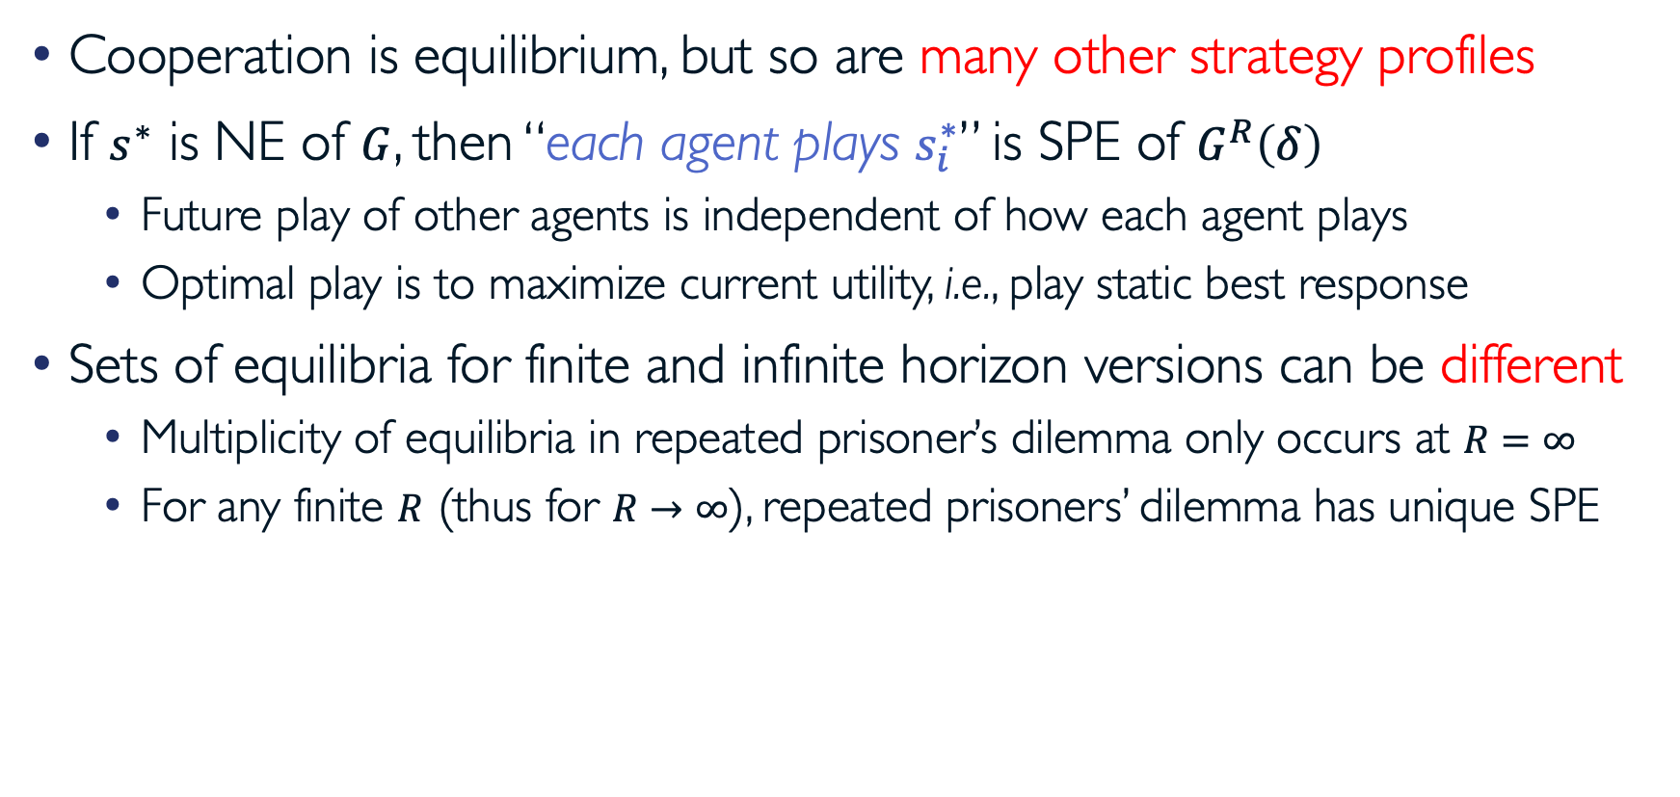
Remarks
Cooperation is equilibrium, but so are many other strategy profiles
If $s^{∗}$ is NE of $G$, then “each agent plays $s_{i}^{∗}$” is SPE of $G^{R}\left(δ\right)$
  Future play of other agents is independent of how each agent plays
  Optimal play is to maximize current utility, i.e., play static best response
Sets of equilibria for finite and infinite horizon versions can be different
  Multiplicity of equilibria in repeated prisoner’s dilemma only occurs at $R=∞$
  For any finite $R$ (thus for $R→∞$), repeated prisoners’ dilemma has unique SPE

Slide 10
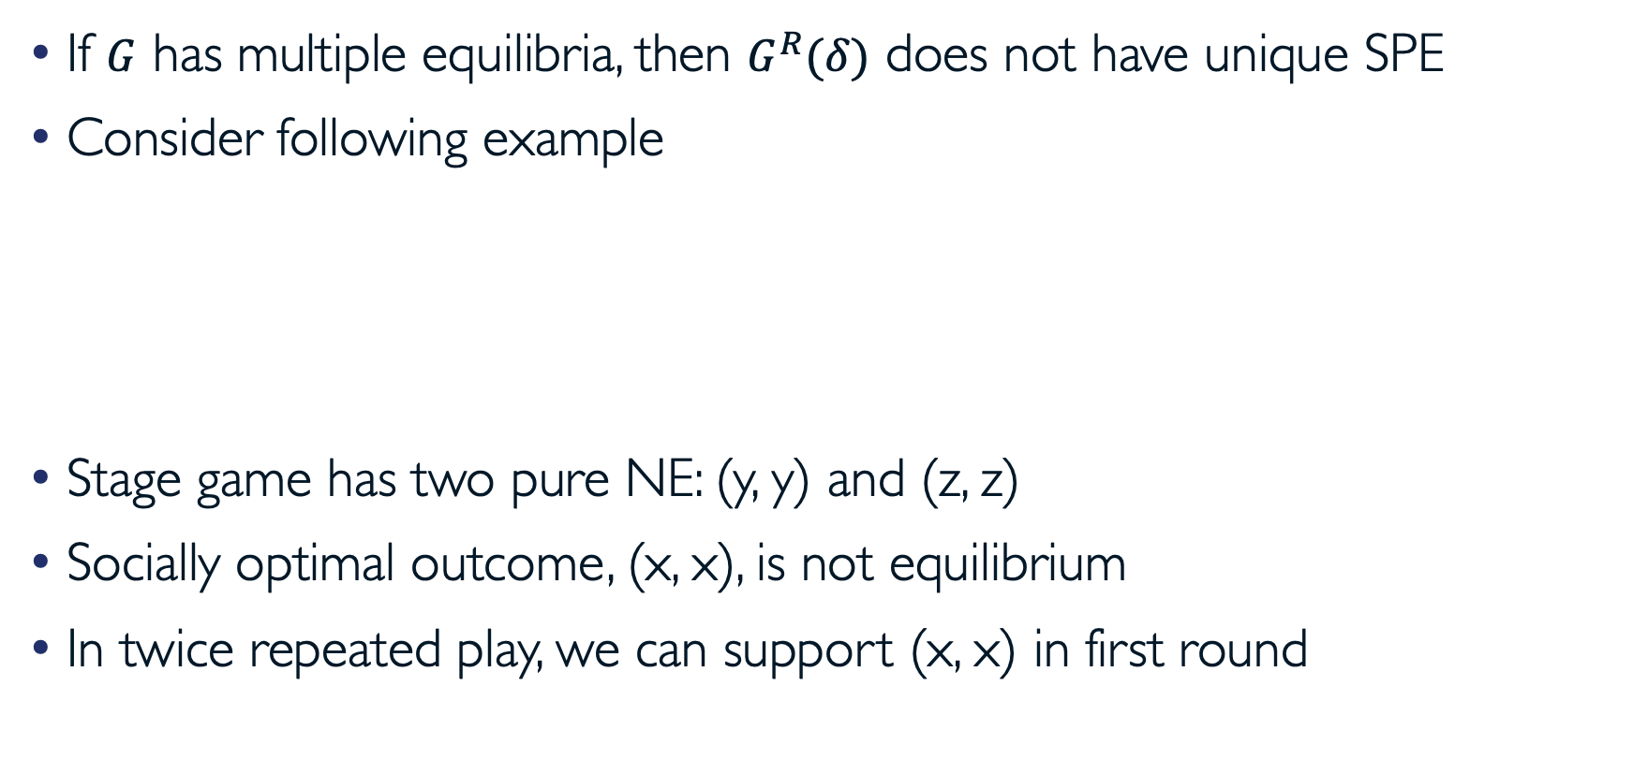
TS in Finitely Repeated Games
If $G$ has multiple equilibria, then $G^{R}(δ)$ does not have unique SPE
Consider following example
Stage game has two pure NE: (y, y) and (z, z)
Socially optimal outcome, (x, x), is not equilibrium
In twice repeated play, we can support (x, x) in first round
Agent 2 Agent 1 | x | y | z
x | (3, 3) | (0, 4) | (-2, 0)
y | (4, 0) | (1, 1) | (-2, 0)
z | (0, -2) | (0, -2) | (-1, -1)

Slide 11
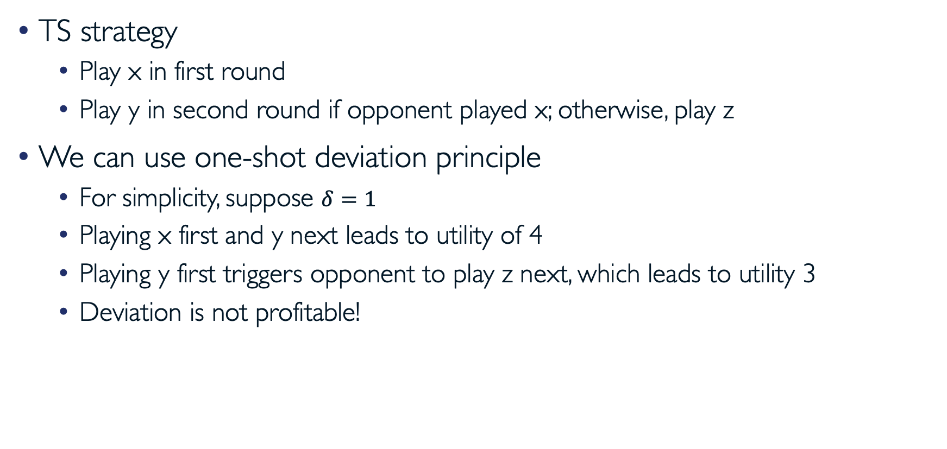
TS in Finitely Repeated Games (cont.)
TS strategy
  Play x in first round
  Play y in second round if opponent played x; otherwise, play z
We can use one-shot deviation principle
  For simplicity, suppose $δ=1$
  Playing x first and y next leads to utility of 4
  Playing y first triggers opponent to play z next, which leads to utility 3
  Deviation is not profitable!

Slide 12
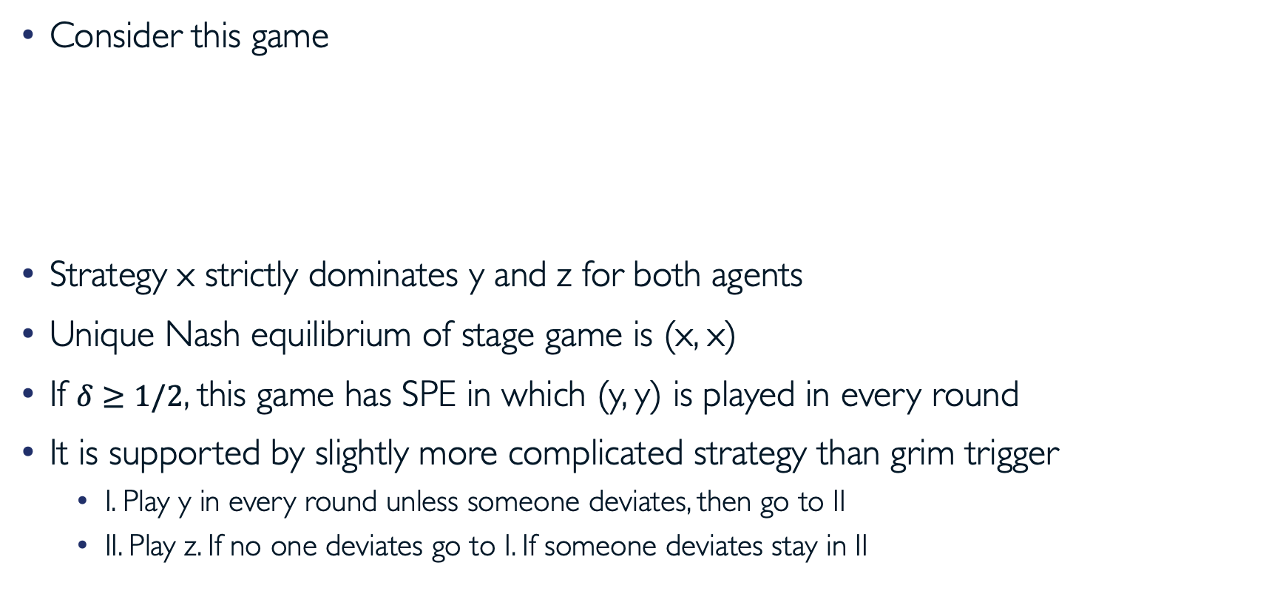
Repetition Can Lead to Bad Outcomes
Consider this game
Strategy x strictly dominates y and z for both agents
Unique Nash equilibrium of stage game is (x, x)
If $δ≥1/2$, this game has SPE in which (y, y) is played in every round
It is supported by slightly more complicated strategy than grim trigger
  I. Play y in every round unless someone deviates, then go to II
  II. Play z. If no one deviates go to I. If someone deviates stay in II
Agent 2 Agent 1 | x | y | z
x | (2, 2) | (2, 1) | (0, 0)
y | (1, 2) | (1, 1) | (-1, 0)
z | (0, 0) | (0, -1) | (-1, -1)

Slide 13
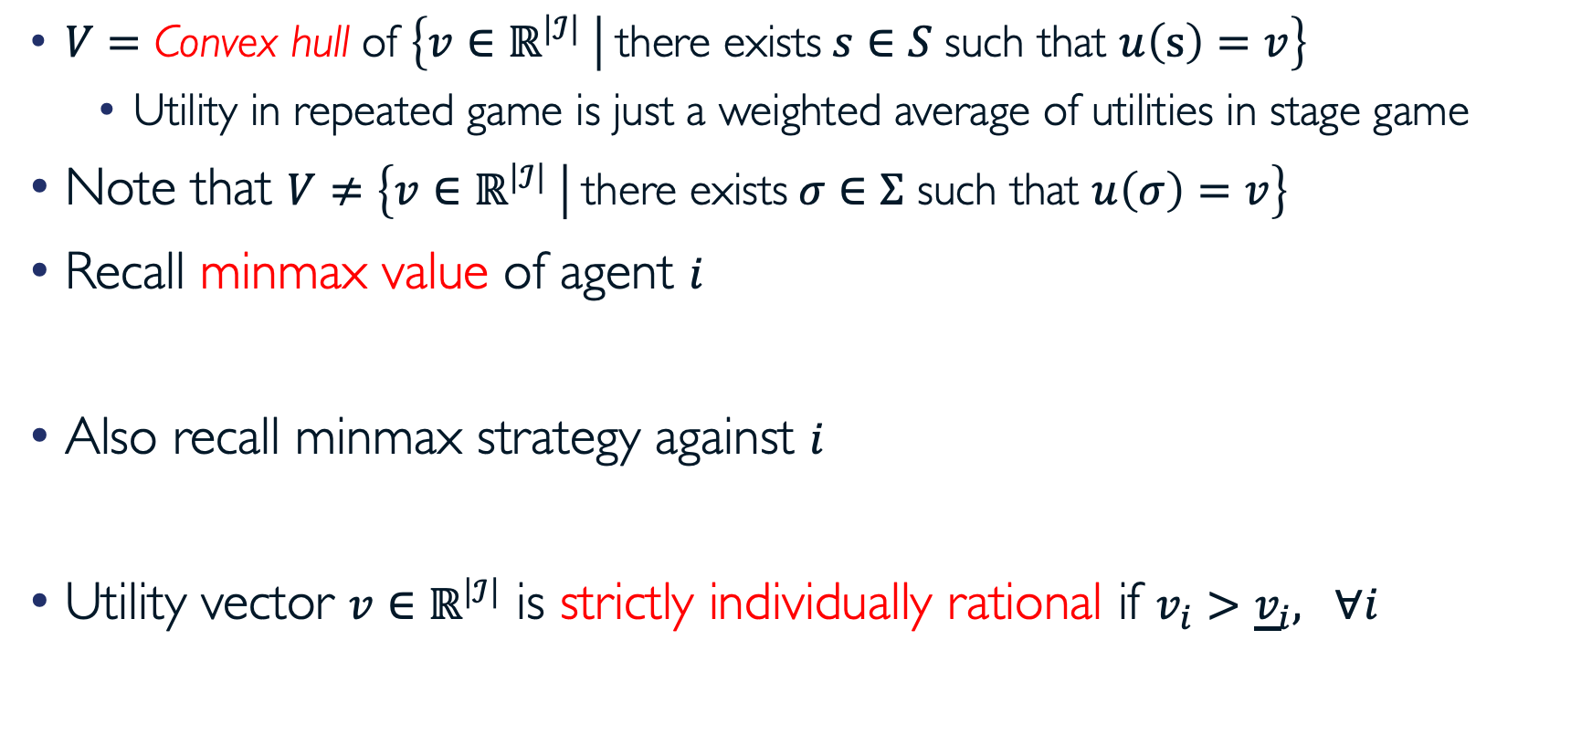
Feasible and Individually Rational Utilities
$V=\text{Convex} \text{hull} \text{of} \left\{v∈ℝ^{\left|ℐ\right|} | \text{there} \text{exists} s∈S \text{such} \text{that} u\left(s\right)=v\right\}$
  Utility in repeated game is just a weighted average of utilities in stage game
Note that $V≠\left\{v∈ℝ^{\left|ℐ\right|} | \text{there} \text{exists} σ∈Σ \text{such} \text{that} u\left(σ\right)=v\right\}$
Recall minmax value of agent $i$
Also recall minmax strategy against $i$
Utility vector $v∈ℝ^{\left|ℐ\right|}$ is strictly individually rational if $v_{i}>{\underline{v}}_{i}, ∀i$

Slide 14

Example
What is minimax value of agent 1?
  Let $q$ denote probability that agent 2 chooses L
What is minimax value of agent 2?
  Let $p$ and $q$ denote probabilities that agent 1 chooses U and M, respectively
Agent 2 Agent 1 | L | R
U | (-2, 2) | (1, -2)
M | (1, -2) | (-2, 2)
D | (0, 1) | (0, 1)

Slide 15
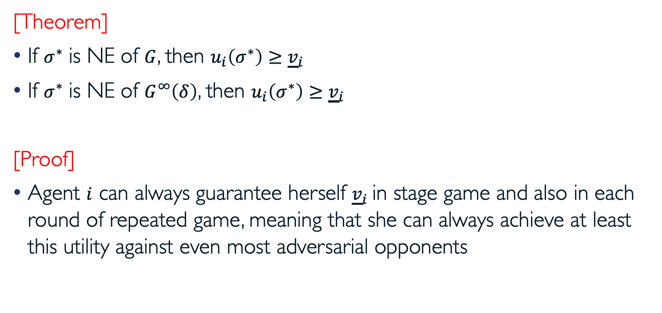
Minmax Utility Lower Bounds
[Theorem]
If $σ^{∗}$ is NE of $G$, then $u_{i}\left(σ^{∗}\right)≥{\underline{v}}_{i}$
If $σ^{∗}$ is NE of $G^{∞}\left(δ\right)$, then $u_{i}\left(σ^{∗}\right)≥{\underline{v}}_{i}$
[Proof]
Agent $i$ can always guarantee herself ${\underline{v}}_{i}$in stage game and also in each round of repeated game, meaning that she can always achieve at least this utility against even most adversarial opponents

Slide 16
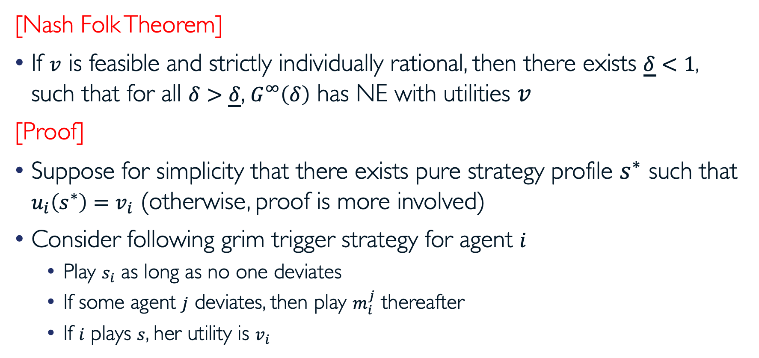
Nash Folk Theorem
[Nash Folk Theorem]
If $v$ is feasible and strictly individually rational, then there exists $\underline{δ}<1$, such that for all $δ>\underline{δ}$, $G^{∞}\left(δ\right)$ has NE with utilities $v$
[Proof]
Suppose for simplicity that there exists pure strategy profile $s^{∗}$ such that $u_{i}\left(s^{∗}\right)=v_{i}$ (otherwise, proof is more involved)
Consider following grim trigger strategy for agent $i$
  Play $s_{i}$ as long as no one deviates
  If some agent $j$ deviates, then play $m_{i}^{j}$ thereafter
  If $i$ plays $s$, her utility is $v_{i}$

Slide 17

Proof of Nash Folk Theorem
We can use one-shot deviation principle
Suppose $i$ deviates from $s$ in round $r$
Define ${\overline{v}}_{i}=\max_{s_{i}}{u_{i}\left(s_{i},s_{−i}^{∗}\right)}$
We have
Following $s^{∗}$ will be optimal if
This means, $s^{∗}$ is NE of $G^{∞}\left(δ\right)$ if

Slide 18
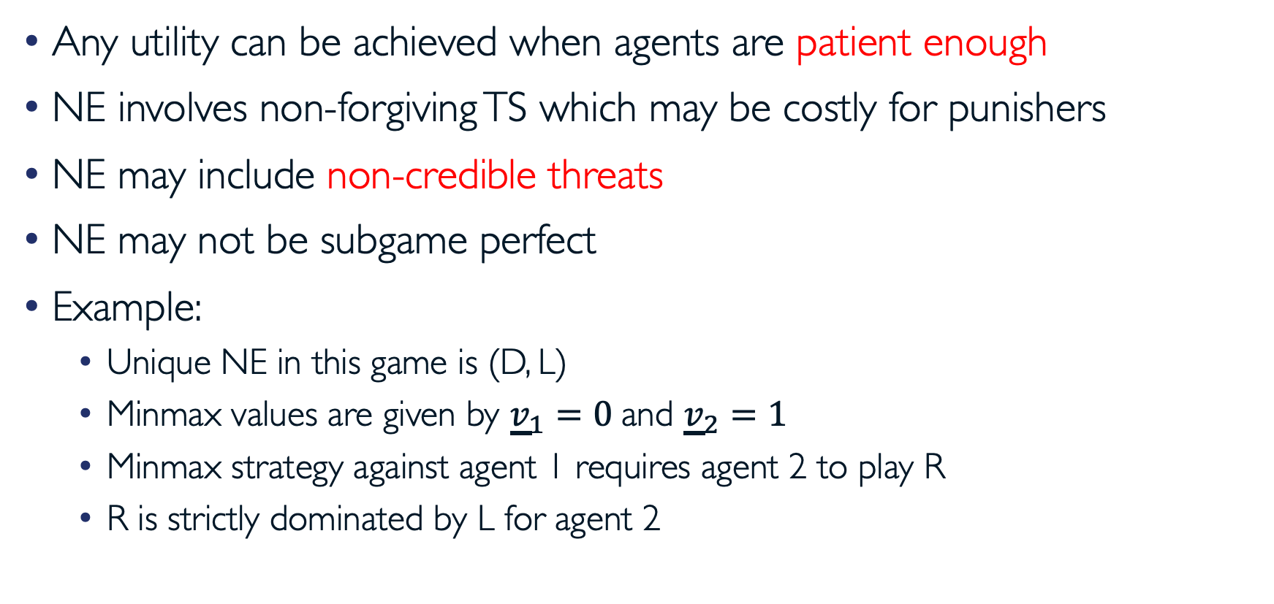
Problems with Nash Folk Theorem
Any utility can be achieved when agents are patient enough
NE involves non-forgiving TS which may be costly for punishers
NE may include non-credible threats
NE may not be subgame perfect
Example:
  Unique NE in this game is (D, L)
  Minmax values are given by ${\underline{v}}_{1}=0$ and ${\underline{v}}_{2}=1$
  Minmax strategy against agent 1 requires agent 2 to play R
  R is strictly dominated by L for agent 2
Agent 2 Agent 1 | L | R
U | (6, 6) | (0, -100)
D | (7, 1) | (0, -100)

Slide 19
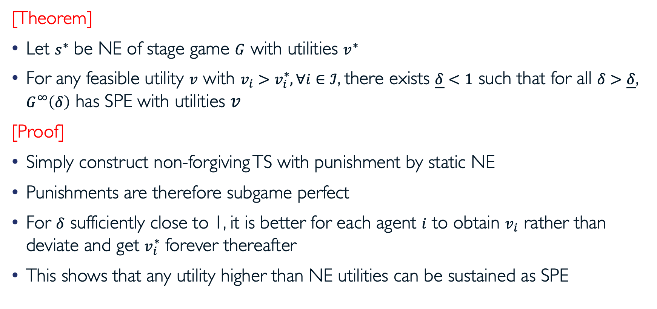
Subgame Perfect Folk Theorem
[Theorem]
Let $s^{∗}$ be NE of stage game $G$ with utilities $v^{∗}$
For any feasible utility $v$ with $v_{i}>v_{i}^{∗}, ∀i∈ℐ$, there exists $\underline{δ}<1$ such that for all $δ>\underline{δ}$, $G^{∞}\left(δ\right)$ has SPE with utilities $v$
[Proof]
Simply construct non-forgiving TS with punishment by static NE
Punishments are therefore subgame perfect
For $δ$ sufficiently close to 1, it is better for each agent $i$ to obtain $v_{i}$ rather than deviate and get $v_{i}^{∗}$ forever thereafter
This shows that any utility higher than NE utilities can be sustained as SPE

Slide 20
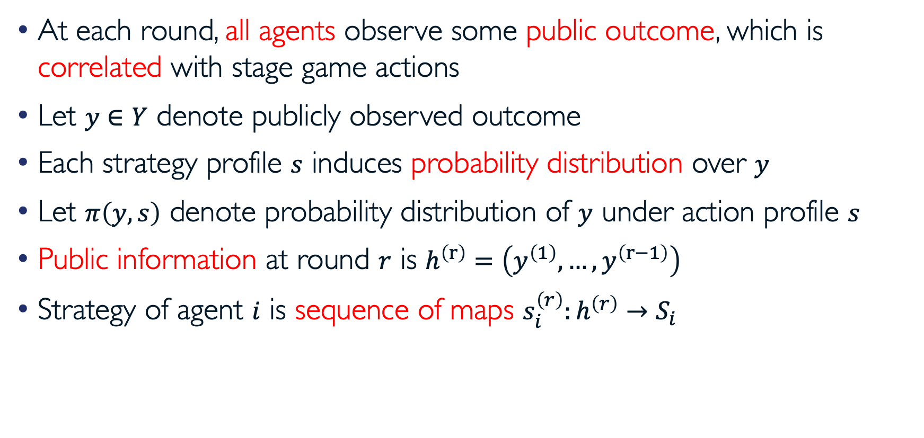
Repeated Games with Imperfect Monitoring
At each round, all agents observe some public outcome, which is correlated with stage game actions
Let $y∈Y$ denote publicly observed outcome
Each strategy profile $s$ induces probability distribution over $y$
Let $π\left(y,s\right)$ denote probability distribution of $y$ under action profile $s$
Public information at round $r$ is $h^{\left(r\right)}=\left(y^{\left(1\right)},…,y^{\left(r−1\right)}\right)$
Strategy of agent $i$ is sequence of maps $s_{i}^{\left(r\right)}:h^{\left(r\right)}→S_{i}$

Slide 21
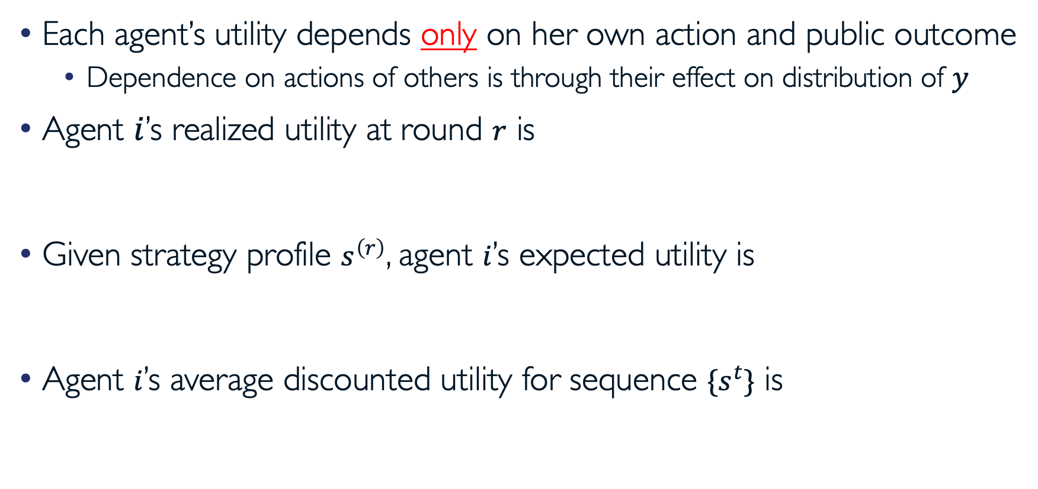
Repeated Games with Imperfect Monitoring (cont.)
Each agent’s utility depends only on her own action and public outcome
  Dependence on actions of others is through their effect on distribution of $y$
Agent $i$’s realized utility at round $r$ is
Given strategy profile $s^{\left(r\right)}$, agent $i$’s expected utility is
Agent $i$’s average discounted utility for sequence $\{s^{t}\}$ is

Slide 22
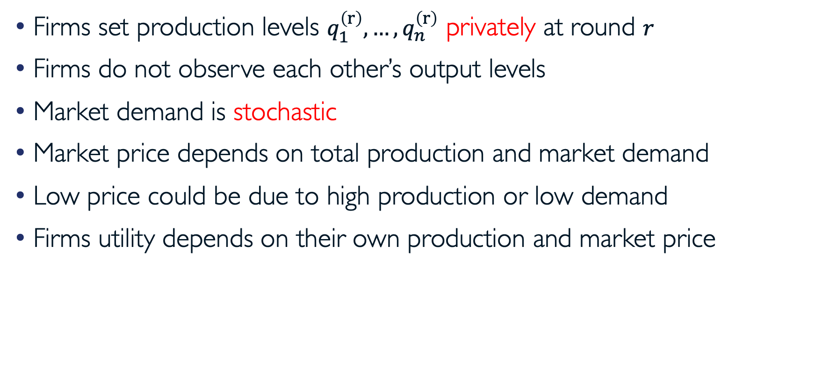
Example: Cournot Competition with Noisy Demand
[Green and Porter, Noncooperative Collusion under Imperfect Price Information, 1984]
Firms set production levels $q_{1}^{\left(r\right)},…,q_{n}^{\left(r\right)}$ privately at round $r$
Firms do not observe each other’s output levels
Market demand is stochastic
Market price depends on total production and market demand
Low price could be due to high production or low demand
Firms utility depends on their own production and market price

Slide 23
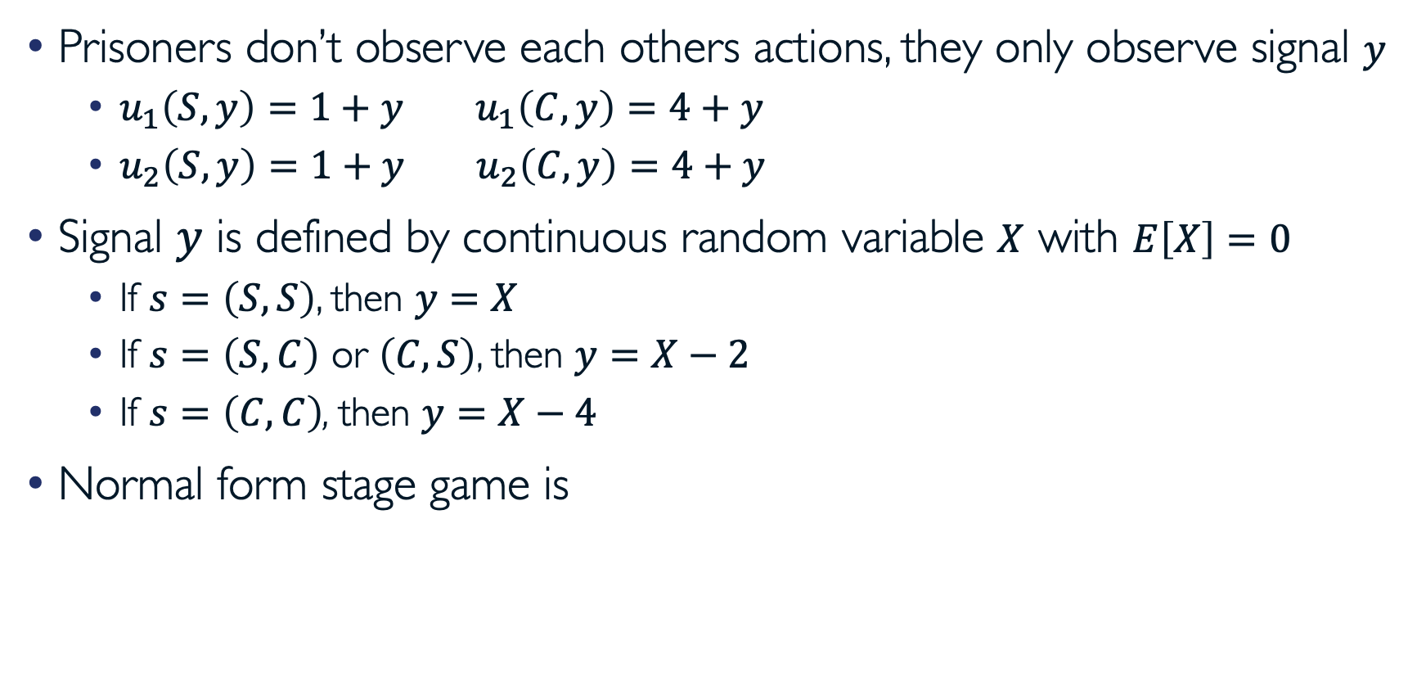
Simpler Example: Noisy Prisoner’s Dilemma
Prisoners don’t observe each others actions, they only observe signal $y$
  $u_{1}\left(S,y\right)=1+y u_{1}\left(C,y\right)=4+y$
  $u_{2}\left(S,y\right)=1+y u_{2}\left(C,y\right)=4+y$
Signal $y$ is defined by continuous random variable $X$ with $E\left[X\right]=0$
  If $s=\left(S,S\right)$, then $y=X$
  If $s=\left(S,C\right)$ or $\left(C,S\right)$, then $y=X−2$
  If $s=\left(C,C\right)$, then $y=X−4$
Normal form stage game is
Prisoner 2 Prisoner 1 | Stay Silent | Confess
Stay Silent | (1+X, 1+X) | (-1+X, 2+X)
Confess | (2+X, -1+X) | (X, X)

Slide 24
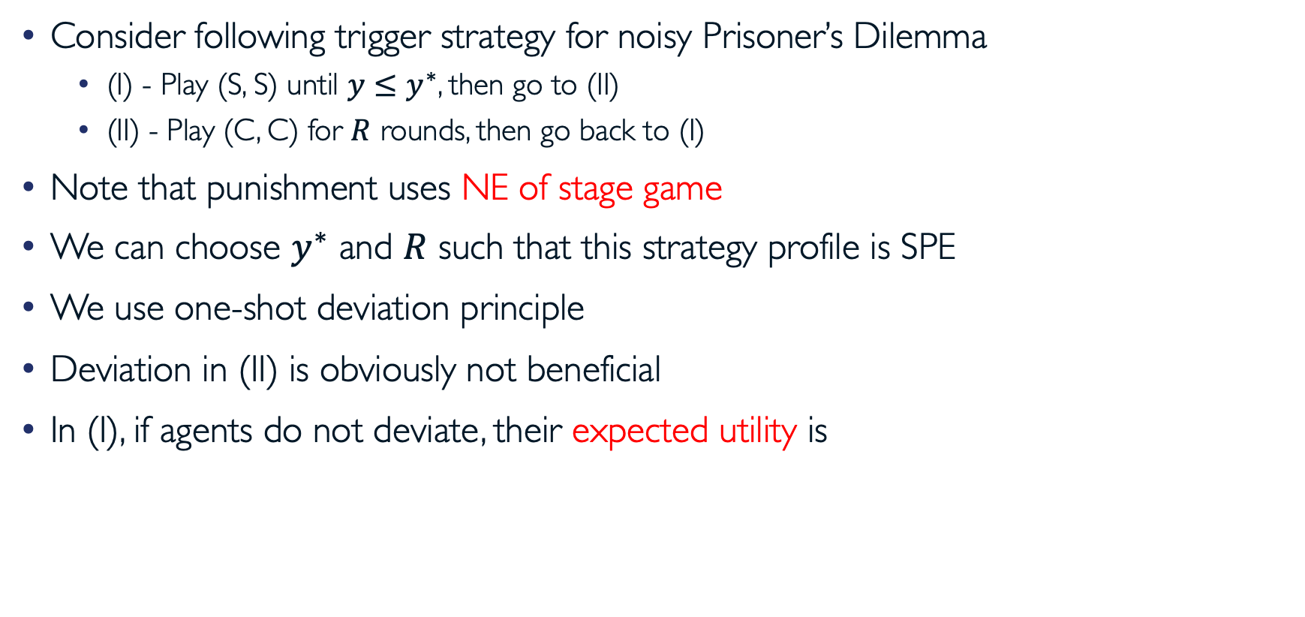
Trigger-Price Strategy
Consider following trigger strategy for noisy Prisoner’s Dilemma
  (I) - Play (S, S) until $y≤y^{∗}$, then go to (II)
  (II) - Play (C, C) for $R$ rounds, then go back to (I)
Note that punishment uses NE of stage game
We can choose $y^{∗}$ and $R$ such that this strategy profile is SPE
We use one-shot deviation principle
Deviation in (II) is obviously not beneficial
In (I), if agents do not deviate, their expected utility is

Slide 25
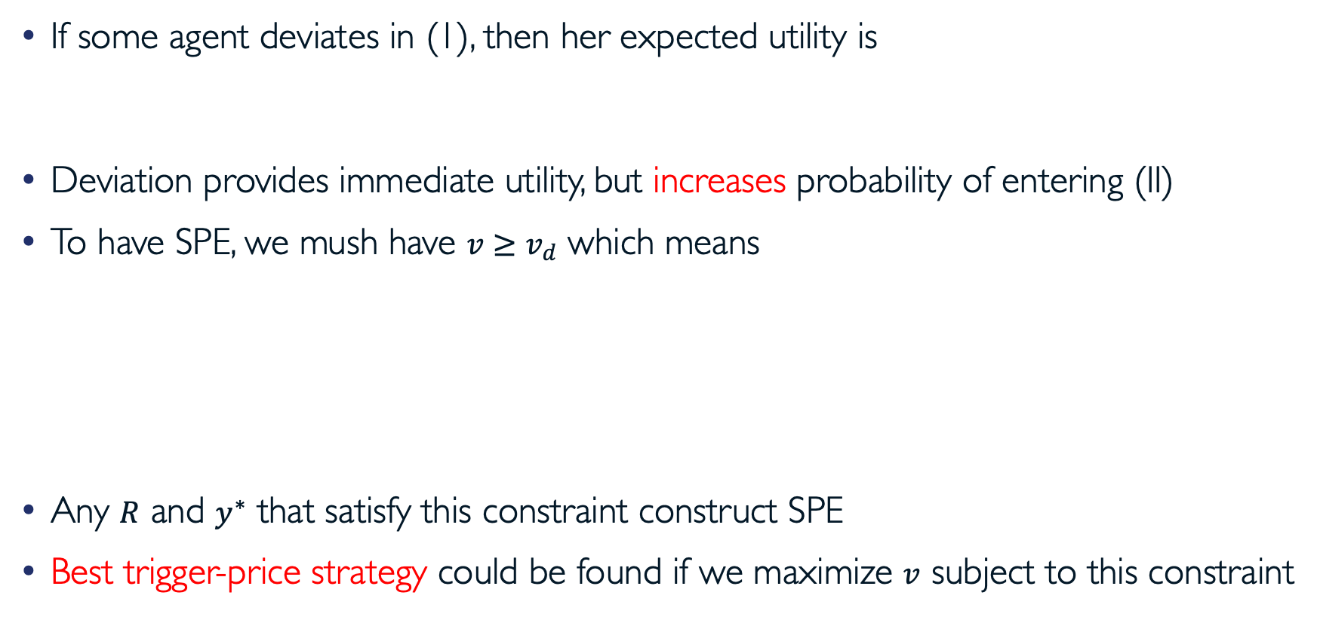
Trigger-Price Strategy (cont.)
If some agent deviates in (1), then her expected utility is
Deviation provides immediate utility, but increases probability of entering (II)
To have SPE, we mush have $v≥v_{d}$ which means
Any $R$ and $y^{∗}$ that satisfy this constraint construct SPE
Best trigger-price strategy could be found if we maximize $v$ subject to this constraint

Slide 26
Questions?

Slide 27
Acknowledgement
This lecture is a slightly modified version of one prepared by
  Asu Ozdaglar [MIT 6.254]

