Slide 1

ECE700.07: Game Theory with
Engineering Applications
Lecture 7: Games with Incomplete Information
Seyed Majid Zahedi

Slide 2
Outline
Bayesian games
Bayes-Nash equilibrium
Auctions
Readings:
  MAS Sec. 6.3, GT Sec. 6.1 - 6.5

Slide 3
Bayesian Games: Games of Incomplete Information
So far, we assumed all agents know what game they are playing
  Number of agents
  Actions available to each agent
  Utilities associated with each outcome
In extensive form games, actions may not be common knowledge, but game itself is
Bayesian games allow us to represent agents’ uncertainties about game being played
  Uncertainty is represented as commonly known probability distribution over possible games
We make following assumptions
  All games have same number of agents and same strategy space for each agents
  Possible games only differ in agents’ utilities for each outcome
  Beliefs are posteriors, obtained by conditioning common prior on private signals

Slide 4
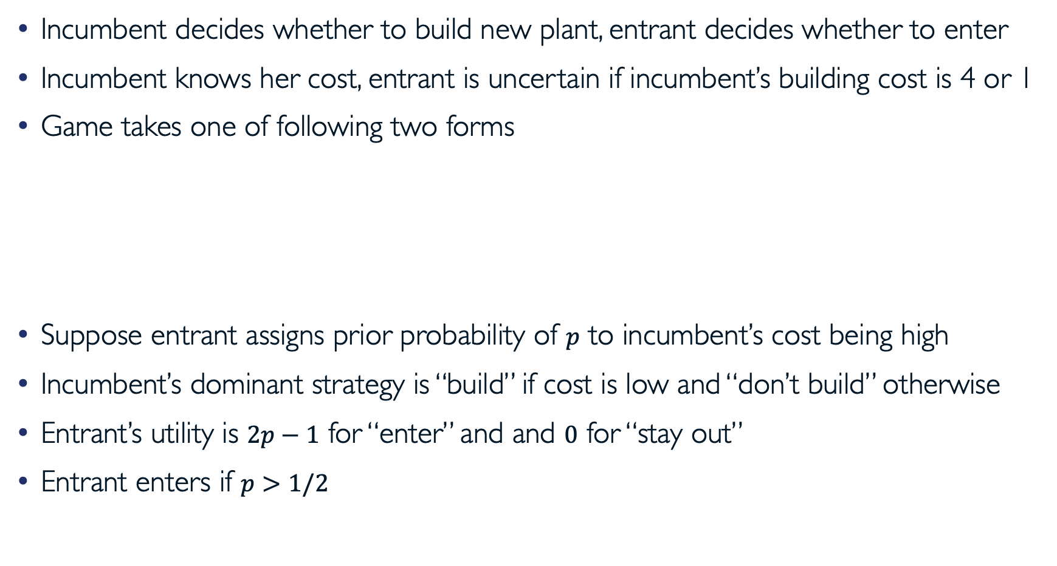
Example: Bayesian Entry Deterrence Game
Incumbent decides whether to build new plant, entrant decides whether to enter
Incumbent knows her cost, entrant is uncertain if incumbent’s building cost is 4 or 1
Game takes one of following two forms
Suppose entrant assigns prior probability of $p$ to incumbent’s cost being high
Incumbent’s dominant strategy is “build” if cost is low and “don’t build” otherwise
Entrant’s utility is $2p−1$ for “enter” and and $0$ for “stay out”
Entrant enters if $p>1/2$
Entrant Incumbent | Enter | Stay Out
Build | (0, -1) | (2, 0)
Don’t Build | (2, 1) | (3, 0)
Entrant Incumbent | Enter | Stay Out
Build | (3, -1) | (5, 0)
Don’t Build | (2, 1) | (3, 0)
High Building Cost
Low Building Cost

Slide 5
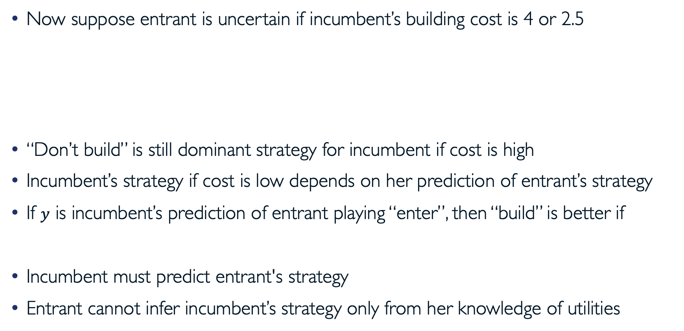
Example: Bayesian Entry Deterrence Game (cont.)
Now suppose entrant is uncertain if incumbent’s building cost is 4 or 2.5
“Don’t build” is still dominant strategy for incumbent if cost is high
Incumbent’s strategy if cost is low depends on her prediction of entrant’s strategy
If $y$ is incumbent’s prediction of entrant playing “enter”, then “build” is better if
Incumbent must predict entrant's strategy
Entrant cannot infer incumbent’s strategy only from her knowledge of utilities
Entrant Incumbent | Enter | Stay Out
Build | (0, -1) | (2, 0)
Don’t Build | (2, 1) | (3, 0)
Entrant Incumbent | Enter | Stay Out
Build | (1.5, -1) | (3.5, 0)
Don’t Build | (2, 1) | (3, 0)
High Building Cost
Low Building Cost

Slide 6

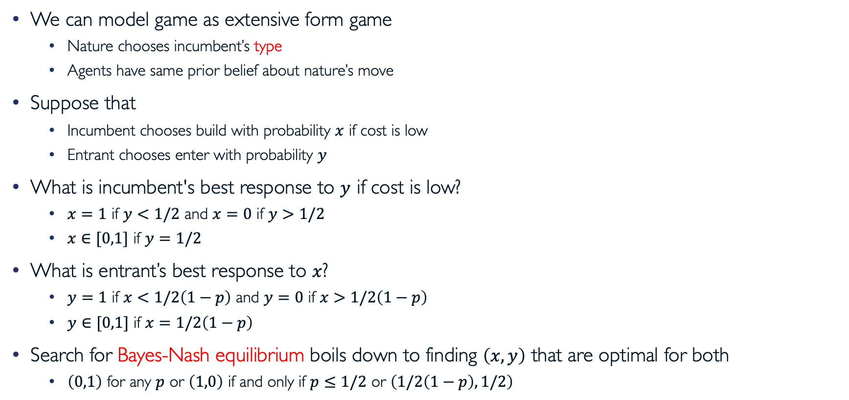

Example: Bayesian Entry Deterrence Game (cont.)
Nature
We can model game as extensive form game
  Nature chooses incumbent’s type
  Agents have same prior belief about nature’s move
Suppose that
  Incumbent chooses build with probability $x$ if cost is low
  Entrant chooses enter with probability $y$
What is incumbent's best response to $y$ if cost is low?
  $x=1$ if $y<1/2$ and $x=0$ if $y>1/2$
  $x∈[0,1]$ if $y=1/2$
What is entrant’s best response to $x$?
  $y=1$ if $x<1/2\left(1−p\right)$ and $y=0$ if $x>1/2\left(1−p\right)$
  $y∈[0,1]$ if $x=1/2\left(1−p\right)$
Search for Bayes-Nash equilibrium boils down to finding $\left(x,y\right)$ that are optimal for both
  $\left(0,1\right)$ for any $p$ or $\left(1,0\right)$ if and only if $p≤1/2$ or $\left(1/2\left(1−p\right),1/2\right)$
$$p$$
$$1−p$$
High Cost
Low Cost
Incumbent
Build
Don’t
Build
Don’t
Entrant
Enter
Don’t
Enter
Don’t
Enter
Don’t
Enter
Don’t
(0,-1)
(2,0)
(2,1)
(3,0)
(1.5,-1)
(3.5,0)
(2,1)
(3,0)

Slide 7
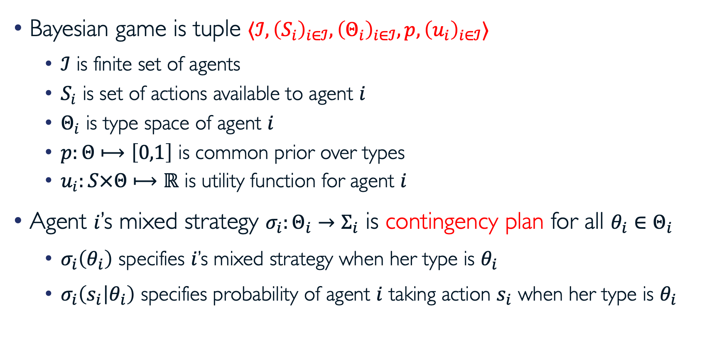
Bayesian Games Model
Bayesian game is tuple $⟨ℐ, {\left(S_{i}\right)}_{i∈ℐ},{\left(Θ_{i}\right)}_{i∈ℐ}, p,{\left(u_{i}\right)}_{i∈ℐ}⟩$
  $ℐ$ is finite set of agents
  $S_{i}$ is set of actions available to agent $i$
  $Θ_{i}$ is type space of agent $i$
  $p:Θ⟼\left[0,1\right]$ is common prior over types
  $u_{i}:S×Θ⟼ℝ$ is utility function for agent $i$
Agent $i$’s mixed strategy $σ_{i}:Θ_{i}→Σ_{i}$ is contingency plan for all $θ_{i}∈Θ_{i}$
  $σ_{i}\left(θ_{i}\right)$ specifies $i$’s mixed strategy when her type is $θ_{i}$
  $σ_{i}\left(s_{i} | θ_{i}\right)$ specifies probability of agent $i$ taking action $s_{i}$ when her type is $θ_{i}$

Slide 8
Expected Utilities
Ex-post expected utility
Ex-interim expected utility
Ex-ante expected utility

Slide 9








Example
Consider following game which consists of four 2×2 games
  Matching Pennies, Prisoner’s Dilemma, Coordination and Battle of the Sexes
$$θ_{21}$$
$$θ_{22}$$
MP
PD
2,0 | 0,2
0,2 | 2,0
2,2 | 0,3
3,0 | 1,1
$$θ_{11}$$
$$p=0.3$$
$$p=0.1$$
Coord
BoS
2,2 | 0,0
0,0 | 1,1
2,1 | 0,0
0,0 | 1,2
$$θ_{12}$$
$$p=0.2$$
$$p=0.4$$

Slide 10

Example (cont.)
What is ${EU}_{2}\left(UD,LR\right)$?

Slide 11

Strategies
Agent $i$’s best response correspondence to mixed strategy $σ_{−i}$ is
  $EU_{i}\left(σ_{i},σ_{−i},θ_{i}\right)$ is independent of $σ_{i}\left(θ_{i}^{′}\right)$ for all $θ_{i}^{′}≠θ_{i}$
  Maximizing $EU_{i}\left(σ_{i},σ_{−i}\right)$ is equal to maximizing $EU_{i}\left(σ_{i},σ_{−i},θ_{i}\right)$ for all $θ_{i}∈Θ_{i}$

Slide 12
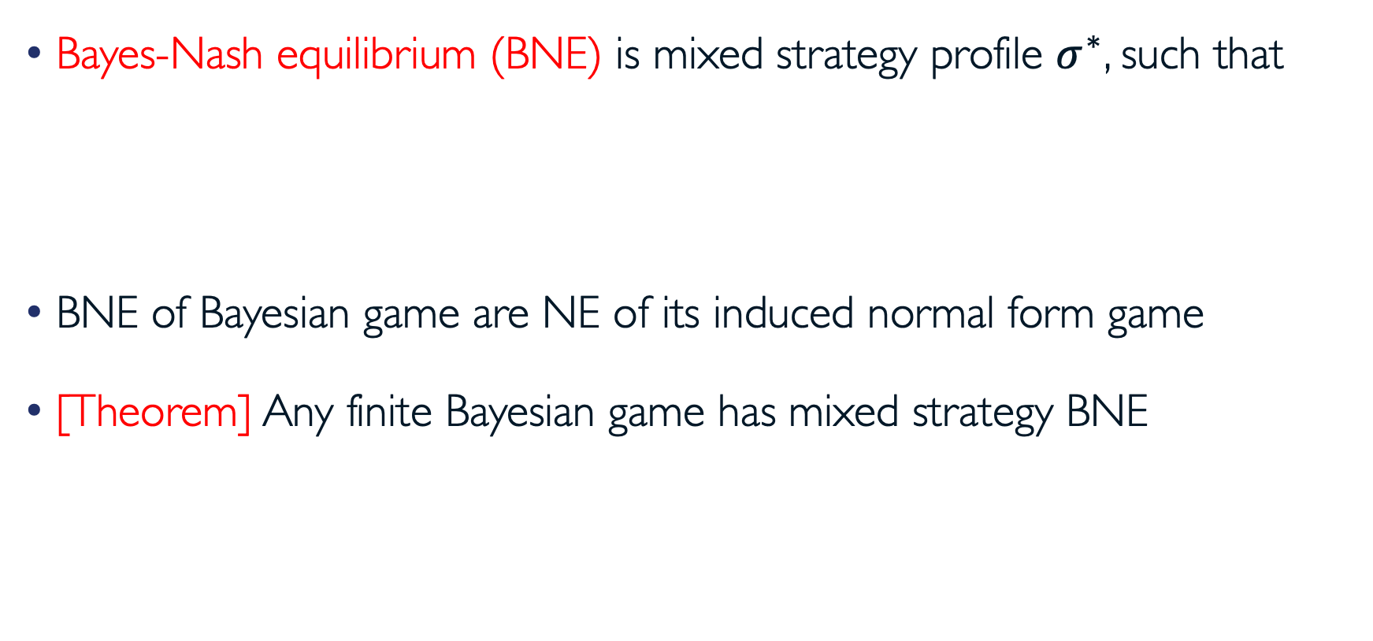
Bayes-Nash Equilibrium
Bayes-Nash equilibrium (BNE) is mixed strategy profile $σ^{∗}$, such that
BNE of Bayesian game are NE of its induced normal form game
[Theorem] Any finite Bayesian game has mixed strategy BNE

Slide 13
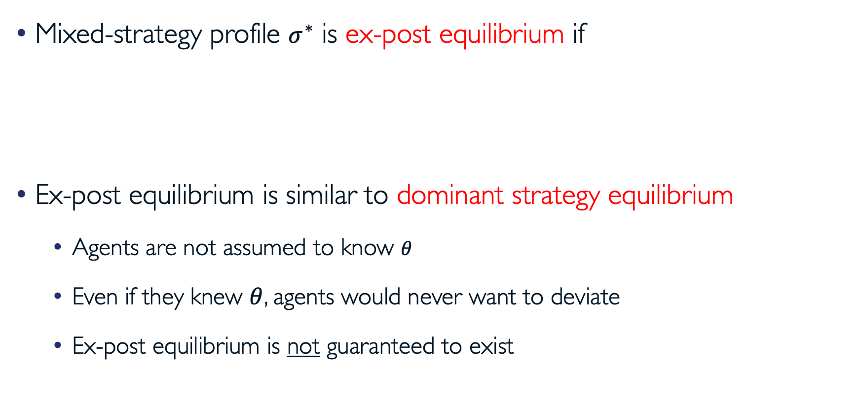
Ex-Post Equilibrium
Mixed-strategy profile $σ^{∗}$ is ex-post equilibrium if
Ex-post equilibrium is similar to dominant strategy equilibrium
  Agents are not assumed to know $θ$
  Even if they knew $θ$, agents would never want to deviate
  Ex-post equilibrium is not guaranteed to exist

Slide 14
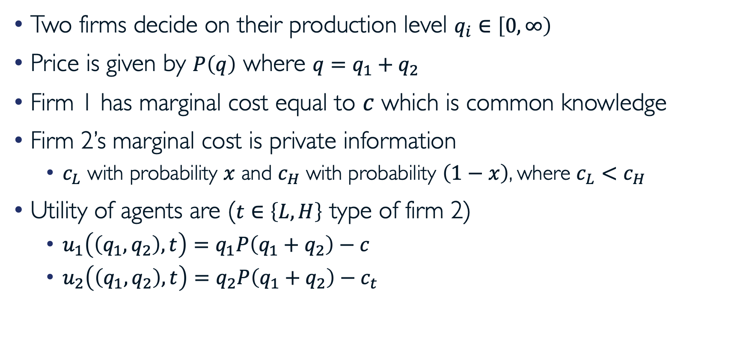
Example: Incomplete Information Cournot
Two firms decide on their production level $q_{i}∈\left[0,∞\right)$
Price is given by $P\left(q\right)$ where $q=q_{1}+q_{2}$
Firm 1 has marginal cost equal to $c$ which is common knowledge
Firm 2’s marginal cost is private information
  $c_{L}$ with probability $x$ and $c_{H}$ with probability $\left(1−x\right)$, where $c_{L}<c_{H}$
Utility of agents are ($t∈\left\{L,H\right\}$ type of firm 2)
  $u_{1}\left(\left(q_{1},q_{2}\right),t\right)=q_{1}P\left(q_{1}+q_{2}\right)−c$
  $u_{2}\left(\left(q_{1},q_{2}\right),t\right)=q_{2}P\left(q_{1}+q_{2}\right)−c_{t}$

Slide 15

Example: Incomplete Information Cournot (cont.)
What is firm 1’s best response to $\left(q_{L},q_{H}\right)$?
BNE of this game is vector $\left(q_{1}^{∗},q_{L}^{∗},q_{H}^{∗}\right)$such that

Slide 16
Auctions
Major application of Bayesian games is in auctions
Auctions are commonly used to sell (allocate) items to bidders
Auctioneer often would like to maximize her revenue
Bidders’ valuations are usually unknown to others and auctioneer
Allocating items to bidders with highest valuations is often desirable
Extracting private valuations could be challenging
  E.g., giving painting for free to bidder with highest valuation would create incentive for all bidders to overstate their valuations

Slide 17
Different Auctions and Terminologies
English auction: ascending sequential bids
First price auction: bidders bid simultaneously, highest bid wins, winner pays her bid
Second price action: similar to first price, except that winner pays second highest bid
Dutch auction: descending sequential prices; price is reduced until one stops auction
Private valuations: valuation of each bidder is independent of others’ valuations
Common valuations: bidders’ valuations are imperfectly correlated to common value

Slide 18
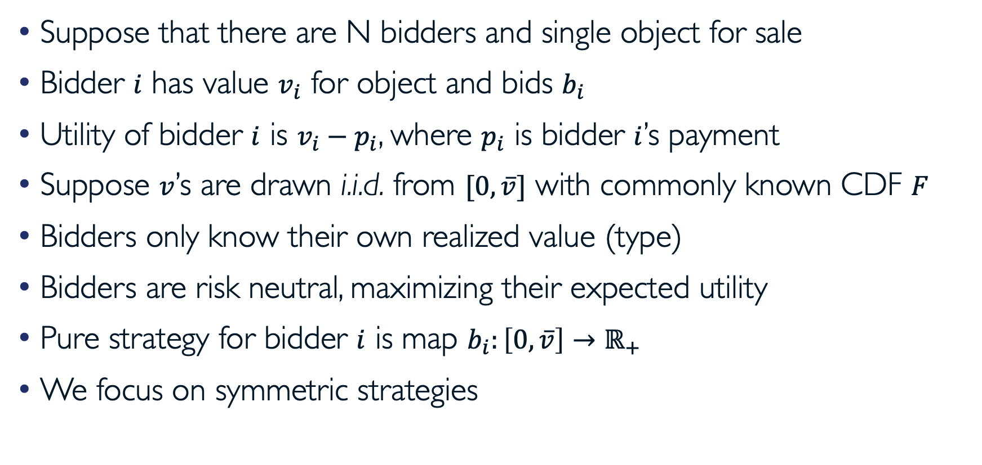
Modeling First and Second Price Auctions
Suppose that there are N bidders and single object for sale
Bidder $i$ has value $v_{i}$ for object and bids $b_{i}$
Utility of bidder $i$ is $v_{i}−p_{i}$, where $p_{i}$ is bidder $i$’s payment
Suppose $v$’s are drawn i.i.d. from $[0,\overline{v}]$ with commonly known CDF $F$
Bidders only know their own realized value (type)
Bidders are risk neutral, maximizing their expected utility
Pure strategy for bidder $i$ is map $b_{i}:\left[0,\overline{v}\right]→ℝ_{+}$
We focus on symmetric strategies

Slide 19
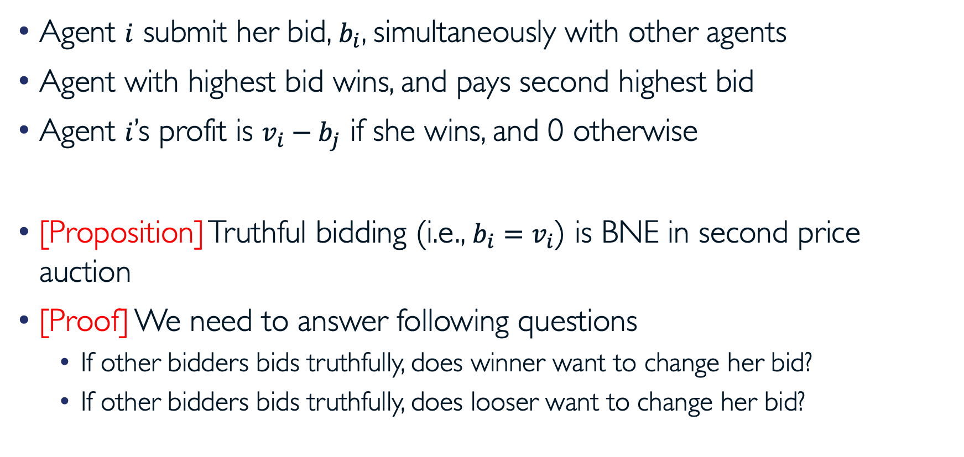
Second Price Auctions
Agent $i$ submit her bid, $b_{i}$, simultaneously with other agents
Agent with highest bid wins, and pays second highest bid
Agent $i$’s profit is $v_{i}−b_{j}$ if she wins, and 0 otherwise
[Proposition] Truthful bidding (i.e., $b_{i}=v_{i}$) is BNE in second price auction
[Proof] We need to answer following questions
  If other bidders bids truthfully, does winner want to change her bid?
  If other bidders bids truthfully, does looser want to change her bid?

Slide 20

Truthful Bidding
Truthful equilibrium is (weak) ex-post equilibrium
  Truthful bidding weakly dominates other strategies even if all values are known
[Picture proof]
  Suppose $B_{i}^{∗}=\max_{j≠i}{b_{j}}$ represents maximum bids excluding $i$’s bid
$$u_{i}(b_{i})$$
$$u_{i}(b_{i})$$
$$u_{i}(b_{i})$$
$$b_{i}$$
$$v_{i}$$
$$B_{i}^{∗}$$
$$b_{i}$$
$$v_{i}$$
$$B_{i}^{∗}$$
$$v_{i}$$
$$B_{i}^{∗}$$
$$b_{i}=v_{i}$$
$$b_{i}<v_{i}$$
$$b_{i}>v_{i}$$

Slide 21

Expected Payment in Second Price Auctions
Define random variable $y_{i}$ to be $\max_{j≠i}{v_{j}}$
  CDF of $y_{i}$ is $G_{y_{i}}\left(v\right)=F{\left(v\right)}^{N−1}$
  PDF of $y_{i}$ is $g_{y_{i}}\left(v\right)=\left(N−1\right)f\left(v\right)F{\left(v\right)}^{N−2}$
Expected payment of bidder $i$ with value $v_{i}$ is given by

Slide 22
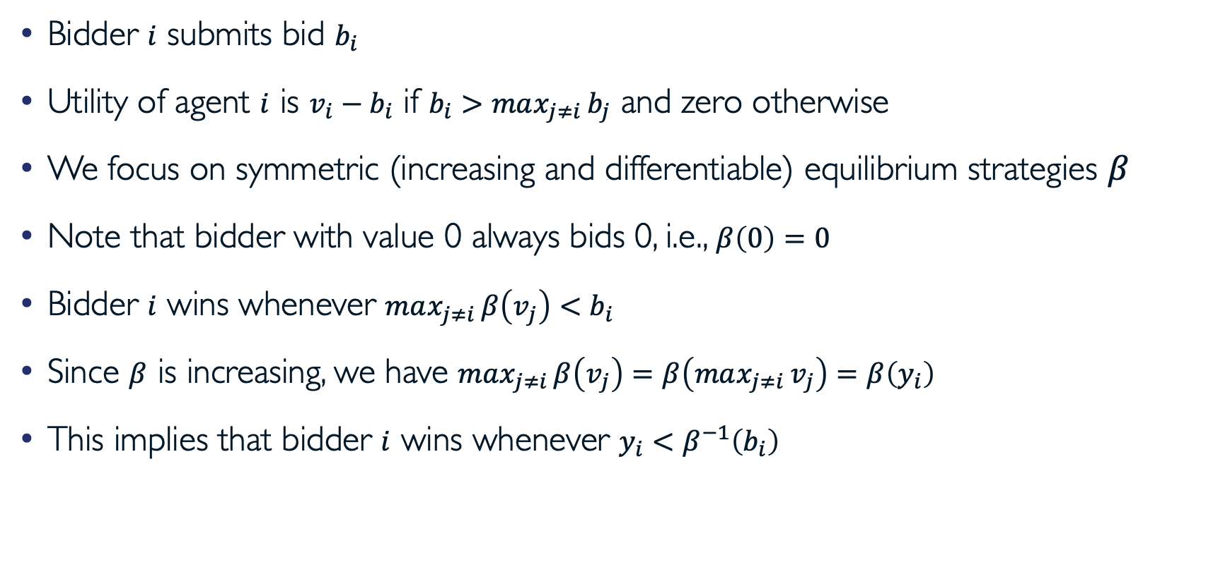
First Price Auctions
Bidder $i$ submits bid $b_{i}$
Utility of agent $i$ is $v_{i}−b_{i}$ if $b_{i}>max_{j≠i}{b_{j}}$ and zero otherwise
We focus on symmetric (increasing and differentiable) equilibrium strategies $β$
Note that bidder with value 0 always bids 0, i.e., $β\left(0\right)=0$
Bidder $i$ wins whenever $max_{j≠i}{β\left(v_{j}\right)}<b_{i}$
Since $β$ is increasing, we have $max_{j≠i}{β\left(v_{j}\right)}=β\left(max_{j≠i}{v_{j}}\right)=β\left(y_{i}\right)$
This implies that bidder $i$ wins whenever $y_{i}<β^{−1}\left(b_{i}\right)$

Slide 23

First Price Auctions (cont.)
Optimal bid of bidder $i$ is
First-order (necessary) optimality conditions imply
  Note that derivative of $β^{−1}\left(b\right)$ is $1/β^{′}\left(β^{−1}\left(b\right)\right)$
In symmetric equilibrium, $b_{i}=β\left(v_{i}\right)$, therefore we have
With boundary condition $β\left(0\right)=0$, we have

Slide 24

Expected Payment in First Price Auctions
Expected payment of bidder $i$ with value $v_{i}$ is
This establishes somewhat surprising results that both first and second price auction formats yield same expected revenue to auctioneer

Slide 25
Revenue Equivalence
In standard auctions item is sold to bidder with highest submitted bid
Suppose that values are i.i.d and all bidders are risk neutral
[Theorem] Any symmetric and increasing equilibria of any standard auction (such that expected payment of bidder with value zero is zero) yields same expected revenue to auctioneer

Slide 26
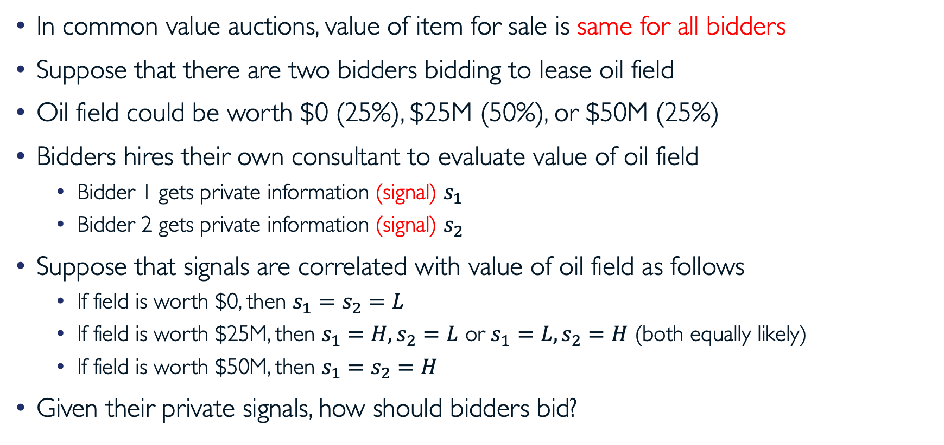
Common Value Auctions (Dependent Signals)
In common value auctions, value of item for sale is same for all bidders
Suppose that there are two bidders bidding to lease oil field
Oil field could be worth $0 (25%), $25M (50%), or $50M (25%)
Bidders hires their own consultant to evaluate value of oil field
  Bidder 1 gets private information (signal) $s_{1}$
  Bidder 2 gets private information (signal) $s_{2}$
Suppose that signals are correlated with value of oil field as follows
  If field is worth $0, then $s_{1}=s_{2}=L$
  If field is worth $25M, then $s_{1}=H, s_{2}=L$ or $s_{1}=L, s_{2}=H$ (both equally likely)
  If field is worth $50M, then $s_{1}=s_{2}=H$
Given their private signals, how should bidders bid?

Slide 27

Oil Field Example: Expected Value
What is expected value of oil field if one receives $L$ signal?
  Given $L$ signal, oil field is worth either $0 or $25

Slide 28
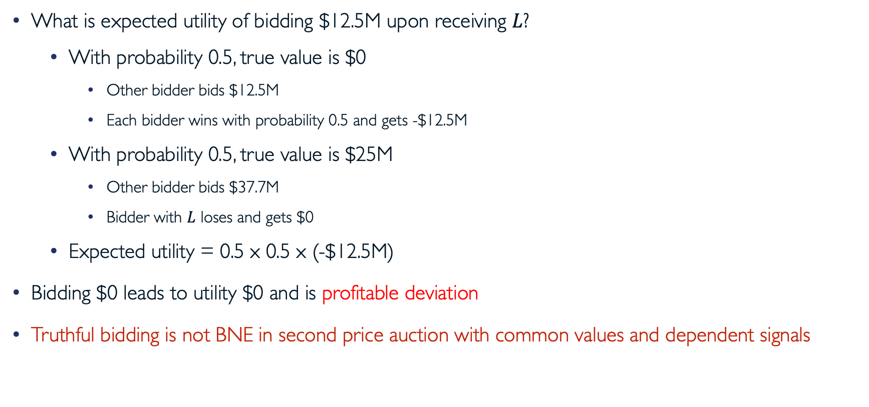
Oil Field Example:
Second Price Auction and Truthful Bidding
What is expected utility of bidding $12.5M upon receiving $L$?
  With probability 0.5, true value is $0
    Other bidder bids $12.5M
    Each bidder wins with probability 0.5 and gets -$12.5M
  With probability 0.5, true value is $25M
    Other bidder bids $37.7M
    Bidder with $L$ loses and gets $0
  Expected utility = 0.5 x 0.5 x (-$12.5M)
Bidding $0 leads to utility $0 and is profitable deviation
Truthful bidding is not BNE in second price auction with common values and dependent signals

Slide 29
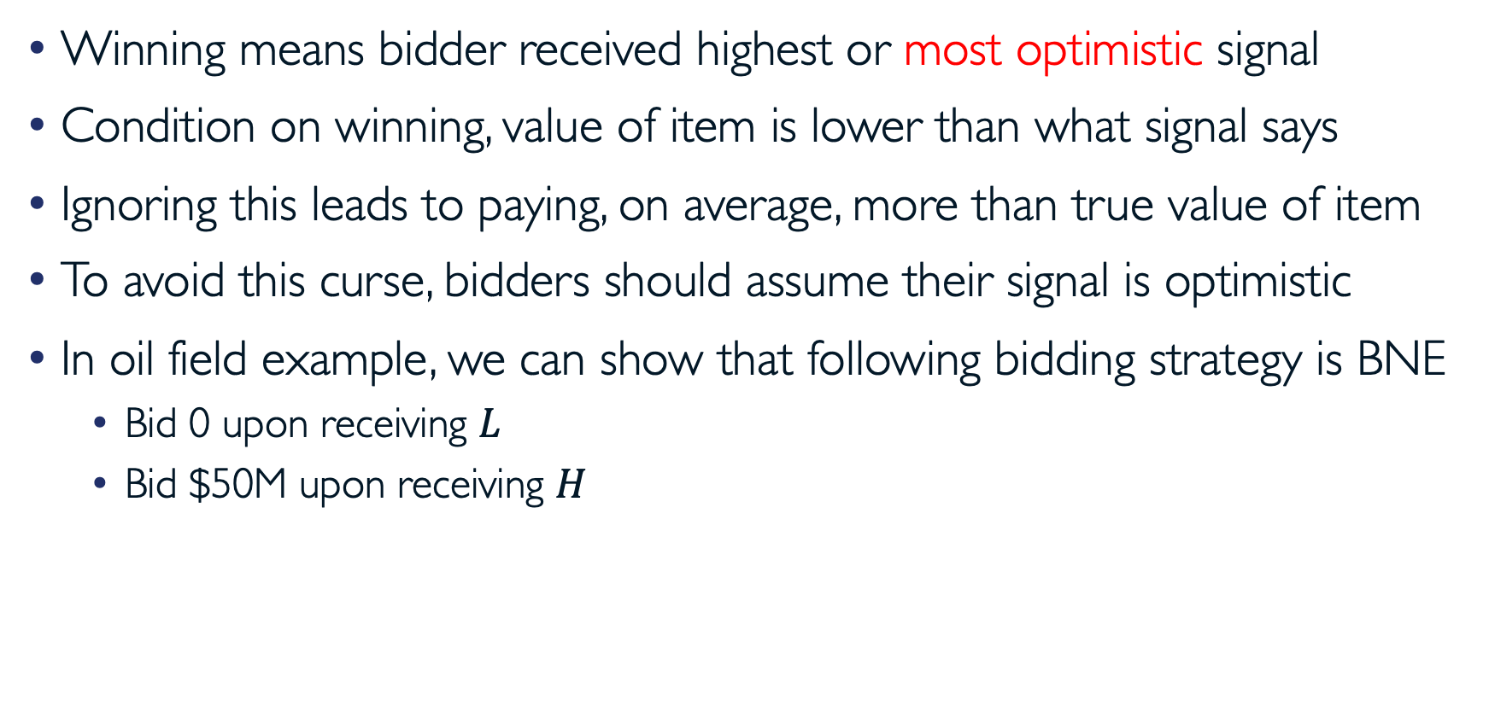
Winner’s Curse
Winning means bidder received highest or most optimistic signal
Condition on winning, value of item is lower than what signal says
Ignoring this leads to paying, on average, more than true value of item
To avoid this curse, bidders should assume their signal is optimistic
In oil field example, we can show that following bidding strategy is BNE
  Bid 0 upon receiving $L$
  Bid $50M upon receiving $H$

Slide 30
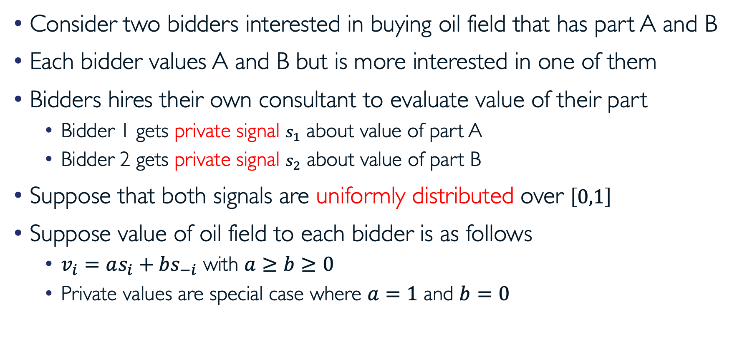
Common Value Auctions (Independent Signals)
Consider two bidders interested in buying oil field that has part A and B
Each bidder values A and B but is more interested in one of them
Bidders hires their own consultant to evaluate value of their part
  Bidder 1 gets private signal $s_{1}$ about value of part A
  Bidder 2 gets private signal $s_{2}$ about value of part B
Suppose that both signals are uniformly distributed over $\left[0,1\right]$
Suppose value of oil field to each bidder is as follows
  $v_{i}=as_{i}+bs_{−i}$ with $a≥b≥0$
  Private values are special case where $a=1$ and $b=0$

Slide 31
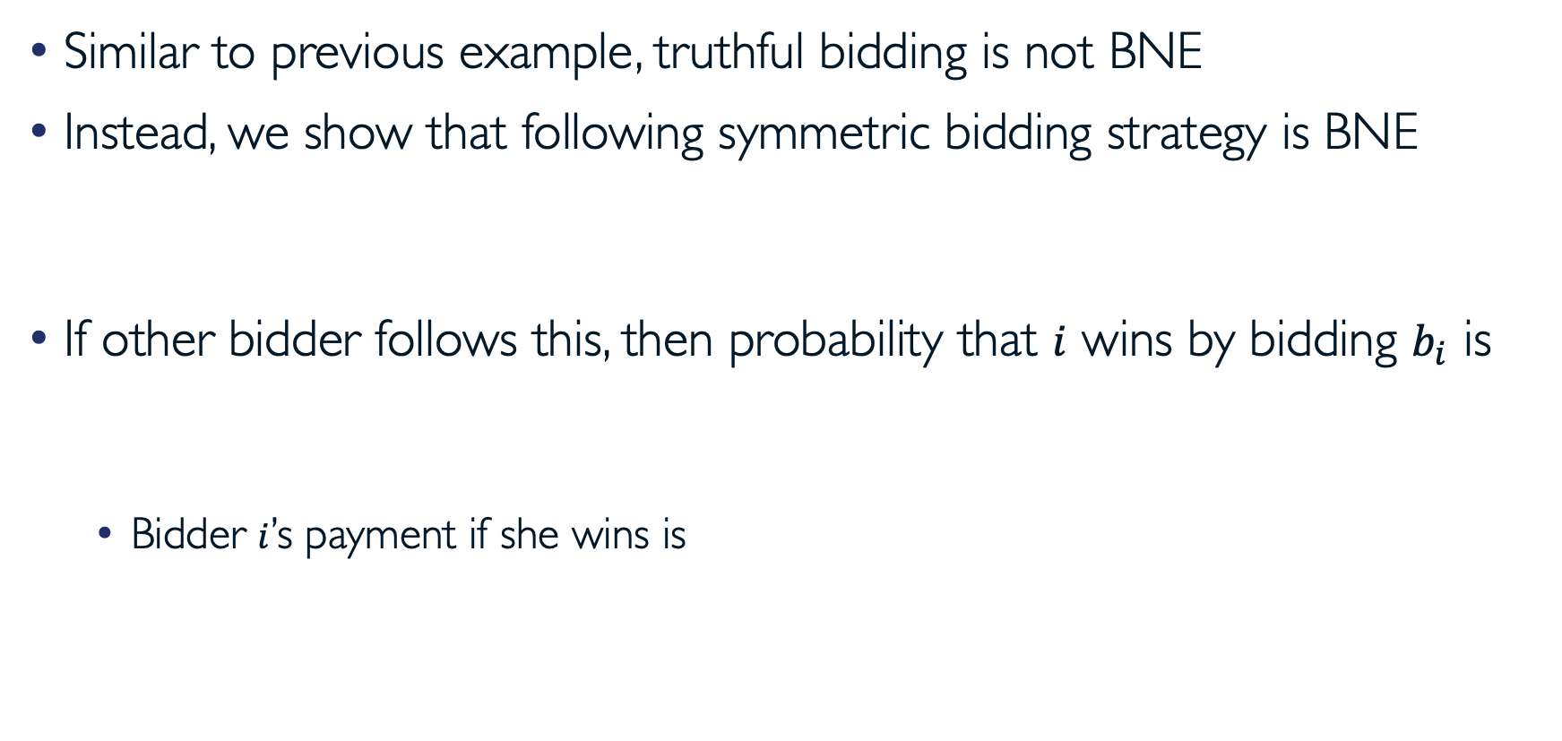
Oil Field Example II:
Second Price Auction and Truthful Bidding
Similar to previous example, truthful bidding is not BNE
Instead, we show that following symmetric bidding strategy is BNE
If other bidder follows this, then probability that $i$ wins by bidding $b_{i}$ is
  Bidder $i$’s payment if she wins is

Slide 32

Oil Field Example II:
Second Price Auction and Truthful Bidding (cont.)
Expected payment of bidder $i$ is
Expected utility of bidding $b_{i}$ with signal $s_{i}$ is
Maximizing this with respect to $b_{i}$ (for given $s_{i}$) implies

Slide 33
Oil Field Example II: First Price Auction
Analysis is similar to that of first price auctions with private values
It can be shown that unique symmetric BNE is for each bidder to bid
It can be shown that expected revenue is equal to first price auction
Revenue equivalence principle continues to hold for common values

Slide 34
Questions?

Slide 35
Acknowledgement
This lecture is a slightly modified version of one prepared by
  Asu Ozdaglar [MIT 6.254]

