Slide 1
SE350: Operating Systems
Lecture 3: Process Management

Slide 2
Outline
Safe control transfer
  How do we switch from one mode to the other?
  What should hardware provide?
Native control of process
  Can processes create other processes?
  fork(), exec(), wait(), signal()

Slide 3
Recall: Three Types of Mode Transfer
Syscall
  Process requests system service, e.g., exit
    Like function call, but outside process
  Process does not have address of system function to call
    Like a Remote Procedure Call (RPC) – for later
  OS marshalls syscall id and args in registers and exec syscall
Interrupt
  External asynchronous event triggers context switch, e. g., Timer, I/O device
    Independent of user process
Trap or exception
  Internal synchronous event in process triggers context switch, e.g., protection violation (segmentation fault), divide by zero, …

Slide 4
Implementing Safe Mode Transfers
It should be impossible for buggy or malicious user program to cause kernel to corrupt itself
  Controlled transfer into kernel (e.g., interrupt vector table)
  Separate kernel stack
Carefully constructed kernel code should pack up user process state and set it aside
  Details depend on the machine architecture

Slide 5
Need for Separate Kernel Stacks
Kernel cannot put anything on user stack (Why?)
  Reliability: what if user program’s SP is not valid?
  Security: what if other threads in user process change kernel’s return address?
Two-stack model
  Kernel keeps separate stack for each thread in kernel memory (in addition to user stack in user memory)

Slide 6
Stack Example
Stack
Pointer
tmp = 1
ret = ext
A0: A(int tmp) {
A1: if (tmp<2)
A2: B();
A3: printf(tmp);
A4: }
B0: B() {
B1: C();
B2: }
C0: C() {
C1: A(2);
C2: }
A(1);
ext:
Stack holds temporary results
Permits recursive execution
Crucial to modern languages

Slide 7
Stack Example
Stack
Pointer
tmp = 1
ret = ext
A0: A(int tmp) {
A1: if (tmp<2)
A2: B();
A3: printf(tmp);
A4: }
B0: B() {
B1: C();
B2: }
C0: C() {
C1: A(2);
C2: }
A(1);
ext:
Stack holds temporary results
Permits recursive execution
Crucial to modern languages

Slide 8
Stack Example
Stack
Pointer
tmp = 1
ret = ext
A0: A(int tmp) {
A1: if (tmp<2)
A2: B();
A3: printf(tmp);
A4: }
B0: B() {
B1: C();
B2: }
C0: C() {
C1: A(2);
C2: }
A(1);
ext:
Stack holds temporary results
Permits recursive execution
Crucial to modern languages

Slide 9
Stack Example
tmp = 1
ret = ext
A0: A(int tmp) {
A1: if (tmp<2)
A2: B();
A3: printf(tmp);
A4: }
B0: B() {
B1: C();
B2: }
C0: C() {
C1: A(2);
C2: }
A(1);
ext:
Stack
Pointer
ret = A3
Stack holds temporary results
Permits recursive execution
Crucial to modern languages

Slide 10
Stack Example
tmp = 1
ret = ext
A0: A(int tmp) {
A1: if (tmp<2)
A2: B();
A3: printf(tmp);
A4: }
B0: B() {
B1: C();
B2: }
C0: C() {
C1: A(2);
C2: }
A(1);
ext:
ret = A3
Stack
Pointer
ret = B2
Stack holds temporary results
Permits recursive execution
Crucial to modern languages

Slide 11
Stack Example
tmp = 1
ret = ext
A0: A(int tmp) {
A1: if (tmp<2)
A2: B();
A3: printf(tmp);
A4: }
B0: B() {
B1: C();
B2: }
C0: C() {
C1: A(2);
C2: }
A(1);
ext:
ret = A3
ret = B2
Stack
Pointer
tmp = 2
ret = C2
Stack holds temporary results
Permits recursive execution
Crucial to modern languages

Slide 12
Stack Example
tmp = 1
ret = ext
A0: A(int tmp) {
A1: if (tmp<2)
A2: B();
A3: printf(tmp);
A4: }
B0: B() {
B1: C();
B2: }
C0: C() {
C1: A(2);
C2: }
A(1);
ext:
ret = A3
ret = B2
Stack
Pointer
tmp = 2
ret = C2
> 2
Stack holds temporary results
Permits recursive execution
Crucial to modern languages

Slide 13
Stack Example
tmp = 1
ret = ext
A0: A(int tmp) {
A1: if (tmp<2)
A2: B();
A3: printf(tmp);
A4: }
B0: B() {
B1: C();
B2: }
C0: C() {
C1: A(2);
C2: }
A(1);
ext:
ret = A3
ret = B2
Stack
Pointer
tmp = 2
ret = C2
> 2
Stack holds temporary results
Permits recursive execution
Crucial to modern languages

Slide 14
Stack Example
tmp = 1
ret = ext
A0: A(int tmp) {
A1: if (tmp<2)
A2: B();
A3: printf(tmp);
A4: }
B0: B() {
B1: C();
B2: }
C0: C() {
C1: A(2);
C2: }
A(1);
ext:
ret = A3
Stack
Pointer
ret = B2
> 2
Stack holds temporary results
Permits recursive execution
Crucial to modern languages

Slide 15
Stack Example
tmp = 1
ret = ext
A0: A(int tmp) {
A1: if (tmp<2)
A2: B();
A3: printf(tmp);
A4: }
B0: B() {
B1: C();
B2: }
C0: C() {
C1: A(2);
C2: }
A(1);
ext:
Stack
Pointer
ret = A3
> 2
Stack holds temporary results
Permits recursive execution
Crucial to modern languages

Slide 16
Stack Example
Stack
Pointer
tmp = 1
ret = ext
A0: A(int tmp) {
A1: if (tmp<2)
A2: B();
A3: printf(tmp);
A4: }
B0: B() {
B1: C();
B2: }
C0: C() {
C1: A(2);
C2: }
A(1);
ext:
> 21
Stack holds temporary results
Permits recursive execution
Crucial to modern languages

Slide 17
Stack Example
Stack
Pointer
tmp = 1
ret = ext
A0: A(int tmp) {
A1: if (tmp<2)
A2: B();
A3: printf(tmp);
A4: }
B0: B() {
B1: C();
B2: }
C0: C() {
C1: A(2);
C2: }
A(1);
ext:
> 21
Stack holds temporary results
Permits recursive execution
Crucial to modern languages

Slide 18
Stack Example
A0: A(int tmp) {
A1: if (tmp<2)
A2: B();
A3: printf(tmp);
A4: }
B0: B() {
B1: C();
B2: }
C0: C() {
C1: A(2);
C2: }
A(1);
ext:
> 21
Stack holds temporary results
Permits recursive execution
Crucial to modern languages

Slide 19
Two-Stack Model
Running
Handling syscall
Ready to run
main
main
main
Proc1
Proc1
Proc1
User stack
Proc2
Proc2
Proc2
syscall
syscall
user CPU state
user CPU state
syscall
handler
Kernel stack
I/O driver

Slide 20
Interrupt Masking
Interrupt handler runs with interrupts off
  Re-enabled when interrupt completes
OS kernel can also turn interrupts off
  E.g., when determining next process/thread to run
  On x86
    cli: disable interrupts
    sti: enable interrupts
    Only applies to current CPU (on a multicore)
We will need this to implement synchronization (more on this later)
Notes:
Instructions to enable or disable interrupts must be privileged

Slide 21
Atomic Transfer of Control
Kernel
handler() {
pushad;
…
}
Processor
Registers
PC
SP
Kernel stack
foo() {
while (…) {
x = x + 1;
y = y – 2;
}
}
EFLAGS
User-level
process
Other Regs
EAX, EXB,
…
User stack
foo
…

Slide 22
Atomic Transfer of Control (cont.)
Kernel
Single instruction to
  Save some registers (e.g., SP, PC)
  Change PC and SP
  Switch Kernel/user mode
handler() {
pushad;
…
}
Processor
Registers
PC
SP
Kernel stack
foo() {
while (…) {
x = x + 1;
y = y – 2;
}
}
EFLAGS
User-level
process
Other Regs
EAX, EXB,
…
Error
User stack
PC
foo
EFLAGS
…
SP

Slide 23
Atomic Transfer of Control (cont.)
Kernel
Single instruction to save all registers
Why is stack pointer saved twice?
  Hint: are they the same?
handler() {
pushad;
…
}
Processor
Registers
PC
SP
Kernel stack
foo() {
while (…) {
x = x + 1;
y = y – 2;
}
}
EFLAGS
User-level
process
Other Regs
EAX, EXB,
…
…
EXB
EXA
SP
All Regs
Error
User stack
PC
foo
EFLAGS
…
SP

Slide 24
Kernel System Call Handler
Vector through well-defined syscall entry points!
  Table mapping system call number to handler
Locate arguments
  In registers or on user (!) stack
Copy arguments (copy before check)
  From user memory into kernel memory
  Protect kernel from malicious code evading checks
Validate arguments
  Protect kernel from errors in user code
Copy results back
  Into user memory

Slide 25
At the End of Handler
Handler restores saved registers
Atomically return to (interrupted) process/thread
  Restore PC, SP
  Restore processor status
  Switch to user mode

Slide 26
How Does Kernel Provide Services?
You said that applications request services from the operating system via syscall, but …
  I’ve been writing all sort of useful applications and I never ever saw a “syscall” !!!
That’s right
It was buried in the programming language runtime library (e.g., libc.a)
  … Layering

Slide 27











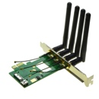
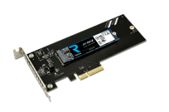
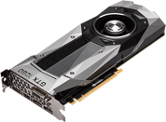
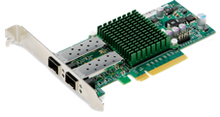




OS Run-Time Library
Proc 1
Proc 2
…
Proc n
OS
Proc 1
Proc 2
Proc n
…
OS Library
OS Library
OS Library
OS

Slide 28
Kernel to User Mode Switch
New process/new thread start
  Jump to first instruction in program/thread
Return from interrupt, exception, system call
  Resume suspended execution
Process/thread context switch
  Resume some other process
User-level upcall (UNIX signal)
  Asynchronous notification to user program
    Preemptive user-level threads
    Asynchronous I/O notification
    Interprocess communication
    User-level excepting handling
    User-level resource allocation

Slide 29
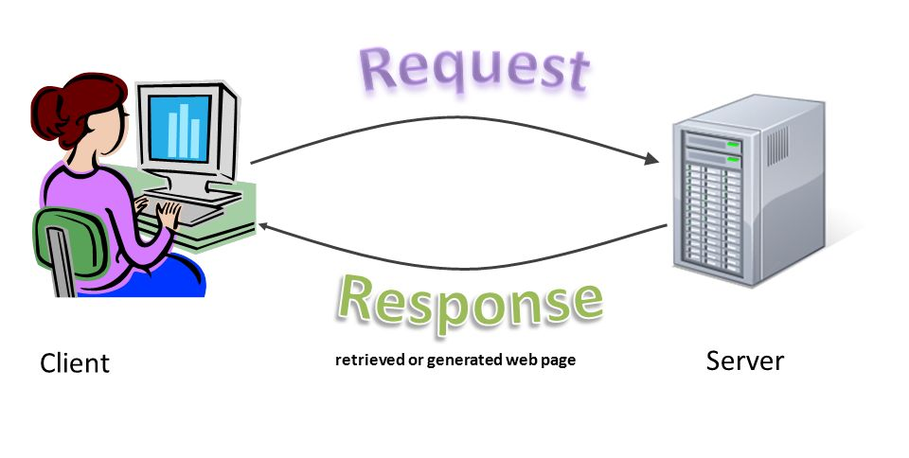
Putting it Together: Web Server
Request
Reply
(retrieved by web server)
Client
Web Server

Slide 30
Putting it Together: Web Server (cont.)
Server
4. parse request
9. format reply
request
buffer
reply
buffer
network
socket
read
3. kernel
copy
10. network
socket
write
5. file
read
8. kernel
copy
syscall
syscall
Kernel
wait
RTU
11. kernel copy
from user buffer
to network buffer
RTU
interrupt
interrupt
2. copy arriving
packet (DMA)
12. format outgoing
packet and DMA
6. disk
request
7. disk data
(DMA)
Hardware
Network
interface
Disk interface
Request
Reply

Slide 31
Summary of Hardware Support for OS
Privilege modes
Privileged instructions
Memory translation
Processor exceptions
Timer interrupts
Device interrupts
Interprocessor interrupts
Interrupt masking
System calls
Return from interrupt

Slide 32
Can a Process Create a Process ?
fork() system call creates copy of current process with new unique process ID (PID)
Return value from fork() is integer
  When > 0
    Running in (original) parent process
    return value is PID of new child
  When = 0
    Running in new child process
  When < 0
    Error! Must be handled somehow
    Running in original process
All state of original process duplicated in both parent and child!
  Memory, file descriptors (more on this later), etc…

Slide 33
UNIX Process Management
Notes:
How is this used – typically, fork a process, child and parent are now both running the same program. One sets up the child program, and runs exec – becoming the new program
The parent, usually, waits for the child to finish

Slide 34
UNIX Process Management (cont.)
fork()
  Syscall to create copy of current process and start it
exec()
  Syscall to change program being run by current process
wait()
  Syscall to wait for process to finish
signal()
  Syscall to send notification to another process
  (e.g., SIGKILL, SIGINT)
Notes:
UNIX splits creating a process into two steps, each of them a lot simpler.

Slide 35
Example
#include <stdlib.h>
#include <stdio.h>
#include <string.h>
#include <unistd.h>
#include <sys/types.h>
int main(int argc, char *argv[]) {
pid_t cpid, mypid;
pid_t pid = getpid(); /* get current processes PID */
printf("Parent pid: %d\n", pid);
cpid = fork();
if (cpid > 0) { /* Parent Process */
mypid = getpid();
printf("[%d] parent of [%d]\n", mypid, cpid);
} else if (cpid == 0) { /* Child Process */
mypid = getpid();
printf("[%d] child\n", mypid);
} else {
perror("Fork failed");
exit(1);
}
exit(0);
}

Slide 36
Implementing a Shell
char *prog, **args;
int child_pid;
// Read and parse the input a line at a time
while (readAndParseCmdLine(&prog, &args)) {
child_pid = fork(); // create a child process
if (child_pid == 0) {
exec(prog, args); // I'm the child process. Run program
// NOT REACHED
} else {
wait(child_pid); // I'm the parent, wait for child
return 0;
}
}

Slide 37
Summary
Safe control transfer
  How do we switch from one mode to the other?
  What should hardware provide?
Native control of process
  Can processes create other processes?
  fork(), exec(), wait(), signal()

Slide 38

Feedback
https://forms.gle/L6oS18zZApNF3ERb8
Will be available until the end of term
Will be checked regularly

Slide 39

Questions?
globaldigitalcitizen.org

Slide 40
Acknowledgment
Slides by courtesy of Anderson, Culler, Stoica, Silberschatz, Joseph, and Canny

