Slide 1
SE350: Operating Systems
Lecture 4: Concurrency

Slide 2
Feedback
https://forms.gle/L6oS18zZApNF3ERb8
Will be available until the end of term
Will be checked regularly

Slide 3
Outline
Multi-threaded processes
Thread data structure and life cycle
Simple thread API
Thread implementation

Slide 4
Recall: Traditional UNIX Process
Process is OS abstraction of what is needed to run single program
Often called “heavyweight process”
Processes have two parts
Sequential program execution stream (active part)
Code executed as sequential stream of execution (i.e., thread)
Includes state of CPU registers
Protected resources (passive part)
Main memory state (contents of Address Space)
I/O state (i.e. file descriptors)

Slide 5
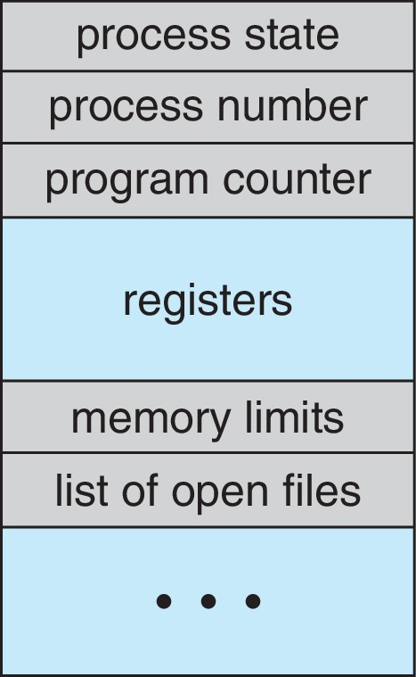
Process Control Block (PCB)
(Assume single threaded processes for now)
OS represents each process as process control block (PCB)
Status (running, ready, blocked, …)
Registers, SP, … (when not running)
Process ID (PID), user, executable, priority, …
Execution time, …
Memory space, translation tables, …

Slide 6
Recall: Time Sharing
vCPU1
vCPU2
vCPU3
vCPU1
vCPU2
vCPU3
vCPU1
vCPU2
Shared Memory
Time
How can we give illusion of multiple processors with single processor?
Multiplex in time!
Each virtual “CPU” needs structure to hold PCBs
PC, SP, and rest of registers (integer, floating point, …)
How do we switch from one vCPU to next?
Save PC, SP, and registers in current PCB
Load PC, SP, and registers from new PCB
What triggers switch?
Timer, voluntary yield, I/O, …

Slide 7
How Do We Multiplex Processes?
Current state of process is held in PCB
This is “snapshot” of execution and protection environment
Only one PCB active at a time (for single-CPU machines)
OS decides which process uses CPU time (scheduling)
Only one process is “running” at a time
Scheduler gives more time to important processes
OS divides resources between processes (protection)
This provides controlled access to non-CPU resources
Example mechanisms:
Memory translation: give each process their own address space
Kernel/User duality: arbitrary multiplexing of I/O through system calls

Slide 8
Scheduling
Kernel scheduler decides which processes/threads receive CPU
There are lots of different scheduling policies providing …
Fairness or
Realtime guarantees or
Latency optimization or …
Kernel Scheduler maintains data structure containing PCBs
if (readyProcesses(PCBs)) {
nextPCB = selectProcess(PCBs);
run(nextPCB);
} else {
run_idle_process();
}

Slide 9
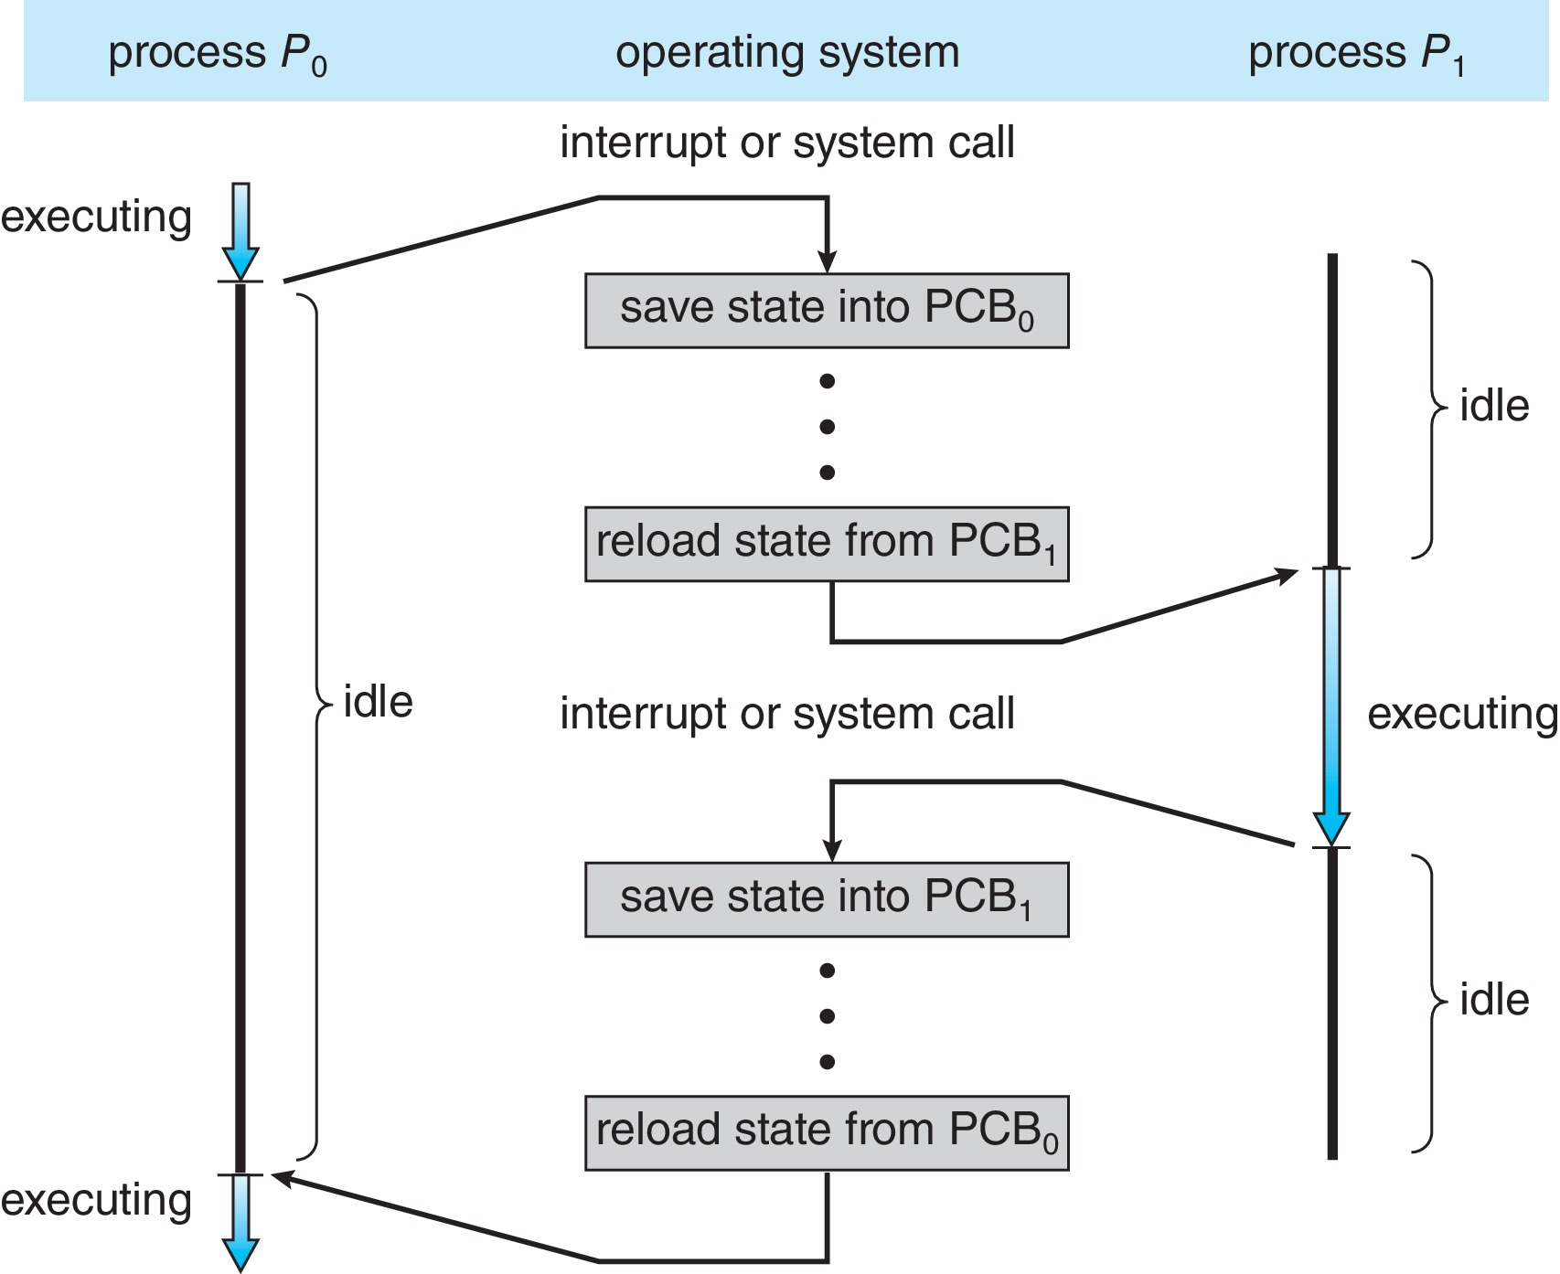
Context Switch: CPU Switch Between Two Processes
Code executed in kernel is overhead
Overhead sets minimum practical switching time
Less overhead with SMT/hyperthreading, but … contention for resources

Slide 10
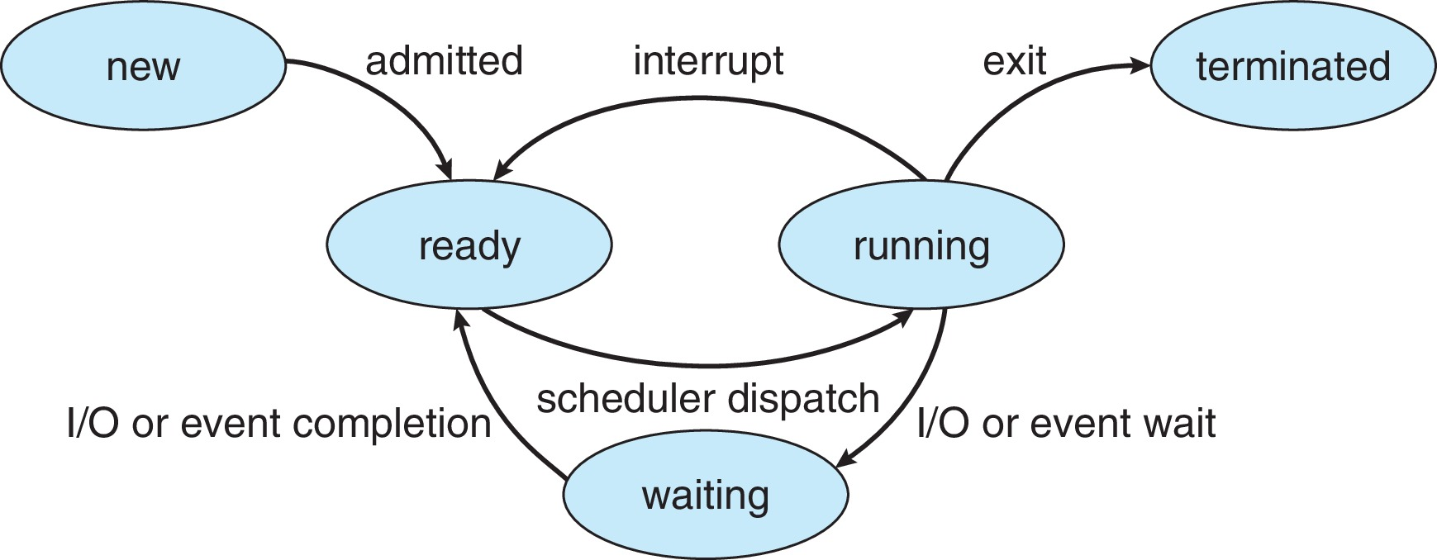
Lifecycle of Processes
As process is executed, its state changes
New: Process is being created
Ready: Process is waiting to run
Running: Instructions are being executed
Waiting: Process waiting for some event to occur
Terminated: Process has finished execution

Slide 11
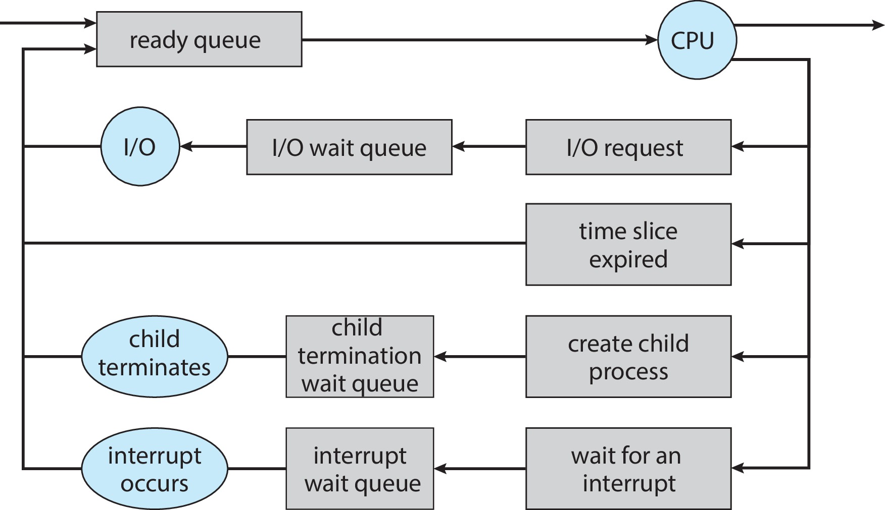
Ready Queue
PCBs move from queue to queue as they change state
Decisions about which order to remove from queues are scheduling decisions
Many algorithms possible (more on this in a few weeks)

Slide 12
Ready Queue And I/O Device Queues
Process not running ⇒ PCB is in some scheduler queue
Separate queue for each device/signal/condition
Each queue can have different scheduler policy
Ready
Queue
Head
Other State
PCB₉
Link
Other State
PCB₆
Link
Other State
PCB₁₆
Link
Tail
Registers
Registers
Registers
USB
Unit 0
Head
Tail
Disk
Unit 0
Head
Other State
PCB₂
Link
Other State
PCB₃
Link
Tail
Registers
Registers
Disk
Unit 2
Head
Tail
Other State
PCB₈
Ether
Netwk 0
Link
Head
Registers
Tail

Slide 13
Drawback of Traditional UNIX Process
Silly example:
main() {
ComputePI(“pi.txt”);
PrintClassList(“class.txt”);
}
Would program ever print out class list?
No! ComputePI would never finish!
Better example:
main() {
ReadLargeFile(“pi.txt”);
RenderUserInterface();
}

Slide 14
Threads Motivation
OS’s need to handle multiple things at once (MTAO)
Processes, interrupts, background system maintenance
Servers need to handle MTAO
Multiple connections handled simultaneously
Parallel programs need to handle MTAO
To achieve better performance
Programs with user interfaces often need to handle MTAO
To achieve user responsiveness while doing computation
Network and disk programs need to handle MTAO
To hide network/disk latency

Slide 15
Modern Process with Threads
Thread: sequential execution stream within process (sometimes called “lightweight process”)
Process still contains single address space
No protection between threads
Multithreading: single program made up of different concurrent activities (sometimes called multitasking)
Some states are shared by all threads
Content of memory (global variables, heap)
I/O state (file descriptors, network connections, etc.)
Some states “private” to each thread
CPU registers (including PC) and stack

Slide 16
A Side Note: Memory Footprint of Multiple Threads
How do we position stacks relative to each other?
What maximum size should we choose for stacks?
8KB for kernel-level stacks in Linux on x86
Less need for tight space constraint for user-level stacks
What happens if threads violate this?
“… program termination and/or corrupted data”
How might you catch violations?
Place guard values at top and bottom of each stack
Check values on every context switch
Stack 1
Stack 2
Address Space
Heap
Global Data
Code

Slide 17
Per Thread Descriptor (Kernel Supported Threads)
Each thread has Thread Control Block (TCB)
Execution State
CPU registers, program counter (PC), pointer to stack (SP)
Scheduling info
State, priority, CPU time
Various pointers (for implementing scheduling queues)
Pointer to enclosing process (PCB) – user threads
… (add stuff as you find a need)
OS Keeps track of TCBs in “kernel memory”
In array, or linked list, or …

Slide 18
Simple Thread API
thread_create(thread*, func*, args*)
Create new thread to run func(args)
thread_yield()
Relinquish processor voluntarily
thread_join(thread)
In parent, wait for the thread to exit, then return
thread_exit()
Quit thread and clean up, wake up joiner if any
pThreads: POSIX standard for thread programming [POSIX.1c, Threads extensions (IEEE Std 1003.1c-1995)]

Slide 19
Thread Lifecycle
Scheduler Resumes Thread
Thread Creation
Thread Exit
Init
Ready
Running
Finished
thread_create()
thread_exit()
Thread Yield/Scheduler Suspends Thread
thread_yield()
Thread Waits for Event
Thread Waits for Event
thread_signal()
thread_join()
Waiting

Slide 20
Use of Threads
Rewrite program with threads (loose syntax)
main() {
thread_t threads[2];
thread_create(&threads[0], &ComputePI, “pi.txt”);
thread_create(&threads[1], &PrintClassList, “class.txt”);
}
What does thread_create do?
Creates independent thread
Behaves as if there are two separate CPUs

Slide 21
Dispatch Loop
Conceptually, dispatching loop of OS looks as follows
Loop {
RunThread();
ChooseNextThread();
SaveStateOfCPU(curTCB);
LoadStateOfCPU(newTCB);
}
This is infinite loop
One could argue that this is all that OS does
Should we ever exit this loop?
When would that be?
Notes:
Emergency crash of operating system called “panic()”

Slide 22
Running Threads
What does LoadStateOfCPU() do?
Loads thread’s state (registers, PC, stack pointer) into CPU
Loads environment (virtual memory space, etc.)
What does RunThread() do?
Jump to PC
How does dispatcher get control back?
Internal events: thread returns control voluntarily
External events: thread gets preempted
Notes:
OS’s have almost human characteristics – unpredictable, hard to understand, …
Different things share the same CPU – one thread, then another
Similar to schizophrenia, like the movie Sybil, one body shared by several people, say we start with Dave Patterson
Threads are like the personalities of the CPU. First one thread/personality uses the CPU, then another,…

Slide 23
Internal Events
Blocking on I/O
Requesting I/O implicitly yields CPU
Waiting on “signal” from other thread
Thread asks to wait and thus yields CPU
Thread executes thread_yield()
Thread volunteers to give up CPU
ComputePI() {
while(TRUE) {
ComputeNextDigit();
thread_yield();
}
}
Notes:
Yield is for really nice people – Ever see two people at the supermarket checkout line? You first, no you first, …

Slide 24
Stack for Yielding Thread
ComputePI
Thread Stack
thread_yield
Trap to OS
Stacks growth
run_new_thread
Kernel Stack
switch
run_new_thread() {
newTCB = PickNewThread();
switch(curTCB, newTCB);
thread_house_keeping(); /* Do any cleanup */
}

Slide 25
How Do Stacks Look Like?
Suppose we have 2 threads
A() {
B();
}
B() {
while(TRUE) {
thread_yield();
}
}
Thread 1
Thread 2
A
A
B
B
thread_yield
thread_yield
run_new_thread
run_new_thread
switch
switch
run_new_thread() {
newThread = PickNewThread();
switch(curTCB, newTCB);
thread_house_keeping(); /* Do any cleanup */
}

Slide 26
Saving/Restoring State: Context Switch
// We enter as curTCB, but we return as newTCB
// Returns with newTCB’s registers and stack
switch(curTCB, newTCB) {
pushad; // Push regs onto kernel stack for curTCB
curTCB->sp = sp; // Save curTCB’s stack pointer
sp = newTCB->sp; // Switch to newTCB’s stack
popad; // Pop regs from kernel stack for newTCB
return();
}
Where does this return to?

Slide 27
Switch Details
What if you make mistakes in implementing switch?
Suppose you forget to save/restore register 32
Get intermittent failures depending on when context switch occurred and whether new thread uses register 32
System will give wrong result without warning
Can you devise exhaustive test to test switch code?
No! Too many combinations and inter-leavings

Slide 28
Creating New Threads
Implementation
Sanity check arguments and copy them to kernel memory
Enter Kernel-mode and sanity check arguments again
Allocate new stack and TCB
Initialize TCB
Place new TCB on ready list (runnable)
How do we initialize TCB and stack?
newTCB->sp points to newly allocated stack
newTCB->pc points to OS routine thread_root()
Push func and args pointers into stack
Call dummy_switch_frame(newTCB) (more on this soon)

Slide 29
How Does thread_root() Look Like?
thread_root(func*, args*) {
DoStartupHousekeeping();
UserModeSwitch(); // enter user mode */
Call func(args);
thread_finish();
}
Startup Housekeeping
Includes things like recording start time of thread
Other statistics
Stack will grow and shrink with execution of thread
Final return from thread returns into thread_root() which calls thread_finish() which wakes up sleeping threads
func(args)
Thread Stack
Switch Mode
thread_root
Kernel Stack

Slide 30
Putting it All Together
Eventually, run_new_thread will select newly created TCB and return into beginning of thread_root
This really starts the new thread
Thread 1
Thread 2
A
A
B
B
thread_yield
thread_yield
thread_root
thread_root
run_new_thread
run_new_thread
switch
switch

Slide 31
A Subtlety: dummy_switch_frame(newTCB)
Newly created thread will run after OS runs switch
Kernel stack of new thread should be the same as others
Recall:
switch(curTCB, newTCB) {
pushad;
curTCB->sp = sp;
sp = newTCB->sp;
popad;
return();
}
dummy_switch_frame(newTCB) {
*(newTCB->sp) = thread_root;
newTCB->sp--;
newTCB->sp -= SizeOfPopad;
}

Slide 32
What Happens When Threads Blocks on I/O?
CopyFile
Thread Stack
read
Trap to OS
Stacks growth
kernel_read
run_new_thread
Kernel Stack
switch
User code invokes system call
Read operation is initiated
OS runs new thread or switches to ready thread

Slide 33
Recall: Running Threads
What does LoadStateOfCPU() do?
Loads thread’s state (registers, PC, stack pointer) into CPU
Loads environment (virtual memory space, etc.)
What does RunThread() do?
Jump to PC
How does dispatcher get control back?
Internal events: thread returns control voluntarily
External events: thread gets preempted

Slide 34
External Events
What happens if thread never does any I/O, never waits, and never yields?
Could ComputePI grab all resources and never release processor?
Must find way that dispatcher can regain control!
OS utilizes external events
Interrupts are signals from hardware or software that stop running code and transfer control to kernel
E.g., timer is like alarm clock that goes off every some milliseconds
Interrupts are hardware-invoked context switch
Interrupt handlers are not threads
No separate step to choose what to run next
Always run the interrupt handler immediately

Slide 35
Timer Interrupt to Return Control
Solution to our dispatcher problem
Use the timer interrupt to force scheduling decisions
TimerInterrupt() { DoPeriodicHouseKeeping(); run_new_thread(); }
Some Routine
Thread Stack
Interrupt
TimerInterrupt
Stacks growth
run_new_thread
Kernel Stack
switch

Slide 36
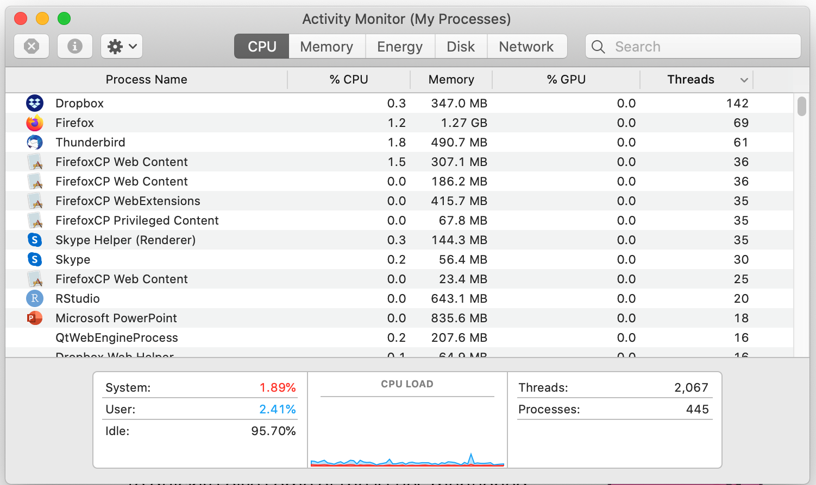
Some Numbers
Many process are multi-threaded, so thread context switches may be either within-process or across-processes

Slide 37
Some Numbers (cont.)
Frequency of performing context switches is ~10-100ms
Context switch time in Linux is ~3-4 us (Intel i7 & Xeon E5)
Thread switching faster than process switching (~100 ns)
Switching across cores is ~2x more expensive than within-core
Context switch time increases sharply with size of working set*
Can increase ~100x or more
Moral: overhead of context switching depends mostly on cache limits and process or thread’s hunger for memory
* Working set is subset of memory used by process in time window

Slide 38
Questions?
globaldigitalcitizen.org

Slide 39
Acknowledgment
Slides by courtesy of Anderson, Culler, Stoica, Silberschatz, Joseph, and Canny

